Slide 1
Module 17: Incident Response and Investigations
4.7 Summarize concepts associated with incident response activities
SY0-801 exam prep · Security Operations · 27% of the exam
SY0-801 Exam Prep: CompTIA Security+ Study Course
Module 17
Notes:
Welcome to Module seventeen: Incident Response and Investigations. It covers the exam area Security Operations.
Each part of this module comes from the study notes of the same name, so you can read the notes after you watch.

Slide 2
What You Will Learn
Module 17
4.7 Summarize concepts associated with incident response activities
4.8 Given a scenario, use data, artifacts and sources to support a security investigation
Practice with exam-style questions and a recall check
SY0-801 Exam Prep | CompTIA Security+ exam
Module 17: Incident Response and Investigations
2 / 21
Notes:
By the end of this module you will be able to do three things.
four point seven Summarize concepts associated with incident response activities.
four point eight Given a scenario, use data, artifacts and sources to support a security investigation.
Practice with exam-style questions and a recall check.

Slide 3
Where This Fits in the Exam
Module 17
EXAM CHECK-IN · Where this fits
Exam area: Security Operations (27%)
Exam format: up to 90 questions in 90 minutes; a score of 750 on a scale of 100 to 900 passes
Validated against: the official CompTIA Security+ SY0-801 V8 exam objectives
SY0-801 Exam Prep | CompTIA Security+ exam
Module 17: Incident Response and Investigations
3 / 21
Notes:
Here is where this module sits in the exam.
Exam area: Security Operations (twenty-seven percent).
Exam format: up to ninety questions in ninety minutes; a score of seven hundred fifty on a scale of one hundred to nine hundred passes.
Validated against: the official Comp T I A Security plus S Y zero eight oh one V eight exam objectives.

Slide 4
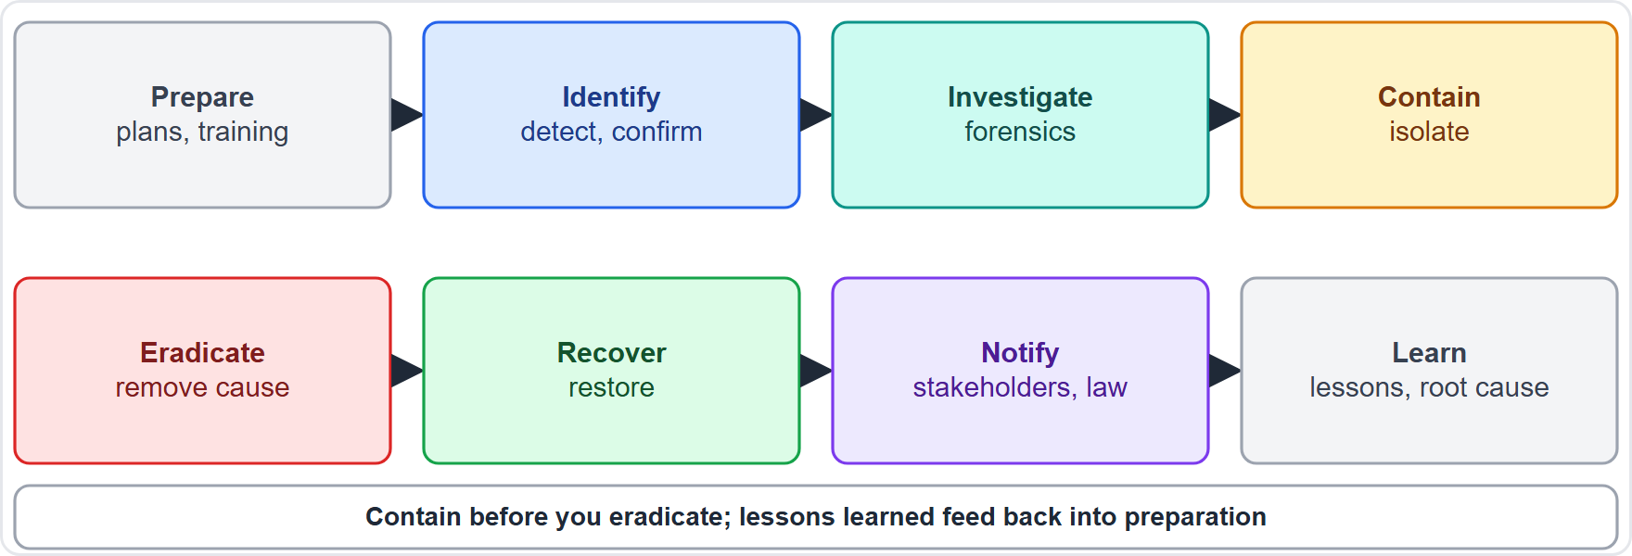
The incident response process
Module 17
Incident response phases from preparation to post-incident review
SY0-801 Exam Prep | CompTIA Security+ exam
Module 17: Incident Response and Investigations
4 / 21
Notes:
The incident response process.
The figure shows this: Incident response phases from preparation to post-incident review.

Slide 5
The incident response process, continued
Module 17
Phase | What happens | Key items
Preparation | Be ready before an incident | Training, testing, tabletop exercises (discussion-based walk-through), playbooks (step-by-step guides), simulations, roles
Identification | Detect and confirm an incident | Detection, internal and external advisories, threat hunting (actively searching for hidden threats)
Investigation | Find what happened | Digital forensics, chain of custody, e-discovery, preservation
SY0-801 Exam Prep | CompTIA Security+ exam
Module 17: Incident Response and Investigations
5 / 21
Notes:
The incident response process.
Preparation. What happens: Be ready before an incident. Key items: Training, testing, tabletop exercises (discussion-based walk-through), playbooks (step-by-step guides), simulations, roles.
Identification. What happens: Detect and confirm an incident. Key items: Detection, internal and external advisories, threat hunting (actively searching for hidden threats).
Investigation. What happens: Find what happened. Key items: Digital forensics, chain of custody, e-discovery, preservation.

Slide 6
The incident response process, continued
Module 17
Phase | What happens | Key items
Containment | Stop the spread | Quarantine and isolation of affected systems
Negotiation | Dealing with an attacker (for example ransom) when decided by leadership | Involve legal and executives
Eradication and recovery | Remove the cause and restore systems | Remove malware, patch, rebuild, restore from clean backups
SY0-801 Exam Prep | CompTIA Security+ exam
Module 17: Incident Response and Investigations
6 / 21
Notes:
The incident response process.
Containment. What happens: Stop the spread. Key items: Quarantine and isolation of affected systems.
Negotiation. What happens: Dealing with an attacker (for example ransom) when decided by leadership. Key items: Involve legal and executives.
Eradication and recovery. What happens: Remove the cause and restore systems. Key items: Remove malware, patch, rebuild, restore from clean backups.

Slide 7
The incident response process, continued
Module 17
Phase | What happens | Key items
Notification and external reporting | Tell the right parties | Stakeholders, customers, law enforcement, mandatory reporting
Post-incident | Learn and improve | Lessons learned, root cause analysis, post-incident reporting (PIR)
EXAM TIP The order is prepare, identify, contain, eradicate, recover, learn. Containment comes before eradication: stop the spread first, then remove. Lessons learned feed back into preparation.
SY0-801 Exam Prep | CompTIA Security+ exam
Module 17: Incident Response and Investigations
7 / 21
Notes:
The incident response process.
Notification and external reporting. What happens: Tell the right parties. Key items: Stakeholders, customers, law enforcement, mandatory reporting.
Post-incident. What happens: Learn and improve. Key items: Lessons learned, root cause analysis, post-incident reporting (P I R).
Exam tip: The order is prepare, identify, contain, eradicate, recover, learn. Containment comes before eradication: stop the spread first, then remove. Lessons learned feed back into preparation.

Slide 8
Preparation and exercises
Module 17
Exercise | Meaning
Tabletop exercise | People talk through a scenario; low cost, no systems touched
Simulation | Hands-on test with a realistic attack
Playbook | Documented steps for a specific incident type
Roles | Incident commander, communications, technical lead, legal
SY0-801 Exam Prep | CompTIA Security+ exam
Module 17: Incident Response and Investigations
8 / 21
Notes:
Preparation and exercises.
Tabletop exercise. People talk through a scenario; low cost, no systems touched.
Simulation. Hands-on test with a realistic attack.
Playbook. Documented steps for a specific incident type.
Roles. Incident commander, communications, technical lead, legal.

Slide 9
Digital forensics concepts
Module 17
Term | Meaning
Digital forensics | Collecting and analyzing digital evidence in a sound way
Chain of custody | A record of who handled the evidence, when and why, so it stays trustworthy in court
Preservation | Keep evidence unchanged (write blockers, copies, legal hold)
E-discovery | Finding and producing electronic records for legal matters
Order of volatility | Collect most volatile first: memory, then temporary files, then disk, then logs and archives [Beyond the objectives]
SY0-801 Exam Prep | CompTIA Security+ exam
Module 17: Incident Response and Investigations
9 / 21
Notes:
Digital forensics concepts.
Digital forensics. Collecting and analyzing digital evidence in a sound way.
Chain of custody. A record of who handled the evidence, when and why, so it stays trustworthy in court.
Preservation. Keep evidence unchanged (write blockers, copies, legal hold).
E-discovery. Finding and producing electronic records for legal matters.
Order of volatility. Collect most volatile first: memory, then temporary files, then disk, then logs and archives.

Slide 10
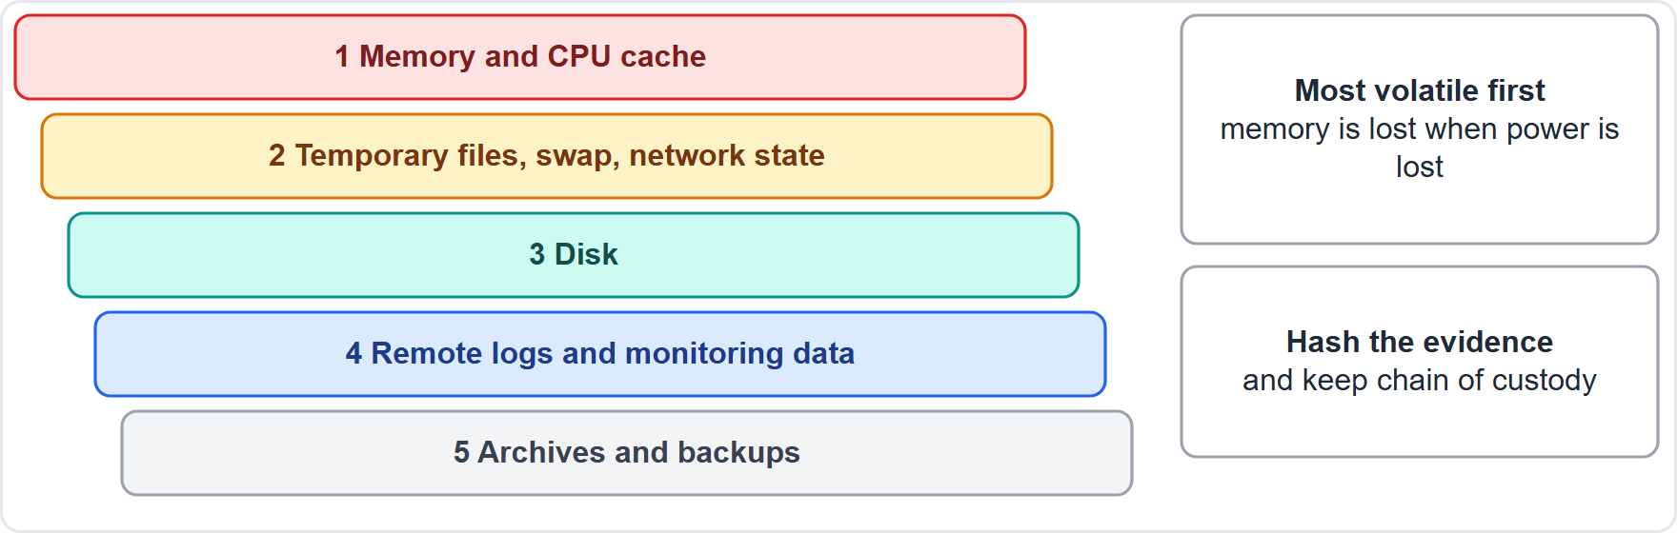
Digital forensics concepts, continued
Module 17
Order of volatility: capture memory first, then disk, then remote logs and archives
SY0-801 Exam Prep | CompTIA Security+ exam
Module 17: Incident Response and Investigations
10 / 21
Notes:
Digital forensics concepts.
The figure shows this: Order of volatility: capture memory first, then disk, then remote logs and archives.

Slide 11
Data, artifacts and sources for investigations
Module 17
Source | Examples
Log types | Access and accounting (logical, physical), device, server, application, authentication, communication, audit, endpoint, network, metadata
Data sources | Vulnerability scans, automated reports, NetFlow/IPFIX, surveillance footage, security tools, dashboards, packet captures
File and log integrity | Hashes and protection show that evidence is unchanged
System image | Memory dump, bit-level copy, snapshot
Stakeholders | Human Resources, accounts, legal are involved when staff or money is concerned
Log-parsing techniques | Searching, filtering and correlating logs to find the story
EXAM TIP A bit-level (forensic) copy keeps deleted data and slack space; a normal copy does not. Always hash the evidence and the copy. Metadata (who, when, where) is often enough to build a timeline.
SY0-801 Exam Prep | CompTIA Security+ exam
Module 17: Incident Response and Investigations
11 / 21
Notes:
Data, artifacts and sources for investigations.
Log types. Access and accounting (logical, physical), device, server, application, authentication, communication, audit, endpoint, network, metadata.
Data sources. Vulnerability scans, automated reports, net flow or I P fix, surveillance footage, security tools, dashboards, packet captures.
File and log integrity. Hashes and protection show that evidence is unchanged.
System image. Memory dump, bit-level copy, snapshot.
Stakeholders. Human Resources, accounts, legal are involved when staff or money is concerned.
Log-parsing techniques. Searching, filtering and correlating logs to find the story.
Exam tip: A bit-level (forensic) copy keeps deleted data and slack space; a normal copy does not. Always hash the evidence and the copy. Metadata (who, when, where) is often enough to build a timeline.

Slide 12
Data, artifacts and sources for investigations, continued
Module 17
EXAM TIP Chain of custody records who handled evidence; the order of volatility says to collect memory first, then disk, then logs and archives.
SY0-801 Exam Prep | CompTIA Security+ exam
Module 17: Incident Response and Investigations
12 / 21
Notes:
Data, artifacts and sources for investigations.
Exam tip: Chain of custody records who handled evidence; the order of volatility says to collect memory first, then disk, then logs and archives.

Slide 13
Practice Question 1
Module 17
Q1
Fabrikam Outdoors finds ransomware spreading across its file servers. What should the team do FIRST?
A
Restore from backup immediately
B
Wipe every server
C
Publish a press release
D
Contain the affected systems by isolating them
SY0-801 Exam Prep | CompTIA Security+ exam
Module 17: Incident Response and Investigations
13 / 21
Notes:
Question one. Fabrikam Outdoors finds ransomware spreading across its file servers. What should the team do first? The four options are on the screen.
[PAUSE 10]
The answer is D: Contain the affected systems by isolating them. Containment stops the spread before eradication and recovery begin.

Slide 14
Practice Question 2
Module 17
Q2
Leadership wants to rehearse a data breach by discussing roles and decisions around a table, without touching systems. Which exercise fits?
A
Parallel processing
B
Penetration test
C
Tabletop exercise
D
Failover test
SY0-801 Exam Prep | CompTIA Security+ exam
Module 17: Incident Response and Investigations
14 / 21
Notes:
Question two. Leadership wants to rehearse a data breach by discussing roles and decisions around a table, without touching systems. Which exercise fits? The four options are on the screen.
[PAUSE 10]
The answer is C: Tabletop exercise. A tabletop exercise walks through a scenario in discussion form.

Slide 15
Practice Question 3
Module 17
Q3
An investigator logs who collected a laptop, who held it and when it was transferred. What does this protect?
A
Data sovereignty
B
Key escrow
C
Chain of custody
D
Rate limiting
SY0-801 Exam Prep | CompTIA Security+ exam
Module 17: Incident Response and Investigations
15 / 21
Notes:
Question three. An investigator logs who collected a laptop, who held it and when it was transferred. What does this protect? The four options are on the screen.
[PAUSE 10]
The answer is C: Chain of custody. Chain of custody records evidence handling so it stays trustworthy.

Slide 16
Practice Question 4
Module 17
Q4
A responder must capture evidence from a running server. Which item should be collected first?
A
Memory contents
B
Archived backups
C
Printed reports
D
Remote logs
SY0-801 Exam Prep | CompTIA Security+ exam
Module 17: Incident Response and Investigations
16 / 21
Notes:
Question four. A responder must capture evidence from a running server. Which item should be collected first? The four options are on the screen.
[PAUSE 10]
The answer is A: Memory contents. Volatile data such as memory is lost first, so it is collected before disk and archives.

Slide 17
Practice Question 5
Module 17
Q5
After an incident, the team meets to document what went wrong and how to improve. Which phase is this?
A
Containment
B
Identification
C
Preparation only
D
Post-incident, lessons learned
SY0-801 Exam Prep | CompTIA Security+ exam
Module 17: Incident Response and Investigations
17 / 21
Notes:
Question five. After an incident, the team meets to document what went wrong and how to improve. Which phase is this? The four options are on the screen.
[PAUSE 10]
The answer is D: Post-incident, lessons learned. Reviewing the incident to improve is the lessons learned and root cause part of the post-incident phase.

Slide 18
Practice Question 6
Module 17
Q6
Which source shows who talked to whom on the network and how much data moved, even without packet contents?
A
A memory dump
B
NetFlow or IPFIX
C
Surveillance footage
D
A password policy report
SY0-801 Exam Prep | CompTIA Security+ exam
Module 17: Incident Response and Investigations
18 / 21
Notes:
Question six. Which source shows who talked to whom on the network and how much data moved, even without packet contents? The four options are on the screen.
[PAUSE 10]
The answer is B: net flow or I P fix. Flow records summarize network conversations and are useful for timelines.

Slide 19
Recall Check 1
Module 17
Q1. Name the phases of incident response in the objectives.
Q2. What is a playbook?
Q3. What is threat hunting?
SY0-801 Exam Prep | CompTIA Security+ exam
Module 17: Incident Response and Investigations
19 / 21
Notes:
Recall check one. Say each answer out loud before you listen to mine.
Question one. Name the phases of incident response in the objectives.
[PAUSE 5]
Answer: Preparation, identification, investigation, containment, negotiation, eradication and recovery, notification, post-incident.
Question two. What is a playbook?
[PAUSE 5]
Answer: A documented set of steps for a specific type of incident.
Question three. What is threat hunting?
[PAUSE 5]
Answer: Actively searching for threats that have evaded detection.

Slide 20
Recall Check 2
Module 17
Q4. What does chain of custody document?
Q5. What is a bit-level copy?
Q6. What does PIR stand for?
SY0-801 Exam Prep | CompTIA Security+ exam
Module 17: Incident Response and Investigations
20 / 21
Notes:
Recall check two. Say each answer out loud before you listen to mine.
Question four. What does chain of custody document?
[PAUSE 5]
Answer: Who handled the evidence, when and why.
Question five. What is a bit-level copy?
[PAUSE 5]
Answer: An exact copy of every bit of a drive, including deleted data.
Question six. What does P I R stand for?
[PAUSE 5]
Answer: Post-incident reporting.

Slide 21
Module Recap
Module 17
1
Phases
2
Exercises
prepare, identify, investigate, contain, negotiate, eradicate and recover, notify, post-incident (lessons learned, root cause)
tabletop (talk), simulation (hands-on), playbooks, roles
3
Forensics
4
Sources
digital forensics, chain of custody, preservation, e-discovery, order of volatility
log types, vulnerability scans, NetFlow/IPFIX, footage, packet captures, hashes, memory dump, bit-level copy, snapshot
SY0-801 Exam Prep | CompTIA Security+ exam
Module 17: Incident Response and Investigations
21 / 21
Notes:
Here is the recap.
Phases: prepare, identify, investigate, contain, negotiate, eradicate and recover, notify, post-incident (lessons learned, root cause).
Exercises: tabletop (talk), simulation (hands-on), playbooks, roles.
Forensics: digital forensics, chain of custody, preservation, e-discovery, order of volatility.
Sources: log types, vulnerability scans, net flow or I P fix, footage, packet captures, hashes, memory dump, bit-level copy, snapshot.
In the next module, we continue the course.

