Slide 1
Module 18: Governance and Risk Management
5.1 Explain the importance of governance, risk, and compliance artifacts
SY0-801 exam prep · Security Program Management and Oversight · 14% of the exam
SY0-801 Exam Prep: CompTIA Security+ Study Course
Module 18
Notes:
Welcome to Module eighteen: Governance and Risk Management. It covers the exam area Security Program Management and Oversight.
Each part of this module comes from the study notes of the same name, so you can read the notes after you watch.

Slide 2
What You Will Learn
Module 18
5.1 Explain the importance of governance, risk, and compliance artifacts
5.2 Explain the impact of risk management processes on the security of the organization
Practice with exam-style questions and a recall check
SY0-801 Exam Prep | CompTIA Security+ exam
Module 18: Governance and Risk Management
2 / 22
Notes:
By the end of this module you will be able to do three things.
five point one Explain the importance of governance, risk, and compliance artifacts.
five point two Explain the impact of risk management processes on the security of the organization.
Practice with exam-style questions and a recall check.

Slide 3
Where This Fits in the Exam
Module 18
EXAM CHECK-IN · Where this fits
Exam area: Security Program Management and Oversight (14%)
Exam format: up to 90 questions in 90 minutes; a score of 750 on a scale of 100 to 900 passes
Validated against: the official CompTIA Security+ SY0-801 V8 exam objectives
SY0-801 Exam Prep | CompTIA Security+ exam
Module 18: Governance and Risk Management
3 / 22
Notes:
Here is where this module sits in the exam.
Exam area: Security Program Management and Oversight (fourteen percent).
Exam format: up to ninety questions in ninety minutes; a score of seven hundred fifty on a scale of one hundred to nine hundred passes.
Validated against: the official Comp T I A Security plus S Y zero eight oh one V eight exam objectives.

Slide 4
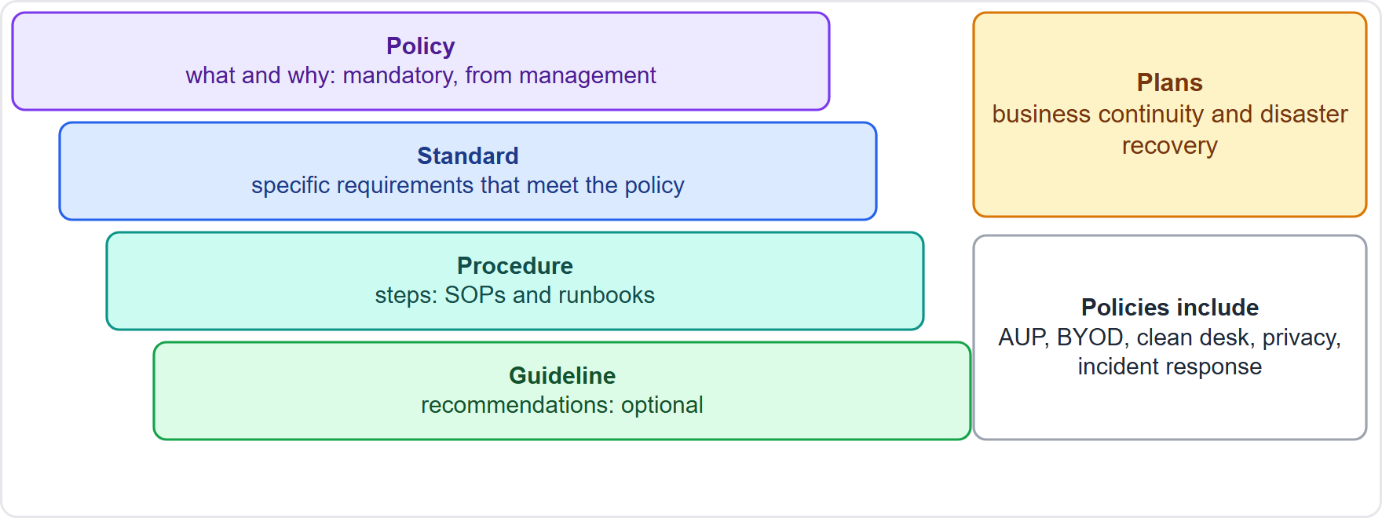
Governance documents
Module 18
The governance hierarchy: policies, standards, procedures, guidelines and plans
SY0-801 Exam Prep | CompTIA Security+ exam
Module 18: Governance and Risk Management
4 / 22
Notes:
Governance documents.
The figure shows this: The governance hierarchy: policies, standards, procedures, guidelines and plans.

Slide 5
Governance documents, continued
Module 18
Document | Purpose | Binding?
Policies | High-level rules set by management: what must be done and why | Mandatory
Standards | Specific required measures to meet a policy: baselines, passwords, physical security, encryption, RFC-based protocol standards | Mandatory
Procedures | Step-by-step instructions: SOPs and runbooks | Mandatory
SY0-801 Exam Prep | CompTIA Security+ exam
Module 18: Governance and Risk Management
5 / 22
Notes:
Governance documents.
Policies. Purpose: High-level rules set by management: what must be done and why. Binding?: Mandatory.
Standards. Purpose: Specific required measures to meet a policy: baselines, passwords, physical security, encryption, R F C-based protocol standards. Binding?: Mandatory.
Procedures. Purpose: Step-by-step instructions: S O Ps and runbooks. Binding?: Mandatory.

Slide 6
Governance documents, continued
Module 18
Document | Purpose | Binding?
Guidelines | Recommendations: benchmarks, advisories, implementation guides, reference architecture | Optional
Plans | Business continuity and disaster recovery | Operational
SY0-801 Exam Prep | CompTIA Security+ exam
Module 18: Governance and Risk Management
6 / 22
Notes:
Governance documents.
Guidelines. Purpose: Recommendations: benchmarks, advisories, implementation guides, reference architecture. Binding?: Optional.
Plans. Purpose: Business continuity and disaster recovery. Binding?: Operational.

Slide 7
Common policies
Module 18
BYOD (bring your own device), acceptable use policy (AUP), clean desk, information security, incident response, data classification and retention, access control, data disposal, vulnerability disclosure, privacy.
EXAM TIP Policy = why and what (mandatory, high level). Standard = what exactly (specific). Procedure = how (steps). Guideline = advice (optional). The AUP says what users may and may not do with company resources.
SY0-801 Exam Prep | CompTIA Security+ exam
Module 18: Governance and Risk Management
7 / 22
Notes:
Common policies.
B Y O D (bring your own device), acceptable use policy (A U P), clean desk, information security, incident response, data classification and retention, access control, data disposal, vulnerability disclosure, privacy.
Exam tip: Policy equals why and what (mandatory, high level). Standard equals what exactly (specific). Procedure equals how (steps). Guideline equals advice (optional). The A U P says what users may and may not do with company resources.

Slide 8
Risk management process
Module 18
Stage | What happens | Items
Risk identification | Find risks | Asset identification, stakeholder ownership
Risk assessment | Rate them | Scoring, categorization
Risk analysis | Understand them | Impact, likelihood or probability, owner, current mitigations, qualitative vs quantitative
Risk register | A recorded list of risks | Communication, reviews
Risk treatment | Decide the response | Transferring, accepting, avoiding, mitigating
SY0-801 Exam Prep | CompTIA Security+ exam
Module 18: Governance and Risk Management
8 / 22
Notes:
Risk management process.
Risk identification. What happens: Find risks. Items: Asset identification, stakeholder ownership.
Risk assessment. What happens: Rate them. Items: Scoring, categorization.
Risk analysis. What happens: Understand them. Items: Impact, likelihood or probability, owner, current mitigations, qualitative versus quantitative.
Risk register. What happens: A recorded list of risks. Items: Communication, reviews.
Risk treatment. What happens: Decide the response. Items: Transferring, accepting, avoiding, mitigating.

Slide 9
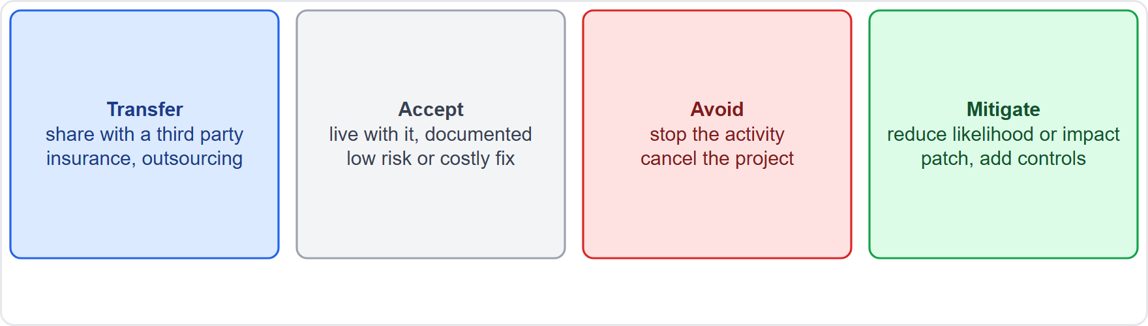
Risk management process, continued
Module 18
The four risk treatments: transfer, accept, avoid, mitigate
SY0-801 Exam Prep | CompTIA Security+ exam
Module 18: Governance and Risk Management
9 / 22
Notes:
Risk management process.
The figure shows this: The four risk treatments: transfer, accept, avoid, mitigate.

Slide 10
Risk management process, continued
Module 18
Treatment | Meaning | Example
Transfer | Shift the risk to a third party | Cyber insurance, outsourcing
Accept | Live with it (documented, approved) | Low risk, cost of fix too high
Avoid | Stop the activity | Cancel a risky project
Mitigate | Reduce likelihood or impact | Patch, add controls
EXAM TIP Insurance = transfer. Residual risk is what remains after controls. The risk owner accepts residual risk; management sets the risk appetite (how much risk is acceptable).
SY0-801 Exam Prep | CompTIA Security+ exam
Module 18: Governance and Risk Management
10 / 22
Notes:
Risk management process.
Transfer. Meaning: Shift the risk to a third party. Example: Cyber insurance, outsourcing.
Accept. Meaning: Live with it (documented, approved). Example: Low risk, cost of fix too high.
Avoid. Meaning: Stop the activity. Example: Cancel a risky project.
Mitigate. Meaning: Reduce likelihood or impact. Example: Patch, add controls.
Exam tip: Insurance equals transfer. Residual risk is what remains after controls. The risk owner accepts residual risk; management sets the risk appetite (how much risk is acceptable).

Slide 11
Business-level considerations
Module 18
Term | Meaning
Business impact analysis (BIA) | Finds critical functions and the effect of losing them (sets RTO and RPO)
Risk appetite | How much risk the organization is willing to take
Residual risk | Risk left after treatment
Stakeholder involvement and management oversight | Decisions are owned by the business
Regulatory and legal | Laws may require specific controls
SY0-801 Exam Prep | CompTIA Security+ exam
Module 18: Governance and Risk Management
11 / 22
Notes:
Business-level considerations.
Business impact analysis (B I A). Finds critical functions and the effect of losing them (sets R T O and R P O).
Risk appetite. How much risk the organization is willing to take.
Residual risk. Risk left after treatment.
Stakeholder involvement and management oversight. Decisions are owned by the business.
Regulatory and legal. Laws may require specific controls.

Slide 12
Quantitative risk formulas
Module 18
Term | Meaning | Formula
SLE (single loss expectancy) | Loss from one event | Asset value × exposure factor
ARO (annualized rate of occurrence) | How often per year | Number of events per year
ALE (annualized loss expectancy) | Expected yearly loss | SLE × ARO
Example: an asset worth $100,000 with 50% exposure has an SLE of $50,000. If it happens twice a year (ARO 2), the ALE is $100,000. A control costing less than the ALE reduction is worthwhile.
SY0-801 Exam Prep | CompTIA Security+ exam
Module 18: Governance and Risk Management
12 / 22
Notes:
Quantitative risk formulas.
S L E (single loss expectancy). Meaning: Loss from one event. Formula: Asset value times exposure factor.
A R O (annualized rate of occurrence). Meaning: How often per year. Formula: Number of events per year.
A L E (annualized loss expectancy). Meaning: Expected yearly loss. Formula: S L E times A R O.
Example: an asset worth $one hundred thousand with fifty percent exposure has an S L E of $fifty thousand. If it happens twice a year (A R O two), the A L E is $one hundred thousand. A control costing less than the A L E reduction is worthwhile.

Slide 13
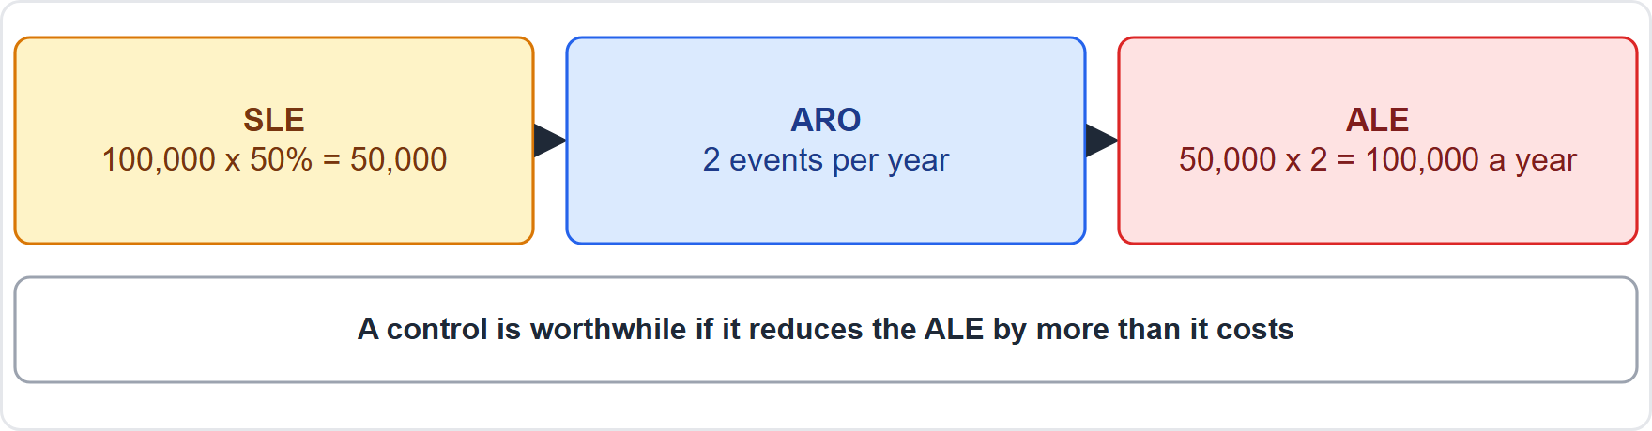
Quantitative risk formulas, continued
Module 18
Worked example: SLE 50,000 times ARO 2 gives ALE 100,000
EXAM TIP ALE = SLE × ARO. Qualitative analysis uses ratings (high, medium, low); quantitative uses numbers and money.
SY0-801 Exam Prep | CompTIA Security+ exam
Module 18: Governance and Risk Management
13 / 22
Notes:
Quantitative risk formulas.
The figure shows this: Worked example: S L E fifty thousand times A R O two gives A L E one hundred thousand.
Exam tip: A L E equals S L E times A R O. Qualitative analysis uses ratings (high, medium, low); quantitative uses numbers and money.

Slide 14
Practice Question 1
Module 18
Q1
Fabrikam Outdoors buys cyber insurance to cover ransomware losses. Which risk treatment is this?
A
Transfer
B
Accept
C
Avoid
D
Mitigate
SY0-801 Exam Prep | CompTIA Security+ exam
Module 18: Governance and Risk Management
14 / 22
Notes:
Question one. Fabrikam Outdoors buys cyber insurance to cover ransomware losses. Which risk treatment is this? The four options are on the screen.
[PAUSE 10]
The answer is A: Transfer. Insurance shifts financial risk to a third party, which is transfer.

Slide 15
Practice Question 2
Module 18
Q2
A server worth 80,000 would lose 25% of its value in one flood. What is the SLE?
A
80,000
B
100,000
C
3,200
D
20,000
SY0-801 Exam Prep | CompTIA Security+ exam
Module 18: Governance and Risk Management
15 / 22
Notes:
Question two. A server worth eighty thousand would lose twenty-five percent of its value in one flood. What is the S L E? The four options are on the screen.
[PAUSE 10]
The answer is D: twenty thousand. S L E is the asset value times the exposure factor: eighty thousand times zero point two five equals twenty thousand.

Slide 16
Practice Question 3
Module 18
Q3
Floods happen once every four years (ARO 0.25) and each costs 20,000. What is the ALE?
A
80,000
B
20,000
C
5,000
D
25,000
SY0-801 Exam Prep | CompTIA Security+ exam
Module 18: Governance and Risk Management
16 / 22
Notes:
Question three. Floods happen once every four years (A R O zero point two five) and each costs twenty thousand. What is the A L E? The four options are on the screen.
[PAUSE 10]
The answer is C: five thousand. A L E is S L E times A R O: twenty thousand times zero point two five equals five thousand per year.

Slide 17
Practice Question 4
Module 18
Q4
Management writes a document that says all laptops must use full disk encryption. Which type of document is this?
A
A guideline
B
A runbook
C
A benchmark
D
A policy
SY0-801 Exam Prep | CompTIA Security+ exam
Module 18: Governance and Risk Management
17 / 22
Notes:
Question four. Management writes a document that says all laptops must use full disk encryption. Which type of document is this? The four options are on the screen.
[PAUSE 10]
The answer is D: A policy. A mandatory high-level rule from management is a policy, backed by standards and procedures.

Slide 18
Practice Question 5
Module 18
Q5
After a patch and monitoring, a small risk remains that the owner agrees to live with. What is the remaining risk called?
A
Inherent risk
B
Total risk
C
Transferred risk
D
Residual risk
SY0-801 Exam Prep | CompTIA Security+ exam
Module 18: Governance and Risk Management
18 / 22
Notes:
Question five. After a patch and monitoring, a small risk remains that the owner agrees to live with. What is the remaining risk called? The four options are on the screen.
[PAUSE 10]
The answer is D: Residual risk. The risk left after controls is residual risk, which the risk owner may accept.

Slide 19
Practice Question 6
Module 18
Q6
A company stops offering a service in a country because compliance is too costly. Which risk treatment is this?
A
Transfer
B
Accept
C
Mitigate
D
Avoid
SY0-801 Exam Prep | CompTIA Security+ exam
Module 18: Governance and Risk Management
19 / 22
Notes:
Question six. A company stops offering a service in a country because compliance is too costly. Which risk treatment is this? The four options are on the screen.
[PAUSE 10]
The answer is D: Avoid. Ending the activity that creates the risk is avoidance.

Slide 20
Recall Check 1
Module 18
Q1. Which governance document is optional advice?
Q2. What is the difference between a standard and a procedure?
Q3. Name the four risk treatments.
SY0-801 Exam Prep | CompTIA Security+ exam
Module 18: Governance and Risk Management
20 / 22
Notes:
Recall check one. Say each answer out loud before you listen to mine.
Question one. Which governance document is optional advice?
[PAUSE 5]
Answer: A guideline.
Question two. What is the difference between a standard and a procedure?
[PAUSE 5]
Answer: A standard states specific requirements; a procedure gives the steps.
Question three. Name the four risk treatments.
[PAUSE 5]
Answer: Transfer, accept, avoid and mitigate.

Slide 21
Recall Check 2
Module 18
Q4. What is the formula for ALE?
Q5. What does a risk register contain?
Q6. What does a business impact analysis find?
SY0-801 Exam Prep | CompTIA Security+ exam
Module 18: Governance and Risk Management
21 / 22
Notes:
Recall check two. Say each answer out loud before you listen to mine.
Question four. What is the formula for A L E?
[PAUSE 5]
Answer: Single loss expectancy times annualized rate of occurrence.
Question five. What does a risk register contain?
[PAUSE 5]
Answer: A list of identified risks with their analysis, owners and status.
Question six. What does a business impact analysis find?
[PAUSE 5]
Answer: Critical business functions and the impact of losing them.

Slide 22
Module Recap
Module 18
1
Documents
2
Policies
3
Risk steps
policy (mandatory, why), standard (specific), procedure (steps: SOP, runbook), guideline (advice), plans (BC, DR)
BYOD, AUP, clean desk, information security, incident response, classification and retention, access control, disposal, vulnerability disclosure, privacy
identify, assess, analyze, register, treat
4
Treatments
5
Numbers
transfer (insurance), accept, avoid, mitigate; residual risk remains
SLE = asset value × exposure; ALE = SLE × ARO; qualitative vs quantitative; BIA; risk appetite
SY0-801 Exam Prep | CompTIA Security+ exam
Module 18: Governance and Risk Management
22 / 22
Notes:
Here is the recap.
Documents: policy (mandatory, why), standard (specific), procedure (steps: S O P, runbook), guideline (advice), plans (B C, D R).
Policies: B Y O D, A U P, clean desk, information security, incident response, classification and retention, access control, disposal, vulnerability disclosure, privacy.
Risk steps: identify, assess, analyze, register, treat.
Treatments: transfer (insurance), accept, avoid, mitigate; residual risk remains.
Numbers: S L E equals asset value times exposure; A L E equals S L E times A R O; qualitative versus quantitative; B I A; risk appetite.
In the next module, we continue the course.

