Slide 1
Module 19: Third-Party Risk and Compliance
5.3 Explain the assessment and management processes associated with third-party risk
SY0-801 exam prep · Security Program Management and Oversight · 14% of the exam
SY0-801 Exam Prep: CompTIA Security+ Study Course
Module 19
Notes:
Welcome to Module nineteen: Third-Party Risk and Compliance. It covers the exam area Security Program Management and Oversight.
Each part of this module comes from the study notes of the same name, so you can read the notes after you watch.

Slide 2
What You Will Learn
Module 19
5.3 Explain the assessment and management processes associated with third-party risk
5.4 Summarize elements of effective security compliance
Practice with exam-style questions and a recall check
SY0-801 Exam Prep | CompTIA Security+ exam
Module 19: Third-Party Risk and Compliance
2 / 19
Notes:
By the end of this module you will be able to do three things.
five point three Explain the assessment and management processes associated with third-party risk.
five point four Summarize elements of effective security compliance.
Practice with exam-style questions and a recall check.

Slide 3
Where This Fits in the Exam
Module 19
EXAM CHECK-IN · Where this fits
Exam area: Security Program Management and Oversight (14%)
Exam format: up to 90 questions in 90 minutes; a score of 750 on a scale of 100 to 900 passes
Validated against: the official CompTIA Security+ SY0-801 V8 exam objectives
SY0-801 Exam Prep | CompTIA Security+ exam
Module 19: Third-Party Risk and Compliance
3 / 19
Notes:
Here is where this module sits in the exam.
Exam area: Security Program Management and Oversight (fourteen percent).
Exam format: up to ninety questions in ninety minutes; a score of seven hundred fifty on a scale of one hundred to nine hundred passes.
Validated against: the official Comp T I A Security plus S Y zero eight oh one V eight exam objectives.

Slide 4
Why third parties matter
Module 19
Vendors, partners and cloud providers touch your data and systems, so their weaknesses become your risk (supply chain risk, module 5). Third-party risk management covers choosing, contracting, monitoring and ending the relationship.
SY0-801 Exam Prep | CompTIA Security+ exam
Module 19: Third-Party Risk and Compliance
4 / 19
Notes:
Why third parties matter.
Vendors, partners and cloud providers touch your data and systems, so their weaknesses become your risk (supply chain risk, module five). Third-party risk management covers choosing, contracting, monitoring and ending the relationship.

Slide 5
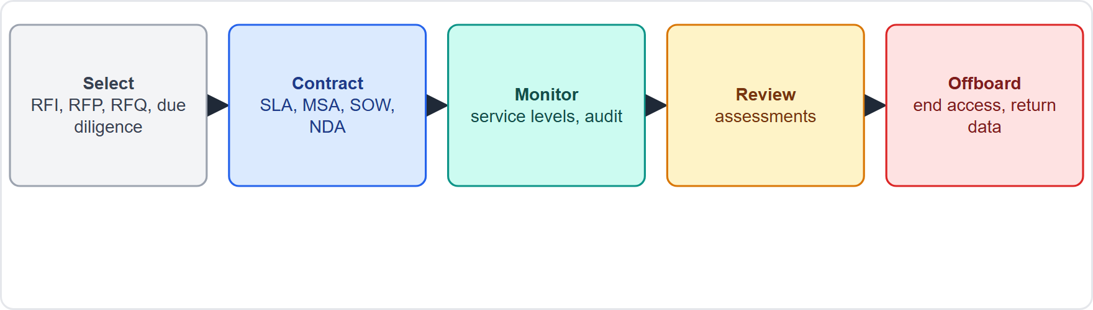
Why third parties matter, continued
Module 19
The vendor life cycle: select, contract, monitor, review, offboard
SY0-801 Exam Prep | CompTIA Security+ exam
Module 19: Third-Party Risk and Compliance
5 / 19
Notes:
Why third parties matter.
The figure shows this: The vendor life cycle: select, contract, monitor, review, offboard.

Slide 6
Vendor selection
Module 19
Term | Meaning
Request for information (RFI) | Gather general information about what vendors offer
Request for proposal (RFP) | Detailed proposal with solution and price for a defined need
Request for quote (RFQ) | Price for a well-defined product or service
Expression of interest (EOI) | A vendor signals interest before the formal process
Due diligence | Investigating the vendor's security, finances and reputation before signing
Conflict of interest | A relationship that could bias the selection
SY0-801 Exam Prep | CompTIA Security+ exam
Module 19: Third-Party Risk and Compliance
6 / 19
Notes:
Vendor selection.
Request for information (R F I). Gather general information about what vendors offer.
Request for proposal (R F P). Detailed proposal with solution and price for a defined need.
Request for quote (R F Q). Price for a well-defined product or service.
Expression of interest (E O I). A vendor signals interest before the formal process.
Due diligence. Investigating the vendor's security, finances and reputation before signing.
Conflict of interest. A relationship that could bias the selection.

Slide 7
Agreement types
Module 19
Agreement | Purpose
SLA (service-level agreement) | Measurable service levels and penalties (uptime, response time)
SLO (service-level objective) | A target inside an SLA
MOU (memorandum of understanding) | Non-binding statement of shared intent
MOA (memorandum of agreement) | Binding agreement on roles and actions
NDA (non-disclosure agreement) | Keeps information confidential
MSA (master services agreement) | Overall terms for a long-term relationship
SOW (statement of work) | Specific tasks, deliverables and timeline of one project
EXAM TIP MSA = umbrella terms; SOW = one project. SLA = measurable service promise. MOU = non-binding; MOA = binding. NDA = secrecy.
SY0-801 Exam Prep | CompTIA Security+ exam
Module 19: Third-Party Risk and Compliance
7 / 19
Notes:
Agreement types.
S L A (service level agreement) (service-level agreement). Measurable service levels and penalties (uptime, response time).
S L O (service-level objective). A target inside an S L A.
M O U (memorandum of understanding). Non-binding statement of shared intent.
M O A (memorandum of agreement). Binding agreement on roles and actions.
N D A (non-disclosure agreement). Keeps information confidential.
M S A (master services agreement). Overall terms for a long-term relationship.
S O W (statement of work). Specific tasks, deliverables and timeline of one project.
Exam tip: M S A equals umbrella terms; S O W equals one project. S L A equals measurable service promise. M O U equals non-binding; M O A equals binding. N D A equals secrecy.

Slide 8
Vendor monitoring and limits
Module 19
Item | Meaning
Right to audit | Contract clause letting you inspect the vendor
Service-level monitoring | Tracking performance against the SLA
Vendor registry | A list of vendors with their risk ratings
Vendor assessment | Questionnaires and reviews of vendor controls
Compliance attestation | A vendor's statement (often an independent report) that it meets a standard
Penetration testing | Testing the vendor's systems (with permission)
Rules of engagement | Written limits and permissions for a test
Limitations and constraints: staffing, resource availability, environment, legal and regulatory factors, geography and jurisdiction, financial or ROI limits, vendor lock-in, assurance mechanisms.
SY0-801 Exam Prep | CompTIA Security+ exam
Module 19: Third-Party Risk and Compliance
8 / 19
Notes:
Vendor monitoring and limits.
Right to audit. Contract clause letting you inspect the vendor.
Service-level monitoring. Tracking performance against the S L A.
Vendor registry. A list of vendors with their risk ratings.
Vendor assessment. Questionnaires and reviews of vendor controls.
Compliance attestation. A vendor's statement (often an independent report) that it meets a standard.
Penetration testing. Testing the vendor's systems (with permission).
Rules of engagement. Written limits and permissions for a test.
Limitations and constraints: staffing, resource availability, environment, legal and regulatory factors, geography and jurisdiction, financial or R O I limits, vendor lock-in, assurance mechanisms.

Slide 9
Security compliance
Module 19
Element | Details
Compliance training | Data handling, anti-money laundering and counter-terrorism financing (AML/CTF), anti-bribery
Compliance monitoring | Attestations (formal statements) and acknowledgements (people confirm they read policies)
Consequences of non-compliance | Reputational damage, financial, legal, contractual, sanctions, loss of license
Privacy | Right to be forgotten, opt-in or opt-out, data correction, processing restrictions, processing prevention, controller vs processor, ownership
Legal compliance | Legal hold (preserve data for litigation), legal orders, data retention requirements
EXAM TIP A legal hold stops normal deletion of relevant data; retention requirements set how long data must be kept.
SY0-801 Exam Prep | CompTIA Security+ exam
Module 19: Third-Party Risk and Compliance
9 / 19
Notes:
Security compliance.
Compliance training. Data handling, anti-money laundering and counter-terrorism financing (A M L or C T F), anti-bribery.
Compliance monitoring. Attestations (formal statements) and acknowledgements (people confirm they read policies).
Consequences of non-compliance. Reputational damage, financial, legal, contractual, sanctions, loss of license.
Privacy. Right to be forgotten, opt-in or opt-out, data correction, processing restrictions, processing prevention, controller versus processor, ownership.
Legal compliance. Legal hold (preserve data for litigation), legal orders, data retention requirements.
Exam tip: A legal hold stops normal deletion of relevant data; retention requirements set how long data must be kept.

Slide 10
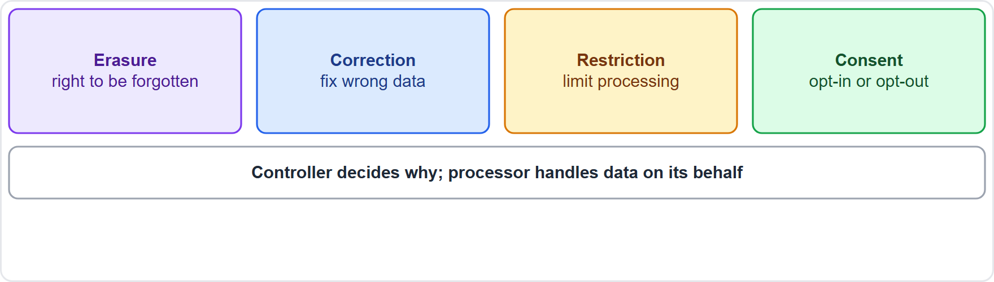
Security compliance, continued
Module 19
Privacy rights: erasure, correction, restriction, consent, with controller and processor roles
EXAM TIP A legal hold overrides normal deletion: nothing relevant may be destroyed. A controller decides the purpose; a processor handles data on its behalf. Right to be forgotten = erasure on request, subject to law.
SY0-801 Exam Prep | CompTIA Security+ exam
Module 19: Third-Party Risk and Compliance
10 / 19
Notes:
Security compliance.
The figure shows this: Privacy rights: erasure, correction, restriction, consent, with controller and processor roles.
Exam tip: A legal hold overrides normal deletion: nothing relevant may be destroyed. A controller decides the purpose; a processor handles data on its behalf. Right to be forgotten equals erasure on request, subject to law.

Slide 11
Practice Question 1
Module 19
Q1
Fabrikam Outdoors already has a long-term contract with a supplier and now wants a document that defines one new project's tasks and deliverables. Which should it use?
A
A master services agreement
B
A statement of work
C
A non-disclosure agreement
D
A memorandum of understanding
SY0-801 Exam Prep | CompTIA Security+ exam
Module 19: Third-Party Risk and Compliance
11 / 19
Notes:
Question one. Fabrikam Outdoors already has a long-term contract with a supplier and now wants a document that defines one new project's tasks and deliverables. Which should it use? The four options are on the screen.
[PAUSE 10]
The answer is B: A statement of work. A statement of work defines the specific tasks and deliverables, under the umbrella of the M S A.

Slide 12
Practice Question 2
Module 19
Q2
A contract lets the company inspect a cloud provider's security controls on request. Which clause is this?
A
Legal hold
B
Right to audit
C
Rate limiting
D
Vendor lock-in
SY0-801 Exam Prep | CompTIA Security+ exam
Module 19: Third-Party Risk and Compliance
12 / 19
Notes:
Question two. A contract lets the company inspect a cloud provider's security controls on request. Which clause is this? The four options are on the screen.
[PAUSE 10]
The answer is B: Right to audit. A right to audit clause allows inspection of the vendor's controls.

Slide 13
Practice Question 3
Module 19
Q3
A company wants vendors to describe their offerings in general before it defines requirements. Which document fits?
A
RFQ
B
RFI
C
SLA
D
SOW
SY0-801 Exam Prep | CompTIA Security+ exam
Module 19: Third-Party Risk and Compliance
13 / 19
Notes:
Question three. A company wants vendors to describe their offerings in general before it defines requirements. Which document fits? The four options are on the screen.
[PAUSE 10]
The answer is B: R F I. A request for information gathers general information from vendors.

Slide 14
Practice Question 4
Module 19
Q4
Litigation is expected, so all emails about the project must be preserved even though the policy says to delete them after 90 days. What applies?
A
Data minimization
B
Right to be forgotten
C
Tokenization
D
Legal hold
SY0-801 Exam Prep | CompTIA Security+ exam
Module 19: Third-Party Risk and Compliance
14 / 19
Notes:
Question four. Litigation is expected, so all emails about the project must be preserved even though the policy says to delete them after ninety days. What applies? The four options are on the screen.
[PAUSE 10]
The answer is D: Legal hold. A legal hold suspends normal deletion for relevant data.

Slide 15
Practice Question 5
Module 19
Q5
A customer asks a company to delete the personal data it holds about them. Which privacy right is this?
A
Right to audit
B
Processing prevention only
C
Data transpose
D
Right to be forgotten
SY0-801 Exam Prep | CompTIA Security+ exam
Module 19: Third-Party Risk and Compliance
15 / 19
Notes:
Question five. A customer asks a company to delete the personal data it holds about them. Which privacy right is this? The four options are on the screen.
[PAUSE 10]
The answer is D: Right to be forgotten. Requesting erasure of personal data is the right to be forgotten.

Slide 16
Practice Question 6
Module 19
Q6
An agreement states uptime of 99.9% and credits if the vendor misses it. Which agreement is this?
A
NDA
B
SLA
C
MOU
D
EOI
SY0-801 Exam Prep | CompTIA Security+ exam
Module 19: Third-Party Risk and Compliance
16 / 19
Notes:
Question six. An agreement states uptime of ninety-nine point nine percent and credits if the vendor misses it. Which agreement is this? The four options are on the screen.
[PAUSE 10]
The answer is B: S L A. A service-level agreement sets measurable service levels and remedies.

Slide 17
Recall Check 1
Module 19
Q1. What is the difference between RFI, RFP and RFQ?
Q2. What does an MSA cover?
Q3. What is due diligence?
SY0-801 Exam Prep | CompTIA Security+ exam
Module 19: Third-Party Risk and Compliance
17 / 19
Notes:
Recall check one. Say each answer out loud before you listen to mine.
Question one. What is the difference between R F I, R F P and R F Q?
[PAUSE 5]
Answer: R F I gathers information, R F P asks for a detailed proposal, R F Q asks for a price.
Question two. What does an M S A cover?
[PAUSE 5]
Answer: The overall terms of a long-term vendor relationship.
Question three. What is due diligence?
[PAUSE 5]
Answer: Investigating a vendor's security, finances and reputation before signing.

Slide 18
Recall Check 2
Module 19
Q4. Name three consequences of non-compliance.
Q5. What is a compliance attestation?
Q6. Controller or processor: who decides why data is processed?
SY0-801 Exam Prep | CompTIA Security+ exam
Module 19: Third-Party Risk and Compliance
18 / 19
Notes:
Recall check two. Say each answer out loud before you listen to mine.
Question four. Name three consequences of non-compliance.
[PAUSE 5]
Answer: For example reputational damage, financial penalties, legal action, sanctions, loss of license.
Question five. What is a compliance attestation?
[PAUSE 5]
Answer: A formal statement, often independent, that a standard is met.
Question six. Controller or processor: who decides why data is processed?
[PAUSE 5]
Answer: The controller.

Slide 19
Module Recap
Module 19
1
Selection
2
Agreements
RFI (information), RFP (proposal), RFQ (price), EOI; due diligence; conflict of interest
SLA/SLO, MOU (non-binding), MOA (binding), NDA, MSA (umbrella), SOW (project)
3
Monitoring
4
Compliance
right to audit, service-level monitoring, vendor registry and assessments, attestations, penetration testing, rules of engagement
training (data handling, AML/CTF, anti-bribery), attestations and acknowledgements, consequences, privacy rights, legal hold and retention
SY0-801 Exam Prep | CompTIA Security+ exam
Module 19: Third-Party Risk and Compliance
19 / 19
Notes:
Here is the recap.
Selection: R F I (information), R F P (proposal), R F Q (price), E O I; due diligence; conflict of interest.
Agreements: S L A or S L O, M O U (non-binding), M O A (binding), N D A, M S A (umbrella), S O W (project).
Monitoring: right to audit, service-level monitoring, vendor registry and assessments, attestations, penetration testing, rules of engagement.
Compliance: training (data handling, A M L or C T F, anti-bribery), attestations and acknowledgements, consequences, privacy rights, legal hold and retention.
In the next module, we continue the course.

