Slide 1
Module 20: Audits, Assessments and Security Awareness
5.5 Explain concepts associated with audit and assessment activities
SY0-801 exam prep · Security Program Management and Oversight · 14% of the exam
SY0-801 Exam Prep: CompTIA Security+ Study Course
Module 20
Notes:
Welcome to Module twenty: Audits, Assessments and Security Awareness. It covers the exam area Security Program Management and Oversight.
Each part of this module comes from the study notes of the same name, so you can read the notes after you watch.

Slide 2
What You Will Learn
Module 20
5.5 Explain concepts associated with audit and assessment activities
5.6 Given a scenario, apply security awareness concepts to improve organizational security
Practice with exam-style questions and a recall check
SY0-801 Exam Prep | CompTIA Security+ exam
Module 20: Audits, Assessments and Security Awareness
2 / 20
Notes:
By the end of this module you will be able to do three things.
five point five Explain concepts associated with audit and assessment activities.
five point six Given a scenario, apply security awareness concepts to improve organizational security.
Practice with exam-style questions and a recall check.

Slide 3
Where This Fits in the Exam
Module 20
EXAM CHECK-IN · Where this fits
Exam area: Security Program Management and Oversight (14%)
Exam format: up to 90 questions in 90 minutes; a score of 750 on a scale of 100 to 900 passes
Validated against: the official CompTIA Security+ SY0-801 V8 exam objectives
SY0-801 Exam Prep | CompTIA Security+ exam
Module 20: Audits, Assessments and Security Awareness
3 / 20
Notes:
Here is where this module sits in the exam.
Exam area: Security Program Management and Oversight (fourteen percent).
Exam format: up to ninety questions in ninety minutes; a score of seven hundred fifty on a scale of one hundred to nine hundred passes.
Validated against: the official Comp T I A Security plus S Y zero eight oh one V eight exam objectives.

Slide 4
Audits and assessments
Module 20
Term | Meaning
Audit | A formal, independent examination against a standard or policy
Assessment | An evaluation of controls or risk, often less formal
Gap analysis | Compare current state with the target to find missing controls
Benchmarking | Compare against peers or a standard
SY0-801 Exam Prep | CompTIA Security+ exam
Module 20: Audits, Assessments and Security Awareness
4 / 20
Notes:
Audits and assessments.
Audit. A formal, independent examination against a standard or policy.
Assessment. An evaluation of controls or risk, often less formal.
Gap analysis. Compare current state with the target to find missing controls.
Benchmarking. Compare against peers or a standard.

Slide 5
Data gathering
Module 20
Reference | Use
MITRE ATT&CK | A catalog of attacker tactics and techniques
Cyber Kill Chain | Stages of an attack (reconnaissance to actions on objectives)
Diamond Model of Intrusion Analysis | Relates adversary, capability, infrastructure and victim
SY0-801 Exam Prep | CompTIA Security+ exam
Module 20: Audits, Assessments and Security Awareness
5 / 20
Notes:
Data gathering.
Sampling (check part of the population), questionnaires and surveys, interviews, assertion (a statement by management that something is true), and reference sources such as.
my ter attack. A catalog of attacker tactics and techniques.
Cyber Kill Chain. Stages of an attack (reconnaissance to actions on objectives).
Diamond Model of Intrusion Analysis. Relates adversary, capability, infrastructure and victim.

Slide 6
Scoping and engagement types
Module 20
Item | Meaning
Audit charter | The document that gives the audit authority and scope
Frequency | How often audits take place
Internal | Compliance checks, audit committee, self-assessments
External | Examinations, assessments, regulatory audits, independent third-party audits
SY0-801 Exam Prep | CompTIA Security+ exam
Module 20: Audits, Assessments and Security Awareness
6 / 20
Notes:
Scoping and engagement types.
Audit charter. The document that gives the audit authority and scope.
Frequency. How often audits take place.
Internal. Compliance checks, audit committee, self-assessments.
External. Examinations, assessments, regulatory audits, independent third-party audits.

Slide 7
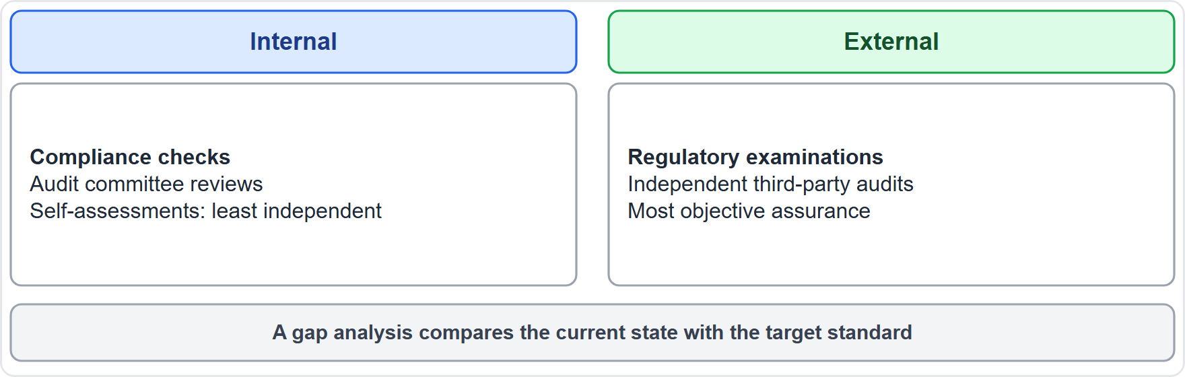
Scoping and engagement types, continued
Module 20
Internal and external audits compared by independence and who performs them
EXAM TIP External independent audits give the most objective assurance. Self-assessments are the least independent. A gap analysis compares today versus the standard.
SY0-801 Exam Prep | CompTIA Security+ exam
Module 20: Audits, Assessments and Security Awareness
7 / 20
Notes:
Scoping and engagement types.
The figure shows this: Internal and external audits compared by independence and who performs them.
Exam tip: External independent audits give the most objective assurance. Self-assessments are the least independent. A gap analysis compares today versus the standard.

Slide 8
Penetration testing
Module 20
Type | Meaning
Known environment (white box) | Tester has full information
Unknown environment (black box) | Tester has no information
Partially known environment (gray box) | Some information
Physical | Tests buildings and locks
Offensive | The red team attacks
Defensive | The blue team defends and detects
Integrated | Red and blue work together (purple)
Reconnaissance | Passive (public information, no contact with the target) or active (probing the target)
A penetration test is an authorized, simulated attack to find weaknesses. Always agree rules of engagement and get written permission first.
Other topics: frameworks and standards (industry, international and region-specific), functional testing (does it do what it should), behavioral testing (how it behaves under unusual input).
SY0-801 Exam Prep | CompTIA Security+ exam
Module 20: Audits, Assessments and Security Awareness
8 / 20
Notes:
Penetration testing.
A penetration test is an authorized, simulated attack to find weaknesses. Always agree rules of engagement and get written permission first.
Known environment (white box). Tester has full information.
Unknown environment (black box). Tester has no information.
Partially known environment (gray box). Some information.
Physical. Tests buildings and locks.
Offensive. The red team attacks.
Defensive. The blue team defends and detects.
Integrated. Red and blue work together (purple).
Reconnaissance. Passive (public information, no contact with the target) or active (probing the target).
Other topics: frameworks and standards (industry, international and region-specific), functional testing (does it do what it should), behavioral testing (how it behaves under unusual input).

Slide 9
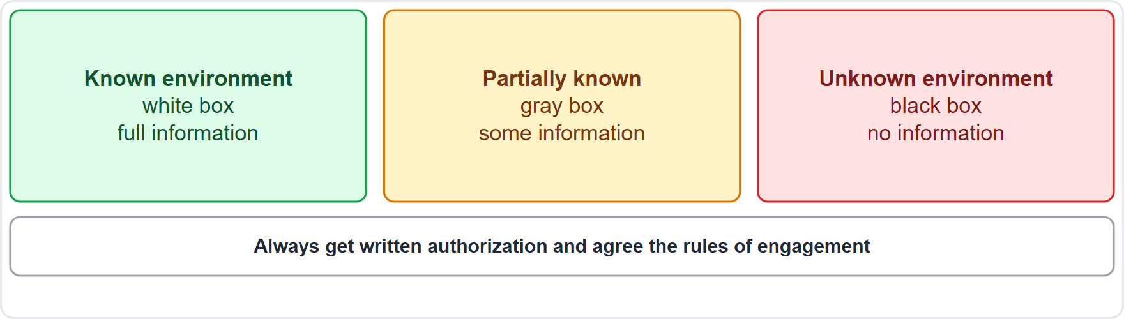
Penetration testing, continued
Module 20
Penetration test types by knowledge: known, partially known, unknown
EXAM TIP Passive recon = no contact (search engines, public records). Active recon = touches the target (port scan). Unknown environment = black box. Never test without written authorization.
SY0-801 Exam Prep | CompTIA Security+ exam
Module 20: Audits, Assessments and Security Awareness
9 / 20
Notes:
Penetration testing.
The figure shows this: Penetration test types by knowledge: known, partially known, unknown.
Exam tip: Passive recon equals no contact (search engines, public records). Active recon equals touches the target (port scan). Unknown environment equals black box. Never test without written authorization.

Slide 10
Security awareness
Module 20
Topic | Details
Types of training | Initial or onboarding, ongoing, targeted (by role or risk), corrective (after a failure, for example a phishing click)
Delivery mechanisms | Learning management system (LMS), self-service portals, one-to-one, one-to-many
Reporting and monitoring effectiveness | Metrics, managerial reports, personnel behavior risk scoring
Common topics | Social engineering, emerging security topics, password and credential management, remote work and hybrid work, BYOD, business email compromise (BEC), removable media and cables, situational awareness, operational security
Measuring success: phishing simulation click rates, reporting rates, training completion, and incident trends. Reward reporting, do not punish it.
SY0-801 Exam Prep | CompTIA Security+ exam
Module 20: Audits, Assessments and Security Awareness
10 / 20
Notes:
Security awareness.
Types of training. Initial or onboarding, ongoing, targeted (by role or risk), corrective (after a failure, for example a phishing click).
Delivery mechanisms. Learning management system (L M S), self-service portals, one-to-one, one-to-many.
Reporting and monitoring effectiveness. Metrics, managerial reports, personnel behavior risk scoring.
Common topics. Social engineering, emerging security topics, password and credential management, remote work and hybrid work, B Y O D, business email compromise (B E C), removable media and cables, situational awareness, operational security.
Measuring success: phishing simulation click rates, reporting rates, training completion, and incident trends. Reward reporting, do not punish it.

Slide 11
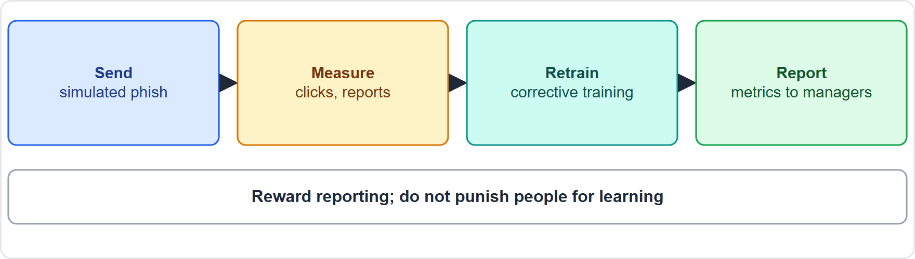
Security awareness, continued
Module 20
A phishing simulation cycle: send, measure, retrain, report
EXAM TIP BEC is an email fraud where an attacker impersonates an executive or vendor to move money. Corrective training follows a failure. Targeted training matches high-risk roles (finance, executives).
SY0-801 Exam Prep | CompTIA Security+ exam
Module 20: Audits, Assessments and Security Awareness
11 / 20
Notes:
Security awareness.
The figure shows this: A phishing simulation cycle: send, measure, retrain, report.
Exam tip: B E C is an email fraud where an attacker impersonates an executive or vendor to move money. Corrective training follows a failure. Targeted training matches high-risk roles (finance, executives).

Slide 12
Practice Question 1
Module 20
Q1
Fabrikam Outdoors hires a firm to test its network. The testers are given no information about the environment. Which type is this?
A
Known environment
B
Partially known environment
C
Integrated
D
Unknown environment
SY0-801 Exam Prep | CompTIA Security+ exam
Module 20: Audits, Assessments and Security Awareness
12 / 20
Notes:
Question one. Fabrikam Outdoors hires a firm to test its network. The testers are given no information about the environment. Which type is this? The four options are on the screen.
[PAUSE 10]
The answer is D: Unknown environment. Testers with no prior information perform an unknown environment (black box) test.

Slide 13
Practice Question 2
Module 20
Q2
A tester searches public records and social media about the company before any contact with its systems. Which activity is this?
A
Active reconnaissance
B
Passive reconnaissance
C
Privilege escalation
D
Functional testing
SY0-801 Exam Prep | CompTIA Security+ exam
Module 20: Audits, Assessments and Security Awareness
13 / 20
Notes:
Question two. A tester searches public records and social media about the company before any contact with its systems. Which activity is this? The four options are on the screen.
[PAUSE 10]
The answer is B: Passive reconnaissance. Collecting information without touching the target is passive reconnaissance.

Slide 14
Practice Question 3
Module 20
Q3
An employee clicks a link in a simulated phishing email. What should the company do?
A
Fire the employee immediately
B
Provide corrective training
C
Ignore the result
D
Disable email
SY0-801 Exam Prep | CompTIA Security+ exam
Module 20: Audits, Assessments and Security Awareness
14 / 20
Notes:
Question three. An employee clicks a link in a simulated phishing email. What should the company do? The four options are on the screen.
[PAUSE 10]
The answer is B: Provide corrective training. Corrective training addresses a failure, and the goal is learning rather than punishment.

Slide 15
Practice Question 4
Module 20
Q4
Which audit gives the most objective view for a regulator?
A
An independent third-party audit
B
A self-assessment
C
A manager's assertion
D
An informal walkthrough
SY0-801 Exam Prep | CompTIA Security+ exam
Module 20: Audits, Assessments and Security Awareness
15 / 20
Notes:
Question four. Which audit gives the most objective view for a regulator? The four options are on the screen.
[PAUSE 10]
The answer is A: An independent third-party audit. Independent third-party audits are the most objective.

Slide 16
Practice Question 5
Module 20
Q5
A team compares its controls with the standard it wants to meet and lists what is missing. Which activity is this?
A
Sampling
B
Gap analysis
C
Benchmarking only
D
Tabletop exercise
SY0-801 Exam Prep | CompTIA Security+ exam
Module 20: Audits, Assessments and Security Awareness
16 / 20
Notes:
Question five. A team compares its controls with the standard it wants to meet and lists what is missing. Which activity is this? The four options are on the screen.
[PAUSE 10]
The answer is B: Gap analysis. A gap analysis compares the current state with the target to find gaps.

Slide 17
Practice Question 6
Module 20
Q6
An attacker poses as the CEO and emails the finance team to change a vendor's bank account. Which threat does training cover here?
A
Watering hole
B
Cache poisoning
C
Tailgating
D
Business email compromise
SY0-801 Exam Prep | CompTIA Security+ exam
Module 20: Audits, Assessments and Security Awareness
17 / 20
Notes:
Question six. An attacker poses as the C E O and emails the finance team to change a vendor's bank account. Which threat does training cover here? The four options are on the screen.
[PAUSE 10]
The answer is D: Business email compromise. Impersonating an executive by email to redirect payments is business email compromise.

Slide 18
Recall Check 1
Module 20
Q1. What does MITRE ATT&CK provide?
Q2. What is the difference between passive and active reconnaissance?
Q3. Which penetration test type gives the tester full information?
SY0-801 Exam Prep | CompTIA Security+ exam
Module 20: Audits, Assessments and Security Awareness
18 / 20
Notes:
Recall check one. Say each answer out loud before you listen to mine.
Question one. What does my ter attack provide?
[PAUSE 5]
Answer: A catalog of attacker tactics and techniques.
Question two. What is the difference between passive and active reconnaissance?
[PAUSE 5]
Answer: Passive uses public information with no contact; active probes the target.
Question three. Which penetration test type gives the tester full information?
[PAUSE 5]
Answer: Known environment.

Slide 19
Recall Check 2
Module 20
Q4. What are the four types of security awareness training?
Q5. What is BEC?
Q6. What does an audit charter define?
SY0-801 Exam Prep | CompTIA Security+ exam
Module 20: Audits, Assessments and Security Awareness
19 / 20
Notes:
Recall check two. Say each answer out loud before you listen to mine.
Question four. What are the four types of security awareness training?
[PAUSE 5]
Answer: Initial or onboarding, ongoing, targeted and corrective.
Question five. What is B E C?
[PAUSE 5]
Answer: Business email compromise: impersonating executives or vendors to move money.
Question six. What does an audit charter define?
[PAUSE 5]
Answer: The authority and scope of an audit.

Slide 20
Module Recap
Module 20
1
Audits
2
Reference models
internal (compliance, audit committee, self-assessment) and external (regulatory, independent third party); gap analysis; benchmarking
MITRE ATT&CK, Cyber Kill Chain, Diamond Model
3
Pen testing
4
Awareness
known, unknown, partially known; physical, offensive, defensive, integrated; passive vs active recon; written authorization
initial, ongoing, targeted, corrective; LMS and portals; metrics and risk scoring
SY0-801 Exam Prep | CompTIA Security+ exam
Module 20: Audits, Assessments and Security Awareness
20 / 20
Notes:
Here is the recap.
Audits: internal (compliance, audit committee, self-assessment) and external (regulatory, independent third party); gap analysis; benchmarking.
Reference models: my ter attack, Cyber Kill Chain, Diamond Model.
Pen testing: known, unknown, partially known; physical, offensive, defensive, integrated; passive versus active recon; written authorization.
Awareness: initial, ongoing, targeted, corrective; L M S and portals; metrics and risk scoring.
In the next module, we continue the course.

