Slide 1
Module 0: Course Introduction
The exam, its scope, and how this course works
Orientation · no task statements
AI Practitioner Exam Prep Masterclass
Module 0
Notes:
Welcome to this exam prep course for the A W S A I Practitioner exam, whose code is A I F dash C zero one. This first module is the orientation. It covers the exam itself, what is in scope, how to read the exam guide, and how this course works. There are no practice questions here; the questions start in Module one.

Slide 2
What You Will Learn
Module 0
Describe the exam: its length, its four question types and how it is scored
Say what the exam guide covers and why you should read the current version
Name the five domains and their weights
Know who the exam is for and what it leaves out
Use the tags, case, Design Checks and questions of this course
AI Practitioner Exam Prep Masterclass | for the AWS AIF-C01 exam
Module 0: Course Introduction and Exam Orientation
2 / 12
Notes:
By the end of this module you will be able to do five things. Describe the exam: its length, its four question types, and how it is scored. Say what the exam guide covers, and why you should read the current version. Name the five domains and their weights. Know who the exam is for, and what it leaves out. And use the tags, the case, the Design Checks and the practice questions of this course.

Slide 3
Case Check-In: Meet Cedar and Salt Travel
Module 0
CASE CHECK-IN · Cedar and Salt Travel
Cedar and Salt Travel is a fictional online travel company with a small product team
Its leaders want artificial intelligence (AI) that helps customers and staff, without losing trust or control
Step by step the team adds a booking assistant, translated listings, review summaries, recommendations and fraud checks
Each module follows one decision: what to use, how to prompt it, how to keep it safe
Your job: learn what each AI idea and AWS service is for, and when to choose it
AI Practitioner Exam Prep Masterclass | for the AWS AIF-C01 exam
Module 0: Course Introduction and Exam Orientation
3 / 12
Notes:
Meet Cedar and Salt Travel, a fictional online travel company with a small product team. Its leaders want A I that helps customers and staff, without losing trust or control. Step by step, the team adds a booking assistant, translated listings, review summaries, recommendations and fraud checks. Each module follows one decision: what to use, how to prompt it, and how to keep it safe. Your job in this course is to learn what each A I idea and each A W S service is for, and when to choose it.

Slide 4
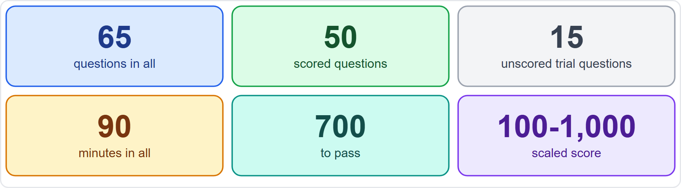
The Exam at a Glance
Module 0
65 questions: 50 are scored and 15 are unscored trial questions
You cannot tell which are unscored, so treat every question as real
90 minutes in all: about 83 seconds a question
Your result is a scaled score from 100 to 1,000, and 700 passes
EXAM TIP The 15 unscored questions are not marked on screen, so give every question your full attention.
AI Practitioner Exam Prep Masterclass | for the AWS AIF-C01 exam
Module 0: Course Introduction and Exam Orientation
4 / 12
Notes:
Here is the exam in six numbers. There are sixty-five questions in total. Fifty are scored, and fifteen are unscored trial questions that A W S uses to test new items. You cannot tell which are which, so treat every question as real. You have ninety minutes, which is about eighty-three seconds a question across all sixty-five. Your result is a scaled score from one hundred to one thousand, and seven hundred passes. Exam tip: the fifteen unscored questions are not marked on screen, so give every question your full attention.

Slide 5
Question Types and Scoring
Module 0
Multiple choice: one correct answer and three distractors
Multiple response: two or more correct answers out of five or more options; you must pick all of them to get credit
Ordering: put three to five steps in the correct order
Matching: match every item to its prompt, from three to seven prompts; all pairs must be right
An unanswered question counts as wrong, and there is no penalty for guessing
Compensatory scoring: you must pass the exam as a whole, not each section
EXAM TIP Never leave a question blank: a guess costs nothing and a blank always scores zero.
AI Practitioner Exam Prep Masterclass | for the AWS AIF-C01 exam
Module 0: Course Introduction and Exam Orientation
5 / 12
Notes:
There are four question types. Multiple choice has one correct answer and three distractors. Multiple response has two or more correct answers out of five or more options, and you must pick all of them to get credit. Ordering gives you three to five steps to put in the correct order. Matching gives you a list of items to match with three to seven prompts, and every pair must be right. An unanswered question counts as wrong, and there is no penalty for guessing, so answer every one. Scoring is compensatory, which means you must pass the exam as a whole, not each section. Exam tip: never leave a question blank, because a guess costs nothing and a blank always scores zero.

Slide 6
Booking, Taking and Keeping the Credential
VERIFY LIVE
Module 0
Fee: USD 100, with possible extra costs such as exchange rates
Delivery: at a Pearson VUE test center or online with a proctor
Languages: several, including English; the Italian and German versions retire after 15 October 2026
Valid for 3 years; renew by passing the latest version of the exam or the Machine Learning Engineer Associate exam
No prerequisites
As of 5 November 2026: check AWS's certification page for price, languages and delivery
EXAM TIP Fees, languages and renewal rules change; read AWS's page before you book.
AI Practitioner Exam Prep Masterclass | for the AWS AIF-C01 exam
Module 0: Course Introduction and Exam Orientation
6 / 12
Notes:
Now the practical facts. The fee is one hundred U S dollars, with possible extra costs such as exchange rates. You take the exam at a Pearson view test center, or online with a proctor. Several languages are offered, including English, and the Italian and German versions retire after the fifteenth of October, twenty twenty-six. The credential is valid for three years, and you can renew it by passing the latest version of the exam, or the Machine Learning Engineer Associate exam. There are no prerequisites. As of the fifth of November, twenty twenty-six, check A W S's certification page for price, languages and delivery. Exam tip: fees, languages and renewal rules change, so read A W S's page before you book.

Slide 7
The Exam Guide Is Your Scope
DATES
Module 0
The exam guide lists the domains, weights, task statements and in-scope services
This course follows version 1.2, published on 29 October 2026
The guide had three versions in 2026: 26 March, 30 April and 29 October
AWS publishes changes about a month before they reach the exam
The service list is non-exhaustive and subject to change
The guide outranks this course on scope
EXAM TIP Read the current exam guide before you book and again in the last week.
AI Practitioner Exam Prep Masterclass | for the AWS AIF-C01 exam
Module 0: Course Introduction and Exam Orientation
7 / 12
Notes:
The exam guide is your scope. It lists the domains, the weights, the task statements and the in-scope services. This course follows version one point two, published on the twenty-ninth of October, twenty twenty-six. The guide had three versions in twenty twenty-six: the twenty-sixth of March, the thirtieth of April, and the twenty-ninth of October. A W S publishes changes about a month before they reach the exam. The service list is non-exhaustive and subject to change, so the guide outranks this course on scope. Exam tip: read the current exam guide before you book, and again in the last week.

Slide 8
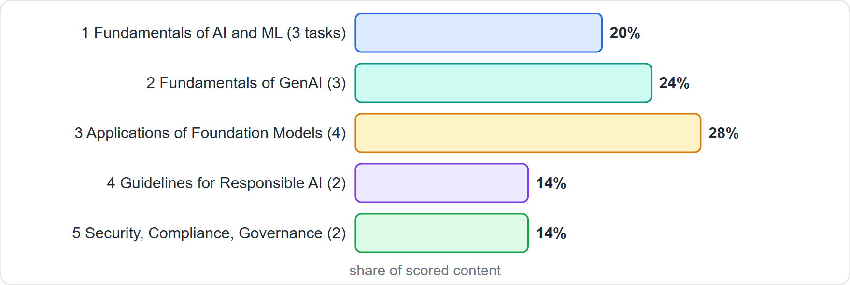
Five Domains, Fourteen Task Statements
Module 0
Domain 1, Fundamentals of AI and ML: 20%, three task statements
Domain 2, Fundamentals of GenAI: 24%, three
Domain 3, Applications of Foundation Models: 28%, four
Domain 4, Guidelines for Responsible AI: 14%, two
Domain 5, Security, Compliance, and Governance for AI Solutions: 14%, two
EXAM TIP Domain 3 is the largest, but domains 1 and 2 together carry 44 percent of the exam.
AI Practitioner Exam Prep Masterclass | for the AWS AIF-C01 exam
Module 0: Course Introduction and Exam Orientation
8 / 12
Notes:
The exam has five domains. Domain one, Fundamentals of A I and M L, is twenty percent, with three task statements. Domain two, Fundamentals of Gen A I, is twenty-four percent, with three. Domain three, Applications of Foundation Models, is twenty-eight percent, with four. Domain four, Guidelines for Responsible A I, is fourteen percent, with two. And domain five, Security, Compliance, and Governance for A I Solutions, is fourteen percent, with two. The figure shows the weights. Exam tip: domain three is the largest, but domains one and two together carry forty-four percent of the exam.

Slide 9
Who the Exam Is For
Module 0
The target candidate has up to six months of exposure to AI/ML technologies on AWS
It uses AI and ML solutions but does not necessarily build them
The focus is practical business applications of AI
Out of scope for the candidate: coding models, data and feature engineering, tuning, building pipelines, statistical analysis, and implementing security or governance frameworks
Task statements use verbs such as explain, identify, describe and recognize
EXAM TIP Learn what each idea and service is for and when to choose it; building it step by step is not what is tested.
AI Practitioner Exam Prep Masterclass | for the AWS AIF-C01 exam
Module 0: Course Introduction and Exam Orientation
9 / 12
Notes:
Who is the exam for? The target candidate has up to six months of exposure to A I and M L technologies on A W S. That person uses A I and M L solutions, but does not necessarily build them. The focus is practical business applications of A I. Out of scope for the candidate are coding models, data and feature engineering, tuning, building pipelines, statistical analysis, and implementing security or governance frameworks. The task statements use verbs such as explain, identify, describe and recognize. Exam tip: learn what each idea and service is for and when to choose it, because building it step by step is not what is tested.

Slide 10
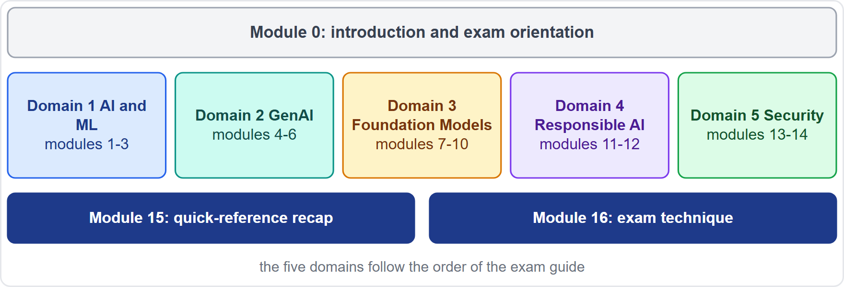
How This Course Works
Module 0
17 modules: this introduction, 14 content modules in the guide's order, a recap and an exam-technique module
Each content module has what you will learn, a Cedar and Salt case, Exam Tips, a recap and practice questions
A Design Check in each module, with orderings and matchings to practice
Slide tags: Beyond the guide, Old name, Verify live, Dates
Practice questions are choice questions; ordering and matching are practiced in the Design Checks
AI Practitioner Exam Prep Masterclass | for the AWS AIF-C01 exam
Module 0: Course Introduction and Exam Orientation
10 / 12
Notes:
Here is how the course works. There are seventeen modules: this introduction, fourteen content modules in the guide's order, a recap, and an exam-technique module. Each content module has what you will learn, a Cedar and Salt case, Exam Tips, a recap and practice questions. Each module also has a Design Check, where you practice orderings and matchings. Slides carry four tags: Beyond the guide, Old name, Verify live and Dates. The practice questions are choice questions; the real exam also has ordering and matching questions, so we practice those in the Design Checks. The figure shows the course map.

Slide 11
Independent Course, Official Sources
Module 0
This course is independent: not affiliated with, endorsed or sponsored by Amazon Web Services
It shows no AWS logos or service icons; service names appear as text
The notes and questions are in our own wording; it uses no AWS exam questions or dumps
AWS documentation and the exam guide outrank this course on every fact and rule
Names, availability and prices change fast in AI: check the source on every Verify-live slide
EXAM TIP When this course and the current AWS documentation disagree, the documentation wins.
AI Practitioner Exam Prep Masterclass | for the AWS AIF-C01 exam
Module 0: Course Introduction and Exam Orientation
11 / 12
Notes:
This course is independent. It is not affiliated with, endorsed by or sponsored by Amazon Web Services. It shows no A W S logos or service icons; service names appear as text. The notes and questions are in our own wording, and the course uses no A W S exam questions or dumps. The A W S documentation and the exam guide outrank this course on every fact and every rule. Names, availability and prices change fast in A I, so check the source on every Verify-live slide. Exam tip: when this course and the current A W S documentation disagree, the documentation wins.

Slide 12
Your Study Plan and Ground Rules
Module 0
1
Study one module, then do its questions
2
Cover every task statement
3
Read the exam guide
the modules follow the exam guide's order
the guide does not weight them separately
before you book and again in the last week
4
Answer all 65 questions
5
This course is independent and educational
the official sources outrank it
on the day; never leave one blank
EXAM TIP Before you book, read AWS's current exam guide and certification page.
AI Practitioner Exam Prep Masterclass | for the AWS AIF-C01 exam
Module 0: Course Introduction and Exam Orientation
12 / 12
Notes:
Here is your study plan. Study one module, then do its questions; the modules follow the exam guide's order. Cover every task statement, because the guide does not weight them separately. Read the exam guide before you book, and again in the last week. On the day, answer all sixty-five questions and never leave one blank. And remember that this course is independent and educational, so the official sources outrank it. Exam tip: before you book, read A W S's current exam guide and certification page. That is the orientation. In Module one we start with the core ideas of A I, M L and deep learning.

