Slide 1
Module 1: AI, ML and Deep Learning: Core Concepts
The terms every other module builds on
Domain 1 · Fundamentals of AI and ML · Task statement 1.1
AI Practitioner Exam Prep Masterclass
Module 1 · Part 1
Notes:
Welcome to Module one: A I, M L and Deep Learning: Core Concepts. This module covers task statement one point one, and it gives you the vocabulary that every other module builds on. You will learn what A I, machine learning and deep learning are, how they relate, and how training, inference, data and learning types fit in. You will also meet fit, bias, large language models, generative A I and agentic A I.

Slide 2
What You Will Learn
Part 1
Define the basic terms: AI, ML, deep learning, neural network, model, algorithm, training and inference
Name the fields of AI: computer vision, natural language processing (NLP) and speech recognition
Tell the types of inference, the types of data and the types of learning apart
Explain bias, fairness and fit
Separate LLMs, generative AI and agentic AI from the rest
AI Practitioner Exam Prep Masterclass | for the AWS AIF-C01 exam
Module 1: AI, ML and Deep Learning: Core Concepts
2 / 26
Notes:
By the end of this module you will be able to do five things. Define the basic terms: A I, M L, deep learning, neural network, model, algorithm, training and inference. Name the fields of A I: computer vision, N L P and speech recognition. Tell the types of inference, the types of data and the types of learning apart. Explain bias, fairness and fit. And separate L L Ms, generative A I and agentic A I from the rest.

Slide 3
Case Check-In: Cedar and Salt Hears the Buzzwords
Part 1
CASE CHECK-IN · Cedar and Salt Travel
At Cedar and Salt, leaders keep saying AI, ML, GenAI and agents as if they were one thing
The product team wants a shared vocabulary before it picks any tool
First question: what is each term, and how do they relate?
Your job: give the team clear definitions and a way to tell them apart
AI Practitioner Exam Prep Masterclass | for the AWS AIF-C01 exam
Module 1: AI, ML and Deep Learning: Core Concepts
3 / 26
Notes:
At Cedar and Salt Travel, the leaders keep saying A I, M L, Gen A I and agents, as if they were one thing. The product team wants a shared vocabulary before it picks any tool. The first question is simple: what is each term, and how do they relate? Your job is to give the team clear definitions, and a way to tell them apart.

Slide 4
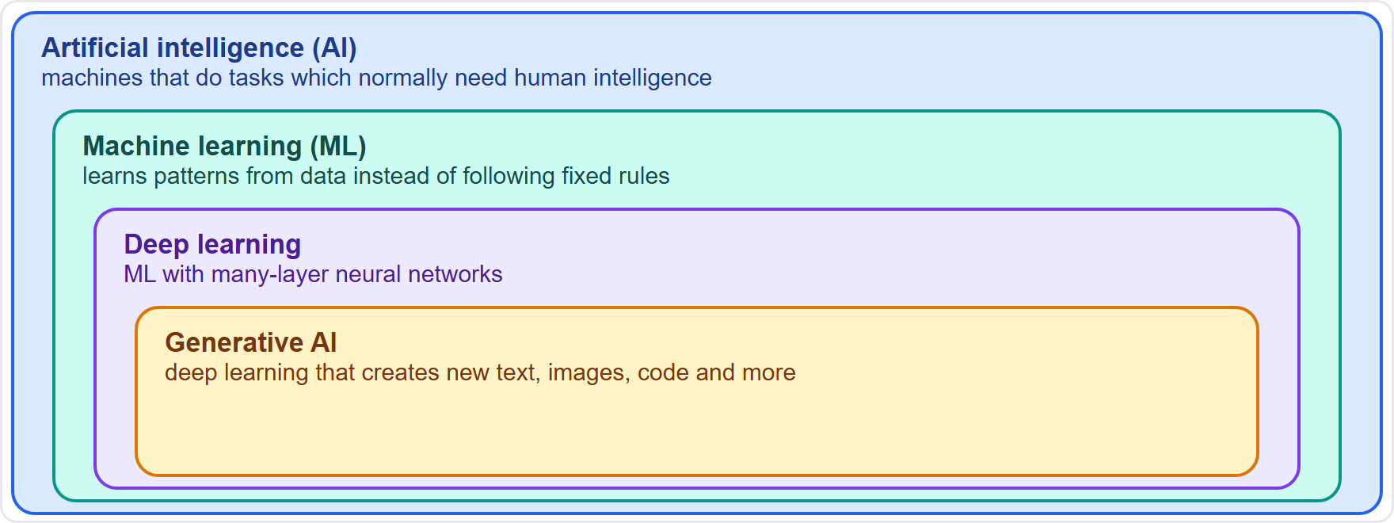
How AI, ML and Deep Learning Fit Together
Part 1
Artificial intelligence (AI): technology that lets machines do human-like problem-solving tasks
Machine learning (ML): a branch of AI that learns from data instead of following explicit instructions
Deep learning: ML that uses neural networks with many layers
Generative AI (GenAI): an advanced form of deep learning that creates new content
Not all AI is ML: AI is the umbrella term
EXAM TIP Nesting from outside in: AI, then ML, then deep learning, then generative AI.
AI Practitioner Exam Prep Masterclass | for the AWS AIF-C01 exam
Module 1: AI, ML and Deep Learning: Core Concepts
4 / 26
Notes:
Start with how the big terms fit together. The figure shows nested boxes. Artificial intelligence is technology that lets machines do human-like problem-solving tasks. Machine learning is a branch of A I that learns from data instead of following explicit instructions. Deep learning is machine learning that uses neural networks with many layers. And generative A I is an advanced form of deep learning that creates new content. Not all A I is machine learning, because A I is the umbrella term. Exam tip: nesting from the outside in goes A I, then M L, then deep learning, then generative A I.

Slide 5
Machine Learning, Models and Algorithms
Part 1
ML analyzes data without explicit instructions: it learns patterns from examples
An algorithm is the method that learns from the data
A model is the result: the learned patterns, stored in its parameters
Training is the learning step; the model is then tested on data it has not seen
A trained model takes new input and gives an output, such as a prediction
EXAM TIP The algorithm is the recipe; the model is what the recipe produces after training.
AI Practitioner Exam Prep Masterclass | for the AWS AIF-C01 exam
Module 1: AI, ML and Deep Learning: Core Concepts
5 / 26
Notes:
Machine learning analyzes data without explicit instructions. It learns patterns from examples. An algorithm is the method that learns from the data. A model is the result: the learned patterns, stored in its parameters. Training is the learning step, and the model is then tested on data it has not seen. A trained model takes new input and gives an output, such as a prediction. Exam tip: the algorithm is the recipe, and the model is what the recipe produces after training.

Slide 6
Neural Networks and Deep Learning
Part 1
A neural network is inspired by the human brain: many connected artificial neurons
It has an input layer, one or more hidden layers and an output layer
Deep learning uses networks with many layers
It can process unstructured data, such as images, speech and text, without manual feature extraction
It needs a lot of data and computing power
EXAM TIP "Deep" in deep learning means many layers.
AI Practitioner Exam Prep Masterclass | for the AWS AIF-C01 exam
Module 1: AI, ML and Deep Learning: Core Concepts
6 / 26
Notes:
A neural network is inspired by the human brain. It is made of many connected artificial neurons, arranged in an input layer, one or more hidden layers and an output layer. Deep learning uses networks with many layers. It can process unstructured data, such as images, speech and text, without manual feature extraction. The price is that it needs a lot of data and a lot of computing power. Exam tip: the word deep in deep learning means many layers.

Slide 7
The Fields of AI: Vision, Language and Speech
Part 1
Field | What it does | Example at Cedar and Salt
Computer vision | Extracts information from images and video | Spotting a damaged room in a photo
Natural language processing (NLP) | Interprets and understands human language in text | Finding the sentiment of a review
Speech recognition | Turns spoken words into text and finds meaning | Transcribing a customer call
Machine translation, named-entity recognition and sentiment analysis are NLP tasks
Recommendation systems, fraud detection and forecasting are other common AI uses
EXAM TIP Pictures: computer vision. Written language: NLP. Spoken words to text: speech recognition.
AI Practitioner Exam Prep Masterclass | for the AWS AIF-C01 exam
Module 1: AI, ML and Deep Learning: Core Concepts
7 / 26
Notes:
A I has several fields, and the exam expects you to match a task to its field. Computer vision extracts information from images and video, like spotting a damaged room in a photo. Natural language processing, or N L P, interprets and understands human language in text, like finding the sentiment of a review. Speech recognition turns spoken words into text and finds meaning, like transcribing a customer call. Machine translation, named-entity recognition and sentiment analysis are N L P tasks. Recommendations, fraud detection and forecasting are other common uses. Exam tip: pictures mean computer vision, written language means N L P, and spoken words to text means speech recognition.

Slide 8
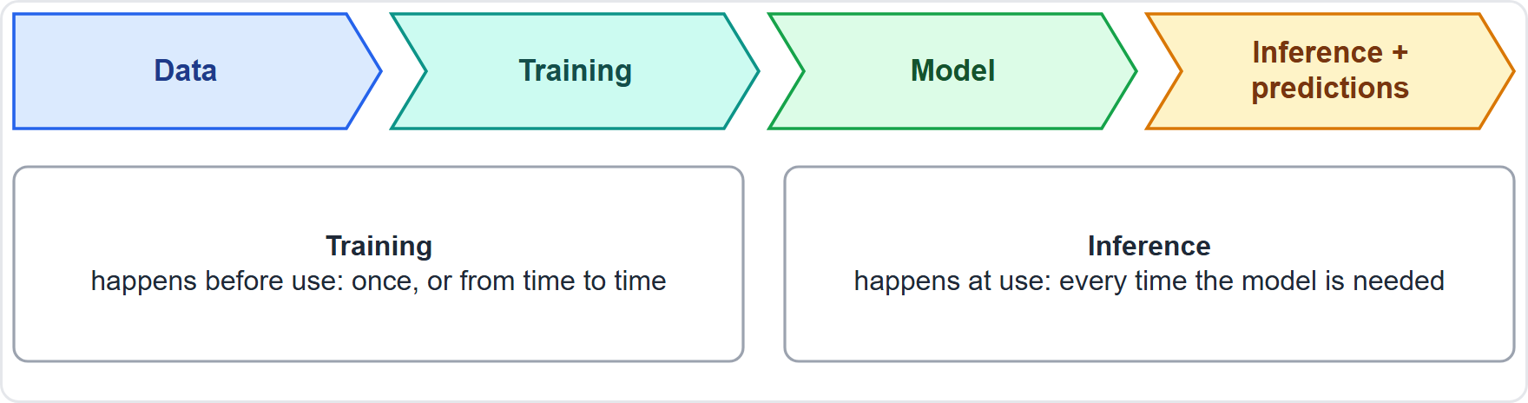
Training and Inference
Part 1
Training: the model learns from data; it takes time and compute
Inference: the trained model is used on new input to give a prediction or an answer
Training happens before use; inference happens every time the model is used
Most of the ongoing cost of a live application is inference
EXAM TIP Training builds the model; inference uses it.
AI Practitioner Exam Prep Masterclass | for the AWS AIF-C01 exam
Module 1: AI, ML and Deep Learning: Core Concepts
8 / 26
Notes:
Two words appear everywhere: training and inference. The figure shows the flow. In training, the model learns from data, and it takes time and compute. In inference, the trained model is used on new input to give a prediction or an answer. Training happens before use. Inference happens every time the model is used. That is why most of the ongoing cost of a live application is inference. Exam tip: training builds the model, and inference uses it.

Slide 9
Types of Inference
VERIFY LIVE
Part 1
Type | How it works | Fits when
Real-time | An always-on endpoint answers each request quickly | Interactive, low-latency needs
Serverless | No infrastructure to manage; scales with traffic | Idle periods between bursts; cold starts are acceptable
Asynchronous | Requests are queued and processed later | Large payloads (up to 1 GB) and long processing (up to 1 hour)
Batch | A job runs the model over a whole dataset | No persistent endpoint is needed
As of 5 November 2026: the limits shown are from the Amazon SageMaker AI documentation
EXAM TIP Instant answers: real-time. Whole dataset, no endpoint: batch. Large or slow requests: asynchronous.
AI Practitioner Exam Prep Masterclass | for the AWS AIF-C01 exam
Module 1: AI, ML and Deep Learning: Core Concepts
9 / 26
Notes:
There are four types of inference to know. Real-time inference uses an always-on endpoint that answers each request quickly, and it fits interactive, low-latency needs. Serverless inference needs no infrastructure to manage and scales with traffic, so it fits idle periods between bursts, as long as cold starts are acceptable. Asynchronous inference queues requests and processes them later, and it fits large payloads, up to one gigabyte, and long processing, up to one hour. Batch inference runs the model over a whole dataset, and it fits when no persistent endpoint is needed. As of the fifth of November, twenty twenty-six, the limits come from the Amazon SageMaker A I documentation. Exam tip: instant answers mean real-time; a whole dataset with no endpoint means batch; large or slow requests mean asynchronous.

Slide 10
Types of Data
Part 1
Kind of data | Meaning | Example
Labeled | Each example has the right answer attached | Reviews tagged positive or negative
Unlabeled | Examples without answers | Raw reviews with no tags
Structured / tabular | Rows and columns with a fixed layout | A bookings table
Time-series | Values recorded over time | Daily bookings per month
Unstructured | No fixed layout: text, images, audio, video | Photos and call recordings
EXAM TIP Labeled data has answers; structured data has a fixed layout. They are different questions.
AI Practitioner Exam Prep Masterclass | for the AWS AIF-C01 exam
Module 1: AI, ML and Deep Learning: Core Concepts
10 / 26
Notes:
Next, the types of data. Labeled data has the right answer attached to each example, such as reviews tagged positive or negative. Unlabeled data has examples without answers. Structured or tabular data has rows and columns in a fixed layout, like a bookings table. Time-series data records values over time, like daily bookings. And unstructured data has no fixed layout: text, images, audio and video, like photos and call recordings. Exam tip: labeled data has answers, and structured data has a fixed layout. They are different questions, so do not mix them up.

Slide 11
Types of Learning
Part 1
Learning type | Learns from | Goal
Supervised | Labeled data | Predict a known kind of answer: a category or a number
Unsupervised | Unlabeled data | Find patterns or groups by itself
Reinforcement | Rewards for its actions | Learn the best sequence of steps toward a goal
Semi-supervised learning mixes a little labeled data with a lot of unlabeled data [Beyond the guide]
Supervised: classification and regression. Unsupervised: clustering. Reinforcement: reward and goal
EXAM TIP Labels given: supervised. No labels: unsupervised. Reward signal: reinforcement.
AI Practitioner Exam Prep Masterclass | for the AWS AIF-C01 exam
Module 1: AI, ML and Deep Learning: Core Concepts
11 / 26
Notes:
There are three types of learning to know. Supervised learning learns from labeled data and predicts a known kind of answer, a category or a number. Unsupervised learning learns from unlabeled data and finds patterns or groups by itself. Reinforcement learning learns from rewards for its actions and finds the best sequence of steps toward a goal. Semi-supervised learning mixes a little labeled data with a lot of unlabeled data, though it goes beyond the guide. Remember: supervised covers classification and regression, unsupervised covers clustering, and reinforcement uses a reward and a goal. Exam tip: labels given means supervised, no labels means unsupervised, and a reward signal means reinforcement.

Slide 12
Design Check: Cedar and Salt's First Vocabulary
Part 1
Cedar and Salt needs to | It is
Read a guest review and find the sentiment | NLP
Spot a damaged room in a photo | Computer vision
Transcribe a recorded call | Speech recognition
Score tonight's bookings with no endpoint running | Batch inference
Group guests into segments with no labels | Unsupervised learning
Predict cancellations from past labeled bookings | Supervised learning
Cover the right column, answer each row yourself, then compare
AI Practitioner Exam Prep Masterclass | for the AWS AIF-C01 exam
Module 1: AI, ML and Deep Learning: Core Concepts
12 / 26
Notes:
Now a design check. Cover the right column and answer each row yourself. Reading a guest review to find the sentiment: N L P. Spotting a damaged room in a photo: computer vision. Transcribing a recorded call: speech recognition. Scoring tonight's bookings with no endpoint running: batch inference. Grouping guests into segments with no labels: unsupervised learning. And predicting cancellations from past labeled bookings: supervised learning. Pause the video if you want more time.

Slide 13
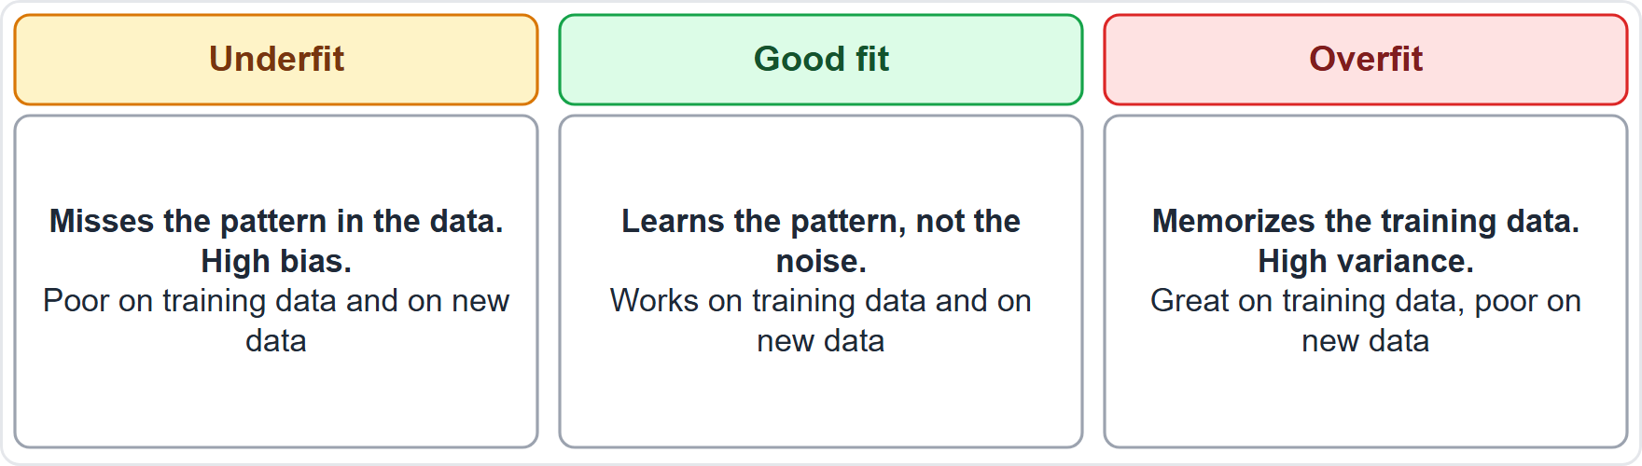
Fit: Underfitting, Overfitting and a Good Fit
Part 2
Underfitting: the model is too simple; it does poorly on training data and new data; high bias
Good fit: it captures the main pattern and works on new data too
Overfitting: it memorizes the training data and fails on new data; high variance
Fix underfitting with a more capable model or better features; fix overfitting with more data or a simpler model
EXAM TIP Great on training data but poor on new data: overfitting.
AI Practitioner Exam Prep Masterclass | for the AWS AIF-C01 exam
Module 1: AI, ML and Deep Learning: Core Concepts
13 / 26
Notes:
Now fit. The figure shows three cards. Underfitting means the model is too simple. It does poorly on the training data and on new data, and it has high bias. A good fit captures the main pattern and works on new data too. Overfitting means the model memorizes the training data and fails on new data, and it has high variance. To fix underfitting, use a more capable model or better features. To fix overfitting, use more data or a simpler model. Exam tip: great on training data but poor on new data means overfitting.

Slide 14
Bias and Fairness
Part 2
Bias in AI is a systematic error that favors or harms some outcomes or groups
It often comes from unrepresentative data or from choices in the model
Fairness means the system treats different groups equitably
Biased data can make biased predictions, even when the model is accurate overall
Bias and fairness are covered in depth in Module 11
EXAM TIP Biased data in, biased predictions out.
AI Practitioner Exam Prep Masterclass | for the AWS AIF-C01 exam
Module 1: AI, ML and Deep Learning: Core Concepts
14 / 26
Notes:
Bias in A I is a systematic error that favors or harms some outcomes or some groups. It often comes from unrepresentative data, or from choices in the model. Fairness means the system treats different groups equitably. Biased data can make biased predictions, even when the model is accurate overall. Module eleven covers bias and fairness in depth. Exam tip: biased data in means biased predictions out.

Slide 15
Large Language Models and Generative AI
Part 2
Generative AI creates new content: text, images, audio, video and code
A foundation model (FM) is trained on broad, unlabeled data and handles many tasks
A large language model (LLM) is a very large deep learning model pre-trained on huge amounts of text
Most LLMs use the transformer design and have billions of parameters
An LLM predicts the next token, which lets it write, summarize, translate and answer questions
EXAM TIP Every LLM is a foundation model for language, and a foundation model is a form of generative AI.
AI Practitioner Exam Prep Masterclass | for the AWS AIF-C01 exam
Module 1: AI, ML and Deep Learning: Core Concepts
15 / 26
Notes:
Generative A I creates new content: text, images, audio, video and code. A foundation model, or F M, is trained on broad, unlabeled data and handles many tasks. A large language model, or L L M, is a very large deep learning model pre-trained on huge amounts of text. Most L L Ms use the transformer design and have billions of parameters. An L L M predicts the next token, which lets it write, summarize, translate and answer questions. Exam tip: every L L M is a foundation model for language, and a foundation model is a form of generative A I.

Slide 16
Agentic AI
Part 2
Agentic AI is an autonomous AI system that acts independently to reach pre-set goals
It is goal-driven: it plans steps, uses tools and adapts as new information arrives
It keeps memory so that long tasks stay consistent
Ordinary software follows fixed rules; an assistant that only answers a prompt is not yet agentic
Modules 4 and 7 cover how agents are built
EXAM TIP Autonomy, goals, tools and memory are the signs of agentic AI.
AI Practitioner Exam Prep Masterclass | for the AWS AIF-C01 exam
Module 1: AI, ML and Deep Learning: Core Concepts
16 / 26
Notes:
Agentic A I is an autonomous A I system that acts independently to reach pre-set goals. It is goal-driven: it plans steps, uses tools and adapts as new information arrives. It keeps memory, so long tasks stay consistent. Ordinary software follows fixed rules, and an assistant that only answers a prompt is not yet agentic. Modules four and seven cover how agents are built. Exam tip: autonomy, goals, tools and memory are the signs of agentic A I.

Slide 17
Telling Them Apart
Part 2
Term | In one line | Key word
AI | Machines doing human-like problem solving | Umbrella
ML | AI that learns from data | Patterns
Deep learning | ML with many-layer neural networks | Layers
Generative AI | Deep learning that creates content | New content
Agentic AI | AI that acts toward goals with tools | Autonomy
EXAM TIP Pick the key word in the question: umbrella, patterns, layers, new content or autonomy.
AI Practitioner Exam Prep Masterclass | for the AWS AIF-C01 exam
Module 1: AI, ML and Deep Learning: Core Concepts
17 / 26
Notes:
Here is a table to tell the terms apart. A I is machines doing human-like problem solving; the key word is umbrella. M L is A I that learns from data; the key word is patterns. Deep learning is M L with many-layer neural networks; the key word is layers. Generative A I is deep learning that creates content; the key words are new content. And agentic A I is A I that acts toward goals with tools; the key word is autonomy. Exam tip: pick the key word in the question: umbrella, patterns, layers, new content or autonomy.

Slide 18
What the Exam Asks: Core Concepts
Part 2
Which term
Which field
Which inference
AI, ML, deep learning, GenAI or agentic AI, from a short description
computer vision, NLP or speech recognition
real-time, serverless, asynchronous or batch
Which data
Which learning
Which problem
labeled or unlabeled, structured or unstructured, time-series
supervised, unsupervised or reinforcement
underfitting, overfitting or bias
EXAM TIP Name the situation first, then the term.
AI Practitioner Exam Prep Masterclass | for the AWS AIF-C01 exam
Module 1: AI, ML and Deep Learning: Core Concepts
18 / 26
Notes:
Here is how the exam frames this module. Which term: A I, M L, deep learning, Gen A I or agentic A I, from a short description. Which field: computer vision, N L P or speech recognition. Which inference: real-time, serverless, asynchronous or batch. Which data: labeled or unlabeled, structured or unstructured, or time-series. Which learning: supervised, unsupervised or reinforcement. And which problem: underfitting, overfitting or bias. Exam tip: name the situation first, then the term.

Slide 19
Module Recap
Part 2
1
Nesting
2
Model
3
Inference
AI, ML, deep learning, generative AI; agentic AI acts toward goals
an algorithm trained on data produces a model; training builds it, inference uses it
real-time, serverless, asynchronous and batch
4
Data and learning
5
Fit
6
LLMs
labeled or not, structured or not; supervised, unsupervised, reinforcement
underfitting is high bias; overfitting is high variance
huge deep learning models trained on text, predicting the next token
AI Practitioner Exam Prep Masterclass | for the AWS AIF-C01 exam
Module 1: AI, ML and Deep Learning: Core Concepts
19 / 26
Notes:
Here is the recap. Nesting: A I, M L, deep learning and generative A I, with agentic A I acting toward goals. An algorithm trained on data produces a model: training builds it and inference uses it. Inference comes in four types: real-time, serverless, asynchronous and batch. Data can be labeled or not, and structured or not, and learning can be supervised, unsupervised or reinforcement. Underfitting is high bias, and overfitting is high variance. And L L Ms are huge deep learning models trained on text that predict the next token.

Slide 20
Practice Question 1
Part 2
Q1
Which statement correctly describes how AI, machine learning and deep learning relate?
A
Machine learning is a branch of AI, and deep learning is machine learning with many-layer neural networks
B
Deep learning is the umbrella term, and AI is one narrow technique used inside machine learning models
C
AI and machine learning are two names for exactly the same field, and neither includes deep learning
D
Deep learning is a separate field of AI that never uses neural networks of any kind in its models
AI Practitioner Exam Prep Masterclass | for the AWS AIF-C01 exam
Module 1: AI, ML and Deep Learning: Core Concepts
20 / 26
Notes:
Question one. Which statement correctly describes how A I, machine learning and deep learning relate? The four options are on the screen. [PAUSE 12] The answer is A. Machine learning is a branch of A I, and deep learning is machine learning with many-layer neural networks. A I is the umbrella, machine learning learns from data, and deep learning uses networks with many layers. The other options reverse or confuse the relationship.

Slide 21
Practice Question 2
Part 2
Q2
Cedar and Salt wants to score last month's bookings for cancellation risk in one overnight job, and it does not want an endpoint left running. Which type of inference fits best?
A
Real-time inference, with an always-on endpoint
B
Batch inference, which runs the model over a whole dataset
C
Serverless inference, which scales with request traffic
D
Asynchronous inference, which queues individual large requests
AI Practitioner Exam Prep Masterclass | for the AWS AIF-C01 exam
Module 1: AI, ML and Deep Learning: Core Concepts
21 / 26
Notes:
Question two. Cedar and Salt wants to score last month's bookings for cancellation risk in one overnight job, and it does not want an endpoint left running. Which type of inference fits best? The four options are on the screen. [PAUSE 12] The answer is B, batch inference. It runs a model over a whole dataset without a persistent endpoint. Real-time and serverless inference serve individual requests as they arrive, and asynchronous inference queues large or slow individual requests.

Slide 22
Practice Question 3
Part 2
Q3
Which TWO of these are examples of unstructured data? (Select TWO.)
A
Photos of hotel rooms
B
A table of bookings with fixed columns
C
Recordings of customer calls
D
A spreadsheet of daily totals
E
A list of prices in a database table
AI Practitioner Exam Prep Masterclass | for the AWS AIF-C01 exam
Module 1: AI, ML and Deep Learning: Core Concepts
22 / 26
Notes:
Question three. Select two. Which two of these are examples of unstructured data? The five options are on the screen. [PAUSE 15] The answers are A and C. Photos and call recordings have no fixed row-and-column layout, so they are unstructured. Tables, spreadsheets and database rows are structured or tabular data.

Slide 23
Practice Question 4
Part 2
Q4
A model scores very well on its training data but poorly on new bookings. What is the most likely problem?
A
Underfitting, with high bias
B
Too little compute for inference
C
Too many labeled examples in the data
D
Overfitting, with high variance
AI Practitioner Exam Prep Masterclass | for the AWS AIF-C01 exam
Module 1: AI, ML and Deep Learning: Core Concepts
23 / 26
Notes:
Question four. A model scores very well on its training data but poorly on new bookings. What is the most likely problem? The four options are on the screen. [PAUSE 12] The answer is D, overfitting, with high variance. A model that memorizes its training data but fails on new data is overfitting. Underfitting would do poorly on both the training data and new data.

Slide 24
Practice Question 5
Part 2
Q5
Cedar and Salt builds an assistant that sets its own steps toward a booking goal, uses tools such as search and payment, and remembers the traveler's earlier choices. Which term describes it best?
A
Agentic AI
B
Computer vision
C
Unsupervised learning
D
Batch inference
AI Practitioner Exam Prep Masterclass | for the AWS AIF-C01 exam
Module 1: AI, ML and Deep Learning: Core Concepts
24 / 26
Notes:
Question five. Cedar and Salt builds an assistant that sets its own steps toward a booking goal, uses tools such as search and payment, and remembers the traveler's earlier choices. Which term describes it best? The four options are on the screen. [PAUSE 12] The answer is A, agentic A I. Autonomy, goals, tool use and memory are its signs. Computer vision works on images, unsupervised learning finds patterns in unlabeled data, and batch inference runs a model over a dataset.

Slide 25
Practice Question 6
Part 2
Q6
The team groups guests into segments by behavior, and none of the guests has a label. Which type of learning is this?
A
Supervised learning
B
Reinforcement learning
C
Unsupervised learning
D
Transfer inference
AI Practitioner Exam Prep Masterclass | for the AWS AIF-C01 exam
Module 1: AI, ML and Deep Learning: Core Concepts
25 / 26
Notes:
Question six. The team groups guests into segments by behavior, and none of the guests has a label. Which type of learning is this? The four options are on the screen. [PAUSE 12] The answer is C, unsupervised learning. Finding groups in data without labels is usually clustering. Supervised learning needs labeled examples, and reinforcement learning learns from rewards for actions.

Slide 26
Answers at a Glance
Part 2
Question | Answer | Why
Q1 | A | ML is a branch of AI; deep learning uses many-layer networks
Q2 | B | A whole dataset with no endpoint is batch inference
Q3 | A, C | Images and audio are unstructured data
Q4 | D | Good on training data, poor on new data is overfitting
Q5 | A | Autonomy, goals, tools and memory mean agentic AI
Q6 | C | Grouping unlabeled data is unsupervised learning
AI Practitioner Exam Prep Masterclass | for the AWS AIF-C01 exam
Module 1: AI, ML and Deep Learning: Core Concepts
26 / 26
Notes:
Here are all six answers. Question one: A. Question two: B. Question three: A and C. Question four: D. Question five: A. Question six: C. That completes Module one. Next, Module two covers practical use cases for A I, how to choose the right technique, and the A W S services that handle common A I tasks.

