Slide 1
Module 0: Course Introduction
The exam, its scope, and how this course works
Orientation · no task statements
Cloud Practitioner Exam Prep Masterclass
Module 0
Notes:
Welcome to this exam prep course for the A W S Cloud Practitioner exam, whose code is C L F dash C zero two. This first module is the orientation. It covers the exam itself, what is in scope, how to read the exam guide, and how this course works. There are no practice questions here; the questions start in Module one.

Slide 2
What You Will Learn
Module 0
Describe the exam: its length, question types and how it is scored
Say what the exam guide covers and why you should read the current version
Name the four domains and their weights
Know who the exam is for and what it leaves out
Use the tags, case, Design Checks and questions of this course
Cloud Practitioner Exam Prep Masterclass | for the AWS CLF-C02 exam
Module 0: Course Introduction and Exam Orientation
2 / 12
Notes:
By the end of this module you will be able to do five things. Describe the exam: its length, its question types, and how it is scored. Say what the exam guide covers, and why you should read the current version. Name the four domains and their weights. Know who the exam is for, and what it leaves out. And use the tags, the case, the Design Checks and the practice questions of this course.

Slide 3
Case Check-In: Meet Tidewater Outfitters
Module 0
CASE CHECK-IN · Tidewater Outfitters
Tidewater Outfitters is a fictional online shop for outdoor gear, run by a small team
Its founder wants everyone to understand the cloud well enough to make sound choices
The shop is moving from a rented server room to AWS, one decision at a time
You will follow each decision: access, security, storage, databases, networks and costs
Your job: learn what each AWS service is for, and when to choose it
Cloud Practitioner Exam Prep Masterclass | for the AWS CLF-C02 exam
Module 0: Course Introduction and Exam Orientation
3 / 12
Notes:
Meet Tidewater Outfitters, a fictional online shop for outdoor gear, run by a small team. Its founder wants everyone to understand the cloud well enough to make sound choices. The shop is moving from a rented server room to A W S, one decision at a time. You will follow each decision: access, security, storage, databases, networks and costs. Your job in this course is to learn what each A W S service is for, and when to choose it.

Slide 4
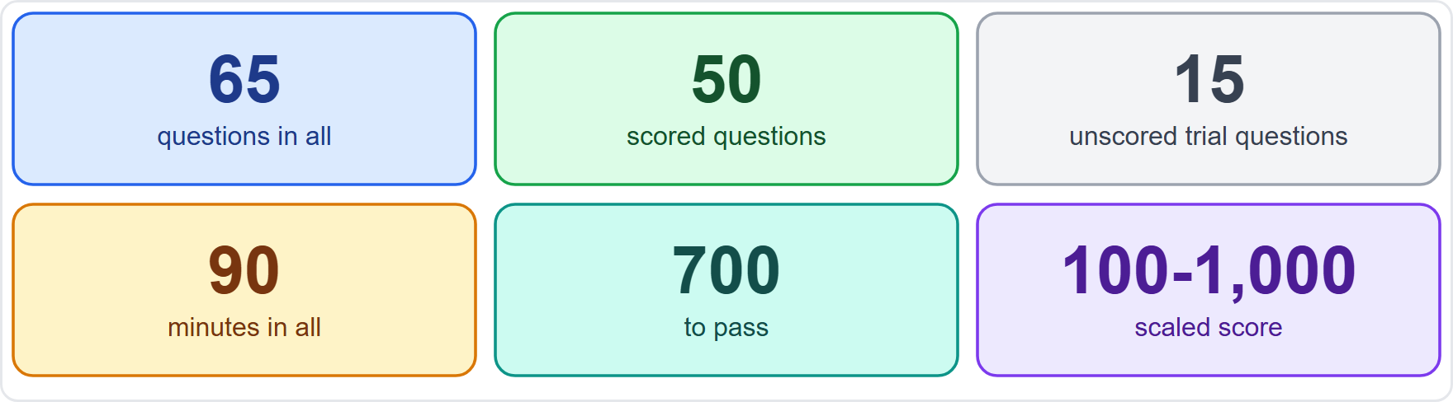
The Exam at a Glance
Module 0
65 questions: 50 are scored and 15 are unscored trial questions
You cannot tell which are unscored, so treat every question as real
90 minutes in all: about 83 seconds a question
Your result is a scaled score from 100 to 1,000, and 700 passes
EXAM TIP The 15 unscored questions are not marked on screen, so give every question your full attention.
Cloud Practitioner Exam Prep Masterclass | for the AWS CLF-C02 exam
Module 0: Course Introduction and Exam Orientation
4 / 12
Notes:
Here is the exam in six numbers. There are sixty-five questions in total. Fifty are scored, and fifteen are unscored trial questions that A W S uses to test new items. You cannot tell which are which, so treat every question as real. You have ninety minutes, which is about eighty-three seconds a question across all sixty-five. Your result is a scaled score from one hundred to one thousand, and seven hundred passes. Exam tip: the fifteen unscored questions are not marked on screen, so give every question your full attention.

Slide 5
Question Types and Scoring
Module 0
Multiple choice: one correct answer and three distractors
Multiple response: two or more correct answers out of five or more options; the question tells you how many to pick
An unanswered question counts as wrong, and there is no penalty for guessing, so answer every one
Compensatory scoring: you must pass the exam as a whole, not each section
Section feedback on the score report is general, and AWS says to read it with care
The guide does not say how multiple-response questions are marked
EXAM TIP Never leave a question blank: a guess costs nothing and a blank always scores zero.
Cloud Practitioner Exam Prep Masterclass | for the AWS CLF-C02 exam
Module 0: Course Introduction and Exam Orientation
5 / 12
Notes:
There are two question types. Multiple choice has one correct answer and three distractors. Multiple response has two or more correct answers out of five or more options, and the question tells you how many to pick. An unanswered question counts as wrong, and there is no penalty for guessing, so answer every one. Scoring is compensatory, which means you must pass the exam as a whole, not each section. The section feedback on your score report is general, and A W S says to read it with care. One thing the guide does not say is how multiple-response questions are marked. Exam tip: never leave a question blank.

Slide 6
Booking, Taking and Keeping the Credential
VERIFY LIVE
Module 0
Fee: USD 100, with possible extra costs such as exchange rates
Delivery: at a Pearson VUE test center or online with a proctor
Languages: several, including English; the Italian and German versions retire after 31 December 2026
Valid for 3 years; renew by passing the latest version of the exam or an Associate or Professional exam
No prerequisites
As of 4 November 2026: check AWS's certification page for price, languages and delivery
EXAM TIP Fees, languages and renewal rules change; read AWS's page before you book.
Cloud Practitioner Exam Prep Masterclass | for the AWS CLF-C02 exam
Module 0: Course Introduction and Exam Orientation
6 / 12
Notes:
Now the practical details. The fee is one hundred U S dollars, with possible extra costs such as exchange rates. You can take the exam at a Pearson view test center, or online with a proctor. It is offered in several languages, including English. The Italian and German versions retire after the thirty-first of December, twenty twenty-six. The credential is valid for three years, and you can renew it by passing the latest version of the exam, or an Associate or Professional exam. There are no prerequisites. As of the fourth of November, twenty twenty-six, check A W S's certification page for price, languages and delivery. Exam tip: fees, languages and renewal rules change, so read A W S's page before you book.

Slide 7
The Exam Guide Is Your Scope
DATES
Module 0
The exam guide lists the domains, weights, task statements and in-scope services
This course follows version 1.3, published on 29 October 2026
The guide had four versions in 2026: 24 June, 28 August, 24 September and 29 October
AWS publishes changes about a month before they reach the exam
The service list is non-exhaustive and subject to change
The guide outranks this course on scope
EXAM TIP Read the current exam guide before you book and again in the last week.
Cloud Practitioner Exam Prep Masterclass | for the AWS CLF-C02 exam
Module 0: Course Introduction and Exam Orientation
7 / 12
Notes:
The exam guide is your scope. It lists the domains, the weights, the task statements and the in-scope services. This course follows version one point three, published on the twenty-ninth of October, twenty twenty-six. The guide had four versions in twenty twenty-six: on the twenty-fourth of June, the twenty-eighth of August, the twenty-fourth of September, and the twenty-ninth of October. A W S publishes changes about a month before they reach the exam. The service list is non-exhaustive and subject to change. So the guide outranks this course on scope. Exam tip: read the current exam guide before you book, and again in the last week.

Slide 8
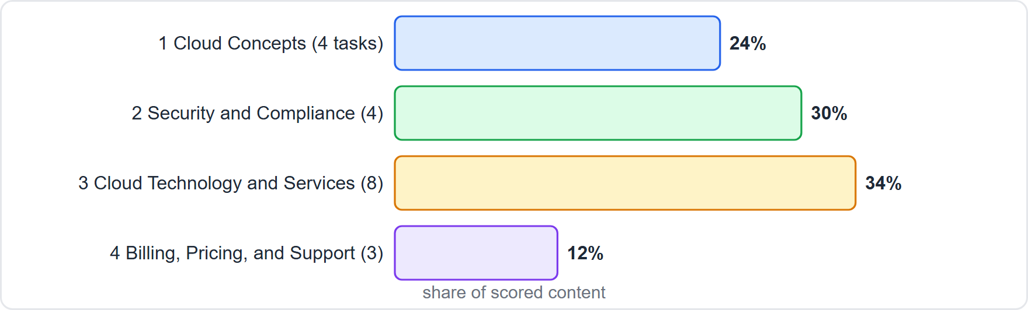
Four Domains, Nineteen Task Statements
Module 0
Domain 1, Cloud Concepts: 24%, four task statements
Domain 2, Security and Compliance: 30%, four
Domain 3, Cloud Technology and Services: 34%, eight
Domain 4, Billing, Pricing, and Support: 12%, three
Weights are shares of scored content; the guide gives no weights below the domain
EXAM TIP Domains 1 and 2 together are more than half of the exam.
Cloud Practitioner Exam Prep Masterclass | for the AWS CLF-C02 exam
Module 0: Course Introduction and Exam Orientation
8 / 12
Notes:
The exam has four domains. Domain one, Cloud Concepts, is twenty-four percent of scored content, with four task statements. Domain two, Security and Compliance, is thirty percent, with four. Domain three, Cloud Technology and Services, is thirty-four percent, with eight task statements. Domain four, Billing, Pricing, and Support, is twelve percent, with three. That makes nineteen task statements. The weights are shares of scored content, and the guide gives no weights below the domain level. Exam tip: domains one and two together are more than half of the exam.

Slide 9
Who the Exam Is For
Module 0
The target candidate has up to six months of exposure to AWS Cloud design, implementation or operations
It may be someone early in a cloud career, or someone who works with people in cloud roles
It is foundational and not tied to a job role
Out of scope for the candidate: coding, designing cloud architecture, troubleshooting, implementation, and load and performance testing
Task statements use verbs such as define, identify and understand
EXAM TIP Learn what each service is for and when to choose it; setting it up step by step is not what is tested.
Cloud Practitioner Exam Prep Masterclass | for the AWS CLF-C02 exam
Module 0: Course Introduction and Exam Orientation
9 / 12
Notes:
Who is the exam for? The target candidate has up to six months of exposure to A W S Cloud design, implementation or operations. That might be someone early in a cloud career, or someone who works with people in cloud roles. The exam is foundational and not tied to a job role. The guide lists what is out of scope for the candidate: coding, designing cloud architecture, troubleshooting, implementation, and load and performance testing. And the task statements use verbs such as define, identify and understand. Exam tip: learn what each service is for and when to choose it; setting it up step by step is not what is tested.

Slide 10
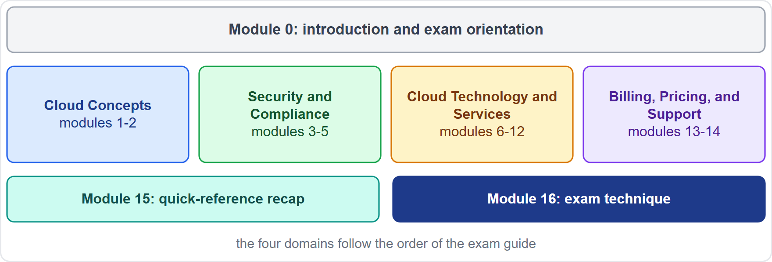
How This Course Works
Module 0
17 modules: this introduction, 14 content modules in the guide's order, a recap and an exam-technique module
Each content module has what you will learn, a Tidewater case, Exam Tips, a recap and practice questions
A Design Check in each module, and a few optional Try it labs
Slide tags: Beyond the guide, Old name, Verify live, Dates
About one question in five is multiple response here: that share is this course's choice, not AWS's
Cloud Practitioner Exam Prep Masterclass | for the AWS CLF-C02 exam
Module 0: Course Introduction and Exam Orientation
10 / 12
Notes:
Here is how this course works. There are seventeen modules: this introduction, fourteen content modules in the guide's order, a recap, and an exam-technique module. Each content module has what you will learn, a Tidewater case, Exam Tips, a recap and practice questions. Each also has a Design Check, and a few have an optional Try it lab. Slides carry four tags: Beyond the guide, Old name, Verify live, and Dates. About one question in five is multiple response in this course. That share is this course's choice, not A W S's, because the guide does not publish one.

Slide 11
Independent Course, Official Sources
Module 0
This course is independent: not affiliated with, endorsed or sponsored by Amazon Web Services
It shows no AWS logos or service icons; service names appear as text
The notes and questions are in our own wording; it uses no AWS exam questions or dumps
AWS documentation and the exam guide outrank this course on every fact and rule
Names, prices and limits change: check the source on every Verify-live slide
EXAM TIP When this course and the current AWS documentation disagree, the documentation wins.
Cloud Practitioner Exam Prep Masterclass | for the AWS CLF-C02 exam
Module 0: Course Introduction and Exam Orientation
11 / 12
Notes:
A word on independence. This course is not affiliated with, endorsed or sponsored by Amazon Web Services. It shows no A W S logos or service icons, and service names appear as text. The notes and questions are in our own wording, and the course uses no A W S exam questions or exam dumps. A W S documentation and the exam guide outrank this course on every fact and rule. Names, prices and limits change, so check the source on every Verify-live slide. Exam tip: when this course and the current documentation disagree, the documentation wins.

Slide 12
Your Study Plan and Ground Rules
Module 0
1
Study one module, then do its questions
2
Cover every task statement
3
Read the exam guide
the modules follow the exam guide's order
the guide does not weight them separately
before you book and again in the last week
4
Answer all 65 questions
5
This course is independent and educational
the official sources outrank it
on the day; never leave one blank
EXAM TIP Before you book, read AWS's current exam guide and certification page.
Cloud Practitioner Exam Prep Masterclass | for the AWS CLF-C02 exam
Module 0: Course Introduction and Exam Orientation
12 / 12
Notes:
Your study plan and ground rules. Study one module, then do its questions; the modules follow the exam guide's order. Cover every task statement, because the guide does not weight them separately. Read the exam guide before you book, and again in the last week. On the day, answer all sixty-five questions and never leave one blank. And remember that this course is independent and educational, so the official sources outrank it. Exam tip: before you book, read A W S's current exam guide and certification page. That is the orientation. In Module one we start with the value of the A W S Cloud.

