Slide 1
Module 1: The AWS Cloud: Value, Reach and Economics
Why organizations move to the cloud, and how the money works
Domain 1 · Cloud Concepts · Task statements 1.1 and 1.4
Cloud Practitioner Exam Prep Masterclass
Module 1 · Part 1
Notes:
Welcome to Module one: the A W S Cloud, its value, its reach, and its economics. This module opens the first domain of the exam, Cloud Concepts, which is twenty-four percent of scored content. It covers task statements one point one and one point four: the benefits of the cloud, and the concepts of cloud economics.

Slide 2
What You Will Learn
Part 1
Define cloud computing and tell the service models apart
Name the six advantages of the AWS Cloud and match each to a situation
Explain speed, global reach, high availability and elasticity
Compare fixed and variable cost and the costs of running your own data center
Describe licensing options, rightsizing and automation as ways to control cost
Cloud Practitioner Exam Prep Masterclass | for the AWS CLF-C02 exam
Module 1: The AWS Cloud: Value, Reach and Economics
2 / 35
Notes:
By the end of this module you will be able to do five things. Define cloud computing, and tell the service models apart. Name the six advantages of the A W S Cloud, and match each to a situation. Explain speed, global reach, high availability and elasticity. Compare fixed and variable cost, and the costs of running your own data center. And describe licensing options, rightsizing and automation as ways to control cost.

Slide 3
Case Check-In: Tidewater Weighs Its Server Room
Part 1
CASE CHECK-IN · Tidewater Outfitters
Tidewater Outfitters rents a small server room that runs its online shop
Sales triple at the holidays and then fall, yet the servers are sized for the peak all year
Buying more hardware takes weeks, and new customers in Europe see slow pages
The finance lead owns Windows Server licenses and wants to keep using them
Your job: explain what moving to AWS would change, in benefits and in cost
Cloud Practitioner Exam Prep Masterclass | for the AWS CLF-C02 exam
Module 1: The AWS Cloud: Value, Reach and Economics
3 / 35
Notes:
Tidewater Outfitters rents a small server room that runs its online shop. Sales triple at the holidays and then fall, yet the servers are sized for the peak all year. Buying more hardware takes weeks, and new customers in Europe see slow pages. The finance lead also owns Windows Server licenses and wants to keep using them. Your job is to explain what moving to A W S would change, in benefits and in cost.

Slide 4
What Is Cloud Computing?
Part 1
Cloud computing is the on-demand delivery of IT resources over the internet, with pay-as-you-go pricing
Instead of owning servers and data centers, you use computing, storage and databases from a provider such as AWS
You pay for what you use, and you can stop when you no longer need a resource
The provider takes care of the facilities, hardware and power; you choose and use the services
EXAM TIP "On demand" plus "pay as you go" is the core definition of cloud computing.
Cloud Practitioner Exam Prep Masterclass | for the AWS CLF-C02 exam
Module 1: The AWS Cloud: Value, Reach and Economics
4 / 35
Notes:
Start with the definition. Cloud computing is the on-demand delivery of I T resources over the internet, with pay-as-you-go pricing. Instead of owning servers and data centers, you use computing, storage and databases from a provider such as A W S. You pay for what you use, and you can stop when you no longer need a resource. The provider takes care of the facilities, the hardware and the power, and you choose and use the services. Exam tip: on demand, plus pay as you go, is the core definition.

Slide 5
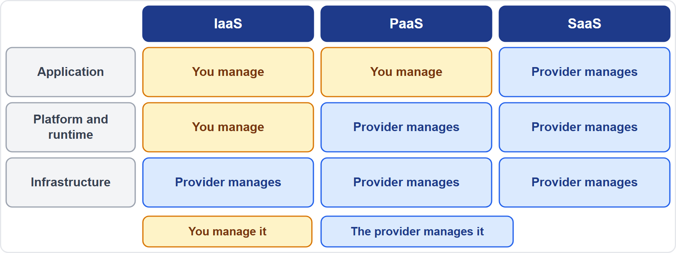
Service Models: IaaS, PaaS and SaaS
BEYOND THE GUIDE
Part 1
Infrastructure as a Service (IaaS): the basic building blocks (networking, compute and storage) with the most control for you
Platform as a Service (PaaS): removes the need to manage the underlying infrastructure, so you focus on your application
Software as a Service (SaaS): a complete product that the provider runs and manages, such as web-based email
Going from IaaS to SaaS, you manage less and the provider manages more
EXAM TIP More control means more to manage: IaaS gives the most control, SaaS the least.
Cloud Practitioner Exam Prep Masterclass | for the AWS CLF-C02 exam
Module 1: The AWS Cloud: Value, Reach and Economics
5 / 35
Notes:
This slide goes beyond the exam guide, but it helps with vocabulary. There are three service models. Infrastructure as a Service, I A A S, gives you the basic building blocks of networking, compute and storage, with the most control. Platform as a Service, P A A S, removes the need to manage the underlying infrastructure, so you can focus on your application. Software as a Service, S A A S, is a complete product that the provider runs and manages, such as web-based email. As you go from I A A S to S A A S, you manage less and the provider manages more. Exam tip: more control means more to manage.

Slide 6
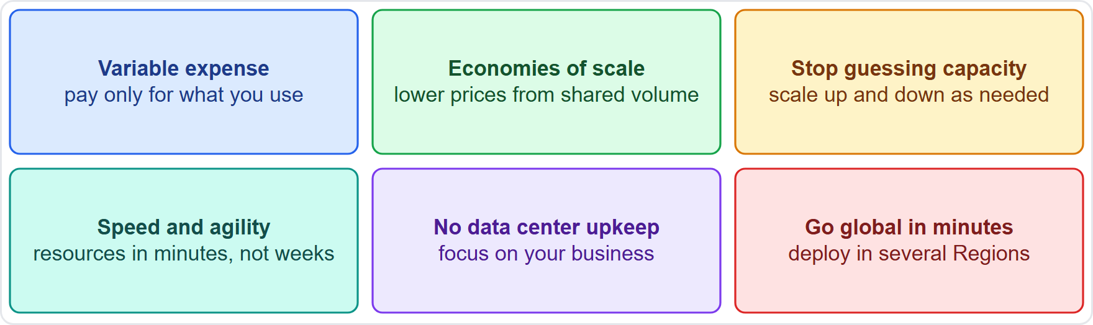
The Value Proposition: Six Advantages
Part 1
Trade fixed expense for variable expense: pay only when you consume
Massive economies of scale: a lower variable cost than on your own
Stop guessing capacity: scale up and down as required
Increase speed and agility: resources in minutes, not weeks
Stop running and maintaining data centers: focus on your business
Go global in minutes: deploy in several Regions with a few clicks
EXAM TIP Know all six; questions often describe one of them in different words.
Cloud Practitioner Exam Prep Masterclass | for the AWS CLF-C02 exam
Module 1: The AWS Cloud: Value, Reach and Economics
6 / 35
Notes:
A W S describes the value of the cloud as six advantages. First, trade fixed expense for variable expense: you pay only when you consume. Second, benefit from massive economies of scale, which gives a lower variable cost than you could get on your own. Third, stop guessing capacity, and scale up and down as required. Fourth, increase speed and agility, with resources in minutes instead of weeks. Fifth, stop spending money running and maintaining data centers, and focus on your business. And sixth, go global in minutes, by deploying in several Regions with a few clicks. Exam tip: know all six, because questions often describe one in different words.

Slide 7
Speed of Deployment and Agility
Part 1
In the cloud, new IT resources are a click away, so the wait for developers falls from weeks to minutes
Experimenting costs less money and less time, which makes the organization more agile
Teams can try different instance types, storage or setups quickly and drop what does not work
Tidewater tip: a new test environment for the holiday sale is ready the same day, not after a hardware order
EXAM TIP Speed of deployment means minutes instead of weeks; agility means the cost of trying things is low.
Cloud Practitioner Exam Prep Masterclass | for the AWS CLF-C02 exam
Module 1: The AWS Cloud: Value, Reach and Economics
7 / 35
Notes:
Take speed first. In the cloud, new I T resources are a click away, so the wait for developers falls from weeks to minutes. Because experimenting costs less money and less time, the organization becomes more agile. Teams can try different instance types, storage or setups quickly, and drop whatever does not work. For Tidewater, a new test environment for the holiday sale is ready the same day, not after a hardware order. Exam tip: speed of deployment means minutes instead of weeks, and agility means the cost of trying things is low.

Slide 8
Global Reach in Minutes
Part 1
With the AWS global infrastructure you can deploy an application in several AWS Regions around the world with a few clicks
Customers connect to resources close to them, which gives lower latency and a better experience
It costs little extra to reach new markets, because you do not build new data centers
Tidewater tip: a second Region near Europe makes the shop faster for European customers
Regions and Availability Zones are covered in Module 6
EXAM TIP Global reach is about deploying close to customers; lower latency is the benefit to remember.
Cloud Practitioner Exam Prep Masterclass | for the AWS CLF-C02 exam
Module 1: The AWS Cloud: Value, Reach and Economics
8 / 35
Notes:
Next, global reach. With the A W S global infrastructure, you can deploy an application in several Regions around the world with a few clicks. Customers then connect to resources close to them, which gives lower latency and a better experience. It costs little extra to reach new markets, because you do not build new data centers. For Tidewater, a second Region near Europe makes the shop faster for European customers. Regions and Availability Zones are covered in Module six. Exam tip: global reach is about deploying close to customers, and lower latency is the benefit to remember.

Slide 9
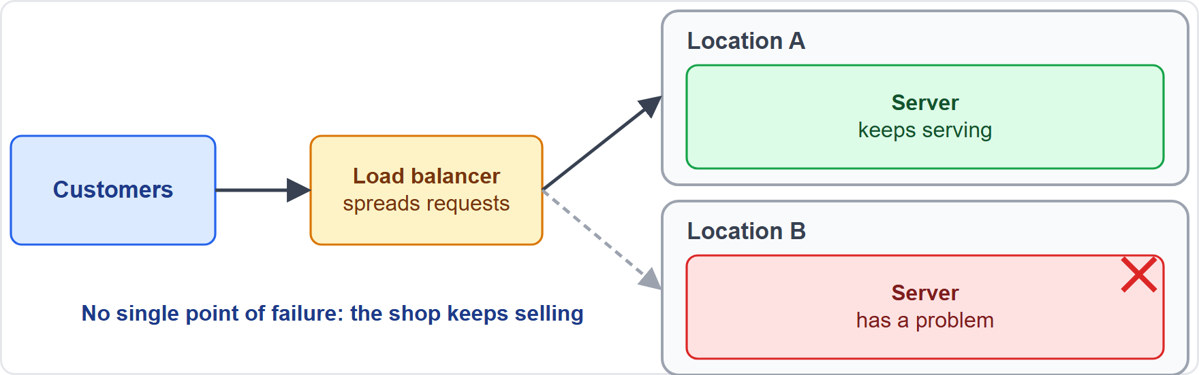
High Availability
Part 1
High availability means a workload keeps running when part of it fails
Use several smaller resources and spread requests across them, so they do not share one point of failure
AWS design guidance: monitor, recover automatically and test your recovery
AWS builds its infrastructure from Regions and Availability Zones, so you can spread a workload across locations
EXAM TIP For "keeps working after a failure", think high availability and no single point of failure.
Cloud Practitioner Exam Prep Masterclass | for the AWS CLF-C02 exam
Module 1: The AWS Cloud: Value, Reach and Economics
9 / 35
Notes:
High availability means a workload keeps running when part of it fails. The idea is to use several smaller resources and spread requests across them, so they do not share one point of failure. Look at the picture. A load balancer sends customers to two servers in separate locations. One location fails, and the other keeps serving. A W S design guidance adds three habits: monitor, recover automatically, and test your recovery. And A W S builds its infrastructure from Regions and Availability Zones, so you can spread a workload across locations. Exam tip: for keeps working after a failure, think high availability.

Slide 10
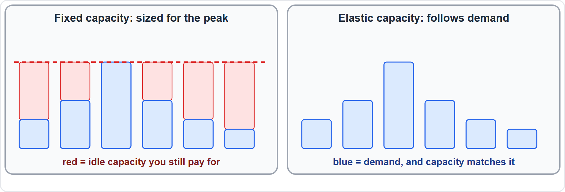
Elasticity: Capacity That Follows Demand
Part 1
Elasticity means adding and removing resources as demand changes
On premises you buy for the peak, and the extra capacity sits idle the rest of the time
In the cloud you stop guessing capacity: scale up and down with a few minutes' notice
Both risks go away: expensive idle resources and too little capacity
Auto scaling is the AWS feature behind it (Module 7)
EXAM TIP Elasticity works in both directions: it adds capacity when demand rises and removes it when demand falls.
Cloud Practitioner Exam Prep Masterclass | for the AWS CLF-C02 exam
Module 1: The AWS Cloud: Value, Reach and Economics
10 / 35
Notes:
Elasticity means adding and removing resources as demand changes. On premises, you buy for the peak, and the extra capacity sits idle the rest of the time. Look at the two panels. On the left, fixed capacity is set at the peak. On the right, elastic capacity rises and falls with demand. In the cloud you stop guessing capacity: you scale up and down with a few minutes' notice. Both risks go away, the expensive idle resources and too little capacity. Auto scaling is the A W S feature behind it, and Module seven covers it. Exam tip: elasticity works in both directions.

Slide 11
Which Benefit Is It?
Part 1
Situation | Benefit
A test environment ready in minutes, not weeks | Speed and agility
Extra servers for the holiday sale, removed after | Elasticity
European customers served from a nearby Region | Global reach
The shop stays up when one location fails | High availability
Paying per use instead of buying servers first | Fixed to variable expense
Lower prices because many customers share the cost | Economies of scale
EXAM TIP Find the key phrase: "minutes" means speed, "both directions" means elasticity, "close to customers" means global reach.
Cloud Practitioner Exam Prep Masterclass | for the AWS CLF-C02 exam
Module 1: The AWS Cloud: Value, Reach and Economics
11 / 35
Notes:
Let us practice matching benefits to situations. A test environment ready in minutes, not weeks, is speed and agility. Extra servers for the holiday sale, removed afterwards, is elasticity. European customers served from a nearby Region is global reach. A shop that stays up when one location fails is high availability. Paying per use instead of buying servers first is trading fixed expense for variable expense. And lower prices because many customers share the cost is economies of scale. Exam tip: find the key phrase. Minutes means speed, both directions means elasticity, and close to customers means global reach.

Slide 12
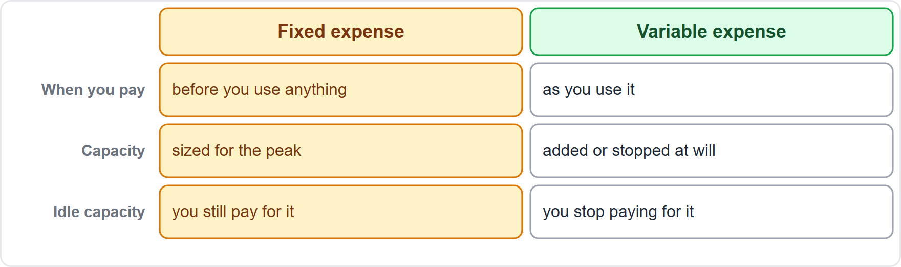
Fixed Costs and Variable Costs
Part 1
Fixed expense: you invest in data centers and servers before you know how you will use them
Variable expense: you pay only when you consume resources, and only for how much you consume
Adopt a consumption model: a development environment used 8 hours a day on weekdays can be stopped when idle, which AWS puts at about 75% savings (40 hours against 168)
Variable cost lowers the risk of buying too much or too little
EXAM TIP "Trade fixed expense for variable expense" means pay for what you use instead of buying capacity first.
Cloud Practitioner Exam Prep Masterclass | for the AWS CLF-C02 exam
Module 1: The AWS Cloud: Value, Reach and Economics
12 / 35
Notes:
Now cloud economics. Fixed expense means you invest in data centers and servers before you know how you will use them. Variable expense means you pay only when you consume resources, and only for how much you consume. A W S gives an example of adopting a consumption model. A development environment used eight hours a day on weekdays can be stopped when it is idle. A W S puts the savings at about seventy-five percent, which is forty hours against one hundred sixty-eight. Variable cost also lowers the risk of buying too much or too little. Exam tip: trade fixed expense for variable expense means pay for what you use instead of buying capacity first.

Slide 13
Costs of Running Your Own Data Center
Part 1
Running your own means procurement (buying and waiting), maintenance and capacity planning
It also means the heavy lifting: racking, stacking and powering servers, and managing operating systems and applications
AWS does the data center work, and managed services remove much of the operating burden
That effort moves from running infrastructure to using services and serving customers
You still pay for the services you use, and for the people who design and run your workloads
EXAM TIP On-premises costs are more than hardware: add buying, upkeep, power, space and staff time.
Cloud Practitioner Exam Prep Masterclass | for the AWS CLF-C02 exam
Module 1: The AWS Cloud: Value, Reach and Economics
13 / 35
Notes:
What does running your own data center cost? It means procurement, which is buying and waiting, plus maintenance and capacity planning. It also means the heavy lifting: racking, stacking and powering servers, and managing operating systems and applications. A W S does the data center work, and managed services remove much of the operating burden. That effort moves from running infrastructure to using services and serving customers. You still pay for the services you use, and for the people who design and run your workloads. Exam tip: on-premises costs are more than hardware. Add buying, upkeep, power, space and staff time.

Slide 14
Economies of Scale
Part 1
Usage from hundreds of thousands of customers is aggregated in the cloud
That lets AWS achieve higher economies of scale, which become lower pay-as-you-go prices
You can reach a lower variable cost than you could on your own
Tidewater tip: a small shop gets prices built on the volume of a very large provider
Prices still differ by Region and service, and are covered in Module 13
EXAM TIP Economies of scale: many customers share the cost, so each pays less per unit.
Cloud Practitioner Exam Prep Masterclass | for the AWS CLF-C02 exam
Module 1: The AWS Cloud: Value, Reach and Economics
14 / 35
Notes:
Economies of scale are one of the six advantages. Usage from hundreds of thousands of customers is aggregated in the cloud. That lets A W S achieve higher economies of scale, and they become lower pay-as-you-go prices. So you can reach a lower variable cost than you could on your own. For Tidewater, a small shop gets prices built on the volume of a very large provider. Prices still differ by Region and service, and Module thirteen covers them. Exam tip: many customers share the cost, so each pays less per unit.

Slide 15
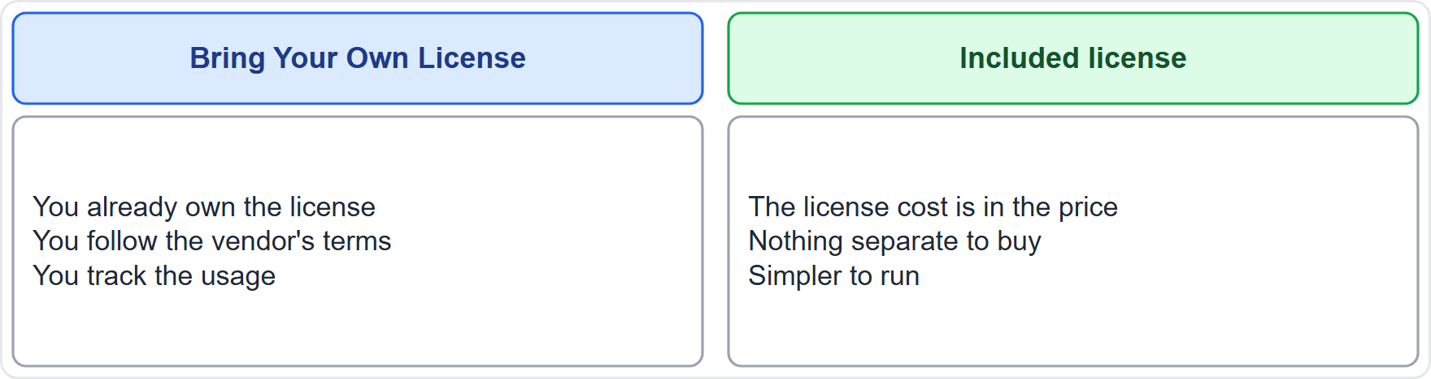
Licensing: Bring Your Own License or License Included
Part 1
Bring Your Own License (BYOL): reuse licenses you already own on AWS, which can save cost
Included license: the license cost is part of the price of the AWS resource
BYOL needs you to follow the vendor's license terms and track usage; an included license is simpler
License Manager can switch a workload between the two license types without redeploying it
EXAM TIP BYOL means you bring a license you own; included means the license is already in the price.
Cloud Practitioner Exam Prep Masterclass | for the AWS CLF-C02 exam
Module 1: The AWS Cloud: Value, Reach and Economics
15 / 35
Notes:
The exam guide names two licensing strategies. With Bring Your Own License, called B Y O L, you reuse licenses you already own on A W S, which can save cost. With an included license, the license cost is part of the price of the A W S resource. B Y O L means you follow the vendor's license terms and track usage, while an included license is simpler. A W S License Manager can switch a workload between the two license types without redeploying it. Exam tip: B Y O L means you bring a license you own; included means the license is already in the price.

Slide 16
AWS License Manager
Part 2
AWS License Manager manages software licenses from vendors such as Microsoft, SAP, Oracle and IBM
It works across Regions and accounts and gives dashboards for usage and vendor audits
Rule-based limits, hard or soft, stop non-compliant use before it happens
It tracks software licensed by vCPUs, physical cores, sockets or machines
It integrates with Amazon EC2, Amazon RDS, AWS Marketplace, Systems Manager and AWS Organizations
EXAM TIP Tracking licenses and staying compliant on AWS: AWS License Manager.
Cloud Practitioner Exam Prep Masterclass | for the AWS CLF-C02 exam
Module 1: The AWS Cloud: Value, Reach and Economics
16 / 35
Notes:
A W S License Manager manages software licenses from vendors such as Microsoft, S A P, Oracle and I B M. It works across Regions and accounts, and gives dashboards for usage and for vendor audits. Rule-based limits, hard or soft, stop non-compliant use before it happens. It tracks software licensed by virtual cores, physical cores, sockets or machines. And it integrates with Amazon E C two, Amazon R D S, A W S Marketplace, Systems Manager and A W S Organizations. Exam tip: tracking licenses and staying compliant on A W S is License Manager.

Slide 17
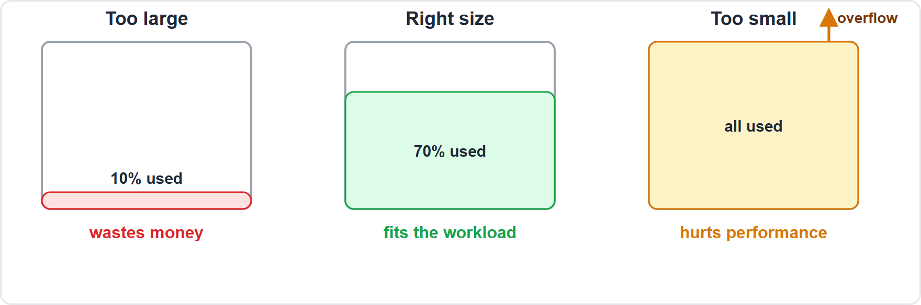
Rightsizing: Matching Size to Workload
Part 2
Rightsizing is matching instance types and sizes to your workload
AWS calls it the most effective way to control cloud costs
Migrated workloads are often oversized, because speed came before cost
Review usage continuously, shut down idle resources and resize overprovisioned ones
Needs change, so treat rightsizing as ongoing, not a one-time task
EXAM TIP Too big wastes money and too small hurts performance; rightsizing finds the match.
Cloud Practitioner Exam Prep Masterclass | for the AWS CLF-C02 exam
Module 1: The AWS Cloud: Value, Reach and Economics
17 / 35
Notes:
Rightsizing is matching instance types and sizes to your workload. A W S calls it the most effective way to control cloud costs. Look at the three servers. One is too large and mostly idle, which wastes money. One is right-sized and fits the workload. One is too small and overflowing, which hurts performance. Migrated workloads are often oversized, because speed came before cost. So review usage continuously, shut down idle resources, and resize overprovisioned ones. Needs change, so treat rightsizing as ongoing. Exam tip: too big wastes money, and too small hurts performance.

Slide 18
Tools That Help: Compute Optimizer and Cost Explorer
Part 2
AWS Compute Optimizer gives recommendations that show where an instance can be resized
AWS Cost Explorer helps you analyze costs and usage over time
Tags let you assign cost to teams and workloads, so waste has an owner
AWS suggests a rightsizing schedule for each team and tagging every instance
Pricing and billing tools are covered in Module 13
EXAM TIP Resize recommendations: Compute Optimizer. Looking at past spend: Cost Explorer.
Cloud Practitioner Exam Prep Masterclass | for the AWS CLF-C02 exam
Module 1: The AWS Cloud: Value, Reach and Economics
18 / 35
Notes:
Two tools help here. A W S Compute Optimizer gives recommendations that show where an instance can be resized. A W S Cost Explorer helps you analyze costs and usage over time. Tags let you assign cost to teams and workloads, so waste has an owner. A W S suggests a rightsizing schedule for each team, and tagging every instance. Pricing and billing tools are covered in Module thirteen. Exam tip: resize recommendations, Compute Optimizer. Looking at past spend, Cost Explorer.

Slide 19
Automation: Faster, Repeatable, Less Error-Prone
Part 2
AWS design guidance: perform operations as code, so procedures are versioned, tested and automated
Manage change through automation, and recover from failure automatically
Automation can add or remove resources to match demand, which supports elasticity
Fewer manual steps mean faster, more repeatable work and fewer mistakes
Experimenting with different configurations becomes cheap when resources are automatable
EXAM TIP Benefits of automation: speed, consistency and less manual effort.
Cloud Practitioner Exam Prep Masterclass | for the AWS CLF-C02 exam
Module 1: The AWS Cloud: Value, Reach and Economics
19 / 35
Notes:
The exam guide also asks for the benefits of automation. A W S design guidance says to perform operations as code, so procedures are versioned, tested and automated. It says to manage change through automation, and to recover from failure automatically. Automation can add or remove resources to match demand, which supports elasticity. Fewer manual steps mean faster, more repeatable work, and fewer mistakes. And experimenting with different configurations becomes cheap when resources can be automated. Exam tip: benefits of automation are speed, consistency and less manual effort.

Slide 20
What the Exam Asks: Value and Economics
Part 2
Elasticity or high availability
Agility or global reach
Fixed or variable expense
capacity follows demand, or the workload survives failure
speed of change, or closeness to customers
pay first, or pay as you use
BYOL or included license
Compute Optimizer or Cost Explorer
IaaS, PaaS or SaaS
how much you manage
a license you own, or one in the price
resize advice, or spend analysis
EXAM TIP Name the situation first, then the benefit.
Cloud Practitioner Exam Prep Masterclass | for the AWS CLF-C02 exam
Module 1: The AWS Cloud: Value, Reach and Economics
20 / 35
Notes:
Here are the look-alike pairs for this module. Elasticity or high availability: capacity follows demand, or the workload survives failure. Agility or global reach: speed of change, or closeness to customers. Fixed or variable expense: pay first, or pay as you use. B Y O L or included license: a license you own, or one in the price. Compute Optimizer or Cost Explorer: resize advice, or spend analysis. And I A A S, P A A S or S A A S: how much you manage. Exam tip: name the situation first, then the benefit.

Slide 21
Design Check: Tidewater's Move
Part 2
Tidewater's situation | The cloud idea
Holiday spikes, idle the rest of the year | Elasticity: scale up and down, pay for use
Buying servers before knowing demand | Fixed to variable expense
New customers in Europe and Asia | Global reach: deploy in more Regions
Windows Server licenses already owned | BYOL, tracked with License Manager
Servers oversized after the move | Rightsizing with Compute Optimizer
Release steps repeated by hand | Automation: operations as code
Cover the right column, answer each row yourself, then compare
Cloud Practitioner Exam Prep Masterclass | for the AWS CLF-C02 exam
Module 1: The AWS Cloud: Value, Reach and Economics
21 / 35
Notes:
Time to design. Look at Tidewater's six situations, and answer each one yourself before I do. [PAUSE 15] Holiday spikes with idle capacity the rest of the year call for elasticity: scale up and down and pay for use. Buying servers before knowing demand is the shift from fixed to variable expense. New customers in Europe and Asia call for global reach: deploy in more Regions. Windows Server licenses already owned mean Bring Your Own License, tracked with License Manager. Servers that are oversized after the move need rightsizing with Compute Optimizer. And release steps repeated by hand call for automation, with operations as code.

Slide 22
Common Traps: Value and Economics
Part 2
Elasticity is not high availability: one changes capacity with demand, the other survives failure
Variable expense is not always cheaper: pay-per-use rewards stopping and rightsizing resources
Agility is about speed of change, not uptime
BYOL is not automatic: it depends on the vendor's license terms
More control means more to manage: IaaS gives the most control and the most work
EXAM TIP If two answers both sound good, check which one matches the exact benefit in the question.
Cloud Practitioner Exam Prep Masterclass | for the AWS CLF-C02 exam
Module 1: The AWS Cloud: Value, Reach and Economics
22 / 35
Notes:
Watch for five traps. Elasticity is not high availability: one changes capacity with demand, the other survives failure. Variable expense is not always cheaper, because pay-per-use rewards stopping and rightsizing resources. Agility is about speed of change, not uptime. B Y O L is not automatic: it depends on the vendor's license terms. And more control means more to manage, so I A A S gives the most control and the most work. Exam tip: if two answers both sound good, check which one matches the exact benefit in the question.

Slide 23
Module Recap
Part 2
1
Cloud computing
2
Six advantages
3
Resilience and demand
on-demand IT resources over the internet with pay-as-you-go pricing; IaaS, PaaS and SaaS differ in what you manage
variable expense, economies of scale, no capacity guessing, speed and agility, no data center upkeep, global reach
high availability avoids single points of failure; elasticity adds and removes capacity
4
Cost model
5
Licenses
6
Cost control
fixed expense is paid first, variable expense follows use; own data centers add buying, upkeep and staff
BYOL reuses what you own, an included license is in the price, License Manager tracks it
rightsize with Compute Optimizer, analyze with Cost Explorer, and automate
Cloud Practitioner Exam Prep Masterclass | for the AWS CLF-C02 exam
Module 1: The AWS Cloud: Value, Reach and Economics
23 / 35
Notes:
Let us recap. Cloud computing is on-demand I T resources over the internet with pay-as-you-go pricing, and the service models differ in what you manage. The six advantages are variable expense, economies of scale, no capacity guessing, speed and agility, no data center upkeep, and global reach. High availability avoids single points of failure, and elasticity adds and removes capacity. Fixed expense is paid first and variable expense follows use, and your own data center adds buying, upkeep and staff. B Y O L reuses licenses you own, an included license is in the price, and License Manager tracks them. And for cost control: rightsize with Compute Optimizer, analyze with Cost Explorer, and automate.

Slide 24
Practice Question 1
Part 2
Q1
Which statement best describes cloud computing?
A
Buying and owning servers in a rented room so that capacity is always available
B
Signing a multi-year contract for a fixed amount of computing power
C
On-demand delivery of IT resources over the internet with pay-as-you-go pricing
D
Running every application only on a private network inside the company
Cloud Practitioner Exam Prep Masterclass | for the AWS CLF-C02 exam
Module 1: The AWS Cloud: Value, Reach and Economics
24 / 35
Notes:
Question one. Which statement best describes cloud computing? The four options are on the screen. [PAUSE 12] The answer is C. Cloud computing is the on-demand delivery of I T resources over the internet with pay-as-you-go pricing. Owning servers, a fixed multi-year contract and a purely private network describe traditional approaches.

Slide 25
Practice Question 2
Part 2
Q2
A team can launch a new test environment in minutes instead of waiting weeks for hardware. Which cloud benefit does this describe?
A
Increased speed and agility
B
Massive economies of scale
C
Global reach in minutes
D
A guarantee of high availability
Cloud Practitioner Exam Prep Masterclass | for the AWS CLF-C02 exam
Module 1: The AWS Cloud: Value, Reach and Economics
25 / 35
Notes:
Question two. A team can launch a new test environment in minutes instead of waiting weeks for hardware. Which cloud benefit does this describe? The four options are on the screen. [PAUSE 12] The answer is A, increased speed and agility. Economies of scale are about lower prices, global reach is about deploying near customers, and high availability is about surviving failures.

Slide 26
Practice Question 3
Part 2
Q3
Tidewater's traffic triples at the holidays and then falls. Which cloud benefit lets the shop add capacity for the season and release it afterwards?
A
Global reach
B
Economies of scale
C
High availability
D
Elasticity
Cloud Practitioner Exam Prep Masterclass | for the AWS CLF-C02 exam
Module 1: The AWS Cloud: Value, Reach and Economics
26 / 35
Notes:
Question three. Tidewater's traffic triples at the holidays and then falls. Which cloud benefit lets the shop add capacity for the season and release it afterwards? The four options are on the screen. [PAUSE 12] The answer is D, elasticity. It adds and removes resources as demand changes, so the shop pays for the extra capacity only while it needs it.

Slide 27
Practice Question 4
Part 2
Q4
Which TWO are advantages of cloud computing? (Select TWO.)
A
Trade fixed expense for variable expense
B
Every workload always costs less than it did on premises
C
Increase speed and agility
D
AWS takes over all responsibility for your application's security
E
Capacity planning is no longer needed in any form
Cloud Practitioner Exam Prep Masterclass | for the AWS CLF-C02 exam
Module 1: The AWS Cloud: Value, Reach and Economics
27 / 35
Notes:
Question four. Select two. Which two are advantages of cloud computing? The five options are on the screen. [PAUSE 15] The answers are A and C: trading fixed expense for variable expense, and increasing speed and agility. The cloud does not guarantee lower cost for every workload, does not remove your own security duties, and does not remove the need to think about capacity.

Slide 28
Practice Question 5
Part 2
Q5
Which description best fits high availability?
A
A workload that automatically gets larger every night
B
A workload that keeps running when part of it fails
C
A workload that costs the least possible amount per hour
D
A workload that is stored in the Region nearest to its owner
Cloud Practitioner Exam Prep Masterclass | for the AWS CLF-C02 exam
Module 1: The AWS Cloud: Value, Reach and Economics
28 / 35
Notes:
Question five. Which description best fits high availability? The four options are on the screen. [PAUSE 12] The answer is B, a workload that keeps running when part of it fails. High availability usually means spreading work across several resources with no single point of failure. Growing automatically is elasticity, and the lowest cost is cost optimization.

Slide 29
Practice Question 6
Part 2
Q6
Which statement describes a variable expense?
A
You pay only for the resources you consume, in the amount you consume
B
You pay a large amount up front before you know how you will use the resources
C
You pay the same amount every month whether or not you use the resources
D
You pay once for equipment that you then own for many years
Cloud Practitioner Exam Prep Masterclass | for the AWS CLF-C02 exam
Module 1: The AWS Cloud: Value, Reach and Economics
29 / 35
Notes:
Question six. Which statement describes a variable expense? The four options are on the screen. [PAUSE 12] The answer is A. You pay only for the resources you consume, in the amount you consume. Paying a large amount up front, paying a flat amount whether or not you use the resources, and buying equipment outright are fixed expenses.

Slide 30
Practice Question 7
Part 2
Q7
Tidewater already owns Windows Server licenses and wants to reuse them on AWS to save cost. Which approach fits?
A
License-included instances, which add the license cost to the hourly price
B
Bring Your Own License (BYOL), reusing licenses it already owns
C
Pay-as-you-go licenses from a reseller that sits outside AWS
D
A new data center purchased just to hold the licenses
Cloud Practitioner Exam Prep Masterclass | for the AWS CLF-C02 exam
Module 1: The AWS Cloud: Value, Reach and Economics
30 / 35
Notes:
Question seven. Tidewater already owns Windows Server licenses and wants to reuse them on A W S to save cost. Which approach fits? The four options are on the screen. [PAUSE 12] The answer is B, Bring Your Own License. It lets a company reuse licenses it already owns, subject to the vendor's terms. Included licenses charge for a license it does not need.

Slide 31
Practice Question 8
Part 2
Q8
After the move, Tidewater's servers run at about ten percent CPU use. Which practice reduces cost without losing the capacity the shop needs?
A
Move to larger instance types so that there is more headroom
B
Add more instances so that the load is spread thinner
C
Rightsize by matching instance sizes to the workload
D
Turn off all monitoring so that no one sees the low use
Cloud Practitioner Exam Prep Masterclass | for the AWS CLF-C02 exam
Module 1: The AWS Cloud: Value, Reach and Economics
31 / 35
Notes:
Question eight. After the move, Tidewater's servers run at about ten percent C P U use. Which practice reduces cost without losing the capacity the shop needs? The four options are on the screen. [PAUSE 12] The answer is C, rightsizing. It matches instance sizes to what the workload really uses, so idle capacity stops costing money. Larger or additional instances raise cost, and turning off monitoring removes the information you need.

Slide 32
Practice Question 9
Part 2
Q9
Which TWO AWS tools help you find and act on rightsizing and spending opportunities? (Select TWO.)
A
Amazon Cognito
B
AWS Compute Optimizer
C
AWS Secrets Manager
D
AWS Cost Explorer
E
AWS Artifact
Cloud Practitioner Exam Prep Masterclass | for the AWS CLF-C02 exam
Module 1: The AWS Cloud: Value, Reach and Economics
32 / 35
Notes:
Question nine. Select two. Which two A W S tools help you find and act on rightsizing and spending opportunities? The five options are on the screen. [PAUSE 15] The answers are B and D: Compute Optimizer recommends where instances can be resized, and Cost Explorer lets you analyze costs and usage. Cognito handles app sign-in, Secrets Manager stores secrets, and Artifact provides compliance reports.

Slide 33
Practice Question 10
Part 2
Q10
Which statement about economies of scale in the cloud is correct?
A
Each customer's usage is priced on its own with no effect from other customers
B
Higher usage across all customers makes prices rise for everyone
C
Economies of scale apply only to long-term storage services
D
Aggregated usage from many customers lets AWS offer lower pay-as-you-go prices
Cloud Practitioner Exam Prep Masterclass | for the AWS CLF-C02 exam
Module 1: The AWS Cloud: Value, Reach and Economics
33 / 35
Notes:
Question ten. Which statement about economies of scale in the cloud is correct? The four options are on the screen. [PAUSE 12] The answer is D. Aggregated usage from many customers lets A W S offer lower pay-as-you-go prices. The other statements deny that effect, or reverse it.

Slide 34
Practice Question 11
Part 2
Q11
Tidewater runs a development environment only during an eight-hour working day. Which action best applies the consumption model?
A
Stop the environment when it is not in use, so it runs only when needed
B
Keep it running all day and night so that it starts instantly each morning
C
Buy a larger instance so that tests finish faster and cost less overall
D
Copy the environment to a second Region so that it is always on
Cloud Practitioner Exam Prep Masterclass | for the AWS CLF-C02 exam
Module 1: The AWS Cloud: Value, Reach and Economics
34 / 35
Notes:
Question eleven. Tidewater runs a development environment only during an eight-hour working day. Which action best applies the consumption model? The four options are on the screen. [PAUSE 12] The answer is A: stop the environment when it is not in use, so it runs only when needed. Running around the clock, buying larger instances, or adding a second Region all increase what you pay.

Slide 35
Answers at a Glance
Part 2
Question | Answer | Why
Q1 | C | On-demand resources with pay-as-you-go pricing
Q2 | A | Minutes instead of weeks is speed and agility
Q3 | D | Elasticity adds and removes capacity with demand
Q4 | A, C | Variable expense and speed and agility
Q5 | B | High availability keeps running when part of it fails
Q6 | A | Variable expense follows consumption
Q7 | B | BYOL reuses licenses already owned
Q8 | C | Rightsizing matches size to the workload
Q9 | B, D | Compute Optimizer and Cost Explorer
Q10 | D | Aggregated usage lowers prices
Q11 | A | Stop idle resources: the consumption model
Cloud Practitioner Exam Prep Masterclass | for the AWS CLF-C02 exam
Module 1: The AWS Cloud: Value, Reach and Economics
35 / 35
Notes:
Here are all eleven answers. Question one: C. Question two: A. Question three: D. Question four: A and C. Question five: B. Question six: A. Question seven: B. Question eight: C. Question nine: B and D. Question ten: D. Question eleven: A. That completes Module one. Next, Module two covers the Well-Architected Framework, cloud adoption, and migration.

