Slide 1
Module 2: Well-Architected, Adoption and Migration
How AWS describes a good design, and how organizations move to the cloud
Domain 1 · Cloud Concepts · Task statements 1.2 and 1.3
Cloud Practitioner Exam Prep Masterclass
Module 2 · Part 1
Notes:
Welcome to Module two: Well-Architected, Adoption and Migration. This module finishes the first domain of the exam, Cloud Concepts. It covers task statements one point two and one point three: how A W S describes a good design, and how organizations move to the cloud.

Slide 2
What You Will Learn
Part 1
Name the six pillars of the AWS Well-Architected Framework and tell them apart
Say what the AWS Well-Architected Tool is for
Describe the AWS Cloud Adoption Framework and its four business outcomes
Match a situation to one of the seven migration strategies
Know which AWS services help you discover, plan and carry out a migration
Cloud Practitioner Exam Prep Masterclass | for the AWS CLF-C02 exam
Module 2: Well-Architected, Adoption and Migration
2 / 34
Notes:
By the end of this module you will be able to do five things. Name the six pillars of the A W S Well-Architected Framework, and tell them apart. Say what the A W S Well-Architected Tool is for. Describe the A W S Cloud Adoption Framework and its four business outcomes. Match a situation to one of the seven migration strategies. And know which A W S services help you discover, plan and carry out a migration.

Slide 3
Case Check-In: Tidewater Plans the Move
Part 1
CASE CHECK-IN · Tidewater Outfitters
Tidewater's board has agreed to move the shop to AWS, and wants a plan it can trust
The CTO asks how to judge whether the new design is a good one
The CFO asks what outcomes the move should deliver for the business
The IT lead must decide how to move the web servers, the database and an old email system
Your job: choose the frameworks, strategies and services that fit
Cloud Practitioner Exam Prep Masterclass | for the AWS CLF-C02 exam
Module 2: Well-Architected, Adoption and Migration
3 / 34
Notes:
Tidewater's board has agreed to move the shop to A W S, and it wants a plan it can trust. The C T O asks how to judge whether the new design is a good one. The C F O asks what outcomes the move should deliver for the business. And the I T lead must decide how to move the web servers, the database, and an old email system. Your job is to choose the frameworks, strategies and services that fit.

Slide 4
What Is the Well-Architected Framework?
Part 1
The AWS Well-Architected Framework is a set of design principles, best practices and questions for building cloud workloads
It is built on six pillars: operational excellence, security, reliability, performance efficiency, cost optimization and sustainability
AWS compares neglecting a pillar to a weak foundation in a building: the system struggles to meet its goals
Following the pillars helps you build stable and efficient systems, and leaves room for the functional side of the design
The exam asks you to name the pillars and to tell them apart
EXAM TIP Learn the six pillar names, and one phrase to recognize each.
Cloud Practitioner Exam Prep Masterclass | for the AWS CLF-C02 exam
Module 2: Well-Architected, Adoption and Migration
4 / 34
Notes:
The A W S Well-Architected Framework is a set of design principles, best practices and questions for building cloud workloads. It is built on six pillars: operational excellence, security, reliability, performance efficiency, cost optimization and sustainability. A W S compares neglecting a pillar to a weak foundation in a building: the system struggles to meet its goals. Following the pillars helps you build stable and efficient systems, and leaves room for the functional side of the design. The exam asks you to name the pillars and to tell them apart. Exam tip: learn the six names, and one phrase to recognize each.

Slide 5
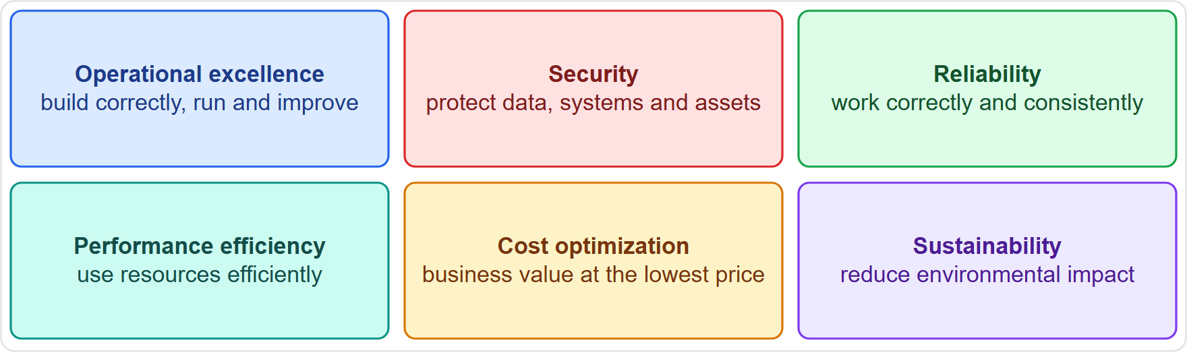
The Six Pillars at a Glance
Part 1
Operational excellence: build correctly, deliver a great customer experience, run and improve operations
Security: protect data, systems and assets
Reliability: work correctly and consistently when expected
Performance efficiency: use resources efficiently, and keep doing so as demand changes
Cost optimization: deliver business value at the lowest price point
Sustainability: reduce environmental impact, especially energy use
EXAM TIP Each pillar answers one question: how to run, protect, keep running, perform, save and sustain.
Cloud Practitioner Exam Prep Masterclass | for the AWS CLF-C02 exam
Module 2: Well-Architected, Adoption and Migration
5 / 34
Notes:
Here are the six pillars with a short meaning for each. Operational excellence is building correctly, delivering a great customer experience, and running and improving operations. Security is protecting data, systems and assets. Reliability is working correctly and consistently when expected. Performance efficiency is using resources efficiently, and keeping that up as demand changes. Cost optimization is delivering business value at the lowest price point. And sustainability is reducing environmental impact, especially energy use. Exam tip: each pillar answers one question: how to run, protect, keep running, perform, save and sustain.

Slide 6
Operational Excellence and Security
Part 1
Operational excellence is a commitment to build software correctly while delivering a great customer experience
Its design principles: perform operations as code, make frequent small reversible changes, refine procedures, anticipate failure and learn from all failures
Security is the ability to protect data, systems and assets, using cloud technology to improve security
Security work on AWS includes access management, encryption, logging and threat detection (Modules 3 to 5)
EXAM TIP Operations as code and learning from failure: operational excellence. Protecting data and systems: security.
Cloud Practitioner Exam Prep Masterclass | for the AWS CLF-C02 exam
Module 2: Well-Architected, Adoption and Migration
6 / 34
Notes:
Two pillars on this slide. Operational excellence is a commitment to build software correctly while delivering a great customer experience. Its design principles are: perform operations as code, make frequent small reversible changes, refine procedures, anticipate failure, and learn from all failures. Security is the ability to protect data, systems and assets, using cloud technology to improve security. On A W S that includes access management, encryption, logging and threat detection, which Modules three to five cover. Exam tip: operations as code and learning from failure mean operational excellence. Protecting data and systems means security.

Slide 7
Reliability and Performance Efficiency
Part 1
Reliability is the ability of a workload to perform its intended function correctly and consistently when expected
Its principles: recover automatically from failure, test recovery procedures, scale horizontally, stop guessing capacity and manage change through automation
Performance efficiency is using cloud resources efficiently to meet performance requirements, and keeping that efficiency as demand and technology change
Its principles: democratize advanced technologies, go global in minutes, use serverless architectures, experiment more often and consider mechanical sympathy
EXAM TIP Recover and test: reliability. Serverless, global and experiments: performance efficiency.
Cloud Practitioner Exam Prep Masterclass | for the AWS CLF-C02 exam
Module 2: Well-Architected, Adoption and Migration
7 / 34
Notes:
Reliability is the ability of a workload to perform its intended function correctly and consistently when expected. Its principles are: recover automatically from failure, test recovery procedures, scale horizontally, stop guessing capacity, and manage change through automation. Performance efficiency is using cloud resources efficiently to meet performance requirements, and keeping that efficiency as demand and technology change. Its principles are: democratize advanced technologies, go global in minutes, use serverless architectures, experiment more often, and consider mechanical sympathy. Exam tip: recover and test means reliability. Serverless, global and experiments mean performance efficiency.

Slide 8
Cost Optimization and Sustainability
Part 1
Cost optimization is running systems to deliver business value at the lowest price point
Its principles: implement cloud financial management, adopt a consumption model, measure overall efficiency, stop spending on undifferentiated heavy lifting and analyze and attribute expenditure
Sustainability focuses on environmental impacts, especially energy consumption and efficiency
Cost and sustainability often point the same way: using fewer resources cuts both the bill and the energy
EXAM TIP Consumption model and heavy lifting: cost optimization. Energy and environment: sustainability.
Cloud Practitioner Exam Prep Masterclass | for the AWS CLF-C02 exam
Module 2: Well-Architected, Adoption and Migration
8 / 34
Notes:
Cost optimization is running systems to deliver business value at the lowest price point. Its principles are: implement cloud financial management, adopt a consumption model, measure overall efficiency, stop spending money on undifferentiated heavy lifting, and analyze and attribute expenditure. Sustainability focuses on environmental impacts, especially energy consumption and efficiency. The two often point the same way, because using fewer resources cuts both the bill and the energy. Exam tip: consumption model and heavy lifting mean cost optimization. Energy and environment mean sustainability.

Slide 9
Telling the Pillars Apart
Part 1
The question mentions | Pillar
Recovering automatically, testing recovery, scaling out | Reliability
Operations as code, small reversible changes, learning from failures | Operational excellence
A consumption model, no undifferentiated heavy lifting | Cost optimization
Serverless, experimenting, going global in minutes | Performance efficiency
Protecting data, systems and assets | Security
Energy use and environmental impact | Sustainability
EXAM TIP "Go global in minutes" and "stop guessing capacity" appear in more than one place: read what the question is really asking.
Cloud Practitioner Exam Prep Masterclass | for the AWS CLF-C02 exam
Module 2: Well-Architected, Adoption and Migration
9 / 34
Notes:
Let us practice telling the pillars apart. A question that mentions recovering automatically, testing recovery, or scaling out is about reliability. Operations as code, small reversible changes and learning from failures point to operational excellence. A consumption model, or no undifferentiated heavy lifting, is cost optimization. Serverless, experimenting and going global in minutes belong to performance efficiency. Protecting data, systems and assets is security. And energy use and environmental impact is sustainability. Exam tip: some phrases, such as go global in minutes and stop guessing capacity, appear in more than one place, so read what the question is really asking.

Slide 10
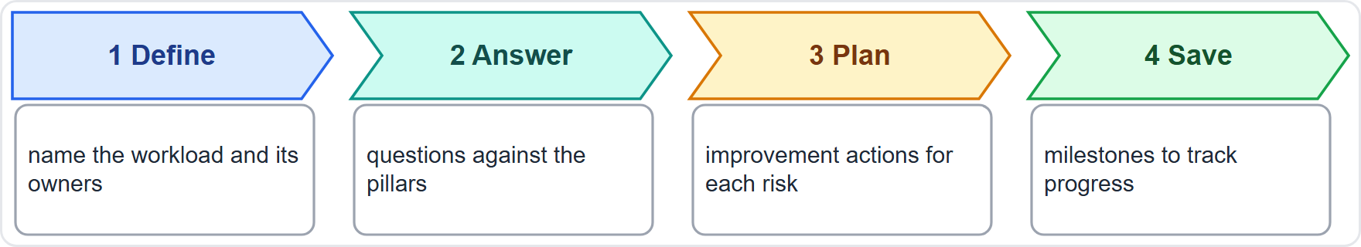
The AWS Well-Architected Tool
Part 1
The AWS Well-Architected Tool is a service in the console for reviewing workloads against best practices
You answer questions about each pillar and receive an action plan to improve
Milestones save a point in time so you can track progress
Lenses add best practices for specific kinds of workload, including your own
Check AWS's pricing page for cost
EXAM TIP Reviewing your design against AWS best practices: the Well-Architected Tool.
Cloud Practitioner Exam Prep Masterclass | for the AWS CLF-C02 exam
Module 2: Well-Architected, Adoption and Migration
10 / 34
Notes:
The A W S Well-Architected Tool is a service in the console for reviewing workloads against best practices. Look at the four steps. You define the workload, answer questions about the pillars, receive an improvement plan, and save milestones. A milestone saves a point in time, so you can track progress. Lenses add best practices for specific kinds of workload, including your own. For cost, check A W S's pricing page. Exam tip: reviewing your design against A W S best practices is the Well-Architected Tool.

Slide 11
The Cloud Adoption Framework: Purpose and Outcomes
Part 1
The AWS Cloud Adoption Framework (AWS CAF) draws on AWS experience to help organizations transform digitally
It identifies the capabilities that underpin a successful cloud transformation
Use it to prioritize opportunities, assess cloud readiness and evolve the roadmap
Four business outcomes: reduce business risk, improve environmental, social and governance (ESG) performance, grow revenue and increase operational efficiency
EXAM TIP The four outcomes to remember: risk, ESG, revenue and efficiency.
Cloud Practitioner Exam Prep Masterclass | for the AWS CLF-C02 exam
Module 2: Well-Architected, Adoption and Migration
11 / 34
Notes:
Now the A W S Cloud Adoption Framework, called the A W S C A F. It draws on A W S experience to help organizations transform digitally. It identifies the capabilities that underpin a successful cloud transformation. You can use it to prioritize opportunities, assess cloud readiness, and evolve your roadmap. It names four business outcomes: reduce business risk, improve environmental, social and governance performance, grow revenue, and increase operational efficiency. Exam tip: the four outcomes to remember are risk, E S G, revenue and efficiency.

Slide 12
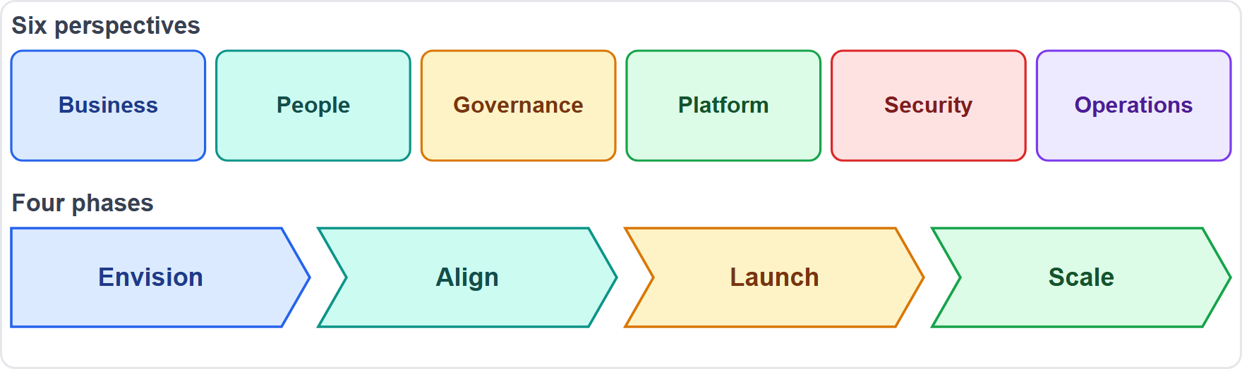
CAF Perspectives and Phases
Part 1
Six perspectives group the capabilities: Business, People, Governance, Platform, Security and Operations
Business: cloud investments support business outcomes
People: culture, structure, leadership and workforce
Governance: orchestrate cloud work to maximize benefit and limit risk
Four phases: Envision, Align, Launch and Scale
EXAM TIP Perspectives say who and what; phases say when: envision, align, launch, scale.
Cloud Practitioner Exam Prep Masterclass | for the AWS CLF-C02 exam
Module 2: Well-Architected, Adoption and Migration
12 / 34
Notes:
The C A F groups its capabilities into six perspectives: Business, People, Governance, Platform, Security and Operations. Business means cloud investments support business outcomes. People covers culture, structure, leadership and workforce. Governance means orchestrating cloud work to maximize benefit and limit risk. It also describes four phases of adoption, shown in the bottom row: Envision, Align, Launch and Scale. Exam tip: perspectives say who and what, and phases say when: envision, align, launch, scale.

Slide 13
Benefits of Migrating to AWS
Part 1
Migration moves fixed expense to variable expense and ends the work of running data centers
It brings the benefits of Module 1: speed and agility, elasticity, global reach and economies of scale
The CAF outcomes add lower risk, better ESG performance, revenue growth and operational efficiency
Workloads are easier to optimize or re-architect once they are running in the cloud
Choose a strategy for each application, so one project can mix strategies
EXAM TIP Benefits of migration repeat the benefits of the cloud: speed, elasticity, global reach, lower cost.
Cloud Practitioner Exam Prep Masterclass | for the AWS CLF-C02 exam
Module 2: Well-Architected, Adoption and Migration
13 / 34
Notes:
What does migration bring? It moves fixed expense to variable expense, and ends the work of running data centers. It brings the benefits of Module one: speed and agility, elasticity, global reach and economies of scale. The C A F outcomes add lower risk, better E S G performance, revenue growth and operational efficiency. Workloads are also easier to optimize or re-architect once they are running in the cloud. And you choose a strategy for each application, so one project can mix strategies. Exam tip: the benefits of migration repeat the benefits of the cloud.

Slide 14
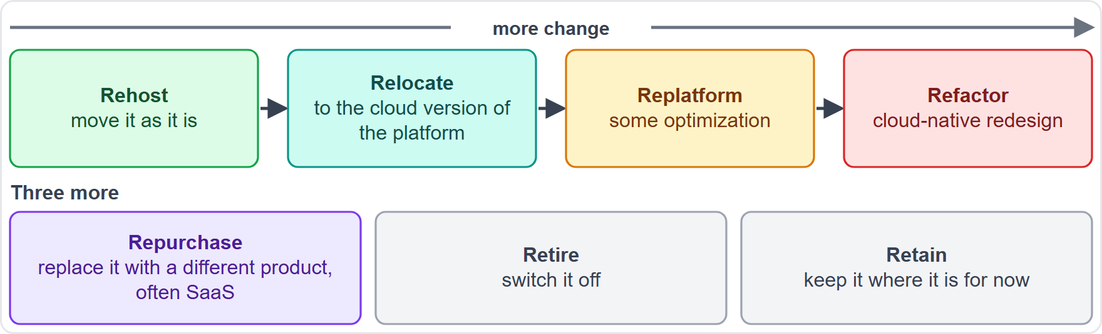
Migration Strategies: The Seven Rs
Part 1
AWS names seven migration strategies, the 7 Rs
Choose one for each application
For large migrations AWS suggests rehost, relocate or replatform first, then modernize after the move
Refactor is the most complex and costly strategy
EXAM TIP Read how much change the question allows: none is rehost, some is replatform, a redesign is refactor.
Cloud Practitioner Exam Prep Masterclass | for the AWS CLF-C02 exam
Module 2: Well-Architected, Adoption and Migration
14 / 34
Notes:
A W S names seven migration strategies, the seven R s. Look at the picture. Along the top, four strategies run from no change to a full redesign: rehost, relocate, replatform and refactor. Below them are three more: repurchase, retire and retain. You choose a strategy for each application. For large migrations, A W S suggests rehosting, relocating or replatforming first, and modernizing after the move. Refactor is the most complex and costly strategy. Exam tip: read how much change the question allows. None is rehost, some is replatform, a redesign is refactor.

Slide 15
Rehost, Relocate and Replatform
Part 2
Rehost ("lift and shift"): move the application without changes; users keep being served while servers migrate
Relocate: move many servers to the cloud version of the platform, or move instances to another VPC, Region or account; no new hardware and no rewrite
Replatform ("lift, tinker and shift"): move and add some optimization, for example a Microsoft SQL Server database to Amazon RDS for SQL Server
Rehosting makes it easier to optimize later, because the workload is already on AWS
EXAM TIP No changes: rehost. A few changes for a managed service: replatform.
Cloud Practitioner Exam Prep Masterclass | for the AWS CLF-C02 exam
Module 2: Well-Architected, Adoption and Migration
15 / 34
Notes:
Three strategies keep the application mostly as it is. Rehost, also called lift and shift, moves the application without changes, and users keep being served while servers migrate. Relocate moves many servers to the cloud version of the platform, or moves instances to another V P C, Region or account, with no new hardware and no rewrite. Replatform, also called lift, tinker and shift, moves the application and adds some optimization. An example is moving a Microsoft S Q L Server database to Amazon R D S for S Q L Server. Rehosting also makes later optimization easier, because the workload is already on A W S. Exam tip: no changes is rehost, and a few changes for a managed service is replatform.

Slide 16
Repurchase, Refactor, Retire and Retain
Part 2
Repurchase ("drop and shop"): replace the application with a different product, often moving from a traditional license to SaaS
Refactor (re-architect): change the architecture to use cloud-native features; the most complex and costly strategy
Retire: decommission applications with no business value, such as idle or unused ones
Retain: keep an application where it is for now, for example for data residency, dependencies or a recent upgrade
EXAM TIP Replace with a product: repurchase. Switch it off: retire. Leave it for now: retain.
Cloud Practitioner Exam Prep Masterclass | for the AWS CLF-C02 exam
Module 2: Well-Architected, Adoption and Migration
16 / 34
Notes:
Four more strategies. Repurchase, also called drop and shop, replaces the application with a different product, often moving from a traditional license to S A A S. Refactor, or re-architect, changes the architecture to use cloud-native features, and it is the most complex and costly strategy. Retire decommissions applications with no business value, such as idle or unused ones. And retain keeps an application where it is for now, for example for data residency, dependencies, or because it was recently upgraded. Exam tip: replace with a product is repurchase. Switch it off is retire. Leave it for now is retain.

Slide 17
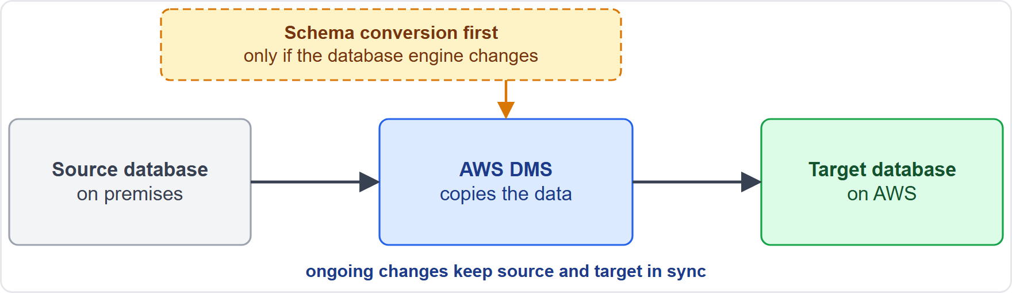
Database Replication With AWS DMS
Part 2
AWS Database Migration Service (AWS DMS) migrates relational databases, data warehouses, NoSQL databases and other data stores
Do a one-time migration, or replicate ongoing changes to keep source and target in sync: this is database replication
Moving to a different engine: convert the schema first with DMS Schema Conversion or the AWS Schema Conversion Tool (AWS SCT)
Pay as you go; data is encrypted at rest with AWS KMS and in transit with SSL
EXAM TIP Move a database and keep it in sync: AWS DMS. Convert schemas between engines: AWS SCT.
Cloud Practitioner Exam Prep Masterclass | for the AWS CLF-C02 exam
Module 2: Well-Architected, Adoption and Migration
17 / 34
Notes:
A W S Database Migration Service, A W S D M S, migrates relational databases, data warehouses, No S Q L databases and other data stores. Look at the picture. You can do a one-time migration, or replicate ongoing changes to keep the source and the target in sync. That ongoing copying is database replication, and it is the example the exam guide gives. If you are moving to a different engine, convert the schema first, with D M S Schema Conversion or the A W S Schema Conversion Tool, called S C T. D M S is pay as you go, and encrypts data at rest with K M S and in transit with S S L. Exam tip: move a database and keep it in sync is D M S; convert schemas between engines is S C T.

Slide 18
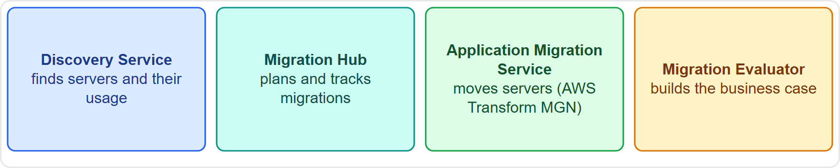
Migration Services: Discover, Track, Move
OLD NAME · VERIFY LIVE
Part 2
AWS Application Discovery Service: collects usage and configuration data about on-premises servers
AWS Migration Hub: one place to plan and track migrations
AWS Application Migration Service: lift and shift of servers with continuous replication; now named AWS Transform MGN
Migration Evaluator: builds a data-driven business case with right-sized cost projections
As of 4 November 2026: Discovery Service and Migration Hub are closed to new customers; AWS points to AWS Transform
EXAM TIP Find servers: Discovery Service. Track: Migration Hub. Move servers: Application Migration Service. Business case: Migration Evaluator.
Cloud Practitioner Exam Prep Masterclass | for the AWS CLF-C02 exam
Module 2: Well-Architected, Adoption and Migration
18 / 34
Notes:
Four services support a migration. A W S Application Discovery Service collects usage and configuration data about on-premises servers. A W S Migration Hub is one place to plan and track migrations. A W S Application Migration Service does lift and shift of servers, with continuous replication, and it is now named A W S Transform M G N. Migration Evaluator builds a data-driven business case with right-sized cost projections. As of the fourth of November, twenty twenty-six, Discovery Service and Migration Hub are closed to new customers, and A W S points to A W S Transform. The exam guide still lists them, so know what each does. Exam tip: find servers, Discovery Service. Track, Migration Hub. Move servers, Application Migration Service. Business case, Migration Evaluator.

Slide 19
What the Exam Asks: Frameworks and Migration
Part 2
Reliability or operational excellence
Cost optimization or sustainability
Well-Architected Framework or Tool
recover and test, or run and learn
lowest price point, or lowest environmental impact
the guidance, or the review in the console
CAF perspectives or phases
Rehost, replatform or refactor
DMS or SCT
move and replicate data, or convert the schema
the areas, or the stages in time
no change, some change, or a redesign
EXAM TIP Name the situation first, then the pillar, strategy or service.
Cloud Practitioner Exam Prep Masterclass | for the AWS CLF-C02 exam
Module 2: Well-Architected, Adoption and Migration
19 / 34
Notes:
Here are the look-alike pairs for this module. Reliability or operational excellence: recover and test, or run and learn. Cost optimization or sustainability: the lowest price point, or the lowest environmental impact. Well-Architected Framework or Tool: the guidance, or the review in the console. C A F perspectives or phases: the areas, or the stages in time. Rehost, replatform or refactor: no change, some change, or a redesign. And D M S or S C T: move and replicate data, or convert the schema. Exam tip: name the situation first.

Slide 20
Design Check: Tidewater's Migration Plan
Part 2
Tidewater's need | Choose
Judge whether the new design is a good one | Well-Architected Framework and Tool
Agree the business outcomes of the move | CAF: risk, ESG, revenue, efficiency
Move the web servers exactly as they are | Rehost
Move the database and keep it in sync | AWS DMS replication
Replace the old email system | Repurchase a SaaS product
An application nobody uses | Retire
Cover the right column, answer each row yourself, then compare
Cloud Practitioner Exam Prep Masterclass | for the AWS CLF-C02 exam
Module 2: Well-Architected, Adoption and Migration
20 / 34
Notes:
Time to design. Look at Tidewater's six needs, and answer each one yourself before I do. [PAUSE 15] To judge whether the new design is a good one, use the Well-Architected Framework and the Tool. To agree the business outcomes, use the C A F: risk, E S G, revenue and efficiency. Moving the web servers exactly as they are is a rehost. Moving the database and keeping it in sync is D M S replication. Replacing the old email system is a repurchase of a S A A S product. And an application nobody uses is a candidate to retire.

Slide 21
Common Traps: Frameworks and Migration
Part 2
Pillars are not services
Tool and Framework differ
Rehost is not replatform
the Well-Architected Framework is guidance, not something you launch
the Tool reviews a workload; the Framework holds the pillars
replatform changes something to gain a benefit
Refactor is not the fast option
Names move
Application Migration Service is now AWS Transform MGN; older material and questions may use the old name
it is the most complex and costly
EXAM TIP When a service name looks unfamiliar, think about what the old name did.
Cloud Practitioner Exam Prep Masterclass | for the AWS CLF-C02 exam
Module 2: Well-Architected, Adoption and Migration
21 / 34
Notes:
Watch for five traps. Pillars are not services: the Well-Architected Framework is guidance, not something you launch. The Tool and the Framework differ: the Tool reviews a workload, and the Framework holds the pillars. Rehost is not replatform: replatform changes something to gain a benefit. Refactor is not the fast option: it is the most complex and costly. And names move: Application Migration Service is now A W S Transform M G N, and older material and questions may use the old name. Exam tip: when a service name looks unfamiliar, think about what the old name did.

Slide 22
Module Recap
Part 2
1
Well-Architected pillars
2
Telling them apart
3
Tool
reviews a workload against best practices and gives an action plan with milestones
operational excellence, security, reliability, performance efficiency, cost optimization, sustainability
operations as code, protect, recover and test, serverless and experiments, consumption model, environmental impact
4
CAF
5
Seven Rs
6
Services
six perspectives, four phases, four outcomes: risk, ESG, revenue, efficiency
retire, retain, rehost, relocate, replatform, repurchase, refactor
DMS replicates databases, Application Migration Service moves servers, Migration Evaluator builds the case
Cloud Practitioner Exam Prep Masterclass | for the AWS CLF-C02 exam
Module 2: Well-Architected, Adoption and Migration
22 / 34
Notes:
Let us recap. The pillars are operational excellence, security, reliability, performance efficiency, cost optimization and sustainability. To tell them apart: operations as code, protect, recover and test, serverless and experiments, consumption model, and environmental impact. The Tool reviews a workload against best practices, and gives an action plan with milestones. The C A F has six perspectives, four phases, and four outcomes: risk, E S G, revenue and efficiency. The seven R s are retire, retain, rehost, relocate, replatform, repurchase and refactor. And for services: D M S replicates databases, Application Migration Service moves servers, and Migration Evaluator builds the case.

Slide 23
Practice Question 1
Part 2
Q1
Which list names the six pillars of the AWS Well-Architected Framework?
A
Operational excellence, security, reliability, performance efficiency, cost optimization and sustainability
B
Security, availability, scalability, speed, support and compliance, each applied to every service
C
Compute, storage, networking, databases, analytics and machine learning, the main service categories
D
Planning, design, build, test, release and maintenance, the phases of a software project
Cloud Practitioner Exam Prep Masterclass | for the AWS CLF-C02 exam
Module 2: Well-Architected, Adoption and Migration
23 / 34
Notes:
Question one. Which list names the six pillars of the A W S Well-Architected Framework? The four options are on the screen. [PAUSE 12] The answer is A: operational excellence, security, reliability, performance efficiency, cost optimization and sustainability. The other lists mix quality words, service categories or project phases that are not the pillars.

Slide 24
Practice Question 2
Part 2
Q2
A team keeps its runbooks as code, makes small reversible changes, and reviews every incident to improve its procedures. Which pillar does this describe?
A
Performance efficiency
B
Operational excellence
C
Cost optimization
D
Reliability
Cloud Practitioner Exam Prep Masterclass | for the AWS CLF-C02 exam
Module 2: Well-Architected, Adoption and Migration
24 / 34
Notes:
Question two. A team keeps its runbooks as code, makes small reversible changes, and reviews every incident to improve its procedures. Which pillar does this describe? The four options are on the screen. [PAUSE 12] The answer is B, operational excellence. Reliability is about recovering and scaling, cost optimization is about price, and performance efficiency is about using resources well.

Slide 25
Practice Question 3
Part 2
Q3
Tidewater wants its shop to recover from failures without manual work. Which TWO practices support the reliability pillar? (Select TWO.)
A
Monitor key indicators and run automation when a threshold is breached
B
Replace one large server with several smaller ones that do not share a failure point
C
Make changes to the infrastructure by hand so that they are fully controlled
D
Skip recovery tests because testing might cause a failure
E
Run the whole shop on one very large server to keep things simple
Cloud Practitioner Exam Prep Masterclass | for the AWS CLF-C02 exam
Module 2: Well-Architected, Adoption and Migration
25 / 34
Notes:
Question three. Select two. Tidewater wants its shop to recover from failures without manual work. Which two practices support the reliability pillar? The five options are on the screen. [PAUSE 15] The answers are A and B: monitoring key indicators and running automation, and replacing one large server with several smaller ones that do not share a failure point. Hand changes, untested recovery and a single large server all raise the risk of failure.

Slide 26
Practice Question 4
Part 2
Q4
Which statement describes the cost optimization pillar?
A
Protecting data, systems and assets from unauthorized access
B
Using cloud resources efficiently to meet performance requirements as demand and technology change
C
Reducing the environmental impact of workloads
D
Running systems to deliver business value at the lowest price point
Cloud Practitioner Exam Prep Masterclass | for the AWS CLF-C02 exam
Module 2: Well-Architected, Adoption and Migration
26 / 34
Notes:
Question four. Which statement describes the cost optimization pillar? The four options are on the screen. [PAUSE 12] The answer is D: running systems to deliver business value at the lowest price point. The other statements describe security, performance efficiency and sustainability.

Slide 27
Practice Question 5
Part 2
Q5
Tidewater wants to review its shop against AWS best practices and receive an improvement plan. Which AWS tool fits?
A
AWS Artifact, the portal for compliance reports
B
AWS CloudTrail, the record of account activity
C
AWS Well-Architected Tool
D
Amazon Inspector, the scanner for vulnerabilities
Cloud Practitioner Exam Prep Masterclass | for the AWS CLF-C02 exam
Module 2: Well-Architected, Adoption and Migration
27 / 34
Notes:
Question five. Tidewater wants to review its shop against A W S best practices and receive an improvement plan. Which A W S tool fits? The four options are on the screen. [PAUSE 12] The answer is C, the A W S Well-Architected Tool. Artifact provides compliance reports, CloudTrail records account activity, and Inspector scans for vulnerabilities.

Slide 28
Practice Question 6
Part 2
Q6
Which pillar focuses on environmental impacts, especially energy consumption and efficiency?
A
Reliability
B
Operational excellence
C
Security
D
Sustainability
Cloud Practitioner Exam Prep Masterclass | for the AWS CLF-C02 exam
Module 2: Well-Architected, Adoption and Migration
28 / 34
Notes:
Question six. Which pillar focuses on environmental impacts, especially energy consumption and efficiency? The four options are on the screen. [PAUSE 12] The answer is D, sustainability. The other pillars cover recovering from failure, running operations, and protecting assets.

Slide 29
Practice Question 7
Part 2
Q7
Which TWO are business outcomes that the AWS Cloud Adoption Framework helps organizations pursue? (Select TWO.)
A
Reduced business risk
B
A smaller number of AWS Regions
C
Increased operational efficiency
D
The removal of all security responsibilities
E
A fixed hardware refresh cycle
Cloud Practitioner Exam Prep Masterclass | for the AWS CLF-C02 exam
Module 2: Well-Architected, Adoption and Migration
29 / 34
Notes:
Question seven. Select two. Which two are business outcomes that the A W S Cloud Adoption Framework helps organizations pursue? The five options are on the screen. [PAUSE 15] The answers are A and C: reduced business risk, and increased operational efficiency. The other two outcomes are improved E S G performance and revenue growth. The remaining options are not outcomes the framework describes.

Slide 30
Practice Question 8
Part 2
Q8
Tidewater moves its web servers to AWS exactly as they are, with no changes to the application. Which migration strategy is this?
A
Rehost
B
Refactor
C
Repurchase
D
Retire
Cloud Practitioner Exam Prep Masterclass | for the AWS CLF-C02 exam
Module 2: Well-Architected, Adoption and Migration
30 / 34
Notes:
Question eight. Tidewater moves its web servers to A W S exactly as they are, with no changes to the application. Which migration strategy is this? The four options are on the screen. [PAUSE 12] The answer is A, rehost, also called lift and shift. Refactoring redesigns, repurchasing replaces, and retiring switches off.

Slide 31
Practice Question 9
Part 2
Q9
A company replaces its on-premises email system with a vendor's software-as-a-service product. Which migration strategy is this?
A
Replatform
B
Relocate
C
Repurchase
D
Retain
Cloud Practitioner Exam Prep Masterclass | for the AWS CLF-C02 exam
Module 2: Well-Architected, Adoption and Migration
31 / 34
Notes:
Question nine. A company replaces its on-premises email system with a vendor's software-as-a-service product. Which migration strategy is this? The four options are on the screen. [PAUSE 12] The answer is C, repurchase, sometimes called drop and shop. Replatforming and relocating keep the same application, and retaining leaves it where it is.

Slide 32
Practice Question 10
Part 2
Q10
Tidewater must keep its order database running during the move and keep the copy in the cloud in sync until cutover. Which AWS service fits?
A
Amazon Athena, the service for querying data
B
AWS Config, the record of resource settings
C
Amazon CloudFront, the content delivery service
D
AWS Database Migration Service
Cloud Practitioner Exam Prep Masterclass | for the AWS CLF-C02 exam
Module 2: Well-Architected, Adoption and Migration
32 / 34
Notes:
Question ten. Tidewater must keep its order database running during the move and keep the copy in the cloud in sync until cutover. Which A W S service fits? The four options are on the screen. [PAUSE 12] The answer is D, A W S Database Migration Service. It migrates databases and can replicate ongoing changes. Athena queries data, Config tracks configuration, and CloudFront delivers content.

Slide 33
Practice Question 11
Part 2
Q11
Which statement about migration strategies is correct?
A
Replatforming never changes anything about the application, because it only moves its servers as they are
B
Replatforming changes the application a little to gain a benefit, such as a managed database service
C
Refactoring is the quickest and least costly strategy, because it needs no redesign of the application
D
Retiring an application means moving it to another Region and keeping it running there as before
Cloud Practitioner Exam Prep Masterclass | for the AWS CLF-C02 exam
Module 2: Well-Architected, Adoption and Migration
33 / 34
Notes:
Question eleven. Which statement about migration strategies is correct? The four options are on the screen. [PAUSE 12] The answer is B. Replatform means moving with some optimization, for example to a managed database service. Refactoring is the most complex and costly strategy, and retiring means decommissioning an application.

Slide 34
Answers at a Glance
Part 2
Question | Answer | Why
Q1 | A | The six pillars by name
Q2 | B | Operations as code and learning from failure
Q3 | A, B | Automatic recovery and scaling out
Q4 | D | Business value at the lowest price point
Q5 | C | The Well-Architected Tool reviews a workload
Q6 | D | Sustainability is about environmental impact
Q7 | A, C | Reduced risk and increased efficiency
Q8 | A | No change is rehost
Q9 | C | Replacing with a SaaS product is repurchase
Q10 | D | DMS replicates a database
Q11 | B | Replatform means a little change for a benefit
Cloud Practitioner Exam Prep Masterclass | for the AWS CLF-C02 exam
Module 2: Well-Architected, Adoption and Migration
34 / 34
Notes:
Here are all eleven answers. Question one: A. Question two: B. Question three: A and B. Question four: D. Question five: C. Question six: D. Question seven: A and C. Question eight: A. Question nine: C. Question ten: D. Question eleven: B. That completes Module two, and the first domain. Next, Module three opens the Security and Compliance domain with the shared responsibility model.

