Slide 1
Module 3: Shared Responsibility, Governance and Compliance
Who secures what on AWS, and how you prove and monitor it
Domain 2 · Security and Compliance · Task statements 2.1 and 2.2
Cloud Practitioner Exam Prep Masterclass
Module 3 · Part 1
Notes:
Welcome to Module three: Shared Responsibility, Governance and Compliance. This module opens the second domain of the exam, Security and Compliance, which is thirty percent of scored content. It covers task statements two point one and two point two: the shared responsibility model, and the security, governance and compliance concepts around it.

Slide 2
What You Will Learn
Part 1
Explain the shared responsibility model: security of the cloud and security in the cloud
Say how responsibility shifts between Amazon EC2, Amazon RDS and AWS Lambda
Find compliance reports and agreements with AWS Artifact
Describe encryption in transit and at rest, AWS KMS and AWS Certificate Manager
Tell CloudTrail, CloudWatch, AWS Config and Control Tower apart, and know where logs live
Cloud Practitioner Exam Prep Masterclass | for the AWS CLF-C02 exam
Module 3
2 / 43
Notes:
By the end of this module you will be able to do five things. Explain the shared responsibility model: security of the cloud, and security in the cloud. Say how responsibility shifts between Amazon E C two, Amazon R D S and A W S Lambda. Find compliance reports and agreements with A W S Artifact. Describe encryption in transit and at rest, A W S K M S, and A W S Certificate Manager. And tell CloudTrail, CloudWatch, A W S Config and Control Tower apart, and know where logs live.

Slide 3
Case Check-In: Tidewater Asks Who Secures What
Part 1
CASE CHECK-IN · Tidewater Outfitters
Tidewater's founder asks: "If we run on AWS, isn't AWS responsible for our security?"
The shop will use virtual servers, a managed database and serverless functions
An auditor wants proof of AWS's own compliance reports
The team wants to know who changed a setting, and whether resources follow its rules
Your job: draw the line between AWS's duties and Tidewater's, and pick the governance tools
Cloud Practitioner Exam Prep Masterclass | for the AWS CLF-C02 exam
Module 3
3 / 43
Notes:
Tidewater's founder asks a fair question: if we run on A W S, isn't A W S responsible for our security? The shop will use virtual servers, a managed database and serverless functions. An auditor wants proof of A W S's own compliance reports. And the team wants to know who changed a setting, and whether resources follow its rules. Your job is to draw the line between A W S's duties and Tidewater's, and to pick the governance tools.

Slide 4
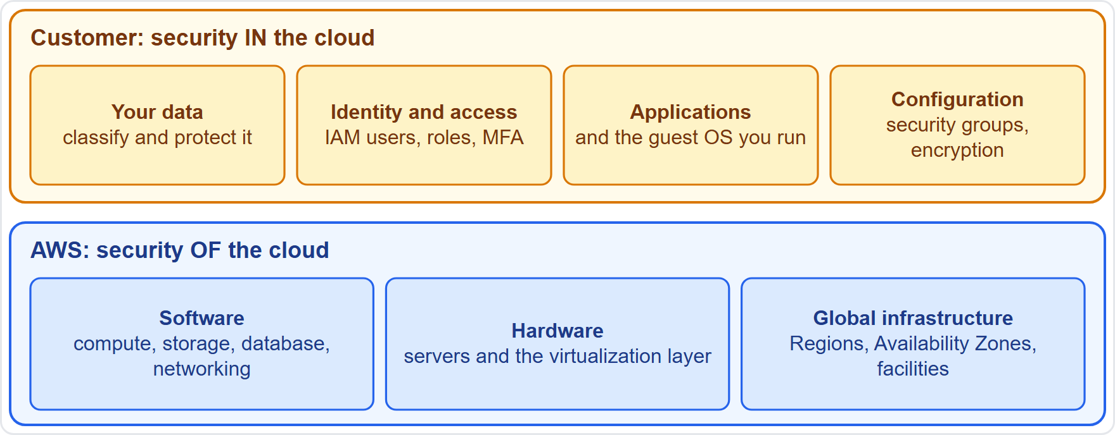
Security of the Cloud, Security in the Cloud
Part 1
Security is a shared responsibility between AWS and the customer
Security of the cloud: AWS protects the infrastructure that runs all AWS services
Security in the cloud: the customer's part, which depends on the services the customer chooses
Customers are also responsible for the sensitivity of their data and the laws that apply to them
EXAM TIP "Of the cloud" is AWS; "in the cloud" is you.
Cloud Practitioner Exam Prep Masterclass | for the AWS CLF-C02 exam
Module 3
4 / 43
Notes:
Security on A W S is a shared responsibility. Look at the two bands. The lower band is security of the cloud: A W S protects the infrastructure that runs all A W S services. The upper band is security in the cloud, and that is the customer's part, which depends on the services the customer chooses. Customers are also responsible for the sensitivity of their data, and for the laws that apply to them. Exam tip: of the cloud is A W S, and in the cloud is you.

Slide 5
What AWS Is Responsible For
Part 1
AWS protects the hardware, software, networking and facilities that run its services
That runs from the host operating system and virtualization layer down to the physical security of the data centers
AWS provides services you can use securely, and independent auditors test its controls
AWS patches its own infrastructure and trains its own employees
EXAM TIP Data center security, hardware and the virtualization layer are always AWS's responsibility.
Cloud Practitioner Exam Prep Masterclass | for the AWS CLF-C02 exam
Module 3
5 / 43
Notes:
What does A W S take care of? It protects the hardware, software, networking and facilities that run its services. That runs from the host operating system and the virtualization layer down to the physical security of the data centers. A W S provides services you can use securely, and independent auditors test its controls. A W S also patches its own infrastructure, and trains its own employees. Exam tip: data center security, hardware and the virtualization layer are always A W S's responsibility.

Slide 6
What You Are Responsible For
Part 1
It typically includes the guest operating system and its patches, installed applications and the security group firewall
Your data: how it is managed, classified and encrypted
Identity and access: who can do what, set with IAM (Module 4)
The more abstracted the service, the less you configure, but your data and access stay yours
Your duties are set by the services you select
EXAM TIP Data, access and the configuration of what you deploy are always yours.
Cloud Practitioner Exam Prep Masterclass | for the AWS CLF-C02 exam
Module 3
6 / 43
Notes:
Now the customer's side. It typically includes the guest operating system and its patches, the applications you install, and the security group firewall configuration. It includes your data: how it is managed, classified and encrypted. And it includes identity and access: who can do what, set with I A M, which Module four covers. The more abstracted the service, the less you configure, but your data and access stay yours. Your duties are set by the services you select. Exam tip: data, access and the configuration of what you deploy are always yours.

Slide 7
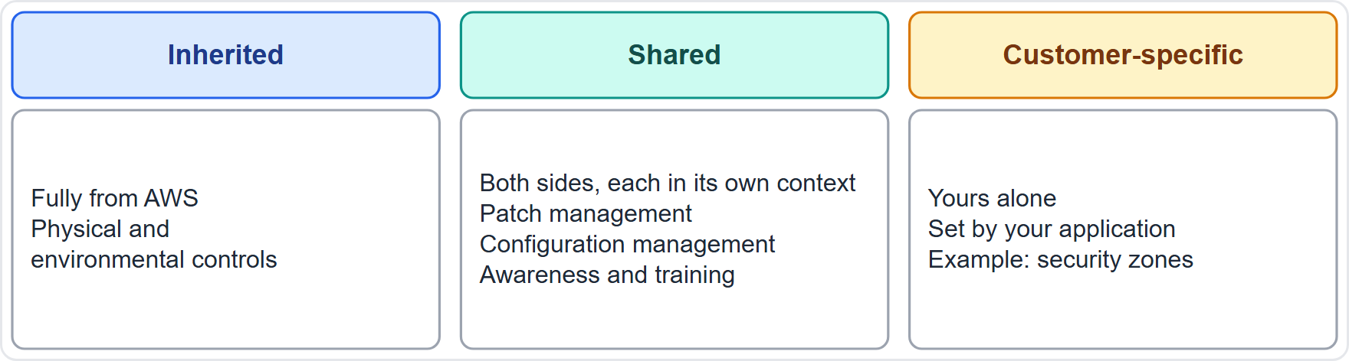
Inherited, Shared and Customer-Specific Controls
Part 1
Inherited controls: you fully inherit them from AWS, such as physical and environmental controls
Shared controls: both sides apply them in their own context: patch management, configuration management, awareness and training
Customer-specific controls: yours alone, set by your application, such as routing data within security zones
EXAM TIP Shared controls to remember: patching, configuration and training.
Cloud Practitioner Exam Prep Masterclass | for the AWS CLF-C02 exam
Module 3
7 / 43
Notes:
A W S describes three kinds of controls. Inherited controls you fully inherit from A W S, such as physical and environmental controls. Shared controls apply to both sides, each in its own context: patch management, configuration management, and awareness and training. A W S patches its infrastructure and you patch what you run; A W S configures its devices and you configure your systems; A W S trains its staff and you train yours. Customer-specific controls are yours alone, set by your application, such as routing data within security zones. Exam tip: the shared controls to remember are patching, configuration and training.

Slide 8
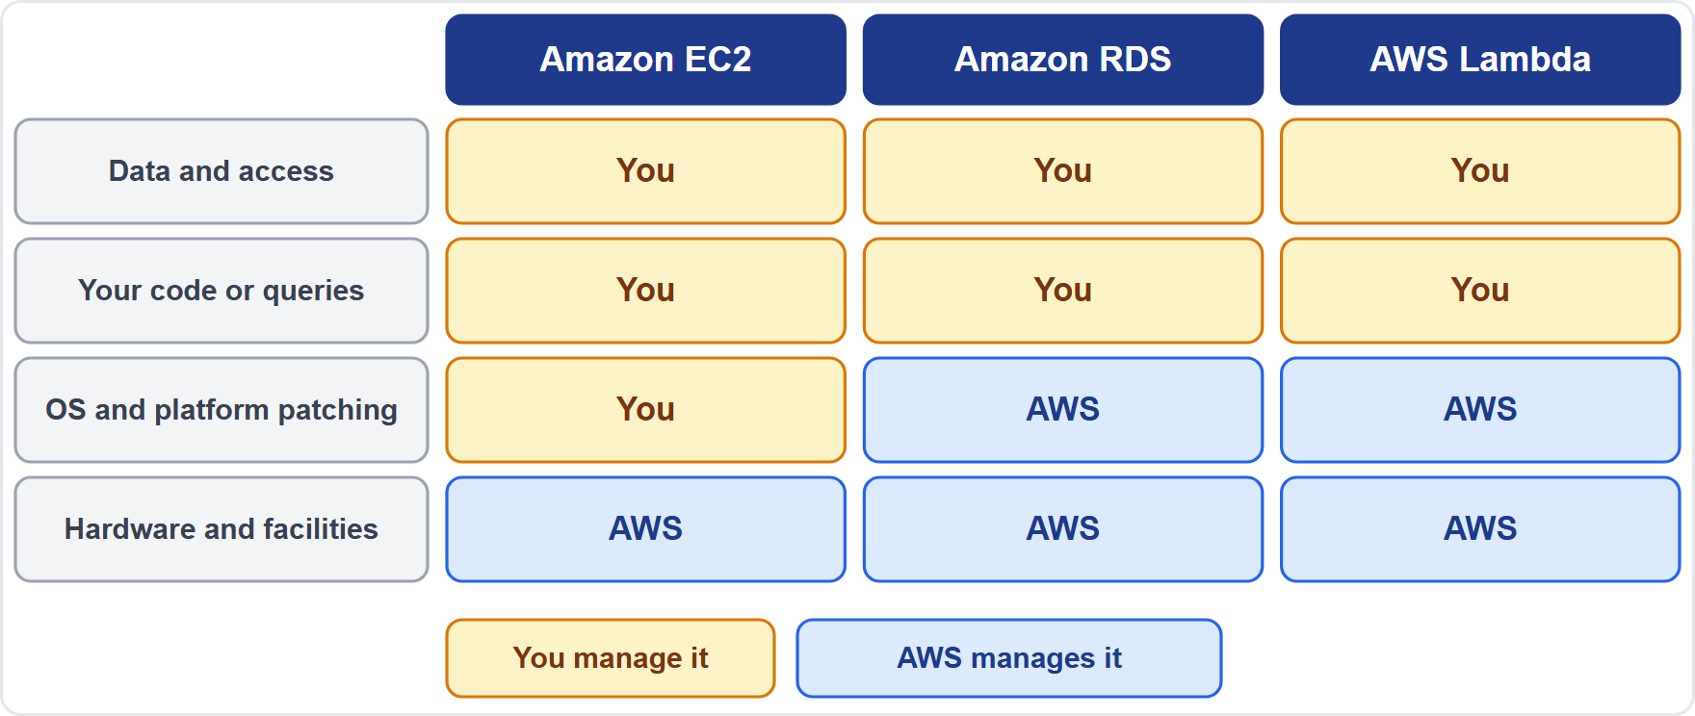
Responsibility Shifts With the Service
Part 1
Amazon EC2: you manage the guest operating system, software and security groups
Amazon RDS: AWS also manages OS and database patching, backups and failover
AWS Lambda: AWS manages servers, patching, capacity and scaling
A managed service moves work to AWS, never your data and access duties
EXAM TIP From EC2 to RDS to Lambda, AWS takes on more of the stack.
Cloud Practitioner Exam Prep Masterclass | for the AWS CLF-C02 exam
Module 3
8 / 43
Notes:
Responsibility is not fixed: it shifts with the service. Look at the three columns. On Amazon E C two, you manage the guest operating system, your software and your security groups. On Amazon R D S, A W S also manages operating system and database patching, backups and failover. On A W S Lambda, A W S manages the servers, patching, capacity and scaling. In every column, the data and access layer stays with the customer. A managed service moves work to A W S, but it never removes your data and access duties. Exam tip: from E C two to R D S to Lambda, A W S takes on more of the stack.

Slide 9
Amazon EC2: Most of the Management Is Yours
Part 1
Amazon EC2 is infrastructure as a service: the customer handles nearly all security configuration and management of the instance
You apply guest operating system updates and security patches
You manage the software and utilities you install, and the security group firewall
AWS manages the hardware layers, so you do not run server hardware
Updating an OS or database by hand can cause user errors and downtime
EXAM TIP Patching the operating system of an EC2 instance is your job, not AWS's.
Cloud Practitioner Exam Prep Masterclass | for the AWS CLF-C02 exam
Module 3
9 / 43
Notes:
Amazon E C two is infrastructure as a service, so the customer handles nearly all security configuration and management of the instance. You apply guest operating system updates and security patches. You manage the software and utilities you install, and the security group firewall. A W S manages the hardware layers, so you do not run server hardware. Be aware that updating an operating system or a database by hand can cause user errors and downtime. Exam tip: patching the operating system of an E C two instance is your job, not A W S's.

Slide 10
Amazon RDS: AWS Runs the Database Platform
Part 1
Task | On premises | Amazon EC2 | Amazon RDS
Application optimization | You | You | You
Database software and OS patching | You | You | AWS
Backups, scaling, high availability | You | You | AWS
Server maintenance, hardware, power | You | AWS | AWS
You still tune queries and control access with IAM and VPC security groups
EXAM TIP On RDS, AWS patches the engine and the OS; you tune the queries and control access.
Cloud Practitioner Exam Prep Masterclass | for the AWS CLF-C02 exam
Module 3
10 / 43
Notes:
Amazon R D S shows the shift clearly. A W S compares four ways of running a database. Application optimization is the customer's job in all three. For database software and operating system patching, on premises and on E C two it is you, but on R D S it is A W S. The same goes for backups, scaling and high availability. For server maintenance, hardware and power, on premises it is you, but on E C two and R D S it is A W S. You still tune queries, and control access with I A M and V P C security groups. Exam tip: on R D S, A W S patches the engine and the O S, and you tune the queries and control access.

Slide 11
AWS Lambda and Other Abstracted Services
Part 1
AWS Lambda runs your code without you provisioning or managing servers
AWS manages server maintenance, capacity, scaling and patching; you provide the code, its permissions and your data
Amazon S3 and DynamoDB: AWS operates the infrastructure, operating system and platform
You use endpoints to store data, and manage your data, encryption options, classification and IAM permissions
Your duties also follow your data and the laws that apply to it
EXAM TIP On abstracted services you give up servers, not responsibility for data and access.
Cloud Practitioner Exam Prep Masterclass | for the AWS CLF-C02 exam
Module 3
11 / 43
Notes:
A W S Lambda runs your code without you provisioning or managing servers. A W S manages server maintenance, capacity, scaling and patching. You provide the code, its permissions and your data. Amazon S three and Dynamo D B are abstracted services too: A W S operates the infrastructure, the operating system and the platform. You use endpoints to store data, and you manage your data, your encryption options, how data is classified, and the I A M permissions. Your duties also follow your data and the laws that apply to it. Exam tip: on abstracted services you give up servers, not responsibility for data and access.

Slide 12
Who Is Responsible?
Part 1
Task | Who
Physical security of the data center | AWS
The hypervisor and host operating system | AWS
Patching the guest OS on an EC2 instance | Customer
Patching the database engine on Amazon RDS | AWS
Setting a security group rule | Customer
Deciding who may read an S3 bucket | Customer
EXAM TIP Ask two questions: is it infrastructure AWS runs, and which service is it on?
Cloud Practitioner Exam Prep Masterclass | for the AWS CLF-C02 exam
Module 3
12 / 43
Notes:
Let us practice. Physical security of the data center is A W S. The hypervisor and host operating system are A W S. Patching the guest operating system on an E C two instance is the customer. Patching the database engine on Amazon R D S is A W S. Setting a security group rule is the customer. And deciding who may read an S three bucket is the customer. Exam tip: ask two questions. Is it infrastructure that A W S runs, and which service is it on?

Slide 13
Common Traps: Shared Responsibility
Part 1
"AWS is responsible for my data" is wrong: you classify, protect and control access to your data
"A managed service means no security work" is wrong: access, data and settings remain yours
Patching is shared, not one-sided: AWS patches its infrastructure, you patch what you run
Responsibility is not fixed: it shifts with the service
Compliance is shared too: AWS has certifications, you follow your laws
EXAM TIP A statement that says AWS handles everything, or that you handle everything, is usually wrong.
Cloud Practitioner Exam Prep Masterclass | for the AWS CLF-C02 exam
Module 3
13 / 43
Notes:
Watch for five traps. A W S is responsible for my data is wrong: you classify, protect and control access to your data. A managed service means no security work is wrong too: access, data and settings remain yours. Patching is shared, not one-sided: A W S patches its infrastructure, and you patch what you run. Responsibility is not fixed, because it shifts with the service. And compliance is shared as well: A W S has certifications, and you follow your own laws. Exam tip: a statement that says A W S handles everything, or that you handle everything, is usually wrong.

Slide 14
AWS Compliance Programs and Your Part
Part 2
AWS compliance programs help customers understand the controls in place at AWS
Three groups: certifications and attestations, laws, regulations and privacy, and alignments and frameworks
Examples: ISO 27001, SOC 1, 2 and 3, PCI DSS (global), HIPAA (US) and GDPR (Europe)
Independent auditors assess many of them
You remain responsible for complying with the laws and rules that apply to your business
EXAM TIP AWS's certifications cover AWS's side; your compliance is still your job.
Cloud Practitioner Exam Prep Masterclass | for the AWS CLF-C02 exam
Module 3
14 / 43
Notes:
A W S compliance programs help customers understand the controls in place at A W S. They fall into three groups: certifications and attestations, laws, regulations and privacy, and alignments and frameworks. Examples include I S O two seven zero zero one, S O C one, two and three, and P C I D S S, which are global; H I P A A in the United States; and G D P R in Europe. Independent auditors assess many of them. But you remain responsible for complying with the laws and rules that apply to your business. Exam tip: A W S's certifications cover A W S's side, and your compliance is still your job.

Slide 15
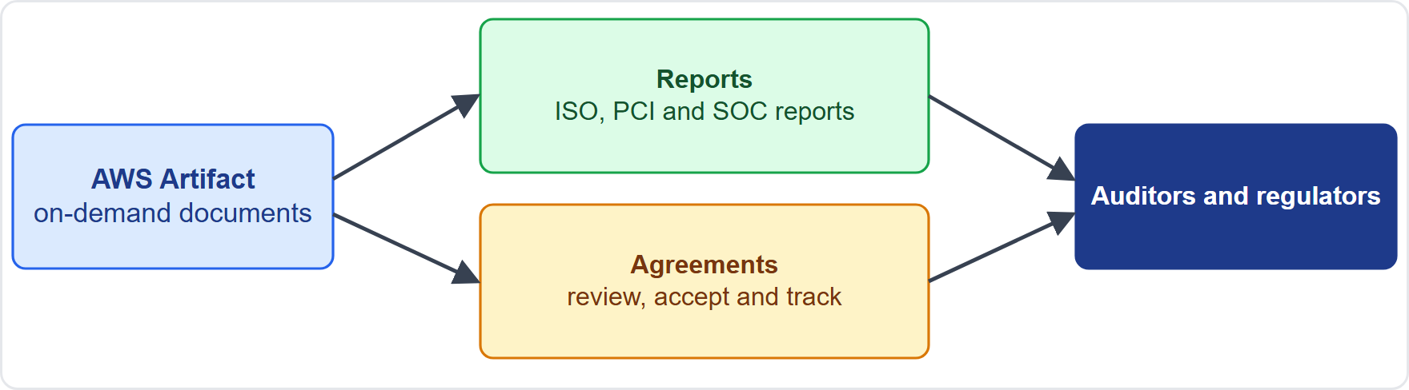
AWS Artifact: Reports and Agreements
Part 2
AWS Artifact gives on-demand downloads of AWS security and compliance documents
Reports: for example ISO, PCI and SOC reports and certifications from accreditation bodies
Agreements: review, accept and track your agreements with AWS, for one account or many accounts in an organization
Give the documents to auditors or regulators as audit artifacts
Documents and agreements are free of charge; you still produce your own evidence
EXAM TIP Where do I find AWS's compliance reports? AWS Artifact.
Cloud Practitioner Exam Prep Masterclass | for the AWS CLF-C02 exam
Module 3
15 / 43
Notes:
A W S Artifact gives on-demand downloads of A W S security and compliance documents. Look at the picture. There are two kinds. Reports include I S O, P C I and S O C reports, and certifications from accreditation bodies. Agreements let you review, accept and track your agreements with A W S, for one account or for many accounts in an organization. You can give the documents to auditors or regulators as audit artifacts. Documents and agreements are free of charge, but you still produce your own evidence. Exam tip: where do I find A W S's compliance reports? A W S Artifact.

Slide 16
Compliance Varies by Location, Industry and Service
Part 2
Needs differ by country and industry: HIPAA for US health data, GDPR for personal data in Europe, PCI DSS for payment cards
AWS publishes AWS Services in Scope by Compliance Program: not every service is in scope for every program
Generally available features are considered in scope unless excluded; a service missing from a list is not forbidden
You decide how a service affects your compliance, based on your data
Check the list for both the program and the service
EXAM TIP Before relying on a service for regulated data, check it is in scope for the program you need.
Cloud Practitioner Exam Prep Masterclass | for the AWS CLF-C02 exam
Module 3
16 / 43
Notes:
Compliance needs differ by country and industry. H I P A A applies to health data in the United States, G D P R to personal data in Europe, and P C I D S S to payment cards. A W S publishes a list called A W S Services in Scope by Compliance Program, and not every service is in scope for every program. Generally available features are considered in scope unless excluded, and a service missing from a list is not forbidden. You decide how a service affects your compliance, based on your data. Exam tip: before relying on a service for regulated data, check it is in scope for the program you need.

Slide 17
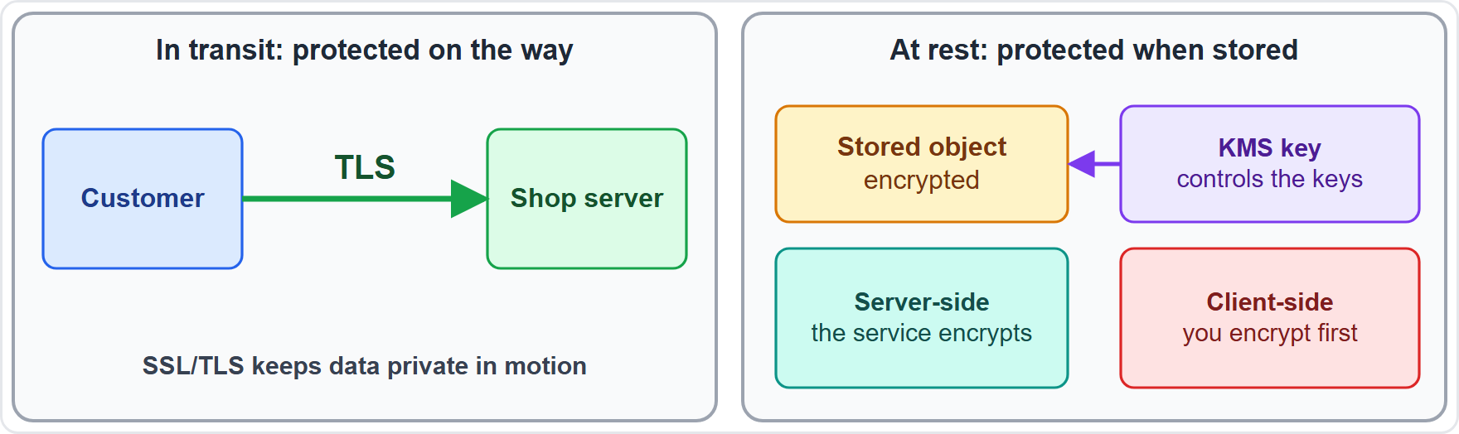
Encryption: In Transit and At Rest
VERIFY LIVE
Part 2
In transit: data is protected as it travels, using SSL/TLS
At rest: stored data is encrypted by the service (server-side) or by you before upload (client-side)
Amazon S3 encrypts every new object at rest by default with SSE-S3, since 5 January 2023; you can choose SSE-KMS, DSSE-KMS or SSE-C
With client-side encryption you manage the process and the keys
As of 4 November 2026: check the S3 documentation for current defaults
EXAM TIP Moving across a network: in transit. Sitting on a disk or in a bucket: at rest.
Cloud Practitioner Exam Prep Masterclass | for the AWS CLF-C02 exam
Module 3
17 / 43
Notes:
Encryption comes in two forms. Encryption in transit protects data as it travels, using S S L or T L S. Encryption at rest protects stored data. It can be server-side, done by the service, or client-side, done by you before you upload. Amazon S three encrypts every new object at rest by default with S S E dash S three, since the fifth of January, twenty twenty-three. You can choose S S E dash K M S, D S S E dash K M S, or S S E dash C. With client-side encryption, you manage the process and the keys. As of the fourth of November, twenty twenty-six, check the S three documentation for current defaults. Exam tip: moving across a network is in transit; sitting on a disk or in a bucket is at rest.

Slide 18
AWS KMS and AWS Certificate Manager
Part 2
AWS Key Management Service (AWS KMS) creates and controls the keys that encrypt and sign your data
KMS keys are protected by hardware security modules and never leave KMS unencrypted; key policies control who may use them
AWS Certificate Manager (ACM) creates, stores and renews SSL/TLS certificates for AWS websites and applications
Certificates managed with ACM have no additional charge; you pay for the resources you run
KMS serves encryption at rest; ACM serves encryption in transit
EXAM TIP Encryption keys: KMS. TLS certificates: ACM.
Cloud Practitioner Exam Prep Masterclass | for the AWS CLF-C02 exam
Module 3
18 / 43
Notes:
Two services support encryption. A W S Key Management Service, K M S, creates and controls the keys that encrypt and sign your data. K M S keys are protected by hardware security modules and never leave K M S unencrypted, and key policies control who may use them. A W S Certificate Manager, A C M, creates, stores and renews S S L and T L S certificates for A W S websites and applications. Certificates managed with A C M carry no additional charge; you pay for the resources you run. K M S serves encryption at rest, and A C M serves encryption in transit. Exam tip: encryption keys, K M S. T L S certificates, A C M.

Slide 19
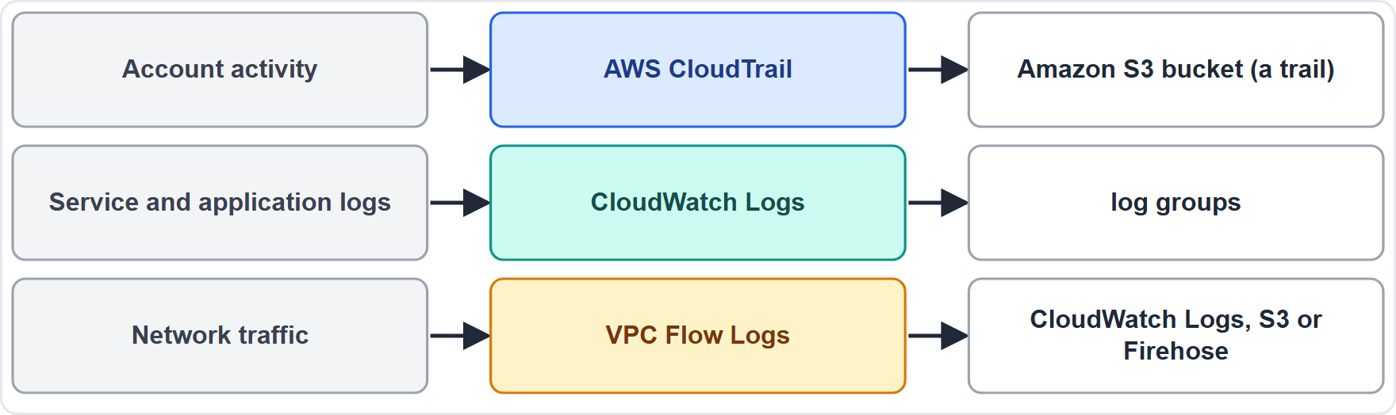
Where to Find Logs
Part 2
AWS CloudTrail records account activity, meaning API (application programming interface) calls: who did what, and when; trails deliver events to an Amazon S3 bucket
Amazon CloudWatch Logs collects logs from AWS services and your applications
VPC Flow Logs capture IP traffic to and from network interfaces and publish to CloudWatch Logs, Amazon S3 or Amazon Data Firehose
EXAM TIP API activity: CloudTrail. Network traffic: VPC Flow Logs. Service and application logs: CloudWatch Logs.
Cloud Practitioner Exam Prep Masterclass | for the AWS CLF-C02 exam
Module 3
19 / 43
Notes:
The exam guide asks where to capture and locate logs. Look at the three sources. A W S CloudTrail records account activity, meaning A P I calls, where A P I stands for application programming interface: who did what, and when, and trails deliver events to an Amazon S three bucket. Amazon CloudWatch Logs collects logs from A W S services and from your applications. And V P C Flow Logs capture I P traffic to and from network interfaces, and publish to CloudWatch Logs, Amazon S three, or Amazon Data Firehose. Exam tip: A P I activity, CloudTrail. Network traffic, V P C Flow Logs. Service and application logs, CloudWatch Logs.

Slide 20
AWS CloudTrail: Who Did What, and When
Part 2
AWS CloudTrail supports auditing, governance and compliance by recording actions of a user, role or AWS service as events
It records actions from the console, the command line interface (CLI), software development kits (SDKs) and APIs
Event history is a viewable, searchable record of the past 90 days of management events in a Region, with no CloudTrail charge to view
Trails and CloudTrail Lake keep events for longer
It shows who acted, on what and when
EXAM TIP Who deleted that resource, and when? CloudTrail.
Cloud Practitioner Exam Prep Masterclass | for the AWS CLF-C02 exam
Module 3
20 / 43
Notes:
A W S CloudTrail supports auditing, governance and compliance. It records the actions of a user, a role or an A W S service as events, including actions from the console, the command line interface, or C L I, software development kits, or S D Ks, and A P Is. Event history is a viewable, searchable record of the past ninety days of management events in a Region, with no CloudTrail charge to view. Trails and CloudTrail Lake keep events for longer. In short, it shows who acted, on what, and when. Exam tip: who deleted that resource, and when? CloudTrail.

Slide 21
Amazon CloudWatch: Metrics, Logs and Alarms
Part 2
Amazon CloudWatch monitors AWS resources and applications in real time
Metrics track performance data, dashboards show it in one place, and alarms watch metrics against thresholds
Alarms can notify you and trigger automated actions
CloudWatch Logs collects, stores and queries logs
Many AWS services send basic metrics for free
EXAM TIP Is it healthy right now, and who should be told if not? CloudWatch.
Cloud Practitioner Exam Prep Masterclass | for the AWS CLF-C02 exam
Module 3
21 / 43
Notes:
Amazon CloudWatch monitors A W S resources and applications in real time. Metrics track performance data, dashboards show it in one place, and alarms watch metrics against thresholds. Alarms can notify you, and they can trigger automated actions. CloudWatch Logs collects, stores and queries logs. And many A W S services send basic metrics for free. Exam tip: is it healthy right now, and who should be told if not? CloudWatch.

Slide 22
AWS Config: What Changed, and Is It Compliant?
Part 2
AWS Config gives a detailed view of resource configuration, how resources relate, and how they changed over time
Config rules check settings and flag noncompliant resources; conformance packs bundle rules
Aggregators give one view across accounts and Regions
Useful for auditing, security analysis and finding the last known good configuration
EXAM TIP What changed, and does it meet our rules? AWS Config.
Cloud Practitioner Exam Prep Masterclass | for the AWS CLF-C02 exam
Module 3
22 / 43
Notes:
A W S Config gives a detailed view of resource configuration, how resources relate, and how they changed over time. Config rules check settings and flag noncompliant resources, and conformance packs bundle rules together. Aggregators give one view across accounts and Regions. It is useful for auditing, for security analysis, and for finding the last known good configuration. Exam tip: what changed, and does it meet our rules? A W S Config.

Slide 23
CloudTrail, CloudWatch or Config?
Part 2
The question | Service
Which user called which API, and when? | AWS CloudTrail
Is CPU high right now? Alert me | Amazon CloudWatch
How was this security group set last month? | AWS Config
Does this resource break our rules? | AWS Config
Keep a record of account activity for auditors | AWS CloudTrail
EXAM TIP Activity is CloudTrail, health is CloudWatch, configuration is Config.
Cloud Practitioner Exam Prep Masterclass | for the AWS CLF-C02 exam
Module 3
23 / 43
Notes:
These three services are easy to mix up. Which user called which A P I, and when? CloudTrail. Is C P U high right now, and alert me? CloudWatch. How was this security group set last month? A W S Config. Does this resource break our rules? A W S Config. And keep a record of account activity for auditors? CloudTrail. Exam tip: activity is CloudTrail, health is CloudWatch, and configuration is Config.

Slide 24
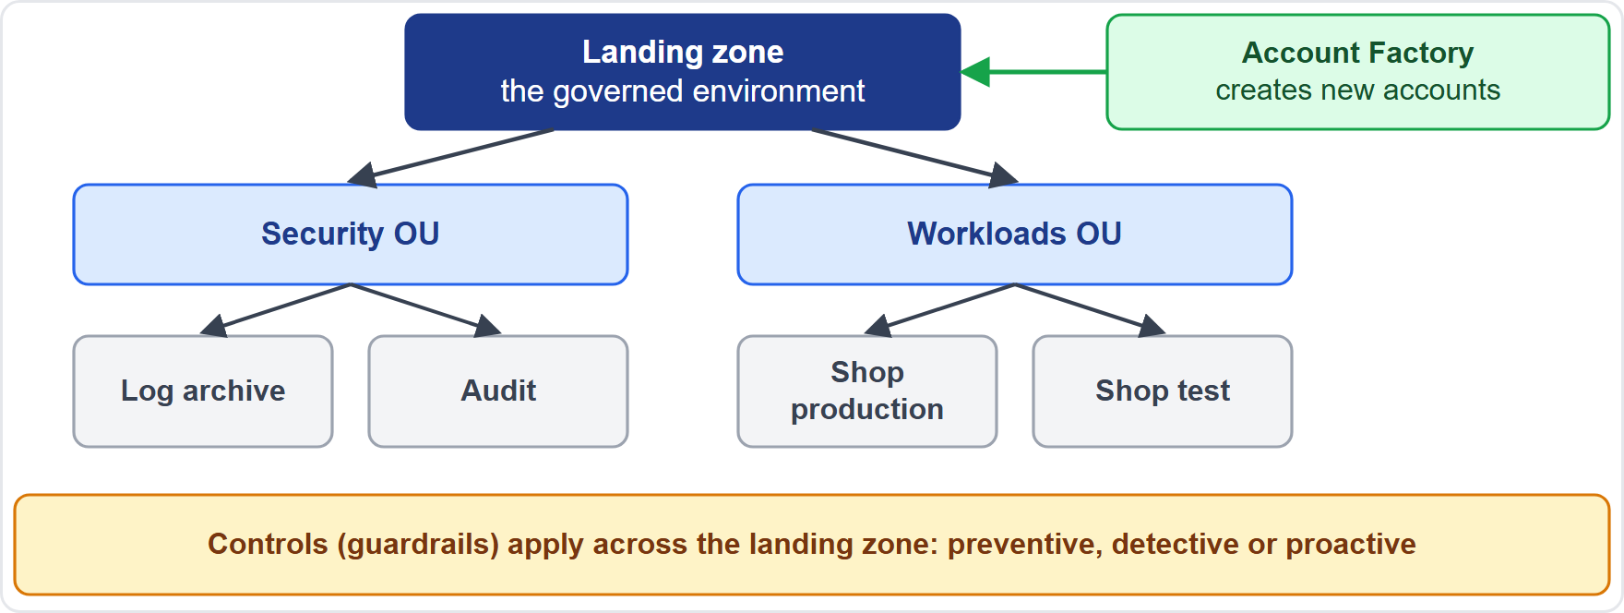
AWS Control Tower: Governing Many Accounts
Part 2
AWS Control Tower sets up and governs a multi-account environment following best practices
It builds a landing zone, orchestrating AWS Organizations, Service Catalog and IAM Identity Center
Controls (guardrails) are high-level rules: preventive, detective or proactive
Account Factory provisions new accounts from approved templates
A dashboard shows accounts, controls and noncompliant resources
EXAM TIP Set up and govern many accounts the same way: AWS Control Tower.
Cloud Practitioner Exam Prep Masterclass | for the AWS CLF-C02 exam
Module 3
24 / 43
Notes:
A W S Control Tower sets up and governs a multi-account environment, following best practices. It builds a landing zone, orchestrating A W S Organizations, Service Catalog and I A M Identity Center. Controls, also called guardrails, are high-level rules: preventive, detective or proactive. Account Factory provisions new accounts from approved templates. And a dashboard shows accounts, controls and noncompliant resources. Exam tip: to set up and govern many accounts the same way, think A W S Control Tower.

Slide 25
Access Reports and Security Services
OLD NAME
Part 2
The IAM credential report lists users and the state of their passwords, access keys and MFA (multi-factor authentication) devices, as a CSV (comma-separated values) file, up to every four hours
Amazon GuardDuty detects threats from sources such as CloudTrail events, VPC flow logs and DNS (Domain Name System) logs
Amazon Inspector scans EC2 instances, container images and Lambda functions for vulnerabilities
AWS Security Hub collects findings and checks standards; the docs now call it Security Hub CSPM
AWS Shield Standard protects against DDoS (distributed denial of service) attacks at no extra charge (Module 5)
EXAM TIP Detect threats: GuardDuty. Scan for vulnerabilities: Inspector. One view of findings: Security Hub.
Cloud Practitioner Exam Prep Masterclass | for the AWS CLF-C02 exam
Module 3
25 / 43
Notes:
A few more tools appear in task statement two point two. The I A M credential report lists users and the state of their passwords, access keys and M F A, or multi-factor authentication, devices, as a C S V, or comma-separated values, file, up to every four hours. Amazon GuardDuty detects threats from sources such as CloudTrail events, V P C flow logs and D N S, or Domain Name System, logs. Amazon Inspector scans E C two instances, container images and Lambda functions for vulnerabilities. A W S Security Hub collects findings and checks standards; the documentation now calls it Security Hub C S P M. And A W S Shield Standard protects against D D O S, or distributed denial of service, attacks at no extra charge. Module five covers these. Exam tip: detect threats, GuardDuty. Scan for vulnerabilities, Inspector.

Slide 26
What the Exam Asks: Responsibility and Governance
Part 2
Of the cloud or in the cloud
Inherited, shared or customer-specific
CloudTrail, CloudWatch or Config
AWS's infrastructure, or your configuration and data
all from AWS, both sides, or yours alone
who did it, how healthy, or what changed
KMS or ACM
Artifact or Config
EC2, RDS or Lambda
keys for data, or certificates for websites
AWS's reports, or your own resource history
how much AWS manages for you
EXAM TIP Name the situation first, then the model or service.
Cloud Practitioner Exam Prep Masterclass | for the AWS CLF-C02 exam
Module 3
26 / 43
Notes:
Here are the look-alike pairs for this module. Of the cloud or in the cloud: A W S's infrastructure, or your configuration and data. Inherited, shared or customer-specific: all from A W S, both sides, or yours alone. CloudTrail, CloudWatch or Config: who did it, how healthy, or what changed. K M S or A C M: keys for data, or certificates for websites. Artifact or Config: A W S's reports, or your own resource history. And E C two, R D S or Lambda: how much A W S manages for you. Exam tip: name the situation first.

Slide 27
Design Check: Tidewater's Security Plan
Part 2
Tidewater's need | Choose
Understand who secures what | Shared responsibility: AWS of the cloud, Tidewater in the cloud
Prove AWS's compliance to the auditor | AWS Artifact reports
Find who deleted a security group | AWS CloudTrail
Alert on high CPU on the web servers | Amazon CloudWatch alarm
Check settings against its rules | AWS Config rules
Encrypt customer data at rest | AWS KMS keys
Cover the right column, answer each row yourself, then compare
Cloud Practitioner Exam Prep Masterclass | for the AWS CLF-C02 exam
Module 3
27 / 43
Notes:
Time to design. Look at Tidewater's six needs, and answer each one yourself before I do. [PAUSE 15] To understand who secures what, use shared responsibility: A W S of the cloud, Tidewater in the cloud. To prove A W S's compliance to the auditor, download A W S Artifact reports. To find who deleted a security group, use CloudTrail. To alert on high C P U, use a CloudWatch alarm. To check settings against its rules, use A W S Config rules. And to encrypt customer data at rest, use A W S K M S keys.

Slide 28
Module Recap
Part 3
1
Shared responsibility
2
Controls
3
Services
inherited from AWS, shared (patching, configuration, training), or customer-specific
EC2 is mostly yours, RDS has AWS manage the platform, Lambda has AWS manage the servers
AWS secures the cloud; you secure what you put in it; responsibility shifts with the service
4
Compliance
5
Encryption
6
Governance
AWS Artifact for AWS's reports and agreements; compliance varies by location, industry and service
TLS in transit, server-side or client-side at rest; KMS for keys, ACM for certificates
CloudTrail for activity, CloudWatch for health, Config for configuration, Control Tower for many accounts
Cloud Practitioner Exam Prep Masterclass | for the AWS CLF-C02 exam
Module 3
28 / 43
Notes:
Let us recap. A W S secures the cloud, you secure what you put in it, and responsibility shifts with the service. Controls are inherited from A W S, shared, such as patching, configuration and training, or customer-specific. E C two is mostly yours, R D S has A W S manage the platform, and Lambda has A W S manage the servers. A W S Artifact provides A W S's reports and agreements, and compliance varies by location, industry and service. Encryption uses T L S in transit, and server-side or client-side encryption at rest, with K M S for keys and A C M for certificates. And for governance: CloudTrail for activity, CloudWatch for health, Config for configuration, and Control Tower for many accounts.

Slide 29
Practice Question 1
Part 3
Q1
Under the shared responsibility model, who is responsible for the physical security of AWS data centers?
A
The customer who stores data in the facility
B
AWS, as part of security of the cloud
C
The customer's chosen colocation partner
D
Each Region's local government office
Cloud Practitioner Exam Prep Masterclass | for the AWS CLF-C02 exam
Module 3
29 / 43
Notes:
Question one. Under the shared responsibility model, who is responsible for the physical security of A W S data centers? The four options are on the screen. [PAUSE 12] The answer is B, A W S, as part of security of the cloud. Customers inherit these controls and do not manage the data centers themselves.

Slide 30
Practice Question 2
Part 3
Q2
Which task is the customer's responsibility for an Amazon EC2 instance?
A
Replacing failed server hardware in the data center
B
Maintaining the hypervisor that runs the instances
C
Providing power and cooling for the facility
D
Applying security patches to the guest operating system
Cloud Practitioner Exam Prep Masterclass | for the AWS CLF-C02 exam
Module 3
30 / 43
Notes:
Question two. Which task is the customer's responsibility for an Amazon E C two instance? The four options are on the screen. [PAUSE 12] The answer is D, applying security patches to the guest operating system. A W S handles the hardware, the virtualization layer and the facility.

Slide 31
Practice Question 3
Part 3
Q3
Tidewater runs its database on Amazon RDS. Which TWO tasks does AWS handle? (Select TWO.)
A
Patching the database engine software
B
Tuning the shop's slow SQL queries
C
Patching the operating system of the database host
D
Deciding who may connect through IAM and security groups
E
Choosing which customer data to store in the database
Cloud Practitioner Exam Prep Masterclass | for the AWS CLF-C02 exam
Module 3
31 / 43
Notes:
Question three. Select two. Tidewater runs its database on Amazon R D S. Which two tasks does A W S handle? The five options are on the screen. [PAUSE 15] The answers are A and C: patching the database engine software, and patching the operating system of the database host. Query tuning, access control and the choice of data remain the customer's responsibility.

Slide 32
Practice Question 4
Part 3
Q4
Tidewater moves a function to AWS Lambda. Which task stays with Tidewater?
A
Writing and securing the function code and its permissions
B
Patching the servers that run the function
C
Provisioning capacity for sudden bursts of traffic
D
Maintaining the operating system of the runtime
Cloud Practitioner Exam Prep Masterclass | for the AWS CLF-C02 exam
Module 3
32 / 43
Notes:
Question four. Tidewater moves a function to A W S Lambda. Which task stays with Tidewater? The four options are on the screen. [PAUSE 12] The answer is A, writing and securing the function code and its permissions. Lambda manages servers, capacity, scaling and patching.

Slide 33
Practice Question 5
Part 3
Q5
Which term describes controls that a customer fully inherits from AWS, such as physical and environmental controls?
A
Customer-specific controls
B
Shared controls
C
Inherited controls
D
Compensating controls
Cloud Practitioner Exam Prep Masterclass | for the AWS CLF-C02 exam
Module 3
33 / 43
Notes:
Question five. Which term describes controls that a customer fully inherits from A W S, such as physical and environmental controls? The four options are on the screen. [PAUSE 12] The answer is C, inherited controls. Shared controls apply to both sides, and customer-specific controls are solely the customer's.

Slide 34
Practice Question 6
Part 3
Q6
Which is an example of a shared control?
A
Physical access to the data centers
B
Patch management
C
Routing data within a customer's own security zones
D
The hardware lifecycle of the host servers
Cloud Practitioner Exam Prep Masterclass | for the AWS CLF-C02 exam
Module 3
34 / 43
Notes:
Question six. Which is an example of a shared control? The four options are on the screen. [PAUSE 12] The answer is B, patch management. A W S patches its infrastructure, and the customer patches what it runs. Physical access and hardware lifecycle are A W S's, and security zone routing is customer-specific.

Slide 35
Practice Question 7
Part 3
Q7
Tidewater stores customer photos in Amazon S3. Which responsibility belongs to Tidewater?
A
Operating and maintaining the infrastructure that provides S3 storage
B
Patching the operating systems of the servers behind S3
C
Choosing who may access the photos and which encryption options to use
D
Replacing failed storage hardware in the data centers
Cloud Practitioner Exam Prep Masterclass | for the AWS CLF-C02 exam
Module 3
35 / 43
Notes:
Question seven. Tidewater stores customer photos in Amazon S three. Which responsibility belongs to Tidewater? The four options are on the screen. [PAUSE 12] The answer is C, choosing who may access the photos and which encryption options to use. On an abstracted service such as S three, A W S runs the infrastructure and platform.

Slide 36
Practice Question 8
Part 3
Q8
Which TWO describe AWS Artifact? (Select TWO.)
A
It provides on-demand downloads of AWS compliance reports
B
It records every API call made in an account
C
It lets you review and accept agreements with AWS
D
It detects threats by analyzing network logs
E
It creates the keys used to encrypt data
Cloud Practitioner Exam Prep Masterclass | for the AWS CLF-C02 exam
Module 3
36 / 43
Notes:
Question eight. Select two. Which two describe A W S Artifact? The five options are on the screen. [PAUSE 15] The answers are A and C: it provides on-demand downloads of compliance reports, and lets you review and accept agreements with A W S. CloudTrail records A P I calls, GuardDuty detects threats, and K M S manages keys.

Slide 37
Practice Question 9
Part 3
Q9
Tidewater's auditor asks for AWS's SOC report. Where can Tidewater download it?
A
AWS Artifact
B
AWS Config
C
Amazon CloudWatch
D
AWS Control Tower
Cloud Practitioner Exam Prep Masterclass | for the AWS CLF-C02 exam
Module 3
37 / 43
Notes:
Question nine. Tidewater's auditor asks for A W S's S O C report. Where can Tidewater download it? The four options are on the screen. [PAUSE 12] The answer is A, A W S Artifact. It provides on-demand downloads of A W S compliance reports such as S O C, I S O and P C I.

Slide 38
Practice Question 10
Part 3
Q10
Tidewater needs to learn which user deleted a security group yesterday. Which service records this?
A
Amazon CloudWatch alarms
B
AWS Config rules
C
AWS CloudTrail
D
AWS Key Management Service
Cloud Practitioner Exam Prep Masterclass | for the AWS CLF-C02 exam
Module 3
38 / 43
Notes:
Question ten. Tidewater needs to learn which user deleted a security group yesterday. Which service records this? The four options are on the screen. [PAUSE 12] The answer is C, A W S CloudTrail. It records account activity, showing who took which action and when.

Slide 39
Practice Question 11
Part 3
Q11
Which service records how a resource was configured in the past and flags settings that break your rules?
A
AWS CloudTrail
B
AWS Config
C
Amazon CloudWatch Logs
D
AWS Artifact
Cloud Practitioner Exam Prep Masterclass | for the AWS CLF-C02 exam
Module 3
39 / 43
Notes:
Question eleven. Which service records how a resource was configured in the past and flags settings that break your rules? The four options are on the screen. [PAUSE 12] The answer is B, A W S Config. It keeps resource configuration history and evaluates it against rules.

Slide 40
Practice Question 12
Part 3
Q12
Which statement about AWS KMS is correct?
A
It issues SSL/TLS certificates for websites and renews them automatically
B
It records the API activity of every user in the account
C
It routes network traffic between virtual private clouds
D
It creates and controls the keys used to encrypt and sign data
Cloud Practitioner Exam Prep Masterclass | for the AWS CLF-C02 exam
Module 3
40 / 43
Notes:
Question twelve. Which statement about A W S K M S is correct? The four options are on the screen. [PAUSE 12] The answer is D: it creates and controls the keys used to encrypt and sign data. Certificates are managed by A W S Certificate Manager, and A P I activity by CloudTrail.

Slide 41
Practice Question 13
Part 3
Q13
Tidewater wants customer data protected in transit and at rest. Which TWO actions fit? (Select TWO.)
A
Use TLS for connections between customers and the shop
B
Turn off all logging to reduce the amount of stored data
C
Encrypt stored data with keys managed in AWS KMS
D
Share the root user password with the auditors
E
Keep card numbers in plain text so lookups stay fast
Cloud Practitioner Exam Prep Masterclass | for the AWS CLF-C02 exam
Module 3
41 / 43
Notes:
Question thirteen. Select two. Tidewater wants customer data protected in transit and at rest. Which two actions fit? The five options are on the screen. [PAUSE 15] The answers are A and C: T L S for connections, and encryption with K M S keys for stored data. Turning off logging, sharing the root password, and storing plain text all weaken security.

Slide 42
Practice Question 14
Part 3
Q14
Tidewater is adding many AWS accounts and wants standard account setup with guardrails. Which service helps?
A
AWS Control Tower
B
AWS Artifact
C
Amazon Inspector
D
AWS Certificate Manager
Cloud Practitioner Exam Prep Masterclass | for the AWS CLF-C02 exam
Module 3
42 / 43
Notes:
Question fourteen. Tidewater is adding many A W S accounts and wants standard account setup with guardrails. Which service helps? The four options are on the screen. [PAUSE 12] The answer is A, A W S Control Tower. It sets up and governs a multi-account environment with controls and Account Factory.

Slide 43
Answers at a Glance
Part 3
Question | Answer | Why
Q1 | B | Physical security is security of the cloud
Q2 | D | The customer patches the guest OS on EC2
Q3 | A, C | On RDS, AWS patches the engine and the OS
Q4 | A | The customer keeps the code and permissions
Q5 | C | Inherited controls come entirely from AWS
Q6 | B | Patch management is a shared control
Q7 | C | The customer manages access and encryption options
Q8 | A, C | Artifact offers reports and agreements
Q9 | A | AWS Artifact holds the SOC report
Q10 | C | CloudTrail shows who did what
Q11 | B | AWS Config keeps configuration history
Q12 | D | KMS creates and controls keys
Q13 | A, C | TLS in transit and KMS at rest
Q14 | A | Control Tower governs many accounts
Cloud Practitioner Exam Prep Masterclass | for the AWS CLF-C02 exam
Module 3
43 / 43
Notes:
Here are all fourteen answers. Question one: B. Question two: D. Question three: A and C. Question four: A. Question five: C. Question six: B. Question seven: C. Question eight: A and C. Question nine: A. Question ten: C. Question eleven: B. Question twelve: D. Question thirteen: A and C. Question fourteen: A. That completes Module three. Next, Module four covers identity and access management.

