Slide 1
Module 4: Identity and Access Management
Who may do what in an AWS account, and how they prove it
Domain 2 · Security and Compliance · Task statement 2.3
Cloud Practitioner Exam Prep Masterclass
Module 4 · Part 1
Notes:
Welcome to Module four: Identity and Access Management. This module covers the second domain of the exam, Security and Compliance, and task statement two point three. You will learn who can do what in an A W S account, and how each person or program proves who it is. It is one of the most heavily tested topics in the whole domain.

Slide 2
What You Will Learn
Part 1
Explain why the root user needs special care and name the tasks only it can do
Tell IAM users, groups and roles apart and say when each one fits
Read the parts of an IAM policy and apply least privilege
Choose among passwords, access keys, multi-factor authentication (MFA) and temporary credentials
Match Secrets Manager, Parameter Store, IAM Identity Center, Amazon Cognito and AWS Directory Service to the need
Cloud Practitioner Exam Prep Masterclass | for the AWS CLF-C02 exam
Module 4: Identity and Access Management
2 / 33
Notes:
By the end of this module you will be able to do five things. Explain why the root user needs special care, and name the tasks only it can do. Tell I A M users, groups and roles apart, and say when each one fits. Read the parts of an I A M policy and apply least privilege. Choose among passwords, access keys, multi-factor authentication, and temporary credentials. And match Secrets Manager, Parameter Store, I A M Identity Center, Amazon Cognito and Directory Service to the need.

Slide 3
Case Check-In: Tidewater's First AWS Account
Part 1
CASE CHECK-IN · Tidewater Outfitters
Tidewater Outfitters has just opened its first AWS account, using the founder's email address
Five staff need the console, and a contractor must read one bucket of product photos
The shop's web servers read product images from storage, and a developer keeps keys in a shared file
Soon customers will sign in to a mobile app and upload photos of their gear
Your job: give each of them the right access, and nothing more
Cloud Practitioner Exam Prep Masterclass | for the AWS CLF-C02 exam
Module 4: Identity and Access Management
3 / 33
Notes:
Meet Tidewater Outfitters, a fictional online shop for outdoor gear. It has just opened its first A W S account, using the founder's email address. Five staff need the console, and a contractor must read one bucket of product photos. The web servers read product images from storage, and one developer keeps keys in a shared file. Soon customers will sign in to a mobile app and upload photos of their gear. Your job is to give each of them the right access, and nothing more.

Slide 4
Authentication and Authorization: Two Questions
Part 1
Authentication answers "who are you?": a password, a code from a device or a key proves it
Authorization answers "what may you do?": permissions written in policies decide
A principal is an identity that can send a request: the root user, an IAM user or an IAM role
AWS Identity and Access Management (IAM) controls both, and adds no charge of its own
IAM changes are eventually consistent: a new user or policy can take a moment to take effect
EXAM TIP "Who is signing in?" is authentication; "what is allowed?" is authorization.
Cloud Practitioner Exam Prep Masterclass | for the AWS CLF-C02 exam
Module 4: Identity and Access Management
4 / 33
Notes:
Access control starts with two different questions. Authentication asks, who are you? A password, a code from a device, or a key proves it. Authorization asks, what may you do? Permissions written in policies decide that. A principal is any identity that can send a request: the root user, an I A M user, or an I A M role. A W S Identity and Access Management, called I A M, controls both, and it adds no charge of its own. One more detail: I A M changes are eventually consistent, so a new user or policy can take a moment to take effect. Exam tip: who is signing in is authentication; what is allowed is authorization.

Slide 5
The Root User: All Power, Few Uses
Part 1
Every account begins with one sign-in identity, the root user, with complete access to every service and resource
You sign in with the email address and password used to create the account
You cannot attach identity-based policies to the root user or set a permissions boundary for it
In an AWS Organizations member account, the root user is still limited by service control policies
Use it only for the few tasks that need it
EXAM TIP The root user is not an IAM user, and everyday work should never be done with it.
Cloud Practitioner Exam Prep Masterclass | for the AWS CLF-C02 exam
Module 4: Identity and Access Management
5 / 33
Notes:
Every A W S account begins with a single sign-in identity, the root user. It has complete access to every service and resource in the account. You sign in with the email address and password that were used to create the account. Notice two limits on what you can do about it. You cannot attach identity-based policies to the root user, and you cannot set a permissions boundary for it. In an A W S Organizations member account, service control policies still apply to it. The rule is simple: use the root user only for the few tasks that need it. Exam tip: the root user is not an I A M user, and everyday work should never be done with it.

Slide 6
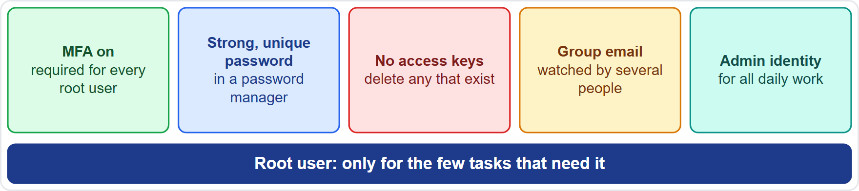
Protecting the Root User: Habits That Matter
Part 1
Turn on MFA: AWS requires it for every root user, so register a device at first sign-in or within the grace period (14 days)
Use a strong, unique password, kept in a password manager
Do not create access keys for the root user; delete any that exist
Use a group email address that several people watch, not one person's inbox
Create an administrative identity for daily work; in AWS Organizations, remove root credentials from member accounts
EXAM TIP For "how do you protect the root user?", think MFA, no access keys and no daily use.
Cloud Practitioner Exam Prep Masterclass | for the AWS CLF-C02 exam
Module 4: Identity and Access Management
6 / 33
Notes:
Five habits protect the root user. First, turn on multi-factor authentication. A W S requires it for every root user, so register a device at first sign-in or within the fourteen-day grace period. Second, use a strong, unique password, kept in a password manager. Third, do not create access keys for the root user, and delete any that exist. Fourth, use a group email address that several people watch, not one person's inbox, so a message from A W S is never stuck with someone on holiday. Fifth, create an administrative identity for daily work. In A W S Organizations, you can also remove root credentials from member accounts. Exam tip: think M F A, no access keys, and no daily use.

Slide 7
Tasks Only the Root User Can Do
VERIFY LIVE
Part 1
Group | Tasks that need root credentials
The account itself | change a standalone account's settings (email, root password, root access keys); close or reopen it; restore permissions after an administrator lock-out
Billing | activate IAM access to the Billing and Cost Management console; some billing tasks and tax invoices
Storage and queues | enable MFA delete on an S3 bucket; fix a policy that locks everyone out
Other | register as a Reserved Instance Marketplace seller; sign up for AWS GovCloud (US); recover an unmanageable AWS KMS key
Older study lists also name changing the Support plan; the current IAM page does not
As of 4 November 2026: check the IAM page "Tasks that require root user credentials"
EXAM TIP Account-level tasks and lock-outs need the root user; creating users or launching instances does not.
Cloud Practitioner Exam Prep Masterclass | for the AWS CLF-C02 exam
Module 4: Identity and Access Management
7 / 33
Notes:
A short list of tasks needs root credentials. About the account itself: changing a standalone account's settings, such as its email address, closing or reopening it, and restoring permissions after an administrator lock-out. In billing: activating I A M access to the Billing and Cost Management console, plus some billing tasks and tax invoices. For storage and queues: enabling M F A delete on an S three bucket, and fixing a policy that locks everyone out. And a few others: registering as a Reserved Instance Marketplace seller, signing up for A W S GovCloud, and recovering a key that K M S can no longer manage. Older study lists also name changing the Support plan; the current page does not. As of the fourth of November, twenty twenty-six, check the I A M page for the live list. Exam tip: account-level tasks and lock-outs need the root user; creating users or launching instances does not.

Slide 8
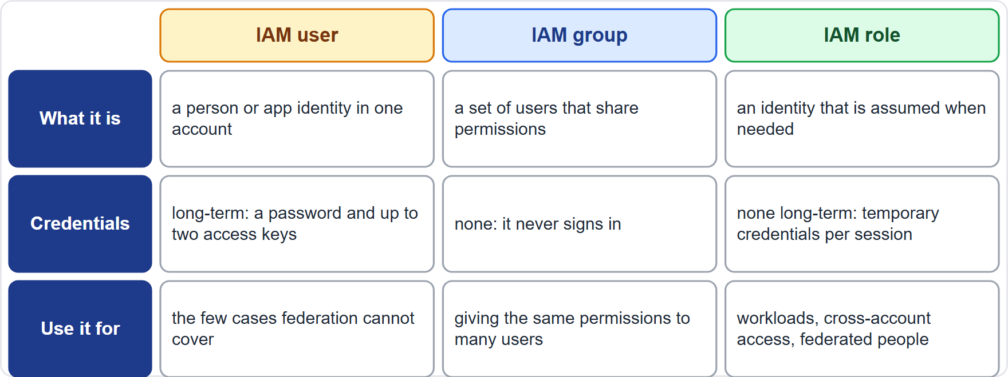
IAM Users, Groups and Roles
Part 1
An IAM user is an identity with long-term credentials: a password and up to two access keys
An IAM group is a set of users that share permissions; it is not something that signs in
An IAM role has no long-term credentials: whoever assumes it receives temporary credentials
Use IAM users only where federation or roles cannot be used, such as certain third-party tools
EXAM TIP Long-term credentials mean a user; temporary credentials mean a role.
Cloud Practitioner Exam Prep Masterclass | for the AWS CLF-C02 exam
Module 4: Identity and Access Management
8 / 33
Notes:
Three identity building blocks come up again and again. An I A M user is an identity with long-term credentials: a password, and up to two access keys. An I A M group is a set of users that share permissions. A group is not something that signs in. An I A M role has no long-term credentials at all. Whoever assumes the role receives temporary credentials for that session. Use I A M users only where federation or roles cannot be used, such as certain third-party tools. Exam tip: long-term credentials mean a user; temporary credentials mean a role.

Slide 9
IAM Groups: One Place for Shared Permissions
Part 1
Attach an identity-based policy to a group, and every user in it receives the permissions
A group can hold many users, and a user can belong to several groups
Groups cannot be nested: they hold users only, never other groups
There is no default group that contains every user; you create one and add users yourself
A group cannot be a principal in a policy, because groups carry permissions, not sign-in identity
Tidewater tip: when someone changes jobs, move them between groups instead of editing their permissions
EXAM TIP Groups simplify permissions for users; they do not sign in and cannot contain groups.
Cloud Practitioner Exam Prep Masterclass | for the AWS CLF-C02 exam
Module 4: Identity and Access Management
9 / 33
Notes:
Groups make permissions easier to manage. Attach an identity-based policy to a group, and every user in it receives those permissions. A group can hold many users, and one user can belong to several groups. Groups cannot be nested: they contain users only, never other groups. There is no default group that contains every user, so you create one and add users yourself. A group also cannot be a principal in a policy, because it carries permissions, not a sign-in identity. A practical tip for Tidewater: when someone changes jobs, move them between groups instead of editing their permissions. Exam tip: groups simplify permissions for users; they do not sign in and cannot contain groups.

Slide 10
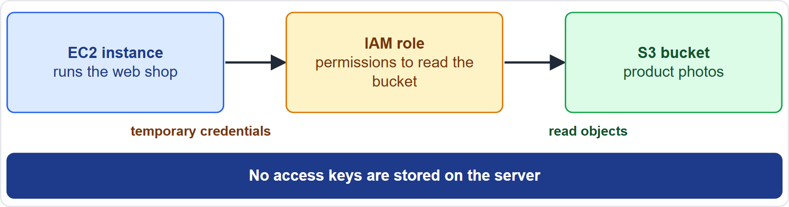
IAM Roles and Temporary Credentials
Part 1
A role is an identity with permissions, meant to be assumed by anyone or anything that needs it
Assuming a role returns temporary security credentials for that session
Who can assume a role: IAM users, other roles, AWS services such as Amazon EC2 and AWS Lambda, and federated people
AWS delivers the role's credentials to the instance or function, so no keys are stored
Some services create service-linked roles, tied to that service, which assumes them for you
EXAM TIP For an application on AWS that needs access, the answer is a role, not stored keys.
Cloud Practitioner Exam Prep Masterclass | for the AWS CLF-C02 exam
Module 4: Identity and Access Management
10 / 33
Notes:
A role is an identity with permissions that is meant to be assumed by anyone or anything that needs it. Assuming a role returns temporary security credentials for that session. Who can assume one? I A M users, other roles, A W S services such as Amazon E C two and Lambda, and federated people. Look at the picture. An E C two instance has a role attached. A W S delivers that role's temporary credentials to the instance, and the instance reads the S three bucket. No keys are stored anywhere. Some services also create service-linked roles, tied to that service, which assumes them for you. Exam tip: for an application running on A W S that needs access, the answer is a role, not stored keys.

Slide 11
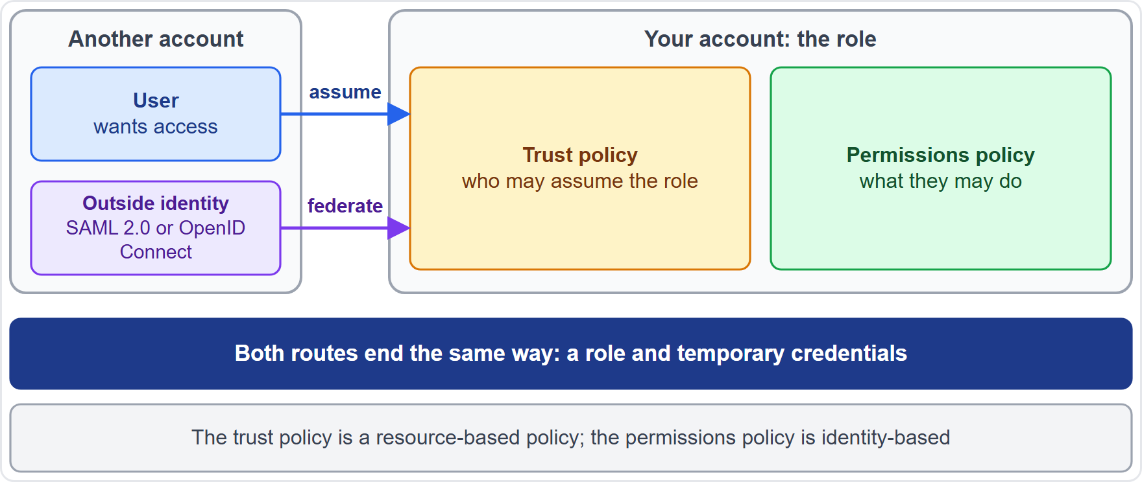
Cross-Account Access and Federation
Part 1
A role in your account can be assumed by a user in another account, which is how access is shared across accounts
Two policies work together: the trust policy says who may assume the role, and the permissions policy says what they may do
Federation lets people use an identity from an outside provider (SAML 2.0, the Security Assertion Markup Language, or OpenID Connect) and receive a role with temporary credentials
AWS recommends federation for human users, so people do not need long-term IAM users
EXAM TIP Cross-account access and federation both end the same way: a role and temporary credentials.
Cloud Practitioner Exam Prep Masterclass | for the AWS CLF-C02 exam
Module 4: Identity and Access Management
11 / 33
Notes:
Roles are also how access crosses account boundaries. A role in your account can be assumed by a user in another account. Two policies work together. The trust policy says who may assume the role. The permissions policy says what they may do once they have. Federation works in a similar way. People use an identity from an outside provider, using S A M L two point zero, which is the Security Assertion Markup Language, or Open I D Connect, and they receive a role with temporary credentials. A W S recommends federation for human users, so people do not need long-term I A M users. Exam tip: cross-account access and federation both end the same way, with a role and temporary credentials.

Slide 12
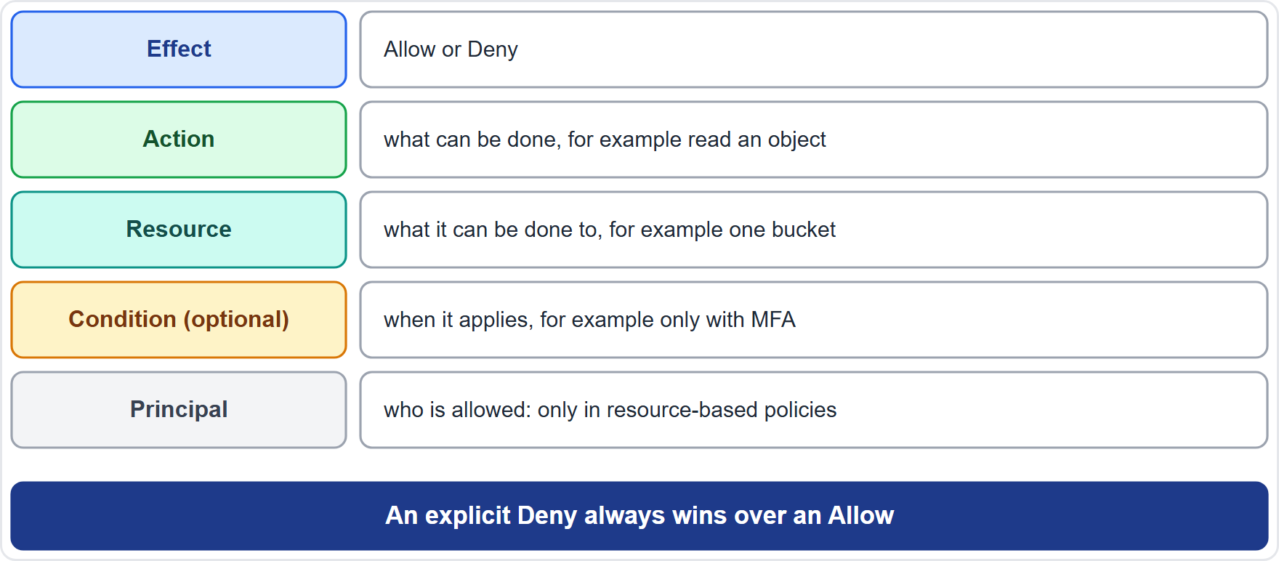
Reading an IAM Policy
Part 1
A policy is a document (usually JSON) made of one or more statements
Effect: Allow or Deny
Action: what can be done, such as reading an object
Resource: what it can be done to, such as one bucket
Condition (optional): when it applies, such as only with MFA or only over TLS
Principal: who is allowed, shown only in resource-based policies
An explicit Deny always wins over an Allow
EXAM TIP You do not need to write JSON, but you do need to know what Effect, Action, Resource and Condition do.
Cloud Practitioner Exam Prep Masterclass | for the AWS CLF-C02 exam
Module 4: Identity and Access Management
12 / 33
Notes:
A policy is a document, usually written in J S O N, made of one or more statements. Each statement has an Effect, which is Allow or Deny. It names the Actions, which say what can be done, such as reading an object. It names the Resources, which say what it can be done to, such as one bucket. And it may have a Condition, which says when it applies, for example only with M F A, or only over T L S. A resource-based policy also names a Principal, who is allowed. An identity-based policy does not, because the principal is the identity it is attached to. One rule to remember: an explicit Deny always wins over an Allow. Exam tip: you do not need to write J S O N, but you do need to know what these parts do.

Slide 13
Policy Types: Identity-Based and Resource-Based
Part 1
Type | Attached to | Notes
Identity-based | a user, group or role | AWS managed (created by AWS), customer managed (created by you), or inline (one identity only)
Resource-based | a resource | Names the principal; examples: an Amazon S3 bucket policy and a role's trust policy
AWS managed policies are a good start but are written for everyone, so they may grant more than you need
Customer managed policies give precise control and can be reused across identities
Inline policies live and die with one identity
EXAM TIP A policy on a bucket that names who may read it is resource-based.
Cloud Practitioner Exam Prep Masterclass | for the AWS CLF-C02 exam
Module 4: Identity and Access Management
13 / 33
Notes:
Two policy types do the granting. Identity-based policies attach to a user, a group or a role. They come in three kinds: A W S managed policies, which A W S creates; customer managed policies, which you create; and inline policies, which belong to one identity only. Resource-based policies attach to a resource and name the principal. Examples are an Amazon S three bucket policy and a role's trust policy. A W S managed policies are a good start, but they are written for everyone, so they may grant more than you need. Customer managed policies give precise control and can be reused. Exam tip: a policy on a bucket that names who may read it is resource-based.

Slide 14
Guardrails Limit; Policies Grant
BEYOND THE GUIDE
Part 1
A permissions boundary sets the maximum an identity-based policy can give one user or role
A service control policy (SCP) in AWS Organizations sets the maximum for accounts, including each account's root user
Neither one grants anything: an identity or resource policy must still allow the action
When policies conflict, an explicit Deny in any of them overrides every Allow
Tidewater tip: think of guardrails as the fence and policies as the gates inside it
EXAM TIP If a question says the policy "limits" or "caps" permissions, it is a boundary or an SCP, not a grant.
Cloud Practitioner Exam Prep Masterclass | for the AWS CLF-C02 exam
Module 4: Identity and Access Management
14 / 33
Notes:
This slide goes beyond the exam guide, but it explains a common trap. A permissions boundary sets the maximum that an identity-based policy can give to one user or role. A service control policy in A W S Organizations sets the maximum for whole accounts, including each account's root user. Neither one grants anything. An identity policy or a resource policy must still allow the action. And when policies conflict, an explicit Deny in any of them overrides every Allow. For Tidewater, think of guardrails as the fence, and policies as the gates inside it. Exam tip: if a policy limits or caps permissions, it is a boundary or a service control policy, not a grant.

Slide 15
Least Privilege in Practice
Part 1
Least privilege means giving only the permissions a task needs, on the resources it needs, under the conditions that fit
Start with an AWS managed policy if you must, then narrow it with a customer managed policy
IAM Access Analyzer can generate a policy from the activity recorded in AWS CloudTrail
Last accessed information shows permissions that are never used, so you can remove them
Review and remove unused users, roles, permissions and credentials regularly
Add conditions, for example to require MFA or TLS
EXAM TIP When two answers both work, choose the one that grants fewer permissions.
Cloud Practitioner Exam Prep Masterclass | for the AWS CLF-C02 exam
Module 4: Identity and Access Management
15 / 33
Notes:
Least privilege means giving only the permissions a task needs, on the resources it needs, under the conditions that fit. In practice, you may start with an A W S managed policy, then narrow it with a customer managed policy. I A M Access Analyzer can generate a policy from the activity recorded in A W S CloudTrail. Last accessed information shows permissions that are never used, so you can remove them. Review and remove unused users, roles, permissions and credentials on a regular schedule. And add conditions, for example to require M F A or T L S. Exam tip: when two answers both work, choose the one that grants fewer permissions.

Slide 16
Passwords and Access Keys
VERIFY LIVE
Part 1
Default password policy: 8 to 128 characters, three of four character types, not the account name or email; passwords never expire
Custom policy: length 6 to 128, expiry 1 to 1,095 days, reuse prevention of 1 to 24 passwords
It does not cover the root user or access keys, and there is no lockout setting
Access keys are an ID plus a secret; a user can have two; the secret shows only at creation
Never put keys in code, and never create them for the root user
As of 4 November 2026: values are from the IAM User Guide
EXAM TIP Prefer roles to keys; if keys must exist, rotate them and delete the unused ones.
Cloud Practitioner Exam Prep Masterclass | for the AWS CLF-C02 exam
Module 4: Identity and Access Management
16 / 33
Notes:
Now the credentials themselves. The default password policy requires between eight and one hundred twenty-eight characters, three of the four character types, and no match with the account name or email address. Passwords never expire by default. A custom policy can set a minimum length from six to one hundred twenty-eight, an expiry from one to one thousand ninety-five days, and prevent reuse of one to twenty-four passwords. The policy does not cover the root user or access keys, and there is no lockout setting. Access keys are an I D plus a secret, a user can have two, and the secret is shown only when you create the key. Never put keys in code, and never create them for the root user. As of the fourth of November, twenty twenty-six, these values come from the I A M User Guide. Exam tip: prefer roles to keys.

Slide 17
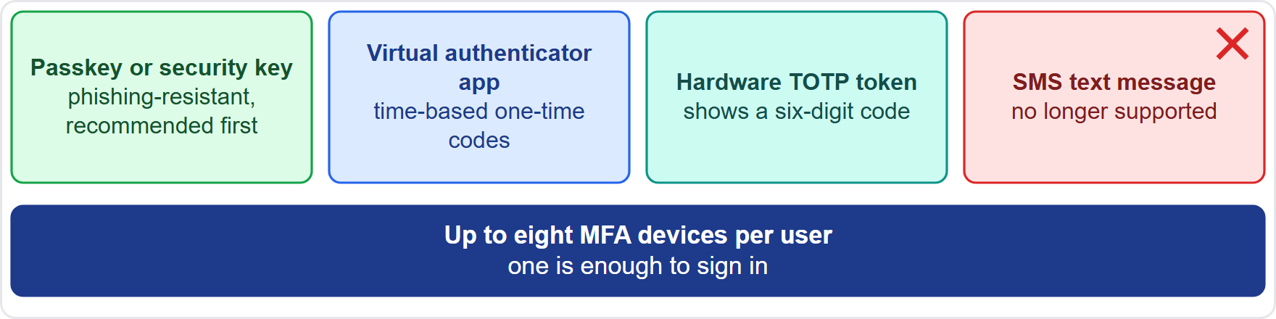
Multi-Factor Authentication
VERIFY LIVE
Part 2
MFA adds a second factor to the sign-in: something you have, in addition to the password
Passkeys and security keys use public key cryptography and resist phishing; AWS recommends them first
Virtual authenticator apps on a phone make time-based one-time passwords (TOTP)
Hardware TOTP tokens show a six-digit code
SMS text message MFA is no longer supported
The root user and each IAM user can register up to eight MFA devices; one is enough to sign in
As of 4 November 2026: supported types are listed in the IAM User Guide
EXAM TIP MFA is "something you know plus something you have"; passkeys and security keys resist phishing best.
Cloud Practitioner Exam Prep Masterclass | for the AWS CLF-C02 exam
Module 4: Identity and Access Management
17 / 33
Notes:
Multi-factor authentication adds a second factor to the sign-in: something you have, in addition to the password. A W S supports three types. Passkeys and security keys use public key cryptography and resist phishing, so A W S recommends them first. Virtual authenticator apps on a phone generate time-based one-time passwords. Hardware tokens show a six-digit code. S M S text message M F A is no longer supported. The root user and each I A M user can register up to eight M F A devices, and one is enough to sign in. As of the fourth of November, twenty twenty-six, the supported types are listed in the I A M User Guide. Exam tip: M F A is something you know plus something you have, and passkeys and security keys resist phishing best.

Slide 18
Where to Keep Secrets: Secrets Manager and Parameter Store
Part 2
AWS Secrets Manager stores and retrieves secrets such as database credentials, API keys and tokens, and can rotate them automatically
Applications fetch the secret at run time, so no hard-coded credentials sit in the code
Secrets are encrypted with AWS KMS, and access is controlled with IAM
AWS Systems Manager Parameter Store holds configuration values, such as endpoints and approved image IDs; its SecureString type encrypts a value with KMS
Parameter Store does not rotate credentials; AWS points to Secrets Manager for passwords and keys
EXAM TIP Credentials that must rotate: Secrets Manager. Plain settings: Parameter Store.
Cloud Practitioner Exam Prep Masterclass | for the AWS CLF-C02 exam
Module 4: Identity and Access Management
18 / 33
Notes:
Applications need secrets, and they should never sit in the code. A W S Secrets Manager stores and retrieves secrets such as database credentials, A P I keys and tokens, and it can rotate them automatically. The application fetches the secret at run time, so no hard-coded credentials are needed. Secrets are encrypted with K M S, and access is controlled with I A M. A W S Systems Manager Parameter Store is for configuration values, such as endpoints and approved image identifiers. Its SecureString type encrypts a value with K M S. But Parameter Store does not rotate credentials, and A W S points to Secrets Manager for passwords and keys. Exam tip: credentials that must rotate, Secrets Manager; plain settings, Parameter Store.

Slide 19
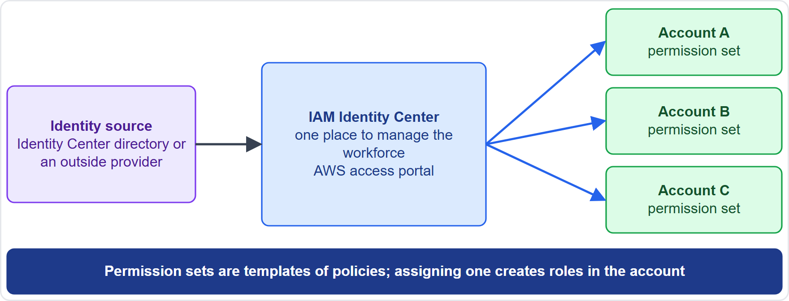
IAM Identity Center: One Front Door for Your Workforce
OLD NAME
Part 2
AWS IAM Identity Center gives workforce users single sign-on to many AWS accounts and to AWS applications
Manage people in its own directory, or connect an existing identity provider
A permission set is a template of policies; assigning it creates roles in each target account
Users reach everything through the AWS access portal, with MFA available
Best practice is an organization instance in the AWS Organizations management account
It was called AWS Single Sign-On before it was renamed, and older material still uses that name
EXAM TIP For workforce single sign-on across many accounts, choose IAM Identity Center.
Cloud Practitioner Exam Prep Masterclass | for the AWS CLF-C02 exam
Module 4: Identity and Access Management
19 / 33
Notes:
I A M Identity Center gives your workforce single sign-on to many A W S accounts and to A W S applications. You can manage people in its own directory, or connect an existing identity provider. A permission set is a template of policies. When you assign one, Identity Center creates roles in each target account. Users reach everything through the A W S access portal, with M F A available. Best practice is an organization instance, in the A W S Organizations management account. A note on names: this service was called A W S Single Sign-On before it was renamed, and older material still uses that name. Exam tip: for workforce single sign-on across many accounts, choose I A M Identity Center.

Slide 20
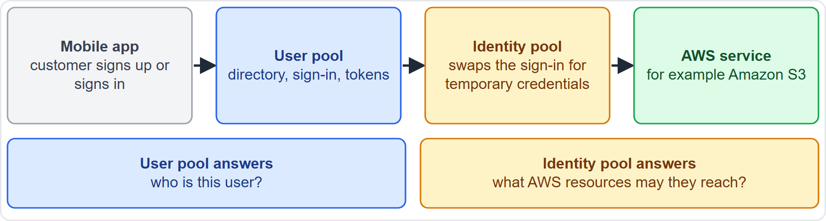
Amazon Cognito and AWS Directory Service
Part 2
Amazon Cognito is for your application's customers
A user pool is a user directory that signs people in and issues tokens, including through Google or Apple
An identity pool swaps a trusted sign-in for temporary AWS credentials
AWS Directory Service is for Microsoft Active Directory: AWS Managed Microsoft AD is a real directory in AWS, AD Connector forwards sign-ins to your on-premises directory, Simple AD is a small compatible directory
EXAM TIP Customers of your app: Cognito. Windows and Active Directory needs: Directory Service.
Cloud Practitioner Exam Prep Masterclass | for the AWS CLF-C02 exam
Module 4: Identity and Access Management
20 / 33
Notes:
Two services solve different directory problems. Amazon Cognito is for your application's customers. A user pool is a user directory that signs people in and issues tokens, including through Google or Apple. An identity pool swaps a trusted sign-in for temporary A W S credentials, so the app can reach services like S three. Look at the picture: the mobile app signs in through the user pool, then receives credentials from the identity pool. A W S Directory Service is for Microsoft Active Directory. A W S Managed Microsoft A D is a real directory running in A W S. A D Connector passes sign-ins through to your on-premises directory. Simple A D is a small, compatible directory. Exam tip: customers of your app, Cognito; Windows and Active Directory needs, Directory Service.

Slide 21
What the Exam Asks: Identity and Access
Part 2
User or role
Group or role
Identity-based or resource-based
long-term credentials or temporary ones
shared permissions for users, or an identity you assume
attached to who, or to what
Limit or grant
Secrets Manager or Parameter Store
Identity Center or Cognito
guardrails cap, policies allow
rotating credentials or plain configuration
your workforce, or your app's customers
Managed AD, AD Connector or Simple AD
a real directory, a pass-through, or a small one
EXAM TIP Name the need first, then the service.
Cloud Practitioner Exam Prep Masterclass | for the AWS CLF-C02 exam
Module 4: Identity and Access Management
21 / 33
Notes:
Here are the look-alike pairs this task statement likes. User or role: long-term credentials, or temporary ones. Group or role: shared permissions for users, or an identity you assume. Identity-based or resource-based: attached to who, or attached to what. Limit or grant: guardrails cap, policies allow. Secrets Manager or Parameter Store: rotating credentials, or plain configuration. Identity Center or Cognito: your workforce, or your app's customers. And Managed A D, A D Connector or Simple A D: a real directory, a pass-through, or a small one. Exam tip: name the need first, then the service.

Slide 22
Design Check: Tidewater's Access Plan
Part 2
Tidewater's need | Choose
The founder's account-owner sign-in | Root user with MFA, locked away, used only for root-only tasks
Five staff in the console | IAM Identity Center users and permission sets, not shared logins
A contractor reading one bucket | A role (or permission set) allowing read on that bucket only, for a limited time
Web servers reading photos | A role for the EC2 instances, no keys
A developer's shared key file | Delete the keys; use a role, or Secrets Manager for a credential that must exist
Customers on the mobile app | Cognito user pool plus identity pool
Cover the right column, answer each row yourself, then compare
Cloud Practitioner Exam Prep Masterclass | for the AWS CLF-C02 exam
Module 4: Identity and Access Management
22 / 33
Notes:
Time to design. Look at Tidewater's six needs, and answer each one yourself before I do. [PAUSE 15] The founder's sign-in is the root user, with M F A, locked away and used only for root-only tasks. The five staff get I A M Identity Center users and permission sets, not shared logins. The contractor gets a role, or a permission set, that allows read on that one bucket only, for a limited time. The web servers get a role for the E C two instances, with no keys. The developer's shared key file is deleted, and replaced by a role, or by Secrets Manager for a credential that must exist. And the mobile app customers use a Cognito user pool plus an identity pool.

Slide 23
Try It: Least Privilege in Twenty Minutes (Optional)
Part 2
Goal: see least privilege work in a practice account; IAM costs nothing
Start: sign in as an administrator, not as the root user
Create a group named ReadOnlyPhotos and attach a customer managed policy that allows only reading objects in one test bucket
Add a test user to the group, sign in as that user, read an object, then try to delete one and see it fail
Review the Access Advisor tab for the user; then clean up the user, group, policy and bucket
SHELL
aws iam list-attached-group-policies --group-name ReadOnlyPhotos
Lists the policies attached to the group (the group name is an example)
EXAM TIP Hands-on work is not tested on this exam; it helps the ideas stay in your head.
Cloud Practitioner Exam Prep Masterclass | for the AWS CLF-C02 exam
Module 4: Identity and Access Management
23 / 33
Notes:
This one is optional, and the exam does not test hands-on work. If you want to try it, use a practice account. I A M costs nothing. Sign in as an administrator, not as the root user. Create a group called ReadOnlyPhotos, and attach a customer managed policy that allows only reading objects in one test bucket. Add a test user to the group, sign in as that user, and read an object. Then try to delete one, and watch it fail. Open the Access Advisor tab to see what was used. When you are done, delete the test user, group, policy and bucket. The command on screen lists the policies attached to the group. Exam tip: hands-on work is not tested on this exam, but it helps the ideas stay in your head.

Slide 24
Module Recap
Part 2
1
Root user
2
Identities
3
Policies
complete access; use MFA, no access keys and no daily use; only a short list of tasks needs it
users have long-term credentials, groups share permissions, roles give temporary credentials
identity-based and resource-based policies grant; boundaries and SCPs only limit; an explicit deny wins
4
Least privilege
5
Credentials
6
Services
start small, use Access Analyzer and last accessed information, add conditions
password policy, two access keys per user, MFA with passkeys, apps or hardware tokens, and no SMS
Secrets Manager for secrets, Parameter Store for settings, Identity Center for the workforce, Cognito for app customers, Directory Service for Active Directory
Cloud Practitioner Exam Prep Masterclass | for the AWS CLF-C02 exam
Module 4: Identity and Access Management
24 / 33
Notes:
Let us recap. The root user has complete access: use M F A, create no access keys, and never use it day to day. Users have long-term credentials, groups share permissions, and roles give temporary credentials. Identity-based and resource-based policies grant; boundaries and service control policies only limit; and an explicit deny wins. For least privilege, start small, use Access Analyzer and last accessed information, and add conditions. For credentials, know the password policy, two access keys per user, and M F A with passkeys, apps or hardware tokens, and no S M S. And for services: Secrets Manager for secrets, Parameter Store for settings, Identity Center for the workforce, Cognito for app customers, and Directory Service for Active Directory.

Slide 25
Practice Question 1
Part 2
Q1
Which AWS identity is created with the account, has complete access to everything in it, and should be used only for the few tasks that require it?
A
An IAM role assumed by the account owner
B
An IAM user in an Administrators group
C
The AWS account root user
D
An IAM Identity Center administrator
Cloud Practitioner Exam Prep Masterclass | for the AWS CLF-C02 exam
Module 4: Identity and Access Management
25 / 33
Notes:
Question one. Which A W S identity is created with the account, has complete access to everything in it, and should be used only for the few tasks that require it? The four options are on the screen. [PAUSE 12] The answer is C, the A W S account root user. It signs in with the email address and password used at sign-up. An I A M user, a role or an Identity Center administrator is created later and can be limited.

Slide 26
Practice Question 2
Part 2
Q2
Which task requires you to sign in as the root user?
A
Create an IAM group and add the finance team to it
B
Attach an AWS managed policy to an existing IAM role
C
Launch an Amazon EC2 instance in a chosen Region
D
Restore access after the only IAM administrator removed their own permissions
Cloud Practitioner Exam Prep Masterclass | for the AWS CLF-C02 exam
Module 4: Identity and Access Management
26 / 33
Notes:
Question two. Which task requires you to sign in as the root user? The four options are on the screen. [PAUSE 12] The answer is D. Restoring permissions when the only I A M administrator has locked themselves out needs root credentials. Creating groups, attaching policies and launching instances are everyday tasks that an administrative identity can perform.

Slide 27
Practice Question 3
Part 2
Q3
Tidewater's founder signed up with a personal email. Which TWO actions best protect the root user? (Select TWO.)
A
Create root access keys so that scripts can run with full access
B
Register MFA for the root user, preferably a passkey or security key
C
Use the root user for everyday administration to keep identities few
D
Share the root password with the shop manager for emergencies
E
Create an administrative identity for daily work and keep root for root-only tasks
Cloud Practitioner Exam Prep Masterclass | for the AWS CLF-C02 exam
Module 4: Identity and Access Management
27 / 33
Notes:
Question three. This one asks you to select two. Tidewater's founder signed up with a personal email address. Which two actions best protect the root user? The five options are on the screen. [PAUSE 15] The answers are B and E. M F A protects the sign-in, and an administrative identity keeps the root user out of daily use. Root access keys, daily use of the root user, and sharing its password all widen the exposure of the most powerful identity in the account.

Slide 28
Practice Question 4
Part 2
Q4
Tidewater's web servers on Amazon EC2 must read product photos from an Amazon S3 bucket. What is the best way to grant that access?
A
Attach an IAM role with the needed S3 permissions to the instances
B
Store an IAM user's access keys in a configuration file on each server
C
Create access keys for the root user and load them at startup
D
Give the bucket a public policy so that no credentials are needed
Cloud Practitioner Exam Prep Masterclass | for the AWS CLF-C02 exam
Module 4: Identity and Access Management
28 / 33
Notes:
Question four. Tidewater's web servers on Amazon E C two must read product photos from an Amazon S three bucket. What is the best way to grant that access? The four options are on the screen. [PAUSE 12] The answer is A. A role delivers temporary credentials to the instances automatically, so no long-term keys are stored. Keys in a file can leak, root keys give far too much power, and a public policy would expose the photos to everyone.

Slide 29
Practice Question 5
Part 2
Q5
A policy attached to an Amazon S3 bucket that names which principals may read its objects is an example of which policy type?
A
A permissions boundary
B
A service control policy
C
A resource-based policy
D
An inline identity-based policy
Cloud Practitioner Exam Prep Masterclass | for the AWS CLF-C02 exam
Module 4: Identity and Access Management
29 / 33
Notes:
Question five. A policy attached to an Amazon S three bucket that names which principals may read its objects is an example of which policy type? The four options are on the screen. [PAUSE 12] The answer is C, a resource-based policy. A policy attached to a resource that names the principals allowed to use it is resource-based. Boundaries and service control policies only limit permissions, and an identity-based policy is attached to a user, group or role.

Slide 30
Practice Question 6
Part 2
Q6
A developer must read objects in one S3 bucket and nothing else. Which approach best follows the principle of least privilege?
A
Attach the AdministratorAccess managed policy so the developer is never blocked
B
Create a customer managed policy that allows only reading objects in that bucket
C
Attach the AmazonS3FullAccess managed policy for every bucket in the account
D
Share the credentials of an administrator who already has access
Cloud Practitioner Exam Prep Masterclass | for the AWS CLF-C02 exam
Module 4: Identity and Access Management
30 / 33
Notes:
Question six. A developer must read objects in one S three bucket and nothing else. Which approach best follows the principle of least privilege? The four options are on the screen. [PAUSE 12] The answer is B. A narrow customer managed policy grants only the actions the task needs on only the resource it needs. Administrator access, full S three access, and shared administrator credentials all give far more than the task requires.

Slide 31
Practice Question 7
Part 2
Q7
Which TWO are MFA options that AWS supports for IAM users? (Select TWO.)
A
A passkey or security key
B
A code sent by SMS text message
C
A security question answered at sign-in
D
A virtual authenticator app that generates one-time codes
E
A code sent to the user's email address
Cloud Practitioner Exam Prep Masterclass | for the AWS CLF-C02 exam
Module 4: Identity and Access Management
31 / 33
Notes:
Question seven. Select two. Which two are M F A options that A W S supports for I A M users? The five options are on the screen. [PAUSE 15] The answers are A and D: a passkey or security key, and a virtual authenticator app. A W S also supports hardware tokens. A W S has ended support for enabling S M S text message M F A, and security questions and email codes are not M F A options for I A M.

Slide 32
Practice Question 8
Part 2
Q8
Tidewater's mobile app lets customers sign up with an email address or a Google account, and then upload photos to Amazon S3 with limited permissions. Which combination meets this need?
A
IAM users created for each customer, with access keys stored in the app
B
IAM Identity Center users with a permission set that allows S3 access
C
AWS Directory Service for Microsoft Active Directory with a trust relationship
D
An Amazon Cognito user pool for sign-in and an identity pool for temporary AWS credentials
Cloud Practitioner Exam Prep Masterclass | for the AWS CLF-C02 exam
Module 4: Identity and Access Management
32 / 33
Notes:
Question eight. Tidewater's mobile app lets customers sign up with an email address or a Google account, and then upload photos to Amazon S three with limited permissions. Which combination meets this need? The four options are on the screen. [PAUSE 12] The answer is D. A Cognito user pool signs customers in, including through Google, and an identity pool exchanges that sign-in for temporary, limited A W S credentials. Per-customer I A M users with stored keys do not scale, Identity Center is for your workforce, and Directory Service is for Active Directory needs.

Slide 33
Answers at a Glance
Part 2
Question | Answer | Why
Q1 | C | The root user is the account's original, all-powerful identity
Q2 | D | Restoring a locked-out administrator needs the root user
Q3 | B, E | MFA, plus an administrative identity for daily work
Q4 | A | A role gives instances temporary credentials, no stored keys
Q5 | C | A policy on a resource that names principals is resource-based
Q6 | B | A narrow customer managed policy gives least privilege
Q7 | A, D | Passkeys or security keys, and virtual authenticator apps
Q8 | D | Cognito user pool for sign-in, identity pool for credentials
Cloud Practitioner Exam Prep Masterclass | for the AWS CLF-C02 exam
Module 4: Identity and Access Management
33 / 33
Notes:
Here are all eight answers. Question one: C. Question two: D. Question three: B and E. Question four: A. Question five: C. Question six: B. Question seven: A and D. Question eight: D. That completes Module four. Next, Module five covers the security services that protect an account: firewalls, threat detection, vulnerability scanning and encryption keys.

