Slide 1
Module 5: Security Services and Resources
The services that block, detect, scan and report, and where to learn more
Domain 2 · Security and Compliance · Task statement 2.4
Cloud Practitioner Exam Prep Masterclass
Module 5 · Part 1
Notes:
Welcome to Module five: Security Services and Resources. This module finishes the second domain of the exam, Security and Compliance, with task statement two point four. You will learn which A W S service blocks attacks, which one detects threats, which one scans for weaknesses, and where to find more security information. Expect questions that describe a need and ask you to name the service.

Slide 2
What You Will Learn
Part 1
Match AWS WAF, AWS Shield and AWS Firewall Manager to the threat each one stops
Tell Amazon GuardDuty, Amazon Inspector, Amazon Macie, Amazon Detective and AWS Security Hub apart
Choose among AWS KMS, AWS CloudHSM and AWS Certificate Manager, and say what AWS RAM does
Use AWS Trusted Advisor to spot security gaps
Know where to find third-party security products and AWS security information
Cloud Practitioner Exam Prep Masterclass | for the AWS CLF-C02 exam
Module 5: Security Services and Resources
2 / 27
Notes:
By the end of this module you will be able to do five things. Match A W S W A F, A W S Shield and A W S Firewall Manager to the threat each one stops. Tell Amazon GuardDuty, Amazon Inspector, Amazon Macie, Amazon Detective and A W S Security Hub apart. Choose among A W S K M S, A W S CloudHSM and A W S Certificate Manager, and say what A W S Resource Access Manager does. Use A W S Trusted Advisor to spot security gaps. And know where to find third-party security products and A W S security information.

Slide 3
Case Check-In: Tidewater Prepares for the Sale
Part 1
CASE CHECK-IN · Tidewater Outfitters
Tidewater's holiday sale is near, and the shop sits behind a load balancer open to the internet
Last year bots and traffic floods slowed the site, and someone tried SQL injection in the search box
The team worries about stolen credentials, unpatched servers and customer addresses stored in S3
The shop now uses several AWS accounts, and only two people look after security
Your job: pick the tools to block, detect, scan and review, and know where to learn more
Cloud Practitioner Exam Prep Masterclass | for the AWS CLF-C02 exam
Module 5: Security Services and Resources
3 / 27
Notes:
Tidewater's holiday sale is near, and the shop sits behind a load balancer that is open to the internet. Last year, bots and traffic floods slowed the site, and someone tried S Q L injection in the search box. The team worries about stolen credentials, unpatched servers, and customer addresses stored in S three. The shop now uses several A W S accounts, and only two people look after security. Your job is to pick the tools to block, detect, scan and review, and to know where to learn more.

Slide 4
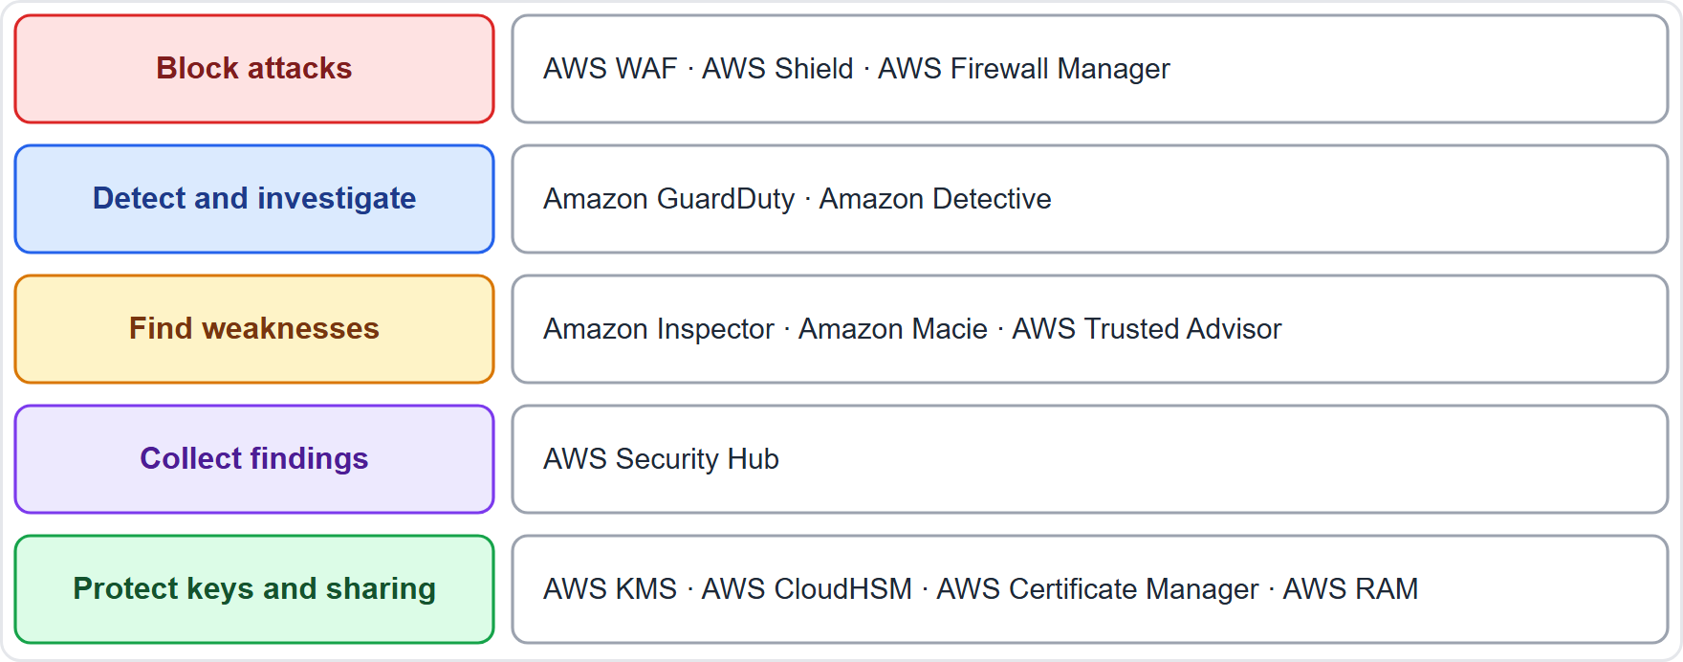
The Security Toolbox at a Glance
Part 1
Block attacks before they reach the app: AWS WAF, AWS Shield, AWS Firewall Manager
Detect and investigate threats: Amazon GuardDuty, Amazon Detective
Find weaknesses: Amazon Inspector, Amazon Macie, AWS Trusted Advisor
Collect every finding in one place: AWS Security Hub
Protect keys, certificates and sharing: AWS KMS, AWS CloudHSM, AWS Certificate Manager, AWS RAM
EXAM TIP Each service has one main job; read the verb in the question: block, detect, scan, discover or investigate.
Cloud Practitioner Exam Prep Masterclass | for the AWS CLF-C02 exam
Module 5: Security Services and Resources
4 / 27
Notes:
Start with the whole toolbox, grouped by job. To block attacks before they reach the application, there are three: A W S W A F, A W S Shield and A W S Firewall Manager. To detect and investigate threats, there is Amazon GuardDuty and Amazon Detective. To find weaknesses, there is Amazon Inspector, Amazon Macie and A W S Trusted Advisor. To collect every finding in one place, there is A W S Security Hub. And to protect keys, certificates and sharing, there is K M S, CloudHSM, Certificate Manager and Resource Access Manager. Exam tip: each service has one main job, so read the verb in the question: block, detect, scan, discover or investigate.

Slide 5
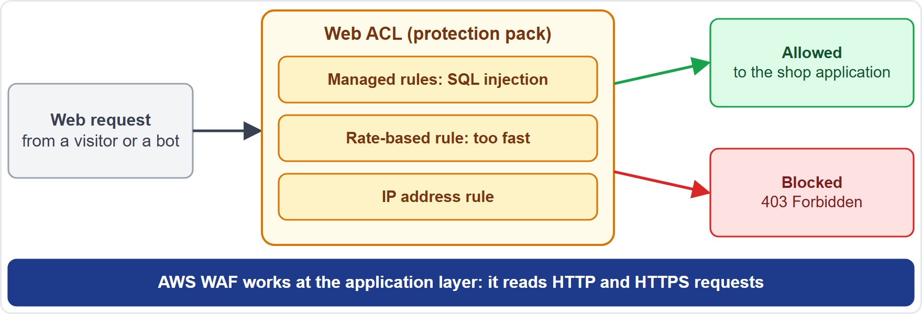
AWS WAF: Filtering Web Requests
OLD NAME
Part 1
AWS WAF is a web application firewall: it inspects the HTTP and HTTPS requests sent to your application
Attach it to Amazon CloudFront, an Application Load Balancer, Amazon API Gateway REST APIs, AWS AppSync and other supported resources
Rules sit in a web ACL (access control list; the new console says protection pack); a rule can allow, block, count or ask for a CAPTCHA
Match IP addresses, headers and query strings; a rate-based rule limits requests that arrive too fast
Managed rule groups block common attacks such as SQL injection and cross-site scripting
EXAM TIP Web exploits and bad bots at the application layer: AWS WAF.
Cloud Practitioner Exam Prep Masterclass | for the AWS CLF-C02 exam
Module 5: Security Services and Resources
5 / 27
Notes:
A W S W A F is a web application firewall. It inspects the H T T P and H T T P S requests that are sent to your application. You attach it to Amazon CloudFront, an Application Load Balancer, Amazon A P I Gateway rest A P Is, A W S AppSync and other supported resources. Its rules sit in a web A C L, short for access control list. The newer console calls that a protection pack, but exam material still says web A C L. A rule can allow, block or count a request, or ask the visitor to solve a captcha. You can match on I P addresses, headers and query strings, and a rate-based rule limits requests that arrive too fast. Managed rule groups block common attacks, such as S Q L injection and cross-site scripting. Exam tip: web exploits and bad bots at the application layer point to A W S W A F.

Slide 6
AWS Shield: Standard and Advanced
VERIFY LIVE
Part 1
 | Shield Standard | Shield Advanced
Cost | Automatic, no extra charge | Paid subscription
Defends against | Common network and transport layer DDoS attacks | Expanded protection, plus automatic layer 7 mitigation with AWS WAF
Resources | All customers; strongest for Route 53, CloudFront, Global Accelerator | Resources you add: CloudFront, Route 53 zones, Global Accelerator, Elastic IPs, load balancers
Extras | Nothing to set up | Shield Response Team, cost protection as credits, health-based detection
A DDoS attack floods a target from many systems so real users cannot get in
As of 4 November 2026: the Response Team needs a paid support plan, and plan names are changing (Module 14)
EXAM TIP Free and automatic: Standard. Response team and cost protection: Advanced.
Cloud Practitioner Exam Prep Masterclass | for the AWS CLF-C02 exam
Module 5: Security Services and Resources
6 / 27
Notes:
A D D O S attack floods a target from many systems, so real users cannot get in. A W S Shield protects against it in two levels. Shield Standard is automatic, with no extra charge, and defends against the most common network and transport layer attacks. Every customer gets it, and the benefit is strongest for Route fifty-three, CloudFront and Global Accelerator. Shield Advanced is a paid subscription for the resources you add, such as CloudFront, Route fifty-three hosted zones, Global Accelerator, Elastic I P addresses and load balancers. It adds expanded protection, automatic layer seven mitigation with W A F, the Shield Response Team, cost protection as service credits, and health-based detection. As of the fourth of November, twenty twenty-six, the Response Team needs a paid support plan, and plan names are changing, which Module fourteen covers. Exam tip: free and automatic means Standard; response team and cost protection mean Advanced.

Slide 7
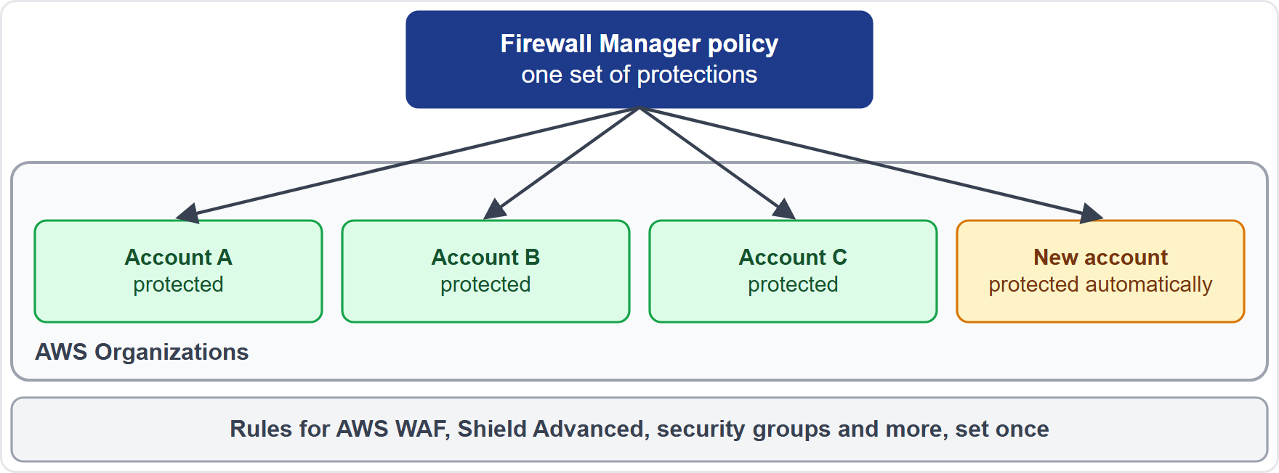
AWS Firewall Manager: One Policy, Many Accounts
Part 1
AWS Firewall Manager sets protections up once and applies them across accounts and resources in AWS Organizations
It manages AWS WAF, AWS Shield Advanced, security groups and network ACLs, AWS Network Firewall and Route 53 Resolver DNS Firewall
Scope a policy to all resources of a type or to resources with specific tags
New accounts and resources are protected automatically
You pay for the underlying services, such as AWS WAF and AWS Config
EXAM TIP One place to manage firewall rules for many accounts: Firewall Manager.
Cloud Practitioner Exam Prep Masterclass | for the AWS CLF-C02 exam
Module 5: Security Services and Resources
7 / 27
Notes:
A W S Firewall Manager sets protections up once and applies them across the accounts and resources in A W S Organizations. It manages W A F rules, Shield Advanced, security groups and network A C Ls, A W S Network Firewall, and Route fifty-three Resolver D N S Firewall. You scope a policy to all resources of a type, or to resources with specific tags. The key benefit is that new accounts and new resources are protected automatically. On cost, you pay for the underlying services, such as W A F and A W S Config. Picture Tidewater with thirty accounts: one policy, applied everywhere, including accounts that do not exist yet. Exam tip: one place to manage firewall rules for many accounts means Firewall Manager.

Slide 8
Amazon GuardDuty: Threat Detection
Part 1
Amazon GuardDuty is threat detection: it watches your account for suspicious activity continuously
Once on, it analyzes CloudTrail management events, VPC flow logs and DNS logs
It uses threat intelligence (known malicious IP addresses and domains) and machine learning
It finds things like compromised credentials, cryptomining and malware
Optional protection plans add sources such as S3, EKS, RDS logins, Lambda, malware scanning and runtime monitoring
Findings go to Security Hub, Detective and EventBridge; new accounts get a 30-day free trial
EXAM TIP Suspicious activity and compromised credentials: GuardDuty.
Cloud Practitioner Exam Prep Masterclass | for the AWS CLF-C02 exam
Module 5: Security Services and Resources
8 / 27
Notes:
Amazon GuardDuty is threat detection. It watches your account for suspicious activity, continuously. As soon as you turn it on, it analyzes CloudTrail management events, V P C flow logs and D N S logs. It compares what it sees with threat intelligence, such as known malicious I P addresses and domains, and uses machine learning. It finds things like compromised credentials, cryptomining and malware. Optional protection plans add more sources, such as S three, E K S, R D S logins, Lambda, malware scanning and runtime monitoring. Findings go to Security Hub, Detective and EventBridge, and new accounts get a thirty-day free trial. Exam tip: suspicious activity and compromised credentials point to GuardDuty.

Slide 9
Amazon Inspector: Finding Weaknesses
Part 1
Amazon Inspector is vulnerability management: it looks for software vulnerabilities and unintended network exposure
It scans Amazon EC2 instances, container images in Amazon ECR and AWS Lambda functions
Scanning is automatic and continuous; it rescans when you install a package, apply a patch or a new CVE is published
Each finding names the resource and suggests a fix, with a risk score adjusted to your environment
Findings flow to EventBridge and Security Hub
Remember: GuardDuty asks "what is happening?"; Inspector asks "what could be exploited?"
EXAM TIP Known vulnerabilities (CVEs) on instances, images or functions: Inspector.
Cloud Practitioner Exam Prep Masterclass | for the AWS CLF-C02 exam
Module 5: Security Services and Resources
9 / 27
Notes:
Amazon Inspector is vulnerability management. It looks for software vulnerabilities and unintended network exposure. It scans Amazon E C two instances, container images in Amazon E C R, and A W S Lambda functions. Scanning is automatic and continuous. It rescans when you install a package, apply a patch, or when a new C V E is published. Each finding names the resource and suggests a fix, with a risk score adjusted to your environment. Findings flow to EventBridge and Security Hub. Here is a way to remember the difference from GuardDuty: GuardDuty asks, what is happening? Inspector asks, what could be exploited? Exam tip: known vulnerabilities on instances, images or functions point to Inspector.

Slide 10
Amazon Macie: Sensitive Data in S3
Part 1
Amazon Macie finds sensitive data in Amazon S3 using machine learning and pattern matching
It detects personally identifiable information (PII), financial information and credentials; you can add custom data identifiers
It keeps an inventory of your S3 buckets and flags risks, such as a bucket that becomes publicly accessible
Automated discovery samples your buckets; discovery jobs go deeper, once or on a schedule
Findings go to EventBridge and Security Hub; new accounts get a 30-day free trial
EXAM TIP Sensitive data, such as PII, stored in S3: Macie.
Cloud Practitioner Exam Prep Masterclass | for the AWS CLF-C02 exam
Module 5: Security Services and Resources
10 / 27
Notes:
Amazon Macie finds sensitive data in Amazon S three, using machine learning and pattern matching. It detects personally identifiable information, which people shorten to P I I, plus financial information and credentials, and you can add your own custom data identifiers. It also keeps an inventory of your S three buckets and flags risks, such as a bucket that becomes publicly accessible. Automated discovery samples your buckets, while discovery jobs go deeper, once or on a schedule. Findings go to EventBridge and Security Hub, and new accounts get a thirty-day free trial. Exam tip: sensitive data, such as P I I, stored in S three points to Macie.

Slide 11
Amazon Detective: Finding the Root Cause
Part 1
Amazon Detective helps you investigate a security finding and find its root cause
It collects CloudTrail logs, VPC flow logs and GuardDuty findings automatically
It builds a behavior graph with visual summaries over time, keeping up to a year of history
It answers questions such as "is this an unusual API call for this role?"
You can jump from a GuardDuty finding straight into Detective
Remember: GuardDuty detects; Detective investigates
EXAM TIP Detect: GuardDuty. Investigate the root cause: Detective.
Cloud Practitioner Exam Prep Masterclass | for the AWS CLF-C02 exam
Module 5: Security Services and Resources
11 / 27
Notes:
Amazon Detective helps you investigate a security finding and find its root cause. It collects CloudTrail logs, V P C flow logs and GuardDuty findings automatically. From them it builds a behavior graph, with visual summaries over time, and it keeps up to a year of history. That lets you answer questions such as, is this an unusual A P I call for this role? You can jump from a GuardDuty finding straight into Detective. Remember the pair: GuardDuty detects, Detective investigates. Exam tip: to detect, think GuardDuty; to investigate the root cause, think Detective.

Slide 12
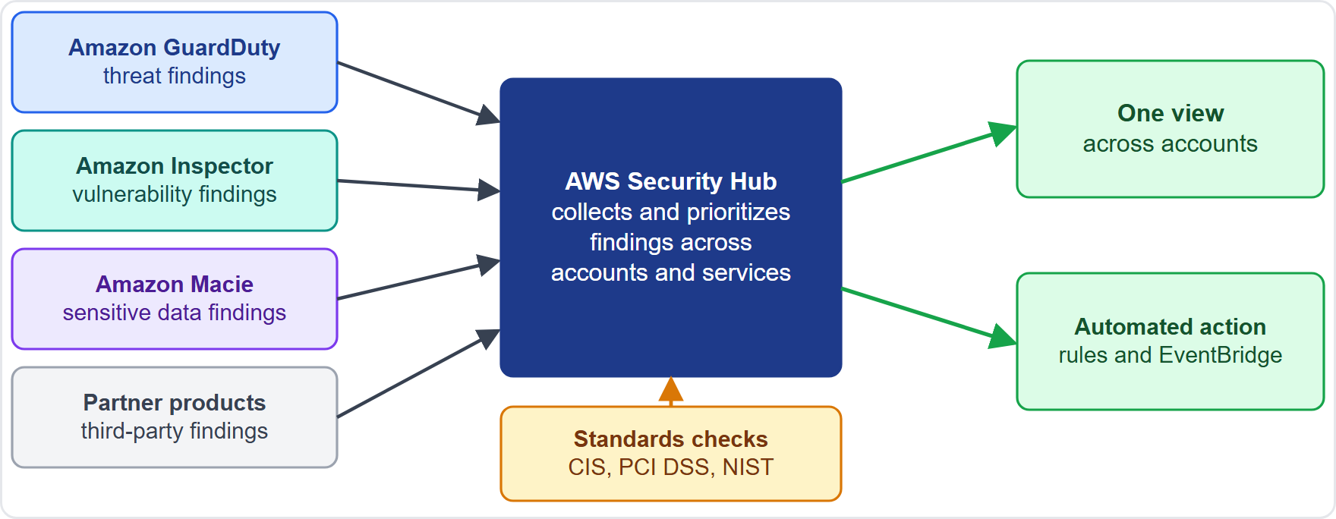
AWS Security Hub: One View of Findings
OLD NAME · VERIFY LIVE
Part 1
AWS Security Hub gives one view of your security state across accounts, AWS services and partner products
It receives findings from GuardDuty, Inspector and Macie
It also checks your setup against standards: AWS Foundational Security Best Practices, CIS, PCI DSS and NIST
Automation rules and EventBridge can act on findings
Most checks need AWS Config recording turned on
As of 4 November 2026: the documentation names the service AWS Security Hub CSPM; the exam may say Security Hub
EXAM TIP One place to see findings and standards checks from many services: Security Hub.
Cloud Practitioner Exam Prep Masterclass | for the AWS CLF-C02 exam
Module 5: Security Services and Resources
12 / 27
Notes:
A W S Security Hub gives you one view of your security state across accounts, A W S services and partner products. Look at the figure. GuardDuty, Inspector, Macie and partner products send their findings in. Security Hub also checks your setup against standards: the A W S Foundational Security Best Practices, C I S, P C I D S S, and N I S T. Automation rules and EventBridge can act on the findings. Most of its checks need A W S Config recording turned on. As of the fourth of November, twenty twenty-six, the documentation names the service A W S Security Hub C S P M, short for Cloud Security Posture Management, while the exam may simply say Security Hub. Exam tip: one place to see findings and standards checks from many services means Security Hub.

Slide 13
Keys and Certificates: KMS, CloudHSM and ACM
Part 2
Service | What it does | Choose it when
AWS KMS | Creates and controls the keys that encrypt and sign your data; keys sit in FIPS 140-3 Level 3 hardware security modules; key policies control access | You want a managed key service that works with AWS services
AWS CloudHSM | Dedicated, single-tenant hardware security modules in your VPC; you control keys, algorithms and users | Rules demand full control of the HSMs, and you accept more responsibility
AWS Certificate Manager (ACM) | Creates, stores and renews public and private SSL/TLS certificates for integrated services | You need HTTPS on a load balancer or CloudFront
ACM adds no charge for certificates; you pay for the resources that use them
EXAM TIP Managed keys: KMS. Your own dedicated hardware: CloudHSM. Website certificates: ACM.
Cloud Practitioner Exam Prep Masterclass | for the AWS CLF-C02 exam
Module 5: Security Services and Resources
13 / 27
Notes:
Three services handle keys and certificates, and the exam asks you to tell them apart. A W S K M S creates and controls the keys that encrypt and sign your data. Its keys sit in hardware security modules validated to F I P S one forty dash three, Level three, and key policies control who can use them. Choose it for a managed key service that works with A W S services. A W S CloudHSM gives you dedicated, single-tenant hardware security modules in your V P C. You control the keys, algorithms and users, so choose it when rules demand full control, and accept more responsibility. A W S Certificate Manager creates, stores and renews public and private S S L and T L S certificates for integrated services, so choose it for H T T P S on a load balancer or CloudFront. It adds no charge for certificates; you pay for the resources that use them. Exam tip: managed keys, K M S; your own dedicated hardware, CloudHSM; website certificates, Certificate Manager.

Slide 14
AWS Resource Access Manager: Share, Don't Copy
Part 2
AWS Resource Access Manager (AWS RAM) lets you share your resources with other AWS accounts, with an organization or organizational unit, and, for some types, with IAM roles and users
Create a resource once, then share it, instead of building a copy in every account
A shared resource looks native in the other account: a shared VPC subnet appears in the VPC console
The owner keeps ownership; a managed permission on the resource share sets what others may do, and their IAM policies and SCPs still apply
No additional charge for AWS RAM; you pay for the shared resource itself
EXAM TIP Share a resource with other accounts without duplicating it: AWS RAM.
Cloud Practitioner Exam Prep Masterclass | for the AWS CLF-C02 exam
Module 5: Security Services and Resources
14 / 27
Notes:
A W S Resource Access Manager, called ram, lets you share your resources with other A W S accounts, with an organization or an organizational unit, and for some resource types with I A M roles and users. You create a resource once, then share it, instead of building a copy in every account. A shared resource looks native in the other account. For example, a shared V P C subnet appears in the V P C console. The owner keeps ownership. A managed permission on the resource share sets what others may do, and their I A M policies and service control policies still apply. There is no additional charge for ram itself; you pay for the shared resource. Exam tip: share a resource with other accounts without duplicating it, and the answer is Resource Access Manager.

Slide 15
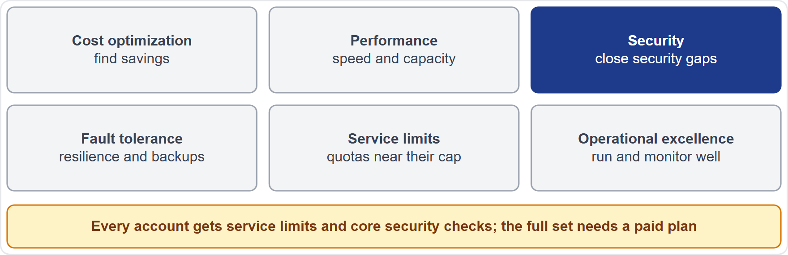
AWS Trusted Advisor: Security Checks
OLD NAME · VERIFY LIVE
Part 2
AWS Trusted Advisor inspects your account and recommends ways to save money, improve performance and availability, and close security gaps
Every account gets the service limits checks and core security checks: S3 bucket permissions, security groups with unrestricted ports, MFA on the root account, and public EBS and RDS snapshots
The full set of checks and the API need a paid support plan
As of 4 November 2026: the full set comes with Business Support+, Enterprise Support or Unified Operations; older material says Business or Enterprise Support
EXAM TIP A quick review for security gaps: Trusted Advisor; the full set needs a paid plan.
Cloud Practitioner Exam Prep Masterclass | for the AWS CLF-C02 exam
Module 5: Security Services and Resources
15 / 27
Notes:
A W S Trusted Advisor inspects your account and recommends ways to save money, improve performance and availability, and close security gaps. Its checks fall into six categories: cost optimization, performance, security, fault tolerance, service limits, and operational excellence. Every account gets the service limits checks and a set of core security checks: S three bucket permissions, security groups with unrestricted ports, M F A on the root account, and public E B S and R D S snapshots. The full set of checks, and the A P I, need a paid support plan. As of the fourth of November, twenty twenty-six, the full set comes with Business Support plus, Enterprise Support or Unified Operations, while older material says Business or Enterprise Support. Exam tip: a quick review for security gaps points to Trusted Advisor, and the full set needs a paid plan.

Slide 16
AWS Marketplace: Third-Party Security Products
Part 2
AWS Marketplace is a curated digital catalog to find, test, buy and deploy third-party software
Security listings come from independent software vendors in areas such as application security, endpoint security, identity and access control, SIEM, WAF and edge security and managed security services
Use it for a product your team already knows, or one AWS does not offer as a service
Managed rules for AWS WAF can also come from Marketplace sellers
Remember: you still configure and operate what you deploy
EXAM TIP A third-party security product, bought and deployed on AWS: AWS Marketplace.
Cloud Practitioner Exam Prep Masterclass | for the AWS CLF-C02 exam
Module 5: Security Services and Resources
16 / 27
Notes:
A W S Marketplace is a curated digital catalog where you find, test, buy and deploy third-party software. Its security listings come from independent software vendors, in areas such as application security, endpoint security, identity and access control, S I E M, W A F and edge security, and managed security services. Use it for a product your team already knows, or one that A W S does not offer as a service. Managed rules for A W S W A F can also come from Marketplace sellers. Remember that you still configure and operate what you deploy. Exam tip: a third-party security product, bought and deployed on A W S, means A W S Marketplace.

Slide 17
Where to Find Security Information
VERIFY LIVE
Part 2
Resource | What you find there
AWS Security Blog | How-to guides, announcements and compliance news
AWS Knowledge Center | Answers to common AWS questions, hosted with AWS re:Post
AWS re:Post | Community questions and answers
AWS Security Center | The exam guide's name; the AWS cloud security pages gather services, learning, compliance, whitepapers and reference architecture
Report a problem | Pages to report vulnerabilities and suspicious emails
As of 4 November 2026: no page is titled exactly "AWS Security Center"; the cloud security pages play that role
EXAM TIP Learn from the Security Blog and Knowledge Center; get AWS's compliance reports from AWS Artifact.
Cloud Practitioner Exam Prep Masterclass | for the AWS CLF-C02 exam
Module 5: Security Services and Resources
17 / 27
Notes:
The exam guide also asks where security information is available. The A W S Security Blog publishes how-to guides, announcements and compliance news. The A W S Knowledge Center gives answers to common A W S questions, and it is hosted with A W S re:Post, where the community asks and answers questions. The guide also names the A W S Security Center. The A W S cloud security pages gather security services, learning, compliance, whitepapers and reference architecture, and there are pages to report vulnerabilities and suspicious emails. As of the fourth of November, twenty twenty-six, no page is titled exactly A W S Security Center; the cloud security pages play that role. Exam tip: learn from the Security Blog and Knowledge Center, and get A W S's compliance reports from A W S Artifact.

Slide 18
What the Exam Asks: Security Services
Part 2
Web attack or flood
Many accounts, one policy
Detect or scan
WAF filters requests; Shield absorbs DDoS attacks
GuardDuty detects threats; Inspector finds vulnerabilities
Firewall Manager
Discover or investigate
See everything together
Keys, hardware or certificates
Macie finds PII in S3; Detective finds the root cause
Security Hub
KMS, CloudHSM, ACM
Review or buy
Trusted Advisor reviews; Marketplace sells third-party products
EXAM TIP Name the verb first, then the service.
Cloud Practitioner Exam Prep Masterclass | for the AWS CLF-C02 exam
Module 5: Security Services and Resources
18 / 27
Notes:
Here is how the exam frames these services. A web attack or a flood: W A F filters requests, and Shield absorbs D D o S attacks. Many accounts, one policy: Firewall Manager. Detect or scan: GuardDuty detects threats, and Inspector finds vulnerabilities. Discover or investigate: Macie finds P I I in S three, and Detective finds the root cause. See everything together: Security Hub. Keys, hardware or certificates: K M S, CloudHSM and Certificate Manager. And review or buy: Trusted Advisor reviews, and Marketplace sells third-party products. Exam tip: name the verb first, then the service.

Slide 19
Design Check: Tidewater's Security Plan
Part 2
Tidewater's worry | Choose
SQL injection and bad bots at the load balancer | AWS WAF with managed rule groups and a rate-based rule
Traffic floods during the sale | Shield Standard (automatic); Shield Advanced for the most critical sites
The same web rules in every account, including new ones | AWS Firewall Manager
Stolen credentials or cryptomining | GuardDuty, then Detective to find the root cause
Unpatched servers and container images | Amazon Inspector
Customer addresses stored in S3 | Amazon Macie
One place for every finding | AWS Security Hub
Open ports and public buckets, found quickly | AWS Trusted Advisor
Cover the right column, answer each row yourself, then compare
Cloud Practitioner Exam Prep Masterclass | for the AWS CLF-C02 exam
Module 5: Security Services and Resources
19 / 27
Notes:
Now a design check. Cover the right column and answer each row yourself. S Q L injection and bad bots at the load balancer: W A F, with managed rule groups and a rate-based rule. Traffic floods during the sale: Shield Standard, which is automatic, and Shield Advanced for the most critical sites. The same web rules in every account, including new ones: Firewall Manager. Stolen credentials or cryptomining: GuardDuty, then Detective to find the root cause. Unpatched servers and container images: Inspector. Customer addresses stored in S three: Macie. One place for every finding: Security Hub. And open ports and public buckets, found quickly: Trusted Advisor. Pause the video if you want more time.

Slide 20
Module Recap
Part 2
1
Block
2
Detect and investigate
3
Find weaknesses
AWS WAF filters web requests, Shield defends against DDoS, Firewall Manager applies protections across accounts
Inspector scans for vulnerabilities, Macie finds sensitive data in S3, Trusted Advisor checks for gaps
GuardDuty finds threats, Detective finds the root cause
4
Collect
5
Protect
6
Learn and buy
Security Hub brings findings and standards checks together
KMS manages keys, CloudHSM gives dedicated hardware, ACM manages certificates, RAM shares resources
Marketplace for third-party products; Security Blog, Knowledge Center and AWS cloud security pages for information
Cloud Practitioner Exam Prep Masterclass | for the AWS CLF-C02 exam
Module 5: Security Services and Resources
20 / 27
Notes:
Here is the recap. To block: W A F filters web requests, Shield defends against D D o S, and Firewall Manager applies protections across accounts. To detect and investigate: GuardDuty finds threats, and Detective finds the root cause. To find weaknesses: Inspector scans for vulnerabilities, Macie finds sensitive data in S three, and Trusted Advisor checks for gaps. To collect: Security Hub brings findings and standards checks together. To protect: K M S manages keys, CloudHSM gives dedicated hardware, Certificate Manager manages certificates, and Resource Access Manager shares resources. And to learn and buy: Marketplace for third-party products, and the Security Blog, Knowledge Center and cloud security pages for information.

Slide 21
Practice Question 1
Part 2
Q1
Tidewater's shop sits behind an Application Load Balancer, and attackers are sending SQL injection strings in search requests. Which service can block these requests before they reach the application?
A
AWS Shield Standard, which is switched on automatically
B
Amazon Inspector, which scans the web servers for weaknesses
C
Amazon GuardDuty, which analyzes logs to detect threats
D
AWS WAF, with a web ACL attached to the load balancer
Cloud Practitioner Exam Prep Masterclass | for the AWS CLF-C02 exam
Module 5: Security Services and Resources
21 / 27
Notes:
Question one. Tidewater's shop sits behind an Application Load Balancer, and attackers are sending S Q L injection strings in search requests. Which service can block these requests before they reach the application? The four options are on the screen. [PAUSE 12] The answer is D, A W S W A F. It inspects H T T P and H T T P S requests and blocks patterns such as S Q L injection through rules and managed rule groups. Shield Standard defends against network and transport layer floods, Inspector finds vulnerabilities, and GuardDuty detects threats, but none of them filters web requests.

Slide 22
Practice Question 2
Part 2
Q2
Which service continuously analyzes AWS CloudTrail events, VPC flow logs and DNS logs, using threat intelligence and machine learning, to detect suspicious activity such as cryptomining or compromised credentials?
A
Amazon GuardDuty
B
Amazon Inspector
C
Amazon Macie
D
AWS Trusted Advisor
Cloud Practitioner Exam Prep Masterclass | for the AWS CLF-C02 exam
Module 5: Security Services and Resources
22 / 27
Notes:
Question two. Which service continuously analyzes A W S CloudTrail events, V P C flow logs and D N S logs, using threat intelligence and machine learning, to detect suspicious activity such as cryptomining or compromised credentials? The four options are on the screen. [PAUSE 12] The answer is A, Amazon GuardDuty. It is the threat detection service that watches those data sources and reports findings. Inspector scans for software vulnerabilities, Macie discovers sensitive data in S three, and Trusted Advisor recommends improvements from its checks.

Slide 23
Practice Question 3
Part 2
Q3
Which TWO benefits come with an AWS Shield Advanced subscription but not with AWS Shield Standard? (Select TWO.)
A
Protection that is applied automatically at no extra charge
B
Access to the Shield Response Team during a DDoS attack
C
Defense against common network and transport layer attacks
D
Cost protection, given as service credits after an attack
E
Scans of container images for software vulnerabilities
Cloud Practitioner Exam Prep Masterclass | for the AWS CLF-C02 exam
Module 5: Security Services and Resources
23 / 27
Notes:
Question three. Select two. Which two benefits come with an A W S Shield Advanced subscription but not with A W S Shield Standard? The five options are on the screen. [PAUSE 15] The answers are B and D. Shield Advanced adds access to the Shield Response Team, which also needs a paid support plan, and cost protection in the form of service credits. Automatic, no-charge protection against common network and transport layer attacks is what Shield Standard already provides, and container image scanning is Amazon Inspector.

Slide 24
Practice Question 4
Part 2
Q4
Tidewater now runs thirty accounts in AWS Organizations. The security team wants the same AWS WAF rules applied in every account, including accounts created later, from one place. Which service should it use?
A
AWS Security Hub, to collect findings from every account
B
Amazon GuardDuty, with a delegated administrator account
C
AWS Firewall Manager, with a policy for the organization
D
AWS Shield Standard, which is enabled in each account
Cloud Practitioner Exam Prep Masterclass | for the AWS CLF-C02 exam
Module 5: Security Services and Resources
24 / 27
Notes:
Question four. Tidewater now runs thirty accounts in A W S Organizations. The security team wants the same A W S W A F rules applied in every account, including accounts created later, from one place. Which service should it use? The four options are on the screen. [PAUSE 12] The answer is C, A W S Firewall Manager. It applies W A F rules and other protections across accounts in an organization, and covers new accounts and resources automatically. Security Hub collects findings, GuardDuty detects threats, and Shield Standard is automatic but has no rules to manage.

Slide 25
Practice Question 5
Part 2
Q5
A new administrator wants a quick review of the account for security gaps, such as a publicly accessible Amazon S3 bucket, security group ports left open and a root user without MFA. Which AWS tool gives these recommendations?
A
AWS Artifact
B
AWS Trusted Advisor
C
Amazon Inspector
D
AWS Marketplace
Cloud Practitioner Exam Prep Masterclass | for the AWS CLF-C02 exam
Module 5: Security Services and Resources
25 / 27
Notes:
Question five. A new administrator wants a quick review of the account for security gaps, such as a publicly accessible Amazon S three bucket, security group ports left open, and a root user without M F A. Which A W S tool gives these recommendations? The four options are on the screen. [PAUSE 12] The answer is B, A W S Trusted Advisor. It inspects the account and recommends fixes, and its core security checks include bucket permissions, unrestricted security group ports and M F A on the root account. Inspector scans for software vulnerabilities and network exposure, Artifact provides compliance reports, and Marketplace sells third-party software.

Slide 26
Practice Question 6
Part 2
Q6
Tidewater wants a third-party endpoint protection product that AWS does not offer as a service. Where can it find, buy and deploy such security software on AWS?
A
AWS Marketplace, which lists software from independent vendors
B
The AWS Security Blog, which publishes security how-to posts
C
The AWS Knowledge Center, which answers common questions
D
AWS Artifact, which provides compliance reports and agreements
Cloud Practitioner Exam Prep Masterclass | for the AWS CLF-C02 exam
Module 5: Security Services and Resources
26 / 27
Notes:
Question six. Tidewater wants a third-party endpoint protection product that A W S does not offer as a service. Where can it find, buy and deploy such security software on A W S? The four options are on the screen. [PAUSE 12] The answer is A, A W S Marketplace. It is the catalog for finding, testing, buying and deploying third-party software, including security products. The Security Blog and Knowledge Center are places to learn, and Artifact provides A W S's own compliance reports and agreements.

Slide 27
Answers at a Glance
Part 2
Question | Answer | Why
Q1 | D | AWS WAF filters web requests, including SQL injection
Q2 | A | GuardDuty detects threats from logs and threat intelligence
Q3 | B, D | Shield Advanced adds the Response Team and cost protection
Q4 | C | Firewall Manager applies protections across an organization
Q5 | B | Trusted Advisor flags security gaps in the account
Q6 | A | AWS Marketplace sells third-party software
Cloud Practitioner Exam Prep Masterclass | for the AWS CLF-C02 exam
Module 5: Security Services and Resources
27 / 27
Notes:
Here are all six answers. Question one: D. Question two: A. Question three: B and D. Question four: C. Question five: B. Question six: A. That completes Module five, and with it the Security and Compliance domain. Next, Module six begins the technology domain, with how you deploy and operate in the cloud, and the A W S global infrastructure.

