Slide 1
Module 6: Deploying, Operating and the Global Infrastructure
How you reach and build on AWS, and where AWS runs
Domain 3 · Cloud Technology and Services · Task statements 3.1 and 3.2
Cloud Practitioner Exam Prep Masterclass
Module 6 · Part 1
Notes:
Welcome to Module six: Deploying, Operating and the Global Infrastructure. This module opens the third domain of the exam, Cloud Technology and Services, with task statements three point one and three point two. You will learn how people and programs reach A W S, how to build the same environment again and again, and where A W S physically runs: Regions, Availability Zones and edge locations.

Slide 2
What You Will Learn
Part 1
Choose among the console, the CLI, SDKs and infrastructure as code, for one-time and repeatable work
Explain what AWS CloudFormation, AWS Service Catalog and Service Quotas do
Tell cloud, hybrid and on-premises deployment models apart
Describe Regions, Availability Zones and edge locations, and how they relate
Decide when to use multiple Availability Zones and when multiple Regions
Cloud Practitioner Exam Prep Masterclass | for the AWS CLF-C02 exam
Module 6
2 / 24
Notes:
By the end of this module you will be able to do five things. Choose among the console, the C L I, S D Ks and infrastructure as code, for one-time and repeatable work. Explain what A W S CloudFormation, A W S Service Catalog and Service Quotas do. Tell cloud, hybrid and on-premises deployment models apart. Describe Regions, Availability Zones and edge locations, and how they relate. And decide when to use multiple Availability Zones, and when to use multiple Regions.

Slide 3
Case Check-In: Tidewater Goes Global
Part 1
CASE CHECK-IN · Tidewater Outfitters
Tidewater's customers in Europe see slow pages, and the team wants a second copy of the shop near them
Engineers build servers by clicking through the console, and no two environments match
Test and production must be identical and quick to rebuild
The warehouse system stays in the back office but must still talk to the cloud
Your job: choose how to deploy, operate and place the shop
Cloud Practitioner Exam Prep Masterclass | for the AWS CLF-C02 exam
Module 6
3 / 24
Notes:
Back to Tidewater Outfitters. Its customers in Europe see slow pages, and the team wants a second copy of the shop near them. Engineers build servers by clicking through the console, and no two environments match. Test and production must be identical, and quick to rebuild. The warehouse system stays in the back office, but it must still talk to the cloud. Your job is to choose how to deploy, operate and place the shop.

Slide 4
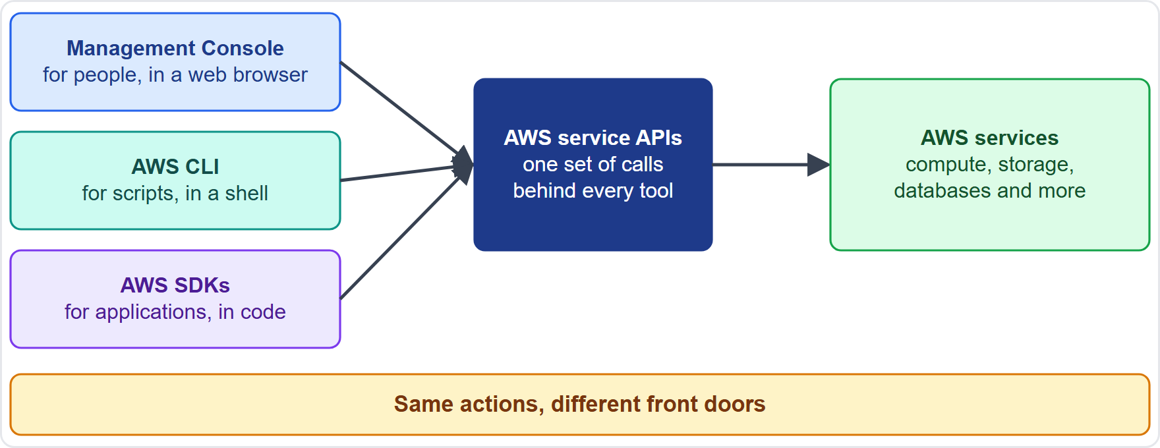
Ways to Reach AWS
Part 1
The AWS Management Console is a web-based interface for people: good for exploring and one-time tasks
The AWS Command Line Interface (AWS CLI) runs commands in a shell, so steps can be scripted and automated
AWS SDKs are libraries for languages such as Python, Java and JavaScript, so applications can call AWS services
The CLI and SDKs call the AWS service APIs directly; sending API requests yourself means signing them too
AWS CloudShell gives you the CLI in a browser tab, already signed in [Beyond the guide]
EXAM TIP Everything in the console is also available through the API, the CLI and the SDKs.
Cloud Practitioner Exam Prep Masterclass | for the AWS CLF-C02 exam
Module 6
4 / 24
Notes:
There are several ways to reach A W S, and the exam expects you to know them. The A W S Management Console is a web-based interface for people. It is good for exploring and for one-time tasks. The A W S Command Line Interface, the C L I, runs commands in a shell, so steps can be scripted and automated. A W S S D Ks are libraries for languages such as Python, Java and JavaScript, so applications can call A W S services. The C L I and the S D Ks call the A W S service A P Is directly, and if you send A P I requests yourself, you must also sign them. A W S CloudShell gives you the C L I in a browser tab, already signed in, though it is beyond the exam guide. Exam tip: everything in the console is also available through the A P I, the C L I and the S D Ks.

Slide 5
Console, CLI, SDK or Template?
Part 1
Tidewater needs to | Best fit | Why
Try a new service once | Management Console | Visual, no code, good for one-time work
Run the same steps every night | AWS CLI script | Commands can be saved, shared and scheduled
Let the shop's code create or read resources | AWS SDK | Calls AWS from your own application
Build the same whole environment every time | Infrastructure as code | A template makes it repeatable
One-time operation: the console is fine
Repeatable process: script it, or put it in a template
EXAM TIP One-time and visual: console. Repeat and automate: CLI, SDK or a template.
Cloud Practitioner Exam Prep Masterclass | for the AWS CLF-C02 exam
Module 6
5 / 24
Notes:
How do you choose? Look at what Tidewater needs. To try a new service once, use the Management Console. It is visual, needs no code, and suits one-time work. To run the same steps every night, use an A W S C L I script, because commands can be saved, shared and scheduled. To let the shop's own code create or read resources, use an A W S S D K, which calls A W S from your application. And to build the same whole environment every time, use infrastructure as code, because a template makes it repeatable. The rule of thumb: a one-time operation is fine in the console; a repeatable process should be scripted or put in a template. Exam tip: one-time and visual means console; repeat and automate means C L I, S D K or a template.

Slide 6
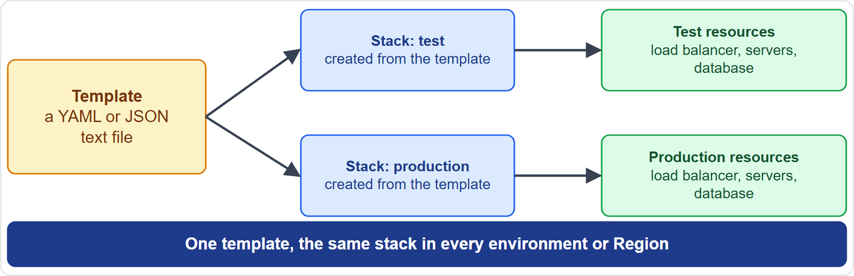
Infrastructure as Code: AWS CloudFormation
Part 1
Infrastructure as code means describing your infrastructure in text files that a tool turns into real resources
A CloudFormation template is a YAML or JSON file that lists resources and their settings
A stack is everything created from one template; you create, update and delete it as one unit
A change set previews an update, and a failed creation rolls back
Reuse one template for test and production, or in several Regions, and keep it in version control
The AWS CDK lets you write the same thing in a programming language [Beyond the guide]
EXAM TIP Repeatable, consistent environments from a template: AWS CloudFormation.
Cloud Practitioner Exam Prep Masterclass | for the AWS CLF-C02 exam
Module 6
6 / 24
Notes:
Infrastructure as code means describing your infrastructure in text files that a tool turns into real resources. A W S CloudFormation does this. A CloudFormation template is a Y A M L or J S O N file that lists resources and their settings. A stack is everything created from one template, and you create, update and delete it as one unit. A change set previews an update before you apply it, and if creation fails, CloudFormation rolls back. The big benefit is reuse. Use one template for test and production, or in several Regions, and keep it in version control so you can track and reverse changes. The A W S C D K lets you write the same thing in a programming language, but that is beyond the exam guide. Exam tip: repeatable, consistent environments from a template point to A W S CloudFormation.

Slide 7
Service Catalog and Service Quotas
Part 1
Service | What it does | Remember
AWS Service Catalog | An organization creates catalogs of approved IT services: products gathered in portfolios; users launch only approved products, within the constraints you set | Approved, standard setups through self-service
Service Quotas | View and manage your quotas (also called limits) in one place, and request increases | A launch fails because an account or Region limit was reached
Each service sets default quotas per account or Region; some are adjustable
AWS Support might approve, deny or partly approve a request
EXAM TIP Approved products for users: Service Catalog. Limits and increase requests: Service Quotas.
Cloud Practitioner Exam Prep Masterclass | for the AWS CLF-C02 exam
Module 6
7 / 24
Notes:
Two more management services appear in this task statement. A W S Service Catalog lets an organization create catalogs of approved I T services. Products are gathered in portfolios, and users can launch only approved products, within the constraints you set. Remember it as approved, standard setups through self-service. Service Quotas lets you view and manage your quotas, which are also called limits, from one place, and request increases. Picture a launch that fails because an account or Region limit was reached. Each service sets default quotas per account or Region, and some are adjustable. A W S Support might approve, deny or partly approve a request. Exam tip: approved products for users, Service Catalog; limits and increase requests, Service Quotas.

Slide 8
Deployment Models: Cloud, Hybrid and On-Premises
Part 1
Model | What it means | Fits when
Cloud | All parts of the application run in the cloud, built there or migrated | You want the full benefit of the cloud
Hybrid | Connects cloud resources to existing resources not in the cloud, most often on-premises | Some systems must stay on site, or you move step by step
On-premises (private cloud) | Resources in your own data center, using virtualization and management tools | You need dedicated resources, with few cloud benefits
Services for hybrid arrive later: Direct Connect and VPN (virtual private network, Module 10), Storage Gateway (Module 8), AWS Outposts (Module 7)
EXAM TIP Some systems in the cloud and some in your own data center, connected: hybrid.
Cloud Practitioner Exam Prep Masterclass | for the AWS CLF-C02 exam
Module 6
8 / 24
Notes:
The exam asks about three deployment models. In a cloud deployment, all parts of the application run in the cloud. It was either built there or migrated, and you get the full benefit of the cloud. A hybrid deployment connects cloud resources to existing resources that are not in the cloud, most often on-premises. It fits when some systems must stay on site, or when you move step by step. An on-premises deployment, sometimes called a private cloud, keeps resources in your own data center, using virtualization and management tools. It offers dedicated resources but few cloud benefits. A W S has services that help with hybrid, and they come later: Direct Connect and V P N, a virtual private network, in Module ten, Storage Gateway in Module eight, and A W S Outposts in Module seven. Exam tip: some systems in the cloud and some in your own data center, connected, is hybrid.

Slide 9
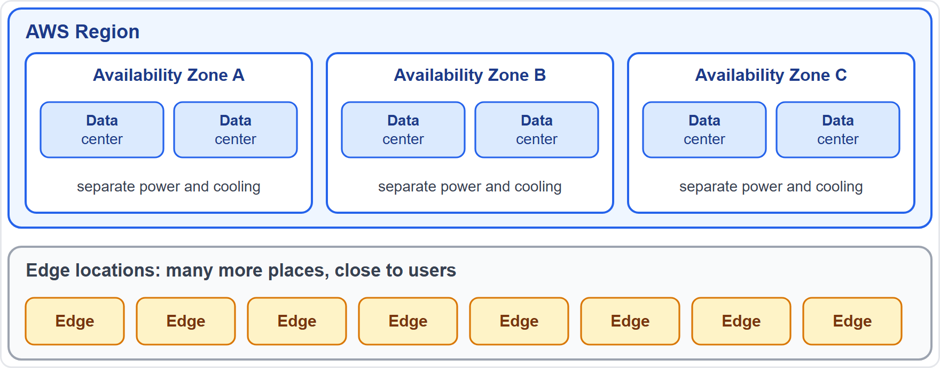
Regions, Availability Zones and Edge Locations
DATES
Part 1
A Region is a physical location where AWS clusters data centers
Each Region has at least three isolated Availability Zones (AZs)
An AZ is one or more discrete data centers with redundant power, networking and connectivity
Edge locations sit in many more places, to deliver content close to users
As of 4 November 2026: AWS reports 39 Regions, 124 AZs and 750+ CloudFront points of presence; counts change, and other AWS pages differ
EXAM TIP A Region contains Availability Zones; edge locations are separate and serve cached content.
Cloud Practitioner Exam Prep Masterclass | for the AWS CLF-C02 exam
Module 6
9 / 24
Notes:
Now the global infrastructure. A Region is a physical location where A W S clusters data centers. Each Region has at least three isolated Availability Zones. An Availability Zone, or A Z, is one or more discrete data centers with redundant power, networking and connectivity. Edge locations are different. They sit in many more places than Regions, and they deliver content close to users. Look at the figure: the Region contains the zones, and the edge locations sit outside it. As of the fourth of November, twenty twenty-six, A W S reports thirty-nine Regions, one hundred twenty-four Availability Zones, and more than seven hundred fifty CloudFront points of presence. Counts change, and other A W S pages differ, and the exam does not test the numbers. Exam tip: a Region contains Availability Zones; edge locations are separate and serve cached content.

Slide 10
Choosing a Region
Part 1
Compliance and data residency: you choose the Region where your content is stored, and AWS will not move it out of that Region except as needed to provide the services or to comply with the law
Latency: pick a Region close to most of your users
Services and features: not every service is in every Region, so check availability
Cost: compare prices between Regions (Module 13)
Regions are independent: each one is isolated from the others
Newer Regions must be enabled in your account before you can use them [Beyond the guide]
EXAM TIP Data must stay in a country: choose a Region there. Users far away: choose a Region near them.
Cloud Practitioner Exam Prep Masterclass | for the AWS CLF-C02 exam
Module 6
10 / 24
Notes:
How do you choose a Region? Start with compliance and data residency. You choose the Region where your content is stored, and A W S will not move it out of that Region except as needed to provide the services or to comply with the law. Next, latency: pick a Region close to most of your users. Then services and features. Not every service is in every Region, so check availability. Cost matters too, so compare prices between Regions, which Module thirteen covers. Remember that Regions are independent, and each is isolated from the others. One extra detail beyond the guide: newer Regions must be enabled in your account before you can use them. Exam tip: if data must stay in a country, choose a Region there; if users are far away, choose a Region near them.

Slide 11
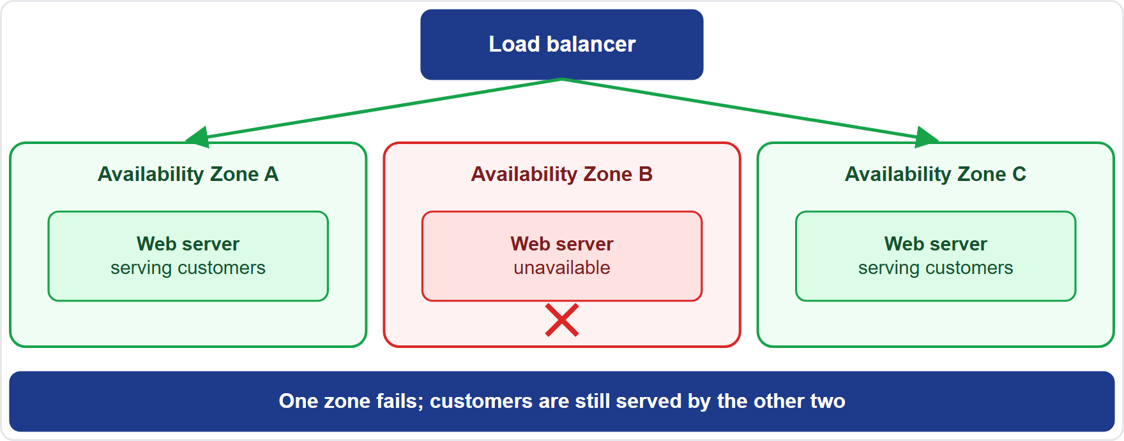
Availability Zones and High Availability
Part 2
High availability means the application keeps working when a part of it fails
Each AZ has its own power, cooling and physical security, so AZs do not share a single point of failure
AZs are many kilometers apart, yet within 100 km (60 miles), joined by low-latency, high-bandwidth links with encrypted traffic
Run the application in at least two AZs behind a load balancer
If one AZ fails, the others keep serving customers
EXAM TIP Survive a data center failure inside a Region: use multiple Availability Zones.
Cloud Practitioner Exam Prep Masterclass | for the AWS CLF-C02 exam
Module 6
11 / 24
Notes:
High availability means the application keeps working when a part of it fails. Availability Zones are how you get it. Each zone has its own power, cooling and physical security, so zones do not share a single point of failure. They are many kilometers apart, yet within one hundred kilometers, or sixty miles, joined by low-latency, high-bandwidth links, and the traffic between them is encrypted. So run your application in at least two zones, behind a load balancer. In the figure, one zone has failed, and the other two keep serving customers. Exam tip: to survive a data center failure inside a Region, use multiple Availability Zones.

Slide 12
Multiple Regions: When and Why
Part 2
Reason | What it gives | Tidewater example
Disaster recovery and business continuity | The shop keeps serving if a whole Region is unavailable | A copy of the shop in a second Region
Low latency | Users are served from a Region near them | European customers served from a Europe Region
Data sovereignty | Data stays in a chosen country to meet the law | Customer records kept in a Region inside that country
Multiple Regions make copying your setup important: one CloudFormation template can build the same stack in each Region
EXAM TIP Whole-Region failure, distance from users or legal location: multiple Regions. One data center failing: multiple AZs.
Cloud Practitioner Exam Prep Masterclass | for the AWS CLF-C02 exam
Module 6
12 / 24
Notes:
When do you need more than one Region? There are three reasons the exam likes. First, disaster recovery and business continuity: the shop keeps serving if a whole Region is unavailable, for example with a copy in a second Region. Second, low latency: users are served from a Region near them, such as a Europe Region for European customers. Third, data sovereignty: data stays in a chosen country to meet the law, so customer records are kept in a Region inside that country. Running in several Regions makes it important to copy your setup, and one CloudFormation template can build the same stack in each Region. Exam tip: a whole-Region failure, distance from users or legal location means multiple Regions; one data center failing means multiple Availability Zones.

Slide 13
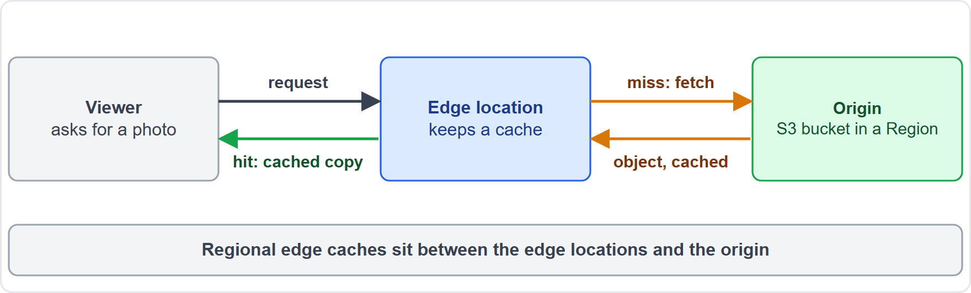
Edge Locations: Content Close to Users
Part 2
Edge locations (CloudFront points of presence) keep cached copies of your content near viewers
DNS sends each request to the edge location that serves it best, usually the nearest in latency
Cache hit: the edge returns the object. Cache miss: it fetches it from the origin, such as an Amazon S3 bucket, then caches it
Regional edge caches sit between the origin and the edge locations and keep content longer
Amazon CloudFront uses them (Module 10); AWS Local Zones place some services closer to big cities [Beyond the guide]
EXAM TIP Faster delivery of content to distant users: edge locations, through CloudFront.
Cloud Practitioner Exam Prep Masterclass | for the AWS CLF-C02 exam
Module 6
13 / 24
Notes:
Edge locations, also called CloudFront points of presence, keep cached copies of your content near viewers. D N S sends each request to the edge location that serves it best, usually the nearest in latency. If the object is in the cache, that is a cache hit, and the edge returns it. If it is not, that is a cache miss. The edge fetches the object from the origin, such as an Amazon S three bucket, and caches it for next time. Regional edge caches sit between the origin and the edge locations and keep content longer. Amazon CloudFront uses all of this, and Module ten covers it. A W S Local Zones, beyond the guide, place some services closer to big cities. Exam tip: faster delivery of content to distant users means edge locations, through CloudFront.

Slide 14
What the Exam Asks: Deploying and Global Infrastructure
Part 2
Console, CLI, SDK or template
One-time or repeatable
CloudFormation, Service Catalog or Service Quotas
explore once, script it, call it from code, or rebuild the same environment
build from a template, offer approved products, or manage limits
console for one-time; CLI, SDK or template for repeatable
Cloud, hybrid or on-premises
Region, AZ or edge location
Multi-AZ or multi-Region
all in AWS, connected to your data center, or only in your data center
where data lives, a data center group inside a Region, or where cached content is served
survive a data center failure, or survive a Region failure and reach distant users
EXAM TIP Match the failure or the need to the smallest unit that solves it.
Cloud Practitioner Exam Prep Masterclass | for the AWS CLF-C02 exam
Module 6
14 / 24
Notes:
Here is how the exam frames this module. Console, C L I, S D K or template: explore once, script it, call it from code, or rebuild the same environment. One-time or repeatable: the console for one-time, and the C L I, an S D K or a template for repeatable. CloudFormation, Service Catalog or Service Quotas: build from a template, offer approved products, or manage limits. Cloud, hybrid or on-premises: all in A W S, connected to your data center, or only in your data center. Region, A Z or edge location: where data lives, a data center group inside a Region, or where cached content is served. And multi-A Z or multi-Region: survive a data center failure, or survive a Region failure and reach distant users. Exam tip: match the failure or the need to the smallest unit that solves it.

Slide 15
Design Check: Tidewater Goes Global
Part 2
Tidewater's need | Choose
Test and production that match exactly | CloudFormation template, one stack per environment
A nightly job that starts and stops test servers | AWS CLI or SDK script on a schedule
Engineers exploring a new service for the first time | Management Console
Only approved server setups for the support team | AWS Service Catalog
A launch fails because the account hit a limit | Service Quotas, then request an increase
The warehouse system stays on site but talks to the cloud | Hybrid deployment
The shop survives the loss of one data center | Servers in two or more AZs behind a load balancer
Product photos load slowly in Europe | CloudFront edge locations, and a Europe Region
Cover the right column, answer each row yourself, then compare
Cloud Practitioner Exam Prep Masterclass | for the AWS CLF-C02 exam
Module 6
15 / 24
Notes:
Now a design check. Cover the right column and answer each row yourself. Test and production that match exactly: a CloudFormation template, with one stack per environment. A nightly job that starts and stops test servers: an A W S C L I or S D K script on a schedule. Engineers exploring a new service for the first time: the Management Console. Only approved server setups for the support team: A W S Service Catalog. A launch fails because the account hit a limit: Service Quotas, then request an increase. The warehouse system stays on site but talks to the cloud: a hybrid deployment. The shop survives the loss of one data center: servers in two or more zones behind a load balancer. And product photos load slowly in Europe: CloudFront edge locations, and a Europe Region. Pause the video if you want more time.

Slide 16
Module Recap
Part 2
1
Access
2
Infrastructure as code
3
Governance
the console is for people and one-time work; the CLI and SDKs call the same APIs for scripts and applications
Service Catalog offers approved products; Service Quotas manages limits
CloudFormation builds consistent stacks from YAML or JSON templates
4
Deployment models
5
Global infrastructure
6
Resilience
cloud, hybrid (cloud plus your own data center) and on-premises
multiple AZs for a data center failure; multiple Regions for a Region failure, low latency or data sovereignty
Regions hold at least three AZs; edge locations serve cached content
Cloud Practitioner Exam Prep Masterclass | for the AWS CLF-C02 exam
Module 6
16 / 24
Notes:
Here is the recap. For access, the console is for people and one-time work, and the C L I and S D Ks call the same A P Is for scripts and applications. For infrastructure as code, CloudFormation builds consistent stacks from Y A M L or J S O N templates. For governance, Service Catalog offers approved products, and Service Quotas manages limits. For deployment models, there are cloud, hybrid, which is cloud plus your own data center, and on-premises. For global infrastructure, Regions hold at least three Availability Zones, and edge locations serve cached content. And for resilience, use multiple zones for a data center failure, and multiple Regions for a Region failure, low latency or data sovereignty.

Slide 17
Practice Question 1
Part 2
Q1
Tidewater needs the same load balancer, servers and database created identically in a test account and a production account, and rebuilt quickly when needed. Which approach fits best?
A
Build each environment by hand in the console and write down the steps
B
Describe the resources in a CloudFormation template and build a stack from it
C
Ask each engineer to type the commands from memory in AWS CloudShell
D
Use Service Quotas to copy the settings from the test account to the production account
Cloud Practitioner Exam Prep Masterclass | for the AWS CLF-C02 exam
Module 6
17 / 24
Notes:
Question one. Tidewater needs the same load balancer, servers and database created identically in a test account and a production account, and rebuilt quickly when needed. Which approach fits best? The four options are on the screen. [PAUSE 12] The answer is B. Describe the resources in a CloudFormation template and build a stack from it. A template describes the resources once, and each stack built from it is consistent and repeatable. Manual steps and commands typed from memory drift between environments, and Service Quotas manages limits rather than copying settings.

Slide 18
Practice Question 2
Part 2
Q2
A developer wants to automate a nightly task that starts and stops test servers on a schedule. Which approach fits best?
A
Sign in to the Management Console every night and click through each of the steps
B
Ask an administrator to run the steps by hand when time allows
C
Write a script that uses the AWS CLI or an AWS SDK and run it on a schedule
D
Use AWS Service Catalog to launch a new copy of the servers each night
Cloud Practitioner Exam Prep Masterclass | for the AWS CLF-C02 exam
Module 6
18 / 24
Notes:
Question two. A developer wants to automate a nightly task that starts and stops test servers by running the same steps on a schedule. Which approach fits best? The four options are on the screen. [PAUSE 12] The answer is C. Write a script that uses the A W S C L I or an A W S S D K, and run it on a schedule. They call the A W S A P Is from code, so the steps can be saved, repeated and scheduled. The console is for one-time and visual work, and Service Catalog offers approved products rather than scheduled tasks.

Slide 19
Practice Question 3
Part 2
Q3
Tidewater keeps its warehouse system in its own data center and connects it to its resources in AWS. Which deployment model is this?
A
Hybrid, which connects cloud resources to existing on-premises ones
B
Cloud, in which every part of the application runs in AWS
C
On-premises, in which all of the resources stay in its own data center
D
Multi-Region, in which copies run in different parts of the world
Cloud Practitioner Exam Prep Masterclass | for the AWS CLF-C02 exam
Module 6
19 / 24
Notes:
Question three. Tidewater keeps its warehouse system in its own data center and connects it to its resources in A W S. Which deployment model is this? The four options are on the screen. [PAUSE 12] The answer is A, hybrid. A hybrid deployment connects cloud-based resources with existing resources that are not in the cloud, most often on-premises. A cloud deployment runs every part in A W S, an on-premises deployment uses no cloud, and multi-Region describes where copies run rather than a deployment model.

Slide 20
Practice Question 4
Part 2
Q4
What is an AWS Availability Zone?
A
A location that caches copies of content close to viewers in cities around the world
B
A separate AWS account that a team uses to keep its own workloads apart from others
C
A geographic area that always contains exactly two data centers and nothing else
D
One or more discrete data centers with redundant power and networking in a Region
Cloud Practitioner Exam Prep Masterclass | for the AWS CLF-C02 exam
Module 6
20 / 24
Notes:
Question four. What is an A W S Availability Zone? The four options are on the screen. [PAUSE 12] The answer is D. An Availability Zone is one or more discrete data centers with redundant power, networking and connectivity in an A W S Region. Caching content near viewers describes an edge location, and an A W S account is a different concept altogether.

Slide 21
Practice Question 5
Part 2
Q5
Tidewater runs its web servers in one Availability Zone, and an outage there would take the shop offline. What is the simplest way to improve availability?
A
Move the web servers to a larger instance type, still in the same zone as before
B
Run the web servers in two Availability Zones behind a load balancer
C
Copy the web servers into a different AWS account in the same zone
D
Add an edge location in front of the web servers, which all stay in the same zone
Cloud Practitioner Exam Prep Masterclass | for the AWS CLF-C02 exam
Module 6
21 / 24
Notes:
Question five. Tidewater runs its web servers in one Availability Zone, and an outage there would take the shop offline. What is the simplest way to improve availability? The four options are on the screen. [PAUSE 12] The answer is B. Run the web servers in two Availability Zones behind a load balancer. Zones do not share a single point of failure, so servers in two zones keep serving if one fails. A bigger instance, another account or an edge location in front still leave every server in the one zone that failed.

Slide 22
Practice Question 6
Part 2
Q6
Tidewater's European customers see slow loads of product photos that are stored in a Region in the United States. Which approach delivers the photos faster?
A
Use Amazon CloudFront to cache the photos at edge locations near them
B
Add a second Availability Zone for the photo storage in the same US Region of AWS
C
Turn on AWS CloudTrail logging in the Region that holds the product photos
D
Increase the size and the number of the web servers in the US Region
Cloud Practitioner Exam Prep Masterclass | for the AWS CLF-C02 exam
Module 6
22 / 24
Notes:
Question six. Tidewater's European customers see slow loads of product photos that are stored in a Region in the United States. Which approach delivers the photos faster? The four options are on the screen. [PAUSE 12] The answer is A. Use Amazon CloudFront to cache the photos at edge locations near them. The photos then travel a shorter distance. Another zone in the same Region adds resilience rather than proximity, CloudTrail records activity, and larger servers do not shorten the distance.

Slide 23
Practice Question 7
Part 2
Q7
Which TWO are valid reasons to run a workload in more than one AWS Region? (Select TWO.)
A
To avoid the need for backups and encryption
B
To keep serving customers if an entire Region becomes unavailable
C
To make Availability Zones unnecessary inside each Region
D
To meet a rule that data must be stored in a specific country
E
To share one set of IAM users across every account automatically
Cloud Practitioner Exam Prep Masterclass | for the AWS CLF-C02 exam
Module 6
23 / 24
Notes:
Question seven. Select two. Which two are valid reasons to run a workload in more than one A W S Region? The five options are on the screen. [PAUSE 15] The answers are B and D. Multiple Regions support disaster recovery and business continuity, and they let you place data in a country to satisfy data sovereignty rules. Low latency for distant users is a third reason. Backups, encryption and Availability Zones are still needed, and I A M users are not shared between accounts automatically.

Slide 24
Answers at a Glance
Part 2
Question | Answer | Why
Q1 | B | A CloudFormation template makes environments consistent and repeatable
Q2 | C | A CLI or SDK script can run on a schedule
Q3 | A | Cloud plus existing on-premises resources is hybrid
Q4 | D | An AZ is one or more discrete data centers in a Region
Q5 | B | Servers in two AZs behind a load balancer survive a zone failure
Q6 | A | CloudFront edge locations cache content near viewers
Q7 | B, D | Regional outages and data sovereignty justify multiple Regions
Cloud Practitioner Exam Prep Masterclass | for the AWS CLF-C02 exam
Module 6
24 / 24
Notes:
Here are all seven answers. Question one: B. Question two: C. Question three: A. Question four: D. Question five: B. Question six: A. Question seven: B and D. That completes Module six. Next, Module seven covers the compute services: virtual servers, containers and serverless functions.

