Slide 1
Module 7: Compute, Containers and Serverless
Virtual servers, containers and functions: choosing how much to manage
Domain 3 · Cloud Technology and Services · Task statement 3.3
Cloud Practitioner Exam Prep Masterclass
Module 7 · Part 1
Notes:
Welcome to Module seven: Compute, Containers and Serverless. This module covers task statement three point three, identifying the A W S compute services. You will learn when to choose virtual servers, containers or functions, and how load balancing and auto scaling make an application elastic. Expect many exam questions that describe a need and ask you to name the service.

Slide 2
What You Will Learn
Part 1
Match EC2 instance families, such as compute optimized and storage optimized, to workloads
Explain what Elastic Load Balancing and Auto Scaling do, and how they give elasticity
Tell Amazon ECS, Amazon EKS and Amazon ECR apart
Choose between AWS Fargate and AWS Lambda for serverless compute
Recognize Elastic Beanstalk, Lightsail, AWS Batch and AWS Outposts
Cloud Practitioner Exam Prep Masterclass | for the AWS CLF-C02 exam
Module 7: Compute, Containers and Serverless
2 / 24
Notes:
By the end of this module you will be able to do five things. Match E C two instance families, such as compute optimized and storage optimized, to workloads. Explain what Elastic Load Balancing and Auto Scaling do, and how they give elasticity. Tell Amazon E C S, Amazon E K S and Amazon E C R apart. Choose between A W S Fargate and A W S Lambda for serverless compute. And recognize Elastic Beanstalk, Lightsail, A W S Batch and A W S Outposts.

Slide 3
Case Check-In: Tidewater Needs Compute That Flexes
Part 1
CASE CHECK-IN · Tidewater Outfitters
The shop runs on a few big servers sized for the holiday peak, and a crashed server takes it offline
Traffic spikes at the sale and then falls
Every photo upload needs a small thumbnail, and the developers want no servers for that job
The team is packaging the shop in containers and wants help running them
The warehouse needs local processing next to its scanners
Your job: choose the compute for each need
Cloud Practitioner Exam Prep Masterclass | for the AWS CLF-C02 exam
Module 7: Compute, Containers and Serverless
3 / 24
Notes:
Tidewater's shop runs on a few big servers, sized for the holiday peak, and when one crashes, the shop goes offline. Traffic spikes at the sale and then falls. Every photo upload needs a small thumbnail, and the developers want no servers for that job. The team is packaging the shop in containers and wants help running them. And the warehouse needs local processing, right next to its scanners. Your job is to choose the compute for each need.

Slide 4
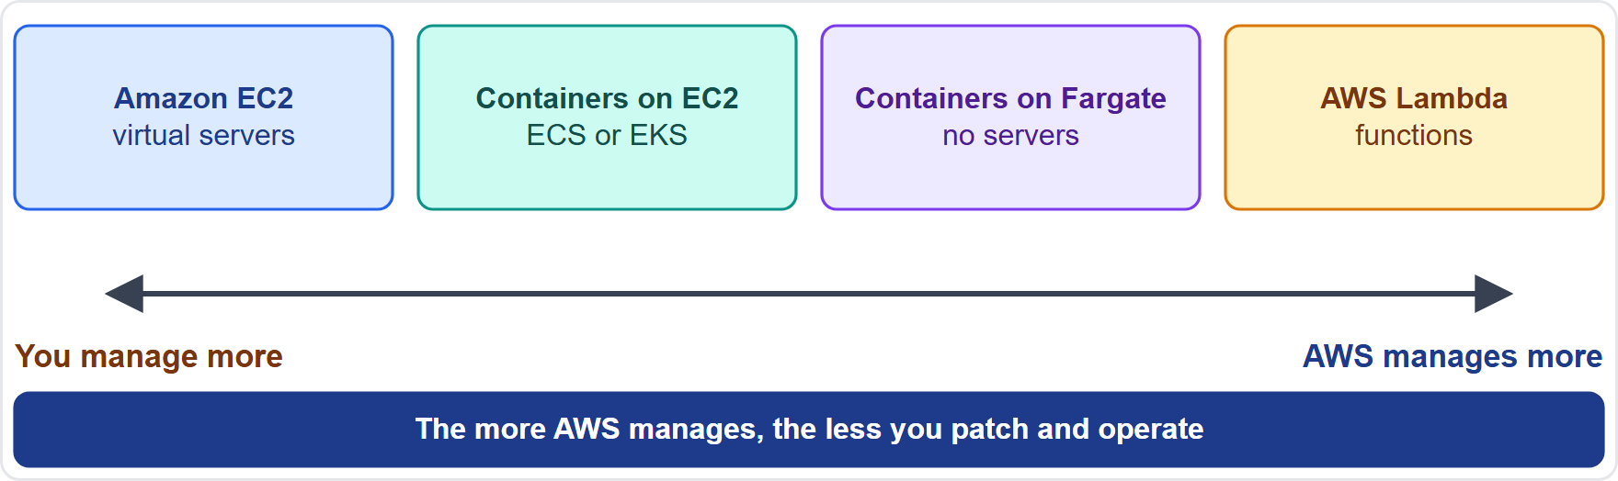
Compute Choices: How Much Do You Manage?
Part 1
Virtual servers: Amazon EC2 gives the most control, and the most to manage
Containers: Amazon ECS and Amazon EKS run packaged applications; AWS Fargate removes the servers
Serverless: Fargate and AWS Lambda mean no servers to provision or manage
The more AWS manages, the less you patch (shared responsibility, Module 3)
Choose by control needed against work you want to avoid
EXAM TIP Most control: EC2. Least to manage: Lambda, with containers and Fargate in between.
Cloud Practitioner Exam Prep Masterclass | for the AWS CLF-C02 exam
Module 7: Compute, Containers and Serverless
4 / 24
Notes:
Think of compute as a spectrum, from most control to least to manage. At one end are virtual servers. Amazon E C two gives you the most control, and the most to manage. Next come containers. Amazon E C S and Amazon E K S run packaged applications, and A W S Fargate removes the servers. At the far end is serverless. Fargate and A W S Lambda mean no servers to provision or manage. Remember the shared responsibility model from Module three: the more A W S manages, the less you patch. So you choose by the control you need, against the work you want to avoid. Exam tip: most control means E C two, and least to manage means Lambda, with containers and Fargate in between.

Slide 5
Amazon EC2: Virtual Servers in the Cloud
Part 1
Amazon EC2 (Elastic Compute Cloud) provides on-demand, scalable computing capacity: virtual servers called instances
Launch as many or as few as you need, scale up for busy periods and scale down afterward
An Amazon Machine Image (AMI) is a preconfigured template with the operating system and software
The instance type sets the CPU, memory, storage and network capacity
Amazon EBS volumes keep data; instance store volumes hold temporary data that is deleted when the instance stops or terminates
A security group is a virtual firewall; a key pair is secure login information
You manage the guest operating system and its patches
EXAM TIP Virtual servers where you control the operating system: Amazon EC2.
Cloud Practitioner Exam Prep Masterclass | for the AWS CLF-C02 exam
Module 7: Compute, Containers and Serverless
5 / 24
Notes:
Amazon Elastic Compute Cloud, or E C two, provides on-demand, scalable computing capacity, in the form of virtual servers called instances. You launch as many or as few as you need, scale up for busy periods, and scale down afterward. An Amazon Machine Image, or A M I, is a preconfigured template with the operating system and software. The instance type sets the C P U, memory, storage and network capacity. Amazon E B S volumes keep data, while instance store volumes hold temporary data that is deleted when the instance stops or terminates. A security group is a virtual firewall, and a key pair is secure login information. And remember: you manage the guest operating system and its patches. Exam tip: virtual servers where you control the operating system means Amazon E C two.

Slide 6
EC2 Instance Types: Match the Family to the Workload
Part 1
Family | Designed for | Think
General purpose | A balance of compute, memory and networking, such as web servers | Everyday
Compute optimized | Compute-intensive work on high performance processors: batch processing, media transcoding, scientific modeling | CPU-bound
Memory optimized | Fast performance on large data sets in memory | Big in-memory data
Storage optimized | High, sequential read and write access to very large data sets on local storage, with many low-latency random IOPS | Disk-heavy
Accelerated computing | Hardware accelerators for graphics, floating-point or pattern matching work | Graphics, machine learning
A name such as c7g.xlarge shows the family, the generation and a size
EXAM TIP Compute optimized for processing power; storage optimized for local disk speed.
Cloud Practitioner Exam Prep Masterclass | for the AWS CLF-C02 exam
Module 7: Compute, Containers and Serverless
6 / 24
Notes:
The exam wants you to match the instance family to the workload. General purpose instances give a balance of compute, memory and networking, such as for web servers. Compute optimized instances are for compute-intensive work on high performance processors, like batch processing, media transcoding and scientific modeling. Memory optimized instances deliver fast performance on large data sets held in memory. Storage optimized instances are for high, sequential read and write access to very large data sets on local storage, with many low-latency random I O P S. And accelerated computing instances use hardware accelerators for graphics, floating-point or pattern matching work. A name such as C seven G dot X large shows the family, the generation and a size. Exam tip: compute optimized for processing power, and storage optimized for local disk speed.

Slide 7
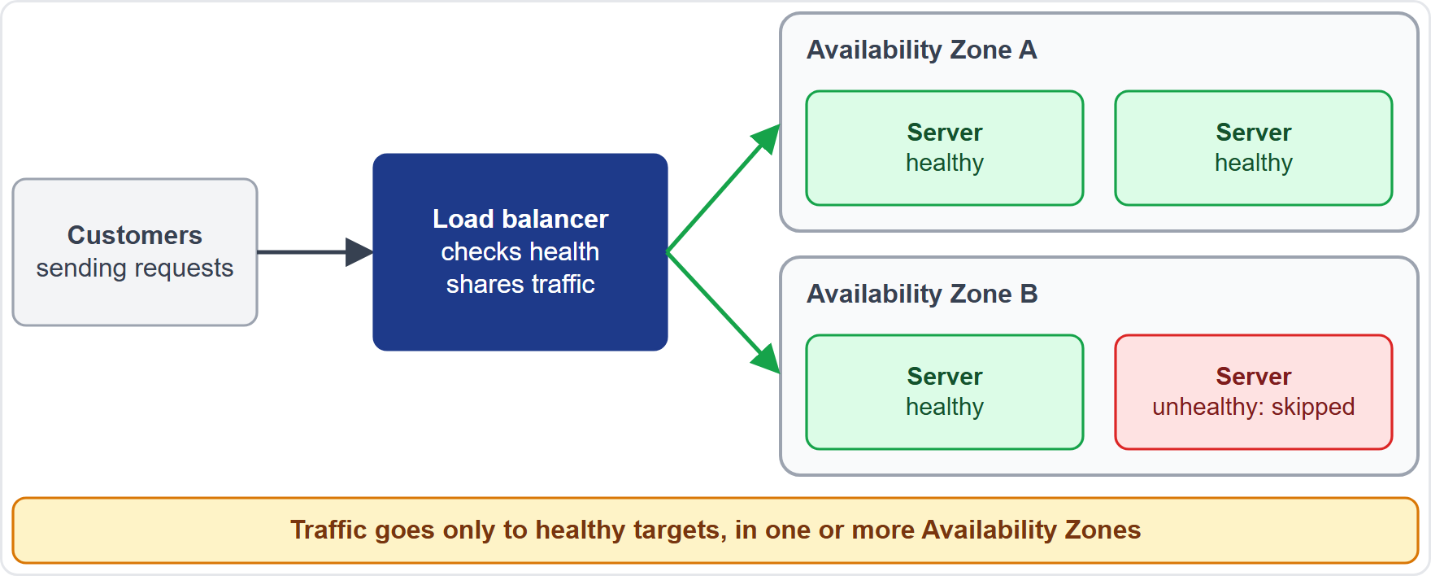
Elastic Load Balancing: Sharing the Traffic
Part 1
Elastic Load Balancing (ELB) automatically distributes incoming traffic across targets such as EC2 instances, containers and IP addresses, in one or more Availability Zones
It checks the health of its targets and sends traffic only to healthy ones
It scales its own capacity as traffic changes, raising availability and fault tolerance
An Application Load Balancer handles HTTP and HTTPS (layer 7); a Network Load Balancer handles TCP and UDP (layer 4)
It can take over encryption and decryption, using certificates from AWS Certificate Manager
Gateway Load Balancers exist, and the Classic Load Balancer is the previous generation [Beyond the guide]
EXAM TIP Spread traffic across servers and skip the failed ones: a load balancer.
Cloud Practitioner Exam Prep Masterclass | for the AWS CLF-C02 exam
Module 7: Compute, Containers and Serverless
7 / 24
Notes:
Elastic Load Balancing automatically distributes incoming traffic across targets, such as E C two instances, containers and I P addresses, in one or more Availability Zones. It checks the health of its targets and sends traffic only to healthy ones. It scales its own capacity as traffic changes, which raises availability and fault tolerance. An Application Load Balancer handles H T T P and H T T P S traffic, at layer seven. A Network Load Balancer handles T C P and U D P traffic, at layer four. A load balancer can also take over encryption and decryption, using certificates from A W S Certificate Manager. Gateway Load Balancers exist, and the Classic Load Balancer is the previous generation, but both are beyond the guide. Exam tip: spread traffic across servers and skip the failed ones, and the answer is a load balancer.

Slide 8
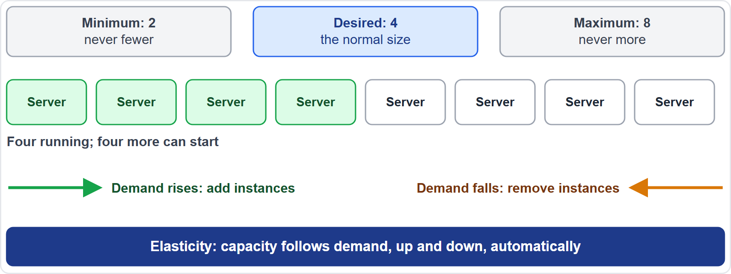
Auto Scaling: Elasticity on Demand
OLD NAME · VERIFY LIVE
Part 1
Amazon EC2 Auto Scaling keeps the right number of instances for the load, in an Auto Scaling group
You set a minimum, a desired capacity and a maximum; the group never goes outside them
Scaling policies add instances as demand rises and remove them as it falls: that is elasticity
It replaces unhealthy instances and balances them across Availability Zones
New instances register with the load balancer automatically; there is no additional fee for Auto Scaling itself
AWS Auto Scaling scaling plans also cover other resources; As of 4 November 2026 the docs show how to migrate them to scaling policies
EXAM TIP Add and remove servers automatically as demand changes: Auto Scaling.
Cloud Practitioner Exam Prep Masterclass | for the AWS CLF-C02 exam
Module 7: Compute, Containers and Serverless
8 / 24
Notes:
Amazon E C two Auto Scaling keeps the right number of instances for the load, in an Auto Scaling group. You set a minimum, a desired capacity and a maximum, and the group never goes outside them. Look at the figure. Scaling policies add instances as demand rises and remove them as it falls. That is elasticity. The group also replaces unhealthy instances and balances them across Availability Zones. New instances register with the load balancer automatically, and there is no additional fee for Auto Scaling itself. A W S Auto Scaling, with scaling plans, also covers other resources. As of the fourth of November, twenty twenty-six, the documentation shows how to migrate those plans to scaling policies, so the older name may appear in study material. Exam tip: adding and removing servers automatically as demand changes means Auto Scaling.

Slide 9
Containers: Amazon ECS, Amazon EKS and Amazon ECR
Part 1
Service | What it is | Remember
Amazon ECS (Elastic Container Service) | Fully managed container orchestration to deploy, manage and scale containerized applications, using task definitions, tasks and services | AWS's container service
Amazon EKS (Elastic Kubernetes Service) | Fully managed Kubernetes: AWS manages the control plane, in AWS and in your own data centers | Choose for Kubernetes
Amazon ECR (Elastic Container Registry) | A managed registry to store, manage and share container images, with image scanning | The image library
A container packages code and its dependencies so it runs the same way everywhere
EXAM TIP Kubernetes: EKS. AWS container orchestration: ECS. Storing images: ECR.
Cloud Practitioner Exam Prep Masterclass | for the AWS CLF-C02 exam
Module 7: Compute, Containers and Serverless
9 / 24
Notes:
A container packages code and its dependencies so it runs the same way everywhere. Three services work with containers. Amazon Elastic Container Service, or E C S, is fully managed container orchestration, to deploy, manage and scale containerized applications, using task definitions, tasks and services. Amazon Elastic Kubernetes Service, or E K S, is fully managed Kubernetes. A W S manages the control plane, and it runs in A W S and in your own data centers. Choose it for Kubernetes. Amazon Elastic Container Registry, or E C R, is a managed registry, to store, manage and share container images, with image scanning. Think of it as the image library. Exam tip: Kubernetes means E K S, A W S container orchestration means E C S, and storing images means E C R.

Slide 10
AWS Fargate: Containers Without Servers
Part 1
AWS Fargate runs containers without servers or clusters of EC2 instances to manage
It works with Amazon ECS: you package the app, set CPU and memory, and launch it
There is no choosing server types, deciding when to scale clusters or packing the cluster
Each Fargate task has its own isolation boundary: it does not share the kernel, CPU, memory or network interface with another task
It is serverless, pay-as-you-go compute for containers
New tasks always start on the latest patched platform revision
EXAM TIP Containers with no servers to manage: AWS Fargate.
Cloud Practitioner Exam Prep Masterclass | for the AWS CLF-C02 exam
Module 7: Compute, Containers and Serverless
10 / 24
Notes:
A W S Fargate runs containers without servers, or clusters of E C two instances, for you to manage. It works with Amazon E C S. You package the application, set the C P U and memory, and launch it. There is no choosing server types, no deciding when to scale a cluster, and no packing the cluster. Each Fargate task has its own isolation boundary, so it does not share the kernel, C P U, memory or network interface with another task. It is serverless, pay-as-you-go compute for containers, and new tasks always start on the latest patched platform revision. Exam tip: containers with no servers to manage means A W S Fargate.

Slide 11
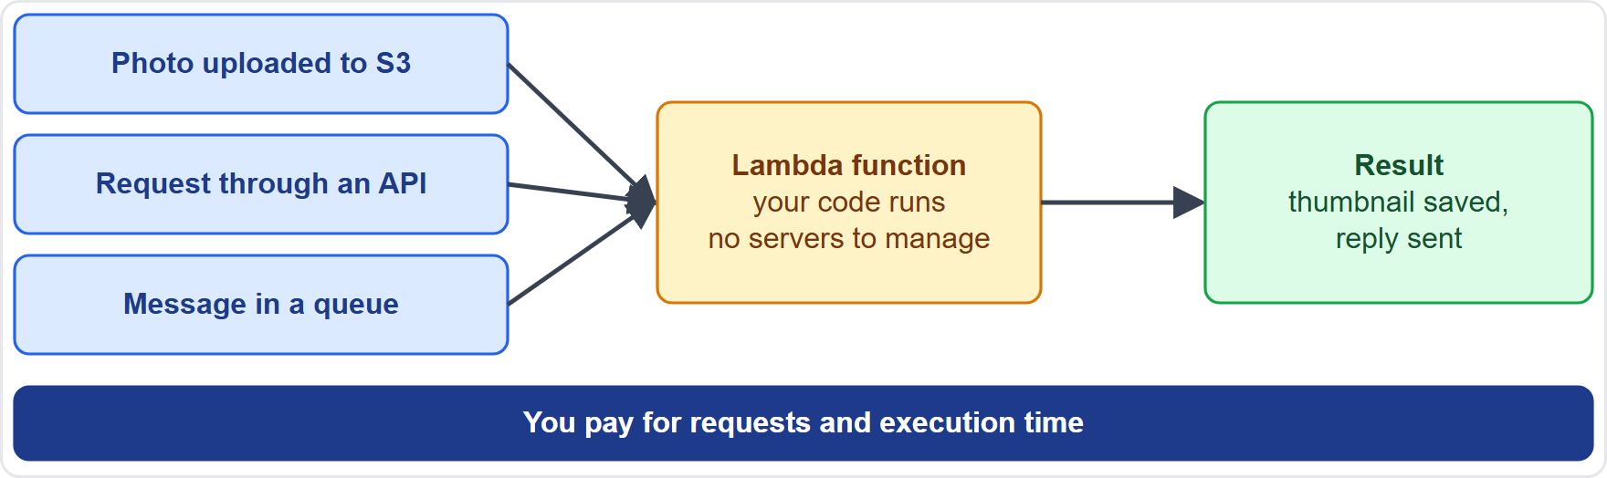
AWS Lambda: Run Code Without Servers
Part 2
AWS Lambda runs your code without provisioning or managing servers
You write a function and connect a trigger, such as Amazon API Gateway, Amazon S3, Amazon SQS or EventBridge
Lambda scales automatically and manages capacity, scaling and patching for you
You pay for requests and execution time, with no upfront commitment
A single invocation can run up to 15 minutes, with 128 MB to 10,240 MB of memory
Lambda suits short-lived, event-driven work
EXAM TIP Run code when something happens, with no servers: AWS Lambda.
Cloud Practitioner Exam Prep Masterclass | for the AWS CLF-C02 exam
Module 7: Compute, Containers and Serverless
11 / 24
Notes:
A W S Lambda runs your code without provisioning or managing servers. You write a function and connect a trigger, such as Amazon A P I Gateway, Amazon S three, Amazon S Q S or EventBridge. Lambda scales automatically, and manages capacity, scaling and patching for you. You pay for requests and execution time, with no upfront commitment. A single invocation can run up to fifteen minutes, with one hundred twenty-eight to ten thousand two hundred forty megabytes of memory. So Lambda suits short-lived, event-driven work. Exam tip: running code when something happens, with no servers, means A W S Lambda.

Slide 12
Elastic Beanstalk, Lightsail and AWS Batch
Part 2
Service | What it does | Choose it when
AWS Elastic Beanstalk | You upload application code; it provisions EC2 instances, sets up load balancing, health monitoring and scaling | You want to deploy a web app without building the infrastructure
Amazon Lightsail | Virtual private servers, containers, databases, storage and networking for a low, predictable monthly price | A simple website or small project
AWS Batch | Runs batch computing jobs at any scale, provisioning the compute each job needs | Large queued jobs, with no batch software to manage
Elastic Beanstalk has no additional charge; you pay for the resources it creates
EXAM TIP Upload code and let AWS build the environment: Elastic Beanstalk. Simple and predictable: Lightsail.
Cloud Practitioner Exam Prep Masterclass | for the AWS CLF-C02 exam
Module 7: Compute, Containers and Serverless
12 / 24
Notes:
Three more compute services appear in the in-scope list. A W S Elastic Beanstalk lets you upload application code, and it provisions E C two instances, and sets up load balancing, health monitoring and scaling. Choose it to deploy a web app without building the infrastructure. Amazon Lightsail offers virtual private servers, containers, databases, storage and networking for a low, predictable monthly price. Choose it for a simple website or a small project. A W S Batch runs batch computing jobs at any scale, provisioning the compute each job needs. Choose it for large queued jobs, with no batch software to manage. Elastic Beanstalk itself has no additional charge; you pay for the resources it creates. Exam tip: upload code and let A W S build the environment means Elastic Beanstalk; simple and predictable means Lightsail.

Slide 13
AWS Outposts: AWS Infrastructure on Your Premises
Part 2
AWS Outposts extends AWS infrastructure, services, APIs and tools to your own premises
An Outpost is a pool of AWS compute and storage at your site that AWS operates, monitors and manages as part of an AWS Region
Run EC2 instances, EBS volumes, ECS clusters and RDS databases there, with the same APIs as in a Region
Use it for low latency and local data processing
A service link connects the Outpost to its Region
It is a hybrid deployment option (Module 6)
EXAM TIP AWS-managed infrastructure inside your own data center: AWS Outposts.
Cloud Practitioner Exam Prep Masterclass | for the AWS CLF-C02 exam
Module 7: Compute, Containers and Serverless
13 / 24
Notes:
A W S Outposts extends A W S infrastructure, services, A P Is and tools to your own premises. An Outpost is a pool of A W S compute and storage at your site, and A W S operates, monitors and manages it as part of an A W S Region. You can run E C two instances, E B S volumes, E C S clusters and R D S databases there, with the same A P Is as in a Region. Use it for low latency and local data processing. A service link connects the Outpost to its Region. It is a hybrid deployment option, as in Module six. Exam tip: A W S-managed infrastructure inside your own data center means A W S Outposts.

Slide 14
What the Exam Asks: Compute
Part 2
Compute or storage optimized
Load balancer or Auto Scaling
ECS, EKS or ECR
AWS orchestration, Kubernetes, or the image library
processing power, or fast local disk access
spread the traffic, or add and remove servers
Fargate or Lambda
Beanstalk, Lightsail or Batch
Outposts
containers with no servers, or functions with no servers
AWS hardware in your data center
upload code, a simple predictable server, or queued jobs
Elasticity
capacity that follows demand, up and down
EXAM TIP Name the need, then the smallest service that meets it.
Cloud Practitioner Exam Prep Masterclass | for the AWS CLF-C02 exam
Module 7: Compute, Containers and Serverless
14 / 24
Notes:
Here is how the exam frames compute. Compute or storage optimized: processing power, or fast local disk access. Load balancer or Auto Scaling: spread the traffic, or add and remove servers. E C S, E K S or E C R: A W S orchestration, Kubernetes, or the image library. Fargate or Lambda: containers with no servers, or functions with no servers. Beanstalk, Lightsail or Batch: upload code, a simple predictable server, or queued jobs. Outposts: A W S hardware in your data center. And elasticity: capacity that follows demand, up and down. Exam tip: name the need, then pick the smallest service that meets it.

Slide 15
Design Check: Tidewater's Compute Plan
Part 2
Tidewater's need | Choose
Servers that grow for the sale and shrink afterward | EC2 Auto Scaling group, behind a load balancer
Spread traffic and skip a failed server | Elastic Load Balancing
A report that holds a huge data set in memory | Memory optimized instance
A thumbnail for every photo upload, with no servers | AWS Lambda, triggered by Amazon S3
The shop's containers, with no servers to manage | Amazon ECS on AWS Fargate
A team that already runs Kubernetes | Amazon EKS
A small blog at a low, predictable price | Amazon Lightsail
Local processing at the warehouse, with AWS tools | AWS Outposts
Cover the right column, answer each row yourself, then compare
Cloud Practitioner Exam Prep Masterclass | for the AWS CLF-C02 exam
Module 7: Compute, Containers and Serverless
15 / 24
Notes:
Now a design check. Cover the right column and answer each row yourself. Servers that grow for the sale and shrink afterward: an E C two Auto Scaling group, behind a load balancer. Spread traffic and skip a failed server: Elastic Load Balancing. A report that holds a huge data set in memory: a memory optimized instance. A thumbnail for every photo upload, with no servers: A W S Lambda, triggered by Amazon S three. The shop's containers, with no servers to manage: Amazon E C S on A W S Fargate. A team that already runs Kubernetes: Amazon E K S. A small blog at a low, predictable price: Amazon Lightsail. And local processing at the warehouse, with A W S tools: A W S Outposts. Pause the video if you want more time.

Slide 16
Module Recap
Part 2
1
EC2
2
Elasticity
3
Containers
virtual servers; families match workloads, such as compute optimized and storage optimized
a load balancer shares traffic across healthy targets; Auto Scaling adds and removes instances
ECS orchestrates, EKS runs Kubernetes, ECR stores images
4
Serverless
5
Simple options
6
Hybrid
Fargate runs containers without servers; Lambda runs functions on events
Elastic Beanstalk deploys uploaded code, Lightsail is simple and predictable, Batch runs queued jobs
Outposts puts AWS infrastructure in your data center
Cloud Practitioner Exam Prep Masterclass | for the AWS CLF-C02 exam
Module 7: Compute, Containers and Serverless
16 / 24
Notes:
Here is the recap. E C two gives virtual servers, and its families match workloads, such as compute optimized and storage optimized. For elasticity, a load balancer shares traffic across healthy targets, and Auto Scaling adds and removes instances. For containers, E C S orchestrates, E K S runs Kubernetes, and E C R stores images. For serverless, Fargate runs containers without servers, and Lambda runs functions on events. The simple options are Elastic Beanstalk, which deploys uploaded code, Lightsail, which is simple and predictable, and Batch, which runs queued jobs. And for hybrid, Outposts puts A W S infrastructure in your data center.

Slide 17
Practice Question 1
Part 2
Q1
Tidewater runs a nightly job that converts product videos to new formats, and the job is limited by processing power. Which EC2 instance family fits best?
A
Memory optimized, for large data sets held in memory
B
Storage optimized, for high sequential access to local disks
C
Compute optimized, for compute-intensive applications
D
General purpose, for an even balance of resources
Cloud Practitioner Exam Prep Masterclass | for the AWS CLF-C02 exam
Module 7: Compute, Containers and Serverless
17 / 24
Notes:
Question one. Tidewater runs a nightly job that converts product videos to new formats, and the job is limited by processing power. Which E C two instance family fits best? The four options are on the screen. [PAUSE 12] The answer is C, compute optimized. These instances are designed for compute-intensive work, and media transcoding is a listed example. Memory optimized instances target large in-memory data sets, storage optimized instances target local disk throughput, and general purpose instances suit balanced workloads.

Slide 18
Practice Question 2
Part 2
Q2
Which TWO statements about EC2 instance families are correct? (Select TWO.)
A
Compute optimized instances are designed for workloads that process large data sets in memory
B
Storage optimized instances suit workloads that need high, sequential read and write access to local storage
C
General purpose instances offer no balance and suit only one kind of workload
D
Memory optimized instances are designed for fast performance on large in-memory data sets
E
Accelerated computing instances use only standard processors and no co-processors
Cloud Practitioner Exam Prep Masterclass | for the AWS CLF-C02 exam
Module 7: Compute, Containers and Serverless
18 / 24
Notes:
Question two. Select two. Which two statements about E C two instance families are correct? The five options are on the screen. [PAUSE 15] The answers are B and D. Storage optimized instances serve workloads with high sequential access to local storage, and memory optimized instances serve large in-memory data sets. Processing large data sets in memory describes memory optimized, not compute optimized. General purpose instances balance resources, and accelerated computing instances add hardware accelerators.

Slide 19
Practice Question 3
Part 2
Q3
Tidewater's traffic spikes during the sale and falls afterward. Which service automatically adds EC2 instances when demand rises and removes them when it falls?
A
Amazon EC2 Auto Scaling, using an Auto Scaling group
B
Elastic Load Balancing, using an Application Load Balancer
C
AWS Outposts, using racks installed on its premises
D
Amazon Lightsail, using a fixed monthly plan
Cloud Practitioner Exam Prep Masterclass | for the AWS CLF-C02 exam
Module 7: Compute, Containers and Serverless
19 / 24
Notes:
Question three. Tidewater's traffic spikes during the sale and falls afterward. Which service automatically adds E C two instances when demand rises and removes them when it falls? The four options are on the screen. [PAUSE 12] The answer is A, Amazon E C two Auto Scaling. It changes the number of instances between the minimum and maximum you set, which is elasticity. A load balancer spreads traffic without adding or removing instances, Outposts is A W S hardware at your site, and Lightsail offers fixed plans.

Slide 20
Practice Question 4
Part 2
Q4
Which service distributes incoming traffic across EC2 instances in more than one Availability Zone and sends requests only to healthy targets?
A
Amazon EC2 Auto Scaling, which adds and removes instances as demand changes
B
AWS Fargate, which runs containers without any servers to manage
C
Amazon ECR, which stores and shares container images for deployment
D
Elastic Load Balancing, which spreads traffic across healthy targets
Cloud Practitioner Exam Prep Masterclass | for the AWS CLF-C02 exam
Module 7: Compute, Containers and Serverless
20 / 24
Notes:
Question four. Which service distributes incoming traffic across E C two instances in more than one Availability Zone and sends requests only to healthy targets? The four options are on the screen. [PAUSE 12] The answer is D, Elastic Load Balancing. It distributes traffic across targets in one or more Availability Zones, and routes only to healthy ones. Auto Scaling changes the number of instances, Fargate runs containers, and E C R stores container images.

Slide 21
Practice Question 5
Part 2
Q5
Tidewater is packaging its shop in containers on Amazon ECS and does not want to provision or manage servers or clusters of EC2 instances. What should it use?
A
Amazon ECR, to store and share the container images
B
AWS Fargate, as the capacity that runs the containers
C
AWS Batch, to queue large computing jobs
D
Amazon EC2, with a cluster of instances it manages itself
Cloud Practitioner Exam Prep Masterclass | for the AWS CLF-C02 exam
Module 7: Compute, Containers and Serverless
21 / 24
Notes:
Question five. Tidewater is packaging its shop in containers on Amazon E C S and does not want to provision or manage servers or clusters of E C two instances. What should it use? The four options are on the screen. [PAUSE 12] The answer is B, A W S Fargate. It runs containers without servers or clusters for you to manage. E C R only stores the images, Batch is for queued computing jobs, and E C two would leave the team managing the cluster.

Slide 22
Practice Question 6
Part 2
Q6
Every time a customer uploads a product photo to Amazon S3, Tidewater needs a thumbnail created automatically, without running any servers. Which service fits best?
A
Amazon EC2, with an instance that runs all day
B
Amazon Lightsail, with a small virtual private server
C
AWS Lambda, with a function started by the upload
D
AWS Elastic Beanstalk, with a web application environment
Cloud Practitioner Exam Prep Masterclass | for the AWS CLF-C02 exam
Module 7: Compute, Containers and Serverless
22 / 24
Notes:
Question six. Every time a customer uploads a product photo to Amazon S three, Tidewater needs a thumbnail created automatically, without running any servers. Which service fits best? The four options are on the screen. [PAUSE 12] The answer is C, A W S Lambda. It runs code in response to events such as an upload, needs no servers, and charges only for requests and execution time. An always-on instance, a Lightsail server or a Beanstalk environment would all keep servers running.

Slide 23
Practice Question 7
Part 2
Q7
Tidewater's developers want to upload the code of a web application and have AWS provision the instances, set up load balancing and scale the environment. Which service fits best?
A
AWS Elastic Beanstalk, which deploys the uploaded code
B
AWS Batch, which runs large queued computing jobs
C
AWS Outposts, which places AWS hardware on premises
D
Amazon ECR, which stores container images
Cloud Practitioner Exam Prep Masterclass | for the AWS CLF-C02 exam
Module 7: Compute, Containers and Serverless
23 / 24
Notes:
Question seven. Tidewater's developers want to upload the code of a web application and have A W S provision the instances, set up load balancing and scale the environment. Which service fits best? The four options are on the screen. [PAUSE 12] The answer is A, A W S Elastic Beanstalk. You upload the code, and it provisions the instances and configures load balancing, health monitoring and scaling. Batch runs queued jobs, Outposts is A W S infrastructure at your site, and E C R is an image registry.

Slide 24
Answers at a Glance
Part 2
Question | Answer | Why
Q1 | C | Compute optimized suits processing-bound work such as transcoding
Q2 | B, D | Storage optimized for local disk access; memory optimized for in-memory data
Q3 | A | EC2 Auto Scaling adds and removes instances with demand
Q4 | D | Elastic Load Balancing spreads traffic across healthy targets
Q5 | B | Fargate runs containers without servers to manage
Q6 | C | Lambda runs code on events with no servers
Q7 | A | Elastic Beanstalk deploys uploaded code and builds the environment
Cloud Practitioner Exam Prep Masterclass | for the AWS CLF-C02 exam
Module 7: Compute, Containers and Serverless
24 / 24
Notes:
Here are all seven answers. Question one: C. Question two: B and D. Question three: A. Question four: D. Question five: B. Question six: C. Question seven: A. That completes Module seven. Next, Module eight covers the storage services: objects, blocks, files and backups.

