Slide 1
Module 9: Databases
Relational, NoSQL, in-memory, document and graph: matching the data to the service
Domain 3 · Cloud Technology and Services · Task statement 3.4
Cloud Practitioner Exam Prep Masterclass
Module 9 · Part 1
Notes:
Welcome to Module nine: Databases. This module covers task statement three point four, identifying the A W S database services. You will learn when to run a database yourself and when to let A W S manage it, which engine fits which kind of data, and how to migrate a database to A W S. Most questions give you a need and ask you to name the database service.

Slide 2
What You Will Learn
Part 1
Explain why a managed database such as Amazon RDS beats one you run on EC2
Tell Multi-AZ deployments from read replicas, and say what Amazon Aurora adds
Recognize Amazon DynamoDB for NoSQL and Amazon ElastiCache for in-memory speed
Place Amazon DocumentDB and Amazon Neptune
Use AWS DMS and AWS SCT to migrate a database
Cloud Practitioner Exam Prep Masterclass | for the AWS CLF-C02 exam
Module 9: Databases
2 / 20
Notes:
By the end of this module you will be able to do five things. Explain why a managed database, such as Amazon R D S, beats one you run on E C two. Tell Multi-A Z deployments from read replicas, and say what Amazon Aurora adds. Recognize Amazon Dynamo D B for no S Q L, and Amazon ElastiCache for in-memory speed. Place Amazon Document D B and Amazon Neptune. And use A W S D M S and A W S S C T to migrate a database.

Slide 3
Case Check-In: Tidewater's Data Needs Differ
Part 1
CASE CHECK-IN · Tidewater Outfitters
The order database runs on a server the team patches and backs up itself, often on weekends
The product catalog needs simple lookups in milliseconds, even at the sale peak
The same popular product pages are read thousands of times a minute
A recommendation idea needs to follow links between customers, orders and products
An old Oracle database must move to AWS with little downtime
Your job: choose the database for each need
Cloud Practitioner Exam Prep Masterclass | for the AWS CLF-C02 exam
Module 9: Databases
3 / 20
Notes:
Tidewater's data needs differ. The order database runs on a server the team patches and backs up itself, often on weekends. The product catalog needs simple lookups in milliseconds, even at the sale peak. The same popular product pages are read thousands of times a minute. A recommendation idea needs to follow links between customers, orders and products. And an old Oracle database must move to A W S with little downtime. Your job is to choose the database for each need.

Slide 4
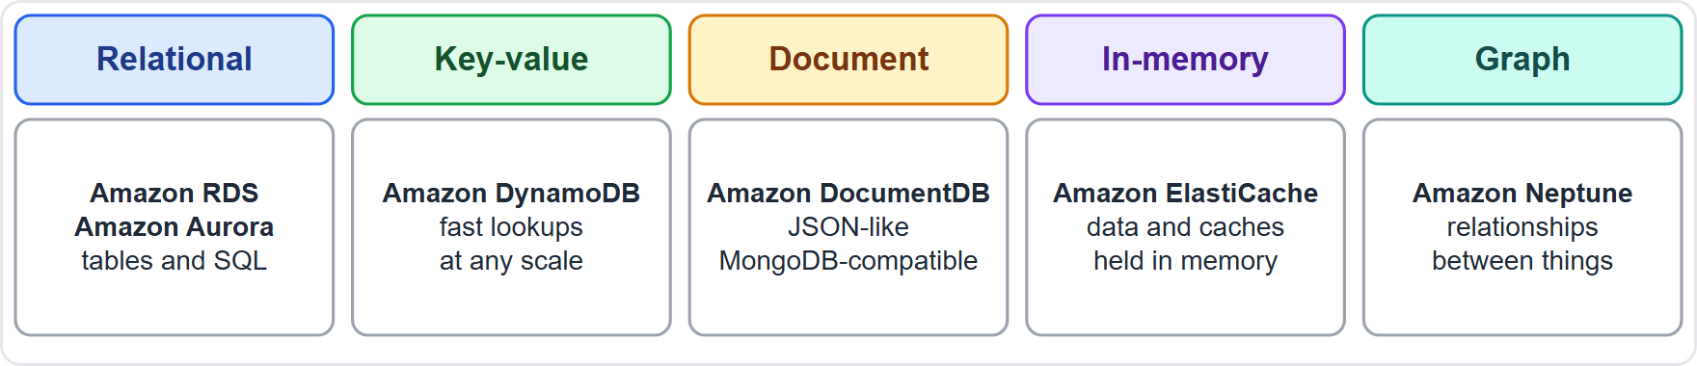
Database Types at a Glance
Part 1
Relational: data in tables, queried with SQL: Amazon RDS and Amazon Aurora
Key-value NoSQL: simple, fast lookups at any scale: Amazon DynamoDB
Document: JSON-like documents, MongoDB-compatible: Amazon DocumentDB
In-memory: data and caches held in memory: Amazon ElastiCache
Graph: relationships between things: Amazon Neptune
EXAM TIP Name the data model first: tables, key-value, documents, memory or relationships.
Cloud Practitioner Exam Prep Masterclass | for the AWS CLF-C02 exam
Module 9: Databases
4 / 20
Notes:
Start with the data model, because it points to the service. Relational databases store data in tables and are queried with S Q L. That is Amazon R D S and Amazon Aurora. Key-value no S Q L databases give simple, fast lookups at any scale. That is Amazon Dynamo D B. Document databases store J S O N-like documents and, in A W S, are compatible with Mongo D B. That is Amazon Document D B. In-memory stores hold data and caches in memory. That is Amazon ElastiCache. And graph databases follow relationships between things. That is Amazon Neptune. Exam tip: name the data model first: tables, key-value, documents, memory or relationships.

Slide 5
Self-Managed or Managed: Databases on EC2 and Amazon RDS
Part 1
Task | Database on EC2 | Amazon RDS
Install and patch the database software | You | AWS
Patch the operating system | You | AWS
Backups, scaling, high availability | You | AWS
Query tuning and application design | You | You
Hardware, power and cooling | AWS | AWS
Amazon RDS (Relational Database Service) runs Db2, MariaDB, SQL Server, MySQL, Oracle and PostgreSQL, plus Aurora
AWS recommends RDS as the default for most relational workloads
EXAM TIP Less administration: Amazon RDS. Full control of the database server: EC2.
Cloud Practitioner Exam Prep Masterclass | for the AWS CLF-C02 exam
Module 9: Databases
5 / 20
Notes:
You can run a database yourself on E C two, or let A W S manage it with Amazon Relational Database Service, or R D S. Compare who does what. Installing and patching the database software: on E C two that is you; on R D S it is A W S. Patching the operating system: you on E C two, A W S on R D S. Backups, scaling and high availability: you on E C two, A W S on R D S. Query tuning and application design: you in both cases. And hardware, power and cooling: A W S in both cases. R D S runs Db two, Maria D B, S Q L Server, My S Q L, Oracle and Postgres S Q L, plus Aurora, and A W S recommends it as the default for most relational workloads. Exam tip: less administration means Amazon R D S; full control of the database server means E C two.

Slide 6
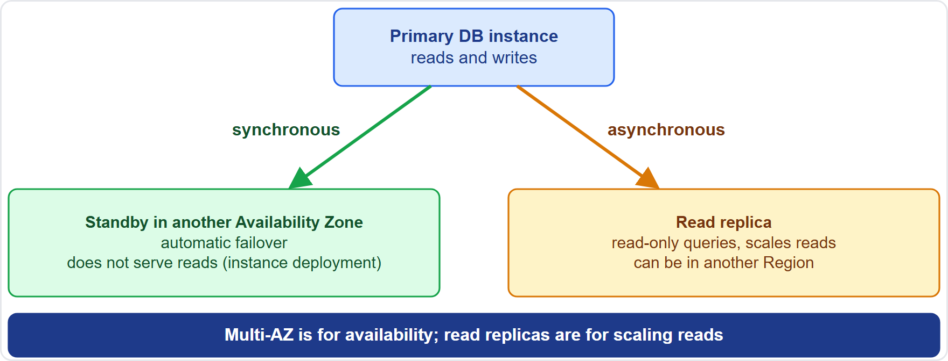
RDS Multi-AZ and Read Replicas
Part 1
Multi-AZ: RDS keeps a standby in another Availability Zone, copied synchronously, and fails over automatically
A Multi-AZ DB instance standby does not serve reads; a Multi-AZ DB cluster has readable standbys
Read replicas are read-only copies, updated asynchronously, that scale reads and run reports
A replica can be in another Region and can be promoted to a standalone instance for disaster recovery
RDS does not autoscale replicas: you create them
EXAM TIP Availability and failover: Multi-AZ. Read scaling: read replicas.
Cloud Practitioner Exam Prep Masterclass | for the AWS CLF-C02 exam
Module 9: Databases
6 / 20
Notes:
Two R D S features are easy to confuse. A Multi-A Z deployment is for availability. R D S keeps a standby in another Availability Zone, copied synchronously, and fails over automatically if the primary fails. In a Multi-A Z D B instance deployment, the standby does not serve reads, though a Multi-A Z D B cluster has readable standbys. Read replicas are for scaling reads. They are read-only copies, updated asynchronously, so they take reporting and read-heavy traffic off the primary. A replica can live in another Region, and it can be promoted to a standalone instance for disaster recovery. R D S does not autoscale replicas; you create them. Look at the figure. Exam tip: availability and failover mean Multi-A Z; read scaling means read replicas.

Slide 7
Amazon Aurora: Relational Built for the Cloud
VERIFY LIVE
Part 1
Amazon Aurora is a fully managed relational engine compatible with MySQL and PostgreSQL
It is part of Amazon RDS: the same console, CLI and API handle provisioning, patching, backup, recovery and failure detection
AWS states throughput of up to 6 times stock MySQL and stock PostgreSQL on similar hardware
Storage grows automatically, up to 256 TiB for a cluster volume
It automates clustering and replication, usually the hardest parts of database administration
You can move from RDS for MySQL or PostgreSQL with a snapshot or one-way replication
As of 4 November 2026: figures are from the Aurora User Guide
EXAM TIP MySQL or PostgreSQL compatible, with higher performance and storage that grows by itself: Aurora.
Cloud Practitioner Exam Prep Masterclass | for the AWS CLF-C02 exam
Module 9: Databases
7 / 20
Notes:
Amazon Aurora is a fully managed relational engine that is compatible with My S Q L and Postgres S Q L. It is part of Amazon R D S, so the same console, C L I and A P I handle provisioning, patching, backup, recovery and failure detection. A W S states throughput of up to six times stock My S Q L and stock Postgres S Q L on similar hardware. Storage grows automatically, up to two hundred fifty-six tebibytes for a cluster volume. Aurora also automates clustering and replication, which are usually the hardest parts of database administration. You can move from R D S for My S Q L or Postgres S Q L with a snapshot or one-way replication. As of the fourth of November, twenty twenty-six, these figures come from the Aurora user guide. Exam tip: My S Q L or Postgres S Q L compatible, with higher performance and storage that grows by itself, means Aurora.

Slide 8
Amazon DynamoDB: Serverless NoSQL
Part 1
Amazon DynamoDB is a serverless, fully managed NoSQL database for key-value and document data
Single-digit millisecond performance at any scale
No servers to provision or patch, and no maintenance windows
On-demand capacity charges per request and scales up and down; provisioned capacity is the alternative
Data is copied across three Availability Zones by default, and global tables replicate across Regions
Data is encrypted at rest by default, with point-in-time recovery for up to 35 days
DAX adds an in-memory cache, from milliseconds to microseconds
DynamoDB has no JOIN operator
EXAM TIP Key-value lookups, milliseconds at any scale, no servers: Amazon DynamoDB.
Cloud Practitioner Exam Prep Masterclass | for the AWS CLF-C02 exam
Module 9: Databases
8 / 20
Notes:
Amazon Dynamo D B is a serverless, fully managed no S Q L database for key-value and document data. It delivers single-digit millisecond performance at any scale. There are no servers to provision or patch, and no maintenance windows. On-demand capacity charges per request and scales up and down, and provisioned capacity is the alternative. Data is copied across three Availability Zones by default, and global tables replicate across Regions. Data is encrypted at rest by default, with point-in-time recovery for up to thirty-five days. D A X adds an in-memory cache, taking responses from milliseconds to microseconds. One limit to remember: Dynamo D B has no join operator. Exam tip: key-value lookups, milliseconds at any scale and no servers means Amazon Dynamo D B.

Slide 9
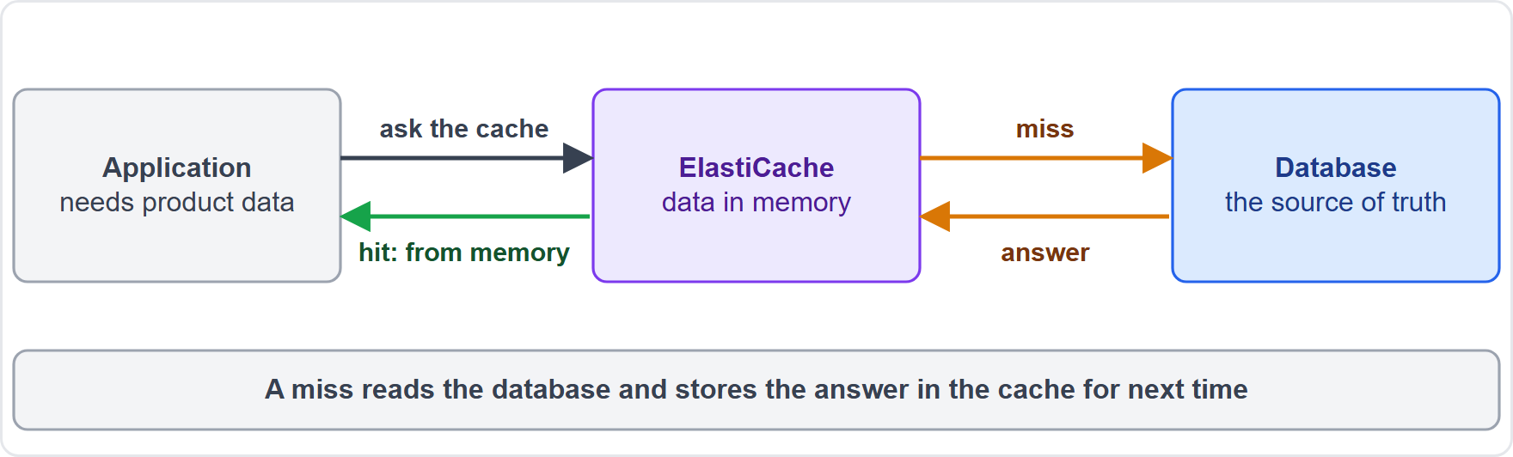
Amazon ElastiCache: In-Memory Caching
Part 1
Amazon ElastiCache is a managed in-memory data store and cache
Its engines are Valkey, Memcached and Redis OSS
Put it in front of a database, so popular reads come from memory: faster for users, less load on the database
ElastiCache Serverless needs only a name; node-based clusters give control over node type, count and Availability Zones
AWS manages hardware, monitoring, node replacement and patching
EXAM TIP Speed up repeated reads with an in-memory cache: Amazon ElastiCache.
Cloud Practitioner Exam Prep Masterclass | for the AWS CLF-C02 exam
Module 9: Databases
9 / 20
Notes:
Amazon ElastiCache is a managed in-memory data store and cache. Its engines are Valkey, Memcached and Redis O S S. Put it in front of a database, so popular reads come from memory. That is faster for users, and it means less load on the database. In the figure, the application asks the cache first. A hit returns data straight from memory. A miss reads the database, then stores the answer in the cache for next time. ElastiCache Serverless needs only a name, and node-based clusters give control over node type, node count and Availability Zones. A W S manages hardware, monitoring, node replacement and patching. Exam tip: speeding up repeated reads with an in-memory cache means Amazon ElastiCache.

Slide 10
Amazon DocumentDB and Amazon Neptune
Part 2
Service | What it is | Remember
Amazon DocumentDB | Fully managed document database, compatible with MongoDB: same code, drivers and tools; storage grows automatically; up to 15 replicas; backups up to 35 days | JSON-like documents
Amazon Neptune | Fully managed graph database for highly connected data; queries in Gremlin, openCypher and SPARQL; recommendation engines, fraud detection, knowledge graphs; up to 15 read replicas | Relationships
EXAM TIP MongoDB workloads: DocumentDB. Recommendations from relationships: Neptune.
Cloud Practitioner Exam Prep Masterclass | for the AWS CLF-C02 exam
Module 9: Databases
10 / 20
Notes:
Two specialist engines complete the list. Amazon Document D B is a fully managed document database, compatible with Mongo D B, so you can use the same code, drivers and tools. Its storage grows automatically, it supports up to fifteen replicas, and backups can be kept for up to thirty-five days. Think of it as J S O N-like documents. Amazon Neptune is a fully managed graph database for highly connected data. You query it in Gremlin, open Cypher and S P A R Q L. Typical uses are recommendation engines, fraud detection and knowledge graphs, and it supports up to fifteen read replicas. Think of it as relationships. Exam tip: Mongo D B workloads mean Document D B; recommendations from relationships mean Neptune.

Slide 11
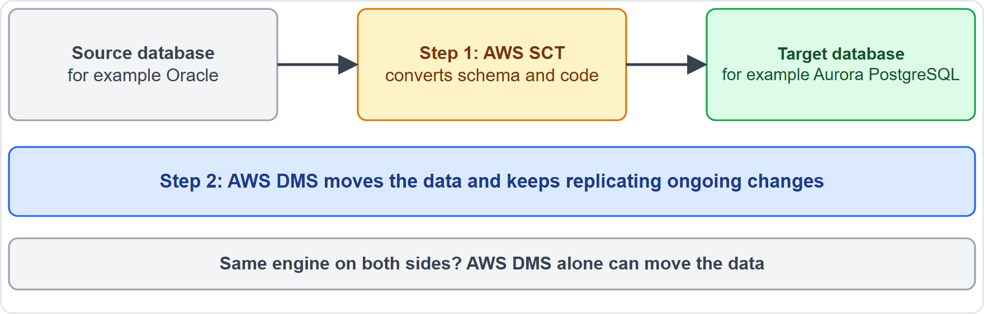
Moving Databases: AWS DMS and AWS SCT
Part 2
AWS Database Migration Service (AWS DMS) migrates databases and data stores to AWS, or between cloud and on-premises
It can do a one-time migration or replicate ongoing changes to keep source and target in sync
It supports same-engine and different-engine migrations
AWS Schema Conversion Tool (AWS SCT) converts the schema and code from one engine to another, such as Oracle to PostgreSQL
DMS Schema Conversion can also convert source schemas
EXAM TIP Different engine: SCT converts the schema, DMS moves the data.
Cloud Practitioner Exam Prep Masterclass | for the AWS CLF-C02 exam
Module 9: Databases
11 / 20
Notes:
Two services help you move a database. A W S Database Migration Service, D M S, migrates databases and data stores to A W S, or between the cloud and on-premises. It can do a one-time migration, or replicate ongoing changes to keep source and target in sync. It supports migrations that keep the same engine and migrations that change engine. The A W S Schema Conversion Tool, S C T, converts the schema and code from one engine to another, such as Oracle to Postgres S Q L. D M S Schema Conversion can also convert source schemas. Look at the figure: S C T converts, then D M S moves the data and keeps replicating changes. Exam tip: when the engine is different, S C T converts the schema, and D M S moves the data.

Slide 12
What the Exam Asks: Databases
Part 2
EC2 or RDS
Multi-AZ or read replica
RDS or Aurora
you run the database, or AWS manages it
standard engines, or MySQL and PostgreSQL compatible with cloud-built storage
failover, or more read capacity
DynamoDB
ElastiCache
DocumentDB or Neptune
key-value lookups with no servers
an in-memory cache for repeated reads
MongoDB documents, or connected data
SCT or DMS
convert the schema, or move the data
EXAM TIP Match the data model and the management you want to the service.
Cloud Practitioner Exam Prep Masterclass | for the AWS CLF-C02 exam
Module 9: Databases
12 / 20
Notes:
Here is how the exam frames databases. E C two or R D S: you run the database, or A W S manages it. Multi-A Z or read replica: failover, or more read capacity. R D S or Aurora: standard engines, or My S Q L and Postgres S Q L compatible with cloud-built storage. Dynamo D B: key-value lookups with no servers. ElastiCache: an in-memory cache for repeated reads. Document D B or Neptune: Mongo D B documents, or connected data. And S C T or D M S: convert the schema, or move the data. Exam tip: match the data model and the management you want to the service.

Slide 13
Design Check: Tidewater's Database Plan
Part 2
Tidewater's need | Choose
The order database, without weekend patching | Amazon RDS
Keep running if a data center fails | Multi-AZ deployment
Reports slowing the order database | A read replica
MySQL compatible, with storage that grows itself | Amazon Aurora
Catalog lookups in milliseconds at any scale | Amazon DynamoDB
Product pages read thousands of times a minute | Amazon ElastiCache
Recommendations from links between customers and products | Amazon Neptune
An old Oracle database to PostgreSQL | SCT to convert, DMS to move
Cover the right column, answer each row yourself, then compare
Cloud Practitioner Exam Prep Masterclass | for the AWS CLF-C02 exam
Module 9: Databases
13 / 20
Notes:
Now a design check. Cover the right column and answer each row yourself. The order database, without weekend patching: Amazon R D S. Keep running if a data center fails: a Multi-A Z deployment. Reports slowing the order database: a read replica. My S Q L compatible, with storage that grows itself: Amazon Aurora. Catalog lookups in milliseconds at any scale: Amazon Dynamo D B. Product pages read thousands of times a minute: Amazon ElastiCache. Recommendations from links between customers and products: Amazon Neptune. And an old Oracle database to Postgres S Q L: S C T to convert, and D M S to move. Pause the video if you want more time.

Slide 14
Module Recap
Part 2
1
Managed or not
2
Availability and reads
3
NoSQL and speed
RDS patches, backs up and fails over; on EC2 you do it all
DynamoDB for key-value at any scale; ElastiCache for in-memory caching
Multi-AZ fails over; read replicas scale reads; Aurora is MySQL and PostgreSQL compatible
4
Specialist engines
5
Migration
SCT converts the schema; DMS moves the data
DocumentDB for MongoDB documents; Neptune for graphs
Cloud Practitioner Exam Prep Masterclass | for the AWS CLF-C02 exam
Module 9: Databases
14 / 20
Notes:
Here is the recap. On managed or not: R D S patches, backs up and fails over for you, while on E C two you do it all. On availability and reads: Multi-A Z fails over, read replicas scale reads, and Aurora is My S Q L and Postgres S Q L compatible. For no S Q L and speed: Dynamo D B for key-value at any scale, and ElastiCache for in-memory caching. For specialist engines: Document D B for Mongo D B documents, and Neptune for graphs. And for migration: S C T converts the schema, and D M S moves the data.

Slide 15
Practice Question 1
Part 2
Q1
Tidewater runs a MySQL database on an EC2 instance and wants AWS to handle patching, backups and failover. Which service fits best?
A
Amazon DynamoDB, a serverless key-value database
B
Amazon ElastiCache, an in-memory data store
C
Amazon RDS for MySQL, a managed relational database
D
Amazon Neptune, a managed graph database
Cloud Practitioner Exam Prep Masterclass | for the AWS CLF-C02 exam
Module 9: Databases
15 / 20
Notes:
Question one. Tidewater runs a My S Q L database on an E C two instance and wants A W S to handle patching, backups and failover. Which service fits best? The four options are on the screen. [PAUSE 12] The answer is C, Amazon R D S for My S Q L. R D S runs My S Q L as a managed service, so A W S handles database and operating system patching, backups and failover. Dynamo D B, ElastiCache and Neptune use different data models, and would not run the existing My S Q L database.

Slide 16
Practice Question 2
Part 2
Q2
Tidewater's order database must stay available if one Availability Zone fails. Which RDS feature meets this need?
A
A Multi-AZ deployment with a synchronous standby in another zone
B
A read replica that serves the reporting queries
C
A larger DB instance class with more memory and CPU
D
A manual snapshot taken each night and stored in S3
Cloud Practitioner Exam Prep Masterclass | for the AWS CLF-C02 exam
Module 9: Databases
16 / 20
Notes:
Question two. Tidewater's order database must stay available if one Availability Zone fails. Which R D S feature meets this need? The four options are on the screen. [PAUSE 12] The answer is A, a Multi-A Z deployment with a synchronous standby in another zone. It fails over automatically. A read replica scales reads, a bigger instance does not remove the single zone, and a nightly snapshot restores slowly, with data loss.

Slide 17
Practice Question 3
Part 2
Q3
The product catalog must answer simple key lookups with single-digit millisecond latency at any scale, with no servers to manage. Which service fits best?
A
Amazon RDS for PostgreSQL, with a Multi-AZ standby
B
Amazon DynamoDB, with on-demand capacity
C
Amazon Neptune, with graph queries
D
Amazon Aurora, with MySQL compatibility
Cloud Practitioner Exam Prep Masterclass | for the AWS CLF-C02 exam
Module 9: Databases
17 / 20
Notes:
Question three. The product catalog must answer simple key lookups with single-digit millisecond latency at any scale, with no servers to manage. Which service fits best? The four options are on the screen. [PAUSE 12] The answer is B, Amazon Dynamo D B, with on-demand capacity. It is a serverless no S Q L database with single-digit millisecond performance at any scale. R D S and Aurora are relational engines with instances to size, and Neptune is built for connected data.

Slide 18
Practice Question 4
Part 2
Q4
The same product pages are read thousands of times a minute and slow the database. Which service can serve those repeated reads from memory?
A
Amazon DocumentDB, a MongoDB-compatible database
B
AWS Database Migration Service, a data mover
C
AWS Schema Conversion Tool, a schema converter
D
Amazon ElastiCache, a managed in-memory cache
Cloud Practitioner Exam Prep Masterclass | for the AWS CLF-C02 exam
Module 9: Databases
18 / 20
Notes:
Question four. The same product pages are read thousands of times a minute and slow the database. Which service can serve those repeated reads from memory? The four options are on the screen. [PAUSE 12] The answer is D, Amazon ElastiCache. It is a managed in-memory data store and cache, so repeated reads come from memory and the database does less work. Document D B stores documents, and D M S and S C T are migration tools.

Slide 19
Practice Question 5
Part 2
Q5
Tidewater is moving an on-premises Oracle database to Amazon Aurora PostgreSQL. Which TWO services help? (Select TWO.)
A
AWS Schema Conversion Tool, to convert the schema and code
B
Amazon ElastiCache, to cache the Oracle data
C
AWS Database Migration Service, to move and replicate the data
D
Amazon Neptune, to store the converted relationships
E
AWS Backup, to schedule the nightly copies
Cloud Practitioner Exam Prep Masterclass | for the AWS CLF-C02 exam
Module 9: Databases
19 / 20
Notes:
Question five. Select two. Tidewater is moving an on-premises Oracle database to Amazon Aurora Postgres S Q L. Which two services help? The five options are on the screen. [PAUSE 15] The answers are A and C. Moving between different engines needs the schema converted, which the A W S Schema Conversion Tool does, and the data moved, which A W S Database Migration Service does. ElastiCache is a cache, Neptune is a graph database, and A W S Backup protects data rather than migrating it.

Slide 20
Answers at a Glance
Part 2
Question | Answer | Why
Q1 | C | RDS manages patching, backups and failover for MySQL
Q2 | A | A Multi-AZ standby in another zone fails over automatically
Q3 | B | DynamoDB gives millisecond key lookups at any scale
Q4 | D | ElastiCache serves repeated reads from memory
Q5 | A, C | SCT converts the schema; DMS moves the data
Cloud Practitioner Exam Prep Masterclass | for the AWS CLF-C02 exam
Module 9: Databases
20 / 20
Notes:
Here are all five answers. Question one: C. Question two: A. Question three: B. Question four: D. Question five: A and C. That completes Module nine. Next, Module ten covers networking and content delivery: the V P C, connectivity options, Route fifty-three and CloudFront.

