Slide 1
Module 10: Networking and Content Delivery
Private networks, firewalls, DNS, delivery and connections to your own sites
Domain 3 · Cloud Technology and Services · Task statement 3.5
Cloud Practitioner Exam Prep Masterclass
Module 10 · Part 1
Notes:
Welcome to Module ten: Networking and Content Delivery. This module covers task statement three point five, identifying the A W S network services. You will learn how a V P C is built, how firewalls and gateways control traffic, how D N S and content delivery work, and how to connect your own sites to A W S. The exam rarely goes deep here, but it expects you to match a need to the right service.

Slide 2
What You Will Learn
Part 1
Describe the parts of an Amazon VPC: subnets, route tables and gateways
Compare security groups and network ACLs
Explain what Amazon Route 53 and Amazon CloudFront do
Choose among Site-to-Site VPN, Client VPN and AWS Direct Connect
Place Transit Gateway, PrivateLink, Global Accelerator and API Gateway
Cloud Practitioner Exam Prep Masterclass | for the AWS CLF-C02 exam
Module 10: Networking and Content Delivery
2 / 21
Notes:
By the end of this module you will be able to do five things. Describe the parts of an Amazon V P C: subnets, route tables and gateways. Compare security groups and network A C Ls. Explain what Amazon Route fifty-three and Amazon CloudFront do. Choose among Site-to-Site V P N, Client V P N and A W S Direct Connect. And place Transit Gateway, PrivateLink, Global Accelerator and A P I Gateway.

Slide 3
Case Check-In: Tidewater Builds Its Network
Part 1
CASE CHECK-IN · Tidewater Outfitters
Customers must reach the web servers, but nobody on the internet may reach the database
Servers in the private network must download updates without accepting outside connections
Visitors type a domain name, and customers in Europe need fast page loads
The warehouse must connect securely to the cloud, and some staff work from home
Your job: choose the network services
Cloud Practitioner Exam Prep Masterclass | for the AWS CLF-C02 exam
Module 10: Networking and Content Delivery
3 / 21
Notes:
Tidewater is building the network for its shop. Customers must reach the web servers, but nobody on the internet may reach the database. Servers in the private network must download updates without accepting outside connections. Visitors type a domain name, and customers in Europe need fast page loads. The warehouse must connect securely to the cloud, and some staff work from home. Your job is to choose the network services.

Slide 4
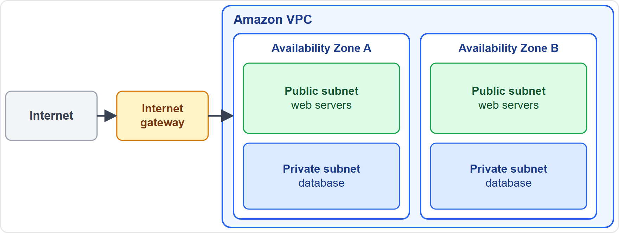
Amazon VPC: Your Private Network in AWS
Part 1
Amazon VPC lets you launch AWS resources in a logically isolated virtual network that you define
A VPC resembles a traditional network in your own data center, with the scalability of AWS
A subnet is a range of IP addresses that lives entirely in one Availability Zone; use several zones for resilience
Route tables decide where traffic goes; gateways connect the VPC to other networks
Every Region starts with a default VPC; a VPC has no additional charge, but parts such as NAT gateways do
EXAM TIP A VPC is your isolated network, and each subnet lives in one Availability Zone.
Cloud Practitioner Exam Prep Masterclass | for the AWS CLF-C02 exam
Module 10: Networking and Content Delivery
4 / 21
Notes:
Amazon V P C lets you launch A W S resources in a logically isolated virtual network that you define. It resembles a traditional network in your own data center, with the scalability of A W S. In the figure, the V P C holds two Availability Zones, and each zone has a public subnet and a private subnet. A subnet is a range of I P addresses that lives entirely in one Availability Zone, so use subnets in several zones for resilience. Route tables decide where traffic goes, and gateways connect the V P C to other networks. Every Region starts with a default V P C. A V P C has no additional charge, but some parts, such as N A T gateways, do. Exam tip: a V P C is your isolated network, and each subnet lives in one Availability Zone.

Slide 5
Public and Private Subnets: Internet and NAT Gateways
Part 1
Component | What it does | Typical use
Public subnet | Has a route to an internet gateway; resources with public IP addresses can reach the internet and be reached | Web servers, load balancers
Private subnet | No direct route to an internet gateway | Databases, application servers
Internet gateway | Redundant, highly available link between the VPC and the internet; no charge | Internet in and out
NAT gateway | Lets private-subnet instances reach out, while the internet cannot start a connection to them; charges apply | Updates for private servers
AWS recommends private subnets to protect your resources
EXAM TIP Reach out but not be reached: NAT gateway. A direct internet path: internet gateway.
Cloud Practitioner Exam Prep Masterclass | for the AWS CLF-C02 exam
Module 10: Networking and Content Delivery
5 / 21
Notes:
The difference between public and private subnets comes down to routing. A public subnet has a route to an internet gateway, so resources with public I P addresses can reach the internet and be reached. Use it for web servers and load balancers. A private subnet has no direct route to an internet gateway. Use it for databases and application servers. The internet gateway is a redundant, highly available link between the V P C and the internet, and it has no charge. A N A T gateway lets instances in a private subnet reach out, while the internet cannot start a connection to them. Charges apply. A W S recommends private subnets to protect your resources. Exam tip: reach out but not be reached means N A T gateway; a direct internet path means internet gateway.

Slide 6
Security Groups and Network ACLs
Part 1
 | Security group | Network ACL (access control list)
Works at | The resource, such as an EC2 instance | The subnet
Rules | Allow rules | Allow and deny rules, checked in number order
State | Stateful: replies to allowed traffic are allowed automatically | Stateless: replies need their own rule
Role | The main firewall for each resource | An extra layer; the default one allows all traffic
Amazon Inspector also checks for unintended network exposure (Module 5)
EXAM TIP Stateful and per resource: security group. Stateless, per subnet, with deny rules: network ACL.
Cloud Practitioner Exam Prep Masterclass | for the AWS CLF-C02 exam
Module 10: Networking and Content Delivery
6 / 21
Notes:
A V P C has two firewall layers, and the exam asks you to compare them. A security group works at the resource, such as an E C two instance. A network A C L, or access control list, works at the subnet. Security groups use allow rules. Network A C Ls use allow and deny rules, checked in number order. Security groups are stateful, so replies to allowed traffic are allowed automatically. Network A C Ls are stateless, so replies need their own rule. In practice, the security group is the main firewall for each resource, and the network A C L is an extra layer; the default one allows all traffic. Amazon Inspector also checks for unintended network exposure, as Module five explained. Exam tip: stateful and per resource means security group; stateless, per subnet, with deny rules means network A C L.

Slide 7
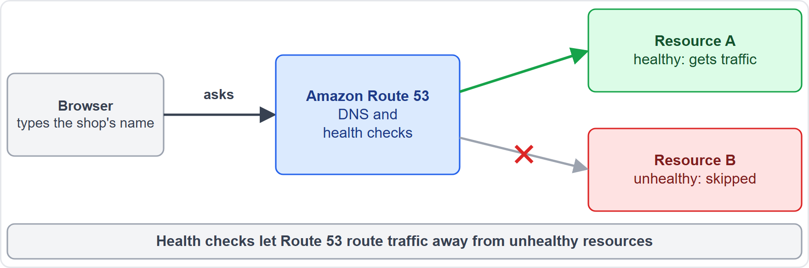
Amazon Route 53: DNS and Health Checks
Part 1
Amazon Route 53 is a highly available, scalable DNS web service
Domain registration: register names such as example.com
DNS routing: connects a browser that types your domain to your website or application
Health checking: sends automated requests to confirm a resource is reachable, notifies you and can route traffic away from unhealthy resources
Traffic Flow routes users by latency, geoproximity and health
VPC Resolver answers DNS queries inside your VPCs
EXAM TIP Domain names and DNS routing: Amazon Route 53.
Cloud Practitioner Exam Prep Masterclass | for the AWS CLF-C02 exam
Module 10: Networking and Content Delivery
7 / 21
Notes:
Amazon Route fifty-three is a highly available, scalable D N S web service. It does three jobs. Domain registration: register names such as example dot com. D N S routing: connect a browser that types your domain to your website or application. And health checking: send automated requests to confirm a resource is reachable, notify you, and route traffic away from unhealthy resources. Traffic Flow adds routing by latency, geoproximity and health, and the V P C Resolver answers D N S queries inside your V P Cs. Exam tip: domain names and D N S routing mean Amazon Route fifty-three.

Slide 8
Amazon CloudFront: Faster Delivery Worldwide
Part 1
Amazon CloudFront is a content delivery network (CDN) that speeds up static and dynamic web content
Content comes from edge locations; each request goes to the one with the lowest latency
On a cache miss, CloudFront fetches the object from your origin: an Amazon S3 bucket or an HTTP server
Objects stay cached for 24 hours by default, and you can change that
A distribution tells CloudFront where your content comes from
You pay for data transfer out and requests; data from AWS origins into CloudFront is free
EXAM TIP Deliver web content quickly to users worldwide: Amazon CloudFront.
Cloud Practitioner Exam Prep Masterclass | for the AWS CLF-C02 exam
Module 10: Networking and Content Delivery
8 / 21
Notes:
Amazon CloudFront is a content delivery network, a C D N, that speeds up static and dynamic web content. It delivers from edge locations, and each request goes to the one with the lowest latency. If the object is not in the cache, that is a cache miss, and CloudFront fetches it from your origin, such as an Amazon S three bucket or an H T T P server. Objects stay cached for twenty-four hours by default, and you can change that. You create a distribution to tell CloudFront where your content comes from. You pay for data transfer out and for requests, while data from A W S origins into CloudFront is free. Exam tip: delivering web content quickly to users worldwide means Amazon CloudFront.

Slide 9
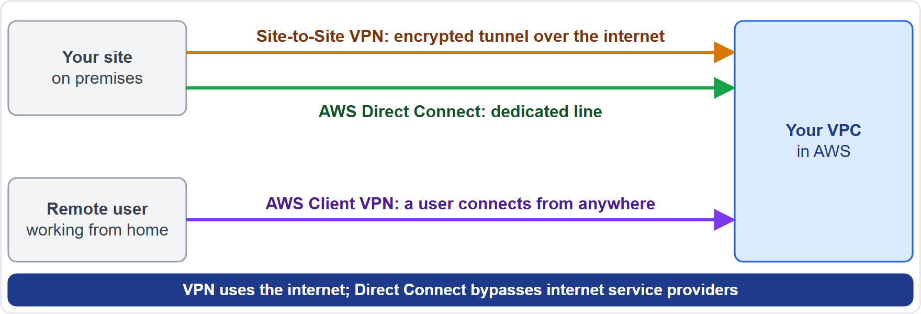
Your Network to AWS: VPN and Direct Connect
Part 1
AWS Site-to-Site VPN: an encrypted IPsec connection between your network and your VPC over the internet, with two tunnels per connection
AWS Client VPN: a managed, client-based VPN; individual users connect from anywhere with an OpenVPN-based client
AWS Direct Connect: a dedicated network connection from your site to AWS, bypassing internet service providers
Direct Connect bills port hours and outbound data transfer
EXAM TIP Encrypted over the internet: VPN. A dedicated private line: AWS Direct Connect.
Cloud Practitioner Exam Prep Masterclass | for the AWS CLF-C02 exam
Module 10: Networking and Content Delivery
9 / 21
Notes:
To connect your own network to A W S, you have three options. A W S Site-to-Site V P N is an encrypted I P sec connection between your network and your V P C, over the internet, with two tunnels per connection. A W S Client V P N is a managed, client-based V P N, where individual users connect from anywhere with an Open V P N-based client. A W S Direct Connect is a dedicated network connection from your site to A W S, bypassing internet service providers. It bills port hours and outbound data transfer. In the figure, the encrypted tunnel travels over the internet, while the dedicated line does not. Exam tip: encrypted over the internet means V P N; a dedicated private line means A W S Direct Connect.

Slide 10
Transit Gateway, PrivateLink and Global Accelerator
Part 2
Service | What it does | Remember
AWS Transit Gateway | A network transit hub that interconnects VPCs and on-premises networks through attachments | Many networks, one hub
AWS PrivateLink | Privately connects your VPC to services as if they were in it, with no internet gateway, NAT device or public IP | Private access to services
AWS Global Accelerator | Two static IP addresses; routes users over the AWS global network to the best healthy endpoint | Global performance and failover
EXAM TIP A hub for networks: Transit Gateway. Private service access: PrivateLink. Static IPs and global routing: Global Accelerator.
Cloud Practitioner Exam Prep Masterclass | for the AWS CLF-C02 exam
Module 10: Networking and Content Delivery
10 / 21
Notes:
Three more networking services are in scope. A W S Transit Gateway is a network transit hub that interconnects V P Cs and on-premises networks through attachments. Think of it as many networks, one hub. A W S PrivateLink privately connects your V P C to services as if they were in it, with no internet gateway, N A T device or public I P address. Think of it as private access to services. A W S Global Accelerator gives you two static I P addresses, and routes users over the A W S global network to the best healthy endpoint. Think of it as global performance and failover. Exam tip: a hub for networks means Transit Gateway; private service access means PrivateLink; static I P addresses and global routing mean Global Accelerator.

Slide 11
Amazon API Gateway: The Front Door for APIs
Part 2
Amazon API Gateway creates, publishes, maintains, monitors and secures APIs at any scale: REST, HTTP and WebSocket
It is a "front door" to backends such as AWS Lambda, Amazon EC2 or any web application
It handles traffic management, authorization, access control, monitoring and version management
Authentication options include IAM policies, Lambda authorizers and Amazon Cognito user pools
AWS WAF can protect your APIs from common web exploits
With Lambda, it forms the app-facing part of serverless applications
EXAM TIP Publish and secure APIs in front of Lambda or other backends: Amazon API Gateway.
Cloud Practitioner Exam Prep Masterclass | for the AWS CLF-C02 exam
Module 10: Networking and Content Delivery
11 / 21
Notes:
Amazon A P I Gateway creates, publishes, maintains, monitors and secures A P Is at any scale. It supports rest, H T T P and WebSocket A P Is. It acts as a front door to backends such as A W S Lambda, Amazon E C two, or any web application. It handles traffic management, authorization, access control, monitoring and version management. Authentication options include I A M policies, Lambda authorizers and Amazon Cognito user pools, and A W S W A F can protect your A P Is from common web exploits. Together with Lambda, it forms the app-facing part of serverless applications. Exam tip: publishing and securing A P Is in front of Lambda or other backends means Amazon A P I Gateway.

Slide 12
What the Exam Asks: Networking
Part 2
Public or private subnet
Internet gateway or NAT gateway
Security group or network ACL
a route to an internet gateway, or none
a direct path, or reach out only
stateful per resource, or stateless per subnet
Route 53 or CloudFront
VPN or Direct Connect
Transit Gateway, PrivateLink or Global Accelerator
encrypted over the internet, or a dedicated line
a hub, private access, or static global IPs
DNS and health checks, or cached content at the edge
API Gateway
a front door for APIs
EXAM TIP Name the layer first: network, firewall, DNS, delivery, connection or API.
Cloud Practitioner Exam Prep Masterclass | for the AWS CLF-C02 exam
Module 10: Networking and Content Delivery
12 / 21
Notes:
Here is how the exam frames networking. Public or private subnet: a route to an internet gateway, or none. Internet gateway or N A T gateway: a direct path, or reach out only. Security group or network A C L: stateful per resource, or stateless per subnet. Route fifty-three or CloudFront: D N S and health checks, or cached content at the edge. V P N or Direct Connect: encrypted over the internet, or a dedicated line. Transit Gateway, PrivateLink or Global Accelerator: a hub, private access, or static global I P addresses. And A P I Gateway: a front door for A P Is. Exam tip: name the layer first: network, firewall, D N S, delivery, connection or A P I.

Slide 13
Design Check: Tidewater's Network Plan
Part 2
Tidewater's need | Choose
Web servers reachable, database not reachable | Public and private subnets
Private servers that download updates | NAT gateway
Allow only web traffic, with replies automatic | Security group
Block one bad IP range at the subnet edge | Network ACL with a deny rule
Customers type the shop's domain name | Amazon Route 53
Fast page loads in Europe | Amazon CloudFront
A quick, encrypted warehouse link | Site-to-Site VPN
A dedicated line to the warehouse | AWS Direct Connect
Staff working from home | AWS Client VPN
Cover the right column, answer each row yourself, then compare
Cloud Practitioner Exam Prep Masterclass | for the AWS CLF-C02 exam
Module 10: Networking and Content Delivery
13 / 21
Notes:
Now a design check. Cover the right column and answer each row yourself. Web servers reachable, database not reachable: public and private subnets. Private servers that download updates: a N A T gateway. Allow only web traffic, with replies automatic: a security group. Block one bad I P range at the subnet edge: a network A C L with a deny rule. Customers type the shop's domain name: Amazon Route fifty-three. Fast page loads in Europe: Amazon CloudFront. A quick, encrypted warehouse link: Site-to-Site V P N. A dedicated line to the warehouse: A W S Direct Connect. And staff working from home: A W S Client V P N. Pause the video if you want more time.

Slide 14
Try It: A VPC with Public and Private Subnets (Optional)
Part 2
Goal: see the parts of a VPC in a practice account; a VPC itself is free, but NAT gateways are not
In the VPC console choose Create VPC, then VPC and more, with two Availability Zones, public and private subnets, and no NAT gateways
Open the route tables: only the public one has a route to the internet gateway
Look at the security group and network ACL the wizard created
Clean up: delete the VPC
SHELL
aws ec2 describe-vpcs --query "Vpcs[].VpcId"
Lists the VPC IDs in the current Region
EXAM TIP Hands-on work is not tested on this exam, but it makes the network pieces concrete.
Cloud Practitioner Exam Prep Masterclass | for the AWS CLF-C02 exam
Module 10: Networking and Content Delivery
14 / 21
Notes:
This optional exercise is not tested on the exam, but it makes the network pieces concrete. Use a practice account. A V P C itself is free, but N A T gateways are not, so avoid creating them. In the V P C console, choose Create V P C, then V P C and more, with two Availability Zones, public and private subnets, and no N A T gateways. Open the route tables, and notice that only the public one has a route to the internet gateway. Look at the security group and network A C L that the wizard created. The command on the screen lists the V P C I Ds in the current Region. When you finish, clean up by deleting the V P C. Exam tip: hands-on work is not tested on this exam, but it makes the network pieces concrete.

Slide 15
Module Recap
Part 2
1
VPC
2
Gateways
3
Firewalls
an isolated network; subnets live in one Availability Zone; public subnets route to an internet gateway
an internet gateway for a direct path; a NAT gateway for outbound-only access
security groups are stateful and per resource; network ACLs are stateless and per subnet
4
DNS and delivery
5
Connections
6
Others
Route 53 for domains and health checks; CloudFront for cached content at the edge
Site-to-Site VPN over the internet, Client VPN for users, Direct Connect for a dedicated line
Transit Gateway hub, PrivateLink private access, Global Accelerator static IPs, API Gateway for APIs
Cloud Practitioner Exam Prep Masterclass | for the AWS CLF-C02 exam
Module 10: Networking and Content Delivery
15 / 21
Notes:
Here is the recap. A V P C is an isolated network. Subnets live in one Availability Zone, and public subnets route to an internet gateway. For gateways, use an internet gateway for a direct path, and a N A T gateway for outbound-only access. For firewalls, security groups are stateful and per resource, and network A C Ls are stateless and per subnet. For D N S and delivery, Route fifty-three handles domains and health checks, and CloudFront serves cached content at the edge. For connections, Site-to-Site V P N runs over the internet, Client V P N is for users, and Direct Connect is a dedicated line. The others are Transit Gateway as a hub, PrivateLink for private access, Global Accelerator for static I P addresses, and A P I Gateway for A P Is.

Slide 16
Practice Question 1
Part 2
Q1
Which VPC feature acts as a stateful firewall for an EC2 instance, automatically allowing the replies to traffic that it permits?
A
A network ACL, which works at the subnet level
B
A NAT gateway, which translates private addresses
C
A security group, which works at the resource level
D
An internet gateway, which links the VPC to the internet
Cloud Practitioner Exam Prep Masterclass | for the AWS CLF-C02 exam
Module 10: Networking and Content Delivery
16 / 21
Notes:
Question one. Which V P C feature acts as a stateful firewall for an E C two instance, automatically allowing the replies to traffic that it permits? The four options are on the screen. [PAUSE 12] The answer is C, a security group. It is a stateful virtual firewall for resources such as E C two instances, so replies to allowed traffic are permitted automatically. A network A C L is stateless and works at the subnet level, and N A T and internet gateways route traffic rather than filter it.

Slide 17
Practice Question 2
Part 2
Q2
Tidewater's application servers are in a private subnet. They must download software updates from the internet, but the internet must not be able to start connections to them. What should Tidewater add?
A
A NAT gateway in a public subnet, with a route from the private subnet
B
A route from the private subnet straight to the internet gateway
C
A public IP address on every application server in the subnet
D
A network ACL that allows all inbound traffic from the internet
Cloud Practitioner Exam Prep Masterclass | for the AWS CLF-C02 exam
Module 10: Networking and Content Delivery
17 / 21
Notes:
Question two. Tidewater's application servers are in a private subnet. They must download software updates from the internet, but the internet must not be able to start connections to them. What should Tidewater add? The four options are on the screen. [PAUSE 12] The answer is A, a N A T gateway in a public subnet, with a route from the private subnet. It lets instances in a private subnet reach the internet while the internet cannot start connections to them. A direct route to the internet gateway or public I P addresses would make the servers reachable, and allowing all inbound traffic does the same.

Slide 18
Practice Question 3
Part 2
Q3
Which AWS service is a highly available DNS web service that can register domain names, route internet traffic to resources and check their health?
A
Amazon CloudFront, a content delivery network
B
AWS Global Accelerator, which provides static IP addresses
C
Amazon API Gateway, a front door for APIs
D
Amazon Route 53, a DNS web service
Cloud Practitioner Exam Prep Masterclass | for the AWS CLF-C02 exam
Module 10: Networking and Content Delivery
18 / 21
Notes:
Question three. Which A W S service is a highly available D N S web service that can register domain names, route internet traffic to resources and check their health? The four options are on the screen. [PAUSE 12] The answer is D, Amazon Route fifty-three. It performs domain registration, D N S routing and health checking. CloudFront caches content at edge locations, Global Accelerator routes traffic over the A W S network to endpoints, and A P I Gateway manages A P Is.

Slide 19
Practice Question 4
Part 2
Q4
Tidewater wants its images, scripts and pages delivered quickly to customers worldwide by caching them near the customers. Which service should it use?
A
AWS Direct Connect, a dedicated line to a data center
B
Amazon CloudFront, a content delivery network
C
A NAT gateway, which lets private servers reach out
D
AWS Transit Gateway, a hub for connecting networks
Cloud Practitioner Exam Prep Masterclass | for the AWS CLF-C02 exam
Module 10: Networking and Content Delivery
19 / 21
Notes:
Question four. Tidewater wants its images, scripts and pages delivered quickly to customers worldwide by caching them near the customers. Which service should it use? The four options are on the screen. [PAUSE 12] The answer is B, Amazon CloudFront. It is a content delivery network that caches static and dynamic content at edge locations, and serves each request from the lowest-latency one. Direct Connect, a N A T gateway and Transit Gateway connect networks rather than deliver cached content.

Slide 20
Practice Question 5
Part 2
Q5
Which TWO statements about connecting an on-premises network to AWS are correct? (Select TWO.)
A
AWS Site-to-Site VPN is an encrypted IPsec connection that runs over the internet
B
AWS Direct Connect runs over the public internet like a standard VPN
C
AWS Direct Connect is a dedicated connection that bypasses internet service providers
D
AWS Client VPN joins two data centers with a dedicated fiber cable
E
AWS Site-to-Site VPN needs a dedicated fiber connection to an AWS location
Cloud Practitioner Exam Prep Masterclass | for the AWS CLF-C02 exam
Module 10: Networking and Content Delivery
20 / 21
Notes:
Question five. Select two. Which two statements about connecting an on-premises network to A W S are correct? The five options are on the screen. [PAUSE 15] The answers are A and C. Site-to-Site V P N carries encrypted I P sec tunnels over the internet, while Direct Connect is a dedicated connection that bypasses internet service providers. Client V P N connects individual users rather than data centers, and only Direct Connect needs a dedicated connection.

Slide 21
Answers at a Glance
Part 2
Question | Answer | Why
Q1 | C | A security group is a stateful firewall per resource
Q2 | A | A NAT gateway gives outbound-only access to a private subnet
Q3 | D | Route 53 registers domains, routes traffic and checks health
Q4 | B | CloudFront caches content at edge locations
Q5 | A, C | Site-to-Site VPN is encrypted over the internet; Direct Connect is dedicated
Cloud Practitioner Exam Prep Masterclass | for the AWS CLF-C02 exam
Module 10: Networking and Content Delivery
21 / 21
Notes:
Here are all five answers. Question one: C. Question two: A. Question three: D. Question four: B. Question five: A and C. That completes Module ten. Next, Module eleven covers machine learning and analytics services.

