Slide 1
Module 0: Course Introduction
The exam, its scope, and how this course works
Orientation · no task statements
Solutions Architect Associate Exam Prep Masterclass
Module 0
Notes:
Welcome to this exam prep course for the A W S Solutions Architect Associate exam, whose code is S A A dash C zero three. This first module is the orientation. It covers the exam itself, what is in scope, how to read the exam guide, and how this course works. There are no practice questions here; the questions start in Module one.

Slide 2
What You Will Learn
Module 0
Describe the exam: its length, its two question types and how it is scored
Say what the exam guide covers and why you should read the current version
Name the four domains and their weights
Know who the exam is for and which services it leaves out
Use the tags, case, Design Checks and questions of this course
Solutions Architect Associate Exam Prep Masterclass | for the AWS SAA-C03 exam
Module 0: Course Introduction and Exam Orientation
2 / 12
Notes:
By the end of this module you will be able to do five things. Describe the exam: its length, its two question types, and how it is scored. Say what the exam guide covers, and why you should read the current version. Name the four domains and their weights. Know who the exam is for, and which services it leaves out. And use the tags, the case, the Design Checks and the practice questions of this course.

Slide 3
Case Check-In: Meet Lantern and Loom
Module 0
CASE CHECK-IN · Lantern and Loom
Lantern and Loom is a fictional online marketplace for handmade goods, run by a small engineering team
It starts as one web server and one database and has to become secure, resilient, fast and affordable
Each module follows one decision: who may do what, how it scales, how it survives a failure, how it stays fast, what it costs
Your job: design the architecture, and learn why one service fits better than its look-alikes
Solutions Architect Associate Exam Prep Masterclass | for the AWS SAA-C03 exam
Module 0: Course Introduction and Exam Orientation
3 / 12
Notes:
Meet Lantern and Loom, a fictional online marketplace for handmade goods, run by a small engineering team. It starts as one web server and one database, and it has to become secure, resilient, fast and affordable. Each module follows one decision: who may do what, how it scales, how it survives a failure, how it stays fast, and what it costs. Your job in this course is to design the architecture, and to learn why one service fits better than its look-alikes.

Slide 4
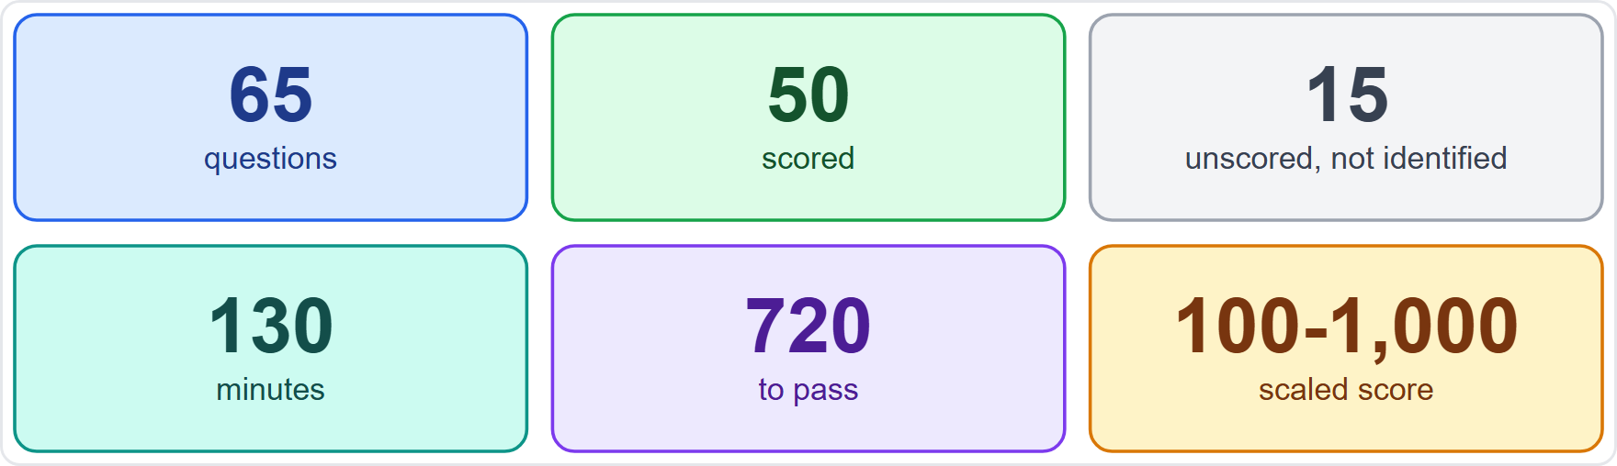
The Exam at a Glance
Module 0
65 questions: 50 are scored and 15 are unscored trial questions
You cannot tell which are unscored, so treat every question as real
130 minutes in all: about 2 minutes a question
Your result is a scaled score from 100 to 1,000, and 720 passes
EXAM TIP The 15 unscored questions are not marked on screen, so give every question your full attention.
Solutions Architect Associate Exam Prep Masterclass | for the AWS SAA-C03 exam
Module 0: Course Introduction and Exam Orientation
4 / 12
Notes:
Here is the exam in six numbers. There are sixty-five questions in total. Fifty are scored, and fifteen are unscored trial questions that A W S uses to test new items. You cannot tell which are which, so treat every question as real. You have one hundred thirty minutes, which is about two minutes a question. Your result is a scaled score from one hundred to one thousand, and seven hundred twenty passes. Exam tip: the fifteen unscored questions are not marked on screen, so give every question your full attention.

Slide 5
Question Types and Scoring
Module 0
Multiple choice: one correct answer and three distractors
Multiple response: two or more correct answers out of five or more options; the question says how many to choose
Distractors are plausible answers that match the topic, so read each option against the requirement
An unanswered question counts as wrong, and there is no penalty for guessing
Compensatory scoring: you must pass the exam as a whole, not each section
EXAM TIP Never leave a question blank: a guess costs nothing and a blank always scores zero.
Solutions Architect Associate Exam Prep Masterclass | for the AWS SAA-C03 exam
Module 0: Course Introduction and Exam Orientation
5 / 12
Notes:
There are two question types. Multiple choice has one correct answer and three distractors. Multiple response has two or more correct answers out of five or more options, and the question tells you how many to choose. Distractors are plausible answers that match the topic, so read each option against the requirement. An unanswered question counts as wrong, and there is no penalty for guessing, so answer every one. Scoring is compensatory, which means you must pass the exam as a whole, not each section. Exam tip: never leave a question blank, because a guess costs nothing and a blank always scores zero.

Slide 6
Booking, Taking and Keeping the Credential
VERIFY LIVE
Module 0
Fee: USD 150, with possible extra costs such as exchange rates
Delivery: at a Pearson VUE test center or online with a proctor
Languages: ten, including English; the Italian version retires after 31 December 2026
Valid for 3 years; renew by passing the latest version of the exam or by earning the Solutions Architect Professional certification
No formal prerequisites
As of 5 November 2026: check AWS's certification page for price, languages and delivery
EXAM TIP Fees, languages and renewal rules change; read AWS's page before you book.
Solutions Architect Associate Exam Prep Masterclass | for the AWS SAA-C03 exam
Module 0: Course Introduction and Exam Orientation
6 / 12
Notes:
Now the practical facts. The fee is one hundred fifty U S dollars, with possible extra costs such as exchange rates. You take the exam at a Pearson view test center, or online with a proctor. Ten languages are offered, including English, and the Italian version retires after the thirty-first of December, twenty twenty-six. The credential is valid for three years, and you can renew it by passing the latest version of the exam, or by earning the Solutions Architect Professional certification. There are no formal prerequisites. As of the fifth of November, twenty twenty-six, check A W S's certification page for price, languages and delivery. Exam tip: fees, languages and renewal rules change, so read A W S's page before you book.

Slide 7
The Exam Guide Is Your Scope
DATES
Module 0
The exam guide lists the domains, weights, task statements and in-scope services
This course follows version 1.1, published on 29 October 2026
The guide had two versions: 28 August 2026 and 29 October 2026
AWS publishes changes about a month before they reach the exam
The service list is non-exhaustive and subject to change
The guide outranks this course on scope
EXAM TIP Read the current exam guide before you book and again in the last week.
Solutions Architect Associate Exam Prep Masterclass | for the AWS SAA-C03 exam
Module 0: Course Introduction and Exam Orientation
7 / 12
Notes:
The exam guide is your scope. It lists the domains, the weights, the task statements and the in-scope services. This course follows version one point one, published on the twenty-ninth of October, twenty twenty-six. The guide had two versions: the twenty-eighth of August, and the twenty-ninth of October, both in twenty twenty-six. A W S publishes changes about a month before they reach the exam. The service list is non-exhaustive and subject to change, so the guide outranks this course on scope. Exam tip: read the current exam guide before you book, and again in the last week.

Slide 8
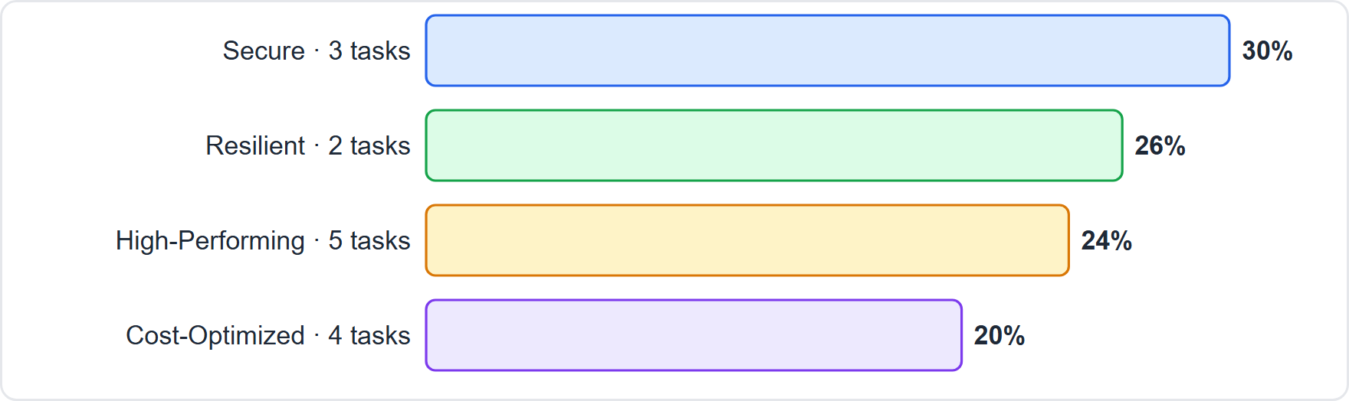
Four Domains, Fourteen Task Statements
Module 0
Domain 1, Design Secure Architectures: 30%, three task statements
Domain 2, Design Resilient Architectures: 26%, two
Domain 3, Design High-Performing Architectures: 24%, five
Domain 4, Design Cost-Optimized Architectures: 20%, four
EXAM TIP Security and resilience together carry 56 percent of the exam; cost is a fifth.
Solutions Architect Associate Exam Prep Masterclass | for the AWS SAA-C03 exam
Module 0: Course Introduction and Exam Orientation
8 / 12
Notes:
The exam has four domains. Domain one, Design Secure Architectures, is thirty percent, with three task statements. Domain two, Design Resilient Architectures, is twenty-six percent, with two. Domain three, Design High-Performing Architectures, is twenty-four percent, with five. And domain four, Design Cost-Optimized Architectures, is twenty percent, with four. The figure shows the weights. Exam tip: security and resilience together carry fifty-six percent of the exam, and cost is a fifth.

Slide 9
Who the Exam Is For
Module 0
The exam validates the ability to design solutions based on the AWS Well-Architected Framework
The target candidate has at least one year of hands-on experience designing cloud solutions with AWS services
Skills tested: design for current needs and future growth, build architectures that are secure, resilient, high-performing and cost-optimized, and review existing solutions
Out of scope services include Internet of Things services, Amazon Lightsail, AWS CodeBuild and CodeDeploy, AWS CDK, Amazon GameLift and the Elemental media services
EXAM TIP Questions ask you to choose a design for a stated requirement, so learn when to use each service, not only what it is.
Solutions Architect Associate Exam Prep Masterclass | for the AWS SAA-C03 exam
Module 0: Course Introduction and Exam Orientation
9 / 12
Notes:
Who is the exam for? It validates the ability to design solutions based on the A W S Well-Architected Framework. The target candidate has at least one year of hands-on experience designing cloud solutions with A W S services. The skills tested are to design for current needs and future growth, to build architectures that are secure, resilient, high-performing and cost-optimized, and to review existing solutions. Out of scope are services such as Internet of Things services, Amazon Lightsail, A W S CodeBuild and CodeDeploy, A W S C D K, Amazon GameLift, and the Elemental media services. Exam tip: questions ask you to choose a design for a stated requirement, so learn when to use each service, not only what it is.

Slide 10
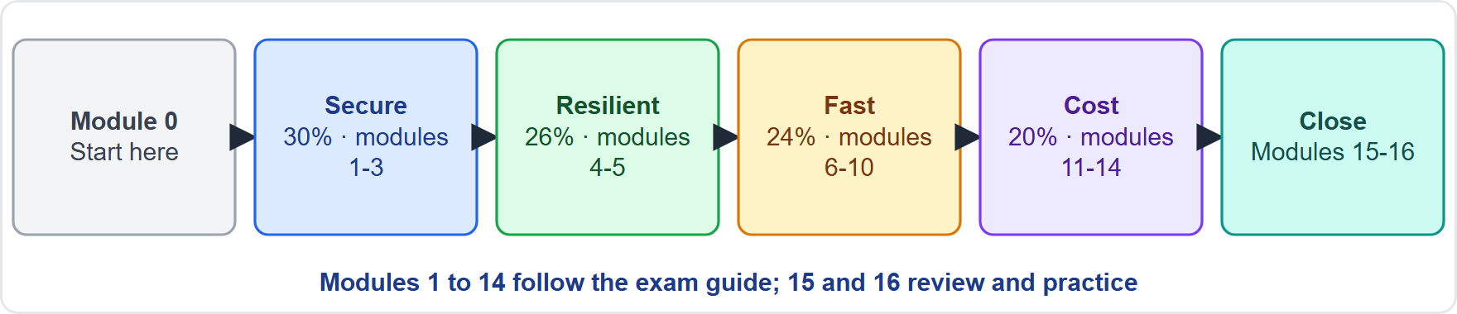
How This Course Works
Module 0
17 modules: this introduction, 14 content modules in the guide's order, a recap and an exam-technique module
Each content module has what you will learn, a Lantern and Loom case, Exam Tips, a recap and practice questions
A Design Check in each module: a requirement, and the design that fits
Slide tags: Beyond the guide, Old name, Verify live, Dates
Solutions Architect Associate Exam Prep Masterclass | for the AWS SAA-C03 exam
Module 0: Course Introduction and Exam Orientation
10 / 12
Notes:
Here is how the course works. There are seventeen modules: this introduction, fourteen content modules in the guide's order, a recap, and an exam-technique module. Each content module has what you will learn, a Lantern and Loom case, Exam Tips, a recap and practice questions. Each module also has a Design Check: a requirement, and the design that fits. Slides carry four tags: Beyond the guide, Old name, Verify live and Dates. The figure shows the course map.

Slide 11
Independent Course, Official Sources
Module 0
This course is independent: not affiliated with, endorsed or sponsored by Amazon Web Services
It shows no AWS logos or service icons; service names appear as text
The notes and questions are in our own wording; it uses no AWS exam questions or dumps
AWS documentation and the exam guide outrank this course on every fact and rule
Limits, prices and service names change: check the source on every Verify-live slide
EXAM TIP When this course and the current AWS documentation disagree, the documentation wins.
Solutions Architect Associate Exam Prep Masterclass | for the AWS SAA-C03 exam
Module 0: Course Introduction and Exam Orientation
11 / 12
Notes:
This course is independent. It is not affiliated with, endorsed by or sponsored by Amazon Web Services. It shows no A W S logos or service icons; service names appear as text. The notes and questions are in our own wording, and the course uses no A W S exam questions or dumps. The A W S documentation and the exam guide outrank this course on every fact and every rule. Limits, prices and service names change, so check the source on every Verify-live slide. Exam tip: when this course and the current A W S documentation disagree, the documentation wins.

Slide 12
Your Study Plan and Ground Rules
Module 0
1
Study one module, then do its questions
2
Cover every task statement
3
Read the exam guide
the modules follow the exam guide's order
the guide does not weight them separately
before you book and again in the last week
4
Answer all 65 questions
5
This course is independent and educational
the official sources outrank it
on the day; never leave one blank
EXAM TIP Before you book, read AWS's current exam guide and certification page.
Solutions Architect Associate Exam Prep Masterclass | for the AWS SAA-C03 exam
Module 0: Course Introduction and Exam Orientation
12 / 12
Notes:
Here is your study plan. Study one module, then do its questions; the modules follow the exam guide's order. Cover every task statement, because the guide does not weight them separately. Read the exam guide before you book, and again in the last week. On the day, answer all sixty-five questions and never leave one blank. And remember that this course is independent and educational, so the official sources outrank it. Exam tip: before you book, read A W S's current exam guide and certification page. That is the orientation. In Module one we start with secure access to A W S resources.

