Slide 1
Module 5: Highly Available and Fault-Tolerant Architectures
Survive a failed server, a failed zone and a failed Region
Domain 2 · Design Resilient Architectures · Task statement 2.2
Solutions Architect Associate Exam Prep Masterclass
Module 5 · Part 1
Notes:
Welcome to Module five: Highly Available and Fault-Tolerant Architectures. This module covers task statement two point two, the second task of Domain two. You will learn how to survive a failed server, a failed zone and a failed Region: redundancy, failover, routing, disaster recovery, automation and visibility. The exam gives you a failure and a target, and asks you to choose the design.

Slide 2
What You Will Learn
Part 1
Design for high availability and fault tolerance across AZs and Regions
Remove single points of failure and choose failover and routing approaches
Select a disaster recovery strategy from RPO and RTO
Use automation and immutable infrastructure, and manage quotas and throttling
Pick services for visibility and for legacy and non-cloud workloads
Solutions Architect Associate Exam Prep Masterclass | for the AWS SAA-C03 exam
Module 5
2 / 36
Notes:
By the end of this module you will be able to do five things. Design for high availability and fault tolerance across Availability Zones and Regions. Remove single points of failure, and choose failover and routing approaches. Select a disaster recovery strategy from the R P O and the R T O. Use automation and immutable infrastructure, and manage quotas and throttling. And pick services for visibility, and for legacy and non-cloud workloads.

Slide 3
Case Check-In: Lantern and Loom Survives a Bad Day
Part 1
CASE CHECK-IN · Lantern and Loom
A power event in one zone took the whole shop offline for 40 minutes
Leaders now ask: what if a whole Region fails?
Targets: lose at most minutes of data, recover in about an hour
An old inventory server cannot be changed
Your job: choose the redundancy, failover and recovery design
Solutions Architect Associate Exam Prep Masterclass | for the AWS SAA-C03 exam
Module 5
3 / 36
Notes:
Lantern and Loom had a bad day. A power event in one zone took the whole shop offline for forty minutes. Leaders now ask: what if a whole Region fails? Their targets are to lose at most minutes of data, and to recover in about an hour. And an old inventory server cannot be changed. Your job is to choose the redundancy, the failover and the recovery design.

Slide 4
High Availability, Fault Tolerance and Resilience
Part 1
Term | Meaning
High availability | The workload keeps serving with minimal interruption when a component fails, using redundancy and fast failover
Fault tolerance | The workload keeps running without interruption through a failure; higher cost and complexity
Resilience | The ability to recover from disruption and keep meeting demand
Availability is a percent of time: 99.9% allows about 8.8 hours of downtime a year, 99.99% about 53 minutes, 99.999% about 5 minutes
Set targets from business requirements
EXAM TIP Each extra nine costs more; choose the availability the business actually needs.
Solutions Architect Associate Exam Prep Masterclass | for the AWS SAA-C03 exam
Module 5
4 / 36
Notes:
Three terms to separate. High availability means the workload keeps serving with minimal interruption when a component fails, using redundancy and fast failover. Fault tolerance means the workload keeps running without interruption through a failure, at higher cost and complexity. Resilience is the ability to recover from disruption and keep meeting demand. Availability is a percent of time: ninety-nine point nine percent allows about eight point eight hours of downtime a year; ninety-nine point nine nine percent about fifty-three minutes; and ninety-nine point nine nine nine percent about five minutes. Set the target from business requirements. Exam tip: each extra nine costs more, so choose the availability the business actually needs.

Slide 5
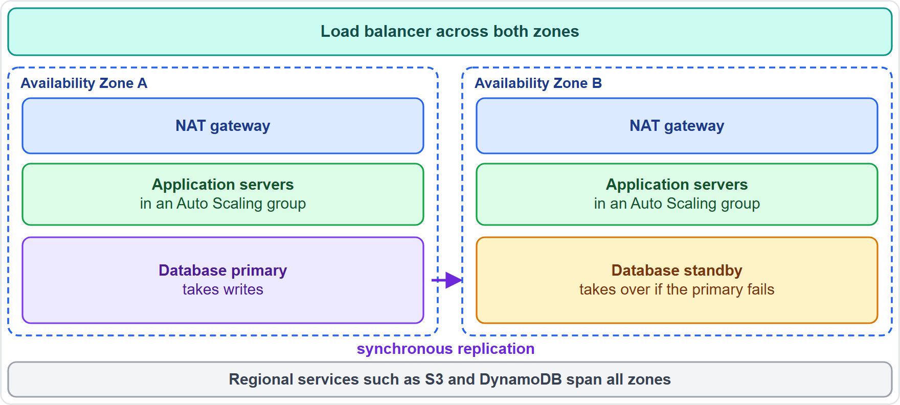
Removing Single Points of Failure
Part 1
A load balancer and an Auto Scaling group that span two or more Availability Zones (AZs)
One NAT gateway per AZ; a Multi-AZ database
Each zone's route table sends traffic to its own NAT gateway
S3, DynamoDB and SQS already run across zones
Hunt for singles: one instance, one AZ, one DNS record, one manual step
EXAM TIP If one thing failing takes the workload down, it is a single point of failure.
Solutions Architect Associate Exam Prep Masterclass | for the AWS SAA-C03 exam
Module 5
5 / 36
Notes:
Start by removing single points of failure. Use a load balancer and an Auto Scaling group that span two or more Availability Zones. Put one N A T gateway in each zone, point each zone's route table at its own gateway, and use a Multi-A Z database. S three, DynamoDB and S Q S already run across zones. Then hunt for the singles: one instance, one zone, one D N S record, one manual step. The figure shows two zones, each with application servers and a N A T gateway, a spanning load balancer, and a database with a standby. Exam tip: if one thing failing takes the workload down, it is a single point of failure.

Slide 6
Multi-AZ or Multi-Region?
Part 1
 | Multi-AZ | Multi-Region
Protects against | A data center or zone failure | A whole Region failure
Distance | AZs are far enough apart to avoid shared failures, close enough for synchronous replication | Far apart: replication is asynchronous
Also gives | The default high availability | Compliance distance, lower latency for global users
Cost and effort | Moderate | Higher
EXAM TIP A zone-level failure needs Multi-AZ; a Region-level disaster or a distance rule needs Multi-Region.
Solutions Architect Associate Exam Prep Masterclass | for the AWS SAA-C03 exam
Module 5
6 / 36
Notes:
Multi-A Z or Multi-Region? Multi-A Z protects against a data center or zone failure. Zones are far enough apart to avoid shared failures, and close enough for synchronous replication. It is the default for high availability, at moderate cost and effort. Multi-Region protects against a whole Region failing. The Regions are far apart, so replication is asynchronous. It also helps with compliance distance and lower latency for global users, but costs more and takes more effort. Exam tip: a zone-level failure needs Multi-A Z; a Region-level disaster, or a distance rule, needs Multi-Region.

Slide 7
Failover Patterns and Health Checks
Part 1
Active-passive: a standby takes traffic only after a failure; active-active: every site serves traffic
Health checks detect failures; load balancers, Auto Scaling and Route 53 act on them
Automatic failover can trigger on false alarms; many teams use manual start with automated steps
Rely on the data plane during failover, not control plane changes
Distributed patterns: timeouts, retries with backoff, queues, stateless services, idempotent work
EXAM TIP Pre-provision what recovery needs, so failover does not depend on creating resources during the outage.
Solutions Architect Associate Exam Prep Masterclass | for the AWS SAA-C03 exam
Module 5
7 / 36
Notes:
Failover comes in two shapes. Active-passive means a standby takes traffic only after a failure. Active-active means every site serves traffic. Health checks detect failures, and load balancers, Auto Scaling and Route fifty-three act on them. Automatic failover can trigger on false alarms, so many teams use a manual start with automated steps. During failover, rely on the data plane, not on control plane changes. Distributed design patterns help too: timeouts, retries with backoff, queues, stateless services and idempotent work. Exam tip: pre-provision what recovery needs, so failover does not depend on creating resources during the outage.

Slide 8
Amazon Route 53 Routing Policies
Part 1
Policy | Use it to
Simple | Serve one resource for a domain
Failover | Set up active-passive failover
Latency | Send users to the Region with the best latency
Weighted | Split traffic in set proportions
Geolocation | Route by the user's location
Geoproximity | Route by resource location, with an optional shift
IP-based | Route by the user's IP address range
Multivalue answer | Return up to eight healthy records at random
EXAM TIP Backup site: failover. Fastest Region: latency. Gradual rollout: weighted.
Solutions Architect Associate Exam Prep Masterclass | for the AWS SAA-C03 exam
Module 5
8 / 36
Notes:
Route fifty-three has eight routing policies. Simple serves one resource for a domain. Failover sets up active-passive failover. Latency sends users to the Region with the best latency. Weighted splits traffic in set proportions. Geolocation routes by the user's location. Geoproximity routes by resource location, with an optional shift. I P based routes by the user's I P address range. And multivalue answer returns up to eight healthy records at random. Exam tip: backup site is failover; fastest Region is latency; gradual rollout is weighted.

Slide 9
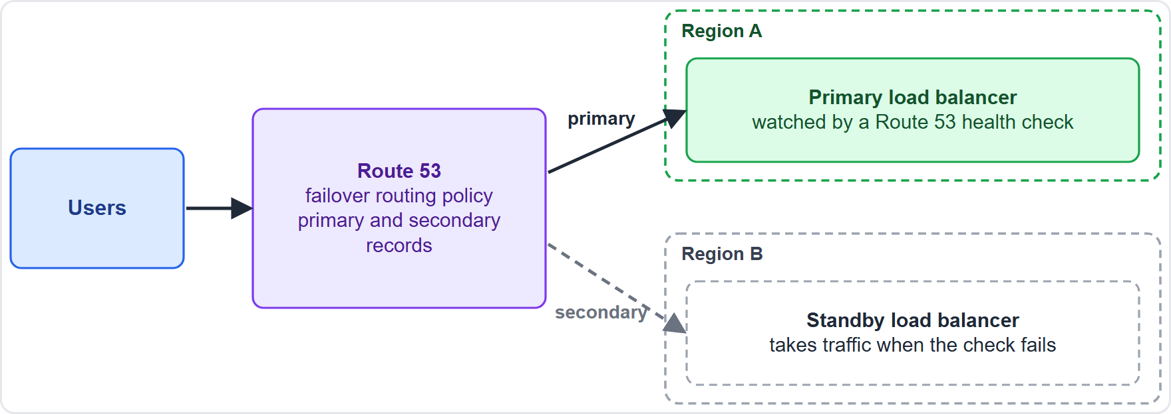
Route 53 Health Checks and DNS Failover
Part 1
Failover records: a primary and a secondary, with a health check on the primary
When the check fails, Route 53 answers with the secondary
Alias records can evaluate target health for AWS resources
DNS caching and the TTL delay a switch; Global Accelerator uses static IP addresses and avoids DNS caching
EXAM TIP Automatic DNS failover to a standby Region: Route 53 failover routing with health checks.
Solutions Architect Associate Exam Prep Masterclass | for the AWS SAA-C03 exam
Module 5
9 / 36
Notes:
Here is how D N S failover works. Failover records have a primary and a secondary, with a health check on the primary. When the check fails, Route fifty-three answers with the secondary. Alias records can evaluate target health for A W S resources. Remember that D N S caching and the T T L delay a switch. Global Accelerator uses static I P addresses and avoids D N S caching. The figure shows users reaching Route fifty-three, which answers with the primary Region until its health check fails. Exam tip: automatic D N S failover to a standby Region means Route fifty-three failover routing with health checks.

Slide 10
Database High Availability
Part 1
Option | What it gives
RDS Multi-AZ DB instance | One synchronous standby in another AZ and automatic failover; the standby does not serve reads
RDS Multi-AZ DB cluster | Two readable standbys
Aurora | Storage copied across three AZs; replicas can take over
Aurora Global Database | Cross-Region replication, typical lag under a second, promote a secondary in under a minute
DynamoDB global tables | Multi-Region reads and writes, last writer wins
EXAM TIP Survive a zone failure: Multi-AZ. Survive a Region failure: Aurora Global Database or global tables.
Solutions Architect Associate Exam Prep Masterclass | for the AWS SAA-C03 exam
Module 5
10 / 36
Notes:
For the database tier, there are several options. An R D S Multi-A Z D B instance keeps one synchronous standby in another zone and fails over automatically; the standby does not serve reads. An R D S Multi-A Z D B cluster has two readable standbys. Aurora copies its storage across three zones, and replicas can take over. Aurora Global Database replicates across Regions, with typical lag under a second, and you can promote a secondary in under a minute. DynamoDB global tables give multi-Region reads and writes, where the last writer wins. Exam tip: to survive a zone failure, use Multi-A Z; to survive a Region failure, use Aurora Global Database or global tables.

Slide 11
Amazon RDS Proxy
Part 1
A managed proxy that pools and shares database connections
Makes applications more resilient to database failures: it connects to a standby while preserving application connections
Absorbs surges and queues or throttles connections the database cannot serve yet
Supports IAM authentication and Secrets Manager credentials
Works for most applications with no code changes
A strong fit for Lambda, which opens many short connections
EXAM TIP Connection storms or slow failover reconnects: RDS Proxy.
Solutions Architect Associate Exam Prep Masterclass | for the AWS SAA-C03 exam
Module 5
11 / 36
Notes:
Amazon R D S Proxy is a managed proxy that pools and shares database connections. It makes applications more resilient to database failures, because it connects to a standby while preserving application connections. It absorbs surges, and queues or throttles connections the database cannot serve yet. It supports I A M authentication and Secrets Manager credentials, and works for most applications with no code changes. It is a strong fit for Lambda, which opens many short connections. Exam tip: connection storms or slow failover reconnects point to R D S Proxy.

Slide 12
Storage Durability and Availability
Part 1
Durability means data is not lost; availability means you can reach it
S3 stores data across multiple AZs and is designed for eleven nines of durability
An EBS volume is replicated inside one AZ: use snapshots to protect it across zones and Regions
EFS is Regional, stored across zones
Replicate to another Region with S3 replication, snapshot copies and AWS Backup
Turn on S3 Versioning to undo mistaken deletes
EXAM TIP Block storage lives in one zone: protect it with snapshots; object storage spans zones by default.
Solutions Architect Associate Exam Prep Masterclass | for the AWS SAA-C03 exam
Module 5
12 / 36
Notes:
Separate durability from availability. Durability means data is not lost; availability means you can reach it. S three stores data across multiple Availability Zones and is designed for eleven nines of durability. An E B S volume is replicated inside one zone, so use snapshots to protect it across zones and Regions. E F S is Regional, stored across zones. Replicate to another Region with S three replication, snapshot copies and A W S Backup. And turn on S three Versioning to undo mistaken deletes. Exam tip: block storage lives in one zone, so protect it with snapshots; object storage spans zones by default.

Slide 13
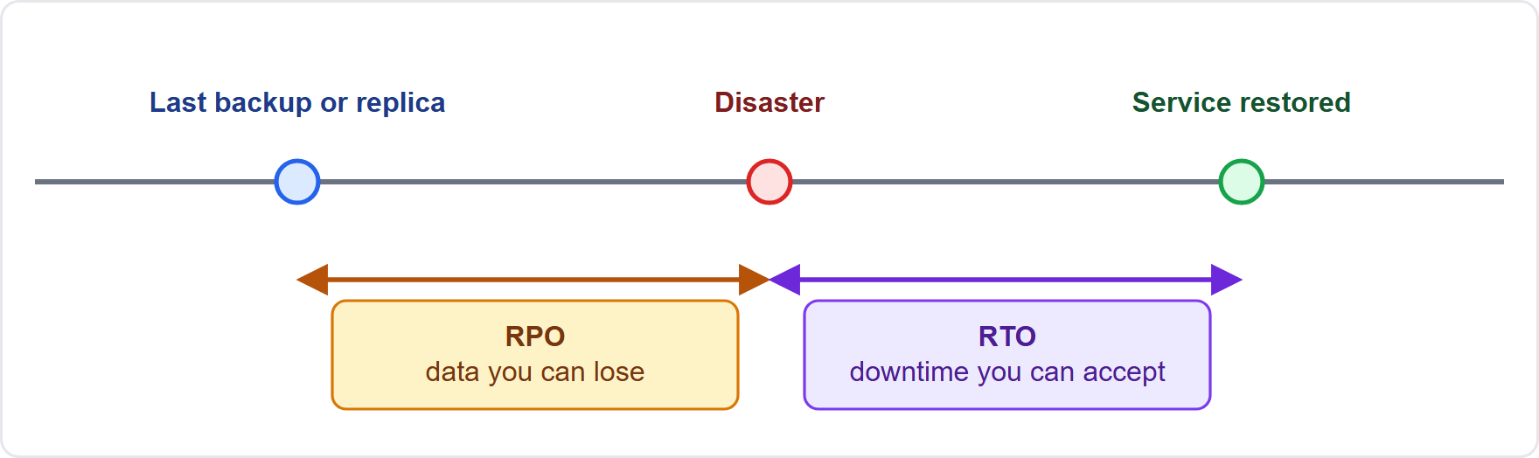
RPO and RTO
Part 2
RPO (recovery point objective): how much data loss, measured in time, is acceptable
RTO (recovery time objective): how long the service may be down
Backup or replication frequency sets the RPO; the recovery process sets the RTO
Both come from business requirements, and tighter targets cost more
EXAM TIP RPO looks back at lost data; RTO looks forward at downtime.
Solutions Architect Associate Exam Prep Masterclass | for the AWS SAA-C03 exam
Module 5
13 / 36
Notes:
Two numbers drive disaster recovery. The R P O, or recovery point objective, is how much data loss, measured in time, is acceptable. The R T O, or recovery time objective, is how long the service may be down. Backup or replication frequency sets the R P O, and the recovery process sets the R T O. Both come from business requirements, and tighter targets cost more. The figure shows a disaster marker, with the R P O bracket before it and the R T O bracket after it. Exam tip: R P O looks back at lost data; R T O looks forward at downtime.

Slide 14
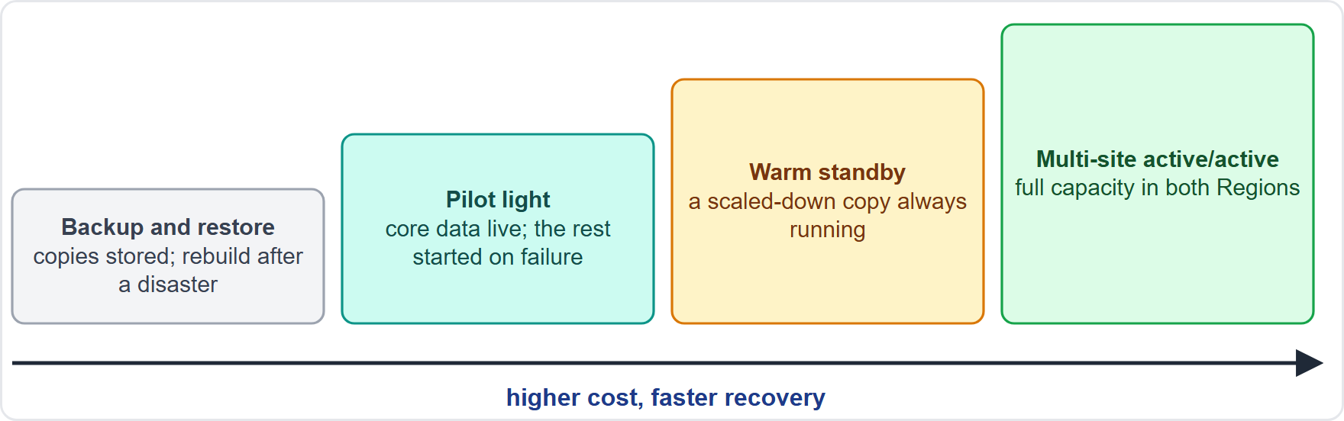
Four Disaster Recovery Strategies
Part 2
Backup and restore: copy data to the recovery Region; redeploy everything after a disaster
Pilot light: data replicated continuously; core infrastructure ready; app servers switched off
Warm standby: a scaled-down but running copy that can take traffic at once
Multi-site active/active: full capacity in several Regions serving users
EXAM TIP The more you keep running in the recovery Region, the faster and costlier the recovery.
Solutions Architect Associate Exam Prep Masterclass | for the AWS SAA-C03 exam
Module 5
14 / 36
Notes:
There are four disaster recovery strategies. Backup and restore copies data to the recovery Region, and you redeploy everything after a disaster. Pilot light replicates data continuously and keeps core infrastructure ready, but the application servers are switched off. Warm standby keeps a scaled-down but running copy that can take traffic at once. And multi-site active-active runs full capacity in several Regions, all serving users. The figure shows the four steps rising, with cost and recovery speed rising too. Exam tip: the more you keep running in the recovery Region, the faster and costlier the recovery.

Slide 15
Comparing the Strategies
Part 2
Strategy | Running in the recovery Region | Typical recovery | Cost
Backup and restore | Only backups | Hours | Lowest
Pilot light | Data stores only | Tens of minutes | Low
Warm standby | A scaled-down full stack | Minutes | Medium
Active/active | A full-size stack | Near zero | Highest
Pilot light cannot take requests until you turn on servers; warm standby can, at reduced capacity
Hot standby is a full-size copy that serves no traffic until needed
EXAM TIP Read the RTO and RPO, then pick the cheapest strategy that still meets both.
Solutions Architect Associate Exam Prep Masterclass | for the AWS SAA-C03 exam
Module 5
15 / 36
Notes:
Here is the comparison. Backup and restore runs only backups in the recovery Region; recovery takes hours, and the cost is lowest. Pilot light runs the data stores only; recovery takes tens of minutes, at low cost. Warm standby runs a scaled-down full stack; recovery takes minutes, at medium cost. Active-active runs a full-size stack; recovery is near zero, at the highest cost. Pilot light cannot take requests until you turn on servers, while warm standby can, at reduced capacity. Exam tip: read the R T O and R P O, then pick the cheapest strategy that still meets both.

Slide 16
Building the Recovery Region
Part 2
Replicate data: S3 replication, RDS read replicas, Aurora Global Database, DynamoDB global tables
Switch traffic: Route 53 health checks, Global Accelerator, or CloudFront origin failover
Promote the replica and scale out the application with Auto Scaling in the recovery Region
Redeploy infrastructure with infrastructure as code
Keep service quotas high enough in the recovery Region
Test failover regularly; AWS Elastic Disaster Recovery replicates servers using pilot light
EXAM TIP A recovery plan you have not tested is a guess.
Solutions Architect Associate Exam Prep Masterclass | for the AWS SAA-C03 exam
Module 5
16 / 36
Notes:
How do you build the recovery Region? Replicate the data with S three replication, R D S read replicas, Aurora Global Database, or DynamoDB global tables. Switch traffic with Route fifty-three health checks, Global Accelerator, or CloudFront origin failover. Promote the replica, and scale out the application with Auto Scaling. Redeploy infrastructure with infrastructure as code. Keep service quotas high enough in the recovery Region. Test failover regularly. A W S Elastic Disaster Recovery replicates servers using the pilot light approach. Exam tip: a recovery plan you have not tested is a guess.

Slide 17
Service Quotas and Throttling
Part 2
Service Quotas shows your quotas from one place and lets you request increases
Quotas are set per account and per Region; some are adjustable, some fixed
A standby Region needs the same quotas as production, or scale-out at failover will fail
Monitor utilization and set alarms before you reach a limit
Throttling returns errors when you exceed a rate: use retries with exponential backoff and jitter
Services such as API Gateway and Lambda also throttle requests
EXAM TIP Raise quotas in the recovery Region before the disaster, not during it.
Solutions Architect Associate Exam Prep Masterclass | for the AWS SAA-C03 exam
Module 5
17 / 36
Notes:
Service Quotas shows your quotas from one place and lets you request increases. Quotas are set per account and per Region; some are adjustable and some are fixed. A standby Region needs the same quotas as production, or scale-out at failover will fail. Monitor utilization, and set alarms before you reach a limit. Throttling returns errors when you exceed a rate, so use retries with exponential backoff and jitter. Services such as A P I Gateway and Lambda also throttle requests. Exam tip: raise quotas in the recovery Region before the disaster, not during it.

Slide 18
Automation and Immutable Infrastructure
Part 2
Infrastructure as code: CloudFormation describes resources in a template and builds the same stack repeatedly, in many Regions
Immutable infrastructure: replace servers from a new golden AMI instead of patching them
Auto Scaling replaces unhealthy instances automatically
Systems Manager automates patching and operations; Service Catalog offers approved products
Templates in version control make changes trackable and reversible
Clicks in the Management Console do not repeat; templates and scripts do
EXAM TIP Repeatable, identical environments in another Region: CloudFormation. Replace, do not patch: immutable.
Solutions Architect Associate Exam Prep Masterclass | for the AWS SAA-C03 exam
Module 5
18 / 36
Notes:
Automation keeps infrastructure consistent. With infrastructure as code, CloudFormation describes resources in a template and builds the same stack repeatedly, in many Regions. With immutable infrastructure, you replace servers from a new golden A M I instead of patching them. Auto Scaling replaces unhealthy instances automatically. Systems Manager automates patching and operations, and Service Catalog offers approved products. Keep templates in version control, so changes are trackable and reversible. Clicks in the Management Console do not repeat, but templates and scripts do. Exam tip: repeatable, identical environments in another Region means CloudFormation; replace, do not patch.

Slide 19
Systems Manager, Service Catalog, Proton and the Well-Architected Tool
VERIFY LIVE
Part 2
Service | What it does
Systems Manager | Manage nodes at scale: patching, Session Manager, Run Command, Automation, Parameter Store, no bastion hosts
Service Catalog | A catalog of approved products, with constraints, for self-service launch
AWS Proton | Templates for standard application stacks and CI/CD
Well-Architected Tool | Review a workload against the framework's pillars and get an improvement plan
As of 5 November 2026: the docs announce Proton end of support on 7 October 2026; check its status
EXAM TIP Operate fleets: Systems Manager. Approved self-service products: Service Catalog.
Solutions Architect Associate Exam Prep Masterclass | for the AWS SAA-C03 exam
Module 5
19 / 36
Notes:
Four governance services appear on the exam. A W S Systems Manager manages nodes at scale: patching, Session Manager, Run Command, Automation and Parameter Store, with no bastion hosts. A W S Service Catalog is a catalog of approved products, with constraints, for self-service launch. A W S Proton offers templates for standard application stacks and C I C D. The Well-Architected Tool reviews a workload against the framework's pillars and gives an improvement plan. As of the fifth of November, twenty twenty-six, the documentation announces Proton end of support on the seventh of October, twenty twenty-six, so check its status. Exam tip: operate fleets with Systems Manager; approved self-service products come from Service Catalog.

Slide 20
Workload Visibility: X-Ray, Health and Grafana
Part 2
Service | What it shows
AWS X-Ray | Traces of requests through your services and a service map to find bottlenecks and errors
AWS Health Dashboard | AWS service events and events that affect your resources; events also reach EventBridge
Amazon Managed Grafana | Dashboards over CloudWatch, X-Ray and other data sources
Amazon Managed Service for Prometheus | Prometheus-compatible metrics, especially for containers
Metrics, logs and alarms in CloudWatch come in module 7
EXAM TIP Which downstream call is slow or failing? X-Ray. Is AWS having a problem? Health Dashboard.
Solutions Architect Associate Exam Prep Masterclass | for the AWS SAA-C03 exam
Module 5
20 / 36
Notes:
Several services give you visibility. A W S X-Ray shows traces of requests through your services, and a service map to find bottlenecks and errors. The A W S Health Dashboard shows A W S service events and events that affect your resources, and events also reach EventBridge. Amazon Managed Grafana builds dashboards over CloudWatch, X-Ray and other data sources. Amazon Managed Service for Prometheus provides Prometheus-compatible metrics, especially for containers. CloudWatch metrics, logs and alarms come in module seven. Exam tip: which downstream call is slow or failing is X-Ray; is A W S having a problem is the Health Dashboard.

Slide 21
Improving Reliability of Legacy Applications
OLD NAME · VERIFY LIVE
Part 2
AWS Application Migration Service (the docs now call it AWS Transform MGN) rehosts servers with continuous block-level replication and short cutovers, with no application changes
AWS Application Discovery Service collects server usage and dependencies for planning
RDS Proxy, load balancers and Route 53 add resilience without code changes
Elastic Disaster Recovery protects servers without changing them
VMware Cloud on AWS runs existing VMware workloads unchanged on AWS
As of 5 November 2026: Application Discovery Service is closed to new customers; check the page
EXAM TIP When the application cannot change, add resilience around it: rehost, proxy, balance and replicate.
Solutions Architect Associate Exam Prep Masterclass | for the AWS SAA-C03 exam
Module 5
21 / 36
Notes:
What if the application cannot change? A W S Application Migration Service, which the documentation now calls A W S Transform M G N, rehosts servers with continuous block-level replication and short cutovers, with no application changes. A W S Application Discovery Service collects server usage and dependencies for planning. R D S Proxy, load balancers and Route fifty-three add resilience without code changes, Elastic Disaster Recovery protects servers without changing them, and VMware Cloud on A W S runs existing VMware workloads unchanged. As of the fifth of November, twenty twenty-six, Application Discovery Service is closed to new customers, so check the page. Exam tip: when the application cannot change, add resilience around it: rehost, proxy, balance and replicate.

Slide 22
Purpose-Built AWS AI Services
Part 2
Service | Use it for
Amazon Comprehend | Sentiment, entities and key phrases in text
Amazon Polly | Text to lifelike speech
Amazon Transcribe | Speech to text
Amazon Translate | Language translation
Amazon Rekognition | Objects, faces and unsafe content in images and video
Amazon Textract | Text, forms and tables from scanned documents
Amazon Lex | Chatbots for voice and text
Amazon SageMaker AI | Build, train and deploy your own models
EXAM TIP A ready-made API beats running your own models: less to operate and built to scale.
Solutions Architect Associate Exam Prep Masterclass | for the AWS SAA-C03 exam
Module 5
22 / 36
Notes:
The guide also expects you to know when a ready-made A I, short for artificial intelligence, service is the right managed choice. Amazon Comprehend finds sentiment, entities and key phrases in text. Amazon Polly turns text into lifelike speech. Amazon Transcribe turns speech into text. Amazon Translate translates languages. Amazon Rekognition finds objects, faces and unsafe content in images and video. Amazon Textract extracts text, forms and tables from scanned documents. Amazon Lex builds chatbots. And Amazon SageMaker A I builds, trains and deploys your own models. Exam tip: a ready-made A P I beats running your own models, because there is less to operate and it is built to scale.

Slide 23
What the Exam Asks: High Availability and Recovery
Part 2
Which redundancy
Which routing or failover
Which DR strategy
Multi-AZ, Multi-Region, Auto Scaling or a Multi-AZ database
from RPO, RTO and cost
Route 53 policy, health check or Global Accelerator
Which automation
Which visibility or legacy tool
CloudFormation, Systems Manager or Service Catalog
X-Ray, Health, RDS Proxy or Application Migration Service
EXAM TIP Match the failure size to the fix: instance, zone, Region or data corruption.
Solutions Architect Associate Exam Prep Masterclass | for the AWS SAA-C03 exam
Module 5
23 / 36
Notes:
Here is what the exam asks. Which redundancy: Multi-A Z, Multi-Region, Auto Scaling, or a Multi-A Z database. Which routing or failover: a Route fifty-three policy, a health check, or Global Accelerator. Which disaster recovery strategy: chosen from the R P O, the R T O and cost. Which automation: CloudFormation, Systems Manager or Service Catalog. And which visibility or legacy tool: X-Ray, Health, R D S Proxy or Application Migration Service. Exam tip: match the failure size to the fix: instance, zone, Region or data corruption.

Slide 24
Design Check: Lantern and Loom Survives a Bad Day
Part 2
Requirement | Design
Survive the loss of a zone | Auto Scaling across two AZs, a load balancer, Multi-AZ RDS
Database failover without code changes | RDS Multi-AZ, with RDS Proxy for connections
Region disaster, an hour to recover, minutes of data loss | Pilot light: replicated data, switched-off servers
Switch users to the other Region automatically | Route 53 failover with health checks
Rebuild the stack identically elsewhere | CloudFormation templates
Make sure scale-out works at failover | Raise Service Quotas in the recovery Region
Find the slow downstream call | AWS X-Ray
The old inventory server cannot change | Application Migration Service
Cover the right column, answer each row yourself, then compare
Solutions Architect Associate Exam Prep Masterclass | for the AWS SAA-C03 exam
Module 5
24 / 36
Notes:
Here is the Design Check. Cover the right column and answer each row yourself. Survive the loss of a zone: Auto Scaling across two zones, a load balancer, and Multi-A Z R D S. Database failover without code changes: R D S Multi-A Z, with R D S Proxy for connections. A Region disaster, an hour to recover, minutes of data loss: pilot light, with replicated data and switched-off servers. Switch users to the other Region automatically: Route fifty-three failover with health checks. Rebuild the stack identically elsewhere: CloudFormation templates. Make sure scale-out works at failover: raise Service Quotas in the recovery Region. Find the slow downstream call: X-Ray. And the old inventory server that cannot change: Application Migration Service.

Slide 25
Module Recap
Part 3
1
Availability
2
Failover
3
Disaster recovery
no single point of failure; Multi-AZ for zones, Multi-Region for Regions
health checks, Route 53 policies, RDS Multi-AZ, RDS Proxy
RPO and RTO choose between backup and restore, pilot light, warm standby and active/active
4
Operations
5
Visibility and legacy
infrastructure as code, immutable servers, quotas and retries
X-Ray, Health, Application Migration Service, managed AI services
Solutions Architect Associate Exam Prep Masterclass | for the AWS SAA-C03 exam
Module 5
25 / 36
Notes:
Here is the recap. For availability, remove single points of failure; use Multi-A Z for zones and Multi-Region for Regions. For failover, use health checks, Route fifty-three policies, R D S Multi-A Z and R D S Proxy. For disaster recovery, the R P O and R T O choose between backup and restore, pilot light, warm standby and active-active. For operations, use infrastructure as code, immutable servers, quotas and retries. And for visibility and legacy, use X-Ray, Health, Application Migration Service and the managed A I services.

Slide 26
Practice Question 1
Part 3
Q1
What does a recovery point objective (RPO) of 15 minutes mean for Lantern and Loom's order data?
A
The service must be running again within 15 minutes of a failure
B
No more than 15 minutes of order data may be lost
C
Backups must be kept for 15 minutes before they are deleted
D
Failover must be tested every 15 minutes
Solutions Architect Associate Exam Prep Masterclass | for the AWS SAA-C03 exam
Module 5
26 / 36
Notes:
Question one. What does a recovery point objective of fifteen minutes mean for Lantern and Loom's order data? The four options are on the screen. [PAUSE 12] The answer is B: no more than fifteen minutes of order data may be lost. R P O is the maximum acceptable data loss measured in time. The time to restore service is the recovery time objective.

Slide 27
Practice Question 2
Part 3
Q2
Lantern and Loom runs one EC2 instance and one single-AZ RDS database in the same Availability Zone. Which TWO changes let the shop survive the loss of that zone? (Select TWO.)
A
Run the web tier in an Auto Scaling group across two zones behind a load balancer
B
Replace the instance with a larger instance type
C
Convert the database to a Multi-AZ deployment
D
Take a manual snapshot of the database each night
E
Attach an Elastic IP address to the instance
Solutions Architect Associate Exam Prep Masterclass | for the AWS SAA-C03 exam
Module 5
27 / 36
Notes:
Question two. Select two. Lantern and Loom runs one E C two instance and one single-A Z R D S database in the same Availability Zone. Which two changes let the shop survive the loss of that zone? The five options are on the screen. [PAUSE 15] The answers are A and C. Run the web tier in an Auto Scaling group across two zones behind a load balancer, and convert the database to a Multi-A Z deployment. A larger instance, nightly snapshots and an Elastic I P address stay in the failed zone or recover slowly.

Slide 28
Practice Question 3
Part 3
Q3
Lantern and Loom wants product pages read aloud for visually impaired shoppers, and wants the sentiment of reviews flagged, with the least operational effort. Which services fit?
A
Two custom models trained and hosted on Amazon SageMaker AI
B
Amazon Rekognition and Amazon Textract
C
Amazon Polly for speech and Amazon Comprehend for sentiment analysis
D
Amazon Lex and Amazon Transcribe
Solutions Architect Associate Exam Prep Masterclass | for the AWS SAA-C03 exam
Module 5
28 / 36
Notes:
Question three. Lantern and Loom wants product pages read aloud for visually impaired shoppers, and wants the sentiment of reviews flagged, with the least operational effort. Which services fit? The four options are on the screen. [PAUSE 12] The answer is C: Amazon Polly for speech and Amazon Comprehend for sentiment. Both are ready-made services with nothing to train or run. Rekognition and Textract read images and documents, and Lex and Transcribe handle chatbots and speech to text.

Slide 29
Practice Question 4
Part 3
Q4
If a whole Region fails, Lantern and Loom accepts about an hour to recover and a few minutes of data loss, and wants the lowest running cost that still meets this. Which strategy fits?
A
Pilot light: replicate the data and keep servers switched off
B
Backup and restore from nightly backups copied to a second Region
C
Multi-site active/active with full capacity in two Regions
D
Warm standby with a scaled-down copy that serves traffic
Solutions Architect Associate Exam Prep Masterclass | for the AWS SAA-C03 exam
Module 5
29 / 36
Notes:
Question four. If a whole Region fails, Lantern and Loom accepts about an hour to recover and a few minutes of data loss, and wants the lowest running cost that still meets this. Which strategy fits? The four options are on the screen. [PAUSE 12] The answer is A: pilot light, with replicated data and switched-off application servers. Continuous replication meets the few-minutes R P O, and turning on servers fits an hour at low cost. Nightly backups miss the R P O, and the other two cost more than needed.

Slide 30
Practice Question 5
Part 3
Q5
The order database must survive the loss of its Availability Zone, with automatic failover and no application changes. Reads can stay on the primary. Which RDS configuration fits?
A
A read replica in the same Availability Zone
B
A cross-Region read replica that is promoted by hand
C
Daily automated backups only
D
A Multi-AZ DB instance deployment
Solutions Architect Associate Exam Prep Masterclass | for the AWS SAA-C03 exam
Module 5
30 / 36
Notes:
Question five. The order database must survive the loss of its Availability Zone, with automatic failover and no application changes. Reads can stay on the primary. Which R D S configuration fits? The four options are on the screen. [PAUSE 12] The answer is D: a Multi-A Z D B instance deployment. It keeps a synchronous standby in another zone and fails over automatically through the same endpoint. A replica in the same zone does not help, and a cross-Region replica or backups need manual recovery.

Slide 31
Practice Question 6
Part 3
Q6
Many Lambda functions open database connections that exhaust an RDS database, and failovers disrupt the functions. What should the architect add?
A
More memory and a longer timeout for each Lambda function
B
A read replica for every function
C
Amazon ElastiCache for every query
D
Amazon RDS Proxy in front of the database
Solutions Architect Associate Exam Prep Masterclass | for the AWS SAA-C03 exam
Module 5
31 / 36
Notes:
Question six. Many Lambda functions open database connections that exhaust an R D S database, and failovers disrupt the functions. What should the architect add? The four options are on the screen. [PAUSE 12] The answer is D: Amazon R D S Proxy in front of the database. It pools and shares connections, and reconnects to the standby during a failover while preserving application connections.

Slide 32
Practice Question 7
Part 3
Q7
Which TWO statements about Amazon Route 53 routing policies are correct? (Select TWO.)
A
Failover routing sets up active-passive failover
B
Geolocation routing sends users to the Region with the lowest latency
C
Latency routing sends users to the Region that gives the best latency
D
Weighted routing can send traffic to only one resource
E
Simple routing is the policy for active-passive failover
Solutions Architect Associate Exam Prep Masterclass | for the AWS SAA-C03 exam
Module 5
32 / 36
Notes:
Question seven. Select two. Which two statements about Amazon Route fifty-three routing policies are correct? The five options are on the screen. [PAUSE 15] The answers are A and C. Failover routing sets up active-passive failover, and latency routing picks the Region with the best latency. Geolocation routes by user location, weighted routing splits traffic in proportions, and simple routing serves a single resource.

Slide 33
Practice Question 8
Part 3
Q8
After a disaster, Lantern and Loom must recreate its whole environment, including network, load balancers and servers, in a second Region quickly and identically. What is the best approach?
A
Follow a written runbook that engineers carry out step by step in the console
B
Keep screenshots of every console setting for the engineers to follow
C
Define it in CloudFormation templates and deploy them to the second Region
D
Keep one golden server image and rebuild the rest of the stack by hand
Solutions Architect Associate Exam Prep Masterclass | for the AWS SAA-C03 exam
Module 5
33 / 36
Notes:
Question eight. After a disaster, Lantern and Loom must recreate its whole environment, including network, load balancers and servers, in a second Region quickly and identically. What is the best approach? The four options are on the screen. [PAUSE 12] The answer is C: define it in CloudFormation templates and deploy them to the second Region. Infrastructure as code is repeatable. Runbooks, screenshots and a lone image leave manual steps.

Slide 34
Practice Question 9
Part 3
Q9
An aging inventory application runs on a physical server in the warehouse and cannot be changed. Lantern and Loom wants to move it to AWS with minimal downtime. Which service fits?
A
AWS Application Migration Service
B
AWS Service Catalog, to publish an approved product
C
AWS Proton, to template the server's deployment pipeline
D
AWS Health Dashboard, to monitor the move
Solutions Architect Associate Exam Prep Masterclass | for the AWS SAA-C03 exam
Module 5
34 / 36
Notes:
Question nine. An aging inventory application runs on a physical server in the warehouse and cannot be changed. Lantern and Loom wants to move it to A W S with minimal downtime. Which service fits? The four options are on the screen. [PAUSE 12] The answer is A: A W S Application Migration Service, which the documentation now calls A W S Transform M G N. It rehosts servers with continuous replication and a short cutover, with no application changes.

Slide 35
Practice Question 10
Part 3
Q10
Requests to Lantern and Loom's API pass through API Gateway, Lambda and DynamoDB, and some are slow. Which service shows a service map and request traces to find the slow component?
A
AWS Config
B
AWS X-Ray
C
AWS Health Dashboard
D
AWS Service Catalog
Solutions Architect Associate Exam Prep Masterclass | for the AWS SAA-C03 exam
Module 5
35 / 36
Notes:
Question ten. Requests to Lantern and Loom's A P I pass through A P I Gateway, Lambda and DynamoDB, and some are slow. Which service shows a service map and request traces to find the slow component? The four options are on the screen. [PAUSE 12] The answer is B: A W S X-Ray. It collects traces of requests across services and draws a service map that points to bottlenecks and errors.

Slide 36
Answers at a Glance
Part 3
Question | Answer | Why
Q1 | B | RPO is the data you can afford to lose
Q2 | A, C | Servers across zones and a Multi-AZ database
Q3 | C | Polly and Comprehend are ready-made
Q4 | A | Pilot light is the cheapest fit
Q5 | D | Multi-AZ DB instance with automatic failover
Q6 | D | RDS Proxy pools connections
Q7 | A, C | Failover is active-passive; latency picks the best Region
Q8 | C | Infrastructure as code with CloudFormation
Q9 | A | Application Migration Service rehosts servers
Q10 | B | X-Ray traces requests and maps services
Solutions Architect Associate Exam Prep Masterclass | for the AWS SAA-C03 exam
Module 5
36 / 36
Notes:
Here are all ten answers. Question one: B. Question two: A and C. Question three: C. Question four: A. Question five: D. Question six: D. Question seven: A and C. Question eight: C. Question nine: A. Question ten: B. In Module six, we start Domain three: high-performing storage.

