Slide 1
Module 0: Course Introduction, Exam Orientation and the Six Scenarios
What the exam is: 60 scenario-based items, 120 minutes, a scaled score of 720
Course module · exam orientation and review
Claude Architect Foundations Exam Prep Masterclass
Module 0 · Part 1
Notes:
Welcome to Module zero: Course Introduction, Exam Orientation and the Six Scenarios. This module covers exam orientation, the six scenarios and the course map.
Each part of this module comes from the study notes of the same name, so you can read the notes after you watch.

Slide 2
What You Will Learn
Part 1
What the exam is: 60 scenario-based items, 120 minutes, a scaled score of 720 to pass
The five domains, their weights and the 30 task statements behind them
The six scenarios (you meet four of them on exam day) and which domains each one tests
The ten decision rules that explain most correct answers
How the course is built and how to use it
Claude Architect Foundations Exam Prep | for the CCAR-F exam
Module 0
2 / 25
Notes:
By the end of this module you will be able to do five things.
What the exam is: sixty scenario-based items, one hundred twenty minutes, a scaled score of seven hundred twenty to pass.
The five domains, their weights and the thirty task statements behind them.
The six scenarios (you meet four of them on exam day) and which domains each one tests.
The ten decision rules that explain most correct answers.
How the course is built and how to use it.

Slide 3
Case Check-In: Birchwood Supply
Part 1
CASE CHECK-IN · Birchwood Supply
Throughout the course you follow Birchwood Supply, a fictional online retailer
Its support agent answers returns and billing questions, its research assistant writes market reports, and its engineers use Claude Code every day
Each module solves one problem of this company; the questions use the same style as the exam scenarios
Claude Architect Foundations Exam Prep | for the CCAR-F exam
Module 0
3 / 25
Notes:
Our running case is Birchwood Supply. Birchwood Supply.
Throughout the course you follow Birchwood Supply, a fictional online retailer.
Its support agent answers returns and billing questions, its research assistant writes market reports, and its engineers use Claude Code every day.
Each module solves one problem of this company; the questions use the same style as the exam scenarios.

Slide 4
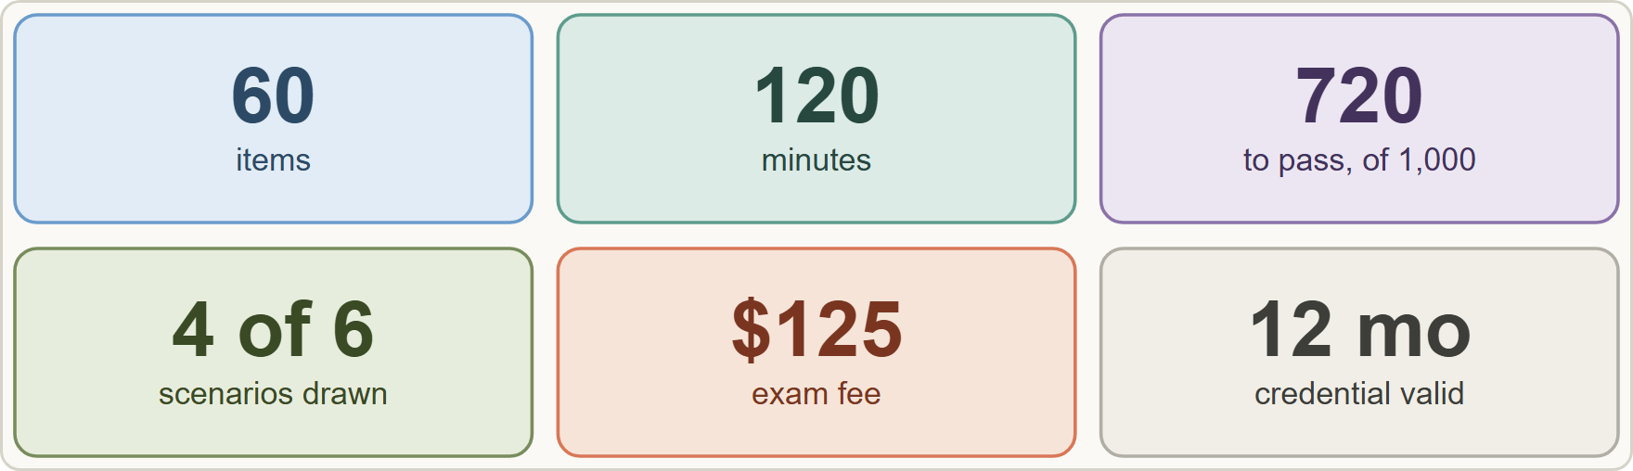
The Exam at a Glance
Part 1
The CCAR-F exam at a glance: 60 items, 120 minutes, scaled score 100 to 1,000 with 720 to pass, 4 of 6 scenarios, USD 125, valid 12 months
Claude Architect Foundations Exam Prep | for the CCAR-F exam
Module 0
4 / 25
Notes:
The Exam at a Glance.
The figure shows this: The C C A R F exam at a glance: sixty items, one hundred twenty minutes, scaled score one hundred to one thousand with seven hundred twenty to pass, four of six scenarios, U S D one hundred twenty-five, valid twelve months.

Slide 5
The Exam at a Glance, continued
DATES
Part 1
Fact | Value (guide v1.0, July 2026)
Credential / code | Claude Architect – Foundations / CCAR-F
Items | 60, multiple choice and multiple response; each item says how many answers to select
Structure | 4 scenarios picked at random from a bank of 6; the questions are framed by the scenario
Time | 120 minutes (about 2 minutes per item)
Passing score | 720 on a scaled range of 100 to 1,000 (criterion-referenced: you are measured against a fixed standard, not against other candidates)
Fee | USD 125 per attempt
Delivery | Proctored by Pearson VUE: online or at a test center; closed book
Claude Architect Foundations Exam Prep | for the CCAR-F exam
Module 0
5 / 25
Notes:
The Exam at a Glance, continued.
Credential or code. Claude Architect to Foundations or C C A R F.
Items. sixty, multiple choice and multiple response; each item says how many answers to select.
Structure. four scenarios picked at random from a bank of six; the questions are framed by the scenario.
Time. one hundred twenty minutes (about two minutes per item).
Passing score. seven hundred twenty on a scaled range of one hundred to one thousand (criterion-referenced: you are measured against a fixed standard, not against other candidates).
Fee. U S D one hundred twenty-five per attempt.
Delivery. Proctored by Pearson V U E: online or at a test center; closed book.

Slide 6
The Exam at a Glance, continued
DATES
Part 1
Fact | Value (guide v1.0, July 2026)
Validity | 12 months; renewal on time is a free, non-proctored assessment; a lapsed credential needs the full exam again
Retakes | Wait 14 days after the first failed attempt, 30 after the second, 90 after the third; at most 4 attempts in a rolling 12 months; limits are per exam
Score report | Pass or fail, the scaled score, and the percent correct per domain (the domain figures do not decide pass or fail)
Claude Architect Foundations Exam Prep | for the CCAR-F exam
Module 0
6 / 25
Notes:
The Exam at a Glance, continued.
Validity. twelve months; renewal on time is a free, non-proctored assessment; a lapsed credential needs the full exam again.
Retakes. Wait fourteen days after the first failed attempt, thirty after the second, ninety after the third; at most four attempts in a rolling twelve months; limits are per exam.
Score report. Pass or fail, the scaled score, and the percent correct per domain (the domain figures do not decide pass or fail).

Slide 7
The Exam at a Glance, continued
Part 1
Who can sit it [Verify live]. Exams are open to people who work at organizations in the Claude Partner Network, registering with a company email on the organization's listed domain; candidates must be 18 or older with a government photo ID whose name matches the registration. People outside the network can take the free Anthropic Academy courses, which give completion certificates, not the credential. This course teaches the same knowledge to everyone.
EXAM TIP Item formats are not scored differently. For a multiple-response item the stem says how many to pick: read that number first, then choose exactly that many.
Claude Architect Foundations Exam Prep | for the CCAR-F exam
Module 0
7 / 25
Notes:
The Exam at a Glance, continued.
Who can sit it. Exams are open to people who work at organizations in the Claude Partner Network, registering with a company email on the organization's listed domain; candidates must be eighteen or older with a government photo I D whose name matches the registration. People outside the network can take the free Anthropic Academy courses, which give completion certificates, not the credential. This course teaches the same knowledge to everyone.
Exam tip: Item formats are not scored differently. For a multiple-response item the stem says how many to pick: read that number first, then choose exactly that many.

Slide 8
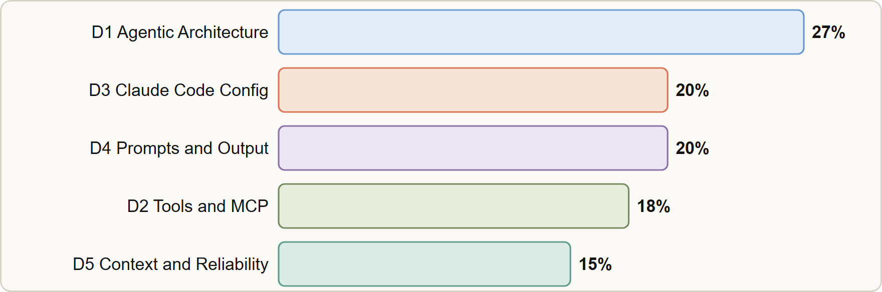
The Five Domains
Part 1
Domain weights: D1 Agentic Architecture and Orchestration 27, D3 Claude Code Configuration and Workflows 20, D4 Prompt Engineering and Structured Output 20, D2 Tool Design and MCP Integration 18, D5 Context Management and Reliability 15
Claude Architect Foundations Exam Prep | for the CCAR-F exam
Module 0
8 / 25
Notes:
The Five Domains.
The figure shows this: Domain weights: D one Agentic Architecture and Orchestration twenty-seven, D three Claude Code Configuration and Workflows twenty, D four Prompt Engineering and Structured Output twenty, D two Tool Design and M C P (Model Context Protocol) Integration eighteen, D five Context Management and Reliability fifteen.

Slide 9
The Five Domains, continued
Part 1
Domain | Weight | Task statements | Course modules
D1 Agentic Architecture and Orchestration | 27% | 1.1 to 1.7 (7) | 1 to 4
D2 Tool Design and MCP Integration | 18% | 2.1 to 2.5 (5) | 5 and 6
D3 Claude Code Configuration and Workflows | 20% | 3.1 to 3.6 (6) | 7 and 8
D4 Prompt Engineering and Structured Output | 20% | 4.1 to 4.6 (6) | 9 to 11
D5 Context Management and Reliability | 15% | 5.1 to 5.6 (6) | 12 to 14
Claude Architect Foundations Exam Prep | for the CCAR-F exam
Module 0
9 / 25
Notes:
The Five Domains, continued.
D one Agentic Architecture and Orchestration. Weight: twenty-seven percent. Task statements: one point one to one point seven (seven). Course modules: one to four.
D two Tool Design and M C P Integration. Weight: eighteen percent. Task statements: two point one to two point five (five). Course modules: five and six.
D three Claude Code Configuration and Workflows. Weight: twenty percent. Task statements: three point one to three point six (six). Course modules: seven and eight.
D four Prompt Engineering and Structured Output. Weight: twenty percent. Task statements: four point one to four point six (six). Course modules: nine to eleven.
D five Context Management and Reliability. Weight: fifteen percent. Task statements: five point one to five point six (six). Course modules: twelve to fourteen.

Slide 10
The Five Domains, continued
Part 1
The weights are the approximate share of scored items: of 60 items, about 16 come from D1, 11 from D2, 12 from D3, 12 from D4 and 9 from D5.
Each task statement lists Knowledge of (concepts) and Skills in (what you can do); items are written against them.
Claude Architect Foundations Exam Prep | for the CCAR-F exam
Module 0
10 / 25
Notes:
The Five Domains, continued.
The weights are the approximate share of scored items: of sixty items, about sixteen come from D one, eleven from D two, twelve from D three, twelve from D four and nine from D five.
Each task statement lists Knowledge of (concepts) and Skills in (what you can do); items are written against them.

Slide 11
The Five Domains, continued
Part 1
Out of scope (will not appear): fine-tuning or training models; API authentication, billing or account management; programming-language specifics; deploying or hosting MCP servers; model internals, RLHF or Constitutional AI; embeddings and vector databases; computer use; vision; streaming and server-sent events; rate limits, quotas or pricing math; OAuth and key rotation; cloud-provider setup; benchmarking; prompt caching details; tokenization.
Claude Architect Foundations Exam Prep | for the CCAR-F exam
Module 0
11 / 25
Notes:
The Five Domains, continued.
Out of scope (will not appear): fine-tuning or training models; A P I (application programming interface) authentication, billing or account management; programming-language specifics; deploying or hosting M C P servers; model internals, R L H F or Constitutional A I; embeddings and vector databases; computer use; vision; streaming and server-sent events; rate limits, quotas or pricing math; OAuth and key rotation; cloud-provider setup; benchmarking; prompt caching details; tokenization.

Slide 12
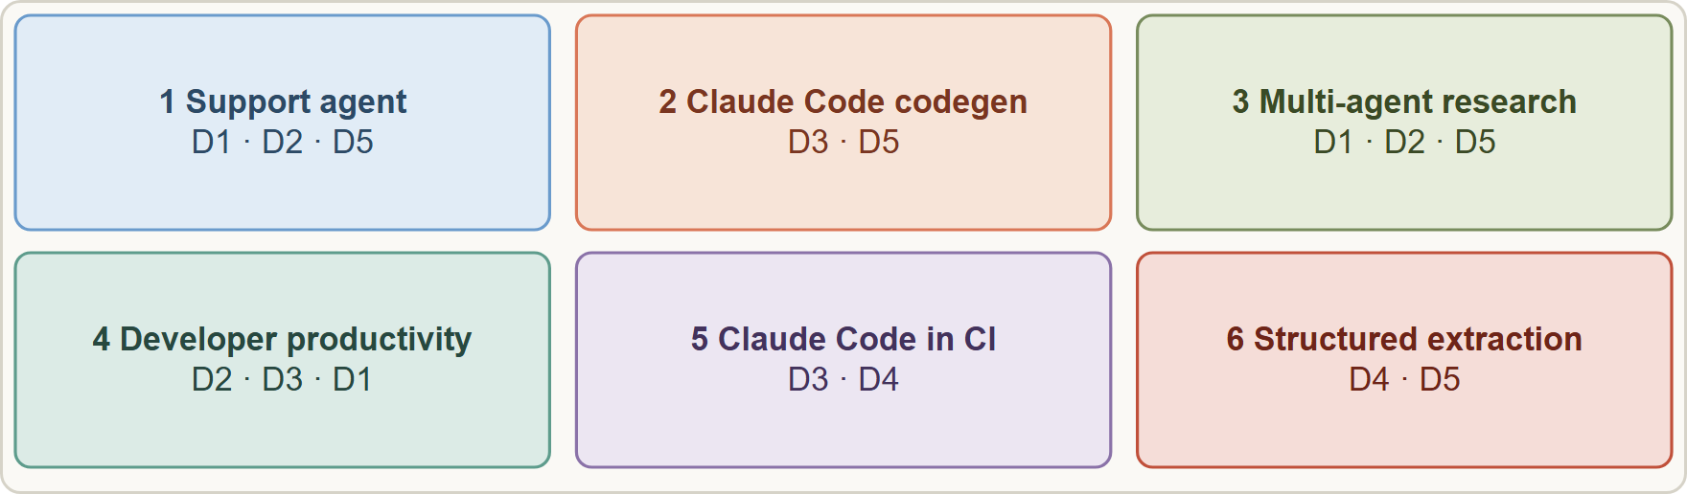
The Six Scenarios
Part 1
The six scenarios and the domains they mostly test
Claude Architect Foundations Exam Prep | for the CCAR-F exam
Module 0
12 / 25
Notes:
The Six Scenarios.
The figure shows this: The six scenarios and the domains they mostly test.

Slide 13
The Six Scenarios, continued
Part 1
# | Scenario | What you build | Primary domains
1 | Customer Support Resolution Agent | Agent SDK agent with MCP tools get_customer, lookup_order, process_refund, escalate_to_human; target 80%+ first-contact resolution and knowing when to escalate | D1, D2, D5
2 | Code Generation with Claude Code | Team use of Claude Code: slash commands, CLAUDE.md, plan mode vs direct execution | D3, D5
3 | Multi-Agent Research System | Coordinator with subagents: web search, document analysis, synthesis, report generation; cited reports | D1, D2, D5
Claude Architect Foundations Exam Prep | for the CCAR-F exam
Module 0
13 / 25
Notes:
The Six Scenarios, continued.
one. Scenario: Customer Support Resolution Agent. What you build: Agent S D K (software development kit) agent with M C P tools get customer, lookup order, process refund, escalate to human; target eighty percent plus first-contact resolution and knowing when to escalate. Primary domains: D one, D two, D five.
two. Scenario: Code Generation with Claude Code. What you build: Team use of Claude Code: slash commands, Claude dot M D, plan mode versus direct execution. Primary domains: D three, D five.
three. Scenario: Multi-Agent Research System. What you build: Coordinator with subagents: web search, document analysis, synthesis, report generation; cited reports. Primary domains: D one, D two, D five.

Slide 14
The Six Scenarios, continued
Part 2
# | Scenario | What you build | Primary domains
4 | Developer Productivity with Claude | Agent SDK tools to explore codebases, using Read, Write, Bash, Grep, Glob and MCP servers | D2, D3, D1
5 | Claude Code for Continuous Integration | Automated code review, test generation and PR feedback in CI; minimize false positives | D3, D4
6 | Structured Data Extraction | Extract data from unstructured documents, validate with JSON schemas, handle edge cases | D4, D5
EXAM TIP You will not know in advance which four scenarios you get, so study all six. Module 15 walks through each one from the first requirement to the best architecture.
Claude Architect Foundations Exam Prep | for the CCAR-F exam
Module 0
14 / 25
Notes:
The Six Scenarios, continued.
four. Scenario: Developer Productivity with Claude. What you build: Agent S D K tools to explore codebases, using Read, Write, Bash, Grep, Glob and M C P servers. Primary domains: D two, D three, D one.
five. Scenario: Claude Code for Continuous Integration. What you build: Automated code review, test generation and P R (pull request) feedback in C I; minimize false positives. Primary domains: D three, D four.
six. Scenario: Structured Data Extraction. What you build: Extract data from unstructured documents, validate with Jason (Java Script Object Notation) schemas, handle edge cases. Primary domains: D four, D five.
Exam tip: You will not know in advance which four scenarios you get, so study all six. Module fifteen walks through each one from the first requirement to the best architecture.

Slide 15
Ten Decision Rules the Questions Reward
Part 2
Most items present a problem seen in logs or production data and four plausible fixes. The best answer usually follows one of these rules. Learn them now; each later module shows them at work.
Claude Architect Foundations Exam Prep | for the CCAR-F exam
Module 0
15 / 25
Notes:
Ten Decision Rules the Questions Reward.
Most items present a problem seen in logs or production data and four plausible fixes. The best answer usually follows one of these rules. Learn them now; each later module shows them at work.

Slide 16
Ten Decision Rules the Questions Reward, continued
Part 2
# | Rule | Typical wrong answers
1 | A hard business requirement needs programmatic enforcement (hooks, prerequisite gates), because prompts have a non-zero failure rate | Stronger system prompt wording, more few-shot examples
2 | Find the root cause from the evidence given before choosing the fix (the logs usually name it) | Blaming a downstream agent that behaved correctly
3 | Choose the proportionate first step: low effort, high leverage (better tool descriptions, explicit criteria, a few examples) before new infrastructure | A separate classifier, a routing layer, fine-tuning
Claude Architect Foundations Exam Prep | for the CCAR-F exam
Module 0
16 / 25
Notes:
Ten Decision Rules the Questions Reward, continued.
one. Rule: A hard business requirement needs programmatic enforcement (hooks, prerequisite gates), because prompts have a non-zero failure rate. Typical wrong answers: Stronger system prompt wording, more few-shot examples.
two. Rule: Find the root cause from the evidence given before choosing the fix (the logs usually name it). Typical wrong answers: Blaming a downstream agent that behaved correctly.
three. Rule: Choose the proportionate first step: low effort, high leverage (better tool descriptions, explicit criteria, a few examples) before new infrastructure. Typical wrong answers: A separate classifier, a routing layer, fine-tuning.

Slide 17
Ten Decision Rules the Questions Reward, continued
Part 2
# | Rule | Typical wrong answers
4 | Least privilege: each agent gets only the tools its role needs, plus a narrow shared tool for a frequent need | Giving every agent every tool
5 | Structured beats generic: structured errors, structured handoffs, claim-to-source mappings, case-fact blocks | "Operation failed", free-text summaries
6 | Self-reported confidence and sentiment are weak proxies for difficulty; use explicit criteria and calibrated, validated signals | "Escalate when confidence < 7", sentiment thresholds
7 | Independent review beats self-review; split big reviews into per-file passes plus an integration pass | Asking the same session to double-check itself; a bigger context window
Claude Architect Foundations Exam Prep | for the CCAR-F exam
Module 0
17 / 25
Notes:
Ten Decision Rules the Questions Reward, continued.
four. Rule: Least privilege: each agent gets only the tools its role needs, plus a narrow shared tool for a frequent need. Typical wrong answers: Giving every agent every tool.
five. Rule: Structured beats generic: structured errors, structured handoffs, claim-to-source mappings, case-fact blocks. Typical wrong answers: "Operation failed", free-text summaries.
six. Rule: Self-reported confidence and sentiment are weak proxies for difficulty; use explicit criteria and calibrated, validated signals. Typical wrong answers: "Escalate when confidence less than seven", sentiment thresholds.
seven. Rule: Independent review beats self-review; split big reviews into per-file passes plus an integration pass. Typical wrong answers: Asking the same session to double-check itself; a bigger context window.

Slide 18
Ten Decision Rules the Questions Reward, continued
Part 2
# | Rule | Typical wrong answers
8 | Match the API to the latency need: synchronous for blocking steps, batch for overnight work | Batch for pre-merge checks
9 | Never suppress errors and never abort everything: return partial results with failure context and annotate gaps | Empty result marked as success; kill the whole run on one timeout
10 | Context is a budget: isolate verbose work in subagents, persist key facts outside summaries, trim tool output | Reading everything up front, relying on a long history
EXAM TIP When two options both "work", prefer the one that is deterministic, specific, scoped and proportionate. Words like "always", "guarantee" and "must" in the requirement point to rule 1.
Claude Architect Foundations Exam Prep | for the CCAR-F exam
Module 0
18 / 25
Notes:
Ten Decision Rules the Questions Reward, continued.
eight. Rule: Match the A P I to the latency need: synchronous for blocking steps, batch for overnight work. Typical wrong answers: Batch for pre-merge checks.
nine. Rule: Never suppress errors and never abort everything: return partial results with failure context and annotate gaps. Typical wrong answers: Empty result marked as success; kill the whole run on one timeout.
ten. Rule: Context is a budget: isolate verbose work in subagents, persist key facts outside summaries, trim tool output. Typical wrong answers: Reading everything up front, relying on a long history.
Exam tip: When two options both "work", prefer the one that is deterministic, specific, scoped and proportionate. Words like "always", "guarantee" and "must" in the requirement point to rule one.

Slide 19
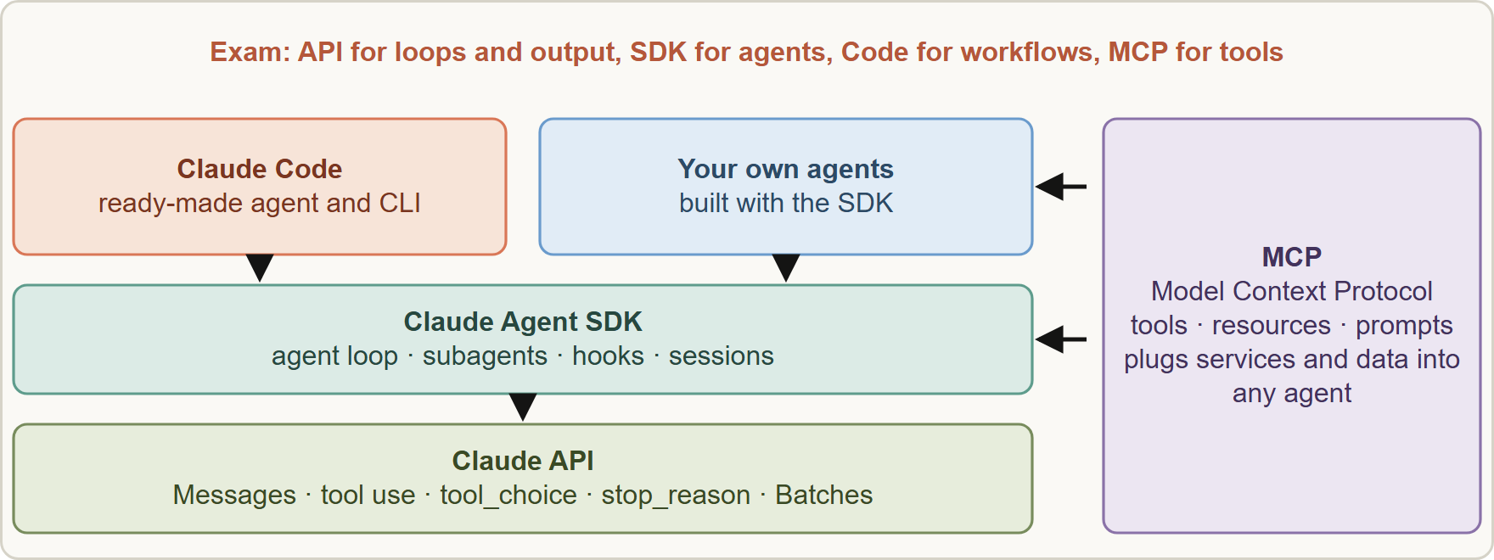
The Technologies at a Glance
Part 2
How the pieces fit: Claude API at the base, Agent SDK for building agents, Claude Code as the ready-made agent and CLI, and MCP connecting tools and data
Claude Architect Foundations Exam Prep | for the CCAR-F exam
Module 0
19 / 25
Notes:
The Technologies at a Glance.
The figure shows this: How the pieces fit: Claude A P I at the base, Agent S D K for building agents, Claude Code as the ready-made agent and C L I (command-line interface), and M C P connecting tools and data.

Slide 20
The Technologies at a Glance, continued
Part 2
Piece | What it is | Exam focus
Claude API | The Messages API: send messages, define tools (tool_use), steer with `tool_choice`, read `stop_reason`, cap output with `max_tokens`, set a system prompt; Message Batches API for asynchronous bulk work | D1 loops, D2 tool_choice, D4 structured output and batches
Claude Agent SDK | The same agent loop that powers Claude Code, as a library: tools, subagents, hooks, sessions | D1, D2, D5
Claude Code | The coding agent and CLI: CLAUDE.md, rules, skills, plan mode, MCP servers, `-p` for scripts and CI | D3, D2
Claude Architect Foundations Exam Prep | for the CCAR-F exam
Module 0
20 / 25
Notes:
The Technologies at a Glance, continued.
Claude A P I. What it is: The Messages A P I: send messages, define tools (tool use), steer with tool choice, read stop reason, cap output with max tokens, set a system prompt; Message Batches A P I for asynchronous bulk work. Exam focus: D one loops, D two tool choice, D four structured output and batches.
Claude Agent S D K. What it is: The same agent loop that powers Claude Code, as a library: tools, subagents, hooks, sessions. Exam focus: D one, D two, D five.
Claude Code. What it is: The coding agent and C L I: Claude dot M D, rules, skills, plan mode, M C P servers, dash p for scripts and C I. Exam focus: D three, D two.

Slide 21
The Technologies at a Glance, continued
Part 2
Piece | What it is | Exam focus
MCP (Model Context Protocol) | An open standard to connect tools (actions), resources (read-only content catalogs) and prompts to an agent | D2
JSON Schema / Pydantic | Describe and validate structured output | D4
Claude Architect Foundations Exam Prep | for the CCAR-F exam
Module 0
21 / 25
Notes:
The Technologies at a Glance, continued.
M C P (Model Context Protocol). What it is: An open standard to connect tools (actions), resources (read-only content catalogs) and prompts to an agent. Exam focus: D two.
Jason Schema or Pydantic. What it is: Describe and validate structured output. Exam focus: D four.

Slide 22
How to Use This Course
Part 2
Order: read modules 1 to 14 in order (they follow the guide's domains), then module 15 (scenarios), 16 (recap) and 17 (exam technique).
Each module has task statements, a case, tables, figures, Exam tips, six or more scenario questions with explanations, and a Quick Reference Card.
Claude Architect Foundations Exam Prep | for the CCAR-F exam
Module 0
22 / 25
Notes:
How to Use This Course.
Order: read modules one to fourteen in order (they follow the guide's domains), then module fifteen (scenarios), sixteen (recap) and seventeen (exam technique).
Each module has task statements, a case, tables, figures, Exam tips, six or more scenario questions with explanations, and a Quick Reference Card.

Slide 23
How to Use This Course, continued
Part 2
Hands-on practice matters. The guide recommends four exercises: (1) a multi-tool agent with escalation logic; (2) Claude Code configured for a team (CLAUDE.md, rules, a skill, an MCP server); (3) a structured extraction pipeline with validation, retry and batches; (4) a multi-agent research pipeline with error propagation and provenance. Do at least the first two with real code.
Product details change fast (tool names, flags, model behavior). Boxes marked show where the current documentation differs from the wording of the guide; on the exam, answer as the guide teaches.
Claude Architect Foundations Exam Prep | for the CCAR-F exam
Module 0
23 / 25
Notes:
How to Use This Course, continued.
Hands-on practice matters. The guide recommends four exercises: (one) a multi-tool agent with escalation logic; (two) Claude Code configured for a team (Claude dot M D, rules, a skill, an M C P server); (three) a structured extraction pipeline with validation, retry and batches; (four) a multi-agent research pipeline with error propagation and provenance. Do at least the first two with real code.
Product details change fast (tool names, flags, model behavior). Boxes marked show where the current documentation differs from the wording of the guide; on the exam, answer as the guide teaches.

Slide 24
How to Use This Course, continued
Part 2
Independence. This course is independent study material; it is not affiliated with, endorsed by or sponsored by Anthropic or Pearson VUE. Read the official exam guide, the Certification Terms and Conditions and the Exam Policy before you register.
Claude Architect Foundations Exam Prep | for the CCAR-F exam
Module 0
24 / 25
Notes:
How to Use This Course, continued.
Independence. This course is independent study material; it is not affiliated with, endorsed by or sponsored by Anthropic or Pearson V U E. Read the official exam guide, the Certification Terms and Conditions and the Exam Policy before you register.

Slide 25
Module Recap
Part 2
1
Exam
2
Domains
3
Task statements
CCAR-F; 60 items; 120 min; 4 of 6 scenarios; pass 720 of 1,000; USD 125
D1 27 Agentic · D2 18 Tools and MCP · D3 20 Claude Code · D4 20 Prompts and structured output · D5 15 Context and reliability
30 in all: 7, 5, 6, 6, 6
4
Scenarios
5
Retakes
6
Eligibility
Support agent · Claude Code codegen · Multi-agent research · Developer productivity · Claude Code in CI · Structured extraction
14, 30, 90 days; max 4 per rolling 12 months
Partner Network staff with a company email; Academy courses give completion certificates only
Claude Architect Foundations Exam Prep | for the CCAR-F exam
Module 0
25 / 25
Notes:
Here is the recap.
Exam: C C A R F; sixty items; one hundred twenty min; four of six scenarios; pass seven hundred twenty of one thousand; U S D one hundred twenty-five.
Domains: D one twenty-seven Agentic, D two eighteen Tools and M C P, D three twenty Claude Code, D four twenty Prompts and structured output, D five fifteen Context and reliability.
Task statements: thirty in all: seven, five, six, six, six.
Scenarios: Support agent, Claude Code codegen, Multi-agent research, Developer productivity, Claude Code in C I, Structured extraction.
Retakes: fourteen, thirty, ninety days; max four per rolling twelve months.
Eligibility: Partner Network staff with a company email; Academy courses give completion certificates only.
In the next module, we continue the course.

