Slide 1
Module 1: Agentic Loops and stop_reason
The agentic loop lifecycle: request, inspect stop_reason, run the tools, return the results, repeat
Domain 1 · Agentic Architecture and Orchestration · Task statements 1.1
Claude Architect Foundations Exam Prep Masterclass
Module 1
Notes:
Welcome to Module one: Agentic Loops and stop reason. This module covers task statement one point one: design and implement agentic loops.
Each part of this module comes from the study notes of the same name, so you can read the notes after you watch.

Slide 2
What You Will Learn
Module 1
The agentic loop lifecycle: request, inspect stop_reason, run the tools, return the results, repeat
How tool results are added to the conversation history
Model-driven decisions versus pre-configured decision trees or tool sequences
The anti-patterns that the exam names: parsing natural language, an iteration cap as the main stop, checking for assistant text
Claude Architect Foundations Exam Prep | for the CCAR-F exam
Module 1: Agentic Loops and stop_reason
2 / 26
Notes:
By the end of this module you will be able to do four things.
The agentic loop lifecycle: request, inspect stop reason, run the tools, return the results, repeat.
How tool results are added to the conversation history.
Model-driven decisions versus pre-configured decision trees or tool sequences.
The anti-patterns that the exam names: parsing natural language, an iteration cap as the main stop, checking for assistant text.

Slide 3
Case Check-In: Birchwood Supply Answers a Return Request
Module 1
CASE CHECK-IN · Birchwood Supply
A customer writes: "My blender arrived cracked. I want my money back."
The support agent must look up the customer, find the order, check the return policy and issue a refund
Nobody knows in advance how many tool calls that takes: the agent decides step by step
Claude Architect Foundations Exam Prep | for the CCAR-F exam
Module 1: Agentic Loops and stop_reason
3 / 26
Notes:
Our running case is Birchwood Supply. Birchwood Supply Answers a Return Request.
A customer writes: "My blender arrived cracked. I want my money back.".
The support agent must look up the customer, find the order, check the return policy and issue a refund.
Nobody knows in advance how many tool calls that takes: the agent decides step by step.

Slide 4
The Agentic Loop
Module 1
An agentic loop lets Claude work toward a goal over several steps. Each cycle has the same shape:
Send a request to Claude with the conversation so far and the list of tools.
Inspect `stop_reason` in the response.
If it is `"tool_use"`, Claude wants tools run: execute each requested tool in your code.
Append the results to the conversation (the assistant message with the tool_use blocks, then a user message with the matching tool_result blocks) and send the next request.
If it is `"end_turn"`, Claude has finished: stop the loop and present the final answer.
Claude Architect Foundations Exam Prep | for the CCAR-F exam
Module 1: Agentic Loops and stop_reason
4 / 26
Notes:
The Agentic Loop.
An agentic loop lets Claude work toward a goal over several steps. Each cycle has the same shape.
Send a request to Claude with the conversation so far and the list of tools.
Inspect stop reason in the response.
If it is "tool use", Claude wants tools run: execute each requested tool in your code.
Append the results to the conversation (the assistant message with the tool use blocks, then a user message with the matching tool result blocks) and send the next request.
If it is "end turn", Claude has finished: stop the loop and present the final answer.

Slide 5
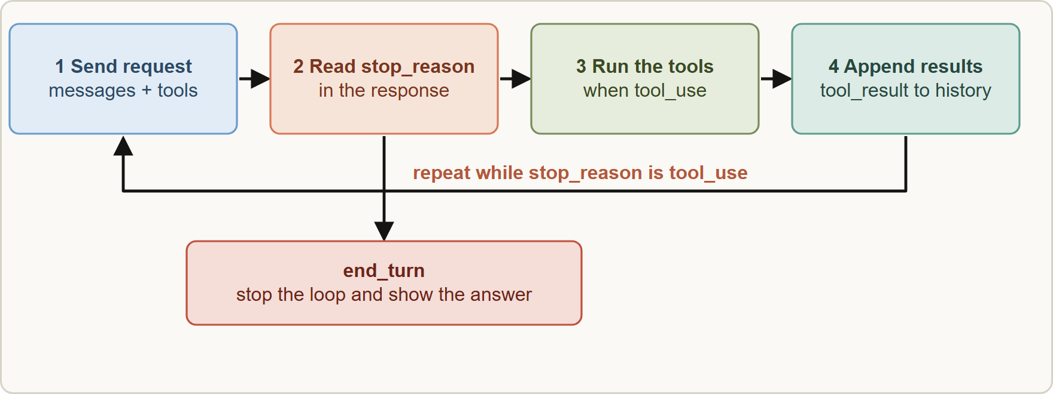
The Agentic Loop, continued
Module 1
The agentic loop: send the request, read stop_reason, run the requested tools and append their results while stop_reason is tool_use, and finish when stop_reason is end_turn
Claude Architect Foundations Exam Prep | for the CCAR-F exam
Module 1: Agentic Loops and stop_reason
5 / 26
Notes:
The Agentic Loop, continued.
The figure shows this: The agentic loop: send the request, read stop reason, run the requested tools and append their results while stop reason is tool use, and finish when stop reason is end turn.

Slide 6
The Agentic Loop, continued
Module 1
PYTHON
messages = [{"role": "user", "content": user_text}]
while True:
resp = client.messages.create(model=MODEL, max_tokens=1024,
tools=TOOLS, messages=messages)
messages.append({"role": "assistant", "content": resp.content})
if resp.stop_reason == "tool_use":
results = [{"type": "tool_result", "tool_use_id": b.id,
"content": run_tool(b.name, b.input)}
for b in resp.content if b.type == "tool_use"]
messages.append({"role": "user", "content": results}) # tool results go back as a user message
elif resp.stop_reason == "end_turn":
break # finished: show resp to the user
Example from the study note (names are examples)
EXAM TIP The loop continues when `stop_reason` is `"tool_use"` and terminates when it is `"end_turn"`. Memorize both values and what each triggers.
Claude Architect Foundations Exam Prep | for the CCAR-F exam
Module 1: Agentic Loops and stop_reason
6 / 26
Notes:
The Agentic Loop, continued.
The example is on the screen; read it line by line when you study.
Exam tip: The loop continues when stop reason is "tool use" and terminates when it is "end turn". Memorize both values and what each triggers.

Slide 7
How Tool Results Reach the Model
Module 1
The API is stateless: Claude only knows what you send. After a tool runs, you must append the result to the history so the next request can reason about it.
The history grows in pairs: the assistant message (text plus tool_use blocks) and the user message carrying the `tool_result` blocks, each linked by tool_use_id.
Rules of the API: the tool_result blocks must immediately follow the assistant's tool_use message, and in that user message the tool_result blocks must come first, before any text.
Claude Architect Foundations Exam Prep | for the CCAR-F exam
Module 1: Agentic Loops and stop_reason
7 / 26
Notes:
How Tool Results Reach the Model.
The A P I (application programming interface) is stateless: Claude only knows what you send. After a tool runs, you must append the result to the history so the next request can reason about it.
The history grows in pairs: the assistant message (text plus tool use blocks) and the user message carrying the tool result blocks, each linked by tool use id.
Rules of the A P I: the tool result blocks must immediately follow the assistant's tool use message, and in that user message the tool result blocks must come first, before any text.

Slide 8
How Tool Results Reach the Model, continued
Module 1
Claude may request several tools in one response (parallel tool use): run them all and return all the results in one user message.
If a tool fails, return the error text in the tool_result with `is_error: true` so Claude can adapt instead of guessing.
Claude Architect Foundations Exam Prep | for the CCAR-F exam
Module 1: Agentic Loops and stop_reason
8 / 26
Notes:
How Tool Results Reach the Model, continued.
Claude may request several tools in one response (parallel tool use): run them all and return all the results in one user message.
If a tool fails, return the error text in the tool result with is error: true so Claude can adapt instead of guessing.

Slide 9
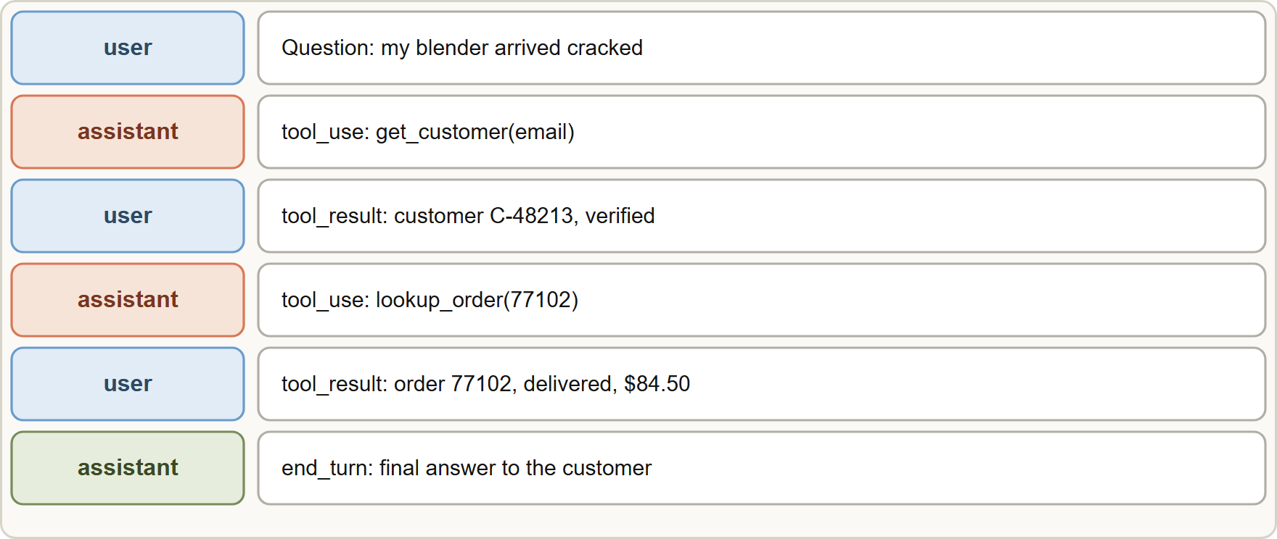
How Tool Results Reach the Model, continued
Module 1
How the history grows: each tool_use from the assistant is followed by a user message with the matching tool_result, until the assistant ends the turn
EXAM TIP The API is stateless: if a question says Claude "forgot" an earlier tool result, the history was not appended or resent.
Claude Architect Foundations Exam Prep | for the CCAR-F exam
Module 1: Agentic Loops and stop_reason
9 / 26
Notes:
How Tool Results Reach the Model, continued.
The figure shows this: How the history grows: each tool use from the assistant is followed by a user message with the matching tool result, until the assistant ends the turn.
Exam tip: The A P I is stateless: if a question says Claude "forgot" an earlier tool result, the history was not appended or resent.

Slide 10
Model-Driven Versus Pre-Configured
Module 1
 | Model-driven (agentic loop) | Pre-configured (decision tree or fixed sequence)
Who chooses the next tool? | Claude, from the context and the last tool results | Your code, in a fixed order or rule set
Best for | Open-ended tasks where the path depends on what is found | Predictable steps with a known order
Risk | The model may skip or reorder steps unless something enforces them | Rigid; breaks on cases you did not foresee
Exam link | This task statement | Used with the model-driven loop when order is mandatory (Module 3)
Claude Architect Foundations Exam Prep | for the CCAR-F exam
Module 1: Agentic Loops and stop_reason
10 / 26
Notes:
Model-Driven Versus Pre-Configured.
Who chooses the next tool? Model-driven (agentic loop): Claude, from the context and the last tool results. Pre-configured (decision tree or fixed sequence): Your code, in a fixed order or rule set.
Best for. Model-driven (agentic loop): Open-ended tasks where the path depends on what is found. Pre-configured (decision tree or fixed sequence): Predictable steps with a known order.
Risk. Model-driven (agentic loop): The model may skip or reorder steps unless something enforces them. Pre-configured (decision tree or fixed sequence): Rigid; breaks on cases you did not foresee.
Exam link. Model-driven (agentic loop): This task statement. Pre-configured (decision tree or fixed sequence): Used with the model-driven loop when order is mandatory (Module three).

Slide 11
Model-Driven Versus Pre-Configured, continued
Module 1
The exam contrasts "Claude reasons about which tool to call next based on context" with "pre-configured decision trees or tool sequences". The agentic loop is the first.
A fixed order that is required by the business is not solved by turning the whole agent into a decision tree; you add enforcement at the points that matter (Module 3).
EXAM TIP "Claude decides the next tool from context" is the agentic (model-driven) pattern; "your code fixes the order" is pre-configured. A required order is enforced at specific points (Module 3), not by dropping the loop.
Claude Architect Foundations Exam Prep | for the CCAR-F exam
Module 1: Agentic Loops and stop_reason
11 / 26
Notes:
Model-Driven Versus Pre-Configured, continued.
The exam contrasts "Claude reasons about which tool to call next based on context" with "pre-configured decision trees or tool sequences". The agentic loop is the first.
A fixed order that is required by the business is not solved by turning the whole agent into a decision tree; you add enforcement at the points that matter (Module three).
Exam tip: "Claude decides the next tool from context" is the agentic (model-driven) pattern; "your code fixes the order" is pre-configured. A required order is enforced at specific points (Module three), not by dropping the loop.

Slide 12
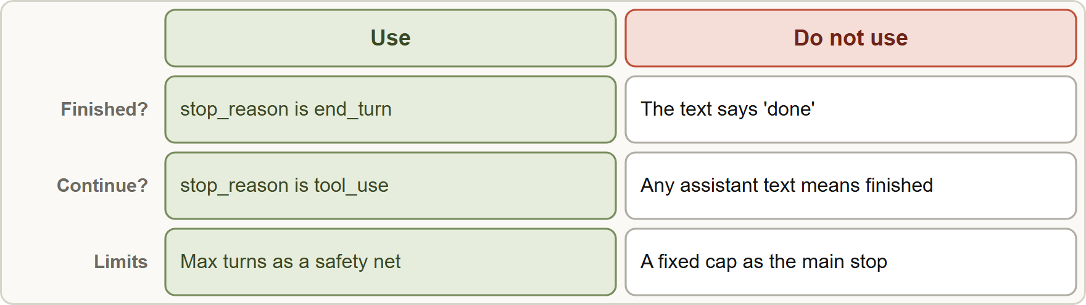
Stopping the Loop Correctly
Module 1
Stop on stop_reason; do not stop on parsed text, on an arbitrary iteration cap, or on the mere presence of assistant text
Claude Architect Foundations Exam Prep | for the CCAR-F exam
Module 1: Agentic Loops and stop_reason
12 / 26
Notes:
Stopping the Loop Correctly.
The figure shows this: Stop on stop reason; do not stop on parsed text, on an arbitrary iteration cap, or on the mere presence of assistant text.

Slide 13
Stopping the Loop Correctly, continued
Module 1
Anti-pattern | Why it fails
Parsing natural language ("if the reply says 'I'm done'") | Wording varies; a polite sentence can appear while a tool call is still pending
An arbitrary iteration cap as the main stop (for example 5 turns) | Cuts off tasks that need more steps and wastes turns on easy ones; the cap hides the real signal
Checking for assistant text as a completion indicator | Claude often writes text together with a tool_use block ("Let me look that up")
Use stop_reason as the authoritative signal.
Claude Architect Foundations Exam Prep | for the CCAR-F exam
Module 1: Agentic Loops and stop_reason
13 / 26
Notes:
Stopping the Loop Correctly, continued.
Parsing natural language ("if the reply says 'I'm done'"). Wording varies; a polite sentence can appear while a tool call is still pending.
An arbitrary iteration cap as the main stop (for example five turns). Cuts off tasks that need more steps and wastes turns on easy ones; the cap hides the real signal.
Checking for assistant text as a completion indicator. Claude often writes text together with a tool use block ("Let me look that up").
Use stop reason as the authoritative signal.

Slide 14
Stopping the Loop Correctly, continued
Module 1
A maximum-turns or budget limit is still a good safety net against runaway loops; it is just not the primary stopping mechanism.
Claude Architect Foundations Exam Prep | for the CCAR-F exam
Module 1: Agentic Loops and stop_reason
14 / 26
Notes:
Stopping the Loop Correctly, continued.
A maximum-turns or budget limit is still a good safety net against runaway loops; it is just not the primary stopping mechanism.

Slide 15
Other stop reasons
BEYOND THE GUIDE
Module 1
stop_reason | Meaning | What to do
end_turn | Claude finished naturally | Present the answer
tool_use | Claude requests tool calls | Run them, append results, continue
max_tokens | The reply hit your max_tokens limit | The output is cut off: raise the limit or continue the turn
stop_sequence | A stop sequence you set was produced | Handle as your design requires
pause_turn | A server-side tool loop paused | Send the response back to continue
refusal | Claude declined the request | Handle as a refusal, do not retry blindly
Claude Architect Foundations Exam Prep | for the CCAR-F exam
Module 1: Agentic Loops and stop_reason
15 / 26
Notes:
Other stop reasons.
end turn. Meaning: Claude finished naturally. What to do: Present the answer.
tool use. Meaning: Claude requests tool calls. What to do: Run them, append results, continue.
max tokens. Meaning: The reply hit your max tokens limit. What to do: The output is cut off: raise the limit or continue the turn.
stop sequence. Meaning: A stop sequence you set was produced. What to do: Handle as your design requires.
pause turn. Meaning: A server-side tool loop paused. What to do: Send the response back to continue.
refusal. Meaning: Claude declined the request. What to do: Handle as a refusal, do not retry blindly.

Slide 16
Other stop reasons, continued
BEYOND THE GUIDE · DATES
Module 1
The Claude Agent SDK runs this loop for you: it keeps going until Claude replies with no tool calls, then returns a result whose subtype is success; limits such as maxTurns end it with error_max_turns instead. As of 8 November 2026.
Claude Architect Foundations Exam Prep | for the CCAR-F exam
Module 1: Agentic Loops and stop_reason
16 / 26
Notes:
Other stop reasons, continued.
The Claude Agent S D K (software development kit) runs this loop for you: it keeps going until Claude replies with no tool calls, then returns a result whose subtype is success; limits such as max Turns end it with error max turns instead. As of eight November two thousand twenty-six.

Slide 17
Module Recap
Module 1
1
Loop
2
Continue / stop
3
History
Request → inspect stop_reason → run tools → append tool_result → repeat
`tool_use` = continue, `end_turn` = stop
Append the assistant message (with tool_use) and a user message with tool_result blocks, matched by tool_use_id
4
Parallel calls
5
Model-driven vs fixed
6
Anti-patterns
Several tool_use blocks may come at once: run all, return all results together
Parse text for "done"; arbitrary iteration cap as main stop; treat any text as completion
Claude chooses next tool from context (agentic) vs your code fixes the order (decision tree)
7
Safety net
A max-turns or budget limit is fine as a guard rail, not as the main stop
Claude Architect Foundations Exam Prep | for the CCAR-F exam
Module 1: Agentic Loops and stop_reason
17 / 26
Notes:
Here is the recap.
Loop: Request to inspect stop reason to run tools to append tool result to repeat.
Continue or stop: tool use equals continue, end turn equals stop.
History: Append the assistant message (with tool use) and a user message with tool result blocks, matched by tool use id.
Parallel calls: Several tool use blocks may come at once: run all, return all results together.
Model-driven versus fixed: Claude chooses next tool from context (agentic) versus your code fixes the order (decision tree).
Anti-patterns: Parse text for "done"; arbitrary iteration cap as main stop; treat any text as completion.
Safety net: A max-turns or budget limit is fine as a guard rail, not as the main stop.

Slide 18
Practice Question 1
Module 1
Q1
Birchwood's support agent sometimes stops after Claude writes "Let me check that order for you" even though the same response contains a tool_use block. The loop ends because it checks whether the response contains any text. What is the best fix?
A
Continue the loop while stop_reason is "tool_use" and stop when it is "end_turn"
B
Stop the loop only after exactly five iterations
C
Search the text for the word "done" before stopping
D
Add a system prompt line telling Claude never to write any text before it calls a tool, so that text always means done
Claude Architect Foundations Exam Prep | for the CCAR-F exam
Module 1: Agentic Loops and stop_reason
18 / 26
Notes:
Question one.
Birchwood's support agent sometimes stops after Claude writes "Let me check that order for you" even though the same response contains a tool use block. The loop ends because it checks whether the response contains any text. What is the best fix?
The four options are on the screen.
[PAUSE 12]
The answer is A. stop reason is the authoritative loop signal. Text can accompany a tool call, so text is not a completion indicator; a prompt tweak, a fixed count and a keyword search all keep a fragile signal.

Slide 19
Practice Question 2
Module 1
Q2
A developer ends the agent run after a fixed 8 iterations because "most tasks finish by then". Several complex refund cases return incomplete answers. What is the root problem?
A
The tools return so much data that the conversation history overflows
B
The model is too small to finish complex refund cases within one run
C
The system prompt is too long
D
An arbitrary iteration cap is the main stop signal
Claude Architect Foundations Exam Prep | for the CCAR-F exam
Module 1: Agentic Loops and stop_reason
19 / 26
Notes:
Question two.
A developer ends the agent run after a fixed eight iterations because "most tasks finish by then". Several complex refund cases return incomplete answers. What is the root problem?
The four options are on the screen.
[PAUSE 12]
The answer is D. A cap cuts off tasks that need more steps. Terminate on end turn; keep a cap only as a safety limit.

Slide 20
Practice Question 3
Module 1
Q3
After running a requested tool, what must the application do before the next request?
A
Start a new conversation with only the tool result
B
Discard the tool output to save tokens and let Claude infer the result from its own earlier reasoning
C
Send the tool result as a system prompt
D
Append the assistant tool_use message and a user message with the matching tool_result to the history
Claude Architect Foundations Exam Prep | for the CCAR-F exam
Module 1: Agentic Loops and stop_reason
20 / 26
Notes:
Question three.
After running a requested tool, what must the application do before the next request?
The four options are on the screen.
[PAUSE 12]
The answer is D. The A P I is stateless; the model can reason about the result only if it is in the history it receives.

Slide 21
Practice Question 4
Module 1
Q4
Which design uses model-driven decision making?
A
A lookup table keyed by the customer's account type
B
A script that always calls search, then summarize, then email in that order
C
A rule engine that maps keywords in the user message to tools
D
A loop in which Claude picks the next tool from the context
Claude Architect Foundations Exam Prep | for the CCAR-F exam
Module 1: Agentic Loops and stop_reason
21 / 26
Notes:
Question four.
Which design uses model-driven decision making?
The four options are on the screen.
[PAUSE 12]
The answer is D. Model-driven means Claude chooses the next action from context. The other options are pre-configured sequences.

Slide 22
Practice Question 5
Module 1
Q5
Claude returns a response with stop_reason: "tool_use" containing three tool_use blocks. What is the correct handling?
A
Run all three tools and return all three results in the next user message
B
Return an error, because only one tool call is allowed in a single response
C
Wait for the user to choose which tool to run
D
Run only the first tool and ignore the others
Claude Architect Foundations Exam Prep | for the CCAR-F exam
Module 1: Agentic Loops and stop_reason
22 / 26
Notes:
Question five.
Claude returns a response with stop reason: "tool use" containing three tool use blocks. What is the correct handling?
The four options are on the screen.
[PAUSE 12]
The answer is A. Claude may request several tools at once; run each and return all results together (each linked to its tool use id).

Slide 23
Practice Question 6
Module 1
Q6
A team wants protection against runaway loops. Which statement is best?
A
Remove all limits; stop_reason is enough
B
Use the iteration cap as the only stop signal
C
Stop whenever the response is longer than 500 words, because long replies mean the task is done
D
A turn or budget limit as a safety net, with stop_reason as the main signal
Claude Architect Foundations Exam Prep | for the CCAR-F exam
Module 1: Agentic Loops and stop_reason
23 / 26
Notes:
Question six.
A team wants protection against runaway loops. Which statement is best?
The four options are on the screen.
[PAUSE 12]
The answer is D. A limit is a sensible guard rail, but the loop should normally end on end turn.

Slide 24
Practice Question 7
Module 1
Q7
A response arrives with stop_reason: "max_tokens" and the answer ends mid-sentence. What does this tell you?
A
The reply hit the output limit and was cut off; raise max_tokens
B
The user cancelled the request before the model could finish its reply
C
Claude requested a tool call
D
Claude finished its task normally and the answer is complete as written
Claude Architect Foundations Exam Prep | for the CCAR-F exam
Module 1: Agentic Loops and stop_reason
24 / 26
Notes:
Question seven.
A response arrives with stop reason: "max tokens" and the answer ends mid-sentence. What does this tell you?
The four options are on the screen.
[PAUSE 12]
The answer is A. max tokens means the output limit was reached, so the answer is incomplete.

Slide 25
Practice Question 8
Module 1
Q8
Which TWO statements about the agentic loop are correct? (Select TWO.)
A
The loop ends when the reply contains the word "done"
B
The loop continues while stop_reason is "tool_use"
C
Claude keeps tool results between requests, so the history need not be resent
D
A fixed iteration count is the recommended primary stop signal
E
Tool results are returned in a user message linked to the request by tool_use_id
Claude Architect Foundations Exam Prep | for the CCAR-F exam
Module 1: Agentic Loops and stop_reason
25 / 26
Notes:
Question eight. Select two.
Which two statements about the agentic loop are correct?
The five options are on the screen.
[PAUSE 15]
The answers are B and E. The loop runs on stop reason, and results travel back in a user message matched by tool use id. Keyword checks and fixed counts are fragile, and the A P I is stateless so the history must be resent.

Slide 26
Answers at a Glance
Module 1
Question | Answer | Why
Q1 | A | stop_reason is the authoritative loop signal
Q2 | D | A cap cuts off tasks that need more steps
Q3 | D | The API is stateless
Q4 | D | Model-driven means Claude chooses the next action from context
Q5 | A | Claude may request several tools at once
Q6 | D | A limit is a sensible guard rail
Q7 | A | max_tokens means the output limit was reached
Q8 | B, E | The loop runs on stop_reason
Claude Architect Foundations Exam Prep | for the CCAR-F exam
Module 1: Agentic Loops and stop_reason
26 / 26
Notes:
Here are all eight answers. Question one: A. Question two: D. Question three: D. Question four: D. Question five: A. Question six: D. Question seven: A. Question eight: B and E.
In the next module, we continue the course.

