Slide 1
Module 2: Multi-Agent Orchestration: Coordinator, Subagents and Spawning
The hub-and-spoke (coordinator and subagents) architecture and why all communication goes through the coordinator
Domain 1 · Agentic Architecture and Orchestration · Task statements 1.2 and 1.3
Claude Architect Foundations Exam Prep Masterclass
Module 2
Notes:
Welcome to Module two: Multi-Agent Orchestration: Coordinator, Subagents and Spawning. This module covers task statements one point two and one point three: coordinators, subagents and spawning.
Each part of this module comes from the study notes of the same name, so you can read the notes after you watch.

Slide 2
What You Will Learn
Module 2
The hub-and-spoke (coordinator and subagents) architecture and why all communication goes through the coordinator
Why subagents have isolated context and what that means for prompts
How the coordinator decomposes, delegates, aggregates and refines, and the risk of too narrow a decomposition
How to spawn subagents: the Task tool, allowedTools, AgentDefinition, parallel spawning, forks
Claude Architect Foundations Exam Prep | for the CCAR-F exam
Module 2
2 / 26
Notes:
By the end of this module you will be able to do four things.
The hub-and-spoke (coordinator and subagents) architecture and why all communication goes through the coordinator.
Why subagents have isolated context and what that means for prompts.
How the coordinator decomposes, delegates, aggregates and refines, and the risk of too narrow a decomposition.
How to spawn subagents: the Task tool, allowed Tools, Agent Definition, parallel spawning, forks.

Slide 3
Case Check-In: Birchwood Supply Researches a Market
Module 2
CASE CHECK-IN · Birchwood Supply
Birchwood's analysts ask: "What is changing in home energy?"
A coordinator agent splits the question and hands parts to four subagents: web search, document analysis, synthesis and report generation
The final report must be complete and cited
Claude Architect Foundations Exam Prep | for the CCAR-F exam
Module 2
3 / 26
Notes:
Our running case is Birchwood Supply. Birchwood Supply Researches a Market.
Birchwood's analysts ask: "What is changing in home energy?".
A coordinator agent splits the question and hands parts to four subagents: web search, document analysis, synthesis and report generation.
The final report must be complete and cited.

Slide 4
The Coordinator and Subagents
Module 2
In the hub-and-spoke pattern, one coordinator agent is the hub; the subagents are spokes.
Claude Architect Foundations Exam Prep | for the CCAR-F exam
Module 2
4 / 26
Notes:
The Coordinator and Subagents.
In the hub-and-spoke pattern, one coordinator agent is the hub; the subagents are spokes.

Slide 5
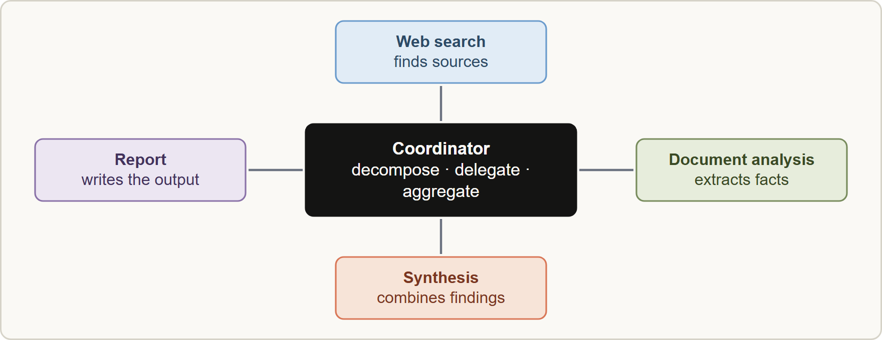
The Coordinator and Subagents, continued
Module 2
Hub-and-spoke: the coordinator decomposes the task, delegates to subagents, collects results, handles errors and decides what to run next; subagents never talk to each other directly
Claude Architect Foundations Exam Prep | for the CCAR-F exam
Module 2
5 / 26
Notes:
The Coordinator and Subagents, continued.
The figure shows this: Hub-and-spoke: the coordinator decomposes the task, delegates to subagents, collects results, handles errors and decides what to run next; subagents never talk to each other directly.

Slide 6
The Coordinator and Subagents, continued
Module 2
The coordinator... | Why it matters
Decomposes the task and decides which subagents to invoke from the query's complexity | Simple questions should not run the full pipeline
Delegates with clear goals and passes the needed context | Subagents do not share memory
Aggregates results and evaluates them for gaps | Quality control sits in one place
Manages all communication, error handling and information routing | Gives observability, consistent error handling and controlled information flow
Subagents operate with isolated context: they do not inherit the coordinator's conversation history.
Route every subagent exchange through the coordinator, not subagent to subagent.
EXAM TIP "Why route communication through the coordinator?" → observability, consistent error handling, controlled information flow.
Claude Architect Foundations Exam Prep | for the CCAR-F exam
Module 2
6 / 26
Notes:
The Coordinator and Subagents, continued.
Decomposes the task and decides which subagents to invoke from the query's complexity. Simple questions should not run the full pipeline.
Delegates with clear goals and passes the needed context. Subagents do not share memory.
Aggregates results and evaluates them for gaps. Quality control sits in one place.
Manages all communication, error handling and information routing. Gives observability, consistent error handling and controlled information flow.
Subagents operate with isolated context: they do not inherit the coordinator's conversation history.
Route every subagent exchange through the coordinator, not subagent to subagent.
Exam tip: "Why route communication through the coordinator?" to observability, consistent error handling, controlled information flow.

Slide 7
Decomposition: Coverage and Dynamic Selection
Module 2
Too narrow a decomposition is the classic failure. If the coordinator turns "home energy" into "rooftop solar", "solar inverters" and "solar financing", every subagent can do a perfect job and the report still misses batteries, heat pumps and wind. The root cause is the coordinator's task decomposition, not the downstream agents.
Design the coordinator to analyze the query's requirements and choose which subagents to invoke, instead of always running the whole pipeline.
Partition the scope to minimize duplication: give each agent a distinct subtopic or source type (for example "market data" versus "academic papers").
Claude Architect Foundations Exam Prep | for the CCAR-F exam
Module 2
7 / 26
Notes:
Decomposition: Coverage and Dynamic Selection.
Too narrow a decomposition is the classic failure. If the coordinator turns "home energy" into "rooftop solar", "solar inverters" and "solar financing", every subagent can do a perfect job and the report still misses batteries, heat pumps and wind. The root cause is the coordinator's task decomposition, not the downstream agents.
Design the coordinator to analyze the query's requirements and choose which subagents to invoke, instead of always running the whole pipeline.
Partition the scope to minimize duplication: give each agent a distinct subtopic or source type (for example "market data" versus "academic papers").

Slide 8
Decomposition: Coverage and Dynamic Selection, continued
Module 2
Use an iterative refinement loop: the coordinator checks the synthesis for gaps, re-delegates targeted queries to search and analysis agents, and re-invokes synthesis until coverage is sufficient.
Claude Architect Foundations Exam Prep | for the CCAR-F exam
Module 2
8 / 26
Notes:
Decomposition: Coverage and Dynamic Selection, continued.
Use an iterative refinement loop: the coordinator checks the synthesis for gaps, re-delegates targeted queries to search and analysis agents, and re-invokes synthesis until coverage is sufficient.

Slide 9
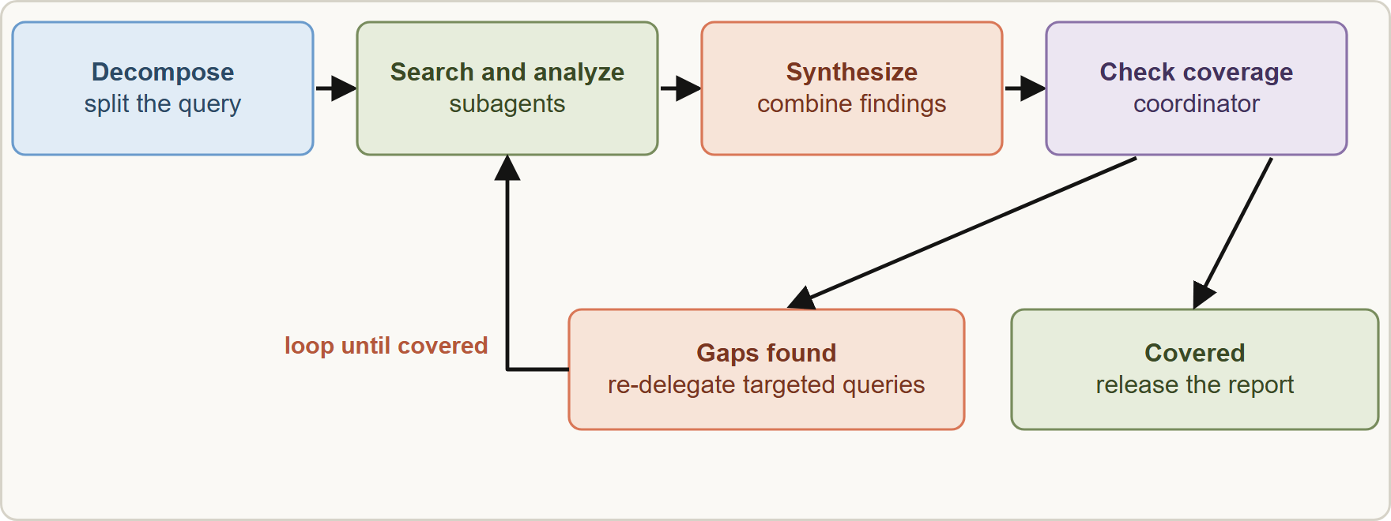
Decomposition: Coverage and Dynamic Selection, continued
Module 2
Iterative refinement: after synthesis the coordinator evaluates coverage, re-delegates targeted queries for gaps, and repeats until coverage is sufficient
EXAM TIP When the final output has a missing area but each subagent "succeeded", look at how the coordinator split the task.
Claude Architect Foundations Exam Prep | for the CCAR-F exam
Module 2
9 / 26
Notes:
Decomposition: Coverage and Dynamic Selection, continued.
The figure shows this: Iterative refinement: after synthesis the coordinator evaluates coverage, re-delegates targeted queries for gaps, and repeats until coverage is sufficient.
Exam tip: When the final output has a missing area but each subagent "succeeded", look at how the coordinator split the task.

Slide 10
Spawning Subagents
Module 2
Element | What to know
Spawning tool | Subagents are started by the Task tool. For a coordinator to start them, `allowedTools` must include `"Task"`
`AgentDefinition` | Each subagent type has a description (when to use it), a system prompt and tool restrictions
Context | A subagent does not inherit the parent's context or share memory between invocations: put everything it needs in its prompt
Forks | Fork-based session management creates branches to explore divergent approaches from a shared baseline (see Module 4)
Claude Architect Foundations Exam Prep | for the CCAR-F exam
Module 2
10 / 26
Notes:
Spawning Subagents.
Spawning tool. Subagents are started by the Task tool. For a coordinator to start them, allowed Tools must include "Task".
Agent Definition. Each subagent type has a description (when to use it), a system prompt and tool restrictions.
Context. A subagent does not inherit the parent's context or share memory between invocations: put everything it needs in its prompt.
Forks. Fork-based session management creates branches to explore divergent approaches from a shared baseline (see Module four).

Slide 11
Spawning Subagents, continued
DATES
Module 2
[Old name] / [Verify live] In current Claude Code and Agent SDK documentation the spawning tool is named `Agent`; it was renamed from Task in Claude Code v2.1.63, and Task still works as an alias. The exam guide uses Task and allowedTools containing "Task". Answer with the guide's wording; in real code include both names or the current one. As of 8 November 2026.
Claude Architect Foundations Exam Prep | for the CCAR-F exam
Module 2
11 / 26
Notes:
Spawning Subagents, continued.
or In current Claude Code and Agent S D K (software development kit) documentation the spawning tool is named Agent; it was renamed from Task in Claude Code version two point one point sixty-three, and Task still works as an alias. The exam guide uses Task and allowed Tools containing "Task". Answer with the guide's wording; in real code include both names or the current one. As of eight November two thousand twenty-six.

Slide 12
Spawning Subagents, continued
Module 2
PYTHON
research_agents = {
"web-search": AgentDefinition(
description="Finds recent web sources for a research subtopic.",
prompt="You search the web and return findings as structured JSON.",
tools=["WebSearch"]),
"synthesis": AgentDefinition(
description="Combines findings into a cited summary.",
prompt="You merge the findings you are given and keep every citation.",
tools=["verify_fact"]), # narrow tool for a frequent need (Module 6)
}
options = ClaudeAgentOptions(allowed_tools=["Task"], agents=research_agents)
Example from the study note (names are examples)
Claude Architect Foundations Exam Prep | for the CCAR-F exam
Module 2
12 / 26
Notes:
Spawning Subagents, continued.
The example is on the screen; read it line by line when you study.

Slide 13
Passing context
Module 2
Include complete findings from earlier agents directly in the next subagent's prompt (for example, the search results and the document analysis go into the synthesis prompt).
Use a structured format that separates content from metadata (claim, source URL, document name, page number, date) so attribution survives the hand-off.
Spawn in parallel by emitting several Task tool calls in one coordinator response, not across separate turns; parallel calls cut latency.
Write coordinator prompts that give the goal and the quality criteria, not a step-by-step procedure, so subagents can adapt.
Claude Architect Foundations Exam Prep | for the CCAR-F exam
Module 2
13 / 26
Notes:
Passing context.
Include complete findings from earlier agents directly in the next subagent's prompt (for example, the search results and the document analysis go into the synthesis prompt).
Use a structured format that separates content from metadata (claim, source U R L (uniform resource locator), document name, page number, date) so attribution survives the hand-off.
Spawn in parallel by emitting several Task tool calls in one coordinator response, not across separate turns; parallel calls cut latency.
Write coordinator prompts that give the goal and the quality criteria, not a step-by-step procedure, so subagents can adapt.

Slide 14
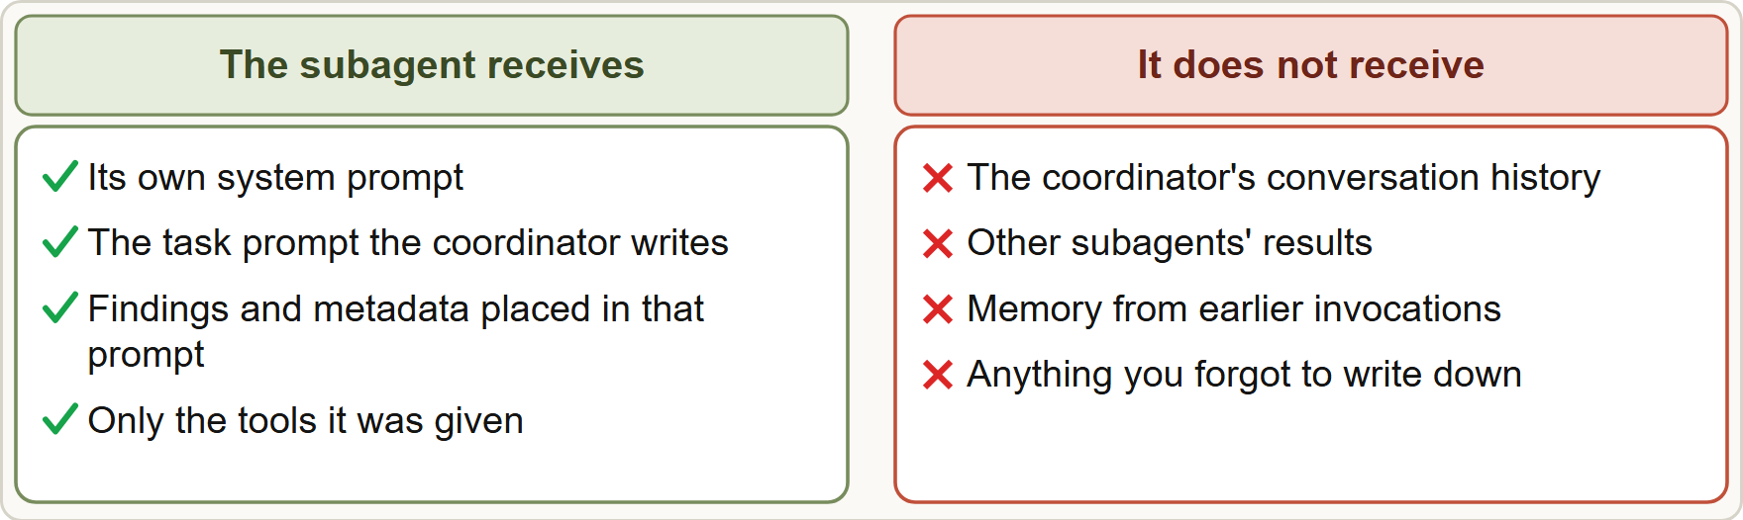
Passing context, continued
DATES
Module 2
Current documentation: a subagent's final message returns to the parent as a summary, so verbose intermediate work stays out of the parent's context; subagents can run in parallel and (by default) can themselves spawn subagents up to three levels below the main agent. As of 8 November 2026.
Current documentation: a subagent's final message returns to the parent as a summary, so verbose intermediate work stays out of the parent's context; subagents can run in parallel and (by default) can themselves spawn subagents up to three levels below the main agent. As of 8 November 2026.
EXAM TIP A subagent that "does not know" something almost always means the coordinator never put it in the prompt: subagents do not inherit context or memory.
Claude Architect Foundations Exam Prep | for the CCAR-F exam
Module 2
14 / 26
Notes:
Passing context, continued.
The figure shows this: Subagents start fresh: they see their own system prompt and the prompt the coordinator writes, not the coordinator's history or other subagents' results.
Current documentation: a subagent's final message returns to the parent as a summary, so verbose intermediate work stays out of the parent's context; subagents can run in parallel and (by default) can themselves spawn subagents up to three levels below the main agent. As of eight November two thousand twenty-six.
Exam tip: A subagent that "does not know" something almost always means the coordinator never put it in the prompt: subagents do not inherit context or memory.

Slide 15
Module Recap
Module 2
1
Pattern
2
Why via coordinator
3
Subagent context
Hub-and-spoke: coordinator + subagents; all communication via the coordinator
Isolated; does not inherit history or share memory; give it everything in its prompt
Observability, consistent error handling, controlled information flow
4
Spawning
5
Parallel
6
Decomposition risk
Task tool (now called Agent); allowedTools must include it; AgentDefinition = description + prompt + tool limits
Several Task calls in one coordinator response
Too narrow → incomplete coverage though every subagent "succeeded"
7
Refinement loop
8
Prompts
Check gaps → re-delegate targeted queries → re-run synthesis until covered
Coordinator gives goals and criteria, not procedures; pass content + metadata in structured form
Claude Architect Foundations Exam Prep | for the CCAR-F exam
Module 2
15 / 26
Notes:
Here is the recap.
Pattern: Hub-and-spoke: coordinator plus subagents; all communication via the coordinator.
Why via coordinator: Observability, consistent error handling, controlled information flow.
Subagent context: Isolated; does not inherit history or share memory; give it everything in its prompt.
Spawning: Task tool (now called Agent); allowed Tools must include it; Agent Definition equals description plus prompt plus tool limits.
Parallel: Several Task calls in one coordinator response.
Decomposition risk: Too narrow to incomplete coverage though every subagent "succeeded".
Refinement loop: Check gaps to re-delegate targeted queries to re-run synthesis until covered.
Prompts: Coordinator gives goals and criteria, not procedures; pass content plus metadata in structured form.

Slide 16
Practice Question 1
Module 2
Q1
Birchwood's research system produces a report on "the future of home energy" that covers only solar power. Logs show each subagent finished successfully and the coordinator created three subtasks, all about solar panels. What is the most likely root cause?
A
The web search agent's queries were too short
B
The coordinator's task decomposition was too narrow
C
The document analysis agent filtered out battery and heat-pump sources
D
The synthesis agent lacks gap-detection instructions
Claude Architect Foundations Exam Prep | for the CCAR-F exam
Module 2
16 / 26
Notes:
Question one.
Birchwood's research system produces a report on "the future of home energy" that covers only solar power. Logs show each subagent finished successfully and the coordinator created three subtasks, all about solar panels. What is the most likely root cause?
The four options are on the screen.
[PAUSE 12]
The answer is B. The logs show the coordinator assigned only solar subtasks. The subagents did what they were assigned; the gap comes from the decomposition.

Slide 17
Practice Question 2
Module 2
Q2
Which is the main reason to route all subagent communication through the coordinator?
A
Subagents cannot communicate with each other in any multi-agent system, so the hub is mandatory
B
It makes every subagent run noticeably faster because they all share the same context
C
It removes the need for a system prompt
D
Observability, consistent error handling and controlled information flow
Claude Architect Foundations Exam Prep | for the CCAR-F exam
Module 2
17 / 26
Notes:
Question two.
Which is the main reason to route all subagent communication through the coordinator?
The four options are on the screen.
[PAUSE 12]
The answer is D. The hub-and-spoke pattern centralizes monitoring, errors and routing in one place.

Slide 18
Practice Question 3
Module 2
Q3
A coordinator always runs search, analysis, synthesis and reporting for every request, even a one-line factual question. What change is most appropriate?
A
Remove the reporting subagent and let the search subagent write each answer
B
Force every request through the pipeline twice
C
Let it analyze the query and invoke only the subagents needed
D
Make subagents call each other directly
Claude Architect Foundations Exam Prep | for the CCAR-F exam
Module 2
18 / 26
Notes:
Question three.
A coordinator always runs search, analysis, synthesis and reporting for every request, even a one-line factual question. What change is most appropriate?
The four options are on the screen.
[PAUSE 12]
The answer is C. A coordinator should select subagents dynamically based on complexity instead of always running the full pipeline.

Slide 19
Practice Question 4
Module 2
Q4
The synthesis subagent produces summaries with missing citations. It receives only the instruction "combine the findings", while the coordinator holds the search results in its own conversation. What is the best fix?
A
Ask the subagent to search again from scratch
B
Include the complete findings, with source URLs and document names in a structured format, in the synthesis subagent's prompt
C
Assume the subagent can read the coordinator's conversation history and find the sources itself
D
Raise max_tokens for the coordinator
Claude Architect Foundations Exam Prep | for the CCAR-F exam
Module 2
19 / 26
Notes:
Question four.
The synthesis subagent produces summaries with missing citations. It receives only the instruction "combine the findings", while the coordinator holds the search results in its own conversation. What is the best fix?
The four options are on the screen.
[PAUSE 12]
The answer is B. Subagents do not inherit context; everything required, including attribution metadata, must be in the prompt.

Slide 20
Practice Question 5
Module 2
Q5
A coordinator must delegate a search and a document analysis that do not depend on each other. How should it start them to minimize latency?
A
Merge both jobs into one subagent prompt
B
Start the analysis first and the search only if the analysis fails
C
Emit both Task tool calls in a single response so they run in parallel
D
Start the search, wait for the full result, then start the analysis in a later turn
Claude Architect Foundations Exam Prep | for the CCAR-F exam
Module 2
20 / 26
Notes:
Question five.
A coordinator must delegate a search and a document analysis that do not depend on each other. How should it start them to minimize latency?
The four options are on the screen.
[PAUSE 12]
The answer is C. Multiple Task calls in one coordinator response let independent subagents run in parallel.

Slide 21
Practice Question 6
Module 2
Q6
A coordinator's allowedTools list contains only Read and Grep, and no subagent ever starts. What is missing?
A
A larger context window
B
A longer system prompt
C
A Pydantic model that describes each subagent's output
D
The "Task" tool in allowedTools
Claude Architect Foundations Exam Prep | for the CCAR-F exam
Module 2
21 / 26
Notes:
Question six.
A coordinator's allowed Tools list contains only Read and Grep, and no subagent ever starts. What is missing?
The four options are on the screen.
[PAUSE 12]
The answer is D. To invoke subagents, the coordinator's allowed Tools must include the Task tool (named Agent in current documentation).

Slide 22
Practice Question 7
Module 2
Q7
Which coordinator prompt follows the recommended style?
A
"Step 1: search exactly three named sites. Step 2: copy the first paragraph of each page. Step 3: stop and report."
B
"Research the topic broadly; goal: a cited overview that covers all major sub-areas; quality: every claim has a source and gaps are named."
C
"Do whatever seems right."
D
"Use the same prompt for every subagent."
Claude Architect Foundations Exam Prep | for the CCAR-F exam
Module 2
22 / 26
Notes:
Question seven.
Which coordinator prompt follows the recommended style?
The four options are on the screen.
[PAUSE 12]
The answer is B. Specify goals and quality criteria so subagents can adapt, rather than a rigid procedure.

Slide 23
Practice Question 8
Module 2
Q8
After synthesis, the coordinator notices that the report has no data on the Asian market. What should it do?
A
Re-delegate targeted queries to search and analysis, then re-invoke synthesis
B
Ask the synthesis agent to invent plausible figures
C
Publish the report as it is and mention the missing Asian market in a footnote only
D
End the run with an error
Claude Architect Foundations Exam Prep | for the CCAR-F exam
Module 2
23 / 26
Notes:
Question eight.
After synthesis, the coordinator notices that the report has no data on the Asian market. What should it do?
The four options are on the screen.
[PAUSE 12]
The answer is A. The iterative refinement loop re-delegates for gaps and repeats until coverage is sufficient.

Slide 24
Practice Question 9
Module 2
Q9
A research subagent returns summaries without citations. Which TWO changes help most? (Select TWO.)
A
Let subagents message one another directly to share citations
B
Rely on the subagent inheriting the coordinator's conversation
C
Drop citations to save tokens
D
Require the subagent to output each claim together with its source metadata
E
Put the findings, with source URLs and document names in a structured format, into the subagent's prompt
Claude Architect Foundations Exam Prep | for the CCAR-F exam
Module 2
24 / 26
Notes:
Question nine. Select two.
A research subagent returns summaries without citations. Which two changes help most?
The five options are on the screen.
[PAUSE 15]
The answers are D and E. Subagents do not inherit context, so attribution must be passed in and must be produced as structured output. Peer messaging bypasses the coordinator and dropping citations loses provenance.

Slide 25
Practice Question 10
Module 2
Q10
Which TWO are benefits of routing all subagent communication through the coordinator? (Select TWO.)
A
Consistent error handling in one place
B
Faster peer-to-peer messaging between subagents
C
No need to write prompts for subagents
D
Observability of what each subagent did
E
Lower token use in every case
Claude Architect Foundations Exam Prep | for the CCAR-F exam
Module 2
25 / 26
Notes:
Question ten. Select two.
Which two are benefits of routing all subagent communication through the coordinator?
The five options are on the screen.
[PAUSE 15]
The answers are A and D. A central hub gives observability, consistent error handling and controlled information flow. It does not remove the need for prompts or guarantee lower token use.

Slide 26
Answers at a Glance
Module 2
Question | Answer | Why
Q1 | B | The logs show the coordinator assigned only solar
Q2 | D | The hub-and-spoke pattern centralizes monitoring
Q3 | C | A coordinator should select subagents dynamically based on
Q4 | B | Subagents do not inherit context
Q5 | C | Multiple Task calls in one coordinator response let
Q6 | D | To invoke subagents, the coordinator's allowedTools must include
Q7 | B | Specify goals and quality criteria so subagents can
Q8 | A | The iterative refinement loop re-delegates for gaps and
Q9 | D, E | Subagents do not inherit context
Q10 | A, D | A central hub gives observability
Claude Architect Foundations Exam Prep | for the CCAR-F exam
Module 2
26 / 26
Notes:
Here are all ten answers. Question one: B. Question two: D. Question three: C. Question four: B. Question five: C. Question six: D. Question seven: B. Question eight: A. Question nine: D and E. Question ten: A and D.
In the next module, we continue the course.

