Slide 1
Module 3: Enforcement, Handoffs and Hooks
Programmatic enforcement (hooks, prerequisite gates) versus prompt-based guidance
Domain 1 · Agentic Architecture and Orchestration · Task statements 1.4 and 1.5
Claude Architect Foundations Exam Prep Masterclass
Module 3
Notes:
Welcome to Module three: Enforcement, Handoffs and Hooks. This module covers task statements one point four and one point five: enforcement, handoffs and hooks.
Each part of this module comes from the study notes of the same name, so you can read the notes after you watch.

Slide 2
What You Will Learn
Module 3
Programmatic enforcement (hooks, prerequisite gates) versus prompt-based guidance
When a rule needs deterministic compliance, and why prompts alone have a non-zero failure rate
Prerequisite gates that block a tool until an earlier step has finished
Structured handoffs when the agent escalates to a person
Hooks: PostToolUse to normalize results, and call interception to block policy violations
Claude Architect Foundations Exam Prep | for the CCAR-F exam
Module 3: Enforcement, Handoffs and Hooks
2 / 25
Notes:
By the end of this module you will be able to do five things.
Programmatic enforcement (hooks, prerequisite gates) versus prompt-based guidance.
When a rule needs deterministic compliance, and why prompts alone have a non-zero failure rate.
Prerequisite gates that block a tool until an earlier step has finished.
Structured handoffs when the agent escalates to a person.
Hooks: Post Tool Use to normalize results, and call interception to block policy violations.

Slide 3
Case Check-In: Birchwood Supply Stops Wrong Refunds
Module 3
CASE CHECK-IN · Birchwood Supply
In 9% of conversations the support agent calls process_refund without first verifying the customer with get_customer
Some refunds went to the wrong account
The team has already written "ALWAYS verify the customer first" in the system prompt; the problem continues
Claude Architect Foundations Exam Prep | for the CCAR-F exam
Module 3: Enforcement, Handoffs and Hooks
3 / 25
Notes:
Our running case is Birchwood Supply. Birchwood Supply Stops Wrong Refunds.
In nine percent of conversations the support agent calls process refund without first verifying the customer with get customer.
Some refunds went to the wrong account.
The team has already written "A L W A Y S verify the customer first" in the system prompt; the problem continues.

Slide 4
Enforcement Versus Guidance
Module 3
 | Prompt-based guidance | Programmatic enforcement
How it works | Instructions, rules and examples in the prompt | Code outside the model: hooks and prerequisite gates
Reliability | Probabilistic: the model usually complies, but not always | Deterministic: the code runs every time
Use when | Style, preferences, soft ordering | Identity checks before money moves, hard limits, legal or financial rules
When errors have financial or legal consequences, "usually" is not enough. A prompt has a non-zero failure rate; more emphasis or more examples reduce it but never remove it.
Claude Architect Foundations Exam Prep | for the CCAR-F exam
Module 3: Enforcement, Handoffs and Hooks
4 / 25
Notes:
Enforcement Versus Guidance.
How it works. Prompt-based guidance: Instructions, rules and examples in the prompt. Programmatic enforcement: Code outside the model: hooks and prerequisite gates.
Reliability. Prompt-based guidance: Probabilistic: the model usually complies, but not always. Programmatic enforcement: Deterministic: the code runs every time.
Use when. Prompt-based guidance: Style, preferences, soft ordering. Programmatic enforcement: Identity checks before money moves, hard limits, legal or financial rules.
When errors have financial or legal consequences, "usually" is not enough. A prompt has a non-zero failure rate; more emphasis or more examples reduce it but never remove it.

Slide 5
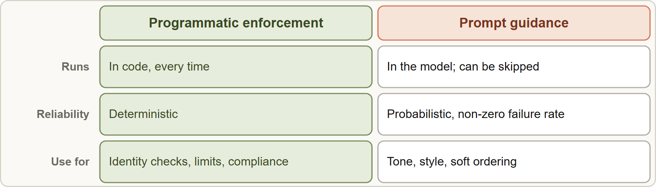
Enforcement Versus Guidance, continued
Module 3
Prompt guidance is probabilistic; programmatic enforcement (hooks and prerequisite gates) is deterministic and is the answer when compliance must be guaranteed
EXAM TIP Requirement says "must", "always", "guarantee", money, identity or compliance? → programmatic enforcement. Answers that only strengthen the prompt, add few-shot examples or filter which tools exist are probabilistic or off-target.
Claude Architect Foundations Exam Prep | for the CCAR-F exam
Module 3: Enforcement, Handoffs and Hooks
5 / 25
Notes:
Enforcement Versus Guidance, continued.
The figure shows this: Prompt guidance is probabilistic; programmatic enforcement (hooks and prerequisite gates) is deterministic and is the answer when compliance must be guaranteed.
Exam tip: Requirement says "must", "always", "guarantee", money, identity or compliance? to programmatic enforcement. Answers that only strengthen the prompt, add few-shot examples or filter which tools exist are probabilistic or off-target.

Slide 6
Prerequisite Gates and Multi-Concern Requests
Module 3
Prerequisite gate: the code blocks a downstream tool call until the prerequisite step has completed. Example: process_refund and lookup_order stay blocked until get_customer has returned a verified customer ID.
The gate can live in the tool wrapper (check shared state) or in a hook (next section). The model sees a clear message such as "verify the customer first" and corrects itself.
Multi-concern requests ("my order is late and I was charged twice"): decompose the message into separate items, investigate each in parallel using shared context (for example the verified customer), then synthesize one unified resolution.
Claude Architect Foundations Exam Prep | for the CCAR-F exam
Module 3: Enforcement, Handoffs and Hooks
6 / 25
Notes:
Prerequisite Gates and Multi-Concern Requests.
Prerequisite gate: the code blocks a downstream tool call until the prerequisite step has completed. Example: process refund and lookup order stay blocked until get customer has returned a verified customer I D.
The gate can live in the tool wrapper (check shared state) or in a hook (next section). The model sees a clear message such as "verify the customer first" and corrects itself.
Multi-concern requests ("my order is late and I was charged twice"): decompose the message into separate items, investigate each in parallel using shared context (for example the verified customer), then synthesize one unified resolution.

Slide 7
Structured Handoffs to Humans
Module 3
When the agent escalates, the human agent usually cannot see the conversation transcript. So the agent compiles a structured handoff summary:
Claude Architect Foundations Exam Prep | for the CCAR-F exam
Module 3: Enforcement, Handoffs and Hooks
7 / 25
Notes:
Structured Handoffs to Humans.
When the agent escalates, the human agent usually cannot see the conversation transcript. So the agent compiles a structured handoff summary.

Slide 8
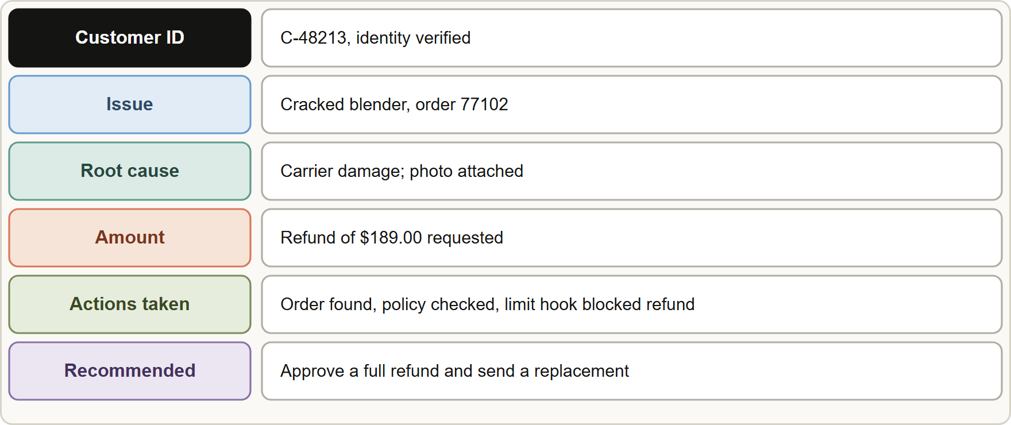
Structured Handoffs to Humans, continued
Module 3
A structured handoff summary for a human agent: customer ID, root cause, amount, what was tried, and the recommended action
Claude Architect Foundations Exam Prep | for the CCAR-F exam
Module 3: Enforcement, Handoffs and Hooks
8 / 25
Notes:
Structured Handoffs to Humans, continued.
The figure shows this: A structured handoff summary for a human agent: customer I D, root cause, amount, what was tried, and the recommended action.

Slide 9
Structured Handoffs to Humans, continued
Module 3
Field | Example
Customer ID | C-48213 (verified)
Root cause | Carrier damaged the parcel; photo evidence attached
Amount | Refund of $189.00 requested
Actions taken | Order located, return policy checked, refund blocked by the limit rule
Recommended action | Approve a full refund and send a replacement
EXAM TIP A handoff should be self-contained and structured, not "see transcript" and not a free-text paragraph.
Claude Architect Foundations Exam Prep | for the CCAR-F exam
Module 3: Enforcement, Handoffs and Hooks
9 / 25
Notes:
Structured Handoffs to Humans, continued.
Customer I D. C-forty-eight thousand two hundred thirteen (verified).
Root cause. Carrier damaged the parcel; photo evidence attached.
Amount. Refund of one hundred eighty-nine dollars and zero cents requested.
Actions taken. Order located, return policy checked, refund blocked by the limit rule.
Recommended action. Approve a full refund and send a replacement.
Exam tip: A handoff should be self-contained and structured, not "see transcript" and not a free-text paragraph.

Slide 10
Hooks
Module 3
Hooks are code that the SDK runs at fixed points of the agent loop, outside the model. Two patterns matter for the exam:
Claude Architect Foundations Exam Prep | for the CCAR-F exam
Module 3: Enforcement, Handoffs and Hooks
10 / 25
Notes:
Hooks.
Hooks are code that the S D K (software development kit) runs at fixed points of the agent loop, outside the model. Two patterns matter for the exam.

Slide 11
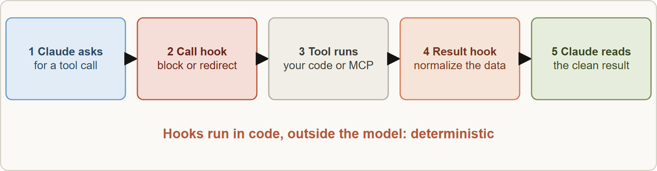
Hooks, continued
Module 3
Where hooks act: intercept outgoing tool calls to enforce rules, and intercept tool results to normalize data before the model processes it
Claude Architect Foundations Exam Prep | for the CCAR-F exam
Module 3: Enforcement, Handoffs and Hooks
11 / 25
Notes:
Hooks, continued.
The figure shows this: Where hooks act: intercept outgoing tool calls to enforce rules, and intercept tool results to normalize data before the model processes it.

Slide 12
Hooks, continued
Module 3
Hook pattern | What it does | Example
Tool-result hook (PostToolUse) | Transforms the result before the model reads it | Normalize Unix timestamps, ISO 8601 dates and numeric status codes from different MCP tools into one format
Tool-call interception (before the tool runs) | Inspects the outgoing call and can block it or redirect it | Block process_refund for amounts above $500 and send the case to human escalation
Deterministic guarantee (hook) versus probabilistic compliance (prompt): choose a hook when a business rule must hold every time.
Claude Architect Foundations Exam Prep | for the CCAR-F exam
Module 3: Enforcement, Handoffs and Hooks
12 / 25
Notes:
Hooks, continued.
Tool-result hook (Post Tool Use). What it does: Transforms the result before the model reads it. Example: Normalize Unix timestamps, I S O eighty-six oh one dates and numeric status codes from different M C P (Model Context Protocol) tools into one format.
Tool-call interception (before the tool runs). What it does: Inspects the outgoing call and can block it or redirect it. Example: Block process refund for amounts above five hundred dollars and send the case to human escalation.
Deterministic guarantee (hook) versus probabilistic compliance (prompt): choose a hook when a business rule must hold every time.

Slide 13
Hooks, continued
Module 3
PYTHON
async def cap_refunds(input_data, tool_use_id, context):
if input_data["tool_name"] == "process_refund":
if input_data["tool_input"].get("amount", 0) > 500:
return {"hookSpecificOutput": {
"hookEventName": "PreToolUse",
"permissionDecision": "deny",
"permissionDecisionReason": "Refunds over $500 need a human: use escalate_to_human."}}
return {}
Example from the study note (names are examples)
Claude Architect Foundations Exam Prep | for the CCAR-F exam
Module 3: Enforcement, Handoffs and Hooks
13 / 25
Notes:
Hooks, continued.
The example is on the screen; read it line by line when you study.

Slide 14
Hooks, continued
DATES
Module 3
In current documentation, the call-interception hook is the `PreToolUse` event: it can deny a call (permissionDecision: "deny", or exit code 2 for shell hooks) with a reason that Claude sees, and can rewrite arguments with updatedInput. The result hook is `PostToolUse`: the tool has already run, so it cannot prevent the call, but it can replace the result with updatedToolOutput. Hooks are registered in the SDK hooks option (matcher such as "Bash" or "mcp__server__tool") or in settings files. As of 8 November 2026.
EXAM TIP Choose the hook by what it acts on: the outgoing call (block or redirect) or the incoming result (normalize). A rule about money or identity is a call hook.
Claude Architect Foundations Exam Prep | for the CCAR-F exam
Module 3: Enforcement, Handoffs and Hooks
14 / 25
Notes:
Hooks, continued.
In current documentation, the call-interception hook is the Pre Tool Use event: it can deny a call (permission Decision: "deny", or exit code two for shell hooks) with a reason that Claude sees, and can rewrite arguments with updated Input. The result hook is Post Tool Use: the tool has already run, so it cannot prevent the call, but it can replace the result with updated Tool Output. Hooks are registered in the S D K hooks option (matcher such as "Bash" or "mcp server tool") or in settings files. As of eight November two thousand twenty-six.
Exam tip: Choose the hook by what it acts on: the outgoing call (block or redirect) or the incoming result (normalize). A rule about money or identity is a call hook.

Slide 15
Module Recap
Module 3
1
Enforce vs guide
2
Why prompts fall short
3
Prerequisite gate
Hard rules (money, identity, compliance) → hooks or gates; soft style → prompt
Block process_refund/lookup_order until get_customer returns a verified ID
Non-zero failure rate; more emphasis only lowers the odds
4
Multi-concern request
5
Handoff
6
PostToolUse hook
Structured: customer ID, root cause, amount, actions taken, recommended action
Normalizes results (timestamps, ISO dates, status codes) before the model reads them
Decompose → investigate in parallel with shared context → one unified answer
7
Interception hook
Blocks/redirects calls (refund > $500 → human); event PreToolUse in current docs
Claude Architect Foundations Exam Prep | for the CCAR-F exam
Module 3: Enforcement, Handoffs and Hooks
15 / 25
Notes:
Here is the recap.
Enforce versus guide: Hard rules (money, identity, compliance) to hooks or gates; soft style to prompt.
Why prompts fall short: Non-zero failure rate; more emphasis only lowers the odds.
Prerequisite gate: Block process refund or lookup order until get customer returns a verified I D.
Multi-concern request: Decompose to investigate in parallel with shared context to one unified answer.
Handoff: Structured: customer I D, root cause, amount, actions taken, recommended action.
Post Tool Use hook: Normalizes results (timestamps, I S O dates, status codes) before the model reads them.
Interception hook: Blocks or redirects calls (refund greater than five hundred dollars to human); event Pre Tool Use in current docs.

Slide 16
Practice Question 1
Module 3
Q1
Birchwood's agent sometimes calls process_refund before verifying the customer. The system prompt already says verification is mandatory. What change most effectively fixes this?
A
Add ten few-shot examples of correct verification
B
Add a programmatic prerequisite that blocks process_refund until get_customer returned a verified customer ID
C
Repeat the verification instruction three times in the system prompt, in capital letters, at the start and end
D
Reduce the number of tools so the agent has fewer choices
Claude Architect Foundations Exam Prep | for the CCAR-F exam
Module 3: Enforcement, Handoffs and Hooks
16 / 25
Notes:
Question one.
Birchwood's agent sometimes calls process refund before verifying the customer. The system prompt already says verification is mandatory. What change most effectively fixes this?
The four options are on the screen.
[PAUSE 12]
The answer is B. A required order for a financial operation needs deterministic enforcement. Prompt wording and examples stay probabilistic, and fewer tools do not control order.

Slide 17
Practice Question 2
Module 3
Q2
A mobile app sends refund amounts, and policy says refunds over $500 must be approved by a person. Which design guarantees the policy?
A
A system prompt rule saying that the agent must never refund more than $500 under any circumstances
B
A tool-call interception hook that blocks calls above $500 and redirects them to escalation
C
A few-shot example showing an escalation for $600
D
A note in CLAUDE.md
Claude Architect Foundations Exam Prep | for the CCAR-F exam
Module 3: Enforcement, Handoffs and Hooks
17 / 25
Notes:
Question two.
A mobile app sends refund amounts, and policy says refunds over five hundred dollars must be approved by a person. Which design guarantees the policy?
The four options are on the screen.
[PAUSE 12]
The answer is B. A hook enforces the threshold every time and can redirect to the right workflow. The others rely on the model following instructions.

Slide 18
Practice Question 3
Module 3
Q3
Three MCP tools return dates as Unix timestamps, ISO 8601 strings and "MM/DD/YY" text, and the agent mixes up the order of events. What is the best approach?
A
Remove the tools that return unusual date formats from the agent's tool list
B
Ask the model in the prompt to convert all dates mentally before it compares them
C
Increase max_tokens
D
Use a PostToolUse hook to normalize each result to one date format
Claude Architect Foundations Exam Prep | for the CCAR-F exam
Module 3: Enforcement, Handoffs and Hooks
18 / 25
Notes:
Question three.
Three M C P tools return dates as Unix timestamps, I S O eighty-six oh one strings and "month, day, year" text, and the agent mixes up the order of events. What is the best approach?
The four options are on the screen.
[PAUSE 12]
The answer is D. A result-transforming hook gives the model consistent data deterministically, before it reads it.

Slide 19
Practice Question 4
Module 3
Q4
When the agent escalates, support staff complain they cannot tell what was already done. The staff cannot open the chat transcript. What should the agent produce?
A
A short message saying "customer is upset"
B
A structured summary: customer ID, root cause, amount, actions taken, recommended action
C
The full raw conversation pasted into the ticket so that nothing is missing from the record
D
Nothing; staff should ask the customer again
Claude Architect Foundations Exam Prep | for the CCAR-F exam
Module 3: Enforcement, Handoffs and Hooks
19 / 25
Notes:
Question four.
When the agent escalates, support staff complain they cannot tell what was already done. The staff cannot open the chat transcript. What should the agent produce?
The four options are on the screen.
[PAUSE 12]
The answer is B. Humans who cannot see the transcript need a structured, self-contained handoff to act on.

Slide 20
Practice Question 5
Module 3
Q5
A customer writes: "My package is late and I see a duplicate charge." What is the best way to handle the two concerns?
A
Answer only the first issue and ignore the second
B
Decompose into two items, investigate each in parallel with shared customer context, and give one unified resolution
C
Escalate every multi-issue message to a human agent, because the agent cannot handle two concerns
D
Ask the customer to send two separate messages
Claude Architect Foundations Exam Prep | for the CCAR-F exam
Module 3: Enforcement, Handoffs and Hooks
20 / 25
Notes:
Question five.
A customer writes: "My package is late and I see a duplicate charge." What is the best way to handle the two concerns?
The four options are on the screen.
[PAUSE 12]
The answer is B. Decompose, investigate in parallel using shared context, then synthesize a single resolution.

Slide 21
Practice Question 6
Module 3
Q6
Which statement about hooks versus prompts is correct?
A
Hooks give deterministic guarantees; prompts give probabilistic compliance
B
Hooks can only log events
C
Both give identical guarantees if the prompt is long enough
D
Hooks give probabilistic compliance and prompts give deterministic compliance
Claude Architect Foundations Exam Prep | for the CCAR-F exam
Module 3: Enforcement, Handoffs and Hooks
21 / 25
Notes:
Question six.
Which statement about hooks versus prompts is correct?
The four options are on the screen.
[PAUSE 12]
The answer is A. Hook code runs every time, so it gives deterministic guarantees; prompt instructions can be skipped with a small but non-zero probability.

Slide 22
Practice Question 7
Module 3
Q7
Which requirement is the best candidate for a prompt instruction, not a hook?
A
Stop refunds that exceed a compliance limit
B
Never delete production data
C
Prefer a friendly tone when replying to customers
D
Block a wire transfer until multi-factor authentication succeeds
Claude Architect Foundations Exam Prep | for the CCAR-F exam
Module 3: Enforcement, Handoffs and Hooks
22 / 25
Notes:
Question seven.
Which requirement is the best candidate for a prompt instruction, not a hook?
The four options are on the screen.
[PAUSE 12]
The answer is C. Tone is a soft preference where small variation is acceptable. The other three are hard rules that need enforcement.

Slide 23
Practice Question 8
Module 3
Q8
Which TWO requirements should be enforced in code with a hook or gate rather than only in the prompt? (Select TWO.)
A
Prefer short answers
B
Block refunds above a fixed limit and send them to a person
C
Use a warm, friendly tone
D
Verify the customer's identity before any payment is made
E
Mention the help-center link when it fits
Claude Architect Foundations Exam Prep | for the CCAR-F exam
Module 3: Enforcement, Handoffs and Hooks
23 / 25
Notes:
Question eight. Select two.
Which two requirements should be enforced in code with a hook or gate rather than only in the prompt?
The five options are on the screen.
[PAUSE 15]
The answers are B and D. Identity checks before money moves and hard monetary limits are non-negotiable rules that need deterministic enforcement. Tone, brevity and optional links are soft preferences.

Slide 24
Practice Question 9
Module 3
Q9
Which TWO items belong in a structured handoff to a human agent? (Select TWO.)
A
Nothing, because humans can ask again
B
The customer's mood described in one word
C
The root cause found so far
D
The verified customer ID
E
The complete raw transcript pasted as one block
Claude Architect Foundations Exam Prep | for the CCAR-F exam
Module 3: Enforcement, Handoffs and Hooks
24 / 25
Notes:
Question nine. Select two.
Which two items belong in a structured handoff to a human agent?
The five options are on the screen.
[PAUSE 15]
The answers are C and D. A handoff must be self-contained: identifiers and findings the human needs to act. A raw transcript or a mood word does not help, and asking the customer again wastes their time.

Slide 25
Answers at a Glance
Module 3
Question | Answer | Why
Q1 | B | A required order for a financial operation needs deterministic
Q2 | B | A hook enforces the threshold every time and can
Q3 | D | A result-transforming hook gives the model consistent data deterministically
Q4 | B | Humans who cannot see the transcript need a structured
Q5 | B | Decompose, investigate in parallel using shared context, then synthesize
Q6 | A | Hook code runs every time
Q7 | C | Tone is a soft preference where small variation is
Q8 | B, D | Identity checks before money moves and hard monetary limits
Q9 | C, D | A handoff must be self-contained: identifiers and findings the
Claude Architect Foundations Exam Prep | for the CCAR-F exam
Module 3: Enforcement, Handoffs and Hooks
25 / 25
Notes:
Here are all nine answers. Question one: B. Question two: B. Question three: D. Question four: B. Question five: B. Question six: A. Question seven: C. Question eight: B and D. Question nine: C and D.
In the next module, we continue the course.

