Slide 1
Module 4: Task Decomposition, Sessions, Resume and Fork
Prompt chaining (fixed sequential steps) versus dynamic, adaptive decomposition
Domain 1 · Agentic Architecture and Orchestration · Task statements 1.6 and 1.7
Claude Architect Foundations Exam Prep Masterclass
Module 4
Notes:
Welcome to Module four: Task Decomposition, Sessions, Resume and Fork. This module covers task statements one point six and one point seven: task decomposition, sessions, resume and fork.
Each part of this module comes from the study notes of the same name, so you can read the notes after you watch.

Slide 2
What You Will Learn
Module 4
Prompt chaining (fixed sequential steps) versus dynamic, adaptive decomposition
Splitting a large review into per-file passes plus a cross-file integration pass
Decomposing an open-ended task by mapping first, then planning
Named session resumption, `fork_session`, and when to start fresh with a summary instead of resuming
Claude Architect Foundations Exam Prep | for the CCAR-F exam
Module 4: Task Decomposition, Sessions, Resume and Fork
2 / 22
Notes:
By the end of this module you will be able to do four things.
Prompt chaining (fixed sequential steps) versus dynamic, adaptive decomposition.
Splitting a large review into per-file passes plus a cross-file integration pass.
Decomposing an open-ended task by mapping first, then planning.
Named session resumption, fork session, and when to start fresh with a summary instead of resuming.

Slide 3
Case Check-In: Birchwood Supply Reviews a Big Change
Module 4
CASE CHECK-IN · Birchwood Supply
A pull request changes 12 files of the checkout module
A separate request asks the agent to "add tests to the legacy order system", a codebase nobody fully understands
The two jobs need different ways of breaking work down
Claude Architect Foundations Exam Prep | for the CCAR-F exam
Module 4: Task Decomposition, Sessions, Resume and Fork
3 / 22
Notes:
Our running case is Birchwood Supply. Birchwood Supply Reviews a Big Change.
A pull request changes twelve files of the checkout module.
A separate request asks the agent to "add tests to the legacy order system", a codebase nobody fully understands.
The two jobs need different ways of breaking work down.

Slide 4
Choosing a Decomposition Strategy
Module 4
 | Prompt chaining (fixed pipeline) | Dynamic adaptive decomposition
Idea | Break the job into known sequential steps; each step's output feeds the next | Let what you discover decide the next subtasks
Use when | The aspects are predictable: multi-aspect reviews, standard report building | The task is open-ended: unfamiliar code, investigations
Example | Analyze each file, then run a cross-file integration pass | Map the structure, find high-impact areas, write a prioritized plan, adapt as dependencies appear
Claude Architect Foundations Exam Prep | for the CCAR-F exam
Module 4: Task Decomposition, Sessions, Resume and Fork
4 / 22
Notes:
Choosing a Decomposition Strategy.
Idea. Prompt chaining (fixed pipeline): Break the job into known sequential steps; each step's output feeds the next. Dynamic adaptive decomposition: Let what you discover decide the next subtasks.
Use when. Prompt chaining (fixed pipeline): The aspects are predictable: multi-aspect reviews, standard report building. Dynamic adaptive decomposition: The task is open-ended: unfamiliar code, investigations.
Example. Prompt chaining (fixed pipeline): Analyze each file, then run a cross-file integration pass. Dynamic adaptive decomposition: Map the structure, find high-impact areas, write a prioritized plan, adapt as dependencies appear.

Slide 5
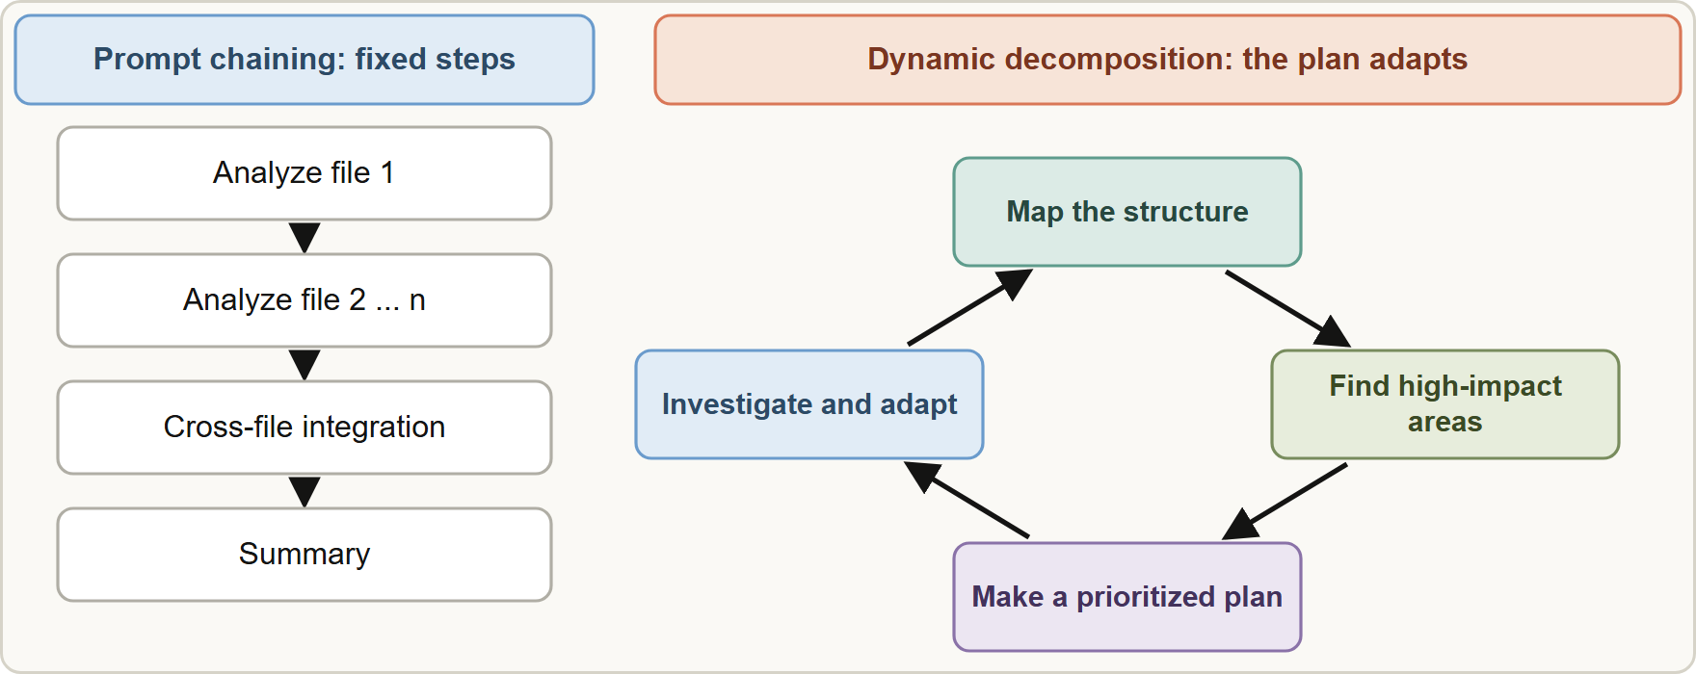
Choosing a Decomposition Strategy, continued
Module 4
Prompt chaining suits predictable multi-step work; dynamic decomposition suits open-ended tasks where each finding changes the plan
EXAM TIP "Predictable aspects" → prompt chaining. "Unfamiliar, open-ended" → dynamic decomposition.
Claude Architect Foundations Exam Prep | for the CCAR-F exam
Module 4: Task Decomposition, Sessions, Resume and Fork
5 / 22
Notes:
Choosing a Decomposition Strategy, continued.
The figure shows this: Prompt chaining suits predictable multi-step work; dynamic decomposition suits open-ended tasks where each finding changes the plan.
Exam tip: "Predictable aspects" to prompt chaining. "Unfamiliar, open-ended" to dynamic decomposition.

Slide 6
Reviewing many files: local passes plus an integration pass
Module 4
One pass over 12 files gives uneven depth (thorough for some files, shallow for others), missed bugs and contradictory feedback (a pattern flagged in one file and approved in another). The cause is attention dilution.
Fix: one focused pass per file for local issues, then a separate integration pass for cross-file data flow and interfaces.
A bigger context window, or asking developers to shrink the pull request, does not fix the quality of attention; and requiring 2 of 3 runs to agree would hide real bugs found only once.
Claude Architect Foundations Exam Prep | for the CCAR-F exam
Module 4: Task Decomposition, Sessions, Resume and Fork
6 / 22
Notes:
Reviewing many files: local passes plus an integration pass.
One pass over twelve files gives uneven depth (thorough for some files, shallow for others), missed bugs and contradictory feedback (a pattern flagged in one file and approved in another). The cause is attention dilution.
Fix: one focused pass per file for local issues, then a separate integration pass for cross-file data flow and interfaces.
A bigger context window, or asking developers to shrink the pull request, does not fix the quality of attention; and requiring two of three runs to agree would hide real bugs found only once.

Slide 7
Open-ended tasks ("add tests to the legacy system")
Module 4
Map the structure (modules, entry points).
Identify high-impact areas (critical or untested code).
Create a prioritized plan.
Work through it and adapt as new dependencies are discovered.
EXAM TIP A big pull request reviewed unevenly means attention dilution: per-file passes plus an integration pass, not a bigger context window.
Claude Architect Foundations Exam Prep | for the CCAR-F exam
Module 4: Task Decomposition, Sessions, Resume and Fork
7 / 22
Notes:
Open-ended tasks ("add tests to the legacy system").
Map the structure (modules, entry points).
Identify high-impact areas (critical or untested code).
Create a prioritized plan.
Work through it and adapt as new dependencies are discovered.
Exam tip: A big pull request reviewed unevenly means attention dilution: per-file passes plus an integration pass, not a bigger context window.

Slide 8
Session State, Resumption and Forking
Module 4
Need | Use | Command or option
Continue a specific named investigation across work sessions | Named session resumption | claude --resume <session-name> (give names with claude -n "name" or /rename)
Try two approaches from the same analyzed baseline | `fork_session` | claude --resume <id> --fork-session (SDK: resume + forkSession)
Prior context is mostly still valid | Resume | Add a note about what changed
Prior tool results are stale (files changed) | Start a new session with an injected structured summary | Summary of findings, not raw old output
A session is the stored conversation (prompts, tool calls, results). You can come back to it later.
Claude Architect Foundations Exam Prep | for the CCAR-F exam
Module 4: Task Decomposition, Sessions, Resume and Fork
8 / 22
Notes:
Session State, Resumption and Forking.
A session is the stored conversation (prompts, tool calls, results). You can come back to it later.
Continue a specific named investigation across work sessions. Use: Named session resumption. Command or option: claude dash dash resume less than session-name greater than (give names with claude dash n "name" or slash rename).
Try two approaches from the same analyzed baseline. Use: fork session. Command or option: claude dash dash resume less than id greater than dash dash fork session (S D K: resume plus fork Session).
Prior context is mostly still valid. Use: Resume. Command or option: Add a note about what changed.
Prior tool results are stale (files changed). Use: Start a new session with an injected structured summary. Command or option: Summary of findings, not raw old output.

Slide 9
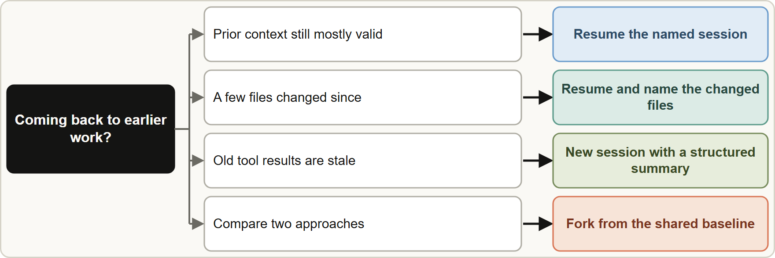
Session State, Resumption and Forking, continued
Module 4
Fork creates independent branches from a shared baseline, for example comparing two testing strategies or two refactorings. Each branch keeps its own history; the original is unchanged.
When you resume after code changes, tell the agent which files changed so it re-analyzes just those, rather than trusting stale reads or re-exploring everything.
Fork creates independent branches from a shared baseline, for example comparing two testing strategies or two refactorings. Each branch keeps its own history; the original is unchanged.
When you resume after code changes, tell the agent which files changed so it re-analyzes just those, rather than trusting stale reads or re-exploring everything.
Claude Architect Foundations Exam Prep | for the CCAR-F exam
Module 4: Task Decomposition, Sessions, Resume and Fork
9 / 22
Notes:
Session State, Resumption and Forking, continued.
The figure shows this: Resume when the prior context is mostly valid, tell the agent what changed, and start fresh with a structured summary when the old tool results are stale.
Fork creates independent branches from a shared baseline, for example comparing two testing strategies or two refactorings. Each branch keeps its own history; the original is unchanged.
When you resume after code changes, tell the agent which files changed so it re-analyzes just those, rather than trusting stale reads or re-exploring everything.

Slide 10
Session State, Resumption and Forking, continued
Module 4
Why a fresh session with a summary can beat a resume: old tool results may no longer match the files, and the model may keep acting on them.
Claude Architect Foundations Exam Prep | for the CCAR-F exam
Module 4: Task Decomposition, Sessions, Resume and Fork
10 / 22
Notes:
Session State, Resumption and Forking, continued.
Why a fresh session with a summary can beat a resume: old tool results may no longer match the files, and the model may keep acting on them.

Slide 11
Session State, Resumption and Forking, continued
Module 4
TERMINAL
claude -n "checkout-review" # name the session when you start it
claude --resume "checkout-review" # continue it later
claude --resume "checkout-review" --fork-session # branch it to try another approach
Example from the study note (names are examples)
Claude Architect Foundations Exam Prep | for the CCAR-F exam
Module 4: Task Decomposition, Sessions, Resume and Fork
11 / 22
Notes:
Session State, Resumption and Forking, continued.
The example is on the screen; read it line by line when you study.

Slide 12
Session State, Resumption and Forking, continued
DATES
Module 4
In current Claude Code, --resume accepts a session ID or name, --fork-session creates a new session ID when resuming, and the Agent SDK offers resume and fork_session / forkSession options. A fork branches the conversation, not the files: edits made in a fork are real. As of 8 November 2026.
EXAM TIP Stale results after code changes: tell the resumed session which files changed, or start fresh with a summary. Never trust old tool output.
Claude Architect Foundations Exam Prep | for the CCAR-F exam
Module 4: Task Decomposition, Sessions, Resume and Fork
12 / 22
Notes:
Session State, Resumption and Forking, continued.
In current Claude Code, dash dash resume accepts a session I D or name, dash dash fork session creates a new session I D when resuming, and the Agent S D K (software development kit) offers resume and fork session or fork Session options. A fork branches the conversation, not the files: edits made in a fork are real. As of eight November two thousand twenty-six.
Exam tip: Stale results after code changes: tell the resumed session which files changed, or start fresh with a summary. Never trust old tool output.

Slide 13
Module Recap
Module 4
1
Prompt chaining
2
Dynamic decomposition
3
Large review
Fixed sequential steps for predictable multi-aspect work
Per-file local passes + integration pass (cures attention dilution)
Plan adapts to discoveries; for open-ended tasks (map → prioritize → adapt)
4
Resume
5
Fork
6
Fresh start
--resume <name>; tell the agent which files changed
fork_session / --fork-session: independent branches from one baseline (conversation only)
When tool results are stale: new session + structured summary
Claude Architect Foundations Exam Prep | for the CCAR-F exam
Module 4: Task Decomposition, Sessions, Resume and Fork
13 / 22
Notes:
Here is the recap.
Prompt chaining: Fixed sequential steps for predictable multi-aspect work.
Dynamic decomposition: Plan adapts to discoveries; for open-ended tasks (map to prioritize to adapt).
Large review: Per-file local passes plus integration pass (cures attention dilution).
Resume: dash dash resume less than name greater than; tell the agent which files changed.
Fork: fork session or dash dash fork session: independent branches from one baseline (conversation only).
Fresh start: When tool results are stale: new session plus structured summary.

Slide 14
Practice Question 1
Module 4
Q1
A pull request changes 12 files, and a single-pass review gives deep feedback on some files, shallow comments on others, and contradicts itself across files. How should the review be restructured?
A
Run the same full pass three times and keep only the issues that were found at least twice
B
Run focused per-file passes for local issues, then one integration pass across files
C
Require authors to split every pull request into 3 to 4 files
D
Switch to a model with a larger context window
Claude Architect Foundations Exam Prep | for the CCAR-F exam
Module 4: Task Decomposition, Sessions, Resume and Fork
14 / 22
Notes:
Question one.
A pull request changes twelve files, and a single-pass review gives deep feedback on some files, shallow comments on others, and contradicts itself across files. How should the review be restructured?
The four options are on the screen.
[PAUSE 12]
The answer is B. The problem is attention dilution. Per-file passes plus an integration pass give consistent depth and still catch cross-file issues.

Slide 15
Practice Question 2
Module 4
Q2
For which task is dynamic adaptive decomposition the best fit?
A
Converting 500 files with an identical mechanical edit
B
Generating the same standard report from a fixed template every night for the finance team
C
Adding tests to an unfamiliar legacy codebase where dependencies emerge along the way
D
Running a fixed three-step review on each pull request
Claude Architect Foundations Exam Prep | for the CCAR-F exam
Module 4: Task Decomposition, Sessions, Resume and Fork
15 / 22
Notes:
Question two.
For which task is dynamic adaptive decomposition the best fit?
The four options are on the screen.
[PAUSE 12]
The answer is C. Open-ended work needs a plan that adapts to what is discovered. The others are predictable.

Slide 16
Practice Question 3
Module 4
Q3
A team wants a repeatable analysis for every pull request: security, style, tests, then a summary. The aspects never change. Which strategy fits?
A
Use a different, random order of steps for each pull request
B
A single huge prompt with no steps
C
Fully dynamic decomposition
D
Prompt chaining with a fixed sequence of steps
Claude Architect Foundations Exam Prep | for the CCAR-F exam
Module 4: Task Decomposition, Sessions, Resume and Fork
16 / 22
Notes:
Question three.
A team wants a repeatable analysis for every pull request: security, style, tests, then a summary. The aspects never change. Which strategy fits?
The four options are on the screen.
[PAUSE 12]
The answer is D. Predictable multi-aspect work, with aspects that never change, suits a fixed chain of steps.

Slide 17
Practice Question 4
Module 4
Q4
An engineer analyzed a payment module yesterday in a named session. Overnight, two files changed. What is the best way to continue?
A
Resume the named session and tell the agent which two files changed
B
Start a brand-new session and re-read all 300 files in the repository from scratch
C
Delete the session and rely on memory
D
Resume and say nothing; the agent will notice
Claude Architect Foundations Exam Prep | for the CCAR-F exam
Module 4: Task Decomposition, Sessions, Resume and Fork
17 / 22
Notes:
Question four.
An engineer analyzed a payment module yesterday in a named session. Overnight, two files changed. What is the best way to continue?
The four options are on the screen.
[PAUSE 12]
The answer is A. The prior context is mostly valid; informing the agent of the changed files gives targeted re-analysis.

Slide 18
Practice Question 5
Module 4
Q5
After a week, a session's saved tool results come from a repository that has been heavily refactored. What is the most reliable approach?
A
Only ask short questions
B
Start a new session and inject a structured summary of the earlier findings, then verify against the current code
C
Fork the session and keep the stale results
D
Resume the session and trust the old tool results, because they were correct when they were read
Claude Architect Foundations Exam Prep | for the CCAR-F exam
Module 4: Task Decomposition, Sessions, Resume and Fork
18 / 22
Notes:
Question five.
After a week, a session's saved tool results come from a repository that has been heavily refactored. What is the most reliable approach?
The four options are on the screen.
[PAUSE 12]
The answer is B. Stale tool results are risky; a fresh session seeded with a summary is more reliable than resuming.

Slide 19
Practice Question 6
Module 4
Q6
An engineer wants to compare a refactor to repository classes with a refactor to service classes, both starting from the same codebase analysis. Which mechanism fits?
A
fork_session to branch independently from the shared baseline
B
Two unrelated new sessions that each repeat the whole codebase analysis
C
--continue twice
D
One session where both approaches are mixed together in a single conversation
Claude Architect Foundations Exam Prep | for the CCAR-F exam
Module 4: Task Decomposition, Sessions, Resume and Fork
19 / 22
Notes:
Question six.
An engineer wants to compare a refactor to repository classes with a refactor to service classes, both starting from the same codebase analysis. Which mechanism fits?
The four options are on the screen.
[PAUSE 12]
The answer is A. Forking branches from a shared analysis so each approach develops separately.

Slide 20
Practice Question 7
Module 4
Q7
What does a fork of a session branch?
A
The model weights, so each branch trains on its own edits
B
The conversation history; edited files remain shared
C
The files on disk
D
The user's permissions only
Claude Architect Foundations Exam Prep | for the CCAR-F exam
Module 4: Task Decomposition, Sessions, Resume and Fork
20 / 22
Notes:
Question seven.
What does a fork of a session branch?
The four options are on the screen.
[PAUSE 12]
The answer is B. Forking copies the conversation, not the file system; file edits in a fork are real.

Slide 21
Practice Question 8
Module 4
Q8
Which TWO tasks are best served by dynamic adaptive decomposition? (Select TWO.)
A
Running the same linter on every file
B
Investigating an unexplained slowdown across several services
C
Applying an identical mechanical edit to 500 files
D
Adding tests to an unfamiliar legacy codebase
E
A nightly report from a fixed template
Claude Architect Foundations Exam Prep | for the CCAR-F exam
Module 4: Task Decomposition, Sessions, Resume and Fork
21 / 22
Notes:
Question eight. Select two.
Which two tasks are best served by dynamic adaptive decomposition?
The five options are on the screen.
[PAUSE 15]
The answers are B and D. Open-ended work where each finding changes the next step needs an adaptive plan. Templates, linting and mechanical edits follow predictable steps.

Slide 22
Answers at a Glance
Module 4
Question | Answer | Why
Q1 | B | The problem is attention dilution
Q2 | C | Open-ended work needs a plan that adapts to what is discovered
Q3 | D | Predictable multi-aspect work, with aspects that never change, suits a fixed
Q4 | A | The prior context is mostly valid
Q5 | B | Stale tool results are risky
Q6 | A | Forking branches from a shared analysis so each approach develops separately
Q7 | B | Forking copies the conversation, not the file system
Q8 | B, D | Open-ended work where each finding changes the next step needs an
Claude Architect Foundations Exam Prep | for the CCAR-F exam
Module 4: Task Decomposition, Sessions, Resume and Fork
22 / 22
Notes:
Here are all eight answers. Question one: B. Question two: C. Question three: D. Question four: A. Question five: B. Question six: A. Question seven: B. Question eight: B and D.
In the next module, we continue the course.

