Slide 1
Module 5: Tool Interfaces and Structured Error Responses
Why the tool description is the main thing Claude uses to pick a tool
Domain 2 · Tool Design and MCP Integration · Task statements 2.1 and 2.2
Claude Architect Foundations Exam Prep Masterclass
Module 5 · Part 1
Notes:
Welcome to Module five: Tool Interfaces and Structured Error Responses. This module covers task statements two point one and two point two: tool interfaces and structured error responses.
Each part of this module comes from the study notes of the same name, so you can read the notes after you watch.

Slide 2
What You Will Learn
Part 1
Why the tool description is the main thing Claude uses to pick a tool
What a good description contains, and how to fix overlapping tools
The MCP `isError` pattern and structured error metadata
Error categories, retryable versus non-retryable, and access failure versus valid empty result
Claude Architect Foundations Exam Prep | for the CCAR-F exam
Module 5: Tool Interfaces and Structured Error Responses
2 / 28
Notes:
By the end of this module you will be able to do four things.
Why the tool description is the main thing Claude uses to pick a tool.
What a good description contains, and how to fix overlapping tools.
The M C P (Model Context Protocol) is Error pattern and structured error metadata.
Error categories, retryable versus non-retryable, and access failure versus valid empty result.

Slide 3
Case Check-In: Birchwood Supply's Agent Picks the Wrong Tool
Part 1
CASE CHECK-IN · Birchwood Supply
Customers write: "is the blue kettle, item K-2210, in stock?"
The agent keeps calling `find_product` instead of `check_stock`
Both tools are described in three words ("Finds product information", "Gets stock details") and take similar identifiers
Claude Architect Foundations Exam Prep | for the CCAR-F exam
Module 5: Tool Interfaces and Structured Error Responses
3 / 28
Notes:
Our running case is Birchwood Supply. Birchwood Supply's Agent Picks the Wrong Tool.
Customers write: "is the blue kettle, item K-two thousand two hundred ten, in stock?".
The agent keeps calling find product instead of check stock.
Both tools are described in three words ("Finds product information", "Gets stock details") and take similar identifiers.

Slide 4
Tool Descriptions Drive Tool Selection
Part 1
Claude decides which tool to call mainly from the tool's name, description and input schema. Minimal descriptions leave it guessing between similar tools.
A strong description states: what it does, expected input formats, example queries it should handle, edge cases and boundaries ("use this for X, not for Y: use check_stock for availability").
Claude Architect Foundations Exam Prep | for the CCAR-F exam
Module 5: Tool Interfaces and Structured Error Responses
4 / 28
Notes:
Tool Descriptions Drive Tool Selection.
Claude decides which tool to call mainly from the tool's name, description and input schema. Minimal descriptions leave it guessing between similar tools.
A strong description states: what it does, expected input formats, example queries it should handle, edge cases and boundaries ("use this for X, not for Y: use check stock for availability").

Slide 5
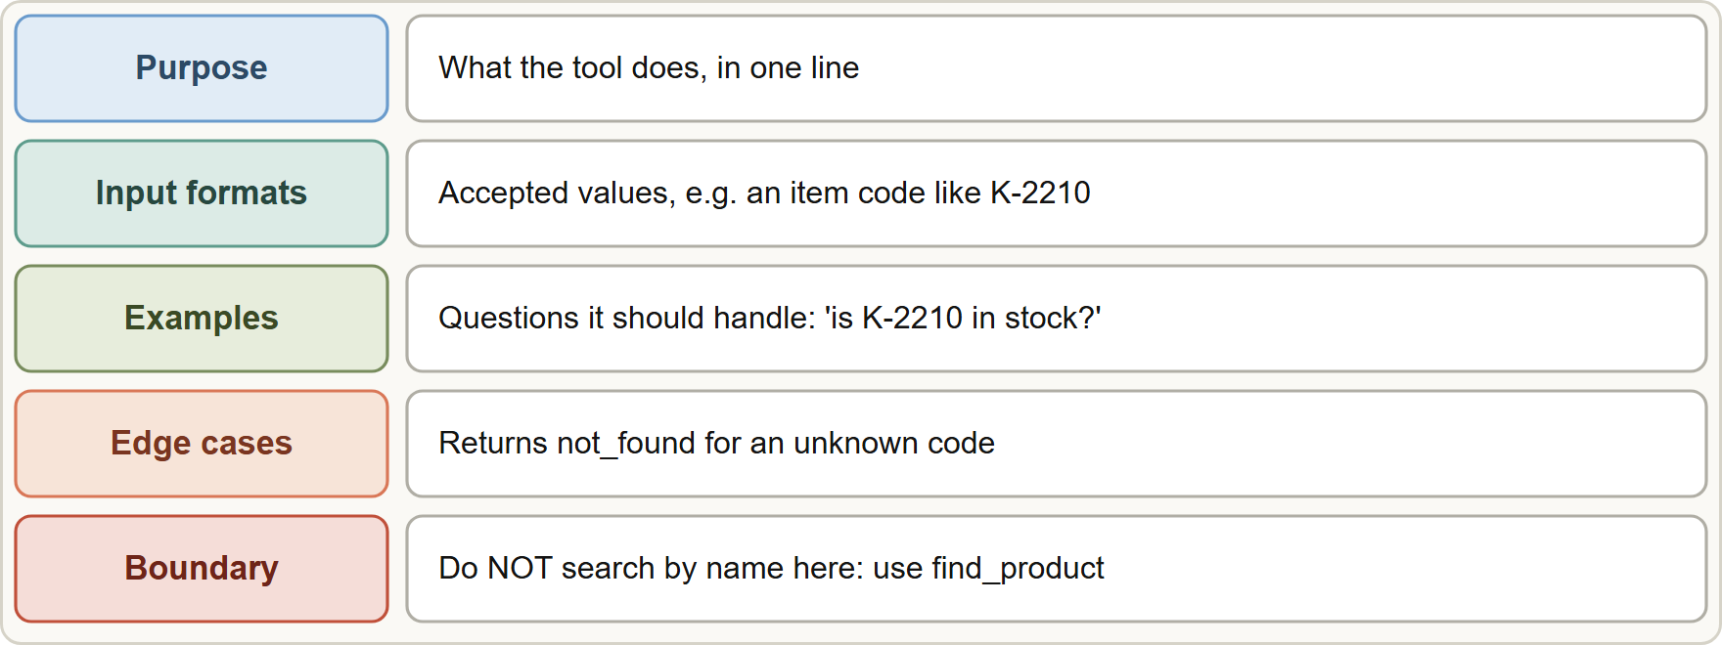
Tool Descriptions Drive Tool Selection, continued
Part 1
A good tool description: purpose, input formats, examples, edge cases and boundaries against similar tools
Claude Architect Foundations Exam Prep | for the CCAR-F exam
Module 5: Tool Interfaces and Structured Error Responses
5 / 28
Notes:
Tool Descriptions Drive Tool Selection, continued.
The figure shows this: A good tool description: purpose, input formats, examples, edge cases and boundaries against similar tools.

Slide 6
Tool Descriptions Drive Tool Selection, continued
Part 1
Weak | Strong
check_stock: "Gets stock details" | check_stock: "Returns units on hand and the restock date for ONE item. Input: an item code like K-2210 (letter, dash, four digits). Use for availability questions. Do NOT use to search by name or description: use find_product for that. Returns not_found if the code does not exist."
Claude Architect Foundations Exam Prep | for the CCAR-F exam
Module 5: Tool Interfaces and Structured Error Responses
6 / 28
Notes:
Tool Descriptions Drive Tool Selection, continued.
check stock: "Gets stock details". check stock: "Returns units on hand and the restock date for O N E item. Input: an item code like K-two thousand two hundred ten (letter, dash, four digits). Use for availability questions. Do not use to search by name or description: use find product for that. Returns not found if the code does not exist.".

Slide 7
Fixing overlap
Part 1
Ambiguous or overlapping descriptions cause misrouting (two tools such as analyze_content and analyze_document with near-identical text).
Rename and rewrite to remove the overlap: analyze_content → extract_web_results, with a web-specific description.
Split a generic tool into purpose-specific tools with defined input and output contracts: analyze_document → extract_data_points, summarize_content, verify_claim_against_source.
Check the system prompt for keyword-sensitive wording that can override good descriptions and create unintended tool associations (for example, a line that says "when the user mentions an item, always call find_product").
EXAM TIP "Most effective first step" for wrong tool choice between similar tools → expand the descriptions (formats, examples, edge cases, boundaries). Few-shot examples (extra tokens), a pre-routing layer (over-engineered) and merging the tools (more effort) are not the first step.
Claude Architect Foundations Exam Prep | for the CCAR-F exam
Module 5: Tool Interfaces and Structured Error Responses
7 / 28
Notes:
Fixing overlap.
Ambiguous or overlapping descriptions cause misrouting (two tools such as analyze content and analyze document with near-identical text).
Rename and rewrite to remove the overlap: analyze content to extract web results, with a web-specific description.
Split a generic tool into purpose-specific tools with defined input and output contracts: analyze document to extract data points, summarize content, verify claim against source.
Check the system prompt for keyword-sensitive wording that can override good descriptions and create unintended tool associations (for example, a line that says "when the user mentions an item, always call find product").
Exam tip: "Most effective first step" for wrong tool choice between similar tools to expand the descriptions (formats, examples, edge cases, boundaries). Few-shot examples (extra tokens), a pre-routing layer (over-engineered) and merging the tools (more effort) are not the first step.

Slide 8
Fixing overlap, continued
Part 1
EXAM TIP Ambiguous or overlapping descriptions cause misrouting: rename, split into purpose-specific tools or rewrite them, and check the system prompt for keyword traps.
Claude Architect Foundations Exam Prep | for the CCAR-F exam
Module 5: Tool Interfaces and Structured Error Responses
8 / 28
Notes:
Fixing overlap, continued.
Exam tip: Ambiguous or overlapping descriptions cause misrouting: rename, split into purpose-specific tools or rewrite them, and check the system prompt for keyword traps.

Slide 9
Structured Error Responses
Part 1
An MCP tool signals failure with the `isError` flag on its result so the agent knows the call failed; the content should say why, in a form the agent can act on.
Claude Architect Foundations Exam Prep | for the CCAR-F exam
Module 5: Tool Interfaces and Structured Error Responses
9 / 28
Notes:
Structured Error Responses.
An M C P tool signals failure with the is Error flag on its result so the agent knows the call failed; the content should say why, in a form the agent can act on.

Slide 10
Structured Error Responses, continued
Part 1
Error category | Examples | Retry? | What the agent should do
Transient | Timeout, service unavailable | Yes (with backoff) | Retry, then try an alternative or report partial results
Validation | Bad input format, missing field | After fixing the input | Correct the argument and call again
Business (policy) | Refund window expired, limit exceeded | No (retriable: false) | Explain to the customer in plain words, or escalate
Permission | Not allowed to access this record | No (unless access changes) | Stop and escalate or ask for authorization
Claude Architect Foundations Exam Prep | for the CCAR-F exam
Module 5: Tool Interfaces and Structured Error Responses
10 / 28
Notes:
Structured Error Responses, continued.
Transient. Examples: Timeout, service unavailable. Retry?: Yes (with backoff). What the agent should do: Retry, then try an alternative or report partial results.
Validation. Examples: Bad input format, missing field. Retry?: After fixing the input. What the agent should do: Correct the argument and call again.
Business (policy). Examples: Refund window expired, limit exceeded. Retry?: No (retriable: false). What the agent should do: Explain to the customer in plain words, or escalate.
Permission. Examples: Not allowed to access this record. Retry?: No (unless access changes). What the agent should do: Stop and escalate or ask for authorization.

Slide 11
Structured Error Responses, continued
Part 1
JSON
{
"isError": true,
"content": [{ "type": "text", "text": "{\"errorCategory\":\"business\",\"isRetryable\":false,\"message\":\"The 30-day return window closed on 4 March.\",\"customerMessage\":\"This item is outside our 30-day return window, but I can connect you with a specialist.\"}" }]
}
Example from the study note (names are examples)
Claude Architect Foundations Exam Prep | for the CCAR-F exam
Module 5: Tool Interfaces and Structured Error Responses
11 / 28
Notes:
Structured Error Responses, continued.
The example is on the screen; read it line by line when you study.

Slide 12
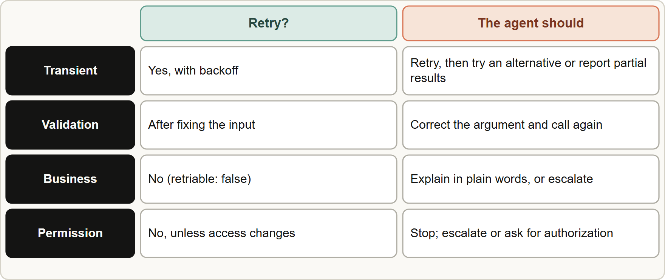
Structured Error Responses, continued
Part 1
Why generic errors hurt: a plain "Operation failed" hides whether to retry, fix the input, or stop. The agent wastes retries or gives up too early.
Structured metadata (errorCategory, isRetryable, a human-readable description) lets the agent choose the right recovery, and prevents wasted retry attempts.
Why generic errors hurt: a plain "Operation failed" hides whether to retry, fix the input, or stop. The agent wastes retries or gives up too early.
Structured metadata (errorCategory, isRetryable, a human-readable description) lets the agent choose the right recovery, and prevents wasted retry attempts.
Claude Architect Foundations Exam Prep | for the CCAR-F exam
Module 5: Tool Interfaces and Structured Error Responses
12 / 28
Notes:
Structured Error Responses, continued.
The figure shows this: Error categories and the right response: retry transient errors, fix validation errors, explain business errors, escalate permission errors.
Why generic errors hurt: a plain "Operation failed" hides whether to retry, fix the input, or stop. The agent wastes retries or gives up too early.
Structured metadata (error Category, is Retryable, a human-readable description) lets the agent choose the right recovery, and prevents wasted retry attempts.

Slide 13
Structured Error Responses, continued
Part 1
For business rule violations include retriable: false and a customer-friendly explanation the agent can pass on.
Local recovery first: a subagent should retry transient failures itself and propagate to the coordinator only what it cannot resolve, together with partial results and what was attempted (Module 13).
Claude Architect Foundations Exam Prep | for the CCAR-F exam
Module 5: Tool Interfaces and Structured Error Responses
13 / 28
Notes:
Structured Error Responses, continued.
For business rule violations include retriable: false and a customer-friendly explanation the agent can pass on.
Local recovery first: a subagent should retry transient failures itself and propagate to the coordinator only what it cannot resolve, together with partial results and what was attempted (Module thirteen).

Slide 14
Access failure versus valid empty result
Part 1
 | Access failure | Valid empty result
Meaning | The query could not be completed (timeout, auth) | The query ran fine and found no matches
Signal | isError: true with category | Success with an empty list
Agent behavior | Decide: retry, alternative, partial | Report "nothing found" as a real answer
Claude Architect Foundations Exam Prep | for the CCAR-F exam
Module 5: Tool Interfaces and Structured Error Responses
14 / 28
Notes:
Access failure versus valid empty result.
Meaning. Access failure: The query could not be completed (timeout, auth). Valid empty result: The query ran fine and found no matches.
Signal. Access failure: is Error: true with category. Valid empty result: Success with an empty list.
Agent behavior. Access failure: Decide: retry, alternative, partial. Valid empty result: Report "nothing found" as a real answer.

Slide 15
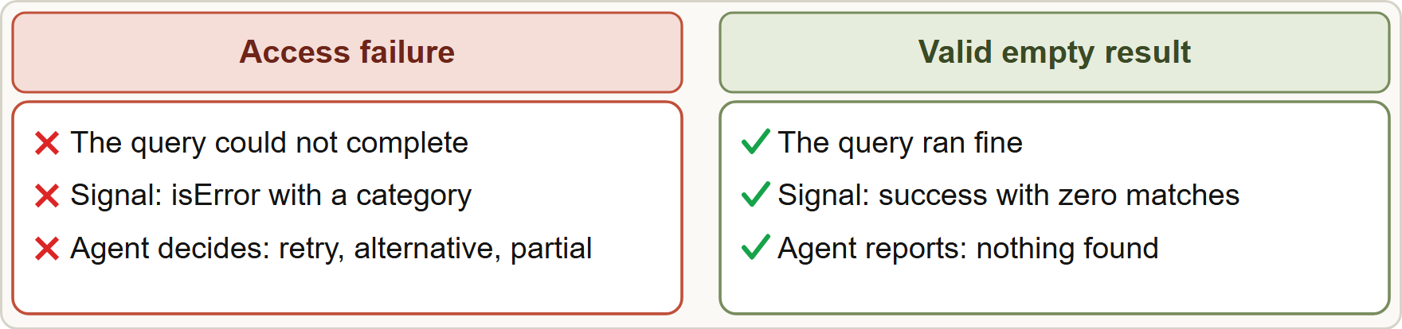
Access failure versus valid empty result, continued
Part 1
Do not confuse the two: an error means the answer is unknown; an empty success means the answer is none
EXAM TIP Returning an empty result as success when a timeout happened is an anti-pattern: the agent will conclude that nothing exists.
Claude Architect Foundations Exam Prep | for the CCAR-F exam
Module 5: Tool Interfaces and Structured Error Responses
15 / 28
Notes:
Access failure versus valid empty result, continued.
The figure shows this: Do not confuse the two: an error means the answer is unknown; an empty success means the answer is none.
Exam tip: Returning an empty result as success when a timeout happened is an anti-pattern: the agent will conclude that nothing exists.

Slide 16
Module Recap
Part 1
1
Selection signal
2
Good description
3
Overlap fixes
The tool description (plus name and schema) is the primary mechanism
Purpose · input formats · example queries · edge cases · boundaries vs similar tools
Rename + rewrite; split generic tools; check system prompt for keyword-sensitive wording
4
First step
5
Error flag
6
Categories
Better descriptions before few-shot, routers or merging
MCP `isError` (API: is_error in tool_result)
Transient (retry) · validation (fix input) · business (retriable:false, friendly text) · permission
7
Metadata
8
Empty vs failure
9
Local recovery
errorCategory, isRetryable, human-readable description
Access failure = error; no matches = valid empty success
Subagent retries transient errors; propagates only the unresolved, with partial results
Claude Architect Foundations Exam Prep | for the CCAR-F exam
Module 5: Tool Interfaces and Structured Error Responses
16 / 28
Notes:
Here is the recap.
Selection signal: The tool description (plus name and schema) is the primary mechanism.
Good description: Purpose, input formats, example queries, edge cases, boundaries versus similar tools.
Overlap fixes: Rename plus rewrite; split generic tools; check system prompt for keyword-sensitive wording.
First step: Better descriptions before few-shot, routers or merging.
Error flag: M C P is Error (A P I: is error in tool result).
Categories: Transient (retry), validation (fix input), business (retriable:false, friendly text), permission.
Metadata: error Category, is Retryable, human-readable description.
Empty versus failure: Access failure equals error; no matches equals valid empty success.
Local recovery: Subagent retries transient errors; propagates only the unresolved, with partial results.

Slide 17
Practice Question 1
Part 2
Q1
The agent often calls find_product when shoppers ask whether an item code is in stock, instead of check_stock. Both tools have one-line descriptions and accept similar identifiers. What is the most effective first step?
A
Expand each description with input formats, example queries, edge cases and boundaries against the similar tool
B
Merge both tools into one lookup_entity tool
C
Add eight few-shot examples to the system prompt
D
Build a keyword router that pre-selects the tool each turn from patterns in the message
Claude Architect Foundations Exam Prep | for the CCAR-F exam
Module 5: Tool Interfaces and Structured Error Responses
17 / 28
Notes:
Question one.
The agent often calls find product when shoppers ask whether an item code is in stock, instead of check stock. Both tools have one-line descriptions and accept similar identifiers. What is the most effective first step?
The four options are on the screen.
[PAUSE 12]
The answer is A. Descriptions are the primary selection mechanism, so improving them is the low-effort, high-leverage fix. The other options add tokens, infrastructure or redesign work before the root cause is addressed.

Slide 18
Practice Question 2
Part 2
Q2
Two tools, analyze_content and analyze_document, have nearly identical descriptions and are often confused. Which fix is best?
A
Give both tools exactly the same description so that the choice between them becomes random
B
Keep the names and add "be careful" to the system prompt
C
Rename one to something specific such as extract_web_results and rewrite both descriptions to remove the overlap
D
Remove one tool and handle both jobs by prompt
Claude Architect Foundations Exam Prep | for the CCAR-F exam
Module 5: Tool Interfaces and Structured Error Responses
18 / 28
Notes:
Question two.
Two tools, analyze content and analyze document, have nearly identical descriptions and are often confused. Which fix is best?
The four options are on the screen.
[PAUSE 12]
The answer is C. Renaming and rewriting removes the functional overlap that causes misrouting.

Slide 19
Practice Question 3
Part 2
Q3
A generic analyze_document tool is used for extraction, summaries and fact checks, with inconsistent results. How should it be redesigned?
A
Add a second generic tool
B
Add a free-form mode string to the tool and hope that Claude chooses it well each time
C
Split it into purpose-specific tools with defined input and output contracts
D
Increase the model temperature
Claude Architect Foundations Exam Prep | for the CCAR-F exam
Module 5: Tool Interfaces and Structured Error Responses
19 / 28
Notes:
Question three.
A generic analyze document tool is used for extraction, summaries and fact checks, with inconsistent results. How should it be redesigned?
The four options are on the screen.
[PAUSE 12]
The answer is C. Specific tools with clear contracts (for example extract data points, summarize content, verify claim against source) are easier for the model to select and use correctly.

Slide 20
Practice Question 4
Part 2
Q4
Well-written tool descriptions exist, yet the agent keeps preferring one tool whenever the user says "item". The system prompt says: "When the user mentions an item, call find_product first." What is the likely cause?
A
The tool schemas are so long that Claude cannot read all of them
B
The tool names are too short for Claude to tell them apart reliably
C
The API does not support two tools
D
Keyword-sensitive system prompt wording biases tool choice
Claude Architect Foundations Exam Prep | for the CCAR-F exam
Module 5: Tool Interfaces and Structured Error Responses
20 / 28
Notes:
Question four.
Well-written tool descriptions exist, yet the agent keeps preferring one tool whenever the user says "item". The system prompt says: "When the user mentions an item, call find product first." What is the likely cause?
The four options are on the screen.
[PAUSE 12]
The answer is D. Review system prompts for wording that overrides tool descriptions.

Slide 21
Practice Question 5
Part 2
Q5
A tool call fails with a timeout. Which tool result best supports recovery?
A
A successful result with an empty list, so that the agent keeps going without errors
B
"Operation failed"
C
An empty string
D
A structured error: category transient, isRetryable: true, plus a description
Claude Architect Foundations Exam Prep | for the CCAR-F exam
Module 5: Tool Interfaces and Structured Error Responses
21 / 28
Notes:
Question five.
A tool call fails with a timeout. Which tool result best supports recovery?
The four options are on the screen.
[PAUSE 12]
The answer is D. Structured metadata tells the agent that retrying makes sense. A generic message hides the choice, and an empty success would be treated as "no data".

Slide 22
Practice Question 6
Part 2
Q6
A refund request is rejected because the return window has closed. What should the tool return?
A
A business error with isRetryable: false and a customer-friendly explanation
B
A success with an empty body, because a policy decision is not a technical failure
C
A transient error with isRetryable: true, so the agent tries the refund again later
D
A permission error
Claude Architect Foundations Exam Prep | for the CCAR-F exam
Module 5: Tool Interfaces and Structured Error Responses
22 / 28
Notes:
Question six.
A refund request is rejected because the return window has closed. What should the tool return?
The four options are on the screen.
[PAUSE 12]
The answer is A. A policy violation is a business error that must not be retried; the explanation lets the agent communicate it well.

Slide 23
Practice Question 7
Part 2
Q7
A search tool returns zero matches for an existing customer's order history. How should the agent treat this?
A
As proof the tool is broken
B
As an access failure that requires several retries with exponential backoff
C
As a valid empty result, a successful query with no matches
D
As a permission error
Claude Architect Foundations Exam Prep | for the CCAR-F exam
Module 5: Tool Interfaces and Structured Error Responses
23 / 28
Notes:
Question seven.
A search tool returns zero matches for an existing customer's order history. How should the agent treat this?
The four options are on the screen.
[PAUSE 12]
The answer is C. A successful query with no matches is a real answer; do not confuse it with failure.

Slide 24
Practice Question 8
Part 2
Q8
A subagent hits a brief network timeout on a search. What is the best behavior?
A
Ask the human to retry manually
B
Retry locally; if it still fails, propagate what was attempted and any partial results
C
Immediately fail the whole workflow
D
Hide the timeout and return an empty result marked as success so the whole workflow can continue
Claude Architect Foundations Exam Prep | for the CCAR-F exam
Module 5: Tool Interfaces and Structured Error Responses
24 / 28
Notes:
Question eight.
A subagent hits a brief network timeout on a search. What is the best behavior?
The four options are on the screen.
[PAUSE 12]
The answer is B. Resolve transient problems locally and escalate only what cannot be resolved, with context.

Slide 25
Practice Question 9
Part 2
Q9
Which field combination in an error result prevents wasted retries on a permission failure?
A
isError: false with a free-text note that explains the permission problem
B
isRetryable: true for every error
C
Only a stack trace
D
isError: true, errorCategory: "permission", isRetryable: false
Claude Architect Foundations Exam Prep | for the CCAR-F exam
Module 5: Tool Interfaces and Structured Error Responses
25 / 28
Notes:
Question nine.
Which field combination in an error result prevents wasted retries on a permission failure?
The four options are on the screen.
[PAUSE 12]
The answer is D. Category and retryable flag let the agent stop retrying and escalate instead.

Slide 26
Practice Question 10
Part 2
Q10
Which TWO changes most improve selection between two similar tools? (Select TWO.)
A
Return only "Operation failed" on errors
B
Rename both tools to tool1 and tool2
C
Add input formats and example queries to each description
D
Remove the descriptions so the model is not biased
E
State boundaries that say when to use the other tool instead
Claude Architect Foundations Exam Prep | for the CCAR-F exam
Module 5: Tool Interfaces and Structured Error Responses
26 / 28
Notes:
Question ten. Select two.
Which two changes most improve selection between two similar tools?
The five options are on the screen.
[PAUSE 15]
The answers are C and E. Clear formats, examples and boundaries differentiate tools. Removing text, meaningless names and generic errors make selection and recovery harder.

Slide 27
Practice Question 11
Part 2
Q11
Which TWO pieces of metadata should a failed tool call return to guide recovery? (Select TWO.)
A
The server's internal address
B
Only a raw stack trace
C
Whether the error is retryable
D
An error category such as transient or business
E
A random request number
Claude Architect Foundations Exam Prep | for the CCAR-F exam
Module 5: Tool Interfaces and Structured Error Responses
27 / 28
Notes:
Question eleven. Select two.
Which two pieces of metadata should a failed tool call return to guide recovery?
The five options are on the screen.
[PAUSE 15]
The answers are C and D. A category and a retryable flag tell the agent whether to retry, fix the input or stop. The other items do not support a recovery decision.

Slide 28
Answers at a Glance
Part 2
Question | Answer | Why
Q1 | A | Descriptions are the primary selection mechanism
Q2 | C | Renaming and rewriting removes the functional overlap that
Q3 | C | Specific tools with clear contracts (for example extract_data_points
Q4 | D | Review system prompts for wording that overrides tool
Q5 | D | Structured metadata tells the agent that retrying makes
Q6 | A | A policy violation is a business error that
Q7 | C | A successful query with no matches is a
Q8 | B | Resolve transient problems locally and escalate only what
Q9 | D | Category and retryable flag let the agent stop
Q10 | C, E | Clear formats, examples and boundaries differentiate tools
Q11 | C, D | A category and a retryable flag tell the
Claude Architect Foundations Exam Prep | for the CCAR-F exam
Module 5: Tool Interfaces and Structured Error Responses
28 / 28
Notes:
Here are all eleven answers. Question one: A. Question two: C. Question three: C. Question four: D. Question five: D. Question six: A. Question seven: C. Question eight: B. Question nine: D. Question ten: C and E. Question eleven: C and D.
In the next module, we continue the course.

