Slide 1
Module 6: Tool Distribution, tool_choice, MCP Servers and Built-in Tools
Why too many tools hurt, and how to scope tools to roles
Domain 2 · Tool Design and MCP Integration · Task statements 2.3 to 2.5
Claude Architect Foundations Exam Prep Masterclass
Module 6 · Part 1
Notes:
Welcome to Module six: Tool Distribution, tool choice, M C P Servers and Built-in Tools. This module covers task statements two point three to two point five: tool distribution, tool choice, m c p servers and built-in tools.
Each part of this module comes from the study notes of the same name, so you can read the notes after you watch.

Slide 2
What You Will Learn
Part 1
Why too many tools hurt, and how to scope tools to roles
The three `tool_choice` modes: auto, any, and forced selection
MCP server scoping: project .mcp.json versus user ~/.claude.json, environment variable expansion, resources
Choosing among Read, Write, Edit, Bash, Grep, Glob
Claude Architect Foundations Exam Prep | for the CCAR-F exam
Module 6
2 / 30
Notes:
By the end of this module you will be able to do four things.
Why too many tools hurt, and how to scope tools to roles.
The three tool choice modes: auto, any, and forced selection.
M C P (Model Context Protocol) server scoping: project dot M C P dot Jason versus user home dot Claude dot json, environment variable expansion, resources.
Choosing among Read, Write, Edit, Bash, Grep, Glob.

Slide 3
Case Check-In: Birchwood Supply's Synthesis Agent Wanders
Part 1
CASE CHECK-IN · Birchwood Supply
The research system gave every subagent all 18 tools
The synthesis agent started running web searches itself, and tool choices became unreliable
Meanwhile about four in five of its "verification" needs are simple fact checks (a date, a name)
Claude Architect Foundations Exam Prep | for the CCAR-F exam
Module 6
3 / 30
Notes:
Our running case is Birchwood Supply. Birchwood Supply's Synthesis Agent Wanders.
The research system gave every subagent all eighteen tools.
The synthesis agent started running web searches itself, and tool choices became unreliable.
Meanwhile about four in five of its "verification" needs are simple fact checks (a date, a name).

Slide 4
Distributing Tools Across Agents
Part 1
Too many tools (18 instead of 4 or 5) increases decision complexity and degrades selection reliability.
Agents given tools outside their specialization misuse them (a synthesis agent trying web searches).
Scoped tool access (least privilege): each agent gets only the tools its role needs, plus a few narrow cross-role tools for frequent needs.
Replace generic tools with constrained ones: fetch_url → load_document, which validates that the URL is a document URL.
Claude Architect Foundations Exam Prep | for the CCAR-F exam
Module 6
4 / 30
Notes:
Distributing Tools Across Agents.
Too many tools (eighteen instead of four or five) increases decision complexity and degrades selection reliability.
Agents given tools outside their specialization misuse them (a synthesis agent trying web searches).
Scoped tool access (least privilege): each agent gets only the tools its role needs, plus a few narrow cross-role tools for frequent needs.
Replace generic tools with constrained ones: fetch url to load document, which validates that the U R L (uniform resource locator) is a document U R L.

Slide 5
Distributing Tools Across Agents, continued
Part 1
Scoped cross-role tool: give the synthesis agent a small `verify_fact` tool for the common simple checks, and route complex verification through the coordinator to the web search agent.
Claude Architect Foundations Exam Prep | for the CCAR-F exam
Module 6
5 / 30
Notes:
Distributing Tools Across Agents, continued.
Scoped cross-role tool: give the synthesis agent a small verify fact tool for the common simple checks, and route complex verification through the coordinator to the web search agent.

Slide 6
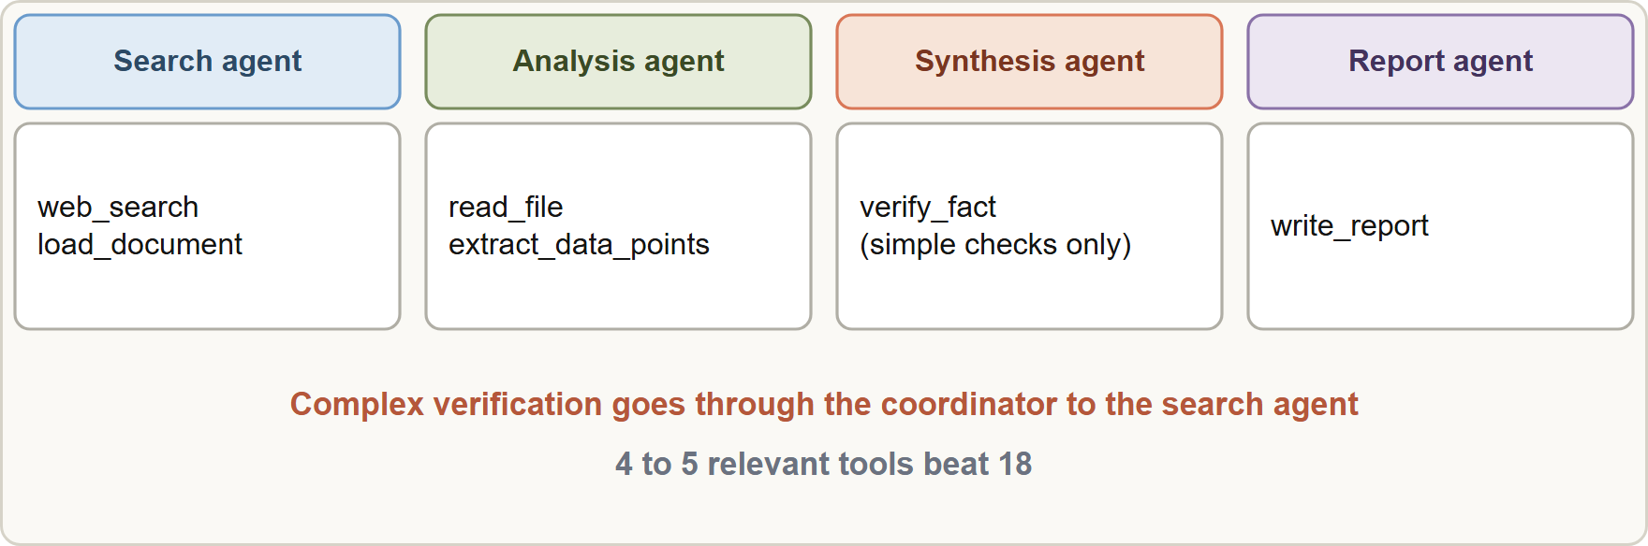
Distributing Tools Across Agents, continued
Part 1
Scoped tool sets: each agent gets the few tools its role needs; a narrow verify_fact tool serves the frequent simple check, and complex cases still go through the coordinator
EXAM TIP "Reduce round-trips but keep reliability" → a scoped tool for the common case (least privilege), with the coordinator still handling the rare complex case. Giving all web-search tools to the synthesis agent over-provisions it.
Claude Architect Foundations Exam Prep | for the CCAR-F exam
Module 6
6 / 30
Notes:
Distributing Tools Across Agents, continued.
The figure shows this: Scoped tool sets: each agent gets the few tools its role needs; a narrow verify fact tool serves the frequent simple check, and complex cases still go through the coordinator.
Exam tip: "Reduce round-trips but keep reliability" to a scoped tool for the common case (least privilege), with the coordinator still handling the rare complex case. Giving all web-search tools to the synthesis agent over-provisions it.

Slide 7
tool_choice
Part 1
Setting | Behavior | Use it when
`"auto"` (default with tools) | The model may call a tool or answer in text | Normal agent behavior
`"any"` | The model must call a tool, but picks which | You need structured output and several schemas fit; the document type is unknown
Forced: {"type": "tool", "name": "..."} | The model must call that named tool | A specific step must run first, e.g. extract_metadata before enrichment tools; then handle later steps in follow-up turns
Claude Architect Foundations Exam Prep | for the CCAR-F exam
Module 6
7 / 30
Notes:
tool choice.
"auto" (default with tools). Behavior: The model may call a tool or answer in text. Use it when: Normal agent behavior.
"any". Behavior: The model must call a tool, but picks which. Use it when: You need structured output and several schemas fit; the document type is unknown.
Forced: {"type": "tool", "name": "..."}. Behavior: The model must call that named tool. Use it when: A specific step must run first, for example extract metadata before enrichment tools; then handle later steps in follow-up turns.

Slide 8
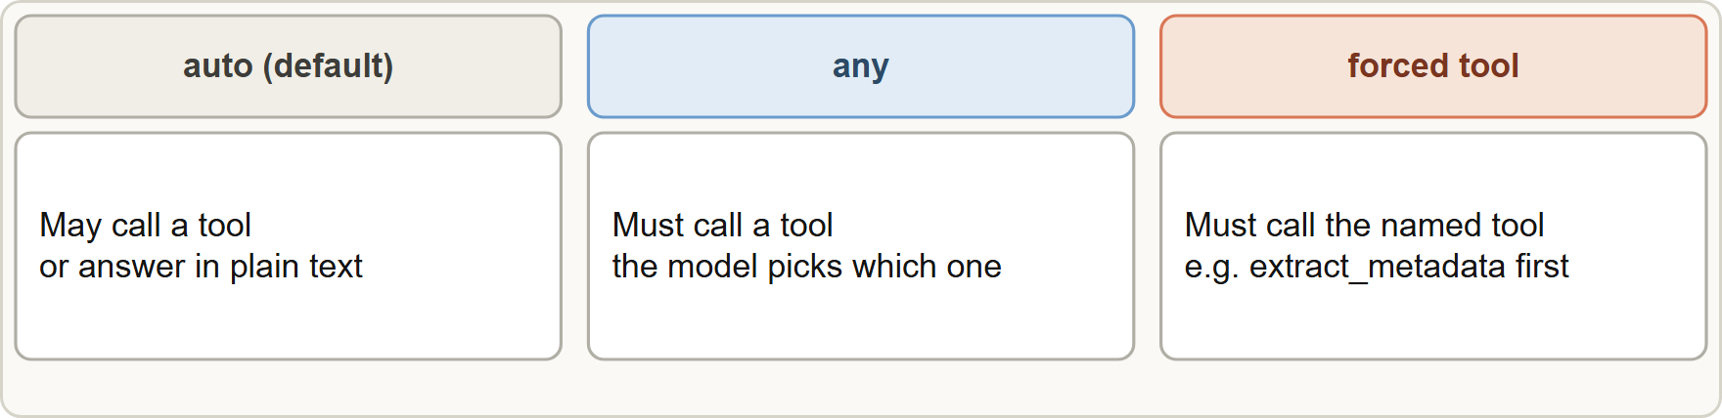
tool_choice, continued
DATES
Part 1
In current API documentation, forced tool use (any and tool) returns an error on some models: it is not supported with manual extended thinking, and it returns a 400 error on Claude Opus 5.5, Sonnet 5.5, Fable 5.1 and Mythos 5.1. The documented alternatives are auto with strict tool use (schema-valid inputs) or structured outputs (output_config.format). The exam guide still teaches "any" and forced selection, so answer as the guide teaches; in real code, check the model's support first. As of 8 November 2026.
In current API documentation, forced tool use (any and tool) returns an error on some models: it is not supported with manual extended thinking, and it returns a 400 error on Claude Opus 5.5, Sonnet 5.5, Fable 5.1 and Mythos 5.1. The documented alternatives are auto with strict tool use (schema-valid inputs) or structured outputs (output_config.format). The exam guide still teaches "any" and forced selection, so answer as the guide teaches; in real code, check the model's support first. As of 8 November 2026.
Claude Architect Foundations Exam Prep | for the CCAR-F exam
Module 6
8 / 30
Notes:
tool choice, continued.
The figure shows this: tool choice: auto may answer in text, any must call some tool, and a forced selection must call the named tool.
In current A P I (application programming interface) documentation, forced tool use (any and tool) returns an error on some models: it is not supported with manual extended thinking, and it returns a four hundred error on Claude Opus five point five, Sonnet five point five, Fable five point one and Mythos five point one. The documented alternatives are auto with strict tool use (schema-valid inputs) or structured outputs (output config.format). The exam guide still teaches "any" and forced selection, so answer as the guide teaches; in real code, check the model's support first. As of eight November two thousand twenty-six.

Slide 9
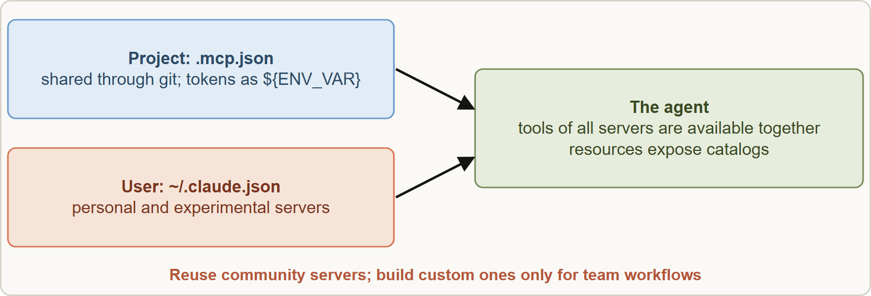
MCP Servers in Claude Code and Agent Workflows
Part 1
Two homes for MCP servers: project .mcp.json for shared team tooling and user ~/.claude.json for personal or experimental servers; the agent gets the tools of all of them
Claude Architect Foundations Exam Prep | for the CCAR-F exam
Module 6
9 / 30
Notes:
M C P Servers in Claude Code and Agent Workflows.
The figure shows this: Two homes for M C P servers: project dot M C P dot Jason for shared team tooling and user home dot Claude dot json for personal or experimental servers; the agent gets the tools of all of them.

Slide 10
MCP Servers in Claude Code and Agent Workflows, continued
Part 1
Question | Answer
Where do shared team servers go? | Project scope: `.mcp.json` in the repository, shared through version control
Where do personal or experimental servers go? | User scope: `~/.claude.json`, not shared
How to keep tokens out of the repo? | Environment variable expansion in .mcp.json, e.g. ${GITHUB_TOKEN}
Are all servers' tools available together? | Yes: tools from all configured servers are discovered at connection time and available simultaneously
How to reduce exploratory calls? | Expose content catalogs as MCP resources (issue summaries, documentation hierarchy, database schemas)
Claude Architect Foundations Exam Prep | for the CCAR-F exam
Module 6
10 / 30
Notes:
M C P Servers in Claude Code and Agent Workflows, continued.
Where do shared team servers go? Project scope: dot M C P dot Jason in the repository, shared through version control.
Where do personal or experimental servers go? User scope: home dot Claude dot json, not shared.
How to keep tokens out of the repo? Environment variable expansion in dot M C P dot Jason, for example the github token variable.
Are all servers' tools available together? Yes: tools from all configured servers are discovered at connection time and available simultaneously.
How to reduce exploratory calls? Expose content catalogs as M C P resources (issue summaries, documentation hierarchy, database schemas).

Slide 11
MCP Servers in Claude Code and Agent Workflows, continued
Part 1
Question | Answer
Build or reuse? | Use an existing community server for standard integrations (e.g. Jira); build a custom server only for team-specific workflows
Agent prefers built-in Grep over a better MCP tool? | Enhance the MCP tool's description to explain capabilities and outputs in detail
Claude Architect Foundations Exam Prep | for the CCAR-F exam
Module 6
11 / 30
Notes:
M C P Servers in Claude Code and Agent Workflows, continued.
Build or reuse? Use an existing community server for standard integrations (for example Jira); build a custom server only for team-specific workflows.
Agent prefers built-in Grep over a better M C P tool? Enhance the M C P tool's description to explain capabilities and outputs in detail.

Slide 12
MCP Servers in Claude Code and Agent Workflows, continued
Part 1
JSON
{
"mcpServers": {
"issues": {
"type": "http",
"url": "https://mcp.example.com/issues",
"headers": { "Authorization": "Bearer ${ISSUES_TOKEN}" }
}
}
}
Example from the study note (names are examples)
Claude Architect Foundations Exam Prep | for the CCAR-F exam
Module 6
12 / 30
Notes:
M C P Servers in Claude Code and Agent Workflows, continued.
The example is on the screen; read it line by line when you study.

Slide 13
MCP Servers in Claude Code and Agent Workflows, continued
DATES
Part 1
Current Claude Code documentation names three scopes: local (default, stored in ~/.claude.json, private to you in one project), project (.mcp.json, shared) and user (all your projects). When a name appears in several, local beats project beats user. Project servers need your approval in interactive use. Expansion supports ${VAR} and ${VAR:-default}. MCP tools appear as mcp__<server>__<tool>, and newer versions can defer loading MCP tool definitions until needed. As of 8 November 2026.
EXAM TIP Shared team servers go in the project `.mcp.json` with ${ENV_VAR} tokens; personal or experimental servers go in the user `~/.claude.json`.
Claude Architect Foundations Exam Prep | for the CCAR-F exam
Module 6
13 / 30
Notes:
M C P Servers in Claude Code and Agent Workflows, continued.
Current Claude Code documentation names three scopes: local (default, stored in home dot Claude dot json, private to you in one project), project (dot M C P dot Jason, shared) and user (all your projects). When a name appears in several, local beats project beats user. Project servers need your approval in interactive use. Expansion supports dollar brace V A R and dollar brace V A R colon dash default. M C P tools appear as M C P, then the server name, then the tool name, and newer versions can defer loading M C P tool definitions until needed. As of eight November two thousand twenty-six.
Exam tip: Shared team servers go in the project dot M C P dot Jason with an environment variable reference tokens; personal or experimental servers go in the user home dot Claude dot json.

Slide 14
Built-in Tools
Part 1
Tool | Use it to... | Remember
Grep | Search file contents (function names, error messages, imports) | First step to find entry points and callers
Glob | Find files by name pattern (**/*.test.tsx) | Path patterns, not contents
Read | Load a whole file | To follow imports and trace flow
Write | Create or fully rewrite a file | Replaces the content
Edit | Targeted change by matching unique text | Fails if the text is not unique
Bash | Run shell commands (tests, git) | Use for execution, not for searching code
Claude Architect Foundations Exam Prep | for the CCAR-F exam
Module 6
14 / 30
Notes:
Built-in Tools.
Grep. Use it to...: Search file contents (function names, error messages, imports). Remember: First step to find entry points and callers.
Glob. Use it to...: Find files by name pattern (any test T S X file). Remember: Path patterns, not contents.
Read. Use it to...: Load a whole file. Remember: To follow imports and trace flow.
Write. Use it to...: Create or fully rewrite a file. Remember: Replaces the content.
Edit. Use it to...: Targeted change by matching unique text. Remember: Fails if the text is not unique.
Bash. Use it to...: Run shell commands (tests, git). Remember: Use for execution, not for searching code.

Slide 15
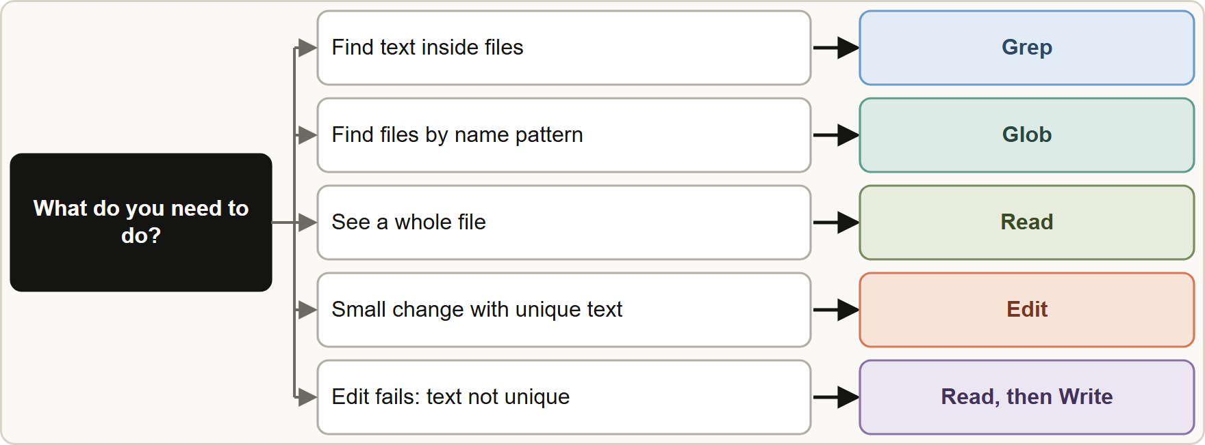
Built-in Tools, continued
Part 1
When Edit fails because the anchor text appears more than once: Read the file, then Write the corrected full file (the reliable fallback).
Build understanding incrementally: Grep for entry points, Read to follow imports and trace flows, rather than reading every file up front.
When Edit fails because the anchor text appears more than once: Read the file, then Write the corrected full file (the reliable fallback).
Build understanding incrementally: Grep for entry points, Read to follow imports and trace flows, rather than reading every file up front.
Claude Architect Foundations Exam Prep | for the CCAR-F exam
Module 6
15 / 30
Notes:
Built-in Tools, continued.
The figure shows this: Choosing a built-in tool: Grep for content, Glob for names, Read for whole files, Edit for unique targeted changes, and Read plus Write when Edit has no unique anchor.
When Edit fails because the anchor text appears more than once: Read the file, then Write the corrected full file (the reliable fallback).
Build understanding incrementally: Grep for entry points, Read to follow imports and trace flows, rather than reading every file up front.

Slide 16
Built-in Tools, continued
Part 1
Trace usage through wrapper modules: first list the exported names, then Grep each name across the codebase.
EXAM TIP Edit needs unique anchor text; when it is not unique, Read then Write. Search content with Grep and find names with Glob.
Claude Architect Foundations Exam Prep | for the CCAR-F exam
Module 6
16 / 30
Notes:
Built-in Tools, continued.
Trace usage through wrapper modules: first list the exported names, then Grep each name across the codebase.
Exam tip: Edit needs unique anchor text; when it is not unique, Read then Write. Search content with Grep and find names with Glob.

Slide 17
Module Recap
Part 2
1
Tool count
2
Scoping
3
tool_choice
4 to 5 relevant tools beat 18; too many degrade selection
Role-specific tools; narrow cross-role tool (verify_fact); constrained replacement (load_document for fetch_url)
auto (text or tool) · any (must call some tool) · forced {"type":"tool","name":...} (must call that tool)
4
MCP scopes
5
MCP behavior
6
Grep / Glob
Project `.mcp.json` (shared) · user `~/.claude.json` (personal) · ${ENV_VAR} expansion
All servers' tools available at once; resources expose catalogs; prefer community servers; enrich tool descriptions
Grep = contents; Glob = file names/paths
7
Read / Write / Edit
8
Exploration
Grep entry points → Read to follow imports; for wrappers list exports then grep each name
Read whole · Write replaces · Edit needs unique text; Edit fails → Read + Write
Claude Architect Foundations Exam Prep | for the CCAR-F exam
Module 6
17 / 30
Notes:
Here is the recap.
Tool count: four to five relevant tools beat eighteen; too many degrade selection.
Scoping: Role-specific tools; narrow cross-role tool (verify fact); constrained replacement (load document for fetch url).
tool choice: auto (text or tool), any (must call some tool), forced {"type":"tool","name":...} (must call that tool).
M C P scopes: Project dot M C P dot Jason (shared), user home dot Claude dot json (personal), an environment variable reference expansion.
M C P behavior: All servers' tools available at once; resources expose catalogs; prefer community servers; enrich tool descriptions.
Grep or Glob: Grep equals contents; Glob equals file names or paths.
Read or Write or Edit: Read whole, Write replaces, Edit needs unique text; Edit fails to Read plus Write.
Exploration: Grep entry points to Read to follow imports; for wrappers list exports then grep each name.

Slide 18
Practice Question 1
Part 2
Q1
Birchwood's synthesis agent has all 18 tools, keeps performing its own web searches, and picks wrong tools. What is the best change?
A
Ask it nicely in the prompt to avoid web searches
B
Remove the coordinator
C
Give it even more tools, including every search tool, so that it never needs the coordinator or search agent
D
Restrict it to a small tool set for synthesis, such as a scoped verify_fact tool, and leave searching to the search agent
Claude Architect Foundations Exam Prep | for the CCAR-F exam
Module 6
18 / 30
Notes:
Question one.
Birchwood's synthesis agent has all eighteen tools, keeps performing its own web searches, and picks wrong tools. What is the best change?
The four options are on the screen.
[PAUSE 12]
The answer is D. Fewer, role-specific tools improve selection and prevent cross-specialization misuse.

Slide 19
Practice Question 2
Part 2
Q2
About four in five of the synthesis agent's verification needs are quick lookups (a date, a name, a figure); the rest need real research. Each round trip through the coordinator adds delay. Which approach is best?
A
Make it batch all verification needs and return them to the coordinator in one list at the end of its pass
B
Give it a scoped verify_fact tool for simple lookups and keep complex cases routed through the coordinator
C
Cache extra context around each source in advance
D
Give it every web search tool
Claude Architect Foundations Exam Prep | for the CCAR-F exam
Module 6
19 / 30
Notes:
Question two.
About four in five of the synthesis agent's verification needs are quick lookups (a date, a name, a figure); the rest need real research. Each round trip through the coordinator adds delay. Which approach is best?
The four options are on the screen.
[PAUSE 12]
The answer is B. A narrow tool covers the common case; the rest keeps the existing coordination. Full tool access over-provisions the agent, batching creates blocking dependencies and speculative caching cannot predict needs.

Slide 20
Practice Question 3
Part 2
Q3
A pipeline must always run extract_metadata before any enrichment tool. Which setting makes the model call that tool first?
A
tool_choice: "auto" with a polite reminder in the system prompt to call it first
B
Removing extract_metadata from the tool list so that no enrichment tool runs first
C
Force extract_metadata first, then handle later steps in follow-up turns
D
Setting max_tokens to 1
Claude Architect Foundations Exam Prep | for the CCAR-F exam
Module 6
20 / 30
Notes:
Question three.
A pipeline must always run extract metadata before any enrichment tool. Which setting makes the model call that tool first?
The four options are on the screen.
[PAUSE 12]
The answer is C. Forced selection guarantees the named tool is called; subsequent steps continue in later turns.

Slide 21
Practice Question 4
Part 2
Q4
A document extraction service receives invoices, receipts or contracts and has one extraction schema per type. The type is unknown up front, and the model sometimes replies in plain text. Which tool_choice is best?
A
Forced selection of the invoice tool for every incoming document
B
"auto"
C
"any", so the model must call one of the extraction tools
D
No tools at all, and parse the model's text reply with a regular expression
Claude Architect Foundations Exam Prep | for the CCAR-F exam
Module 6
21 / 30
Notes:
Question four.
A document extraction service receives invoices, receipts or contracts and has one extraction schema per type. The type is unknown up front, and the model sometimes replies in plain text. Which tool choice is best?
The four options are on the screen.
[PAUSE 12]
The answer is C. "any" guarantees a tool call while letting the model pick the matching schema.

Slide 22
Practice Question 5
Part 2
Q5
Where should a team-shared Jira MCP server be configured, with its token kept out of version control?
A
In project-level .mcp.json using ${JIRA_TOKEN} expansion
B
In ~/.claude.json on one developer's laptop, with the token written into the file
C
Hard-coded in CLAUDE.md
D
In a public README
Claude Architect Foundations Exam Prep | for the CCAR-F exam
Module 6
22 / 30
Notes:
Question five.
Where should a team-shared Jira M C P server be configured, with its token kept out of version control?
The four options are on the screen.
[PAUSE 12]
The answer is A. Project scope shares the server through version control; environment variable expansion keeps secrets out of the file.

Slide 23
Practice Question 6
Part 2
Q6
A developer wants to try a new experimental MCP server without affecting teammates. Where should it go?
A
Project-level .mcp.json
B
User-level configuration (~/.claude.json)
C
The shared repository's CLAUDE.md, committed so that the whole team gets the server
D
A pull request to the main branch so that the whole team reviews the server
Claude Architect Foundations Exam Prep | for the CCAR-F exam
Module 6
23 / 30
Notes:
Question six.
A developer wants to try a new experimental M C P server without affecting teammates. Where should it go?
The four options are on the screen.
[PAUSE 12]
The answer is B. Personal and experimental servers belong in user scope; project scope would add it for everyone.

Slide 24
Practice Question 7
Part 2
Q7
A custom MCP search tool is far more capable than Grep, but the agent keeps using built-in Grep. What helps most?
A
Rename the server so that its name sorts ahead of the built-in tools in the list
B
Write a detailed description of the tool's capabilities and outputs
C
Add more built-in tools
D
Remove Grep from the system
Claude Architect Foundations Exam Prep | for the CCAR-F exam
Module 6
24 / 30
Notes:
Question seven.
A custom M C P search tool is far more capable than Grep, but the agent keeps using built-in Grep. What helps most?
The four options are on the screen.
[PAUSE 12]
The answer is B. Better descriptions guide selection toward the more capable tool.

Slide 25
Practice Question 8
Part 2
Q8
Agents repeatedly make exploratory calls to learn which documentation pages exist. Which MCP feature reduces this?
A
Disabling all resources
B
Exposing the documentation hierarchy as an MCP resource
C
Using a longer system prompt that lists every documentation page by hand
D
Adding more write tools
Claude Architect Foundations Exam Prep | for the CCAR-F exam
Module 6
25 / 30
Notes:
Question eight.
Agents repeatedly make exploratory calls to learn which documentation pages exist. Which M C P feature reduces this?
The four options are on the screen.
[PAUSE 12]
The answer is B. Resources expose content catalogs so the agent can see what is available without exploratory calls.

Slide 26
Practice Question 9
Part 2
Q9
An Edit call fails because the target text appears in six places. What is the most reliable approach?
A
Delete the file
B
Read the file and Write the corrected full contents
C
Retry the same Edit several times until the text happens to be unique
D
Use Glob to find the text
Claude Architect Foundations Exam Prep | for the CCAR-F exam
Module 6
26 / 30
Notes:
Question nine.
An Edit call fails because the target text appears in six places. What is the most reliable approach?
The four options are on the screen.
[PAUSE 12]
The answer is B. When there is no unique anchor, Read plus Write is the dependable fallback.

Slide 27
Practice Question 10
Part 2
Q10
An engineer must find every caller of calculateTotal in an unfamiliar repository. Which first step is best?
A
Glob for *.total
B
Read every file in the repository first, then search through what was read
C
Grep for calculateTotal, then Read the matches to follow the flow
D
Use Bash to print all files
Claude Architect Foundations Exam Prep | for the CCAR-F exam
Module 6
27 / 30
Notes:
Question ten.
An engineer must find every caller of calculate Total in an unfamiliar repository. Which first step is best?
The four options are on the screen.
[PAUSE 12]
The answer is C. Grep finds entry points by content; Read then follows imports. Reading everything up front wastes context.

Slide 28
Practice Question 11
Part 2
Q11
Which TWO statements about MCP configuration in Claude Code are correct? (Select TWO.)
A
Only one server's tools are available at a time
B
Environment variable expansion keeps tokens out of the committed file
C
User-level ~/.claude.json is shared with teammates automatically
D
Project-level .mcp.json is shared with the team through version control
E
Tokens must be hard-coded in .mcp.json
Claude Architect Foundations Exam Prep | for the CCAR-F exam
Module 6
28 / 30
Notes:
Question eleven. Select two.
Which two statements about M C P configuration in Claude Code are correct?
The five options are on the screen.
[PAUSE 15]
The answers are B and D. The project file is shared and can reference an environment variable reference values, so secrets stay out of version control. User scope is personal, and tools from all configured servers are available together.

Slide 29
Practice Question 12
Part 2
Q12
Which TWO statements about tool_choice are correct? (Select TWO.)
A
A forced selection makes the model call the named tool
B
any makes the model call some tool
C
auto never allows a text answer
D
any forces one particular tool
E
auto always forces a tool call
Claude Architect Foundations Exam Prep | for the CCAR-F exam
Module 6
29 / 30
Notes:
Question twelve. Select two.
Which two statements about tool choice are correct?
The five options are on the screen.
[PAUSE 15]
The answers are A and B. any guarantees a tool call but lets the model choose, and a forced selection names the tool. auto allows either a tool call or text.

Slide 30
Answers at a Glance
Part 2
Question | Answer | Why
Q1 | D | Fewer, role-specific tools improve selection and prevent
Q2 | B | A narrow tool covers the common case
Q3 | C | Forced selection guarantees the named tool is
Q4 | C | "any" guarantees a tool call while letting
Q5 | A | Project scope shares the server through version
Q6 | B | Personal and experimental servers belong in user
Q7 | B | Better descriptions guide selection toward the more
Q8 | B | Resources expose content catalogs so the agent
Q9 | B | When there is no unique anchor
Q10 | C | Grep finds entry points by content
Q11 | B, D | The project file is shared and can
Q12 | A, B | any guarantees a tool call but lets
Claude Architect Foundations Exam Prep | for the CCAR-F exam
Module 6
30 / 30
Notes:
Here are all twelve answers. Question one: D. Question two: B. Question three: C. Question four: C. Question five: A. Question six: B. Question seven: B. Question eight: B. Question nine: B. Question ten: C. Question eleven: B and D. Question twelve: A and B.
In the next module, we continue the course.

