Slide 1
Module 7: CLAUDE.md, Rules, Slash Commands and Skills
The CLAUDE.md hierarchy: user, project and directory level, and who shares what
Domain 3 · Claude Code Configuration and Workflows · Task statements 3.1 to 3.3
Claude Architect Foundations Exam Prep Masterclass
Module 7 · Part 1
Notes:
Welcome to Module seven: Claude dot M D, Rules, Slash Commands and Skills. This module covers task statements three point one to three point three: claude dot m d, rules, slash commands and skills.
Each part of this module comes from the study notes of the same name, so you can read the notes after you watch.

Slide 2
What You Will Learn
Part 1
The CLAUDE.md hierarchy: user, project and directory level, and who shares what
`@import` and `.claude/rules/` to keep instructions modular; `/memory` to diagnose
Slash commands and skills: where they live, and the frontmatter `context: fork`, `allowed-tools`, `argument-hint`
Path-specific rules with glob patterns, and when they beat directory-level files
Claude Architect Foundations Exam Prep | for the CCAR-F exam
Module 7: CLAUDE.md, Rules, Slash Commands and Skills
2 / 31
Notes:
By the end of this module you will be able to do four things.
The Claude dot M D hierarchy: user, project and directory level, and who shares what.
the at import syntax and the dot Claude rules folder to keep instructions modular; slash memory to diagnose.
Slash commands and skills: where they live, and the frontmatter context: fork, allowed-tools, argument-hint.
Path-specific rules with glob patterns, and when they beat directory-level files.

Slide 3
Case Check-In: A New Engineer at Birchwood Supply Gets Different Answers
Part 1
CASE CHECK-IN · Birchwood Supply
A teammate joins and Claude Code ignores the team's coding standards
The standards sit in the lead developer's own `~/.claude/CLAUDE.md`
Another problem: the root file has grown to 800 lines, mixing testing, API and deployment rules
Claude Architect Foundations Exam Prep | for the CCAR-F exam
Module 7: CLAUDE.md, Rules, Slash Commands and Skills
3 / 31
Notes:
Our running case is Birchwood Supply. A New Engineer at Birchwood Supply Gets Different Answers.
A teammate joins and Claude Code ignores the team's coding standards.
The standards sit in the lead developer's own home dot Claude, Claude dot M D.
Another problem: the root file has grown to eight hundred lines, mixing testing, A P I (application programming interface) and deployment rules.

Slide 4
CLAUDE.md Files and Their Hierarchy
Part 1
Level | Location | Shared with the team?
User | ~/.claude/CLAUDE.md | No: applies only to you, not in version control
Project | CLAUDE.md at the repo root, or .claude/CLAUDE.md | Yes, through version control
Directory | CLAUDE.md inside a subdirectory | Yes (committed); applies to work in that directory
CLAUDE.md is a Markdown file of persistent instructions that Claude Code loads into context at the start of a session.
Claude Architect Foundations Exam Prep | for the CCAR-F exam
Module 7: CLAUDE.md, Rules, Slash Commands and Skills
4 / 31
Notes:
Claude dot M D Files and Their Hierarchy.
Claude dot M D is a Markdown file of persistent instructions that Claude Code loads into context at the start of a session.
User. Location: home dot Claude, Claude dot M D. Shared with the team?: No: applies only to you, not in version control.
Project. Location: Claude dot M D at the repo root, or the dot Claude Claude dot M D file. Shared with the team?: Yes, through version control.
Directory. Location: Claude dot M D inside a subdirectory. Shared with the team?: Yes (committed); applies to work in that directory.

Slide 5
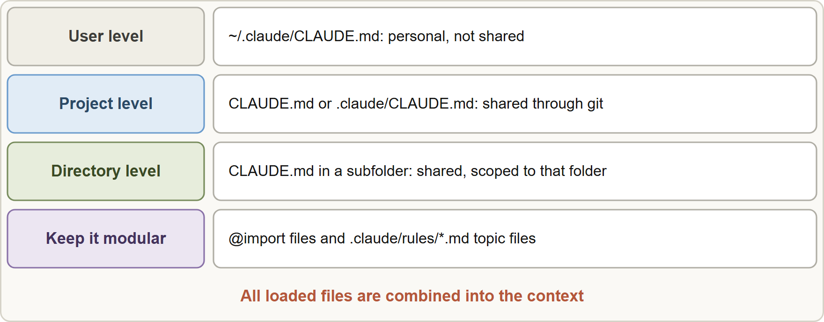
CLAUDE.md Files and Their Hierarchy, continued
Part 1
Diagnosis rule: a new teammate not receiving instructions usually means those instructions live in user-level configuration instead of project-level configuration.
Files are combined, not overridden: more specific content is simply added to the context. Keep each file short (the guidance is under about 200 lines) and avoid contradictions.
Diagnosis rule: a new teammate not receiving instructions usually means those instructions live in user-level configuration instead of project-level configuration.
Files are combined, not overridden: more specific content is simply added to the context. Keep each file short (the guidance is under about 200 lines) and avoid contradictions.
Claude Architect Foundations Exam Prep | for the CCAR-F exam
Module 7: CLAUDE.md, Rules, Slash Commands and Skills
5 / 31
Notes:
Claude dot M D Files and Their Hierarchy, continued.
The figure shows this: Claude dot M D levels: user (personal, not shared), project (shared via version control) and directory (shared, scoped to a folder); loaded files are combined into the context.
Diagnosis rule: a new teammate not receiving instructions usually means those instructions live in user-level configuration instead of project-level configuration.
Files are combined, not overridden: more specific content is simply added to the context. Keep each file short (the guidance is under about two hundred lines) and avoid contradictions.

Slide 6
Keeping it modular
Part 1
`@import`: reference other files from a CLAUDE.md so each package pulls in only the standards that apply to it (for example @docs/standards/testing.md). Paths resolve relative to the file that contains the import.
`.claude/rules/`: split a large CLAUDE.md into topic files such as testing.md, api-conventions.md, deployment.md.
`/memory` shows which memory files are loaded and lets you open them: use it to diagnose inconsistent behavior across sessions.
EXAM TIP "Instructions apply for me but not for a teammate" → user vs project level. "One huge file" → split into `.claude/rules/` topic files or `@import`.
Claude Architect Foundations Exam Prep | for the CCAR-F exam
Module 7: CLAUDE.md, Rules, Slash Commands and Skills
6 / 31
Notes:
Keeping it modular.
the at import syntax: reference other files from a Claude dot M D so each package pulls in only the standards that apply to it (for example @docs or standards or testing dot M D). Paths resolve relative to the file that contains the import.
the dot Claude rules folder: split a large Claude dot M D into topic files such as testing dot M D, api-conventions dot M D, deployment dot M D.
slash memory shows which memory files are loaded and lets you open them: use it to diagnose inconsistent behavior across sessions.
Exam tip: "Instructions apply for me but not for a teammate" to user versus project level. "One huge file" to split into the dot Claude rules folder topic files or the at import syntax.

Slide 7
Keeping it modular, continued
DATES
Part 1
Current documentation adds: a `CLAUDE.local.md` for private project preferences (gitignored); managed policy CLAUDE.md for organizations; CLAUDE.md files in directories above the working directory load at launch while those in subdirectories load on demand when Claude works with files there; imports can nest up to four levels. CLAUDE.md is context, not enforcement: for guaranteed behavior use hooks (Module 3). As of 8 November 2026.
Claude Architect Foundations Exam Prep | for the CCAR-F exam
Module 7: CLAUDE.md, Rules, Slash Commands and Skills
7 / 31
Notes:
Keeping it modular, continued.
Current documentation adds: a Claude dot local dot M D for private project preferences (gitignored); managed policy Claude dot M D for organizations; Claude dot M D files in directories above the working directory load at launch while those in subdirectories load on demand when Claude works with files there; imports can nest up to four levels. Claude dot M D is context, not enforcement: for guaranteed behavior use hooks (Module three). As of eight November two thousand twenty-six.

Slide 8
Slash Commands and Skills
Part 1
 | Project-scoped | User-scoped
Custom slash command | .claude/commands/ (in the repo, shared when teammates clone or pull) | ~/.claude/commands/ (personal)
Skill | .claude/skills/<name>/SKILL.md (shared) | ~/.claude/skills/<name>/SKILL.md (personal)
A skill is a folder with a `SKILL.md` file: YAML frontmatter plus instructions, used on demand for a task-specific workflow.
Claude Architect Foundations Exam Prep | for the CCAR-F exam
Module 7: CLAUDE.md, Rules, Slash Commands and Skills
8 / 31
Notes:
Slash Commands and Skills.
Custom slash command. Project-scoped: the dot Claude commands folder (in the repo, shared when teammates clone or pull). User-scoped: home dot Claude commands (personal).
Skill. Project-scoped: a skill folder with a Skill dot M D file (shared). User-scoped: home dot Claude skills less than name greater than or Skill dot M D (personal).
A skill is a folder with a Skill dot M D file: Yammel (a human-readable data format for configuration) frontmatter plus instructions, used on demand for a task-specific workflow.

Slide 9
Slash Commands and Skills, continued
Part 1
MARKDOWN
---
name: analyze-codebase
description: Map modules and dependencies of a package and report findings
context: fork
allowed-tools: Read, Grep, Glob
argument-hint: "[package-name]"
---
Analyze the package $ARGUMENTS. List its modules, public interfaces and dependencies.
Return a short summary only.
Example from the study note (names are examples)
Claude Architect Foundations Exam Prep | for the CCAR-F exam
Module 7: CLAUDE.md, Rules, Slash Commands and Skills
9 / 31
Notes:
Slash Commands and Skills, continued.
The example is on the screen; read it line by line when you study.

Slide 10
Slash Commands and Skills, continued
Part 1
Frontmatter | What it does
`context: fork` | Runs the skill in an isolated sub-agent context, so verbose output (codebase analysis) or exploratory context (brainstorming alternatives) does not pollute the main conversation
`allowed-tools` | Restricts tool access during skill execution (for example only file-write or read-only tools) to avoid destructive actions
`argument-hint` | Prompts the developer for required parameters when they invoke the skill without arguments
Claude Architect Foundations Exam Prep | for the CCAR-F exam
Module 7: CLAUDE.md, Rules, Slash Commands and Skills
10 / 31
Notes:
Slash Commands and Skills, continued.
context: fork. Runs the skill in an isolated sub-agent context, so verbose output (codebase analysis) or exploratory context (brainstorming alternatives) does not pollute the main conversation.
allowed-tools. Restricts tool access during skill execution (for example only file-write or read-only tools) to avoid destructive actions.
argument-hint. Prompts the developer for required parameters when they invoke the skill without arguments.

Slide 11
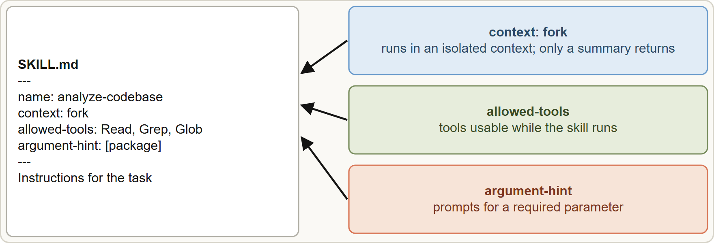
Slash Commands and Skills, continued
Part 1
Personal variants: to customize a team skill for yourself, create your own in ~/.claude/skills/ with a different name, so teammates are unaffected.
Personal variants: to customize a team skill for yourself, create your own in ~/.claude/skills/ with a different name, so teammates are unaffected.
Claude Architect Foundations Exam Prep | for the CCAR-F exam
Module 7: CLAUDE.md, Rules, Slash Commands and Skills
11 / 31
Notes:
Slash Commands and Skills, continued.
The figure shows this: A skill is a Skill dot M D with frontmatter: context fork isolates its output, allowed-tools limits its tools, argument-hint prompts for parameters.
Personal variants: to customize a team skill for yourself, create your own in home dot Claude skills with a different name, so teammates are unaffected.

Slide 12
Skills versus CLAUDE.md
Part 1
 | CLAUDE.md | Skill or command
Loaded | Always | On demand, when invoked (or chosen by Claude for a matching task)
Use for | Universal standards that apply to nearly every task | Task-specific workflows (review checklist, release steps, migrations)
Claude Architect Foundations Exam Prep | for the CCAR-F exam
Module 7: CLAUDE.md, Rules, Slash Commands and Skills
12 / 31
Notes:
Skills versus Claude dot M D.
Loaded. Claude dot M D: Always. Skill or command: On demand, when invoked (or chosen by Claude for a matching task).
Use for. Claude dot M D: Universal standards that apply to nearly every task. Skill or command: Task-specific workflows (review checklist, release steps, migrations).

Slide 13
Skills versus CLAUDE.md, continued
DATES
Part 1
[Verify live] [Old name] In current Claude Code, custom commands have been merged into skills: a file at .claude/commands/deploy.md and a skill at .claude/skills/deploy/SKILL.md both create /deploy; existing command files keep working, and if both exist the skill wins. Note that allowed-tools pre-approves the listed tools (no permission prompt) and does not by itself forbid other tools; use disallowedTools or permission rules to restrict. Skill descriptions are always in context; the full content loads when the skill is used. As of 8 November 2026. For the exam, answer as the guide teaches (commands in .claude/commands/, allowed-tools to limit tools).
EXAM TIP Always-needed standards go in CLAUDE.md; task workflows go in skills or commands; verbose or exploratory skills use `context: fork`.
Claude Architect Foundations Exam Prep | for the CCAR-F exam
Module 7: CLAUDE.md, Rules, Slash Commands and Skills
13 / 31
Notes:
Skills versus Claude dot M D, continued.
In current Claude Code, custom commands have been merged into skills: a file at the dot Claude commands folderdeploy dot M D and a skill at the dot Claude skills folderdeploy or Skill dot M D both create or deploy; existing command files keep working, and if both exist the skill wins. Note that allowed-tools pre-approves the listed tools (no permission prompt) and does not by itself forbid other tools; use disallowed Tools or permission rules to restrict. Skill descriptions are always in context; the full content loads when the skill is used. As of eight November two thousand twenty-six. For the exam, answer as the guide teaches (commands in the dot Claude commands folder, allowed-tools to limit tools).
Exam tip: Always-needed standards go in Claude dot M D; task workflows go in skills or commands; verbose or exploratory skills use context: fork.

Slide 14
Path-Specific Rules
Part 1
Problem: coding conventions differ by area (React components, API handlers, database models) and test files sit next to the code they test throughout the repository. A directory-level CLAUDE.md cannot cover files spread across many directories.
Solution: put rule files in .claude/rules/ with YAML frontmatter `paths` holding glob patterns. The rule loads only when Claude works with a matching file.
Claude Architect Foundations Exam Prep | for the CCAR-F exam
Module 7: CLAUDE.md, Rules, Slash Commands and Skills
14 / 31
Notes:
Path-Specific Rules.
Problem: coding conventions differ by area (React components, A P I handlers, database models) and test files sit next to the code they test throughout the repository. A directory-level Claude dot M D cannot cover files spread across many directories.
Solution: put rule files in the dot Claude rules folder with Yammel frontmatter paths holding glob patterns. The rule loads only when Claude works with a matching file.

Slide 15
Path-Specific Rules, continued
Part 1
"*/.test.tsx"
"*/.test.ts"
Use React Testing Library queries by role, not by test id.
One behavior per test; name tests "it ... when ...".
MARKDOWN
---
paths:
- "**/*.test.tsx"
- "**/*.test.ts"
---
# Testing conventions
- Use React Testing Library queries by role, not by test id.
- One behavior per test; name tests "it ... when ...".
Example from the study note (names are examples)
Claude Architect Foundations Exam Prep | for the CCAR-F exam
Module 7: CLAUDE.md, Rules, Slash Commands and Skills
15 / 31
Notes:
Path-Specific Rules, continued.
The example is on the screen; read it line by line when you study.

Slide 16
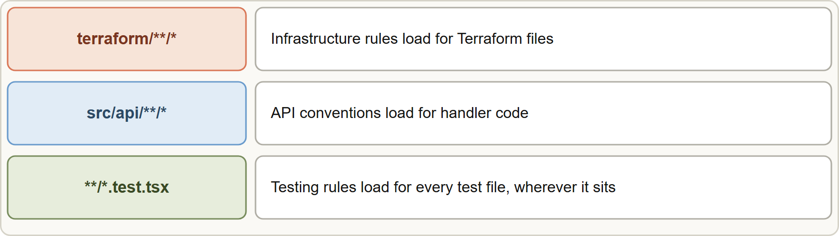
Path-Specific Rules, continued
Part 1
Path-specific rules: a glob pattern in the rule's frontmatter loads the convention only when a matching file is edited, wherever it lives
Claude Architect Foundations Exam Prep | for the CCAR-F exam
Module 7: CLAUDE.md, Rules, Slash Commands and Skills
16 / 31
Notes:
Path-Specific Rules, continued.
The figure shows this: Path-specific rules: a glob pattern in the rule's frontmatter loads the convention only when a matching file is edited, wherever it lives.

Slide 17
Path-Specific Rules, continued
Part 1
Choice | Best when
Path-specific rule (paths: globs) | Conventions follow file type or pattern, spread across directories (all test files), and should apply automatically and deterministically
Directory-level CLAUDE.md | Conventions belong to one directory tree
Skill | A workflow the developer invokes on demand; not automatic by file path
One big root CLAUDE.md | Small projects; unreliable when areas differ (relies on the model inferring which section applies)
Advantages: less irrelevant context and fewer tokens, because the rule is absent until needed.
EXAM TIP Conventions tied to file type and scattered across directories (tests) call for path-specific rules with globs, not many directory CLAUDE.md files.
Claude Architect Foundations Exam Prep | for the CCAR-F exam
Module 7: CLAUDE.md, Rules, Slash Commands and Skills
17 / 31
Notes:
Path-Specific Rules, continued.
Path-specific rule (paths: globs). Conventions follow file type or pattern, spread across directories (all test files), and should apply automatically and deterministically.
Directory-level Claude dot M D. Conventions belong to one directory tree.
Skill. A workflow the developer invokes on demand; not automatic by file path.
One big root Claude dot M D. Small projects; unreliable when areas differ (relies on the model inferring which section applies).
Advantages: less irrelevant context and fewer tokens, because the rule is absent until needed.
Exam tip: Conventions tied to file type and scattered across directories (tests) call for path-specific rules with globs, not many directory Claude dot M D files.

Slide 18
Module Recap
Part 2
1
Levels
2
Modular
3
Commands
User ~/.claude/CLAUDE.md (personal) · Project CLAUDE.md/.claude/CLAUDE.md (shared) · Directory subfolder files
@import · .claude/rules/*.md topic files · /memory to see what loaded
Project .claude/commands/ (shared) vs user ~/.claude/commands/ (personal)
4
Skills
5
Personal variant
6
Skill vs CLAUDE.md
.claude/skills/<name>/SKILL.md; frontmatter `context: fork`, `allowed-tools`, `argument-hint`
Own skill in ~/.claude/skills/ under a different name
Skill = on demand, task-specific; CLAUDE.md = always loaded, universal
7
Path rules
.claude/rules/x.md with paths: globs (e.g. **/*.test.tsx); loads only for matching files
Claude Architect Foundations Exam Prep | for the CCAR-F exam
Module 7: CLAUDE.md, Rules, Slash Commands and Skills
18 / 31
Notes:
Here is the recap.
Levels: User home dot Claude, Claude dot M D (personal), Project Claude dot M D or the dot Claude Claude dot M D file (shared), Directory subfolder files.
Modular: the at import syntax, the markdown files in the dot Claude rules folder topic files, slash memory to see what loaded.
Commands: Project the dot Claude commands folder (shared) versus user home dot Claude commands (personal).
Skills: a skill folder with a Skill dot M D file; frontmatter context: fork, allowed-tools, argument-hint.
Personal variant: Own skill in home dot Claude skills under a different name.
Skill versus Claude dot M D: Skill equals on demand, task-specific; Claude dot M D equals always loaded, universal.
Path rules: the dot Claude rules folderx dot M D with paths: globs (for example any test T S X file); loads only for matching files.

Slide 19
Practice Question 1
Part 2
Q1
A new engineer says Claude Code does not follow the team's standards, but it does for the lead developer. The lead put the standards in ~/.claude/CLAUDE.md. What is the fix?
A
Re-run /init on the new engineer's laptop only
B
Move the standards into the project CLAUDE.md and commit it
C
Ask the new engineer to copy the lead's home directory
D
Add the standards to each developer's ~/.claude/commands/ folder as a command
Claude Architect Foundations Exam Prep | for the CCAR-F exam
Module 7: CLAUDE.md, Rules, Slash Commands and Skills
19 / 31
Notes:
Question one.
A new engineer says Claude Code does not follow the team's standards, but it does for the lead developer. The lead put the standards in home dot Claude, Claude dot M D. What is the fix?
The four options are on the screen.
[PAUSE 12]
The answer is B. User-level files apply only to that user; project-level files travel with the repository.

Slide 20
Practice Question 2
Part 2
Q2
A root CLAUDE.md has grown to 800 lines covering testing, API design and deployment. Which change keeps instructions maintainable?
A
Delete the file
B
Split it into topic files under .claude/rules/ (testing.md, api-conventions.md)
C
Move everything into the user-level file so that it no longer clutters the repository root
D
Add more headings and keep one file
Claude Architect Foundations Exam Prep | for the CCAR-F exam
Module 7: CLAUDE.md, Rules, Slash Commands and Skills
20 / 31
Notes:
Question two.
A root Claude dot M D has grown to eight hundred lines covering testing, A P I design and deployment. Which change keeps instructions maintainable?
The four options are on the screen.
[PAUSE 12]
The answer is B. Topic-specific rule files give a modular alternative to a monolithic file.

Slide 21
Practice Question 3
Part 2
Q3
A monorepo has packages that each need different standards documents. How can each package's CLAUDE.md include only the right ones?
A
Copy and paste the documents into every package file so each one is self-contained
B
Use @import to pull the relevant standards files into each package's CLAUDE.md
C
Rename the documents to CLAUDE.md
D
Put all standards in the user-level file
Claude Architect Foundations Exam Prep | for the CCAR-F exam
Module 7: CLAUDE.md, Rules, Slash Commands and Skills
21 / 31
Notes:
Question three.
A monorepo has packages that each need different standards documents. How can each package's Claude dot M D include only the right ones?
The four options are on the screen.
[PAUSE 12]
The answer is B. the at import syntax pulls in selected files and keeps each file modular.

Slide 22
Practice Question 4
Part 2
Q4
Claude behaves differently between two sessions on the same repository. How can you check what instructions were loaded?
A
Delete the .claude directory and start again with a clean configuration
B
Ask the model to guess which files it loaded in the earlier session
C
Reinstall Claude Code
D
Run /memory to see which memory files are loaded
Claude Architect Foundations Exam Prep | for the CCAR-F exam
Module 7: CLAUDE.md, Rules, Slash Commands and Skills
22 / 31
Notes:
Question four.
Claude behaves differently between two sessions on the same repository. How can you check what instructions were loaded?
The four options are on the screen.
[PAUSE 12]
The answer is D. slash memory shows the loaded memory files and helps diagnose inconsistency.

Slide 23
Practice Question 5
Part 2
Q5
The team wants a /release-check command that runs its standard release checklist and should be available to every developer who clones the repository. Where should the command file go?
A
~/.claude/commands/ on one laptop
B
The root CLAUDE.md as a paragraph
C
.claude/commands/ in the project repository
D
A hidden file in each developer's home directory
Claude Architect Foundations Exam Prep | for the CCAR-F exam
Module 7: CLAUDE.md, Rules, Slash Commands and Skills
23 / 31
Notes:
Question five.
The team wants a or release-check command that runs its standard release checklist and should be available to every developer who clones the repository. Where should the command file go?
The four options are on the screen.
[PAUSE 12]
The answer is C. Project-scoped commands in the repository are version-controlled and shared.

Slide 24
Practice Question 6
Part 2
Q6
A skill that analyzes a whole codebase prints thousands of lines and clutters the main conversation. Which frontmatter helps?
A
argument-hint
B
A longer description
C
context: fork
D
name
Claude Architect Foundations Exam Prep | for the CCAR-F exam
Module 7: CLAUDE.md, Rules, Slash Commands and Skills
24 / 31
Notes:
Question six.
A skill that analyzes a whole codebase prints thousands of lines and clutters the main conversation. Which frontmatter helps?
The four options are on the screen.
[PAUSE 12]
The answer is C. context: fork runs the skill in an isolated context and returns only its summary.

Slide 25
Practice Question 7
Part 2
Q7
A skill needs a required package name but developers often run it with no argument. Which option prompts for it?
A
context: fork
B
allowed-tools
C
paths
D
argument-hint
Claude Architect Foundations Exam Prep | for the CCAR-F exam
Module 7: CLAUDE.md, Rules, Slash Commands and Skills
25 / 31
Notes:
Question seven.
A skill needs a required package name but developers often run it with no argument. Which option prompts for it?
The four options are on the screen.
[PAUSE 12]
The answer is D. argument-hint shows what parameter is expected when the skill is invoked without arguments.

Slide 26
Practice Question 8
Part 2
Q8
A developer wants a personal variation of a shared skill without changing it for teammates. What should they do?
A
Delete the shared skill
B
Edit the shared skill in the repository and ask teammates to ignore the change
C
Create a personal skill in ~/.claude/skills/ under a different name
D
Rename the repository
Claude Architect Foundations Exam Prep | for the CCAR-F exam
Module 7: CLAUDE.md, Rules, Slash Commands and Skills
26 / 31
Notes:
Question eight.
A developer wants a personal variation of a shared skill without changing it for teammates. What should they do?
The four options are on the screen.
[PAUSE 12]
The answer is C. A personal skill under a different name leaves teammates unaffected.

Slide 27
Practice Question 9
Part 2
Q9
Test files (*.test.tsx) sit next to components all over the codebase, and all of them must follow the same testing conventions automatically. What is the most maintainable setup?
A
A rule file in .claude/rules/ with paths: ["**/*.test.tsx"]
B
A skill that the developer remembers to run
C
Add a CLAUDE.md in every directory that holds tests
D
One root CLAUDE.md with a testing section and hope Claude infers when it applies
Claude Architect Foundations Exam Prep | for the CCAR-F exam
Module 7: CLAUDE.md, Rules, Slash Commands and Skills
27 / 31
Notes:
Question nine.
Test files (.test.tsx) sit next to components all over the codebase, and all of them must follow the same testing conventions automatically. What is the most maintainable setup?
The four options are on the screen.
[PAUSE 12]
The answer is A. Glob-scoped rules apply by file pattern wherever the files are and load only when needed.

Slide 28
Practice Question 10
Part 2
Q10
Which content belongs in the always-loaded CLAUDE.md, not in a skill?
A
A brainstorming workflow for architecture decisions that engineers start on demand
B
A release checklist that is used by the team only twice a year
C
Universal coding standards that apply to nearly every task
D
A one-off migration script
Claude Architect Foundations Exam Prep | for the CCAR-F exam
Module 7: CLAUDE.md, Rules, Slash Commands and Skills
28 / 31
Notes:
Question ten.
Which content belongs in the always-loaded Claude dot M D, not in a skill?
The four options are on the screen.
[PAUSE 12]
The answer is C. Always-loaded context is for universal standards; task-specific workflows suit on-demand skills.

Slide 29
Practice Question 11
Part 2
Q11
Which TWO statements about path-specific rules are correct? (Select TWO.)
A
They only work for one directory
B
They load when Claude works with a matching file
C
They load for every file at all times
D
They must be run as a slash command
E
They use frontmatter paths with glob patterns
Claude Architect Foundations Exam Prep | for the CCAR-F exam
Module 7: CLAUDE.md, Rules, Slash Commands and Skills
29 / 31
Notes:
Question eleven. Select two.
Which two statements about path-specific rules are correct?
The five options are on the screen.
[PAUSE 15]
The answers are B and E. A glob in the rule's frontmatter scopes it to matching files wherever they are, and it loads only when needed. It is not limited to one directory and needs no command.

Slide 30
Practice Question 12
Part 2
Q12
Which TWO belong in the user-level ~/.claude/CLAUDE.md? (Select TWO.)
A
The shared testing rules of the repository
B
Your personal preferences, such as how you like explanations
C
The repository-wide release steps
D
The team coding standards new teammates must follow
E
Your own shortcuts and habits
Claude Architect Foundations Exam Prep | for the CCAR-F exam
Module 7: CLAUDE.md, Rules, Slash Commands and Skills
30 / 31
Notes:
Question twelve. Select two.
Which two belong in the user-level home dot Claude, Claude dot M D?
The five options are on the screen.
[PAUSE 15]
The answers are B and E. User-level instructions are personal and not shared. Standards, testing rules and release steps for the team belong at project level.

Slide 31
Answers at a Glance
Part 2
Question | Answer | Why
Q1 | B | User-level files apply only to that user
Q2 | B | Topic-specific rule files give a modular alternative
Q3 | B | @import pulls in selected files and keeps
Q4 | D | /memory shows the loaded memory files and
Q5 | C | Project-scoped commands in the repository are version-controlled
Q6 | C | context: fork runs the skill in an
Q7 | D | argument-hint shows what parameter is expected when
Q8 | C | A personal skill under a different name
Q9 | A | Glob-scoped rules apply by file pattern wherever
Q10 | C | Always-loaded context is for universal standards
Q11 | B, E | A glob in the rule's frontmatter scopes
Q12 | B, E | User-level instructions are personal and not shared
Claude Architect Foundations Exam Prep | for the CCAR-F exam
Module 7: CLAUDE.md, Rules, Slash Commands and Skills
31 / 31
Notes:
Here are all twelve answers. Question one: B. Question two: B. Question three: B. Question four: D. Question five: C. Question six: C. Question seven: D. Question eight: C. Question nine: A. Question ten: C. Question eleven: B and E. Question twelve: B and E.
In the next module, we continue the course.

