Slide 1
Module 8: Plan Mode, Iterative Refinement and CI/CD
Plan mode versus direct execution, and the Explore subagent
Domain 3 · Claude Code Configuration and Workflows · Task statements 3.4 to 3.6
Claude Architect Foundations Exam Prep Masterclass
Module 8 · Part 1
Notes:
Welcome to Module eight: Plan Mode, Iterative Refinement and C I C D. This module covers task statements three point four to three point six: plan mode, iterative refinement and c i c d.
Each part of this module comes from the study notes of the same name, so you can read the notes after you watch.

Slide 2
What You Will Learn
Part 1
Plan mode versus direct execution, and the Explore subagent
Four iterative refinement techniques: examples, test-driven iteration, the interview pattern, one message versus many
Running Claude Code in CI/CD: `-p`, `--output-format json`, `--json-schema`, CLAUDE.md for context, independent review, no duplicate comments
Claude Architect Foundations Exam Prep | for the CCAR-F exam
Module 8: Plan Mode, Iterative Refinement and CI/CD
2 / 29
Notes:
By the end of this module you will be able to do three things.
Plan mode versus direct execution, and the Explore subagent.
Four iterative refinement techniques: examples, test-driven iteration, the interview pattern, one message versus many.
Running Claude Code in C I C D (continuous integration and continuous delivery): dash p, dash dash output format json, dash dash json schema, Claude dot M D for context, independent review, no duplicate comments.

Slide 3
Case Check-In: Two Tickets at Birchwood Supply
Part 1
CASE CHECK-IN · Birchwood Supply
Ticket A: "The checkout page crashes with a stack trace pointing to formatPrice when the price is null"
Ticket B: "Replace the charting library in the reporting module; it touches more than 40 files, and two candidate libraries need different hosting setups"
Claude Architect Foundations Exam Prep | for the CCAR-F exam
Module 8: Plan Mode, Iterative Refinement and CI/CD
3 / 29
Notes:
Our running case is Birchwood Supply. Two Tickets at Birchwood Supply.
Ticket A: "The checkout page crashes with a stack trace pointing to format Price when the price is null".
Ticket B: "Replace the charting library in the reporting module; it touches more than forty files, and two candidate libraries need different hosting setups".

Slide 4
Plan Mode or Direct Execution
Part 1
 | Plan mode | Direct execution
Choose it for | Complex tasks: large-scale changes, several valid approaches, architectural decisions, multi-file modifications (microservice restructuring, a library migration touching 45+ files, choosing between integration approaches with different infrastructure needs) | Simple, well-scoped changes: a single-file bug fix with a clear stack trace, adding one validation check
Benefit | Safe exploration and design before committing; avoids costly rework | Fast, no overhead
Wrong choice costs | Overhead for trivial work | Late discovery of dependencies and rework
Plan mode lets Claude explore the code and design an approach without making changes. You review the plan, then approve it for execution.
Claude Architect Foundations Exam Prep | for the CCAR-F exam
Module 8: Plan Mode, Iterative Refinement and CI/CD
4 / 29
Notes:
Plan Mode or Direct Execution.
Plan mode lets Claude explore the code and design an approach without making changes. You review the plan, then approve it for execution.
Choose it for. Plan mode: Complex tasks: large-scale changes, several valid approaches, architectural decisions, multi-file modifications (microservice restructuring, a library migration touching forty-five plus files, choosing between integration approaches with different infrastructure needs). Direct execution: Simple, well-scoped changes: a single-file bug fix with a clear stack trace, adding one validation check.
Benefit. Plan mode: Safe exploration and design before committing; avoids costly rework. Direct execution: Fast, no overhead.
Wrong choice costs. Plan mode: Overhead for trivial work. Direct execution: Late discovery of dependencies and rework.

Slide 5
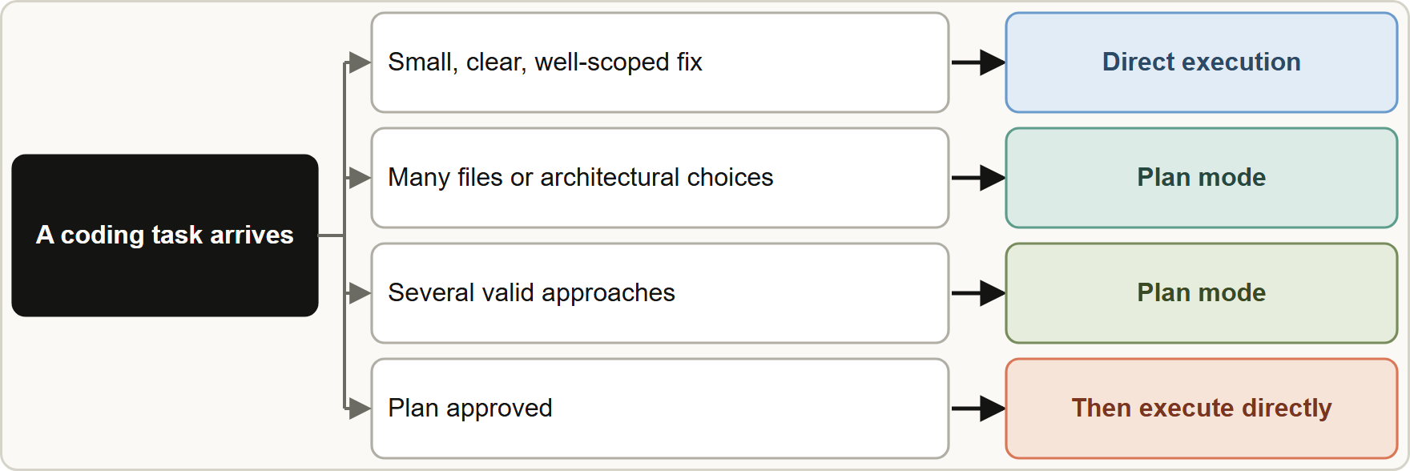
Plan Mode or Direct Execution, continued
Part 1
Combine them: plan mode to investigate and plan (for example a library migration), then direct execution to carry out the chosen plan.
Explore subagent: a built-in subagent that does verbose discovery work in its own context and returns a summary, so the main conversation does not fill up during multi-phase tasks.
Combine them: plan mode to investigate and plan (for example a library migration), then direct execution to carry out the chosen plan.
Explore subagent: a built-in subagent that does verbose discovery work in its own context and returns a summary, so the main conversation does not fill up during multi-phase tasks.
Claude Architect Foundations Exam Prep | for the CCAR-F exam
Module 8: Plan Mode, Iterative Refinement and CI/CD
5 / 29
Notes:
Plan Mode or Direct Execution, continued.
The figure shows this: Plan mode for complex, multi-file or architectural work; direct execution for small, well-understood changes; often plan first, then execute directly.
Combine them: plan mode to investigate and plan (for example a library migration), then direct execution to carry out the chosen plan.
Explore subagent: a built-in subagent that does verbose discovery work in its own context and returns a summary, so the main conversation does not fill up during multi-phase tasks.

Slide 6
Plan Mode or Direct Execution, continued
DATES
Part 1
If the complexity is already stated in the requirements (dozens of files, boundary decisions), start in plan mode; do not "see if it gets complicated".
Enter plan mode with Shift+Tab or claude --permission-mode plan; Claude reads and proposes a plan but makes no edits until you approve. Explore and Plan are built-in, read-only subagents. As of 8 November 2026.
EXAM TIP Complexity that is already stated in the requirements (dozens of files, several approaches) means plan mode now, not "switch if it gets hard".
Claude Architect Foundations Exam Prep | for the CCAR-F exam
Module 8: Plan Mode, Iterative Refinement and CI/CD
6 / 29
Notes:
Plan Mode or Direct Execution, continued.
If the complexity is already stated in the requirements (dozens of files, boundary decisions), start in plan mode; do not "see if it gets complicated".
Enter plan mode with Shift plus Tab or claude dash dash permission mode plan; Claude reads and proposes a plan but makes no edits until you approve. Explore and Plan are built-in, read-only subagents. As of eight November two thousand twenty-six.
Exam tip: Complexity that is already stated in the requirements (dozens of files, several approaches) means plan mode now, not "switch if it gets hard".

Slide 7
Iterative Refinement
Part 1
Technique | Use it when | How
Concrete input/output examples | Prose descriptions are interpreted inconsistently | Give 2 to 3 examples of the input and the exact expected output
Test-driven iteration | You can specify behavior as tests | Write the test suite first (expected behavior, edge cases, performance), then iterate by sharing test failures
Interview pattern | The domain is unfamiliar or has hidden design choices | Have Claude ask you questions first (cache invalidation? failure modes?) before implementing
Specific test cases | An edge case is mishandled (null values in a migration) | Provide the case with example input and expected output
Claude Architect Foundations Exam Prep | for the CCAR-F exam
Module 8: Plan Mode, Iterative Refinement and CI/CD
7 / 29
Notes:
Iterative Refinement.
Concrete input or output examples. Use it when: Prose descriptions are interpreted inconsistently. How: Give two to three examples of the input and the exact expected output.
Test-driven iteration. Use it when: You can specify behavior as tests. How: Write the test suite first (expected behavior, edge cases, performance), then iterate by sharing test failures.
Interview pattern. Use it when: The domain is unfamiliar or has hidden design choices. How: Have Claude ask you questions first (cache invalidation? failure modes?) before implementing.
Specific test cases. Use it when: An edge case is mishandled (null values in a migration). How: Provide the case with example input and expected output.

Slide 8
Iterative Refinement, continued
Part 1
Technique | Use it when | How
One message vs several | Problems interact | Put all interacting issues in one detailed message; fix independent problems one at a time
Claude Architect Foundations Exam Prep | for the CCAR-F exam
Module 8: Plan Mode, Iterative Refinement and CI/CD
8 / 29
Notes:
Iterative Refinement, continued.
One message versus several. Use it when: Problems interact. How: Put all interacting issues in one detailed message; fix independent problems one at a time.

Slide 9
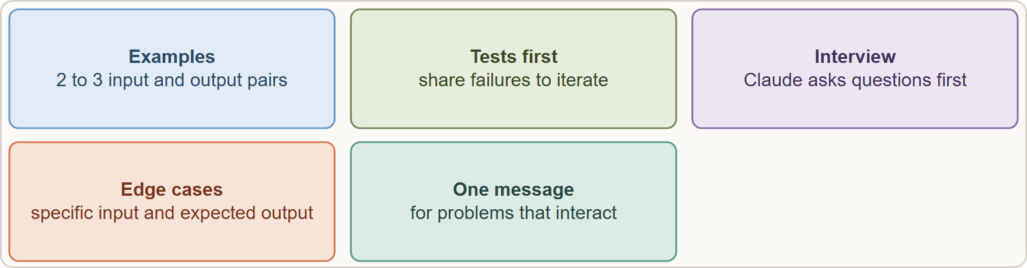
Iterative Refinement, continued
Part 1
Five techniques for progressive improvement of results
EXAM TIP Output formats keep coming back different from what you described? → show 2 to 3 concrete before/after examples, not a longer prose description.
Claude Architect Foundations Exam Prep | for the CCAR-F exam
Module 8: Plan Mode, Iterative Refinement and CI/CD
9 / 29
Notes:
Iterative Refinement, continued.
The figure shows this: Five techniques for progressive improvement of results.
Exam tip: Output formats keep coming back different from what you described? to show two to three concrete before or after examples, not a longer prose description.

Slide 10
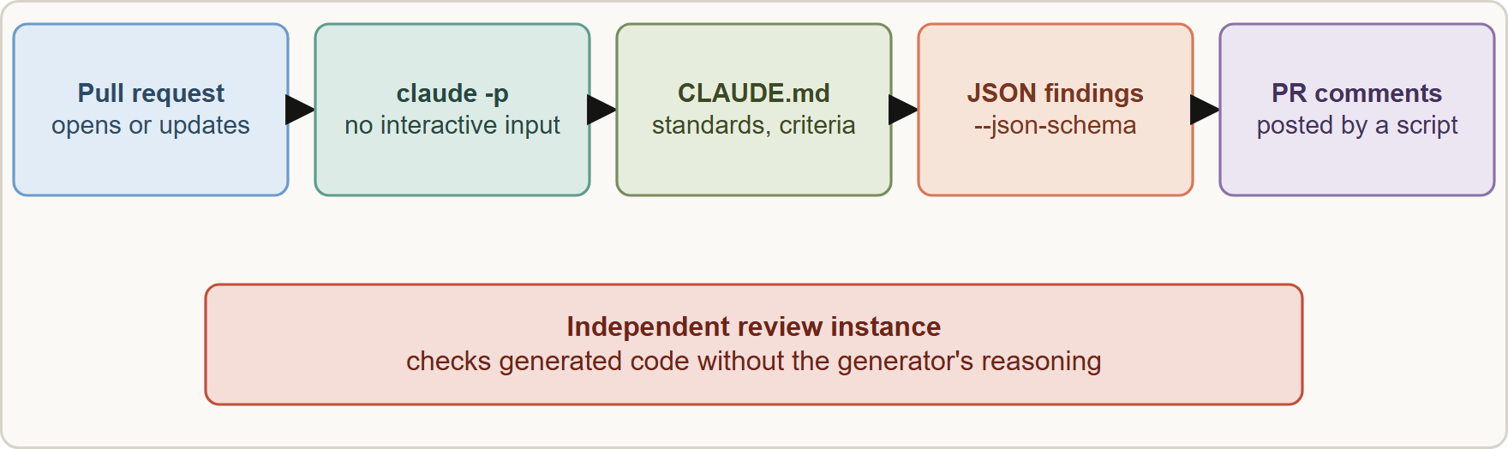
Claude Code in CI/CD
Part 1
In CI, run claude -p so nothing waits for input, ask for JSON that matches a schema, load standards from CLAUDE.md, and post the findings as PR comments
Claude Architect Foundations Exam Prep | for the CCAR-F exam
Module 8: Plan Mode, Iterative Refinement and CI/CD
10 / 29
Notes:
Claude Code in C I C D.
The figure shows this: In C I, run claude dash p so nothing waits for input, ask for Jason (Java Script Object Notation) that matches a schema, load standards from Claude dot M D, and post the findings as P R (pull request) comments.

Slide 11
Claude Code in CI/CD, continued
Part 1
Need | Use
Run without interactive input (a plain claude "..." hangs waiting) | `-p` (or `--print`): process the prompt, print the result, exit
Machine-readable results | `--output-format json` and `--json-schema` (structured findings to post as inline PR comments)
Project context for CI runs | CLAUDE.md: testing standards, fixture conventions, review criteria
Avoid duplicate comments after new commits | Include prior review findings in the context and tell Claude to report only new or still-unaddressed issues
Avoid duplicate test suggestions | Provide the existing test files in context
Better test generation | Document testing standards, what makes a valuable test, and available fixtures in CLAUDE.md
Claude Architect Foundations Exam Prep | for the CCAR-F exam
Module 8: Plan Mode, Iterative Refinement and CI/CD
11 / 29
Notes:
Claude Code in C I C D, continued.
Run without interactive input (a plain claude "..." hangs waiting). dash p (or dash dash print): process the prompt, print the result, exit.
Machine-readable results. dash dash output format json and dash dash json schema (structured findings to post as inline P R comments).
Project context for C I runs. Claude dot M D: testing standards, fixture conventions, review criteria.
Avoid duplicate comments after new commits. Include prior review findings in the context and tell Claude to report only new or still-unaddressed issues.
Avoid duplicate test suggestions. Provide the existing test files in context.
Better test generation. Document testing standards, what makes a valuable test, and available fixtures in Claude dot M D.

Slide 12
Claude Code in CI/CD, continued
Part 1
TERMINAL
claude -p "Review this pull request for security issues" \
--output-format json \
--json-schema '{"type":"object","properties":{"findings":{"type":"array","items":{"type":"object","properties":{"file":{"type":"string"},"line":{"type":"integer"},"severity":{"type":"string"},"issue":{"type":"string"}},"required":["file","issue"]}}},"required":["findings"]}'
Example from the study note (names are examples)
Claude Architect Foundations Exam Prep | for the CCAR-F exam
Module 8: Plan Mode, Iterative Refinement and CI/CD
12 / 29
Notes:
Claude Code in C I C D, continued.
The example is on the screen; read it line by line when you study.

Slide 13
Claude Code in CI/CD, continued
Part 1
Independent review instance: the session that generated the code retains its reasoning, so it is less likely to question its own work. Use a second, independent Claude Code instance (no generator reasoning) to review.
Distractors: there is no `CLAUDE_HEADLESS` environment variable and no `--batch` flag for this purpose; redirecting stdin from /dev/null does not make Claude Code non-interactive.
Claude Architect Foundations Exam Prep | for the CCAR-F exam
Module 8: Plan Mode, Iterative Refinement and CI/CD
13 / 29
Notes:
Claude Code in C I C D, continued.
Independent review instance: the session that generated the code retains its reasoning, so it is less likely to question its own work. Use a second, independent Claude Code instance (no generator reasoning) to review.
Distractors: there is no Claude H E A D L E S S environment variable and no dash dash batch flag for this purpose; redirecting stdin from or dev or null does not make Claude Code non-interactive.

Slide 14
Claude Code in CI/CD, continued
DATES
Part 1
The structured result appears in the JSON output's `structured_output` field (check it exists before using it). `--bare` starts faster and is recommended for scripted calls, but it skips auto-discovery of CLAUDE.md, hooks, skills and MCP servers: if you use it, pass context explicitly (for example --append-system-prompt or --mcp-config). Add --allowedTools or a permission mode so no step waits for approval. As of 8 November 2026.
EXAM TIP In CI always use `-p`; for machine-readable output add `--output-format json` with `--json-schema`; give context through CLAUDE.md.
Claude Architect Foundations Exam Prep | for the CCAR-F exam
Module 8: Plan Mode, Iterative Refinement and CI/CD
14 / 29
Notes:
Claude Code in C I C D, continued.
The structured result appears in the Jason output's structured output field (check it exists before using it). dash dash bare starts faster and is recommended for scripted calls, but it skips auto-discovery of Claude dot M D, hooks, skills and M C P (Model Context Protocol) servers: if you use it, pass context explicitly (for example dash dash append system prompt or dash dash mcp config). Add dash dash allowed Tools or a permission mode so no step waits for approval. As of eight November two thousand twenty-six.
Exam tip: In C I always use dash p; for machine-readable output add dash dash output format json with dash dash json schema; give context through Claude dot M D.

Slide 15
Module Recap
Part 1
1
Plan mode
2
Direct execution
3
Both
Complex, multi-file, architectural, several valid approaches; explore and design before changing code
Simple, well-scoped (one-file fix with a stack trace)
Plan to investigate, then execute directly
4
Explore subagent
5
Refinement
6
CI flags
Verbose discovery in its own context; returns a summary
2 to 3 examples · tests first · interview first · specific edge cases · interacting issues together, independent ones in turn
`-p`/`--print` (no hang) · `--output-format json` · `--json-schema`
7
CI context
8
Review
9
Not real
CLAUDE.md (standards, fixtures, criteria); give prior findings and existing tests
Use an independent instance; the generating session reviews itself poorly
CLAUDE_HEADLESS, --batch
Claude Architect Foundations Exam Prep | for the CCAR-F exam
Module 8: Plan Mode, Iterative Refinement and CI/CD
15 / 29
Notes:
Here is the recap.
Plan mode: Complex, multi-file, architectural, several valid approaches; explore and design before changing code.
Direct execution: Simple, well-scoped (one-file fix with a stack trace).
Both: Plan to investigate, then execute directly.
Explore subagent: Verbose discovery in its own context; returns a summary.
Refinement: two to three examples, tests first, interview first, specific edge cases, interacting issues together, independent ones in turn.
C I flags: dash p or dash dash print (no hang), dash dash output format json, dash dash json schema.
C I context: Claude dot M D (standards, fixtures, criteria); give prior findings and existing tests.
Review: Use an independent instance; the generating session reviews itself poorly.
Not real: Claude H E A D L E S S, dash dash batch.

Slide 16
Practice Question 1
Part 2
Q1
Birchwood must replace the charting library in its reporting module. More than 40 files are affected, and the two candidate libraries need different hosting setups. Which approach is best?
A
Write exhaustive upfront instructions and execute directly
B
Pick a library at random and start editing
C
Start directly and switch to plan mode only if unexpected problems appear later
D
Enter plan mode to explore usage, compare the options and design the migration before changing code
Claude Architect Foundations Exam Prep | for the CCAR-F exam
Module 8: Plan Mode, Iterative Refinement and CI/CD
16 / 29
Notes:
Question one.
Birchwood must replace the charting library in its reporting module. More than forty files are affected, and the two candidate libraries need different hosting setups. Which approach is best?
The four options are on the screen.
[PAUSE 12]
The answer is D. A multi-file change with several valid approaches and infrastructure consequences is what plan mode is for. Waiting for trouble ignores that the complexity is already known.

Slide 17
Practice Question 2
Part 2
Q2
A stack trace shows formatPrice crashing on a null price in one file. What is the best mode?
A
Create a new service
B
Direct execution with a null check
C
Plan mode with a full architecture review
D
Ask for a plan document first
Claude Architect Foundations Exam Prep | for the CCAR-F exam
Module 8: Plan Mode, Iterative Refinement and CI/CD
17 / 29
Notes:
Question two.
A stack trace shows format Price crashing on a null price in one file. What is the best mode?
The four options are on the screen.
[PAUSE 12]
The answer is B. A clear, single-file fix is well scoped; direct execution is efficient.

Slide 18
Practice Question 3
Part 2
Q3
During a multi-phase migration, discovery output (hundreds of lines of file listings) fills the main context. What helps most?
A
Turn off exploration
B
Use the Explore subagent so that verbose discovery stays out of the main context
C
Increase the prompt length limit
D
Paste the contents of every file into the prompt so that the model never has to explore
Claude Architect Foundations Exam Prep | for the CCAR-F exam
Module 8: Plan Mode, Iterative Refinement and CI/CD
18 / 29
Notes:
Question three.
During a multi-phase migration, discovery output (hundreds of lines of file listings) fills the main context. What helps most?
The four options are on the screen.
[PAUSE 12]
The answer is B. The Explore subagent isolates verbose discovery in its own context and returns only a summary.

Slide 19
Practice Question 4
Part 2
Q4
A team describes a conversion rule in prose three times and Claude interprets it differently each time. What works best?
A
Switch to a different model
B
Remove the rule and describe the transformation again in other words
C
Write an even longer prose description with more detail and more adjectives
D
Provide 2 to 3 concrete input/output examples
Claude Architect Foundations Exam Prep | for the CCAR-F exam
Module 8: Plan Mode, Iterative Refinement and CI/CD
19 / 29
Notes:
Question four.
A team describes a conversion rule in prose three times and Claude interprets it differently each time. What works best?
The four options are on the screen.
[PAUSE 12]
The answer is D. Concrete input and output examples communicate the expected transformation unambiguously.

Slide 20
Practice Question 5
Part 2
Q5
A developer needs a caching layer in an unfamiliar domain and does not know what could go wrong. Which technique brings up the unknowns?
A
Ask for the shortest possible solution and add the missing safeguards afterwards
B
Copy a solution from another project
C
The interview pattern: have Claude ask you questions before it implements
D
Implement immediately
Claude Architect Foundations Exam Prep | for the CCAR-F exam
Module 8: Plan Mode, Iterative Refinement and CI/CD
20 / 29
Notes:
Question five.
A developer needs a caching layer in an unfamiliar domain and does not know what could go wrong. Which technique brings up the unknowns?
The four options are on the screen.
[PAUSE 12]
The answer is C. Interviewing first surfaces considerations the developer had not thought of.

Slide 21
Practice Question 6
Part 2
Q6
Three bugs in a pricing function interact (fixing one changes the others). How should they be reported?
A
All together in one detailed message
B
In separate sessions
C
One at a time over many messages
D
Only the first one, and ignore the rest until the first is completely fixed
Claude Architect Foundations Exam Prep | for the CCAR-F exam
Module 8: Plan Mode, Iterative Refinement and CI/CD
21 / 29
Notes:
Question six.
Three bugs in a pricing function interact (fixing one changes the others). How should they be reported?
The four options are on the screen.
[PAUSE 12]
The answer is A. Interacting problems should be addressed together; independent problems can be handled sequentially.

Slide 22
Practice Question 7
Part 2
Q7
A nightly job runs claude "Summarize today's failed tests" and never finishes because Claude Code waits for input. What is the correct change?
A
Increase the job timeout to several hours so that the run can complete
B
Wrap it in a terminal multiplexer session
C
Run it with the -p flag so it prints the result and exits
D
Pipe the word yes into the command
Claude Architect Foundations Exam Prep | for the CCAR-F exam
Module 8: Plan Mode, Iterative Refinement and CI/CD
22 / 29
Notes:
Question seven.
A nightly job runs claude "Summarize today's failed tests" and never finishes because Claude Code waits for input. What is the correct change?
The four options are on the screen.
[PAUSE 12]
The answer is C. dash p or dash dash print is the documented non-interactive mode for scripts and C I. Feeding fake input, hiding the terminal or waiting longer does not make the tool non-interactive.

Slide 23
Practice Question 8
Part 2
Q8
A CI job should post findings as inline comments through a script. What should the command output?
A
A screenshot
B
Free-form prose that a script splits into comments with regular expressions
C
An email
D
JSON that conforms to a schema (--output-format json, --json-schema)
Claude Architect Foundations Exam Prep | for the CCAR-F exam
Module 8: Plan Mode, Iterative Refinement and CI/CD
23 / 29
Notes:
Question eight.
A C I job should post findings as inline comments through a script. What should the command output?
The four options are on the screen.
[PAUSE 12]
The answer is D. Machine-parseable structured findings that follow a schema are easy for a script to post as comments.

Slide 24
Practice Question 9
Part 2
Q9
After a developer pushes new commits, the review bot repeats comments already made. How can it avoid duplicates?
A
Lower the model temperature
B
Review only the first commit
C
Delete every earlier comment from the pull request before each new review run is started
D
Include the earlier findings and tell Claude to report only new or unaddressed issues
Claude Architect Foundations Exam Prep | for the CCAR-F exam
Module 8: Plan Mode, Iterative Refinement and CI/CD
24 / 29
Notes:
Question nine.
After a developer pushes new commits, the review bot repeats comments already made. How can it avoid duplicates?
The four options are on the screen.
[PAUSE 12]
The answer is D. Prior findings in the context let Claude suppress what is already reported and mention only new items.

Slide 25
Practice Question 10
Part 2
Q10
Generated tests keep suggesting scenarios that already exist. Which change helps?
A
Use a shorter prompt
B
Provide the existing test files in the context
C
Ask for more tests so that the duplicates are outnumbered
D
Remove CLAUDE.md so that no standards are loaded into the context
Claude Architect Foundations Exam Prep | for the CCAR-F exam
Module 8: Plan Mode, Iterative Refinement and CI/CD
25 / 29
Notes:
Question ten.
Generated tests keep suggesting scenarios that already exist. Which change helps?
The four options are on the screen.
[PAUSE 12]
The answer is B. Showing the existing tests lets Claude avoid suggesting scenarios that are already covered.

Slide 26
Practice Question 11
Part 2
Q11
The same Claude Code session that wrote a change is asked to review it and finds nothing. What is the better design?
A
Use an independent Claude Code instance with no generator reasoning to review
B
Ask the same session to try harder and turn on extended thinking for the review pass
C
Skip review
D
Review only formatting
Claude Architect Foundations Exam Prep | for the CCAR-F exam
Module 8: Plan Mode, Iterative Refinement and CI/CD
26 / 29
Notes:
Question eleven.
The same Claude Code session that wrote a change is asked to review it and finds nothing. What is the better design?
The four options are on the screen.
[PAUSE 12]
The answer is A. The generating session keeps its reasoning and is less likely to challenge itself; independent review catches more.

Slide 27
Practice Question 12
Part 2
Q12
Which TWO options help run Claude Code in a pipeline and return machine-parseable findings? (Select TWO.)
A
--output-format json together with --json-schema
B
A --batch flag
C
An --interactive flag
D
The -p flag
E
A CLAUDE_HEADLESS environment variable
Claude Architect Foundations Exam Prep | for the CCAR-F exam
Module 8: Plan Mode, Iterative Refinement and CI/CD
27 / 29
Notes:
Question twelve. Select two.
Which two options help run Claude Code in a pipeline and return machine-parseable findings?
The five options are on the screen.
[PAUSE 15]
The answers are A and D. dash p prevents waiting for input, and the Jason options give structured output. The other options are not the documented mechanism.

Slide 28
Practice Question 13
Part 2
Q13
Which TWO tasks favor plan mode? (Select TWO.)
A
Renaming one local variable
B
Choosing between two integrations with different infrastructure needs
C
Fixing a typo in a comment
D
Adding one null check at a stack-trace line
E
A library migration touching more than 40 files
Claude Architect Foundations Exam Prep | for the CCAR-F exam
Module 8: Plan Mode, Iterative Refinement and CI/CD
28 / 29
Notes:
Question thirteen. Select two.
Which two tasks favor plan mode?
The five options are on the screen.
[PAUSE 15]
The answers are B and E. Large multi-file changes and architectural choices benefit from planning before editing. Tiny, well-scoped edits are quicker with direct execution.

Slide 29
Answers at a Glance
Part 2
Question | Answer | Why
Q1 | D | A multi-file change with several valid
Q2 | B | A clear, single-file fix is well
Q3 | B | The Explore subagent isolates verbose discovery
Q4 | D | Concrete input and output examples communicate
Q5 | C | Interviewing first surfaces considerations the developer
Q6 | A | Interacting problems should be addressed together
Q7 | C | -p / --print is the documented
Q8 | D | Machine-parseable structured findings that follow a
Q9 | D | Prior findings in the context let
Q10 | B | Showing the existing tests lets Claude
Q11 | A | The generating session keeps its reasoning
Q12 | A, D | -p prevents waiting for input
Q13 | B, E | Large multi-file changes and architectural choices
Claude Architect Foundations Exam Prep | for the CCAR-F exam
Module 8: Plan Mode, Iterative Refinement and CI/CD
29 / 29
Notes:
Here are all thirteen answers. Question one: D. Question two: B. Question three: B. Question four: D. Question five: C. Question six: A. Question seven: C. Question eight: D. Question nine: D. Question ten: B. Question eleven: A. Question twelve: A and D. Question thirteen: B and E.
In the next module, we continue the course.

