Slide 1
Module 9: Explicit Criteria and Few-Shot Prompting
Why explicit criteria beat vague instructions and "be conservative"
Domain 4 · Prompt Engineering and Structured Output · Task statements 4.1 and 4.2
Claude Architect Foundations Exam Prep Masterclass
Module 9
Notes:
Welcome to Module nine: Explicit Criteria and Few-Shot Prompting. This module covers task statements four point one and four point two: explicit criteria and few-shot prompting.
Each part of this module comes from the study notes of the same name, so you can read the notes after you watch.

Slide 2
What You Will Learn
Module 9
Why explicit criteria beat vague instructions and "be conservative"
How false positives destroy developer trust, and what to do about them
Severity criteria with concrete code examples
Few-shot examples: when, how many, and what they should show
Claude Architect Foundations Exam Prep | for the CCAR-F exam
Module 9: Explicit Criteria and Few-Shot Prompting
2 / 20
Notes:
By the end of this module you will be able to do four things.
Why explicit criteria beat vague instructions and "be conservative".
How false positives destroy developer trust, and what to do about them.
Severity criteria with concrete code examples.
Few-shot examples: when, how many, and what they should show.

Slide 3
Case Check-In: Birchwood Supply's Review Bot Cries Wolf
Module 9
CASE CHECK-IN · Birchwood Supply
The CI review bot comments on every pull request
Developers say "half the comments are noise" and have started ignoring all of them, including the real security findings
The prompt says: "Review the code and report issues. Be conservative; only report high-confidence findings."
Claude Architect Foundations Exam Prep | for the CCAR-F exam
Module 9: Explicit Criteria and Few-Shot Prompting
3 / 20
Notes:
Our running case is Birchwood Supply. Birchwood Supply's Review Bot Cries Wolf.
The C I review bot comments on every pull request.
Developers say "half the comments are noise" and have started ignoring all of them, including the real security findings.
The prompt says: "Review the code and report issues. Be conservative; only report high-confidence findings.".

Slide 4
Explicit Criteria Beat Vague Instructions
Module 9
Vague instruction | Explicit criterion
"Check that comments are accurate" | "Flag a comment only when the behavior it claims contradicts what the code actually does"
"Be conservative" / "only report high-confidence findings" | "Report: bugs and security vulnerabilities. Skip: minor style and local naming patterns"
"Rate how severe it is" | A severity table with a short code example for each level
Claude Architect Foundations Exam Prep | for the CCAR-F exam
Module 9: Explicit Criteria and Few-Shot Prompting
4 / 20
Notes:
Explicit Criteria Beat Vague Instructions.
"Check that comments are accurate". "Flag a comment only when the behavior it claims contradicts what the code actually does".
"Be conservative" or "only report high-confidence findings". "Report: bugs and security vulnerabilities. Skip: minor style and local naming patterns".
"Rate how severe it is". A severity table with a short code example for each level.

Slide 5
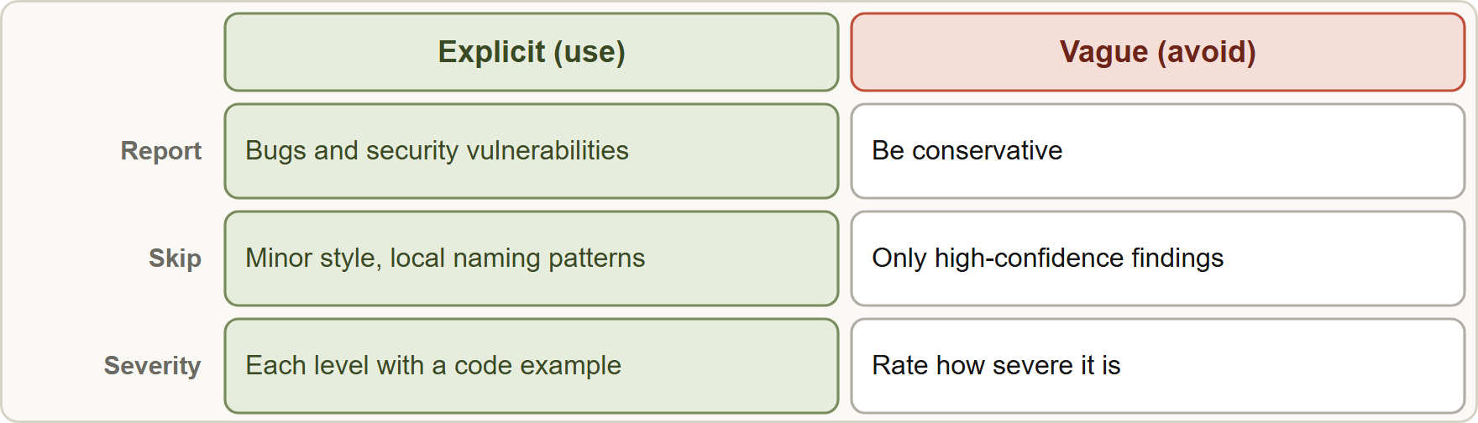
Explicit Criteria Beat Vague Instructions, continued
Module 9
General phrases such as "be conservative" or "only report high-confidence findings" do not improve precision: the model cannot calibrate "confidence" the way you imagine. Specific, categorical criteria do.
False positives are costly beyond the noise. A category with a high false-positive rate undermines trust in the accurate categories too.
General phrases such as "be conservative" or "only report high-confidence findings" do not improve precision: the model cannot calibrate "confidence" the way you imagine. Specific, categorical criteria do.
False positives are costly beyond the noise. A category with a high false-positive rate undermines trust in the accurate categories too.
Claude Architect Foundations Exam Prep | for the CCAR-F exam
Module 9: Explicit Criteria and Few-Shot Prompting
5 / 20
Notes:
Explicit Criteria Beat Vague Instructions, continued.
The figure shows this: Replace general instructions with categorical criteria: what to report, what to skip, and how to rate severity.
General phrases such as "be conservative" or "only report high-confidence findings" do not improve precision: the model cannot calibrate "confidence" the way you imagine. Specific, categorical criteria do.
False positives are costly beyond the noise. A category with a high false-positive rate undermines trust in the accurate categories too.

Slide 6
Explicit Criteria Beat Vague Instructions, continued
Module 9
If one category is noisy, temporarily disable it to restore trust while you improve its prompt, then re-enable it.
Severity levels need definitions and examples: for each level give a short concrete code example, so classification is consistent from run to run.
Claude Architect Foundations Exam Prep | for the CCAR-F exam
Module 9: Explicit Criteria and Few-Shot Prompting
6 / 20
Notes:
Explicit Criteria Beat Vague Instructions, continued.
If one category is noisy, temporarily disable it to restore trust while you improve its prompt, then re-enable it.
Severity levels need definitions and examples: for each level give a short concrete code example, so classification is consistent from run to run.

Slide 7
Explicit Criteria Beat Vague Instructions, continued
Module 9
TEXT
Report: SQL built by string concatenation (high); missing null check before dereference (medium).
Skip: variable naming, import order, formatting, patterns that match the file's existing style.
Severity high example: query = "SELECT * FROM users WHERE id=" + user_id
Severity low example: a TODO comment without a ticket number
Example from the study note (names are examples)
EXAM TIP Asked how to reduce false positives? → specific criteria for what to report and skip, not "be more conservative" and not a confidence cutoff.
Claude Architect Foundations Exam Prep | for the CCAR-F exam
Module 9: Explicit Criteria and Few-Shot Prompting
7 / 20
Notes:
Explicit Criteria Beat Vague Instructions, continued.
The example is on the screen; read it line by line when you study.
Exam tip: Asked how to reduce false positives? to specific criteria for what to report and skip, not "be more conservative" and not a confidence cutoff.
Exam tip: Severity that varies between runs needs a definition and a code example for each level.

Slide 8
Few-Shot Prompting
Module 9
Use few-shot to... | Detail
Get consistent format | When detailed instructions still give inconsistent output, examples are the most effective technique
Show ambiguous cases | Examples of tool selection for ambiguous requests, or branch-level test-coverage gaps
Generalize judgment | Models apply the reasoning to novel patterns, not only to the examples listed
Reduce hallucination in extraction | Show handling of informal measurements and varied document structures
Few-shot prompting puts a few worked examples of input and desired output in the prompt.
Claude Architect Foundations Exam Prep | for the CCAR-F exam
Module 9: Explicit Criteria and Few-Shot Prompting
8 / 20
Notes:
Few-Shot Prompting.
Few-shot prompting puts a few worked examples of input and desired output in the prompt.
Get consistent format. When detailed instructions still give inconsistent output, examples are the most effective technique.
Show ambiguous cases. Examples of tool selection for ambiguous requests, or branch-level test-coverage gaps.
Generalize judgment. Models apply the reasoning to novel patterns, not only to the examples listed.
Reduce hallucination in extraction. Show handling of informal measurements and varied document structures.

Slide 9
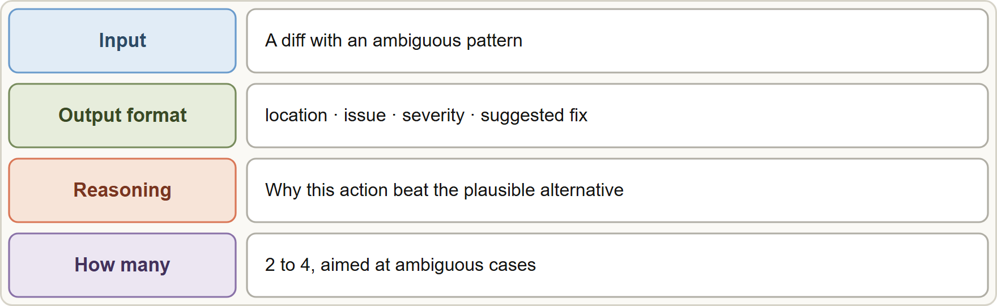
Few-Shot Prompting, continued
Module 9
How many: 2 to 4 targeted examples, aimed at the ambiguous situations (not easy cases).
Show the reasoning: state why one action was chosen over plausible alternatives.
Show the output format: location, issue, severity, suggested fix.
How many: 2 to 4 targeted examples, aimed at the ambiguous situations (not easy cases).
Show the reasoning: state why one action was chosen over plausible alternatives.
Show the output format: location, issue, severity, suggested fix.
Claude Architect Foundations Exam Prep | for the CCAR-F exam
Module 9: Explicit Criteria and Few-Shot Prompting
9 / 20
Notes:
Few-Shot Prompting, continued.
The figure shows this: A good few-shot example shows the input, the exact output format, and the reasoning for the choice.
How many: two to four targeted examples, aimed at the ambiguous situations (not easy cases).
Show the reasoning: state why one action was chosen over plausible alternatives.
Show the output format: location, issue, severity, suggested fix.

Slide 10
Few-Shot Prompting, continued
Module 9
Contrast acceptable patterns with genuine issues so the model skips harmless code (fewer false positives) yet still generalizes.
Varied document structures (inline citations versus a bibliography; methodology sections versus details embedded in text) → examples with each structure.
Empty or null extraction of fields that exist in the source? Add examples from documents with varied formats showing the correct extraction.
EXAM TIP Instructions alone give inconsistent output → few-shot examples. But a missing-information problem (the document does not contain the data) is not fixed by examples; see Modules 10 and 11.
Claude Architect Foundations Exam Prep | for the CCAR-F exam
Module 9: Explicit Criteria and Few-Shot Prompting
10 / 20
Notes:
Few-Shot Prompting, continued.
Contrast acceptable patterns with genuine issues so the model skips harmless code (fewer false positives) yet still generalizes.
Varied document structures (inline citations versus a bibliography; methodology sections versus details embedded in text) to examples with each structure.
Empty or null extraction of fields that exist in the source? Add examples from documents with varied formats showing the correct extraction.
Exam tip: Instructions alone give inconsistent output to few-shot examples. But a missing-information problem (the document does not contain the data) is not fixed by examples; see Modules ten and eleven.

Slide 11
Module Recap
Module 9
1
Explicit criteria
2
Contradiction example
3
False positives
Say what to report and what to skip; categorical beats "be conservative" or confidence cutoffs
Hurt trust in all categories; temporarily disable a noisy one while you fix the prompt
Flag a comment only when its claim contradicts the code
4
Severity
5
Few-shot
6
Few-shot extras
Define each level with a concrete code example
Best for consistent format and ambiguous cases; 2 to 4 targeted examples with reasoning
Show the target format; contrast acceptable vs genuine; varied document structures reduce empty extraction
Claude Architect Foundations Exam Prep | for the CCAR-F exam
Module 9: Explicit Criteria and Few-Shot Prompting
11 / 20
Notes:
Here is the recap.
Explicit criteria: Say what to report and what to skip; categorical beats "be conservative" or confidence cutoffs.
Contradiction example: Flag a comment only when its claim contradicts the code.
False positives: Hurt trust in all categories; temporarily disable a noisy one while you fix the prompt.
Severity: Define each level with a concrete code example.
Few-shot: Best for consistent format and ambiguous cases; two to four targeted examples with reasoning.
Few-shot extras: Show the target format; contrast acceptable versus genuine; varied document structures reduce empty extraction.

Slide 12
Practice Question 1
Module 9
Q1
A review bot's developers ignore comments because many are false positives. The prompt says "only report high-confidence findings". What change is most effective?
A
Ask it to attach a confidence number from 1 to 10 to each finding and filter out anything below 8
B
Tell the model to be even more conservative
C
Add explicit criteria that list which issue types to report (bugs, security) and which to skip (minor style, local patterns)
D
Lower the temperature to zero
Claude Architect Foundations Exam Prep | for the CCAR-F exam
Module 9: Explicit Criteria and Few-Shot Prompting
12 / 20
Notes:
Question one.
A review bot's developers ignore comments because many are false positives. The prompt says "only report high-confidence findings". What change is most effective?
The four options are on the screen.
[PAUSE 12]
The answer is C. Categorical criteria improve precision. General cautions and confidence filtering do not.

Slide 13
Practice Question 2
Module 9
Q2
One category (naming comments) has a 60% false-positive rate, while the security category is accurate. Developers have started ignoring everything. What is the best short-term step?
A
Temporarily disable the noisy category while improving its prompt
B
Tell developers to read every comment carefully, including the noisy ones
C
Remove the security category too
D
Add more comments per file
Claude Architect Foundations Exam Prep | for the CCAR-F exam
Module 9: Explicit Criteria and Few-Shot Prompting
13 / 20
Notes:
Question two.
One category (naming comments) has a sixty percent false-positive rate, while the security category is accurate. Developers have started ignoring everything. What is the best short-term step?
The four options are on the screen.
[PAUSE 12]
The answer is A. Disabling a noisy category restores trust in the accurate ones while you fix it.

Slide 14
Practice Question 3
Module 9
Q3
Severity labels vary between runs: the same missing check is "medium" once and "critical" the next time. What is the best fix?
A
Define each severity level with a concrete code example
B
Ask for shorter output so that fewer severity labels need to be assigned
C
Remove severity from the output
D
Use all capitals in the prompt so the severity rules are taken seriously
Claude Architect Foundations Exam Prep | for the CCAR-F exam
Module 9: Explicit Criteria and Few-Shot Prompting
14 / 20
Notes:
Question three.
Severity labels vary between runs: the same missing check is "medium" once and "critical" the next time. What is the best fix?
The four options are on the screen.
[PAUSE 12]
The answer is A. Examples per level anchor the classification and make it consistent.

Slide 15
Practice Question 4
Module 9
Q4
Detailed written instructions still produce inconsistent report formatting. What technique is the most effective next?
A
Retrying until it looks right
B
A longer system prompt with more adjectives and more emphatic wording
C
Few-shot examples showing the exact desired output format
D
A higher max_tokens limit so that the replies are never cut off
Claude Architect Foundations Exam Prep | for the CCAR-F exam
Module 9: Explicit Criteria and Few-Shot Prompting
15 / 20
Notes:
Question four.
Detailed written instructions still produce inconsistent report formatting. What technique is the most effective next?
The four options are on the screen.
[PAUSE 12]
The answer is C. Examples demonstrate the format that prose fails to convey.

Slide 16
Practice Question 5
Module 9
Q5
How many few-shot examples are typically best, and aimed at what?
A
One example of the easiest case
B
2 to 4 targeted examples for ambiguous scenarios, with reasoning
C
20 examples of simple cases
D
None, because examples make the model copy them and overfit to the sample
Claude Architect Foundations Exam Prep | for the CCAR-F exam
Module 9: Explicit Criteria and Few-Shot Prompting
16 / 20
Notes:
Question five.
How many few-shot examples are typically best, and aimed at what?
The four options are on the screen.
[PAUSE 12]
The answer is B. A few well-chosen examples of the ambiguous situations teach judgment.

Slide 17
Practice Question 6
Module 9
Q6
An extraction prompt keeps returning empty values for "author" in documents where the author appears in different places. Which improvement fits?
A
Increase the document length
B
Make the field required in the schema so that the model always has to fill it in for every document
C
Add few-shot examples of varied document formats showing the correct extraction
D
Remove the author field
Claude Architect Foundations Exam Prep | for the CCAR-F exam
Module 9: Explicit Criteria and Few-Shot Prompting
17 / 20
Notes:
Question six.
An extraction prompt keeps returning empty values for "author" in documents where the author appears in different places. Which improvement fits?
The four options are on the screen.
[PAUSE 12]
The answer is C. Examples from varied structures help the model find the field wherever it appears.

Slide 18
Practice Question 7
Module 9
Q7
What is a benefit of including both acceptable code patterns and genuine issues in the examples?
A
It disables severity ratings
B
It makes responses longer
C
The model matches only those exact snippets and ignores any similar patterns
D
It reduces false positives while letting the model generalize to new patterns
Claude Architect Foundations Exam Prep | for the CCAR-F exam
Module 9: Explicit Criteria and Few-Shot Prompting
18 / 20
Notes:
Question seven.
What is a benefit of including both acceptable code patterns and genuine issues in the examples?
The four options are on the screen.
[PAUSE 12]
The answer is D. Contrast examples teach the boundary between harmless and harmful code.

Slide 19
Practice Question 8
Module 9
Q8
Which TWO changes most improve the precision of a review prompt? (Select TWO.)
A
Ask for a confidence number and filter below a cutoff
B
Ask it to review fewer files
C
List the categories to report and the categories to skip
D
Tell the model to be conservative
E
Define each severity level with a code example
Claude Architect Foundations Exam Prep | for the CCAR-F exam
Module 9: Explicit Criteria and Few-Shot Prompting
19 / 20
Notes:
Question eight. Select two.
Which two changes most improve the precision of a review prompt?
The five options are on the screen.
[PAUSE 15]
The answers are C and E. Categorical criteria and severity examples change what is reported. Vague caution and confidence filtering do not.

Slide 20
Answers at a Glance
Module 9
Question | Answer | Why
Q1 | C | Categorical criteria improve precision
Q2 | A | Disabling a noisy category restores trust in the accurate ones while
Q3 | A | Examples per level anchor the classification and make it consistent
Q4 | C | Examples demonstrate the format that prose fails to convey
Q5 | B | A few well-chosen examples of the ambiguous situations teach judgment
Q6 | C | Examples from varied structures help the model find the field wherever
Q7 | D | Contrast examples teach the boundary between harmless and harmful code
Q8 | C, E | Categorical criteria and severity examples change what is reported
Claude Architect Foundations Exam Prep | for the CCAR-F exam
Module 9: Explicit Criteria and Few-Shot Prompting
20 / 20
Notes:
Here are all eight answers. Question one: C. Question two: A. Question three: A. Question four: C. Question five: B. Question six: C. Question seven: D. Question eight: C and E.
In the next module, we continue the course.

