Slide 1
Module 10: Structured Output, Schemas, Validation and Retry
Why tool use with a JSON schema is the most reliable way to get
Domain 4 · Prompt Engineering and Structured Output · Task statements 4.3 and 4.4
Claude Architect Foundations Exam Prep Masterclass
Module 10
Notes:
Welcome to Module ten: Structured Output, Schemas, Validation and Retry. This module covers task statements four point three and four point four: structured output, validation and retry.
Each part of this module comes from the study notes of the same name, so you can read the notes after you watch.

Slide 2
What You Will Learn
Module 10
Why tool use with a JSON schema is the most reliable way to get structured output
The `tool_choice` modes for extraction
Schema design: required versus optional, nullable, enums with "other" and "unclear"
Validation and retry with error feedback, and when retry cannot help
Syntax errors versus semantic errors, and self-check fields
Claude Architect Foundations Exam Prep | for the CCAR-F exam
Module 10
2 / 25
Notes:
By the end of this module you will be able to do five things.
Why tool use with a Jason (Java Script Object Notation) schema is the most reliable way to get structured output.
The tool choice modes for extraction.
Schema design: required versus optional, nullable, enums with "other" and "unclear".
Validation and retry with error feedback, and when retry cannot help.
Syntax errors versus semantic errors, and self-check fields.

Slide 3
Case Check-In: Birchwood Supply Reads Supplier Invoices
Module 10
CASE CHECK-IN · Birchwood Supply
Suppliers send invoices as PDFs, emails and scans
The system must produce clean JSON: supplier, invoice date, line items, total
Sometimes the text answer has broken JSON, and sometimes a required field is invented because the document does not contain it
Claude Architect Foundations Exam Prep | for the CCAR-F exam
Module 10
3 / 25
Notes:
Our running case is Birchwood Supply. Birchwood Supply Reads Supplier Invoices.
Suppliers send invoices as P D F s, emails and scans.
The system must produce clean Jason: supplier, invoice date, line items, total.
Sometimes the text answer has broken Jason, and sometimes a required field is invented because the document does not contain it.

Slide 4
Structured Output with Tool Use
Module 10
Tool use with a JSON schema is the most reliable approach for schema-compliant output: define an extraction tool whose input schema is your target structure, make Claude call it, and read the data from the `tool_use` block's input. That removes JSON syntax errors.
The three tool_choice modes matter here:
Claude Architect Foundations Exam Prep | for the CCAR-F exam
Module 10
4 / 25
Notes:
Structured Output with Tool Use.
Tool use with a Jason schema is the most reliable approach for schema-compliant output: define an extraction tool whose input schema is your target structure, make Claude call it, and read the data from the tool use block's input. That removes Jason syntax errors.
The three tool choice modes matter here.

Slide 5
Structured Output with Tool Use, continued
Module 10
tool_choice | Result | Use for extraction when
"auto" | The model may return text instead of calling the tool | Not enough if you need guaranteed structure
"any" | The model must call a tool, but chooses which | Several extraction schemas exist (invoice, receipt, contract) and the document type is unknown
Forced {"type":"tool","name":"extract_metadata"} | The model must call that tool | A particular extraction must run first, before enrichment steps
Claude Architect Foundations Exam Prep | for the CCAR-F exam
Module 10
5 / 25
Notes:
Structured Output with Tool Use, continued.
"auto". Result: The model may return text instead of calling the tool. Use for extraction when: Not enough if you need guaranteed structure.
"any". Result: The model must call a tool, but chooses which. Use for extraction when: Several extraction schemas exist (invoice, receipt, contract) and the document type is unknown.
Forced {"type":"tool","name":"extract metadata"}. Result: The model must call that tool. Use for extraction when: A particular extraction must run first, before enrichment steps.

Slide 6
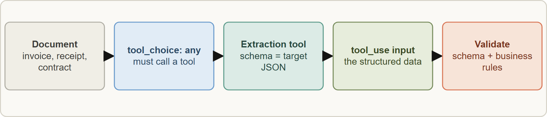
Structured Output with Tool Use, continued
DATES
Module 10
In current API documentation, any and forced tool are rejected (400 error) on some newer models and with manual extended thinking. The documented alternatives are `strict: true` on the tool (inputs guaranteed to match the schema) with auto, or structured outputs (output_config.format with a JSON schema). The exam guide teaches tool use with "any" and forced selection; answer as the guide does. As of 8 November 2026.
In current API documentation, any and forced tool are rejected (400 error) on some newer models and with manual extended thinking. The documented alternatives are `strict: true` on the tool (inputs guaranteed to match the schema) with auto, or structured outputs (output_config.format with a JSON schema). The exam guide teaches tool use with "any" and forced selection; answer as the guide does. As of 8 November 2026.
Claude Architect Foundations Exam Prep | for the CCAR-F exam
Module 10
6 / 25
Notes:
Structured Output with Tool Use, continued.
The figure shows this: Extraction with tool use: the model fills a schema through a tool call; tool choice any guarantees a tool call when the document type is unknown.
In current A P I (application programming interface) documentation, any and forced tool are rejected (four hundred error) on some newer models and with manual extended thinking. The documented alternatives are strict: true on the tool (inputs guaranteed to match the schema) with auto, or structured outputs (output config.format with a Jason schema). The exam guide teaches tool use with "any" and forced selection; answer as the guide does. As of eight November two thousand twenty-six.

Slide 7
What a schema does not guarantee
Module 10
 | Syntax errors (broken JSON, wrong types, missing required keys) | Semantic errors (valid JSON, wrong meaning)
Examples | Unclosed brace, string instead of number | Line items do not sum to the total; a value placed in the wrong field
Tool use / strict schema | Eliminated | Not prevented
Handle with | The schema itself | Validation code and self-check fields
Claude Architect Foundations Exam Prep | for the CCAR-F exam
Module 10
7 / 25
Notes:
What a schema does not guarantee.
Examples. Syntax errors (broken Jason, wrong types, missing required keys): Unclosed brace, string instead of number. Semantic errors (valid Jason, wrong meaning): Line items do not sum to the total; a value placed in the wrong field.
Tool use or strict schema. Syntax errors (broken Jason, wrong types, missing required keys): Eliminated. Semantic errors (valid Jason, wrong meaning): Not prevented.
Handle with. Syntax errors (broken Jason, wrong types, missing required keys): The schema itself. Semantic errors (valid Jason, wrong meaning): Validation code and self-check fields.

Slide 8
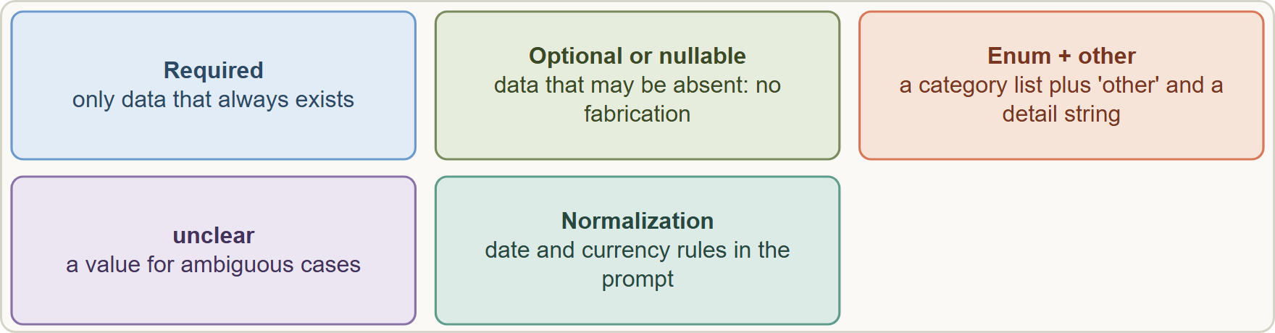
Schema design rules
Module 10
Make a field optional or nullable when the document may not contain it. If a field is required, the model may fabricate a value to satisfy the schema.
Use enums for categories, with an `"other"` value plus a detail string so new categories do not break the schema.
Make a field optional or nullable when the document may not contain it. If a field is required, the model may fabricate a value to satisfy the schema.
Use enums for categories, with an `"other"` value plus a detail string so new categories do not break the schema.
Claude Architect Foundations Exam Prep | for the CCAR-F exam
Module 10
8 / 25
Notes:
Schema design rules.
The figure shows this: Schema design: nullable fields prevent fabrication, enums with other plus detail allow growth, unclear handles ambiguity.
Make a field optional or nullable when the document may not contain it. If a field is required, the model may fabricate a value to satisfy the schema.
Use enums for categories, with an "other" value plus a detail string so new categories do not break the schema.

Slide 9
Schema design rules, continued
Module 10
Add an `"unclear"` value for genuinely ambiguous cases.
Put format normalization rules in the prompt (dates as YYYY-MM-DD, currency as numbers) alongside the strict schema, to handle inconsistent source formatting.
Claude Architect Foundations Exam Prep | for the CCAR-F exam
Module 10
9 / 25
Notes:
Schema design rules, continued.
Add an "unclear" value for genuinely ambiguous cases.
Put format normalization rules in the prompt (dates as year, month, day, currency as numbers) alongside the strict schema, to handle inconsistent source formatting.

Slide 10
Schema design rules, continued
Module 10
JSON
{
"name": "extract_invoice",
"description": "Extract fields from ONE supplier invoice. Use null for anything not in the document.",
"input_schema": {
"type": "object",
"properties": {
"supplier": {"type": "string"},
"invoice_date": {"type": ["string", "null"], "description": "YYYY-MM-DD"},
"category": {"type": "string", "enum": ["goods", "freight", "services", "other", "unclear"]},
"category_other": {"type": ["string", "null"]},
"stated_total": {"type": ["number", "null"]},
"calculated_total": {"type": ["number", "null"]}
},
"required": ["supplier", "category"]
}
}
Example from the study note (names are examples)
EXAM TIP A field that may be missing must be nullable: a required field invites fabricated values.
Claude Architect Foundations Exam Prep | for the CCAR-F exam
Module 10
10 / 25
Notes:
Schema design rules, continued.
The example is on the screen; read it line by line when you study.
Exam tip: A field that may be missing must be nullable: a required field invites fabricated values.
Exam tip: Guaranteed structure with an unknown document type means tool use with tool choice: "any" and one schema per type.

Slide 11
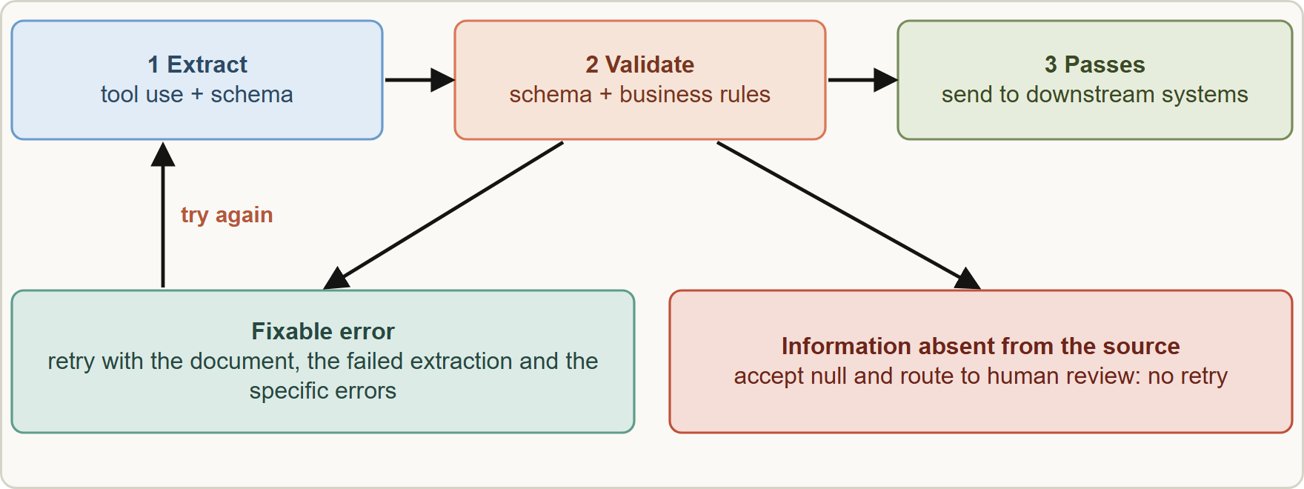
Validation, Retry and Feedback Loops
Module 10
Retry with error feedback: send the document, the failed extraction and the exact validation errors; do not retry when the data is simply not in the source
Claude Architect Foundations Exam Prep | for the CCAR-F exam
Module 10
11 / 25
Notes:
Validation, Retry and Feedback Loops.
The figure shows this: Retry with error feedback: send the document, the failed extraction and the exact validation errors; do not retry when the data is simply not in the source.

Slide 12
Validation, Retry and Feedback Loops, continued
Module 10
Concept | Detail
Retry with error feedback | Send a follow-up request with the original document, the failed extraction and the specific validation errors, so the model can correct itself
When retry works | Format mismatches, structural output errors, wrong field placement
When retry does not work | The information is absent from the source (for example it lives in an external document that was not provided): another try only invites invention
Semantic validation | Check sums, ranges, cross-field rules; with Pydantic or JSON Schema plus business rules
Claude Architect Foundations Exam Prep | for the CCAR-F exam
Module 10
12 / 25
Notes:
Validation, Retry and Feedback Loops, continued.
Retry with error feedback. Send a follow-up request with the original document, the failed extraction and the specific validation errors, so the model can correct itself.
When retry works. Format mismatches, structural output errors, wrong field placement.
When retry does not work. The information is absent from the source (for example it lives in an external document that was not provided): another try only invites invention.
Semantic validation. Check sums, ranges, cross-field rules; with Pydantic or Jason Schema plus business rules.

Slide 13
Validation, Retry and Feedback Loops, continued
Module 10
Concept | Detail
Self-correction fields | Extract `calculated_total` next to `stated_total` to flag discrepancies; add a `conflict_detected` boolean when the source data is inconsistent
Feedback loop on findings | Add a `detected_pattern` field (which construct triggered the finding) so you can analyze which patterns developers dismiss and fix false positives systematically
EXAM TIP Validation failed because "the invoice does not list the shipping address anywhere"? → do not retry; accept null and route to review. Validation failed because "dates are in the wrong format"? → retry with the error message.
Claude Architect Foundations Exam Prep | for the CCAR-F exam
Module 10
13 / 25
Notes:
Validation, Retry and Feedback Loops, continued.
Self-correction fields. Extract calculated total next to stated total to flag discrepancies; add a conflict detected boolean when the source data is inconsistent.
Feedback loop on findings. Add a detected pattern field (which construct triggered the finding) so you can analyze which patterns developers dismiss and fix false positives systematically.
Exam tip: Validation failed because "the invoice does not list the shipping address anywhere"? to do not retry; accept null and route to review. Validation failed because "dates are in the wrong format"? to retry with the error message.

Slide 14
Module Recap
Module 10
1
Structured output
2
tool_choice
3
Not prevented
Tool use + JSON schema; read the tool_use input; eliminates syntax errors
auto may return text · any must call a tool (unknown type, several schemas) · forced = a named tool first
Semantic errors (totals, wrong fields) → validation code
4
Schema design
5
Retry with feedback
6
Retry limits
Optional/nullable if possibly absent · enum + `other` + detail · `unclear` · normalization rules in the prompt
Useless when info is absent; works for format/structure errors
Document + failed output + specific errors
7
Self-check
calculated_total vs stated_total · conflict_detected · detected_pattern
Claude Architect Foundations Exam Prep | for the CCAR-F exam
Module 10
14 / 25
Notes:
Here is the recap.
Structured output: Tool use plus Jason schema; read the tool use input; eliminates syntax errors.
tool choice: auto may return text, any must call a tool (unknown type, several schemas), forced equals a named tool first.
Not prevented: Semantic errors (totals, wrong fields) to validation code.
Schema design: Optional or nullable if possibly absent, enum plus other plus detail, unclear, normalization rules in the prompt.
Retry with feedback: Document plus failed output plus specific errors.
Retry limits: Useless when info is absent; works for format or structure errors.
Self-check: calculated total versus stated total, conflict detected, detected pattern.

Slide 15
Practice Question 1
Module 10
Q1
A pipeline asks Claude for JSON in plain text and sometimes receives malformed output. What is the most reliable fix?
A
Retry until the JSON parses
B
Strip the extra text around the JSON with regular expressions and parse the rest
C
Define an extraction tool with a JSON schema and read the tool_use input
D
Ask politely for valid JSON
Claude Architect Foundations Exam Prep | for the CCAR-F exam
Module 10
15 / 25
Notes:
Question one.
A pipeline asks Claude for Jason in plain text and sometimes receives malformed output. What is the most reliable fix?
The four options are on the screen.
[PAUSE 12]
The answer is C. Tool use with a schema eliminates Jason syntax errors.

Slide 16
Practice Question 2
Module 10
Q2
The pipeline receives invoices, receipts and contracts, each with its own extraction tool, and the type is unknown beforehand. Claude sometimes answers in prose. Which setting is right?
A
tool_choice: "any"
B
No tools
C
Forced selection of the invoice tool
D
tool_choice: "auto"
Claude Architect Foundations Exam Prep | for the CCAR-F exam
Module 10
16 / 25
Notes:
Question two.
The pipeline receives invoices, receipts and contracts, each with its own extraction tool, and the type is unknown beforehand. Claude sometimes answers in prose. Which setting is right?
The four options are on the screen.
[PAUSE 12]
The answer is A. "any" guarantees a tool call while letting Claude choose the schema that matches the document.

Slide 17
Practice Question 3
Module 10
Q3
A required purchase_order field is filled with plausible but made-up numbers for invoices that have none. What is the best schema change?
A
Shorten the field name so that the model is less tempted to fill it
B
Remove validation
C
Add a second required field that holds the same purchase order number
D
Make the field optional or nullable
Claude Architect Foundations Exam Prep | for the CCAR-F exam
Module 10
17 / 25
Notes:
Question three.
A required purchase order field is filled with plausible but made-up numbers for invoices that have none. What is the best schema change?
The four options are on the screen.
[PAUSE 12]
The answer is D. A required field pushes the model to fabricate a value; a nullable field lets it say "not present".

Slide 18
Practice Question 4
Module 10
Q4
The category enum has four values, but suppliers sometimes bring new kinds of charges. How should the schema evolve?
A
Make it free text
B
Add an "other" value with a detail string
C
Remove the enum and let the model answer every category as plain text
D
Reject any invoice whose category is not in the existing list of four values
Claude Architect Foundations Exam Prep | for the CCAR-F exam
Module 10
18 / 25
Notes:
Question four.
The category enum has four values, but suppliers sometimes bring new kinds of charges. How should the schema evolve?
The four options are on the screen.
[PAUSE 12]
The answer is B. "other" plus a detail string keeps structure while allowing new categories.

Slide 19
Practice Question 5
Module 10
Q5
Tool use with a strict schema produces valid JSON, yet line items do not add up to the stated total on some invoices. What does this show?
A
Schemas remove syntax errors but not semantic errors, so add validation code
B
The model must be retrained
C
The schema must be made looser
D
Strict schemas also check arithmetic across fields, so the totals must already be right
Claude Architect Foundations Exam Prep | for the CCAR-F exam
Module 10
19 / 25
Notes:
Question five.
Tool use with a strict schema produces valid Jason, yet line items do not add up to the stated total on some invoices. What does this show?
The four options are on the screen.
[PAUSE 12]
The answer is A. Semantic errors need extra validation, for example comparing a calculated total with the stated one.

Slide 20
Practice Question 6
DATES
Module 10
Q6
A date field fails validation because the model returned "7 Jan 2026" and the schema expects YYYY-MM-DD. What is the best retry?
A
Ask a human immediately
B
Skip validation
C
Send a follow-up with the original document, the failed extraction and the specific validation error
D
Resend the exact same request unchanged, because the model will probably return a different format
Claude Architect Foundations Exam Prep | for the CCAR-F exam
Module 10
20 / 25
Notes:
Question six.
A date field fails validation because the model returned "seven Jan two thousand twenty-six" and the schema expects year, month, day. What is the best retry?
The four options are on the screen.
[PAUSE 12]
The answer is C. Format errors are fixable when the model is shown exactly what failed.

Slide 21
Practice Question 7
Module 10
Q7
Validation fails because a purchase order number is simply not in the document the pipeline has; it lives in a separate email. What should the pipeline do?
A
Accept a null value and route the document to human review or retrieval
B
Retry five times with stricter wording and a lower temperature on each attempt
C
Let the model guess
D
Add the field to the prompt in capitals
Claude Architect Foundations Exam Prep | for the CCAR-F exam
Module 10
21 / 25
Notes:
Question seven.
Validation fails because a purchase order number is simply not in the document the pipeline has; it lives in a separate email. What should the pipeline do?
The four options are on the screen.
[PAUSE 12]
The answer is A. Retry is ineffective when information is absent from the source.

Slide 22
Practice Question 8
Module 10
Q8
A team wants to understand which code patterns produce findings that developers dismiss. What should they add to the structured output?
A
A longer description field
B
A timestamp only
C
A random identifier
D
A detected_pattern field recording which construct triggered each finding
Claude Architect Foundations Exam Prep | for the CCAR-F exam
Module 10
22 / 25
Notes:
Question eight.
A team wants to understand which code patterns produce findings that developers dismiss. What should they add to the structured output?
The four options are on the screen.
[PAUSE 12]
The answer is D. Tracking the triggering pattern enables systematic analysis of dismissals.

Slide 23
Practice Question 9
Module 10
Q9
Which TWO schema choices reduce fabricated values? (Select TWO.)
A
Make fields nullable when the data may be absent
B
Add an unclear value for ambiguous cases
C
Forbid null values
D
Remove all field descriptions
E
Make every field required
Claude Architect Foundations Exam Prep | for the CCAR-F exam
Module 10
23 / 25
Notes:
Question nine. Select two.
Which two schema choices reduce fabricated values?
The five options are on the screen.
[PAUSE 15]
The answers are A and B. Nullable fields and an explicit unclear value give the model an honest way to answer. Required fields and forbidding null push it to invent values.

Slide 24
Practice Question 10
Module 10
Q10
Which TWO validation failures can retry-with-error-feedback realistically fix? (Select TWO.)
A
An unreadable scan with no text at all
B
A field the document never contained
C
A number placed in the wrong field
D
A date returned in the wrong format
E
A value that exists only in a document that was not provided
Claude Architect Foundations Exam Prep | for the CCAR-F exam
Module 10
24 / 25
Notes:
Question ten. Select two.
Which two validation failures can retry-with-error-feedback realistically fix?
The five options are on the screen.
[PAUSE 15]
The answers are C and D. Format and structural mistakes can be corrected when the model sees the exact error. Absent information cannot be retried into existence.

Slide 25
Answers at a Glance
Module 10
Question | Answer | Why
Q1 | C | Tool use with a schema eliminates JSON syntax
Q2 | A | "any" guarantees a tool call while letting Claude
Q3 | D | A required field pushes the model to fabricate
Q4 | B | "other" plus a detail string keeps structure while
Q5 | A | Semantic errors need extra validation
Q6 | C | Format errors are fixable when the model is
Q7 | A | Retry is ineffective when information is absent from
Q8 | D | Tracking the triggering pattern enables systematic analysis of
Q9 | A, B | Nullable fields and an explicit unclear value give
Q10 | C, D | Format and structural mistakes can be corrected when
Claude Architect Foundations Exam Prep | for the CCAR-F exam
Module 10
25 / 25
Notes:
Here are all ten answers. Question one: C. Question two: A. Question three: D. Question four: B. Question five: A. Question six: C. Question seven: A. Question eight: D. Question nine: A and B. Question ten: C and D.
In the next module, we continue the course.

