Slide 1
Module 11: Batch Processing and Multi-Pass Review
The Message Batches API: 50% cost savings, up to 24 hours, no latency guarantee
Domain 4 · Prompt Engineering and Structured Output · Task statements 4.5 and 4.6
Claude Architect Foundations Exam Prep Masterclass
Module 11
Notes:
Welcome to Module eleven: Batch Processing and Multi-Pass Review. This module covers task statements four point five and four point six: batch processing and multi-pass review.
Each part of this module comes from the study notes of the same name, so you can read the notes after you watch.

Slide 2
What You Will Learn
Module 11
The Message Batches API: 50% cost savings, up to 24 hours, no latency guarantee, `custom_id`
Which workflows are batch-friendly and which are blocking
SLA arithmetic for submission windows, and how to resubmit failures
Self-review limits, independent instances, multi-pass reviews and confidence-based routing
Claude Architect Foundations Exam Prep | for the CCAR-F exam
Module 11: Batch Processing and Multi-Pass Review
2 / 25
Notes:
By the end of this module you will be able to do four things.
The Message Batches A P I (application programming interface): fifty percent cost savings, up to twenty-four hours, no latency guarantee, custom id.
Which workflows are batch-friendly and which are blocking.
S L A (service level agreement) arithmetic for submission windows, and how to resubmit failures.
Self-review limits, independent instances, multi-pass reviews and confidence-based routing.

Slide 3
Case Check-In: Birchwood Supply Wants a Smaller Bill
Module 11
CASE CHECK-IN · Birchwood Supply
Two Claude workflows run in real time: (1) a live chat translator that customers wait on, and (2) a weekly refresh of 40,000 product descriptions that is published on Monday
The finance team says: "Move both to the batch API and save 50%"
Claude Architect Foundations Exam Prep | for the CCAR-F exam
Module 11: Batch Processing and Multi-Pass Review
3 / 25
Notes:
Our running case is Birchwood Supply. Birchwood Supply Wants a Smaller Bill.
Two Claude workflows run in real time: (one) a live chat translator that customers wait on, and (two) a weekly refresh of forty thousand product descriptions that is published on Monday.
The finance team says: "Move both to the batch A P I and save fifty percent".

Slide 4
The Message Batches API
Module 11
Fact | Detail
Saving | 50% of the standard price
Time | Results within up to 24 hours; many batches finish much sooner, but there is no guaranteed latency SLA
Matching (correlating) request and response pairs | `custom_id` on each request (unique, 1 to 64 characters); results may come back in any order
Flow | Create the batch → poll its status until it has ended → read results by custom_id
Tool calls | A batch request is one model call: the API cannot run a tool mid-request and send the result back (no multi-turn tool calling inside a single request)
Claude Architect Foundations Exam Prep | for the CCAR-F exam
Module 11: Batch Processing and Multi-Pass Review
4 / 25
Notes:
The Message Batches A P I.
Saving. fifty percent of the standard price.
Time. Results within up to twenty-four hours; many batches finish much sooner, but there is no guaranteed latency S L A.
Matching (correlating) request and response pairs. custom id on each request (unique, one to sixty-four characters); results may come back in any order.
Flow. Create the batch to poll its status until it has ended to read results by custom id.
Tool calls. A batch request is one model call: the A P I cannot run a tool mid-request and send the result back (no multi-turn tool calling inside a single request).

Slide 5
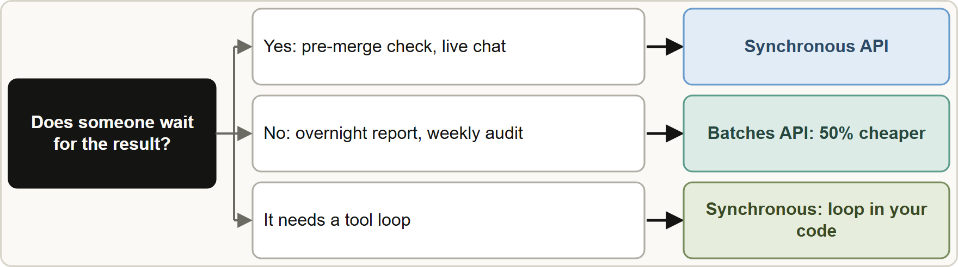
The Message Batches API, continued
Module 11
Match the API to the latency need: synchronous for blocking steps, batch for latency-tolerant work
Claude Architect Foundations Exam Prep | for the CCAR-F exam
Module 11: Batch Processing and Multi-Pass Review
5 / 25
Notes:
The Message Batches A P I, continued.
The figure shows this: Match the A P I to the latency need: synchronous for blocking steps, batch for latency-tolerant work.

Slide 6
The Message Batches API, continued
Module 11
Workflow | API
Live chat translation, pre-merge check (a person waits) | Synchronous
Weekly product-description refresh, overnight technical-debt report | Batch
Weekly audit of documents | Batch
Nightly test generation | Batch
Anything that needs an agentic tool loop | Synchronous (loop in your code)
EXAM TIP "50% cheaper" is not a reason to batch a blocking workflow. "Often finishes faster" is not an SLA.
Claude Architect Foundations Exam Prep | for the CCAR-F exam
Module 11: Batch Processing and Multi-Pass Review
6 / 25
Notes:
The Message Batches A P I, continued.
Live chat translation, pre-merge check (a person waits). Synchronous.
Weekly product-description refresh, overnight technical-debt report. Batch.
Weekly audit of documents. Batch.
Nightly test generation. Batch.
Anything that needs an agentic tool loop. Synchronous (loop in your code).
Exam tip: "fifty percent cheaper" is not a reason to batch a blocking workflow. "Often finishes faster" is not an S L A.

Slide 7
The Message Batches API, continued
DATES
Module 11
Current documentation: most batches finish within an hour; results are available when all requests have finished or after 24 hours; a batch holds up to 100,000 requests or 256 MB; results stay downloadable for 29 days. A batch may include requests that define tools, but each request still ends after one response, so there is no tool-execution round trip. As of 8 November 2026.
Claude Architect Foundations Exam Prep | for the CCAR-F exam
Module 11: Batch Processing and Multi-Pass Review
7 / 25
Notes:
The Message Batches A P I, continued.
Current documentation: most batches finish within an hour; results are available when all requests have finished or after twenty-four hours; a batch holds up to one hundred thousand requests or two hundred fifty-six megabytes; results stay downloadable for twenty-nine days. A batch may include requests that define tools, but each request still ends after one response, so there is no tool-execution round trip. As of eight November two thousand twenty-six.

Slide 8
Planning against an SLA
Module 11
Worst case wait = time until the next submission + the 24-hour processing window.
Example: data must be processed within a 30-hour SLA. If you submit a batch every 4 hours, the worst case is 4 + 24 = 28 hours, which meets the SLA with margin. Submitting once a day (24 + 24 = 48 hours) does not.
Claude Architect Foundations Exam Prep | for the CCAR-F exam
Module 11: Batch Processing and Multi-Pass Review
8 / 25
Notes:
Planning against an S L A.
Worst case wait equals time until the next submission plus the twenty-four-hour processing window.
Example: data must be processed within a thirty-hour S L A. If you submit a batch every four hours, the worst case is four plus twenty-four equals twenty-eight hours, which meets the S L A with margin. Submitting once a day (twenty-four plus twenty-four equals forty-eight hours) does not.

Slide 9
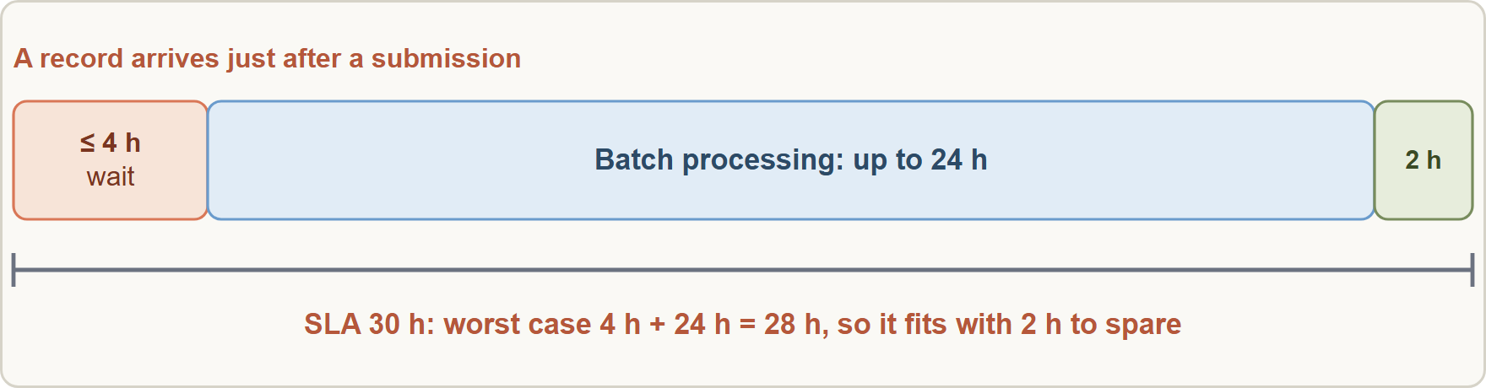
Planning against an SLA, continued
Module 11
SLA arithmetic: submission interval plus the 24-hour processing window must fit inside the SLA
Claude Architect Foundations Exam Prep | for the CCAR-F exam
Module 11: Batch Processing and Multi-Pass Review
9 / 25
Notes:
Planning against an S L A, continued.
The figure shows this: S L A arithmetic: submission interval plus the twenty-four-hour processing window must fit inside the S L A.

Slide 10
Handling failures and improving first-pass success
Module 11
Some requests in a batch may fail (for example a document too long for the context window). Resubmit only the failed ones, found by custom_id, with changes such as chunking the oversized document.
Refine the prompt on a small sample first before submitting thousands of documents, to maximize first-pass success and reduce the cost of iterative resubmission.
EXAM TIP A blocking step (someone waits) is never a batch job; compute the interval as interval + 24 hours ≤ SLA.
Claude Architect Foundations Exam Prep | for the CCAR-F exam
Module 11: Batch Processing and Multi-Pass Review
10 / 25
Notes:
Handling failures and improving first-pass success.
Some requests in a batch may fail (for example a document too long for the context window). Resubmit only the failed ones, found by custom id, with changes such as chunking the oversized document.
Refine the prompt on a small sample first before submitting thousands of documents, to maximize first-pass success and reduce the cost of iterative resubmission.
Exam tip: A blocking step (someone waits) is never a batch job; compute the interval as interval plus twenty-four hours at most S L A.

Slide 11
Why self-review is weak
Module 11
A model that just produced code retains its reasoning context, so in the same session it is less likely to question its own decisions.
An independent review instance (no prior reasoning context) is more effective at catching subtle issues than telling the same session to "review carefully" or turning on extended thinking.
Claude Architect Foundations Exam Prep | for the CCAR-F exam
Module 11: Batch Processing and Multi-Pass Review
11 / 25
Notes:
Why self-review is weak.
A model that just produced code retains its reasoning context, so in the same session it is less likely to question its own decisions.
An independent review instance (no prior reasoning context) is more effective at catching subtle issues than telling the same session to "review carefully" or turning on extended thinking.

Slide 12
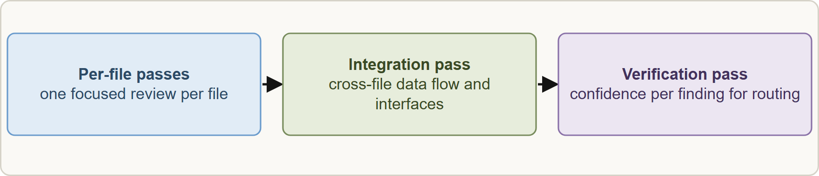
Multi-pass review
Module 11
Multi-pass review: per-file local passes, one cross-file integration pass, and a verification pass with confidence for routing
Claude Architect Foundations Exam Prep | for the CCAR-F exam
Module 11: Batch Processing and Multi-Pass Review
12 / 25
Notes:
Multi-pass review.
The figure shows this: Multi-pass review: per-file local passes, one cross-file integration pass, and a verification pass with confidence for routing.

Slide 13
Multi-pass review, continued
Module 11
Pass | Purpose
Per-file local passes | Consistent depth on each file; avoids attention dilution
Cross-file integration pass | Cross-file data flow and interface issues
Verification pass | The model self-reports a confidence for each finding, enabling calibrated routing (low-confidence findings to human review)
EXAM TIP "Run it three times and keep only findings that appear twice" hides real bugs that a single run catches only sometimes. Prefer independent, differently scoped passes.
Claude Architect Foundations Exam Prep | for the CCAR-F exam
Module 11: Batch Processing and Multi-Pass Review
13 / 25
Notes:
Multi-pass review, continued.
Per-file local passes. Consistent depth on each file; avoids attention dilution.
Cross-file integration pass. Cross-file data flow and interface issues.
Verification pass. The model self-reports a confidence for each finding, enabling calibrated routing (low-confidence findings to human review).
Exam tip: "Run it three times and keep only findings that appear twice" hides real bugs that a single run catches only sometimes. Prefer independent, differently scoped passes.

Slide 14
Module Recap
Module 11
1
Batches API
2
Good for
3
Bad for
50% cheaper · up to 24 h · no latency SLA · custom_id · poll for completion
Overnight reports, weekly audits, nightly test generation
Blocking work (pre-merge checks) and agentic tool loops
4
SLA math
5
Failures
6
Before volume
Interval + 24 h ≤ SLA (4 h + 24 h = 28 h ≤ 30 h)
Resubmit only failed custom_ids, chunk oversized docs
Tune the prompt on a sample
7
Self-review
8
Better
Weak: generator keeps its reasoning
Independent instance · per-file passes + integration pass · verification pass with confidence for routing
Claude Architect Foundations Exam Prep | for the CCAR-F exam
Module 11: Batch Processing and Multi-Pass Review
14 / 25
Notes:
Here is the recap.
Batches A P I: fifty percent cheaper, up to twenty-four h, no latency S L A, custom id, poll for completion.
Good for: Overnight reports, weekly audits, nightly test generation.
Bad for: Blocking work (pre-merge checks) and agentic tool loops.
S L A math: Interval plus twenty-four h at most S L A (four h plus twenty-four h equals twenty-eight h at most thirty h).
Failures: Resubmit only failed custom ids, chunk oversized docs.
Before volume: Tune the prompt on a sample.
Self-review: Weak: generator keeps its reasoning.
Better: Independent instance, per-file passes plus integration pass, verification pass with confidence for routing.

Slide 15
Practice Question 1
Module 11
Q1
The company proposes moving both the live chat translator and the weekly description refresh to the Message Batches API for the 50% saving. What is the best evaluation?
A
Batch both and poll for completion
B
Batch both and fall back to real time if a batch is slow
C
Keep both synchronous
D
Batch the weekly refresh; keep the live translator on the synchronous API
Claude Architect Foundations Exam Prep | for the CCAR-F exam
Module 11: Batch Processing and Multi-Pass Review
15 / 25
Notes:
Question one.
The company proposes moving both the live chat translator and the weekly description refresh to the Message Batches A P I for the fifty percent saving. What is the best evaluation?
The four options are on the screen.
[PAUSE 12]
The answer is D. Batches may take up to twenty-four hours with no guaranteed latency, which suits the weekly refresh but not a customer who is waiting. The fallback design adds complexity that matching each workflow to the right A P I avoids.

Slide 16
Practice Question 2
Module 11
Q2
What identifies which batch result belongs to which request?
A
The title of the document that each request was built from
B
The order in which the results come back from the API
C
The timestamp
D
The custom_id set on each request
Claude Architect Foundations Exam Prep | for the CCAR-F exam
Module 11: Batch Processing and Multi-Pass Review
16 / 25
Notes:
Question two.
What identifies which batch result belongs to which request?
The four options are on the screen.
[PAUSE 12]
The answer is D. Results can arrive in any order, so correlate with custom id.

Slide 17
Practice Question 3
Module 11
Q3
Records must be processed within a 30-hour SLA, and a batch takes up to 24 hours. What submission interval is safe?
A
Every 12 hours, which leaves enough margin for the 24-hour processing time
B
Whenever convenient for the team, as long as batches are eventually sent
C
Once a day
D
Every 4 hours (worst case 28 hours)
Claude Architect Foundations Exam Prep | for the CCAR-F exam
Module 11: Batch Processing and Multi-Pass Review
17 / 25
Notes:
Question three.
Records must be processed within a thirty-hour S L A, and a batch takes up to twenty-four hours. What submission interval is safe?
The four options are on the screen.
[PAUSE 12]
The answer is D. Worst-case wait is the interval plus twenty-four hours; four plus twenty-four equals twenty-eight fits inside thirty. The other intervals break the S L A.

Slide 18
Practice Question 4
Module 11
Q4
In a batch of 500 supplier contracts, eight fail because they exceed the context limit. What is the best response?
A
Resubmit the whole batch
B
Drop them silently
C
Resubmit only the eight failed documents (by custom_id), chunked
D
Switch all documents to the synchronous API and drop the batch entirely
Claude Architect Foundations Exam Prep | for the CCAR-F exam
Module 11: Batch Processing and Multi-Pass Review
18 / 25
Notes:
Question four.
In a batch of five hundred supplier contracts, eight fail because they exceed the context limit. What is the best response?
The four options are on the screen.
[PAUSE 12]
The answer is C. Resubmit failures only, with a modification that addresses the cause.

Slide 19
Practice Question 5
Module 11
Q5
Before running 20,000 documents through a batch, what should the team do to reduce rework?
A
Increase the batch size
B
Submit everything and fix problems afterwards
C
Use the largest possible prompt
D
Refine the prompt on a representative sample first
Claude Architect Foundations Exam Prep | for the CCAR-F exam
Module 11: Batch Processing and Multi-Pass Review
19 / 25
Notes:
Question five.
Before running twenty thousand documents through a batch, what should the team do to reduce rework?
The four options are on the screen.
[PAUSE 12]
The answer is D. Prompt refinement on a sample maximizes first-pass success and avoids expensive iterative resubmission.

Slide 20
Practice Question 6
Module 11
Q6
Why can a batch request not drive a full agentic tool loop?
A
Tools are always disabled
B
Batches are too small
C
Batch requests only support plain text, so tool definitions are rejected outright
D
A request is a single model call, so tools cannot be executed mid-request and their results sent back
Claude Architect Foundations Exam Prep | for the CCAR-F exam
Module 11: Batch Processing and Multi-Pass Review
20 / 25
Notes:
Question six.
Why can a batch request not drive a full agentic tool loop?
The four options are on the screen.
[PAUSE 12]
The answer is D. A tool round trip needs another request; a batch request ends after one response.

Slide 21
Practice Question 7
Module 11
Q7
The same session that wrote a function reviews it and reports "no issues", yet a colleague finds a subtle bug. What is the best architecture?
A
Switch off reviews
B
Review only the formatting
C
Ask the same session to think harder and turn on extended thinking for the review
D
Use an independent Claude instance that lacks the generator's reasoning
Claude Architect Foundations Exam Prep | for the CCAR-F exam
Module 11: Batch Processing and Multi-Pass Review
21 / 25
Notes:
Question seven.
The same session that wrote a function reviews it and reports "no issues", yet a colleague finds a subtle bug. What is the best architecture?
The four options are on the screen.
[PAUSE 12]
The answer is D. The generator's reasoning context makes self-review less critical; an independent instance catches more.

Slide 22
Practice Question 8
Module 11
Q8
A team wants to send only uncertain review findings to a human. Which design supports that?
A
Randomly sampling findings
B
Sending everything to humans so that no finding is ever missed or ignored
C
A verification pass in which the model reports a confidence per finding
D
Sending nothing to humans
Claude Architect Foundations Exam Prep | for the CCAR-F exam
Module 11: Batch Processing and Multi-Pass Review
22 / 25
Notes:
Question eight.
A team wants to send only uncertain review findings to a human. Which design supports that?
The four options are on the screen.
[PAUSE 12]
The answer is C. Per-finding confidence enables routing of limited human attention (with calibration, covered in Module fourteen).

Slide 23
Practice Question 9
Module 11
Q9
Which TWO workloads suit the Message Batches API? (Select TWO.)
A
A live customer chat
B
An approval step a person is waiting on
C
An overnight technical-debt report
D
A pre-merge check that blocks developers
E
A weekly audit of supplier contracts
Claude Architect Foundations Exam Prep | for the CCAR-F exam
Module 11: Batch Processing and Multi-Pass Review
23 / 25
Notes:
Question nine. Select two.
Which two workloads suit the Message Batches A P I?
The five options are on the screen.
[PAUSE 15]
The answers are C and E. Batches suit latency-tolerant, non-blocking jobs. Anything a person or process waits on needs the synchronous A P I.

Slide 24
Practice Question 10
Module 11
Q10
Which TWO practices strengthen a multi-pass review design? (Select TWO.)
A
Per-file local passes plus a cross-file integration pass
B
Using an independent review instance
C
Keeping only findings reported in at least two of three runs
D
One single pass over every changed file
E
Asking the same session to review its own work with extended thinking
Claude Architect Foundations Exam Prep | for the CCAR-F exam
Module 11: Batch Processing and Multi-Pass Review
24 / 25
Notes:
Question ten. Select two.
Which two practices strengthen a multi-pass review design?
The five options are on the screen.
[PAUSE 15]
The answers are A and B. Focused passes and an independent instance counter attention dilution and self-review bias. Consensus filtering hides real findings.

Slide 25
Answers at a Glance
Module 11
Question | Answer | Why
Q1 | D | Batches may take up to 24 hours with
Q2 | D | Results can arrive in any order
Q3 | D | Worst-case wait is the interval plus 24 hours
Q4 | C | Resubmit failures only, with a modification that addresses
Q5 | D | Prompt refinement on a sample maximizes first-pass success
Q6 | D | A tool round trip needs another request
Q7 | D | The generator's reasoning context makes self-review less critical
Q8 | C | Per-finding confidence enables routing of limited human attention
Q9 | C, E | Batches suit latency-tolerant, non-blocking jobs
Q10 | A, B | Focused passes and an independent instance counter attention
Claude Architect Foundations Exam Prep | for the CCAR-F exam
Module 11: Batch Processing and Multi-Pass Review
25 / 25
Notes:
Here are all ten answers. Question one: D. Question two: D. Question three: D. Question four: C. Question five: D. Question six: D. Question seven: D. Question eight: C. Question nine: C and E. Question ten: A and B.
In the next module, we continue the course.

