Slide 1
Module 12: Context Management and Large Codebase Exploration
Progressive summarization risks and the "case facts" block
Domain 5 · Context Management and Reliability · Task statements 5.1 and 5.4
Claude Architect Foundations Exam Prep Masterclass
Module 12
Notes:
Welcome to Module twelve: Context Management and Large Codebase Exploration. This module covers task statements five point one and five point four: context management and large codebase exploration.
Each part of this module comes from the study notes of the same name, so you can read the notes after you watch.

Slide 2
What You Will Learn
Module 12
Progressive summarization risks and the "case facts" block
The "lost in the middle" effect and how to place information
How tool results swell the context, and how to trim them
Context degradation in long sessions, scratchpad files, subagent delegation, manifests and `/compact`
Claude Architect Foundations Exam Prep | for the CCAR-F exam
Module 12
2 / 23
Notes:
By the end of this module you will be able to do four things.
Progressive summarization risks and the "case facts" block.
The "lost in the middle" effect and how to place information.
How tool results swell the context, and how to trim them.
Context degradation in long sessions, scratchpad files, subagent delegation, manifests and slash compact.

Slide 3
Case Check-In: Birchwood Supply's Long Support Chat
Module 12
CASE CHECK-IN · Birchwood Supply
A customer chats for an hour about three issues: a late order, a duplicate charge and a damaged item
After several summarizations, the agent forgets the exact refund amount ($84.50), the promised date (12 March) and which order goes with which problem
Each lookup_order call returns 40+ fields, but only five matter for returns
Claude Architect Foundations Exam Prep | for the CCAR-F exam
Module 12
3 / 23
Notes:
Our running case is Birchwood Supply. Birchwood Supply's Long Support Chat.
A customer chats for an hour about three issues: a late order, a duplicate charge and a damaged item.
After several summarizations, the agent forgets the exact refund amount (eighty-four dollars and fifty cents), the promised date (twelve March) and which order goes with which problem.
Each lookup order call returns forty plus fields, but only five matter for returns.

Slide 4
Keeping Critical Facts Alive
Module 12
Risk | What happens | Remedy
Progressive summarization | Numbers, percentages, dates and customer-stated expectations become vague ("a refund was discussed") | Keep transactional facts in a persistent "case facts" block outside the summarized history, included in every prompt
Multi-issue sessions | Facts of different issues blend together | Extract structured issue data (order IDs, amounts, statuses) into a separate context layer
Tool-result bloat | 40+ fields per lookup eat tokens out of proportion to their value | Trim each result to the relevant fields before it accumulates
Claude Architect Foundations Exam Prep | for the CCAR-F exam
Module 12
4 / 23
Notes:
Keeping Critical Facts Alive.
Progressive summarization. What happens: Numbers, percentages, dates and customer-stated expectations become vague ("a refund was discussed"). Remedy: Keep transactional facts in a persistent "case facts" block outside the summarized history, included in every prompt.
Multi-issue sessions. What happens: Facts of different issues blend together. Remedy: Extract structured issue data (order I Ds, amounts, statuses) into a separate context layer.
Tool-result bloat. What happens: forty plus fields per lookup eat tokens out of proportion to their value. Remedy: Trim each result to the relevant fields before it accumulates.

Slide 5
Keeping Critical Facts Alive, continued
Module 12
Risk | What happens | Remedy
"Lost in the middle" | Models reliably use the beginning and end of a long input but may omit findings from the middle | Put a key-findings summary at the start; organize details under explicit section headers
Context limits of downstream agents | A verbose upstream result overruns the next agent | Have upstream agents return structured data (key facts, citations, relevance scores) instead of long text and reasoning chains
Lost provenance | Synthesis cannot tell where facts came from | Require subagents to include metadata (dates, source locations, methodological context) in structured outputs
Claude Architect Foundations Exam Prep | for the CCAR-F exam
Module 12
5 / 23
Notes:
Keeping Critical Facts Alive, continued.
"Lost in the middle". What happens: Models reliably use the beginning and end of a long input but may omit findings from the middle. Remedy: Put a key-findings summary at the start; organize details under explicit section headers.
Context limits of downstream agents. What happens: A verbose upstream result overruns the next agent. Remedy: Have upstream agents return structured data (key facts, citations, relevance scores) instead of long text and reasoning chains.
Lost provenance. What happens: Synthesis cannot tell where facts came from. Remedy: Require subagents to include metadata (dates, source locations, methodological context) in structured outputs.

Slide 6
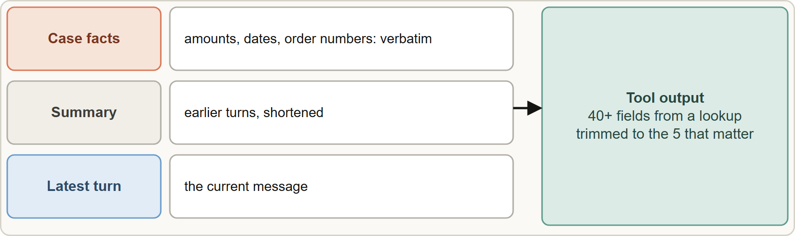
Keeping Critical Facts Alive, continued
Module 12
Keep transactional facts in a persistent case-facts block outside the summarized history, and trim tool output to the fields that matter
Claude Architect Foundations Exam Prep | for the CCAR-F exam
Module 12
6 / 23
Notes:
Keeping Critical Facts Alive, continued.
The figure shows this: Keep transactional facts in a persistent case-facts block outside the summarized history, and trim tool output to the fields that matter.

Slide 7
Keeping Critical Facts Alive, continued
Module 12
Customer: C-48213 (verified)
Issue 1: order 77102, late, promised 12 March
Issue 2: order 77102, duplicate charge $84.50, status: refund pending
Issue 3: order 77310, damaged item, photo received
TEXT
CASE FACTS (verbatim, never summarize)
- Customer: C-48213 (verified)
- Issue 1: order 77102, late, promised 12 March
- Issue 2: order 77102, duplicate charge $84.50, status: refund pending
- Issue 3: order 77310, damaged item, photo received
Example from the study note (names are examples)
Claude Architect Foundations Exam Prep | for the CCAR-F exam
Module 12
7 / 23
Notes:
Keeping Critical Facts Alive, continued.
The example is on the screen; read it line by line when you study.

Slide 8
Keeping Critical Facts Alive, continued
Module 12
The API is stateless: to keep a conversation coherent you must send the complete conversation history (plus your case-facts block) in each request to maintain conversational coherence.
Claude Architect Foundations Exam Prep | for the CCAR-F exam
Module 12
8 / 23
Notes:
Keeping Critical Facts Alive, continued.
The A P I (application programming interface) is stateless: to keep a conversation coherent you must send the complete conversation history (plus your case-facts block) in each request to maintain conversational coherence.

Slide 9
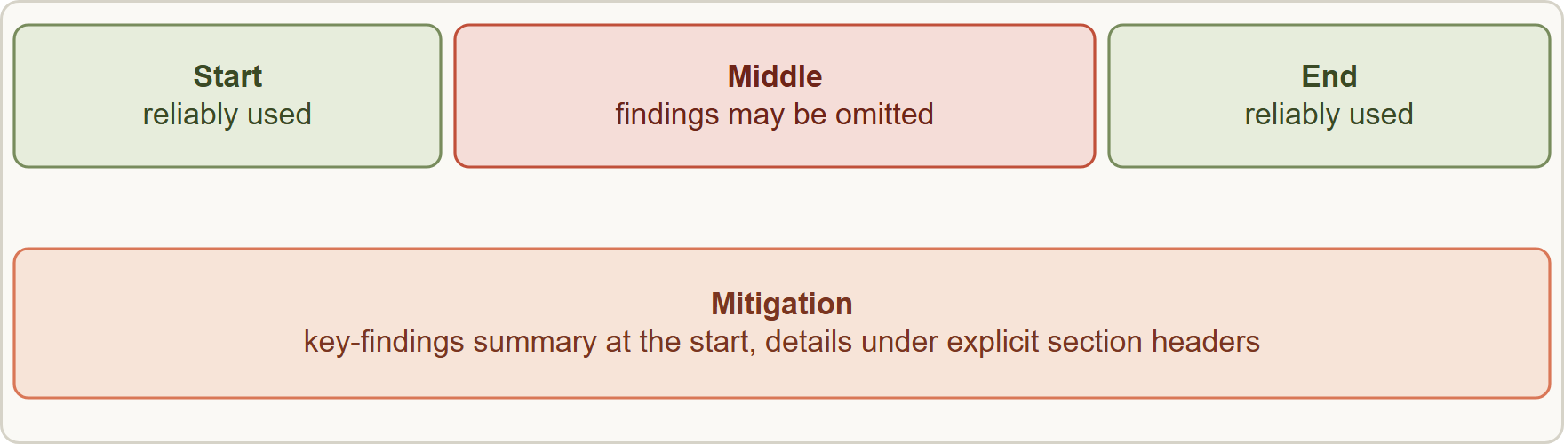
Keeping Critical Facts Alive, continued
Module 12
Position matters in long inputs: put the key findings first and structure the rest with headers so nothing is lost in the middle
EXAM TIP Customer's exact amounts and dates keep disappearing? → a persistent case-facts block outside the summary. Do not "summarize more carefully".
Claude Architect Foundations Exam Prep | for the CCAR-F exam
Module 12
9 / 23
Notes:
Keeping Critical Facts Alive, continued.
The figure shows this: Position matters in long inputs: put the key findings first and structure the rest with headers so nothing is lost in the middle.
Exam tip: Customer's exact amounts and dates keep disappearing? to a persistent case-facts block outside the summary. Do not "summarize more carefully".
Exam tip: Exact amounts and dates lost in a long chat call for a case-facts block outside the summary, not "summarize better".

Slide 10
Exploring Large Codebases
Module 12
Case (continued): An engineer explores Birchwood's 3,000-file monorepo for hours. After a while Claude begins to say "this probably uses the typical repository pattern" instead of naming the specific classes it found earlier.
Context degradation: in extended sessions the model gives inconsistent answers and refers to "typical patterns" instead of the specific classes discovered earlier.
Claude Architect Foundations Exam Prep | for the CCAR-F exam
Module 12
10 / 23
Notes:
Exploring Large Codebases.
Case (continued): An engineer explores Birchwood's three thousand-file monorepo for hours. After a while Claude begins to say "this probably uses the typical repository pattern" instead of naming the specific classes it found earlier.
Context degradation: in extended sessions the model gives inconsistent answers and refers to "typical patterns" instead of the specific classes discovered earlier.

Slide 11
Exploring Large Codebases, continued
Module 12
Technique | How it helps
Scratchpad files | The agent writes key findings to a file and references it for subsequent questions, so facts survive context boundaries
Subagent delegation | Spawn subagents for specific questions ("find all test files", "trace the refund flow's dependencies"); the verbose output stays in their context and the main agent keeps high-level coordination
Phase summaries | Summarize key findings of one phase before spawning subagents for the next, and inject the summary into their initial context
Claude Architect Foundations Exam Prep | for the CCAR-F exam
Module 12
11 / 23
Notes:
Exploring Large Codebases, continued.
Scratchpad files. The agent writes key findings to a file and references it for subsequent questions, so facts survive context boundaries.
Subagent delegation. Spawn subagents for specific questions ("find all test files", "trace the refund flow's dependencies"); the verbose output stays in their context and the main agent keeps high-level coordination.
Phase summaries. Summarize key findings of one phase before spawning subagents for the next, and inject the summary into their initial context.

Slide 12
Exploring Large Codebases, continued
Module 12
Technique | How it helps
State manifests (crash recovery) | Each agent exports its state to a known location; the coordinator loads a manifest on resume and injects the state into agent prompts
`/compact` | Reduces context usage when it fills with verbose discovery output
Claude Architect Foundations Exam Prep | for the CCAR-F exam
Module 12
12 / 23
Notes:
Exploring Large Codebases, continued.
State manifests (crash recovery). Each agent exports its state to a known location; the coordinator loads a manifest on resume and injects the state into agent prompts.
slash compact. Reduces context usage when it fills with verbose discovery output.

Slide 13
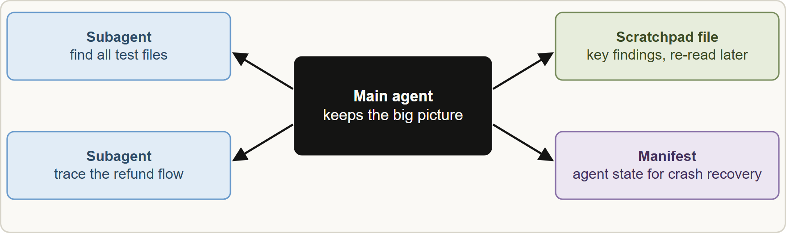
Exploring Large Codebases, continued
DATES
Module 12
Current documentation: a subagent returns only its final message to the parent, so its detailed tool calls stay out of the parent's context; when the context window nears its limit, Claude Code and the Agent SDK compact automatically (older turns are summarized), and instructions that must persist belong in CLAUDE.md, which is re-loaded. As of 8 November 2026.
Current documentation: a subagent returns only its final message to the parent, so its detailed tool calls stay out of the parent's context; when the context window nears its limit, Claude Code and the Agent SDK compact automatically (older turns are summarized), and instructions that must persist belong in CLAUDE.md, which is re-loaded. As of 8 November 2026.
EXAM TIP Long exploration drifting to "typical patterns" calls for a scratchpad file and subagents, and /compact when verbose output fills the context.
Claude Architect Foundations Exam Prep | for the CCAR-F exam
Module 12
13 / 23
Notes:
Exploring Large Codebases, continued.
The figure shows this: Large exploration: delegate verbose searching to subagents, record findings in a scratchpad, and keep a manifest so a crashed run can resume.
Current documentation: a subagent returns only its final message to the parent, so its detailed tool calls stay out of the parent's context; when the context window nears its limit, Claude Code and the Agent S D K (software development kit) compact automatically (older turns are summarized), and instructions that must persist belong in Claude dot M D, which is re-loaded. As of eight November two thousand twenty-six.
Exam tip: Long exploration drifting to "typical patterns" calls for a scratchpad file and subagents, and slash compact when verbose output fills the context.

Slide 14
Module Recap
Module 12
1
Summarization risk
2
Multi-issue
3
Tool output
Separate structured issue layer
Trim to relevant fields (5 of 40+)
Amounts, dates, expectations get vague → case-facts block outside the summary
4
Position effect
5
Upstream agents
6
Statelessness
Beginning and end are reliable; middle is not → summary first + section headers
Return structured facts, citations, relevance scores, with metadata (dates, sources)
Send the complete history each request
7
Degradation
8
Recovery
9
/compact
"Typical patterns" instead of specific classes → scratchpad, subagents, phase summaries
State exports + manifest loaded by the coordinator on resume
Reduce context when verbose discovery fills it
Claude Architect Foundations Exam Prep | for the CCAR-F exam
Module 12
14 / 23
Notes:
Here is the recap.
Summarization risk: Amounts, dates, expectations get vague to case-facts block outside the summary.
Multi-issue: Separate structured issue layer.
Tool output: Trim to relevant fields (five of forty plus ).
Position effect: Beginning and end are reliable; middle is not to summary first plus section headers.
Upstream agents: Return structured facts, citations, relevance scores, with metadata (dates, sources).
Statelessness: Send the complete history each request.
Degradation: "Typical patterns" instead of specific classes to scratchpad, subagents, phase summaries.
Recovery: State exports plus manifest loaded by the coordinator on resume.
slash compact: Reduce context when verbose discovery fills it.

Slide 15
Practice Question 1
Module 12
Q1
After many turns, Birchwood's agent forgets the exact refund amount and a promised date because earlier turns were summarized. What is the best fix?
A
Keep the amounts, dates and order numbers in a persistent case-facts block included in every prompt, outside the summarized history
B
Increase the temperature
C
Ask the summarizer to be more concise and to keep only the most important sentences of each turn
D
Delete the conversation history
Claude Architect Foundations Exam Prep | for the CCAR-F exam
Module 12
15 / 23
Notes:
Question one.
After many turns, Birchwood's agent forgets the exact refund amount and a promised date because earlier turns were summarized. What is the best fix?
The four options are on the screen.
[PAUSE 12]
The answer is A. Transactional facts must not pass through progressive summarization.

Slide 16
Practice Question 2
Module 12
Q2
A customer discusses three issues in one chat, and the agent mixes up which order has which problem. What helps?
A
Extract structured issue data into a separate context layer
B
Handle only the first issue
C
Use a longer system prompt
D
Ask the customer to start again and handle one issue per conversation
Claude Architect Foundations Exam Prep | for the CCAR-F exam
Module 12
16 / 23
Notes:
Question two.
A customer discusses three issues in one chat, and the agent mixes up which order has which problem. What helps?
The four options are on the screen.
[PAUSE 12]
The answer is A. A separate structured layer keeps each issue's facts distinct.

Slide 17
Practice Question 3
Module 12
Q3
An order lookup returns 40+ fields, but only five are relevant for returns, and the context fills quickly. What is the best approach?
A
Keep everything, in case it is needed later
B
Summarize each lookup into one sentence
C
Trim the result to the relevant fields before it is added to the context
D
Disable the tool
Claude Architect Foundations Exam Prep | for the CCAR-F exam
Module 12
17 / 23
Notes:
Question three.
An order lookup returns forty plus fields, but only five are relevant for returns, and the context fills quickly. What is the best approach?
The four options are on the screen.
[PAUSE 12]
The answer is C. Trimming keeps relevant data and prevents token waste.

Slide 18
Practice Question 4
Module 12
Q4
An aggregated research input of 30 findings is passed to a synthesis agent, which tends to omit findings from the middle. What mitigates this?
A
Send the findings one at a time, each in a separate request, and merge the answers
B
Remove the headers
C
Shuffle the findings randomly
D
Put a key-findings summary first and organize the rest under section headers
Claude Architect Foundations Exam Prep | for the CCAR-F exam
Module 12
18 / 23
Notes:
Question four.
An aggregated research input of thirty findings is passed to a synthesis agent, which tends to omit findings from the middle. What mitigates this?
The four options are on the screen.
[PAUSE 12]
The answer is D. Models attend best to the start and end; a summary first and clear headers reduce loss in the middle.

Slide 19
Practice Question 5
Module 12
Q5
A subagent returns paragraphs of reasoning, but the downstream synthesis agent has a small context budget. What should change?
A
Remove citations
B
Make the upstream agent return structured facts, citations and relevance scores
C
Return the raw tool output as well
D
Ask the synthesis agent to read faster and to skip the longest paragraphs on its own
Claude Architect Foundations Exam Prep | for the CCAR-F exam
Module 12
19 / 23
Notes:
Question five.
A subagent returns paragraphs of reasoning, but the downstream synthesis agent has a small context budget. What should change?
The four options are on the screen.
[PAUSE 12]
The answer is B. Structured, compact upstream output fits a limited downstream budget while keeping attribution.

Slide 20
Practice Question 6
Module 12
Q6
During a long exploration, the agent starts to answer with "typical patterns" rather than the specific classes it found earlier. Which combination counters this?
A
Disable all tools
B
Ask the same question again
C
Scratchpad files for key findings plus subagents for verbose exploration
D
Read every file again in the same session to refresh everything it knew before
Claude Architect Foundations Exam Prep | for the CCAR-F exam
Module 12
20 / 23
Notes:
Question six.
During a long exploration, the agent starts to answer with "typical patterns" rather than the specific classes it found earlier. Which combination counters this?
The four options are on the screen.
[PAUSE 12]
The answer is C. Persisting findings and isolating verbose output keep specifics available and context lean.

Slide 21
Practice Question 7
Module 12
Q7
Which TWO practices keep critical facts alive in a long support conversation? (Select TWO.)
A
Deleting the history after each reply
B
Summarizing everything more aggressively
C
Keeping all 40 fields of every lookup
D
Trimming tool output to the relevant fields
E
A persistent case-facts block outside the summarized history
Claude Architect Foundations Exam Prep | for the CCAR-F exam
Module 12
21 / 23
Notes:
Question seven. Select two.
Which two practices keep critical facts alive in a long support conversation?
The five options are on the screen.
[PAUSE 15]
The answers are D and E. Verbatim facts and lean tool output protect important details. Heavier summarization and bloated results make things worse.

Slide 22
Practice Question 8
Module 12
Q8
Which TWO help counter context degradation in a long codebase exploration? (Select TWO.)
A
Disabling all tools
B
Asking the same question again
C
Re-reading every file in the same session
D
Delegating verbose searches to subagents
E
Scratchpad files for key findings
Claude Architect Foundations Exam Prep | for the CCAR-F exam
Module 12
22 / 23
Notes:
Question eight. Select two.
Which two help counter context degradation in a long codebase exploration?
The five options are on the screen.
[PAUSE 15]
The answers are D and E. Persisting findings and isolating verbose exploration keep specifics available and context small.

Slide 23
Answers at a Glance
Module 12
Question | Answer | Why
Q1 | A | Transactional facts must not pass through progressive summarization
Q2 | A | A separate structured layer keeps each issue's facts distinct
Q3 | C | Trimming keeps relevant data and prevents token waste
Q4 | D | Models attend best to the start and end
Q5 | B | Structured, compact upstream output fits a limited downstream budget while keeping
Q6 | C | Persisting findings and isolating verbose output keep specifics available and context
Q7 | D, E | Verbatim facts and lean tool output protect important details
Q8 | D, E | Persisting findings and isolating verbose exploration keep specifics available and context
Claude Architect Foundations Exam Prep | for the CCAR-F exam
Module 12
23 / 23
Notes:
Here are all eight answers. Question one: A. Question two: A. Question three: C. Question four: D. Question five: B. Question six: C. Question seven: D and E. Question eight: D and E.
In the next module, we continue the course.

