Slide 1
Module 13: Escalation and Error Propagation
The right escalation triggers, and why sentiment and self-reported confidence are poor proxies
Domain 5 · Context Management and Reliability · Task statements 5.2 and 5.3
Claude Architect Foundations Exam Prep Masterclass
Module 13
Notes:
Welcome to Module thirteen: Escalation and Error Propagation. This module covers task statements five point two and five point three: escalation and error propagation.
Each part of this module comes from the study notes of the same name, so you can read the notes after you watch.

Slide 2
What You Will Learn
Module 13
The right escalation triggers, and why sentiment and self-reported confidence are poor proxies
What to do on an explicit request for a human, on frustration, on policy gaps and on multiple matches
Structured error context for multi-agent recovery
The two anti-patterns: silent suppression and total abort
Claude Architect Foundations Exam Prep | for the CCAR-F exam
Module 13: Escalation and Error Propagation
2 / 23
Notes:
By the end of this module you will be able to do four things.
The right escalation triggers, and why sentiment and self-reported confidence are poor proxies.
What to do on an explicit request for a human, on frustration, on policy gaps and on multiple matches.
Structured error context for multi-agent recovery.
The two anti-patterns: silent suppression and total abort.

Slide 3
Case Check-In: Birchwood Supply's Agent Escalates the Wrong Cases
Module 13
CASE CHECK-IN · Birchwood Supply
The target is 80%+ first-contact resolution, but the agent reaches only 62%
It escalates routine address changes on unshipped orders and tries to handle alone gift-card disputes that need policy exceptions
Claude Architect Foundations Exam Prep | for the CCAR-F exam
Module 13: Escalation and Error Propagation
3 / 23
Notes:
Our running case is Birchwood Supply. Birchwood Supply's Agent Escalates the Wrong Cases.
The target is eighty percent plus first-contact resolution, but the agent reaches only sixty-two percent.
It escalates routine address changes on unshipped orders and tries to handle alone gift-card disputes that need policy exceptions.

Slide 4
When to escalate
Module 13
Escalate when... | Notes
The customer explicitly asks for a human | Honor it immediately, without first investigating
Policy has an exception or a gap | The policy is silent or ambiguous about the request (for example, a price match against a competitor when policy covers only your own site)
The agent cannot make meaningful progress | Repeated failed attempts, missing access
Claude Architect Foundations Exam Prep | for the CCAR-F exam
Module 13: Escalation and Error Propagation
4 / 23
Notes:
When to escalate.
The customer explicitly asks for a human. Honor it immediately, without first investigating.
Policy has an exception or a gap. The policy is silent or ambiguous about the request (for example, a price match against a competitor when policy covers only your own site).
The agent cannot make meaningful progress. Repeated failed attempts, missing access.

Slide 5
When to escalate, continued
Module 13
Do not escalate only because... | Why
The customer sounds frustrated | Acknowledge the frustration and offer to resolve if it is within the agent's capability; escalate if the customer repeats the wish for a person
The case looks complex | Complexity alone is not the criterion; policy gaps and inability to progress are
Claude Architect Foundations Exam Prep | for the CCAR-F exam
Module 13: Escalation and Error Propagation
5 / 23
Notes:
When to escalate, continued.
The customer sounds frustrated. Acknowledge the frustration and offer to resolve if it is within the agent's capability; escalate if the customer repeats the wish for a person.
The case looks complex. Complexity alone is not the criterion; policy gaps and inability to progress are.

Slide 6
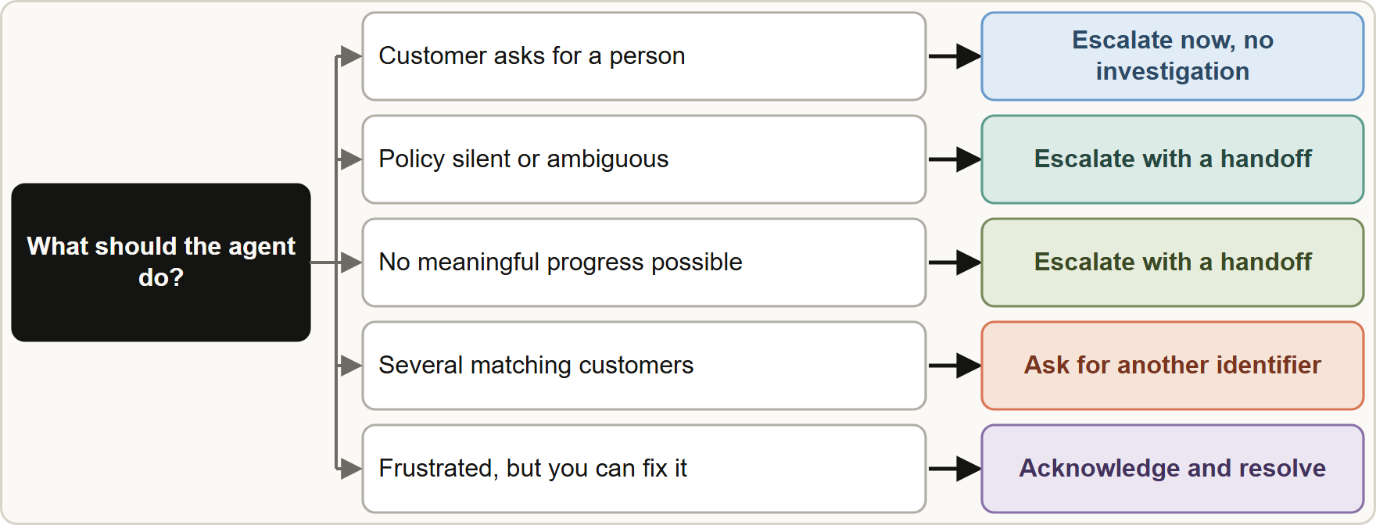
When to escalate, continued
Module 13
Escalation decisions: honor explicit requests at once, escalate for policy gaps or lack of progress, otherwise resolve; ask for identifiers when matches are ambiguous
Claude Architect Foundations Exam Prep | for the CCAR-F exam
Module 13: Escalation and Error Propagation
6 / 23
Notes:
When to escalate, continued.
The figure shows this: Escalation decisions: honor explicit requests at once, escalate for policy gaps or lack of progress, otherwise resolve; ask for identifiers when matches are ambiguous.

Slide 7
Unreliable proxies
Module 13
Sentiment analysis measures mood, not case complexity: a calm customer can have a policy-exception case and an angry one a simple fix.
Self-reported confidence scores (1 to 10) are poorly calibrated: the agent is often confidently wrong on exactly the hard cases.
Fix the root cause (unclear decision boundaries) with explicit escalation criteria and few-shot examples in the system prompt, showing when to escalate and when to resolve alone. Training a separate classifier is over-engineered before prompt optimization has been tried.
Claude Architect Foundations Exam Prep | for the CCAR-F exam
Module 13: Escalation and Error Propagation
7 / 23
Notes:
Unreliable proxies.
Sentiment analysis measures mood, not case complexity: a calm customer can have a policy-exception case and an angry one a simple fix.
Self-reported confidence scores (one to ten) are poorly calibrated: the agent is often confidently wrong on exactly the hard cases.
Fix the root cause (unclear decision boundaries) with explicit escalation criteria and few-shot examples in the system prompt, showing when to escalate and when to resolve alone. Training a separate classifier is over-engineered before prompt optimization has been tried.

Slide 8
Ambiguity: multiple matches
Module 13
If a tool returns several customers with the same name, ask for an additional identifier (email, phone, order number). Do not pick one by a heuristic (most recent, most orders): a wrong guess exposes another person's data or refunds the wrong account.
EXAM TIP Sentiment thresholds and confidence cutoffs are classic wrong answers. The proportionate first step is explicit criteria plus few-shot examples.
Claude Architect Foundations Exam Prep | for the CCAR-F exam
Module 13: Escalation and Error Propagation
8 / 23
Notes:
Ambiguity: multiple matches.
If a tool returns several customers with the same name, ask for an additional identifier (email, phone, order number). Do not pick one by a heuristic (most recent, most orders): a wrong guess exposes another person's data or refunds the wrong account.
Exam tip: Sentiment thresholds and confidence cutoffs are classic wrong answers. The proportionate first step is explicit criteria plus few-shot examples.
Exam tip: Several matching customers to ask for another identifier; never pick one by a heuristic.

Slide 9
Error Propagation in Multi-Agent Systems
Module 13
Case (continued): The research subagent that searches the web times out on a hard topic. What should reach the coordinator?
Claude Architect Foundations Exam Prep | for the CCAR-F exam
Module 13: Escalation and Error Propagation
9 / 23
Notes:
Error Propagation in Multi-Agent Systems.
Case (continued): The research subagent that searches the web times out on a hard topic. What should reach the coordinator?

Slide 10
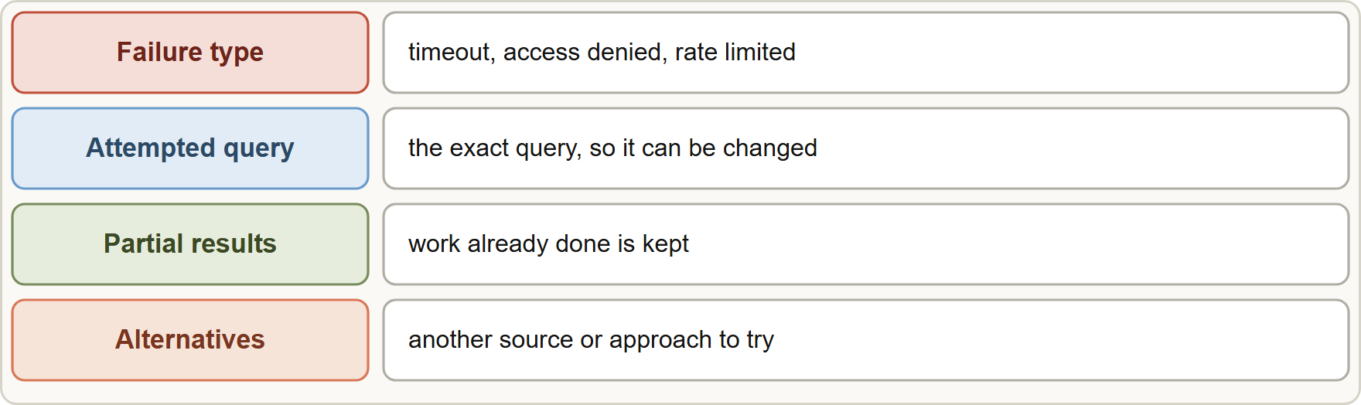
Error Propagation in Multi-Agent Systems, continued
Module 13
Structured error context for the coordinator: failure type, attempted query, partial results and possible alternatives
Claude Architect Foundations Exam Prep | for the CCAR-F exam
Module 13: Escalation and Error Propagation
10 / 23
Notes:
Error Propagation in Multi-Agent Systems, continued.
The figure shows this: Structured error context for the coordinator: failure type, attempted query, partial results and possible alternatives.

Slide 11
Error Propagation in Multi-Agent Systems, continued
Module 13
Return to the coordinator | Why
Failure type (timeout, access denied, rate limited) | Decides retry versus alternative
What was attempted (the exact query) | Lets it retry with a changed query
Partial results | Work already done is not thrown away
Possible alternatives | Suggests another source or approach
Access failure versus valid empty result: a timeout needs a retry decision; a successful search with no matches is a legitimate answer.
Generic statuses such as "search unavailable" hide the context the coordinator needs.
Local recovery: the subagent retries transient failures itself and propagates only unresolved errors, with what was attempted and partial results.
Claude Architect Foundations Exam Prep | for the CCAR-F exam
Module 13: Escalation and Error Propagation
11 / 23
Notes:
Error Propagation in Multi-Agent Systems, continued.
Failure type (timeout, access denied, rate limited). Decides retry versus alternative.
What was attempted (the exact query). Lets it retry with a changed query.
Partial results. Work already done is not thrown away.
Possible alternatives. Suggests another source or approach.
Access failure versus valid empty result: a timeout needs a retry decision; a successful search with no matches is a legitimate answer.
Generic statuses such as "search unavailable" hide the context the coordinator needs.
Local recovery: the subagent retries transient failures itself and propagates only unresolved errors, with what was attempted and partial results.

Slide 12
Error Propagation in Multi-Agent Systems, continued
Module 13
Anti-pattern | Problem
Silently suppressing errors (return an empty set marked successful) | The failure is invisible; the report looks complete but is not
Terminating the whole workflow on one failure | Throws away everything that worked when recovery was possible
Coverage annotations: the final output should mark which findings are well supported and which areas have gaps because sources were unavailable.
EXAM TIP Best answer for a subagent failure = structured error context to the coordinator, then recover or proceed with partial results and annotate gaps.
Claude Architect Foundations Exam Prep | for the CCAR-F exam
Module 13: Escalation and Error Propagation
12 / 23
Notes:
Error Propagation in Multi-Agent Systems, continued.
Silently suppressing errors (return an empty set marked successful). The failure is invisible; the report looks complete but is not.
Terminating the whole workflow on one failure. Throws away everything that worked when recovery was possible.
Coverage annotations: the final output should mark which findings are well supported and which areas have gaps because sources were unavailable.
Exam tip: Best answer for a subagent failure equals structured error context to the coordinator, then recover or proceed with partial results and annotate gaps.

Slide 13
Module Recap
Module 13
1
Escalate when
2
Frustration only
3
Bad proxies
Explicit human request (immediately) · policy gap/exception · no meaningful progress
Acknowledge, offer to resolve; escalate if the customer repeats the request
Sentiment and self-reported confidence
4
Fix calibration
5
Multiple matches
6
Error context
Explicit criteria + few-shot examples in the system prompt
Ask for another identifier; no heuristics
Failure type · attempted query · partial results · alternatives
7
Distinguish
8
Anti-patterns
9
Recovery
Access failure (error, retry decision) vs valid empty result (success, none found)
Silent suppression; abort everything
Local retry of transient errors; propagate the unresolved; annotate coverage gaps
Claude Architect Foundations Exam Prep | for the CCAR-F exam
Module 13: Escalation and Error Propagation
13 / 23
Notes:
Here is the recap.
Escalate when: Explicit human request (immediately), policy gap or exception, no meaningful progress.
Frustration only: Acknowledge, offer to resolve; escalate if the customer repeats the request.
Bad proxies: Sentiment and self-reported confidence.
Fix calibration: Explicit criteria plus few-shot examples in the system prompt.
Multiple matches: Ask for another identifier; no heuristics.
Error context: Failure type, attempted query, partial results, alternatives.
Distinguish: Access failure (error, retry decision) versus valid empty result (success, none found).
Anti-patterns: Silent suppression; abort everything.
Recovery: Local retry of transient errors; propagate the unresolved; annotate coverage gaps.

Slide 14
Practice Question 1
Module 13
Q1
Birchwood's agent escalates routine address changes but tries to settle gift-card disputes that need exceptions by itself. What is the best first improvement?
A
Train a separate classifier on old tickets first
B
Ask the agent to report confidence from 1 to 10 and escalate when it is below 5
C
Escalate every conversation that includes the word "problem"
D
Add explicit escalation criteria with few-shot examples to the system prompt
Claude Architect Foundations Exam Prep | for the CCAR-F exam
Module 13: Escalation and Error Propagation
14 / 23
Notes:
Question one.
Birchwood's agent escalates routine address changes but tries to settle gift-card disputes that need exceptions by itself. What is the best first improvement?
The four options are on the screen.
[PAUSE 12]
The answer is D. The root cause is unclear decision boundaries; criteria with examples are the proportionate fix. Self-reported confidence is unreliable and a classifier is heavy infrastructure.

Slide 15
Practice Question 2
Module 13
Q2
A customer writes: "I want to speak to a person." What should the agent do?
A
Escalate immediately, without investigating first
B
Ask the customer to explain the problem again before deciding what to do
C
Offer a discount
D
Investigate the issue first and then decide
Claude Architect Foundations Exam Prep | for the CCAR-F exam
Module 13: Escalation and Error Propagation
15 / 23
Notes:
Question two.
A customer writes: "I want to speak to a person." What should the agent do?
The four options are on the screen.
[PAUSE 12]
The answer is A. An explicit request for a human is honored at once.

Slide 16
Practice Question 3
Module 13
Q3
A customer sounds irritated about a late parcel but does not ask for a person, and the agent can see the tracking and fix the issue. What is best?
A
Acknowledge the frustration, offer to resolve it, and escalate only if the customer repeats the wish for a person
B
End the chat
C
Ignore the tone and give no acknowledgement
D
Escalate immediately because of the negative tone, so that a person can calm the customer down
Claude Architect Foundations Exam Prep | for the CCAR-F exam
Module 13: Escalation and Error Propagation
16 / 23
Notes:
Question three.
A customer sounds irritated about a late parcel but does not ask for a person, and the agent can see the tracking and fix the issue. What is best?
The four options are on the screen.
[PAUSE 12]
The answer is A. Frustration alone is not an escalation trigger when the agent can resolve the issue.

Slide 17
Practice Question 4
Module 13
Q4
A customer asks for a price match with a competitor's website, and the policy covers only adjustments to Birchwood's own prices. What should the agent do?
A
Approve it to keep the customer happy
B
Escalate, because the policy is silent on the request
C
Deny it with a made-up rule
D
Ask for a coupon code from the competitor and apply it to the order
Claude Architect Foundations Exam Prep | for the CCAR-F exam
Module 13: Escalation and Error Propagation
17 / 23
Notes:
Question four.
A customer asks for a price match with a competitor's website, and the policy covers only adjustments to Birchwood's own prices. What should the agent do?
The four options are on the screen.
[PAUSE 12]
The answer is B. A policy gap is a legitimate trigger for escalation.

Slide 18
Practice Question 5
Module 13
Q5
A search for customer "Sam Rivera" returns three records. What should the agent do?
A
Pick at random
B
Ask the customer for an additional identifier before proceeding
C
Choose the most recently active account
D
Refund all three
Claude Architect Foundations Exam Prep | for the CCAR-F exam
Module 13: Escalation and Error Propagation
18 / 23
Notes:
Question five.
A search for customer "Sam Rivera" returns three records. What should the agent do?
The four options are on the screen.
[PAUSE 12]
The answer is B. With multiple matches, request clarification rather than selecting by heuristic.

Slide 19
Practice Question 6
Module 13
Q6
The web search subagent times out. Which design best allows intelligent recovery?
A
Return structured error context with failure type, attempted query, partial results and possible alternatives
B
Return an empty result marked successful
C
Stop the whole research workflow
D
Return a generic "search unavailable" status once all of the retries have been used up without success
Claude Architect Foundations Exam Prep | for the CCAR-F exam
Module 13: Escalation and Error Propagation
19 / 23
Notes:
Question six.
The web search subagent times out. Which design best allows intelligent recovery?
The four options are on the screen.
[PAUSE 12]
The answer is A. Rich context lets the coordinator retry, change approach or proceed with partial results. A generic status hides it, an empty success hides the failure, and a total stop wastes working parts.

Slide 20
Practice Question 7
Module 13
Q7
Which statement describes a valid empty result?
A
A completed search that found no matching documents
B
A permission error
C
A crashed subagent
D
A timeout from the search service while it was still looking for documents
Claude Architect Foundations Exam Prep | for the CCAR-F exam
Module 13: Escalation and Error Propagation
20 / 23
Notes:
Question seven.
Which statement describes a valid empty result?
The four options are on the screen.
[PAUSE 12]
The answer is A. An empty result from a successful query is an answer; the others are failures.

Slide 21
Practice Question 8
Module 13
Q8
Where should a final research report show that one region's data could not be retrieved?
A
In coverage annotations that mark well-supported findings and gaps
B
In a separate email
C
Nowhere; hide it to look complete
D
In a footnote that describes the model's reasoning about the missing region
Claude Architect Foundations Exam Prep | for the CCAR-F exam
Module 13: Escalation and Error Propagation
21 / 23
Notes:
Question eight.
Where should a final research report show that one region's data could not be retrieved?
The four options are on the screen.
[PAUSE 12]
The answer is A. Annotating coverage keeps the report honest about which areas are well supported and which have gaps.

Slide 22
Practice Question 9
Module 13
Q9
Which TWO are valid reasons to escalate to a human? (Select TWO.)
A
The customer explicitly asks for a person
B
A sentiment score is below a threshold
C
The agent's self-reported confidence is below 7
D
The policy is silent about the request
E
The customer wrote an exclamation mark
Claude Architect Foundations Exam Prep | for the CCAR-F exam
Module 13: Escalation and Error Propagation
22 / 23
Notes:
Question nine. Select two.
Which two are valid reasons to escalate to a human?
The five options are on the screen.
[PAUSE 15]
The answers are A and D. Explicit requests and policy gaps are real triggers. Tone, sentiment scores and self-reported confidence are weak proxies for difficulty.

Slide 23
Answers at a Glance
Module 13
Question | Answer | Why
Q1 | D | The root cause is unclear decision boundaries
Q2 | A | An explicit request for a human is honored at
Q3 | A | Frustration alone is not an escalation trigger when the
Q4 | B | A policy gap is a legitimate trigger for escalation
Q5 | B | With multiple matches, request clarification rather than selecting by
Q6 | A | Rich context lets the coordinator retry
Q7 | A | An empty result from a successful query is an
Q8 | A | Annotating coverage keeps the report honest about which areas
Q9 | A, D | Explicit requests and policy gaps are real triggers
Claude Architect Foundations Exam Prep | for the CCAR-F exam
Module 13: Escalation and Error Propagation
23 / 23
Notes:
Here are all nine answers. Question one: D. Question two: A. Question three: A. Question four: B. Question five: B. Question six: A. Question seven: A. Question eight: A. Question nine: A and D.
In the next module, we continue the course.

