Slide 1
Module 14: Human Review, Confidence and Provenance
Why an overall accuracy figure can hide weak spots
Domain 5 · Context Management and Reliability · Task statements 5.5 and 5.6
Claude Architect Foundations Exam Prep Masterclass
Module 14
Notes:
Welcome to Module fourteen: Human Review, Confidence and Provenance. This module covers task statements five point five and five point six: human review, confidence and provenance.
Each part of this module comes from the study notes of the same name, so you can read the notes after you watch.

Slide 2
What You Will Learn
Module 14
Why an overall accuracy figure can hide weak spots
Stratified random sampling and field-level confidence calibrated on a labeled validation set
Routing documents to human reviewers when capacity is limited
Claim-source mappings, conflicting values, dates and fitting the format to the content
Claude Architect Foundations Exam Prep | for the CCAR-F exam
Module 14: Human Review, Confidence and Provenance
2 / 18
Notes:
By the end of this module you will be able to do four things.
Why an overall accuracy figure can hide weak spots.
Stratified random sampling and field-level confidence calibrated on a labeled validation set.
Routing documents to human reviewers when capacity is limited.
Claim-source mappings, conflicting values, dates and fitting the format to the content.

Slide 3
Case Check-In: Birchwood Supply Automates Invoice Entry
Module 14
CASE CHECK-IN · Birchwood Supply
The extraction system reports 97% accuracy overall, so management wants to stop most human review
Closer inspection shows handwritten receipts at only 70% and the tax-ID field often wrong
Reviewers can check only a few hundred documents a week
Claude Architect Foundations Exam Prep | for the CCAR-F exam
Module 14: Human Review, Confidence and Provenance
3 / 18
Notes:
Our running case is Birchwood Supply. Birchwood Supply Automates Invoice Entry.
The extraction system reports ninety-seven percent accuracy overall, so management wants to stop most human review.
Closer inspection shows handwritten receipts at only seventy percent and the tax-I D field often wrong.
Reviewers can check only a few hundred documents a week.

Slide 4
Human Review and Confidence Calibration
Module 14
Principle | Detail
Aggregate accuracy hides problems | 97% overall can mask poor performance on specific document types or fields
Validate by segment | Measure accuracy by document type and by field before automating high-confidence extractions or reducing review
Stratified random sampling | Keep sampling high-confidence extractions from each segment: it measures the true error rate and detects novel error patterns
Field-level confidence | Have the model output a confidence per field, then calibrate thresholds on a labeled validation set (compare confidence to real correctness)
Routing | Send low-confidence, ambiguous or contradictory-source extractions to people; prioritize limited reviewer capacity where errors are most likely
Claude Architect Foundations Exam Prep | for the CCAR-F exam
Module 14: Human Review, Confidence and Provenance
4 / 18
Notes:
Human Review and Confidence Calibration.
Aggregate accuracy hides problems. ninety-seven percent overall can mask poor performance on specific document types or fields.
Validate by segment. Measure accuracy by document type and by field before automating high-confidence extractions or reducing review.
Stratified random sampling. Keep sampling high-confidence extractions from each segment: it measures the true error rate and detects novel error patterns.
Field-level confidence. Have the model output a confidence per field, then calibrate thresholds on a labeled validation set (compare confidence to real correctness).
Routing. Send low-confidence, ambiguous or contradictory-source extractions to people; prioritize limited reviewer capacity where errors are most likely.

Slide 5
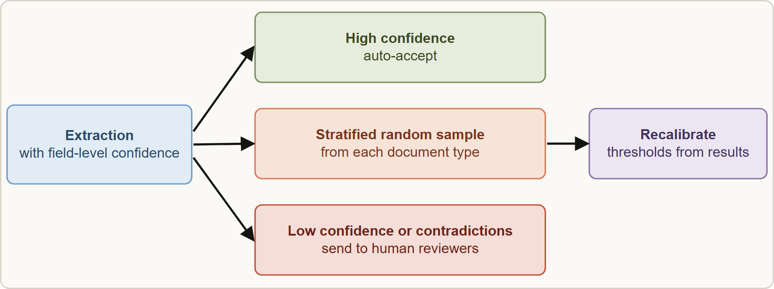
Human Review and Confidence Calibration, continued
Module 14
Why sampling the confident ones matters: a threshold chosen once can drift as documents change; random samples show it.
Raw model confidence is not a calibrated probability. It becomes useful only after you compare it with ground truth on labeled data and set thresholds from that.
Why sampling the confident ones matters: a threshold chosen once can drift as documents change; random samples show it.
Raw model confidence is not a calibrated probability. It becomes useful only after you compare it with ground truth on labeled data and set thresholds from that.
EXAM TIP "Accuracy is 97%, so reduce review" → check accuracy per document type and field first, and keep stratified sampling.
Claude Architect Foundations Exam Prep | for the CCAR-F exam
Module 14: Human Review, Confidence and Provenance
5 / 18
Notes:
Human Review and Confidence Calibration, continued.
The figure shows this: Human review design: auto-accept high confidence, but keep a stratified random sample by document type; route low confidence and contradictions to reviewers; use the results to recalibrate.
Why sampling the confident ones matters: a threshold chosen once can drift as documents change; random samples show it.
Raw model confidence is not a calibrated probability. It becomes useful only after you compare it with ground truth on labeled data and set thresholds from that.
Exam tip: "Accuracy is ninety-seven percent, so reduce review" to check accuracy per document type and field first, and keep stratified sampling.
Exam tip: Confidence scores are useful only after calibration on a labeled validation set.

Slide 6
Provenance and Uncertainty in Multi-Source Synthesis
DATES
Module 14
Case (continued): Birchwood's research system reports two market-size figures: $4.1 billion from an industry association (2022 data) and $5.3 billion from an analyst firm (2025 data). The first draft report quietly uses $5.3 billion and drops the other.
Claude Architect Foundations Exam Prep | for the CCAR-F exam
Module 14: Human Review, Confidence and Provenance
6 / 18
Notes:
Provenance and Uncertainty in Multi-Source Synthesis.
Case (continued): Birchwood's research system reports two market-size figures: four point one billion dollars from an industry association (two thousand twenty-two data) and five point three billion dollars from an analyst firm (two thousand twenty-five data). The first draft report quietly uses five point three billion dollars and drops the other.

Slide 7
Provenance and Uncertainty in Multi-Source Synthesis, continued
Module 14
Problem | Remedy
Source attribution is lost when findings are compressed in summaries | Require structured claim-source mappings (claim, source URL, document name, relevant excerpt) that the synthesis agent preserves and merges
Conflicting statistics from credible sources | Annotate the conflict with source attribution; do not arbitrarily pick one. Let the coordinator decide how to reconcile
Dates ignored | Require publication or data-collection dates in structured outputs, so a temporal difference of years is not misinterpreted as a contradiction
Everything in one format | Render each content type appropriately: financial data as tables, news as prose, technical findings as structured lists
Claude Architect Foundations Exam Prep | for the CCAR-F exam
Module 14: Human Review, Confidence and Provenance
7 / 18
Notes:
Provenance and Uncertainty in Multi-Source Synthesis, continued.
Source attribution is lost when findings are compressed in summaries. Require structured claim-source mappings (claim, source U R L (uniform resource locator), document name, relevant excerpt) that the synthesis agent preserves and merges.
Conflicting statistics from credible sources. Annotate the conflict with source attribution; do not arbitrarily pick one. Let the coordinator decide how to reconcile.
Dates ignored. Require publication or data-collection dates in structured outputs, so a temporal difference of years is not misinterpreted as a contradiction.
Everything in one format. Render each content type appropriately: financial data as tables, news as prose, technical findings as structured lists.

Slide 8
Provenance and Uncertainty in Multi-Source Synthesis, continued
Module 14
Problem | Remedy
Established vs disputed claims blended | Use explicit sections that separate well-established findings from contested ones, keeping the original source characterizations and methodological context
Claude Architect Foundations Exam Prep | for the CCAR-F exam
Module 14: Human Review, Confidence and Provenance
8 / 18
Notes:
Provenance and Uncertainty in Multi-Source Synthesis, continued.
Established versus disputed claims blended. Use explicit sections that separate well-established findings from contested ones, keeping the original source characterizations and methodological context.

Slide 9
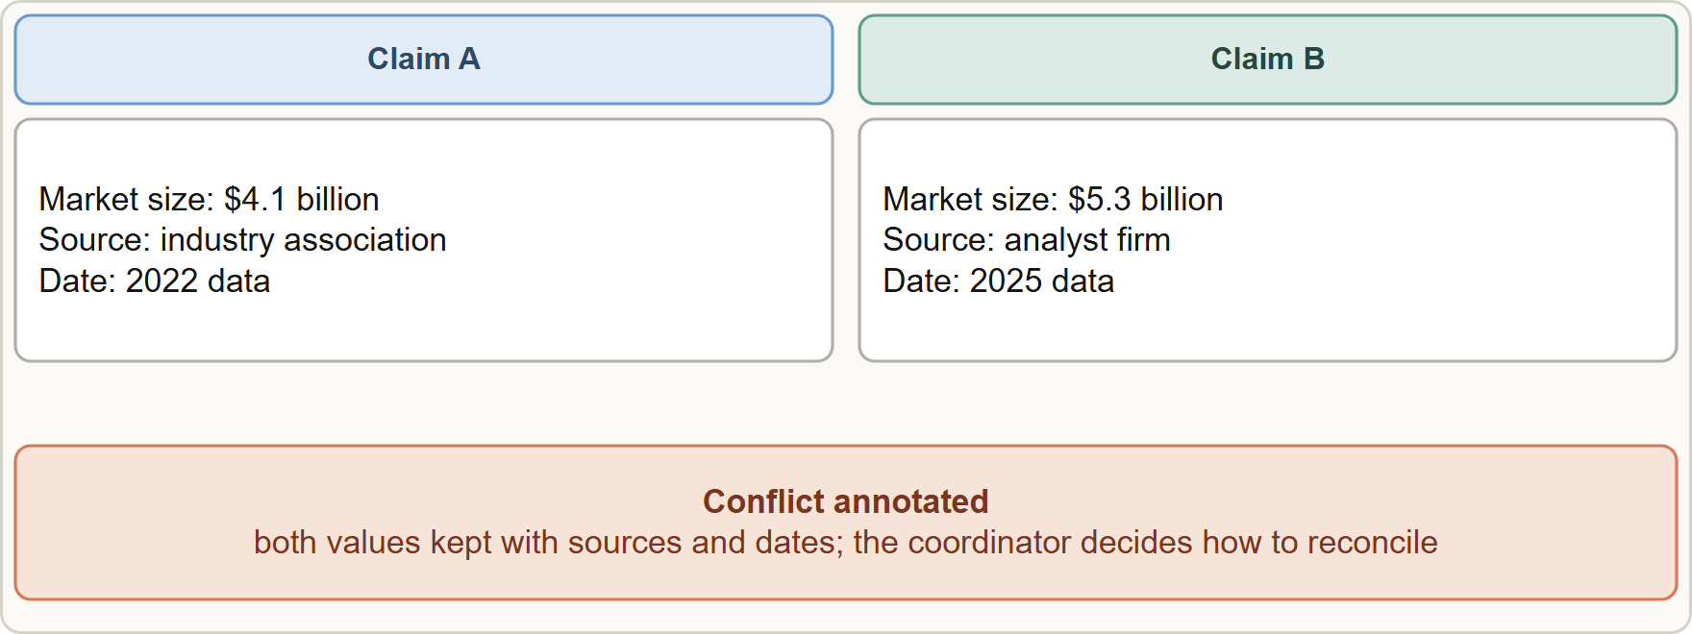
Provenance and Uncertainty in Multi-Source Synthesis, continued
Module 14
The document analysis subagent should finish its work with the conflicting values included and annotated and pass them on, rather than resolving the conflict silently.
The document analysis subagent should finish its work with the conflicting values included and annotated and pass them on, rather than resolving the conflict silently.
EXAM TIP Two credible sources disagree → keep both with attribution (and dates); never "pick the most recent" or "average them" without a stated basis.
Claude Architect Foundations Exam Prep | for the CCAR-F exam
Module 14: Human Review, Confidence and Provenance
9 / 18
Notes:
Provenance and Uncertainty in Multi-Source Synthesis, continued.
The figure shows this: Provenance: every claim travels with its source, excerpt and date; conflicting values are kept side by side and annotated.
The document analysis subagent should finish its work with the conflicting values included and annotated and pass them on, rather than resolving the conflict silently.
Exam tip: Two credible sources disagree to keep both with attribution (and dates); never "pick the most recent" or "average them" without a stated basis.

Slide 10
Module Recap
Module 14
1
Aggregate accuracy
2
Sampling
3
Confidence
Stratified random samples of high-confidence output → true error rate, novel patterns
Field-level; calibrate on a labeled validation set
Can hide poor document types or fields → validate by segment first
4
Routing
5
Provenance
6
Conflicts
Low confidence, ambiguity, contradictions → people; prioritize limited capacity
Claim-source mappings (URL, document, excerpt) preserved through synthesis
Keep both values with attribution; coordinator decides; never pick arbitrarily
7
Dates
8
Rendering
Require publication/collection dates (time differences are not contradictions)
Finance → tables · news → prose · technical findings → structured lists; separate established from contested
Claude Architect Foundations Exam Prep | for the CCAR-F exam
Module 14: Human Review, Confidence and Provenance
10 / 18
Notes:
Here is the recap.
Aggregate accuracy: Can hide poor document types or fields to validate by segment first.
Sampling: Stratified random samples of high-confidence output to true error rate, novel patterns.
Confidence: Field-level; calibrate on a labeled validation set.
Routing: Low confidence, ambiguity, contradictions to people; prioritize limited capacity.
Provenance: Claim-source mappings (U R L, document, excerpt) preserved through synthesis.
Conflicts: Keep both values with attribution; coordinator decides; never pick arbitrarily.
Dates: Require publication or collection dates (time differences are not contradictions).
Rendering: Finance to tables, news to prose, technical findings to structured lists; separate established from contested.

Slide 11
Practice Question 1
Module 14
Q1
Invoice extraction shows 97% accuracy overall, and management wants to remove most human review. What should the team do first?
A
Remove review for all documents
B
Raise the model temperature
C
Analyze accuracy by document type and by field before reducing review
D
Review only the lowest-confidence document each day
Claude Architect Foundations Exam Prep | for the CCAR-F exam
Module 14: Human Review, Confidence and Provenance
11 / 18
Notes:
Question one.
Invoice extraction shows ninety-seven percent accuracy overall, and management wants to remove most human review. What should the team do first?
The four options are on the screen.
[PAUSE 12]
The answer is C. Aggregate accuracy can hide weak segments; validate per type and field first.

Slide 12
Practice Question 2
Module 14
Q2
How can a team keep detecting new error patterns in extractions that the model rates as high confidence?
A
Take stratified random samples of high-confidence extractions
B
Review only the five oldest items
C
Stop looking at high-confidence items
D
Review only the items that already failed validation in the pipeline
Claude Architect Foundations Exam Prep | for the CCAR-F exam
Module 14: Human Review, Confidence and Provenance
12 / 18
Notes:
Question two.
How can a team keep detecting new error patterns in extractions that the model rates as high confidence?
The four options are on the screen.
[PAUSE 12]
The answer is A. Sampling across segments measures error rates and uncovers novel failure patterns.

Slide 13
Practice Question 3
Module 14
Q3
Model-reported field confidence scores exist, but nobody knows what "0.85" means in practice. How should review thresholds be set?
A
Use 0.5 for everything
B
Choose a threshold randomly
C
Calibrate thresholds on a labeled validation set by comparing confidence with correctness
D
Use the highest confidence score ever seen as the single review threshold for every field
Claude Architect Foundations Exam Prep | for the CCAR-F exam
Module 14: Human Review, Confidence and Provenance
13 / 18
Notes:
Question three.
Model-reported field confidence scores exist, but nobody knows what "zero point eight five" means in practice. How should review thresholds be set?
The four options are on the screen.
[PAUSE 12]
The answer is C. Calibration against labeled ground truth turns raw scores into useful routing thresholds.

Slide 14
Practice Question 4
Module 14
Q4
Reviewer capacity is limited. Which routing rule is best?
A
Review a random 10% of everything
B
Send low-confidence, ambiguous or contradictory extractions to review first
C
Send documents in alphabetical order
D
Review only the documents that come from the biggest supplier of the company
Claude Architect Foundations Exam Prep | for the CCAR-F exam
Module 14: Human Review, Confidence and Provenance
14 / 18
Notes:
Question four.
Reviewer capacity is limited. Which routing rule is best?
The four options are on the screen.
[PAUSE 12]
The answer is B. Concentrate scarce attention on the items most likely to be wrong.

Slide 15
Practice Question 5
DATES
Module 14
Q5
Two reputable sources give different market sizes, one with 2022 data and one with 2025 data. What should the report do?
A
Present both values with their sources and dates, annotating the conflict
B
Use the newer figure and omit the older
C
Remove the topic
D
Average the two
Claude Architect Foundations Exam Prep | for the CCAR-F exam
Module 14: Human Review, Confidence and Provenance
15 / 18
Notes:
Question five.
Two reputable sources give different market sizes, one with two thousand twenty-two data and one with two thousand twenty-five data. What should the report do?
The four options are on the screen.
[PAUSE 12]
The answer is A. Preserve both values with attribution and dates; the dates may explain the difference.

Slide 16
Practice Question 6
Module 14
Q6
Which TWO steps are needed before reducing human review of automated extraction? (Select TWO.)
A
Choose a single threshold at random
B
Stop all review at once
C
Rely on the overall accuracy figure only
D
Keep stratified random sampling of confident extractions
E
Measure accuracy by document type and field
Claude Architect Foundations Exam Prep | for the CCAR-F exam
Module 14: Human Review, Confidence and Provenance
16 / 18
Notes:
Question six. Select two.
Which two steps are needed before reducing human review of automated extraction?
The five options are on the screen.
[PAUSE 15]
The answers are D and E. Segment-level accuracy and ongoing sampling show where the system is weak. An overall number can hide poor segments.

Slide 17
Practice Question 7
Module 14
Q7
Which TWO practices handle conflicting statistics from credible sources correctly? (Select TWO.)
A
Include publication or collection dates
B
Keep both values with their sources
C
Drop the older value
D
Pick the largest value
E
Average the values without saying so
Claude Architect Foundations Exam Prep | for the CCAR-F exam
Module 14: Human Review, Confidence and Provenance
17 / 18
Notes:
Question seven. Select two.
Which two practices handle conflicting statistics from credible sources correctly?
The five options are on the screen.
[PAUSE 15]
The answers are A and B. Both values with attribution and dates let readers judge; the dates may explain the difference.

Slide 18
Answers at a Glance
Module 14
Question | Answer | Why
Q1 | C | Aggregate accuracy can hide weak segments
Q2 | A | Sampling across segments measures error rates and uncovers novel failure patterns
Q3 | C | Calibration against labeled ground truth turns raw scores into useful routing thresholds
Q4 | B | Concentrate scarce attention on the items most likely to be wrong
Q5 | A | Preserve both values with attribution and dates
Q6 | D, E | Segment-level accuracy and ongoing sampling show where the system is weak
Q7 | A, B | Both values with attribution and dates let readers judge
Claude Architect Foundations Exam Prep | for the CCAR-F exam
Module 14: Human Review, Confidence and Provenance
18 / 18
Notes:
Here are all seven answers. Question one: C. Question two: A. Question three: C. Question four: B. Question five: A. Question six: D and E. Question seven: A and B.
In the next module, we continue the course.

