Slide 1
Module 4: Scalable and Loosely Coupled Architectures
Grow without breaking: queues, events, load balancers and serverless
Domain 2 · Design Resilient Architectures · Task statement 2.1
Solutions Architect Associate Exam Prep Masterclass
Module 4 · Part 1
Notes:
Welcome to Module four: Scalable and Loosely Coupled Architectures. This module covers task statement two point one, the first task of Domain two, Design Resilient Architectures, which carries twenty-six percent of the exam. You will learn how to decouple components with queues, topics and events, scale each tier on its own, and choose between containers and serverless. The exam describes a growth problem and asks you to pick the service that fixes it.

Slide 2
What You Will Learn
Part 1
Design event-driven, microservice and multi-tier architectures
Choose scaling strategies: horizontal or vertical, stateless or stateful
Pick the services for loose coupling: SQS, SNS, EventBridge, MQ, Step Functions
Decide when to use containers and when to use serverless
Choose load balancers, caches, read replicas and API Gateway
Solutions Architect Associate Exam Prep Masterclass | for the AWS SAA-C03 exam
Module 4: Scalable and Loosely Coupled Architectures
2 / 38
Notes:
By the end of this module you will be able to do five things. Design event-driven, microservice and multi-tier architectures. Choose scaling strategies: horizontal or vertical, stateless or stateful. Pick the services for loose coupling: S Q S, S N S, EventBridge, Amazon M Q and Step Functions. Decide when to use containers and when to use serverless. And choose load balancers, caches, read replicas and A P I Gateway.

Slide 3
Case Check-In: Lantern and Loom Meets the Holiday Rush
Part 1
CASE CHECK-IN · Lantern and Loom
A holiday sale multiplies traffic tenfold
Checkout waits for the email service, so one slow call stalls the page
Sessions vanish when a web server is replaced
Partners want order events pushed to them
Your job: make each part scale and fail on its own
Solutions Architect Associate Exam Prep Masterclass | for the AWS SAA-C03 exam
Module 4: Scalable and Loosely Coupled Architectures
3 / 38
Notes:
A holiday sale is coming to Lantern and Loom, and traffic will grow tenfold. Today, checkout waits for the email service, so one slow call stalls the page. Customer sessions vanish whenever a web server is replaced. And partners want order events pushed to them. Your job is to make each part scale and fail on its own.

Slide 4
Tight and Loose Coupling
Part 1
 | Tightly coupled | Loosely coupled
Calls | Components call each other directly and wait | Components talk through an intermediary
Failure | One slow or failed part stalls the rest | Each part fails and recovers on its own
Scaling | Everything scales together | Each part scales independently
Intermediaries: queues (SQS), topics (SNS), event buses (EventBridge), load balancers, APIs, workflows (Step Functions)
They absorb spikes, retry, and let you deploy separately
EXAM TIP Spikes, retries or independent scaling: put a queue, topic or event bus between the components.
Solutions Architect Associate Exam Prep Masterclass | for the AWS SAA-C03 exam
Module 4: Scalable and Loosely Coupled Architectures
4 / 38
Notes:
Start with the core idea. In a tightly coupled design, components call each other directly and wait. One slow or failed part stalls the rest, and everything scales together. In a loosely coupled design, components talk through an intermediary, so each part fails and recovers on its own, and scales independently. The intermediaries are queues, which is S Q S; topics, which is S N S; event buses, which is EventBridge; load balancers; A P I s; and workflows, which is Step Functions. They absorb spikes, retry, and let you deploy separately. Exam tip: spikes, retries or independent scaling mean put a queue, topic or event bus between the components.

Slide 5
Stateless and Stateful Workloads
Part 1
Stateless: the server keeps no session data between requests, so any instance can serve any request
Stateful: state lives on the instance, so requests must return to the same server, and a failure loses it
Move state out: sessions to ElastiCache or DynamoDB, files to S3 or EFS, data to databases
Sticky sessions pin a client to a target: a workaround, not the best design
Lambda is built for short tasks that keep no state between invocations
EXAM TIP To scale out or replace servers freely, make the tier stateless and store state elsewhere.
Solutions Architect Associate Exam Prep Masterclass | for the AWS SAA-C03 exam
Module 4: Scalable and Loosely Coupled Architectures
5 / 38
Notes:
A stateless server keeps no session data between requests, so any instance can serve any request. A stateful server keeps state on the instance, so requests must return to the same server, and a failure loses that state. The fix is to move state out: sessions to ElastiCache or DynamoDB, files to S three or E F S, and data to databases. Sticky sessions pin a client to one target, but they are a workaround, not the best design. Lambda is built for short tasks that keep no state between invocations. Exam tip: to scale out or replace servers freely, make the tier stateless and store state elsewhere.

Slide 6
Scaling Up and Scaling Out
Part 1
 | Vertical (scale up) | Horizontal (scale out)
How | A bigger instance | More instances
Limits | A ceiling, often a restart, one point of failure | Needs a stateless design and a load balancer
Resilience | Low | High: lose one, keep serving
Web and app tiers: Auto Scaling behind a load balancer; containers scale tasks
Queue workers: scale on queue depth
Data tier: read replicas, caches, DynamoDB capacity
EXAM TIP Resilient and elastic usually means scale out, which means stateless.
Solutions Architect Associate Exam Prep Masterclass | for the AWS SAA-C03 exam
Module 4: Scalable and Loosely Coupled Architectures
6 / 38
Notes:
There are two ways to scale. Vertical scaling, or scaling up, means a bigger instance. It has a ceiling, often needs a restart, and leaves a single point of failure. Horizontal scaling, or scaling out, means more instances. It needs a stateless design and a load balancer, and it is highly resilient, because you can lose one and keep serving. For the web and application tiers, use Auto Scaling behind a load balancer, or containers that scale tasks. Scale queue workers on queue depth. For the data tier, use read replicas, caches and DynamoDB capacity. Exam tip: resilient and elastic usually means scale out, which means stateless.

Slide 7
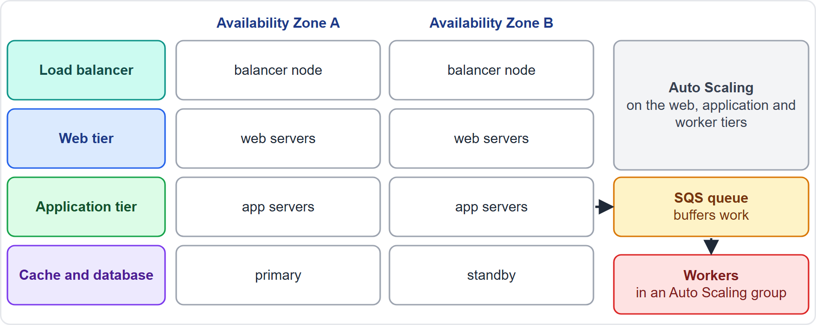
Multi-Tier Architectures
Part 1
Web, application and data tiers, each in private subnets except the load balancer
A load balancer sits in front of each tier that needs one
Each tier scales on its own, across two or more AZs
A cache shields the database; a queue buffers background work
EXAM TIP Separate the tiers so each can scale, fail and be replaced independently.
Solutions Architect Associate Exam Prep Masterclass | for the AWS SAA-C03 exam
Module 4: Scalable and Loosely Coupled Architectures
7 / 38
Notes:
A multi-tier architecture separates the web, application and data tiers. Everything except the load balancer sits in private subnets. A load balancer fronts each tier that needs one, and each tier scales on its own, across two or more Availability Zones. A cache shields the database, and a queue buffers background work. The figure shows the load balancer, the web and application tiers, the cache and database, and a queue feeding workers. Exam tip: separate the tiers so each can scale, fail and be replaced independently.

Slide 8
Choosing a Load Balancer
Part 1
Type | Layer | Best for
Application (ALB) | 7: HTTP and HTTPS | Web apps, microservices, containers; path and host routing; Lambda targets
Network (NLB) | 4: TCP, UDP, TLS | Millions of requests per second, low latency, a static IP per AZ
Gateway (GWLB) | 3: gateway | Third-party virtual appliances such as firewalls
Classic (CLB) | Previous generation | Legacy; migrate to a current type
All spread traffic across AZs, run health checks, and scale automatically
EXAM TIP HTTP routing: ALB. Static IPs or extreme performance on TCP or UDP: NLB. Appliances: GWLB.
Solutions Architect Associate Exam Prep Masterclass | for the AWS SAA-C03 exam
Module 4: Scalable and Loosely Coupled Architectures
8 / 38
Notes:
Elastic Load Balancing has four types. The Application Load Balancer, or A L B, works at layer seven for H T T P and H T T P S. It suits web apps, microservices and containers, with path and host routing and Lambda targets. The Network Load Balancer, or N L B, works at layer four for T C P, U D P and T L S. It handles millions of requests per second with low latency, and gives a static I P address per Availability Zone. The Gateway Load Balancer fronts third-party virtual appliances, such as firewalls. The Classic Load Balancer is the previous generation, so migrate away from it. All of them spread traffic across zones and run health checks. Exam tip: H T T P routing is A L B; static I P s or extreme performance is N L B.

Slide 9
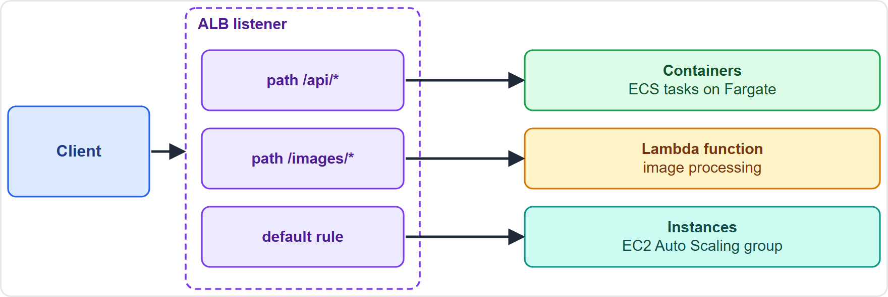
Application Load Balancer Routing
Part 1
A listener checks rules in priority order; each has conditions and actions
Route by path, host, header, method, query string or source IP
A target group holds instances, IP addresses or Lambda functions, with its own health checks
Also redirects, fixed responses, user authentication, AWS WAF and ACM certificates
EXAM TIP Many services behind one URL, routed by path or host: one ALB with several target groups.
Solutions Architect Associate Exam Prep Masterclass | for the AWS SAA-C03 exam
Module 4: Scalable and Loosely Coupled Architectures
9 / 38
Notes:
An Application Load Balancer has listeners. A listener checks rules in priority order, and each rule has conditions and actions. You can route by path, host, header, method, query string or source I P address. A target group holds instances, I P addresses or Lambda functions, and has its own health checks. The load balancer can also redirect, return fixed responses, authenticate users, work with A W S W A F, and use A C M certificates. The figure shows one listener sending path-based requests to an A P I group, an images group and a default web group. Exam tip: many services behind one U R L, routed by path or host, means one A L B with several target groups.

Slide 10
Caching Strategies
Part 1
Layer | Service | What it caches
Edge | CloudFront, a CDN | Content near users (module 9)
API | API Gateway cache | Responses of an API stage
Application | ElastiCache | Query results, sessions
Database | DAX | DynamoDB reads
Lazy loading: load on a miss; caches only what is read; data can go stale
Write-through: update the cache on every write; never stale; extra write cost
Add a TTL to limit stale data and wasted space
EXAM TIP Fresh data on every read: write-through. Cache only what is read: lazy loading. Use a TTL with either.
Solutions Architect Associate Exam Prep Masterclass | for the AWS SAA-C03 exam
Module 4: Scalable and Loosely Coupled Architectures
10 / 38
Notes:
Caching speeds up reads and takes load off the backend. At the edge, CloudFront, a C D N, caches content near users; module nine covers it. A P I Gateway can cache the responses of an A P I stage. ElastiCache caches query results and sessions. And Dax caches DynamoDB reads. Two strategies matter. Lazy loading loads data into the cache on a miss, caches only what is read, but can go stale. Write-through updates the cache on every write, so it is never stale, at the cost of extra writes. Add a T T L, short for time to live, to limit stale data and wasted space. Exam tip: fresh data on every read is write-through; cache only what is read is lazy loading.

Slide 11
Read Replicas and Data-Tier Scaling
Part 1
An RDS read replica is a read-only copy fed by asynchronous replication; it offloads reads
Replicas can be in another Region, and can be promoted to a standalone database for disaster recovery
Replica data can lag, so reads may be slightly stale
RDS does not autoscale replicas: you add them
A Multi-AZ standby is synchronous and cannot serve reads: it is for availability
Pair replicas with a cache for read-heavy workloads
EXAM TIP Scale reads: read replicas or a cache. Survive a failure: Multi-AZ.
Solutions Architect Associate Exam Prep Masterclass | for the AWS SAA-C03 exam
Module 4: Scalable and Loosely Coupled Architectures
11 / 38
Notes:
An R D S read replica is a read-only copy, fed by asynchronous replication, that offloads reads. Replicas can sit in another Region, and can be promoted to a standalone database for disaster recovery. Replica data can lag, so reads may be slightly stale. R D S does not autoscale replicas; you add them. A Multi-A Z standby is different: replication is synchronous, and it cannot serve reads, because it exists for availability. For read-heavy workloads, pair replicas with a cache. Exam tip: to scale reads, use read replicas or a cache; to survive a failure, use Multi-A Z.

Slide 12
Amazon SQS Queues
VERIFY LIVE
Part 2
A hosted queue that decouples producers from consumers and buffers spikes
Standard queues: at-least-once delivery, so consumers must handle duplicates
FIFO queues: exactly-once processing and ordering, with a high-throughput mode
Visibility timeout hides a message while it is processed; the consumer deletes it when done
A dead-letter queue collects messages that keep failing; retention is 60 seconds to 14 days
As of 5 November 2026: a message holds up to 1 MiB; older material says 256 KiB
EXAM TIP Buffer work and scale consumers on queue depth: SQS. Strict order: FIFO.
Solutions Architect Associate Exam Prep Masterclass | for the AWS SAA-C03 exam
Module 4: Scalable and Loosely Coupled Architectures
12 / 38
Notes:
Amazon S Q S is a hosted queue that decouples producers from consumers and buffers spikes. Standard queues use at-least-once delivery, so consumers must tolerate duplicates. Fifo queues provide exactly-once processing and ordering, with a high-throughput mode. The visibility timeout hides a message while it is processed, and the consumer deletes it when done. A dead-letter queue collects messages that keep failing. Retention runs from sixty seconds to fourteen days. As of the fifth of November, twenty twenty-six, a message holds up to one mebibyte, while older material says two hundred fifty-six kibibytes. Exam tip: to buffer work and scale consumers on queue depth, use S Q S; for strict order, use Fifo.

Slide 13
Amazon SNS Publish and Subscribe
Part 2
A publisher sends to a topic; SNS pushes a copy to every subscriber
Subscribers: SQS queues, Lambda, HTTP(S) endpoints, email, SMS, mobile push, Firehose
Supports application-to-application and application-to-person messages
Message filtering sends each subscriber only what it needs
Standard and FIFO topics
SNS does not store messages for offline subscribers: pair it with SQS
EXAM TIP One message to many consumers: SNS. Add SQS queues for durability.
Solutions Architect Associate Exam Prep Masterclass | for the AWS SAA-C03 exam
Module 4: Scalable and Loosely Coupled Architectures
13 / 38
Notes:
Amazon S N S is publish and subscribe. A publisher sends to a topic, and S N S pushes a copy to every subscriber. Subscribers can be S Q S queues, Lambda functions, H T T P endpoints, email, S M S, mobile push, or Firehose. It supports application-to-application and application-to-person messages. Message filtering sends each subscriber only what it needs. There are standard and Fifo topics. S N S does not store messages for offline subscribers, so pair it with S Q S. Exam tip: one message to many consumers is S N S; add S Q S queues for durability.

Slide 14
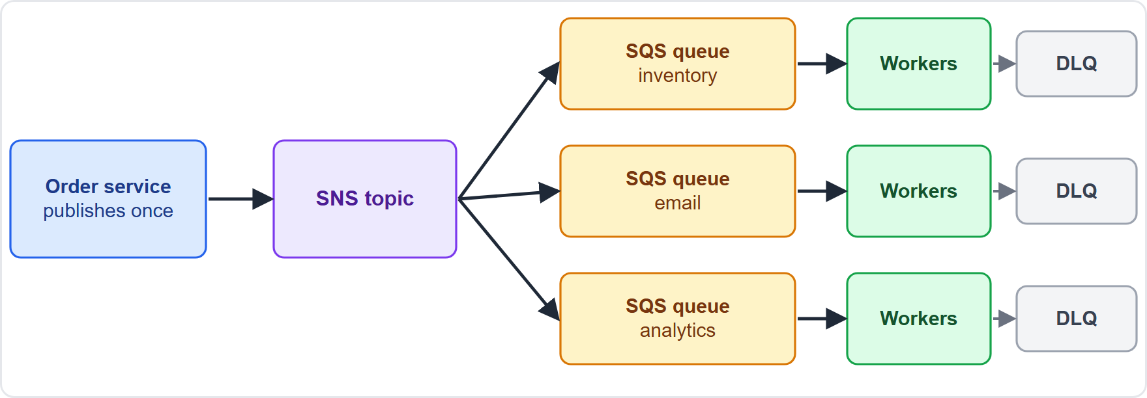
Fan-Out with SNS and SQS
Part 2
The order service publishes once to an SNS topic
Each queue gets a copy and is processed at its own pace
A slow or failed consumer does not affect the others
Add a subscriber without changing the publisher
EXAM TIP Fan-out with SNS plus SQS: one event, many independent, durable consumers.
Solutions Architect Associate Exam Prep Masterclass | for the AWS SAA-C03 exam
Module 4: Scalable and Loosely Coupled Architectures
14 / 38
Notes:
The fan-out pattern combines the two. The order service publishes once to an S N S topic. Each subscribed S Q S queue gets a copy, and its consumers process it at their own pace. A slow or failed consumer does not affect the others, and you can add a subscriber without changing the publisher. The figure shows one order message copied to queues for inventory, email and analytics, each with its own workers and dead-letter queue. Exam tip: fan-out with S N S plus S Q S gives one event, many independent, durable consumers.

Slide 15
Amazon EventBridge
VERIFY LIVE
Part 2
A serverless event bus that connects AWS services, your applications and SaaS partners
Rules match event patterns and send events to targets, with optional transformation
Pipes: point-to-point from one source to one target, with filtering and enrichment
Scheduler: cron, rate and one-time schedules
Built for event-driven architectures: producers do not know the consumers
As of 5 November 2026: the docs describe a newer Custom Event Bus and the Classic one; check which applies
EXAM TIP Route events by content from many sources, or run schedules: EventBridge.
Solutions Architect Associate Exam Prep Masterclass | for the AWS SAA-C03 exam
Module 4: Scalable and Loosely Coupled Architectures
15 / 38
Notes:
Amazon EventBridge is a serverless event bus. It connects A W S services, your own applications and software-as-a-service partners. Rules match event patterns and send events to targets, with optional transformation. Pipes give point-to-point connections from one source to one target, with filtering and enrichment. Scheduler runs cron, rate and one-time schedules. It is built for event-driven architectures, where producers do not know the consumers. As of the fifth of November, twenty twenty-six, the documentation describes a newer Custom Event Bus and the Classic one, so check which applies. Exam tip: routing events by content from many sources, or running schedules, is EventBridge.

Slide 16
Amazon MQ
Part 2
A managed message broker for Apache ActiveMQ and RabbitMQ
Supports JMS, AMQP, MQTT, OpenWire and STOMP
Migrate an existing broker without rewriting the messaging code
Messages are encrypted at rest and in transit; AWS handles setup, maintenance and upgrades
Multi-AZ designs keep brokers available
For new cloud-native apps, SQS and SNS are simpler and scale further
EXAM TIP An existing application that speaks JMS or AMQP: Amazon MQ.
Solutions Architect Associate Exam Prep Masterclass | for the AWS SAA-C03 exam
Module 4: Scalable and Loosely Coupled Architectures
16 / 38
Notes:
Amazon M Q is a managed message broker for Apache ActiveMQ and RabbitMQ. It supports J M S, A M Q P, M Q T T, Open Wire and Stomp. Its main use is to migrate an existing broker without rewriting the messaging code. Messages are encrypted at rest and in transit, and A W S handles setup, maintenance and upgrades. Multi-A Z designs keep brokers available. For new cloud-native applications, S Q S and S N S are simpler and scale further. Exam tip: an existing application that speaks J M S or A M Q P points to Amazon M Q.

Slide 17
Choosing a Messaging Service
Part 2
Need | Service
Buffer work, retry, absorb spikes | SQS
Strict order, exactly-once processing | SQS FIFO
Push one message to many subscribers, including email and SMS | SNS
Durable copies for each consumer | SNS plus SQS
Route events from services and SaaS, schedules | EventBridge
Migrate a JMS or AMQP broker | Amazon MQ
EXAM TIP Match the verb: buffer, push, route or migrate.
Solutions Architect Associate Exam Prep Masterclass | for the AWS SAA-C03 exam
Module 4: Scalable and Loosely Coupled Architectures
17 / 38
Notes:
Choosing a messaging service is about the verb. To buffer work, retry and absorb spikes, use S Q S. For strict order and exactly-once processing, use S Q S Fifo. To push one message to many subscribers, including email and S M S, use S N S. For durable copies for each consumer, use S N S plus S Q S. To route events from services and software-as-a-service, or to run schedules, use EventBridge. And to migrate a J M S or A M Q P broker, use Amazon M Q. Exam tip: match the verb: buffer, push, route or migrate.

Slide 18
AWS Step Functions Workflows
Part 2
 | Standard | Express
Runs for | Up to one year | Up to five minutes
Execution | Exactly once | At least once
Start rate | Hundreds of starts per second | Thousands of starts per second
Use for | Long-running, auditable workflows | High-volume streaming and IoT
State machines with Task, Choice, Parallel, Map, Wait states
Retry and Catch handle errors; callbacks wait for a human
Calls over two hundred services directly
EXAM TIP Multi-step logic with retries and branches: Step Functions, not code inside a Lambda function.
Solutions Architect Associate Exam Prep Masterclass | for the AWS SAA-C03 exam
Module 4: Scalable and Loosely Coupled Architectures
18 / 38
Notes:
A W S Step Functions orchestrates workflows as state machines, with Task, Choice, Parallel, Map and Wait states. Retry and Catch handle errors, callbacks can wait for a human, and it calls over two hundred services directly. There are two workflow types. Standard workflows run for up to one year, execute each step exactly once, and suit long-running, auditable workflows. Express workflows run for up to five minutes, execute at least once, start thousands of executions per second, far more than Standard workflows, and suit high-volume streaming and Internet of Things work. Exam tip: multi-step logic with retries and branches belongs in Step Functions, not in code inside a Lambda function.

Slide 19
AWS Lambda and Serverless Patterns
VERIFY LIVE
Part 2
Run code without servers: Lambda scales automatically and you pay for use
Events from S3, SQS, SNS, EventBridge, API Gateway and DynamoDB start functions
Limits: 15 minutes per invocation; 128 MB to 10,240 MB of memory, with CPU in proportion; 6 MB request and response when synchronous
1,000 concurrent executions per Region by default; new accounts start lower
Stateless: keep data in S3, DynamoDB or a database
As of 5 November 2026: the docs also list newer options such as Lambda Managed Instances and durable functions
EXAM TIP Short, event-driven, spiky work: Lambda. Over 15 minutes: another compute option.
Solutions Architect Associate Exam Prep Masterclass | for the AWS SAA-C03 exam
Module 4: Scalable and Loosely Coupled Architectures
19 / 38
Notes:
A W S Lambda runs code without servers. It scales automatically, and you pay for use. Events from S three, S Q S, S N S, EventBridge, A P I Gateway and DynamoDB start functions. The limits to know: fifteen minutes per invocation; memory from one hundred twenty-eight to ten thousand two hundred forty megabytes, with C P U in proportion; and six megabytes for a synchronous request or response. The default is one thousand concurrent executions per Region, and new accounts start lower. Lambda is stateless, so keep data elsewhere. As of the fifth of November, twenty twenty-six, the documentation also lists newer options such as Lambda Managed Instances and durable functions. Exam tip: short, event-driven, spiky work is Lambda; over fifteen minutes needs another option.

Slide 20
Containers: ECS, EKS and Fargate
VERIFY LIVE
Part 2
Service | What it is | Choose it when
Amazon ECS | AWS-native container orchestration: tasks and services | You want the simplest AWS-native option
Amazon EKS | Managed Kubernetes, Kubernetes-conformant | You need Kubernetes compatibility or portability
AWS Fargate | Serverless compute for ECS and EKS: no servers to manage | You do not want to manage nodes
Move to containers: package the app and its dependencies in an image, store it in ECR, run it on ECS or EKS
On your own servers: ECS Anywhere, EKS Anywhere and EKS Distro, the open-source Kubernetes build
As of 5 November 2026: ECS also lists Managed Instances; EKS has Auto Mode
EXAM TIP Containers without managing servers: Fargate. Kubernetes required: EKS.
Solutions Architect Associate Exam Prep Masterclass | for the AWS SAA-C03 exam
Module 4: Scalable and Loosely Coupled Architectures
20 / 38
Notes:
Three services come up for containers. Amazon E C S is the A W S-native container orchestrator, with tasks and services; choose it for the simplest A W S-native option. Amazon E K S is managed Kubernetes, Kubernetes-conformant; choose it when you need Kubernetes compatibility or portability. A W S Fargate is serverless compute for E C S and E K S, with no servers to manage. To move an application into containers, package it and its dependencies in an image, store the image in E C R, and run it on E C S or E K S. To run containers on your own servers, there are E C S Anywhere, E K S Anywhere and E K S Distro, the open-source Kubernetes build. As of the fifth of November, twenty twenty-six, E C S also lists Managed Instances, and E K S has Auto Mode. Exam tip: containers without managing servers is Fargate; Kubernetes required is E K S.

Slide 21
Amazon API Gateway
Part 2
A front door for REST, HTTP and WebSocket APIs, in front of Lambda, EC2 or any HTTP backend
Handles traffic management, throttling, authorization and monitoring
Authorizers: IAM, Lambda authorizers and Cognito user pools
REST APIs add caching, usage plans and API keys; HTTP APIs are simpler and cheaper
Canary releases, custom domains, AWS WAF and X-Ray support
Edge-optimized, Regional or private endpoints
EXAM TIP A managed API with throttling, keys and a Lambda backend: API Gateway.
Solutions Architect Associate Exam Prep Masterclass | for the AWS SAA-C03 exam
Module 4: Scalable and Loosely Coupled Architectures
21 / 38
Notes:
Amazon A P I Gateway is the front door for Rest, H T T P and WebSocket A P I s, in front of Lambda, E C two, or any H T T P backend. It handles traffic management, throttling, authorization and monitoring. Authorizers can use I A M, Lambda authorizers, or Cognito user pools. Rest A P I s add caching, usage plans and A P I keys, while H T T P A P I s are simpler and cheaper. You also get canary releases, custom domains, W A F and X-Ray support, and edge-optimized, Regional or private endpoints. Exam tip: a managed A P I with throttling, keys and a Lambda backend is A P I Gateway.

Slide 22
Purpose-Built Managed Services
Part 2
Service | Use it for
Elastic Beanstalk | Upload code; it provisions instances, load balancing, scaling and monitoring; no extra charge
AWS Amplify | Build and host full-stack web and mobile apps with Git-based deployment
AWS Device Farm | Test web and mobile apps on real devices
Serverless Application Repository | Find, deploy and publish serverless apps from SAM templates
AWS Transfer Family | Managed SFTP, FTPS and FTP into S3 or EFS (module 11)
AWS Secrets Manager | Store and rotate secrets such as database passwords (module 2)
EXAM TIP Least operational overhead usually means a purpose-built managed service.
Solutions Architect Associate Exam Prep Masterclass | for the AWS SAA-C03 exam
Module 4: Scalable and Loosely Coupled Architectures
22 / 38
Notes:
Several purpose-built services reduce operational work. Elastic Beanstalk takes your uploaded code and provisions instances, load balancing, scaling and monitoring, at no extra charge. A W S Amplify builds and hosts full-stack web and mobile apps, with Git-based deployment. A W S Device Farm tests web and mobile apps on real devices. The Serverless Application Repository finds, deploys and publishes serverless apps from S A M templates. And A W S Transfer Family gives managed S F T P, F T P S and F T P into S three or E F S; module eleven covers it. And Secrets Manager stores and rotates secrets such as database passwords; module two covers it. Exam tip: least operational overhead usually means a purpose-built managed service.

Slide 23
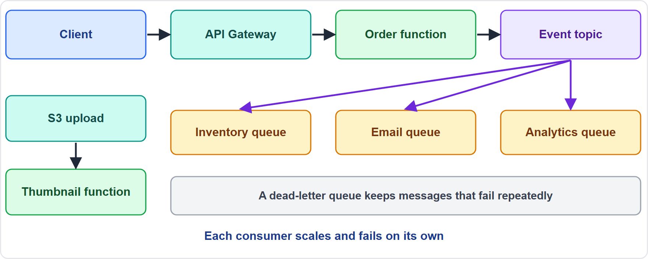
An Event-Driven Microservice Pattern
Part 3
API Gateway receives the request; a function accepts the order and publishes an event
Queues buffer the work for payment, inventory and email workers
Dead-letter queues catch failures; retries are safe if workers are idempotent
Each microservice owns its data and scales alone
EXAM TIP Accept fast, process later: acknowledge the request, then work through queues.
Solutions Architect Associate Exam Prep Masterclass | for the AWS SAA-C03 exam
Module 4: Scalable and Loosely Coupled Architectures
23 / 38
Notes:
Here is a pattern that ties it together. A P I Gateway receives the request, and a function accepts the order and publishes an event. Queues buffer the work for payment, inventory and email workers. Dead-letter queues catch failures, and retries are safe if workers are idempotent, which means repeating a message has no extra effect. Each microservice owns its data and scales alone. The figure also shows an S three upload that triggers a thumbnail function. Exam tip: accept fast, process later: acknowledge the request, then do the work through queues.

Slide 24
Lambda, Fargate or EC2?
Part 3
 | Lambda | Fargate | EC2
Unit | A function | A container | A virtual server
Run time | Up to 15 minutes | No fixed limit | No fixed limit
You manage | Code only | The container | The OS and scaling
Best for | Event-driven, spiky, short | Long-running services, batch jobs | Full control, special hardware, licenses
EXAM TIP Longer than 15 minutes or already a container: Fargate. Least management for short events: Lambda.
Solutions Architect Associate Exam Prep Masterclass | for the AWS SAA-C03 exam
Module 4: Scalable and Loosely Coupled Architectures
24 / 38
Notes:
Here is the compute decision. Lambda's unit is a function, it runs for up to fifteen minutes, you manage only code, and it is best for event-driven, spiky, short work. Fargate's unit is a container, it has no fixed time limit, you manage the container, and it is best for long-running services and batch jobs. E C two's unit is a virtual server, it has no fixed time limit, you manage the operating system and scaling, and it is best for full control, special hardware or licenses. Exam tip: longer than fifteen minutes, or already a container, points to Fargate; least management for short events is Lambda.

Slide 25
What the Exam Asks: Scalable and Loosely Coupled
Part 3
Which coupling service
Which scaling approach
Which load balancer or cache
SQS, SNS, EventBridge, MQ or Step Functions
vertical or horizontal, stateless or stateful
ALB, NLB, GWLB, ElastiCache or a replica
Which compute
Which managed service
Lambda, Fargate, ECS, EKS or EC2
API Gateway, Beanstalk, Amplify or Transfer Family
EXAM TIP Underline the requirement: least overhead, buffering, fan-out, order or portability.
Solutions Architect Associate Exam Prep Masterclass | for the AWS SAA-C03 exam
Module 4: Scalable and Loosely Coupled Architectures
25 / 38
Notes:
Here is what the exam asks. Which coupling service: S Q S, S N S, EventBridge, Amazon M Q or Step Functions. Which scaling approach: vertical or horizontal, stateless or stateful. Which load balancer or cache: A L B, N L B, Gateway Load Balancer, ElastiCache or a replica. Which compute: Lambda, Fargate, E C S, E K S or E C two. And which managed service: A P I Gateway, Beanstalk, Amplify or Transfer Family. Exam tip: underline the requirement: least overhead, buffering, fan-out, order or portability.

Slide 26
Design Check: Lantern and Loom Meets the Holiday Rush
Part 3
Requirement | Design
Checkout waits on the email service | An SQS queue and a worker
Sessions vanish when a server is replaced | Stateless web tier, sessions in ElastiCache
/api and /images served by different services | One ALB, path rules, two target groups
Partners need fixed IP addresses on TCP | A Network Load Balancer with Elastic IPs
Catalog reads overload the database | Read replicas and a cache
One order must reach three consumers | SNS topic fanning out to SQS queues
Multi-step order flow with retries | Step Functions
A public API with throttling and keys | API Gateway
Cover the right column, answer each row yourself, then compare
Solutions Architect Associate Exam Prep Masterclass | for the AWS SAA-C03 exam
Module 4: Scalable and Loosely Coupled Architectures
26 / 38
Notes:
Here is the Design Check. Cover the right column and answer each row yourself. Checkout waits on the email service: an S Q S queue and a worker. Sessions vanish when a server is replaced: a stateless web tier, with sessions in ElastiCache. Slash A P I and slash images served by different services: one A L B, path rules, and two target groups. Partners need fixed I P addresses on T C P: a Network Load Balancer with Elastic I P addresses. Catalog reads overload the database: read replicas and a cache. One order must reach three consumers: an S N S topic fanning out to S Q S queues. A multi-step order flow with retries: Step Functions. And a public A P I with throttling and keys: A P I Gateway.

Slide 27
Module Recap
Part 3
1
Loose coupling
2
Scaling
3
Entry points
queues, topics, event buses and workflows between components
scale out, keep tiers stateless, cache and use read replicas
ALB for HTTP routing, NLB for static IPs and TCP or UDP, API Gateway for APIs
4
Messaging
5
Compute
SQS buffers, SNS fans out, EventBridge routes, MQ migrates, Step Functions orchestrates
Lambda for short events, Fargate for containers, managed services for least overhead
Solutions Architect Associate Exam Prep Masterclass | for the AWS SAA-C03 exam
Module 4: Scalable and Loosely Coupled Architectures
27 / 38
Notes:
Here is the recap. For loose coupling, put queues, topics, event buses and workflows between components. For scaling, scale out, keep tiers stateless, and use caches and read replicas. For entry points, use A L B for H T T P routing, N L B for static I P s and T C P or U D P, and A P I Gateway for A P I s. For messaging, S Q S buffers, S N S fans out, EventBridge routes, Amazon M Q migrates, and Step Functions orchestrates. For compute, Lambda handles short events, Fargate runs containers, and managed services give the least overhead.

Slide 28
Practice Question 1
Part 3
Q1
At Lantern and Loom, the checkout service calls the email service directly, and a slow email service delays every order. Which change makes the two components loosely coupled?
A
Give the email service a larger instance type so it responds faster
B
Send each email request to an SQS queue that a worker reads
C
Put both services on the same instance to cut network latency
D
Increase the timeout of the direct call so checkout waits longer
Solutions Architect Associate Exam Prep Masterclass | for the AWS SAA-C03 exam
Module 4: Scalable and Loosely Coupled Architectures
28 / 38
Notes:
Question one. At Lantern and Loom, the checkout service calls the email service directly, and a slow email service delays every order. Which change makes the two components loosely coupled? The four options are on the screen. [PAUSE 12] The answer is B: send an email request to an Amazon S Q S queue that a worker reads. Checkout finishes immediately, the worker sends emails at its own pace, and the queue buffers spikes.

Slide 29
Practice Question 2
Part 3
Q2
Lantern and Loom's web servers keep shopping-cart sessions in memory, so replacing a server logs customers out. The team wants to scale out freely. What should the architect do?
A
Enable sticky sessions on the load balancer and keep the current design
B
Move to a single larger instance and stop scaling out the web tier
C
Store the sessions on the local disk of each instance in the fleet
D
Store sessions in ElastiCache so any instance can serve any request
Solutions Architect Associate Exam Prep Masterclass | for the AWS SAA-C03 exam
Module 4: Scalable and Loosely Coupled Architectures
29 / 38
Notes:
Question two. Lantern and Loom's web servers keep shopping-cart sessions in memory, so replacing a server logs customers out. The team wants to scale out freely. What should the architect do? The four options are on the screen. [PAUSE 12] The answer is D: store sessions in Amazon ElastiCache, so any instance can serve any request. That makes the web tier stateless. Sticky sessions and local disks still tie a customer to one server.

Slide 30
Practice Question 3
Part 3
Q3
A partner needs to connect to Lantern and Loom over TCP from fixed IP addresses, with very high throughput and low latency. Which load balancer fits?
A
A Network Load Balancer with an Elastic IP address per zone
B
An Application Load Balancer with path-based routing rules and a WAF
C
A Classic Load Balancer with sticky sessions enabled
D
A Gateway Load Balancer in front of a firewall appliance
Solutions Architect Associate Exam Prep Masterclass | for the AWS SAA-C03 exam
Module 4: Scalable and Loosely Coupled Architectures
30 / 38
Notes:
Question three. A partner needs to connect to Lantern and Loom over T C P from fixed I P addresses, with very high throughput and low latency. Which load balancer fits? The four options are on the screen. [PAUSE 12] The answer is A: a Network Load Balancer with an Elastic I P address per zone. It works at layer four with very high throughput. An Application Load Balancer works at layer seven, and a Gateway Load Balancer fronts appliances.

Slide 31
Practice Question 4
Part 3
Q4
The product catalog of Lantern and Loom runs on Amazon RDS and its read traffic is overloading the primary instance. Which TWO actions reduce the read load? (Select TWO.)
A
Add one or more RDS read replicas and send reads to them
B
Use the Multi-AZ standby instance for read queries
C
Reduce the retention period of automated backups
D
Place an Amazon ElastiCache cache in front of the database
E
Turn off synchronous replication to the standby
Solutions Architect Associate Exam Prep Masterclass | for the AWS SAA-C03 exam
Module 4: Scalable and Loosely Coupled Architectures
31 / 38
Notes:
Question four. Select two. The product catalog of Lantern and Loom runs on Amazon R D S, and its read traffic is overloading the primary instance. Which two actions reduce the read load? The five options are on the screen. [PAUSE 15] The answers are A and D. Read replicas serve read-only copies, and an ElastiCache cache answers repeated reads without reaching the database. A Multi-A Z standby cannot serve reads, and changing backups or standby replication does not reduce read load.

Slide 32
Practice Question 5
Part 3
Q5
Lantern and Loom wants a managed, public REST API for its mobile app, with throttling, API keys per partner and a Lambda function behind it. Which service should the architect choose?
A
An Application Load Balancer with a fixed response
B
Amazon CloudFront with a Lambda origin only
C
Amazon API Gateway REST API with usage plans and API keys
D
An Amazon SNS topic with an HTTP subscription
Solutions Architect Associate Exam Prep Masterclass | for the AWS SAA-C03 exam
Module 4: Scalable and Loosely Coupled Architectures
32 / 38
Notes:
Question five. Lantern and Loom wants a managed, public Rest A P I for its mobile app, with throttling, A P I keys per partner and a Lambda function behind it. Which service should the architect choose? The four options are on the screen. [PAUSE 12] The answer is C: Amazon A P I Gateway Rest A P I with usage plans. It provides throttling, usage plans and A P I keys, and integrates directly with Lambda.

Slide 33
Practice Question 6
Part 3
Q6
Which TWO statements about Amazon SQS queue types are correct? (Select TWO.)
A
Standard queues guarantee strict first-in, first-out ordering
B
Standard queues deliver each message at least once, so consumers should tolerate duplicates
C
FIFO queues deliver every message to many subscribers at once
D
Standard queues automatically delete a message when it is received
E
FIFO queues provide ordering and exactly-once processing
Solutions Architect Associate Exam Prep Masterclass | for the AWS SAA-C03 exam
Module 4: Scalable and Loosely Coupled Architectures
33 / 38
Notes:
Question six. Select two. Which two statements about Amazon S Q S queue types are correct? The five options are on the screen. [PAUSE 15] The answers are B and E. Standard queues deliver each message at least once, so consumers should tolerate duplicates. Fifo queues provide ordering and exactly-once processing. Publishing one message to many subscribers is S N S, and a consumer must delete a message after processing it.

Slide 34
Practice Question 7
Part 3
Q7
When an order is placed, Lantern and Loom must notify the inventory, email and analytics systems. Each system must process messages at its own pace, and a new system must be addable without changing the order service. Which design fits?
A
The order service calls the inventory, email and analytics systems in turn
B
Publish to an SNS topic that has one SQS queue per system
C
One shared SQS queue that all three systems read from
D
A scheduled Lambda function that polls the order database for changes
Solutions Architect Associate Exam Prep Masterclass | for the AWS SAA-C03 exam
Module 4: Scalable and Loosely Coupled Architectures
34 / 38
Notes:
Question seven. When an order is placed, Lantern and Loom must notify the inventory, email and analytics systems. Each system must process messages at its own pace, and a new system must be addable without changing the order service. Which design fits? The four options are on the screen. [PAUSE 12] The answer is B: publish to an S N S topic that has one S Q S queue per system. Fan-out gives each system its own durable buffer, while a single shared queue gives each message to only one consumer.

Slide 35
Practice Question 8
Part 3
Q8
Lantern and Loom's refund process has several steps, needs retries, branches on the order value, and must wait for a human approval that can take days. Which service should orchestrate it?
A
A single Lambda function that sleeps until approval
B
An Amazon SQS queue with a long visibility timeout
C
An Amazon SNS topic with email subscribers
D
Step Functions Standard workflow with a callback
Solutions Architect Associate Exam Prep Masterclass | for the AWS SAA-C03 exam
Module 4: Scalable and Loosely Coupled Architectures
35 / 38
Notes:
Question eight. Lantern and Loom's refund process has several steps, needs retries, branches on the order value, and must wait for a human approval that can take days. Which service should orchestrate it? The four options are on the screen. [PAUSE 12] The answer is D: a Step Functions Standard workflow with a callback. Standard workflows run for up to a year. A Lambda function is limited to fifteen minutes, and queues and topics do not orchestrate steps.

Slide 36
Practice Question 9
Part 3
Q9
A nightly job at Lantern and Loom processes catalog images for about forty minutes inside a custom container. The team wants no servers to manage. Which option fits best?
A
An AWS Fargate task that runs the container without servers
B
An AWS Lambda function with the maximum timeout
C
An API Gateway endpoint that runs the job
D
An Application Load Balancer with a fixed response
Solutions Architect Associate Exam Prep Masterclass | for the AWS SAA-C03 exam
Module 4: Scalable and Loosely Coupled Architectures
36 / 38
Notes:
Question nine. A nightly job at Lantern and Loom processes catalog images for about forty minutes inside a custom container. The team wants no servers to manage. Which option fits best? The four options are on the screen. [PAUSE 12] The answer is A: an A W S Fargate task that runs the container. Fargate runs containers without servers and has no fixed time limit. A Lambda invocation stops after fifteen minutes.

Slide 37
Practice Question 10
Part 3
Q10
A company is moving an on-premises application that uses JMS to talk to its message broker. It wants to keep the messaging code unchanged. Which service should it choose?
A
Amazon SNS with an HTTP endpoint
B
Amazon EventBridge with a custom bus
C
Amazon MQ
D
Amazon SQS with a long polling client
Solutions Architect Associate Exam Prep Masterclass | for the AWS SAA-C03 exam
Module 4: Scalable and Loosely Coupled Architectures
37 / 38
Notes:
Question ten. A company is moving an on-premises application that uses J M S to talk to its message broker. It wants to keep the messaging code unchanged. Which service should it choose? The four options are on the screen. [PAUSE 12] The answer is C: Amazon M Q. It is a managed broker for ActiveMQ and RabbitMQ that supports J M S and other standard protocols, so the code can move without a rewrite.

Slide 38
Answers at a Glance
Part 3
Question | Answer | Why
Q1 | B | A queue decouples checkout from email
Q2 | D | Move sessions out of the instances
Q3 | A | NLB with Elastic IPs for TCP
Q4 | A, D | Read replicas and a cache offload reads
Q5 | C | API Gateway with usage plans
Q6 | B, E | At-least-once standard; ordered exactly-once FIFO
Q7 | B | SNS fan-out to one queue per system
Q8 | D | Step Functions Standard with a callback
Q9 | A | Fargate has no 15-minute limit
Q10 | C | Amazon MQ supports JMS
Solutions Architect Associate Exam Prep Masterclass | for the AWS SAA-C03 exam
Module 4: Scalable and Loosely Coupled Architectures
38 / 38
Notes:
Here are all ten answers. Question one: B. Question two: D. Question three: A. Question four: A and D. Question five: C. Question six: B and E. Question seven: B. Question eight: D. Question nine: A. Question ten: C. In Module five, we design for high availability and fault tolerance, including disaster recovery.

