Slide 1
Module 0: Course Introduction and Exam Orientation
What the exam is: 63 items, 120 minutes, a scaled score of 720 to
Course module · exam orientation and review
Claude Architect Professional Exam Prep Masterclass
Module 0
Notes:
Welcome to Module zero: Course Introduction and Exam Orientation. This module covers exam orientation and the course map.
Each part of this module comes from the study notes of the same name, so you can read the notes after you watch.

Slide 2
What You Will Learn
Module 0
What the exam is: 63 items, 120 minutes, a scaled score of 720 to pass
The seven domains, their weights and the 38 objectives behind them
The minimally qualified candidate the exam is written for
The architect decision rules that explain most correct answers
How the course is built and how to use it
Claude Architect Professional Exam Prep | for the CCAR-P exam
Module 0: Course Introduction and Exam Orientation
2 / 19
Notes:
By the end of this module you will be able to do five things.
What the exam is: sixty-three items, one hundred twenty minutes, a scaled score of seven hundred twenty to pass.
The seven domains, their weights and the thirty-eight objectives behind them.
The minimally qualified candidate the exam is written for.
The architect decision rules that explain most correct answers.
How the course is built and how to use it.

Slide 3
Case Check-In: Lumen Advisory
Module 0
CASE CHECK-IN · Lumen Advisory
Throughout the course you follow Lumen Advisory, a fictional consultancy
Its architects design Claude solutions for clients in banking, healthcare, retail and government
Each module solves one architecture problem for a client; the questions use the same style as the exam
Claude Architect Professional Exam Prep | for the CCAR-P exam
Module 0: Course Introduction and Exam Orientation
3 / 19
Notes:
Our running case is Lumen Advisory. Lumen Advisory.
Throughout the course you follow Lumen Advisory, a fictional consultancy.
Its architects design Claude solutions for clients in banking, healthcare, retail and government.
Each module solves one architecture problem for a client; the questions use the same style as the exam.

Slide 4
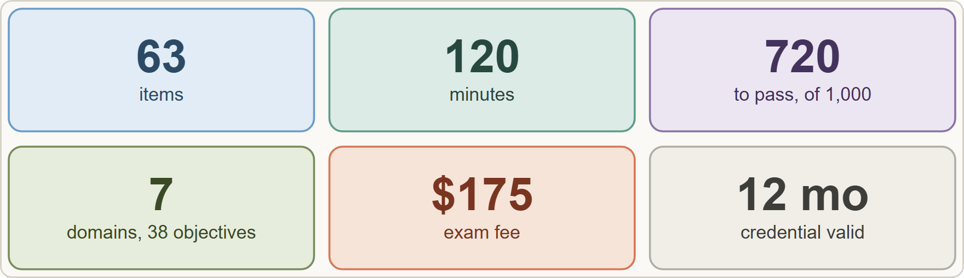
The Exam at a Glance
Module 0
The CCAR-P exam at a glance: 63 items, 120 minutes, scaled score 100 to 1,000 with 720 to pass, 7 domains, USD 175, valid 12 months
Claude Architect Professional Exam Prep | for the CCAR-P exam
Module 0: Course Introduction and Exam Orientation
4 / 19
Notes:
The Exam at a Glance.
The figure shows this: The C C A R P exam at a glance: sixty-three items, one hundred twenty minutes, scaled score one hundred to one thousand with seven hundred twenty to pass, seven domains, U S D one hundred seventy-five, valid twelve months.

Slide 5
The Exam at a Glance, continued
DATES
Module 0
Fact | Value (guide v1.0, July 2026)
Credential / code | Claude Architect – Professional / CCAR-P
Items | 63, multiple choice and multiple response; each item says how many answers to select
Time | 120 minutes (about 1 minute 54 seconds per item)
Passing score | 720 on a scaled range of 100 to 1,000 (criterion-referenced: a fixed standard, not a ranking)
Fee | USD 175 per attempt
Delivery | Proctored by Pearson VUE: online or at a test center
Validity | 12 months from the date the credential is awarded; on-time renewal is a free, non-proctored assessment
Claude Architect Professional Exam Prep | for the CCAR-P exam
Module 0: Course Introduction and Exam Orientation
5 / 19
Notes:
The Exam at a Glance, continued.
Credential or code. Claude Architect to Professional or C C A R P.
Items. sixty-three, multiple choice and multiple response; each item says how many answers to select.
Time. one hundred twenty minutes (about one minute fifty-four seconds per item).
Passing score. seven hundred twenty on a scaled range of one hundred to one thousand (criterion-referenced: a fixed standard, not a ranking).
Fee. U S D one hundred seventy-five per attempt.
Delivery. Proctored by Pearson V U E: online or at a test center.
Validity. twelve months from the date the credential is awarded; on-time renewal is a free, non-proctored assessment.

Slide 6
The Exam at a Glance, continued
DATES
Module 0
Fact | Value (guide v1.0, July 2026)
Retakes | Wait 14 days after the first failed attempt, 30 after the second, 90 after the third; at most 4 attempts in a rolling 12 months; limits are per exam
Prerequisites | None are required; recommended: 3+ years in systems architecture or platform engineering and 6+ months with Claude or comparable LLM systems in production
Score report | Pass or fail, the scaled score, and the percent correct per domain (domain figures do not decide pass or fail)
EXAM TIP For a multiple-response item the stem says how many answers to select: read that number first, then choose exactly that many.
Claude Architect Professional Exam Prep | for the CCAR-P exam
Module 0: Course Introduction and Exam Orientation
6 / 19
Notes:
The Exam at a Glance, continued.
Retakes. Wait fourteen days after the first failed attempt, thirty after the second, ninety after the third; at most four attempts in a rolling twelve months; limits are per exam.
Prerequisites. None are required; recommended: three plus years in systems architecture or platform engineering and six plus months with Claude or comparable L L M (large language model) systems in production.
Score report. Pass or fail, the scaled score, and the percent correct per domain (domain figures do not decide pass or fail).
Exam tip: For a multiple-response item the stem says how many answers to select: read that number first, then choose exactly that many.

Slide 7
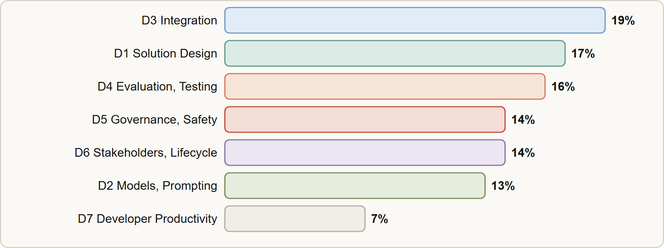
The Seven Domains
Module 0
Domain weights: D3 Integration 19, D1 Solution Design and Architecture 17, D4 Evaluation Testing and Optimization 16, D5 Governance Safety and Risk 14, D6 Stakeholder Communication and Lifecycle 14, D2 Models Prompting and Context 13, D7 Developer Productivity 7
Claude Architect Professional Exam Prep | for the CCAR-P exam
Module 0: Course Introduction and Exam Orientation
7 / 19
Notes:
The Seven Domains.
The figure shows this: Domain weights: D three Integration nineteen, D one Solution Design and Architecture seventeen, D four Evaluation Testing and Optimization sixteen, D five Governance Safety and Risk fourteen, D six Stakeholder Communication and Lifecycle fourteen, D two Models Prompting and Context thirteen, D seven Developer Productivity seven.

Slide 8
The Seven Domains, continued
Module 0
Domain | Weight | What it asks you to do | Modules
D3 Integration | 19% | Spot tool bloat and security gaps; trade accuracy against latency; design RAG; choose MCP, API/CLI or agent-to-agent; observe at scale | 7 to 10
D1 Solution Design & Architecture | 17% | Turn business problems into architectures; pick workflow, agentic or augmented-LLM patterns; design multi-agent systems; decompose | 1 to 3
D4 Evaluation, Testing & Optimization | 16% | Define metrics and datasets; A/B test; diagnose; optimize cost, latency, tokens; monitor | 11, 12
D5 Governance, Safety & Risk | 14% | Guardrails, failure modes, human review, GDPR, HIPAA, FedRAMP, ethics | 13, 14
Claude Architect Professional Exam Prep | for the CCAR-P exam
Module 0: Course Introduction and Exam Orientation
8 / 19
Notes:
The Seven Domains, continued.
D three Integration. Weight: nineteen percent. What it asks you to do: Spot tool bloat and security gaps; trade accuracy against latency; design R A G; choose M C P (Model Context Protocol), A P I (application programming interface) or C L I (command-line interface) or agent-to-agent; observe at scale. Modules: seven to ten.
D one Solution Design and Architecture. Weight: seventeen percent. What it asks you to do: Turn business problems into architectures; pick workflow, agentic or augmented-L L M patterns; design multi-agent systems; decompose. Modules: one to three.
D four Evaluation, Testing and Optimization. Weight: sixteen percent. What it asks you to do: Define metrics and datasets; A or B test; diagnose; optimize cost, latency, tokens; monitor. Modules: eleven, twelve.
D five Governance, Safety and Risk. Weight: fourteen percent. What it asks you to do: Guardrails, failure modes, human review, G D P R, H I P A A, Fed R A M P, ethics. Modules: thirteen, fourteen.

Slide 9
The Seven Domains, continued
Module 0
Domain | Weight | What it asks you to do | Modules
D6 Stakeholder Communication & Lifecycle | 14% | Discovery, communicating trade-offs, SLAs, documentation, lifecycle phases | 15, 16
D2 Claude Models, Prompting & Context | 13% | Model trade-offs, system prompts, prompting techniques, context and token management, reuse | 4 to 6
D7 Developer Productivity & Operational Enablement | 7% | Configure Claude Code for teams, AI-assisted workflows, debugging and operations | 17
Of 63 items, about 12 come from D3, 11 from D1, 10 from D4, 9 each from D5 and D6, 8 from D2 and 4 to 5 from D7.
Claude Architect Professional Exam Prep | for the CCAR-P exam
Module 0: Course Introduction and Exam Orientation
9 / 19
Notes:
The Seven Domains, continued.
D six Stakeholder Communication and Lifecycle. Weight: fourteen percent. What it asks you to do: Discovery, communicating trade-offs, S L A s (service level agreement), documentation, lifecycle phases. Modules: fifteen, sixteen.
D two Claude Models, Prompting and Context. Weight: thirteen percent. What it asks you to do: Model trade-offs, system prompts, prompting techniques, context and token management, reuse. Modules: four to six.
D seven Developer Productivity and Operational Enablement. Weight: seven percent. What it asks you to do: Configure Claude Code for teams, A I-assisted workflows, debugging and operations. Modules: seventeen.
Of sixty-three items, about twelve come from D three, eleven from D one, ten from D four, nine each from D five and D six, eight from D two and four to five from D seven.

Slide 10
The Seven Domains, continued
Module 0
Weights are the approximate share of scored items. Items are written against the 38 objectives listed in the guide.
Study order by value: D3 and D1 first (over a third together), then D4, D5, D6 and D2; D7 is the smallest.
EXAM TIP No domain is negligible except D7 at 7 percent. Integration is the largest, so give it the most practice.
Claude Architect Professional Exam Prep | for the CCAR-P exam
Module 0: Course Introduction and Exam Orientation
10 / 19
Notes:
The Seven Domains, continued.
Weights are the approximate share of scored items. Items are written against the thirty-eight objectives listed in the guide.
Study order by value: D three and D one first (over a third together), then D four, D five, D six and D two; D seven is the smallest.
Exam tip: No domain is negligible except D seven at seven percent. Integration is the largest, so give it the most practice.

Slide 11
The Minimally Qualified Candidate
Module 0
The minimally qualified candidate (MQC) can:
translate business requirements into scalable, secure, reliable architectures
design end-to-end systems: prompt and context engineering, retrieval-augmented generation (RAG), API integration, orchestration and evaluation
weigh trade-offs among cost, latency, performance, safety and maintainability
integrate Claude into production systems with APIs, orchestration tools and data pipelines
build in evaluation, monitoring, security, compliance and governance
communicate architectural decisions to engineers, legal and executives
Claude Architect Professional Exam Prep | for the CCAR-P exam
Module 0: Course Introduction and Exam Orientation
11 / 19
Notes:
The Minimally Qualified Candidate.
The minimally qualified candidate (M Q C) can.
translate business requirements into scalable, secure, reliable architectures.
design end-to-end systems: prompt and context engineering, retrieval-augmented generation (R A G), A P I integration, orchestration and evaluation.
weigh trade-offs among cost, latency, performance, safety and maintainability.
integrate Claude into production systems with A P I s, orchestration tools and data pipelines.
build in evaluation, monitoring, security, compliance and governance.
communicate architectural decisions to engineers, legal and executives.

Slide 12
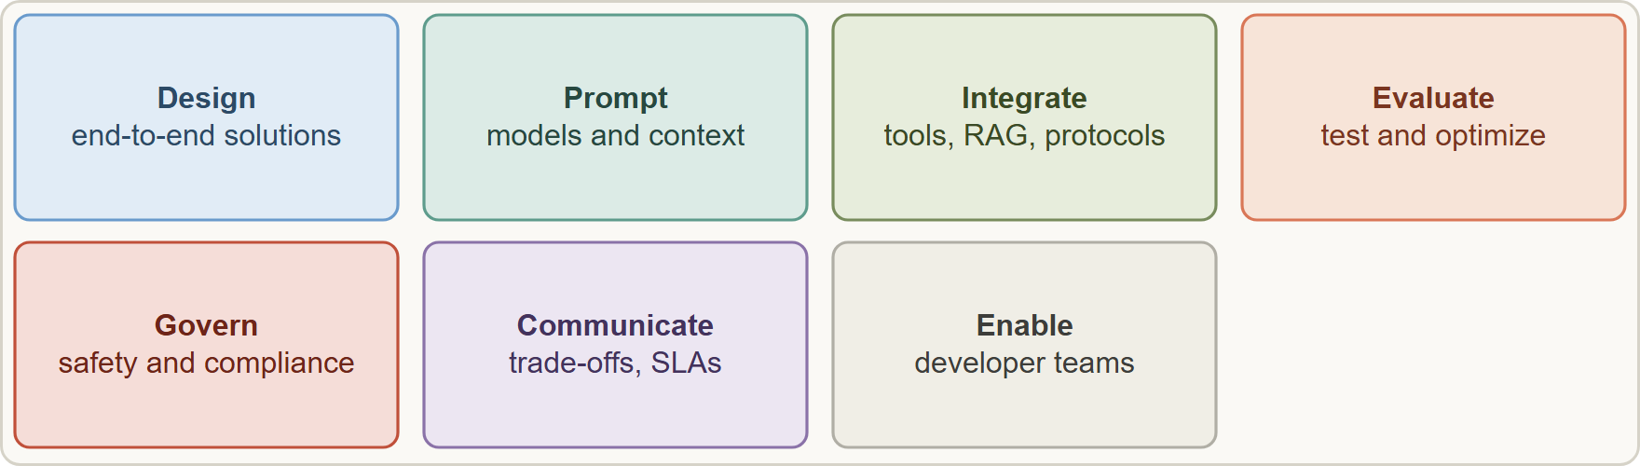
The Minimally Qualified Candidate, continued
Module 0
The minimally qualified candidate designs, prompts, integrates, evaluates, governs, communicates and enables teams on Claude solutions
Claude Architect Professional Exam Prep | for the CCAR-P exam
Module 0: Course Introduction and Exam Orientation
12 / 19
Notes:
The Minimally Qualified Candidate, continued.
The figure shows this: The minimally qualified candidate designs, prompts, integrates, evaluates, governs, communicates and enables teams on Claude solutions.

Slide 13
Ten Decision Rules the Questions Reward
Module 0
Most items describe a requirement or a failure and ask for the best design choice. The best answer usually follows one of these rules. Each later module shows them at work.
Claude Architect Professional Exam Prep | for the CCAR-P exam
Module 0: Course Introduction and Exam Orientation
13 / 19
Notes:
Ten Decision Rules the Questions Reward.
Most items describe a requirement or a failure and ask for the best design choice. The best answer usually follows one of these rules. Each later module shows them at work.

Slide 14
Ten Decision Rules the Questions Reward, continued
Module 0
# | Rule | Typical wrong answers
1 | Start with the simplest pattern that meets the need (single call, then workflow, then agent) | An agent or multi-agent system for a fixed task
2 | Remove risk at the source: least privilege means removing capabilities, not logging them | Adding logging or a confirmation instead of removing the tool
3 | Cache the stable prefix; put static content before dynamic content | Truncating needed context or shrinking the model blindly
4 | Match the model to the task and prove it with evals | "Always the largest" or "always the smallest"
Claude Architect Professional Exam Prep | for the CCAR-P exam
Module 0: Course Introduction and Exam Orientation
14 / 19
Notes:
Ten Decision Rules the Questions Reward, continued.
one. Rule: Start with the simplest pattern that meets the need (single call, then workflow, then agent). Typical wrong answers: An agent or multi-agent system for a fixed task.
two. Rule: Remove risk at the source: least privilege means removing capabilities, not logging them. Typical wrong answers: Adding logging or a confirmation instead of removing the tool.
three. Rule: Cache the stable prefix; put static content before dynamic content. Typical wrong answers: Truncating needed context or shrinking the model blindly.
four. Rule: Match the model to the task and prove it with evals. Typical wrong answers: "Always the largest" or "always the smallest".

Slide 15
Ten Decision Rules the Questions Reward, continued
Module 0
# | Rule | Typical wrong answers
5 | Retrieve only what is needed: tool search, progressive discovery, RAG for large knowledge, full context for small | Loading every tool and document up front
6 | Investigate the first place the symptom points: confident wrong answers after a refresh point to retrieval | Blaming silent model changes
7 | Measure before and after with defined metrics, datasets and controlled comparisons | Judging by a few impressions
8 | Keep humans in the loop for irreversible or high-risk actions, and enforce rules in code | Stronger prompt wording
Claude Architect Professional Exam Prep | for the CCAR-P exam
Module 0: Course Introduction and Exam Orientation
15 / 19
Notes:
Ten Decision Rules the Questions Reward, continued.
five. Rule: Retrieve only what is needed: tool search, progressive discovery, R A G for large knowledge, full context for small. Typical wrong answers: Loading every tool and document up front.
six. Rule: Investigate the first place the symptom points: confident wrong answers after a refresh point to retrieval. Typical wrong answers: Blaming silent model changes.
seven. Rule: Measure before and after with defined metrics, datasets and controlled comparisons. Typical wrong answers: Judging by a few impressions.
eight. Rule: Keep humans in the loop for irreversible or high-risk actions, and enforce rules in code. Typical wrong answers: Stronger prompt wording.

Slide 16
Ten Decision Rules the Questions Reward, continued
Module 0
# | Rule | Typical wrong answers
9 | Meet the regime with the right platform and contract (BAA, ZDR, data residency, GovCloud) | Assuming any API route is compliant
10 | Communicate trade-offs, assumptions and SLAs and document decisions | Promising certainty or hiding limits
EXAM TIP When two options both work, prefer the one that is simple, least-privileged, measured, cost-aware and compliant.
Claude Architect Professional Exam Prep | for the CCAR-P exam
Module 0: Course Introduction and Exam Orientation
16 / 19
Notes:
Ten Decision Rules the Questions Reward, continued.
nine. Rule: Meet the regime with the right platform and contract (B A A, Z D R, data residency, Gov Cloud). Typical wrong answers: Assuming any A P I route is compliant.
ten. Rule: Communicate trade-offs, assumptions and S L A s and document decisions. Typical wrong answers: Promising certainty or hiding limits.
Exam tip: When two options both work, prefer the one that is simple, least-privileged, measured, cost-aware and compliant.

Slide 17
How to Use This Course
Module 0
Order: read modules 1 to 17 in order (they follow the domains), then module 18 (recap) and 19 (technique).
Each module has the objectives it covers, a case, tables, figures, Exam tips, scenario questions with explanations and a Quick Reference Card.
Build one end-to-end solution. The guide recommends building and operating at least one Claude solution with RAG, evaluation and observability.
Product details change fast. Boxes marked show current behavior. On the exam, answer by the principle and check the official documentation for current details.
Claude Architect Professional Exam Prep | for the CCAR-P exam
Module 0: Course Introduction and Exam Orientation
17 / 19
Notes:
How to Use This Course.
Order: read modules one to seventeen in order (they follow the domains), then module eighteen (recap) and nineteen (technique).
Each module has the objectives it covers, a case, tables, figures, Exam tips, scenario questions with explanations and a Quick Reference Card.
Build one end-to-end solution. The guide recommends building and operating at least one Claude solution with R A G, evaluation and observability.
Product details change fast. Boxes marked show current behavior. On the exam, answer by the principle and check the official documentation for current details.

Slide 18
How to Use This Course, continued
Module 0
Independence. This course is independent study material; it is not affiliated with, endorsed by or sponsored by Anthropic or Pearson VUE. Read the official exam guide, the Certification Terms and Conditions and the Exam Policy before you register.
Claude Architect Professional Exam Prep | for the CCAR-P exam
Module 0: Course Introduction and Exam Orientation
18 / 19
Notes:
How to Use This Course, continued.
Independence. This course is independent study material; it is not affiliated with, endorsed by or sponsored by Anthropic or Pearson V U E. Read the official exam guide, the Certification Terms and Conditions and the Exam Policy before you register.

Slide 19
Module Recap
Module 0
1
Exam
2
Domains
3
Objectives
CCAR-P; 63 items; 120 min; pass 720 of 1,000; USD 175; valid 12 months
D3 19 · D1 17 · D4 16 · D5 14 · D6 14 · D2 13 · D7 7
38 in all
4
Prerequisites
5
Retakes
6
Ten rules
None required; 3+ years architecture and 6+ months Claude recommended
14, 30, 90 days; max 4 per rolling 12 months
Simplest pattern · remove risk at the source · cache the stable prefix · match model to task · retrieve only what is needed · investigate the first symptom · measure · humans in the loop · right platform for the regime · communicate trade-offs
Claude Architect Professional Exam Prep | for the CCAR-P exam
Module 0: Course Introduction and Exam Orientation
19 / 19
Notes:
Here is the recap.
Exam: C C A R P; sixty-three items; one hundred twenty min; pass seven hundred twenty of one thousand; U S D one hundred seventy-five; valid twelve months.
Domains: D three nineteen, D one seventeen, D four sixteen, D five fourteen, D six fourteen, D two thirteen, D seven seven.
Objectives: thirty-eight in all.
Prerequisites: None required; three plus years architecture and six plus months Claude recommended.
Retakes: fourteen, thirty, ninety days; max four per rolling twelve months.
Ten rules: Simplest pattern, remove risk at the source, cache the stable prefix, match model to task, retrieve only what is needed, investigate the first symptom, measure, humans in the loop, right platform for the regime, communicate trade-offs.
In the next module, we continue the course.

