Slide 1
Module 1: From Business Problem to Claude Solution
How to turn a vague business ask into a testable problem statement
Domain 1 · Solution Design & Architecture
Claude Architect Professional Exam Prep Masterclass
Module 1
Notes:
Welcome to Module one: From Business Problem to Claude Solution. This module covers from business problem to claude solution.
Each part of this module comes from the study notes of the same name, so you can read the notes after you watch.

Slide 2
What You Will Learn
Module 1
How to turn a vague business ask into a testable problem statement
How to decide whether Claude is the right tool and which solution shape fits
The five business value pillars and how to attach measurable targets to them
How to frame constraints and risks before design starts
Claude Architect Professional Exam Prep | for the CCAR-P exam
Module 1: From Business Problem to Claude Solution
2 / 24
Notes:
By the end of this module you will be able to do four things.
How to turn a vague business ask into a testable problem statement.
How to decide whether Claude is the right tool and which solution shape fits.
The five business value pillars and how to attach measurable targets to them.
How to frame constraints and risks before design starts.

Slide 3
Case Check-In: Lumen Advisory and the Bank That Wants "AI for Customer Service"
Module 1
CASE CHECK-IN · Lumen Advisory
A retail bank's executive says: "We want AI in customer service."
Lumen's architect asks what hurts: average handle time, inconsistent answers, after-hours coverage, cost per contact
The ask becomes: draft replies for agents from the policy library, with citations, cut handle time 25 percent, no regulated advice without review
Claude Architect Professional Exam Prep | for the CCAR-P exam
Module 1: From Business Problem to Claude Solution
3 / 24
Notes:
Our running case is Lumen Advisory. Lumen Advisory and the Bank That Wants "A I for Customer Service".
A retail bank's executive says: "We want A I in customer service.".
Lumen's architect asks what hurts: average handle time, inconsistent answers, after-hours coverage, cost per contact.
The ask becomes: draft replies for agents from the policy library, with citations, cut handle time twenty-five percent, no regulated advice without review.

Slide 4
From Ask to Problem Statement
Module 1
A business ask is a wish; a problem statement names who, what, how well, under which constraints.
Claude Architect Professional Exam Prep | for the CCAR-P exam
Module 1: From Business Problem to Claude Solution
4 / 24
Notes:
From Ask to Problem Statement.
A business ask is a wish; a problem statement names who, what, how well, under which constraints.

Slide 5
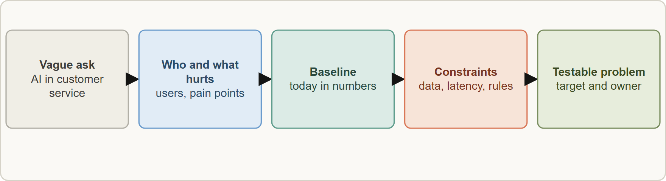
From Ask to Problem Statement, continued
Module 1
From a vague ask to a testable problem statement: who is affected, what hurts, how it is measured today, which constraints apply, and a target with an owner
Claude Architect Professional Exam Prep | for the CCAR-P exam
Module 1: From Business Problem to Claude Solution
5 / 24
Notes:
From Ask to Problem Statement, continued.
The figure shows this: From a vague ask to a testable problem statement: who is affected, what hurts, how it is measured today, which constraints apply, and a target with an owner.

Slide 6
From Ask to Problem Statement, continued
Module 1
Element | Question | Bank example
Users and workflow | Who will use it, in which process step? | Contact-center agents drafting replies
Pain and baseline | What is wrong today, in numbers? | 9-minute handle time, 14 percent rework
Success criteria | What result counts as success, measurably? | 25 percent faster, 95 percent policy-correct
Constraints | Latency, cost, data, regulation, platform, skills | Customer PII, region rules, budget per contact
Risks | What happens when it is wrong? | Wrong fee advice reaches a customer
Ownership | Who accepts, runs and funds it? | Head of service operations
Claude Architect Professional Exam Prep | for the CCAR-P exam
Module 1: From Business Problem to Claude Solution
6 / 24
Notes:
From Ask to Problem Statement, continued.
Users and workflow. Question: Who will use it, in which process step? Bank example: Contact-center agents drafting replies.
Pain and baseline. Question: What is wrong today, in numbers? Bank example: nine-minute handle time, fourteen percent rework.
Success criteria. Question: What result counts as success, measurably? Bank example: twenty-five percent faster, ninety-five percent policy-correct.
Constraints. Question: Latency, cost, data, regulation, platform, skills. Bank example: Customer P I I, region rules, budget per contact.
Risks. Question: What happens when it is wrong? Bank example: Wrong fee advice reaches a customer.
Ownership. Question: Who accepts, runs and funds it? Bank example: Head of service operations.

Slide 7
From Ask to Problem Statement, continued
Module 1
Success criteria first. Specific, measurable, achievable and relevant criteria are the basis of later evals (Module 11).
Translate language to metrics: "faster" becomes handle time; "accurate" becomes policy-correct rate on a test set.
Fit check: LLMs suit language-heavy, variable, judgment-assisted work; they are a poor first choice for exact, rule-bound calculation, hard real-time control, or tasks where a simple rule or classic model is cheaper and fully reliable.
EXAM TIP The first architect move on a vague request is discovery that produces measurable success criteria and constraints, not choosing a model or a framework.
Claude Architect Professional Exam Prep | for the CCAR-P exam
Module 1: From Business Problem to Claude Solution
7 / 24
Notes:
From Ask to Problem Statement, continued.
Success criteria first. Specific, measurable, achievable and relevant criteria are the basis of later evals (Module eleven).
Translate language to metrics: "faster" becomes handle time; "accurate" becomes policy-correct rate on a test set.
Fit check: L L M s (large language model) suit language-heavy, variable, judgment-assisted work; they are a poor first choice for exact, rule-bound calculation, hard real-time control, or tasks where a simple rule or classic model is cheaper and fully reliable.
Exam tip: The first architect move on a vague request is discovery that produces measurable success criteria and constraints, not choosing a model or a framework.

Slide 8
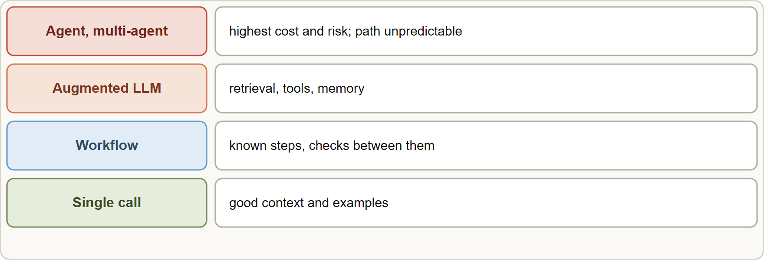
Choosing the Solution Shape
Module 1
Climb only as far as the problem needs: a single optimized call, then a workflow, then an augmented LLM with retrieval and tools, then an agent or multi-agent system
Claude Architect Professional Exam Prep | for the CCAR-P exam
Module 1: From Business Problem to Claude Solution
8 / 24
Notes:
Choosing the Solution Shape.
The figure shows this: Climb only as far as the problem needs: a single optimized call, then a workflow, then an augmented L L M with retrieval and tools, then an agent or multi-agent system.

Slide 9
Choosing the Solution Shape, continued
Module 1
Shape | Use when | Cost and risk
Single optimized call | Task fits one prompt with good context and examples | Lowest
Workflow (chain, route, parallel) | Steps are known; each can be checked | Low; predictable
Augmented LLM (retrieval, tools, memory) | Needs your data or actions | Medium; integration and security work
Agent / multi-agent | Path cannot be predicted in advance | Highest; compounding errors, 4x to 15x tokens
Simplest solution that works: add complexity only when it demonstrably improves the measured outcome.
Build, buy or configure: use built-in product features where they meet the need; build custom only for differentiating or constrained cases.
Claude Architect Professional Exam Prep | for the CCAR-P exam
Module 1: From Business Problem to Claude Solution
9 / 24
Notes:
Choosing the Solution Shape, continued.
Single optimized call. Use when: Task fits one prompt with good context and examples. Cost and risk: Lowest.
Workflow (chain, route, parallel). Use when: Steps are known; each can be checked. Cost and risk: Low; predictable.
Augmented L L M (retrieval, tools, memory). Use when: Needs your data or actions. Cost and risk: Medium; integration and security work.
Agent or multi-agent. Use when: Path cannot be predicted in advance. Cost and risk: Highest; compounding errors, four times to fifteen times tokens.
Simplest solution that works: add complexity only when it demonstrably improves the measured outcome.
Build, buy or configure: use built-in product features where they meet the need; build custom only for differentiating or constrained cases.

Slide 10
Choosing the Solution Shape, continued
Module 1
Plan where a human reviews: draft-and-review is usually the first production pattern for risky outputs.
Claude Architect Professional Exam Prep | for the CCAR-P exam
Module 1: From Business Problem to Claude Solution
10 / 24
Notes:
Choosing the Solution Shape, continued.
Plan where a human reviews: draft-and-review is usually the first production pattern for risky outputs.

Slide 11
Business Value Pillars
Module 1
The guide names five pillars. Tie every design choice to at least one and give it a number.
Claude Architect Professional Exam Prep | for the CCAR-P exam
Module 1: From Business Problem to Claude Solution
11 / 24
Notes:
Business Value Pillars.
The guide names five pillars. Tie every design choice to at least one and give it a number.

Slide 12
Business Value Pillars, continued
Module 1
Pillar | Meaning | Example target | Typical design lever
Efficiency | Same output with less time or effort | Handle time down 25% | Draft generation, retrieval of policy
Transformation | New capability or redesigned process | Instant multilingual support | New workflow, agentic process
Productivity | More output per person | Analyst reviews 3x more files | Summarization, extraction
Cost | Lower total cost to serve | Cost per contact down 30% | Smaller model, caching, batch
Performance SLAs | Meet speed, availability, quality commitments | p95 latency under 3 seconds, 99.9% uptime | Streaming, routing, capacity planning
Claude Architect Professional Exam Prep | for the CCAR-P exam
Module 1: From Business Problem to Claude Solution
12 / 24
Notes:
Business Value Pillars, continued.
Efficiency. Meaning: Same output with less time or effort. Example target: Handle time down twenty-five percent. Typical design lever: Draft generation, retrieval of policy.
Transformation. Meaning: New capability or redesigned process. Example target: Instant multilingual support. Typical design lever: New workflow, agentic process.
Productivity. Meaning: More output per person. Example target: Analyst reviews three times more files. Typical design lever: Summarization, extraction.
Cost. Meaning: Lower total cost to serve. Example target: Cost per contact down thirty percent. Typical design lever: Smaller model, caching, batch.
Performance S L A s (service level agreement). Meaning: Meet speed, availability, quality commitments. Example target: p ninety-five latency under three seconds, ninety-nine point nine percent uptime. Typical design lever: Streaming, routing, capacity planning.

Slide 13
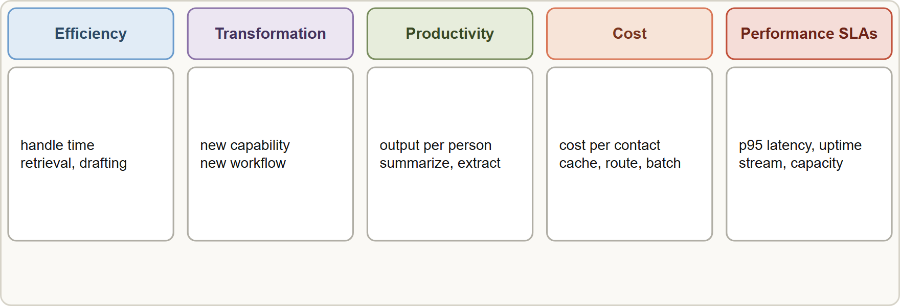
Business Value Pillars, continued
Module 1
Pillars conflict: a larger model may raise quality but lift cost and latency. State the priority order with the client.
Quantify benefit and cost early (tokens per request times volume, review effort, integration work) to test the business case.
Pillars conflict: a larger model may raise quality but lift cost and latency. State the priority order with the client.
Quantify benefit and cost early (tokens per request times volume, review effort, integration work) to test the business case.
EXAM TIP A design justified by a named pillar with a measurable target is stronger than one justified by "better AI". When pillars conflict, the answer states the trade-off and the client's priority.
Claude Architect Professional Exam Prep | for the CCAR-P exam
Module 1: From Business Problem to Claude Solution
13 / 24
Notes:
Business Value Pillars, continued.
The figure shows this: Five value pillars with a measure and a design lever each: efficiency, transformation, productivity, cost and performance S L A s.
Pillars conflict: a larger model may raise quality but lift cost and latency. State the priority order with the client.
Quantify benefit and cost early (tokens per request times volume, review effort, integration work) to test the business case.
Exam tip: A design justified by a named pillar with a measurable target is stronger than one justified by "better A I". When pillars conflict, the answer states the trade-off and the client's priority.

Slide 14
Constraints That Shape the Design
Module 1
Constraint | Effect on design
Data sensitivity and regulation | Platform and region choice, ZDR or BAA, PII masking (Module 14)
Latency | Streaming, smaller model, caching, routing (Module 10)
Volume and cost | Batch, caching, model tiering (Modules 4, 6, 12)
Existing systems | Integration path: API, MCP, queue (Modules 7, 8)
Team skills and operations | Managed services, simpler patterns, runbooks (Module 16)
Accuracy and risk tolerance | Evals, human review, guardrails (Modules 11, 13)
EXAM TIP Pillars conflict (quality against cost and latency): the strong answer names the trade-off and the client's priority.
Claude Architect Professional Exam Prep | for the CCAR-P exam
Module 1: From Business Problem to Claude Solution
14 / 24
Notes:
Constraints That Shape the Design.
Data sensitivity and regulation. Platform and region choice, Z D R or B A A, P I I masking (Module fourteen).
Latency. Streaming, smaller model, caching, routing (Module ten).
Volume and cost. Batch, caching, model tiering (Modules four, six, twelve).
Existing systems. Integration path: A P I (application programming interface), M C P (Model Context Protocol), queue (Modules seven, eight).
Team skills and operations. Managed services, simpler patterns, runbooks (Module sixteen).
Accuracy and risk tolerance. Evals, human review, guardrails (Modules eleven, thirteen).
Exam tip: Pillars conflict (quality against cost and latency): the strong answer names the trade-off and the client's priority.

Slide 15
Module Recap
Module 1
1
First move
2
Problem statement
3
Fit
Discovery to measurable success criteria and constraints
Users · pain and baseline · target · constraints · risks · owner
Language-heavy, variable work; not exact calculation or hard real-time
4
Shapes
5
Rule
6
Pillars
Single call · workflow · augmented LLM · agent or multi-agent
Simplest that works; climb only on evidence
Efficiency · transformation · productivity · cost · performance SLAs
7
Conflict
8
Human review
State the trade-off and the client's priority
Plan it where errors are costly
Claude Architect Professional Exam Prep | for the CCAR-P exam
Module 1: From Business Problem to Claude Solution
15 / 24
Notes:
Here is the recap.
First move: Discovery to measurable success criteria and constraints.
Problem statement: Users, pain and baseline, target, constraints, risks, owner.
Fit: Language-heavy, variable work; not exact calculation or hard real-time.
Shapes: Single call, workflow, augmented L L M, agent or multi-agent.
Rule: Simplest that works; climb only on evidence.
Pillars: Efficiency, transformation, productivity, cost, performance S L A s.
Conflict: State the trade-off and the client's priority.
Human review: Plan it where errors are costly.

Slide 16
Practice Question 1
Module 1
Q1
A client says "we want AI in customer service." What should the architect do first?
A
Build a multi-agent system so that every future requirement can be absorbed without redesigning anything later
B
Run structured discovery to define users, baseline metrics, success criteria and constraints
C
Compare vendor pricing and select the cheapest model before talking to anyone
D
Choose the most capable model and start prototyping an autonomous support agent for the contact center
Claude Architect Professional Exam Prep | for the CCAR-P exam
Module 1: From Business Problem to Claude Solution
16 / 24
Notes:
Question one.
A client says "we want A I in customer service." What should the architect do first?
The four options are on the screen.
[PAUSE 12]
The answer is B. Measurable criteria and constraints must exist before architecture choices.

Slide 17
Practice Question 2
Module 1
Q2
A task has fixed steps, each easy to check, and low tolerance for unpredictability. Which shape fits?
A
A workflow such as prompt chaining with checks between steps
B
A multi-agent system with a coordinator and several specialist agents
C
A single prompt with no intermediate validation to keep latency minimal
D
A fully autonomous agent that decides its own path at every step
Claude Architect Professional Exam Prep | for the CCAR-P exam
Module 1: From Business Problem to Claude Solution
17 / 24
Notes:
Question two.
A task has fixed steps, each easy to check, and low tolerance for unpredictability. Which shape fits?
The four options are on the screen.
[PAUSE 12]
The answer is A. Known steps favor a predictable workflow over an agent.

Slide 18
Practice Question 3
Module 1
Q3
An executive wants an "AI transformation" but cannot name a metric. Which response is best?
A
Tie the initiative to a pillar with a measurable target and a baseline, and agree the priority among pillars
B
Defer all measurement until the system is live and users have formed opinions
C
Agree a broad vision statement and let the engineering team choose measures later
D
Start with the newest model and demonstrate impressive examples to the sponsor to build enthusiasm for the project
Claude Architect Professional Exam Prep | for the CCAR-P exam
Module 1: From Business Problem to Claude Solution
18 / 24
Notes:
Question three.
An executive wants an "A I transformation" but cannot name a metric. Which response is best?
The four options are on the screen.
[PAUSE 12]
The answer is A. Business value must be measurable to guide design and to judge success.

Slide 19
Practice Question 4
Module 1
Q4
Which task is the weakest fit for an LLM as the core component?
A
Summarizing long case notes for a human reviewer
B
Exact interest calculation that must be reproducible to the cent
C
Drafting replies to varied customer emails from a policy library
D
Classifying incoming requests that arrive in free text
Claude Architect Professional Exam Prep | for the CCAR-P exam
Module 1: From Business Problem to Claude Solution
19 / 24
Notes:
Question four.
Which task is the weakest fit for an L L M as the core component?
The four options are on the screen.
[PAUSE 12]
The answer is B. Exact, rule-bound calculation belongs in deterministic code; the L L M can orchestrate or explain.

Slide 20
Practice Question 5
Module 1
Q5
A larger model raises quality but breaks the p95 latency target. How should the architect proceed?
A
Present the quality-latency trade-off, confirm the client's priority, and test routing or a smaller model with caching
B
Switch to the smallest model without testing because latency is a hard constraint
C
Keep the larger model and ask the client to relax the latency target without evidence
D
Remove the latency target from the requirements to simplify the design
Claude Architect Professional Exam Prep | for the CCAR-P exam
Module 1: From Business Problem to Claude Solution
20 / 24
Notes:
Question five.
A larger model raises quality but breaks the p ninety-five latency target. How should the architect proceed?
The four options are on the screen.
[PAUSE 12]
The answer is A. Pillars conflict; make the trade-off explicit and test options against it.

Slide 21
Practice Question 6
Module 1
Q6
Which TWO belong in a problem statement before design begins? (Select TWO.)
A
The brand of the vector database that will be used
B
Constraints such as data sensitivity, latency and regulation
C
The number of agents the final design will contain
D
The exact wording of the system prompt
E
A baseline and a measurable target for the business outcome
Claude Architect Professional Exam Prep | for the CCAR-P exam
Module 1: From Business Problem to Claude Solution
21 / 24
Notes:
Question six. Select two.
Which two belong in a problem statement before design begins?
The five options are on the screen.
[PAUSE 15]
The answers are B and E. Targets and constraints frame the design; implementation details come later.

Slide 22
Practice Question 7
Module 1
Q7
When is a multi-agent design most justified?
A
Any task where several steps exist, because more agents always raise quality
B
Small tasks with strong dependencies between steps and shared context
C
High-value work that parallelizes well and exceeds a single context window
D
Cost-sensitive high-volume classification with a fixed label set
Claude Architect Professional Exam Prep | for the CCAR-P exam
Module 1: From Business Problem to Claude Solution
22 / 24
Notes:
Question seven.
When is a multi-agent design most justified?
The four options are on the screen.
[PAUSE 12]
The answer is C. Multi-agent systems cost many more tokens and suit parallelizable, high-value work.

Slide 23
Practice Question 8
Module 1
Q8
The bank wants to cut cost per contact. Which design lever most directly serves the cost pillar?
A
Caching the stable policy prefix and routing simple requests to a smaller model
B
Adding more agents so that each contact is handled by a specialist
C
Expanding the context with every available policy document on each call, so that nothing is ever missing
D
Increasing effort for every request to reduce rework
Claude Architect Professional Exam Prep | for the CCAR-P exam
Module 1: From Business Problem to Claude Solution
23 / 24
Notes:
Question eight.
The bank wants to cut cost per contact. Which design lever most directly serves the cost pillar?
The four options are on the screen.
[PAUSE 12]
The answer is A. Caching and tiering reduce the cost per request without discarding needed context.

Slide 24
Answers at a Glance
Module 1
Question | Answer | Why
Q1 | B | Measurable criteria and constraints must exist before architecture choices
Q2 | A | Known steps favor a predictable workflow over an agent
Q3 | A | Business value must be measurable to guide design and to judge
Q4 | B | Exact, rule-bound calculation belongs in deterministic code
Q5 | A | Pillars conflict; make the trade-off explicit and test options against it
Q6 | B, E | Targets and constraints frame the design
Q7 | C | Multi-agent systems cost many more tokens and suit parallelizable, high-value work
Q8 | A | Caching and tiering reduce the cost per request without discarding needed
Claude Architect Professional Exam Prep | for the CCAR-P exam
Module 1: From Business Problem to Claude Solution
24 / 24
Notes:
Here are all eight answers. Question one: B. Question two: A. Question three: A. Question four: B. Question five: A. Question six: B and E. Question seven: C. Question eight: A.
In the next module, we continue the course.

