Slide 1
Module 2: Architectures and Patterns
The parts of an end-to-end architecture: input, processing, output and feedback loops
Domain 1 · Solution Design & Architecture
Claude Architect Professional Exam Prep Masterclass
Module 2
Notes:
Welcome to Module two: Architectures and Patterns. This module covers architectures and patterns.
Each part of this module comes from the study notes of the same name, so you can read the notes after you watch.

Slide 2
What You Will Learn
Module 2
The parts of an end-to-end architecture: input, processing, output and feedback loops
The augmented LLM building block
The five workflow patterns and when each fits
Agents: when they are justified, and their costs
How to select a pattern from the problem's shape
Claude Architect Professional Exam Prep | for the CCAR-P exam
Module 2: Architectures and Patterns
2 / 29
Notes:
By the end of this module you will be able to do five things.
The parts of an end-to-end architecture: input, processing, output and feedback loops.
The augmented L L M (large language model) building block.
The five workflow patterns and when each fits.
Agents: when they are justified, and their costs.
How to select a pattern from the problem's shape.

Slide 3
Case Check-In: Lumen Advisory Designs a Claims Intake for a Health Insurer
Module 2
CASE CHECK-IN · Lumen Advisory
Claims arrive as emails, PDFs and portal forms
The system must classify, extract fields, check coverage rules, draft a decision note and let a nurse reviewer approve
Every correction by the reviewer should improve the system
Claude Architect Professional Exam Prep | for the CCAR-P exam
Module 2: Architectures and Patterns
3 / 29
Notes:
Our running case is Lumen Advisory. Lumen Advisory Designs a Claims Intake for a Health Insurer.
Claims arrive as emails, P D F s and portal forms.
The system must classify, extract fields, check coverage rules, draft a decision note and let a nurse reviewer approve.
Every correction by the reviewer should improve the system.

Slide 4
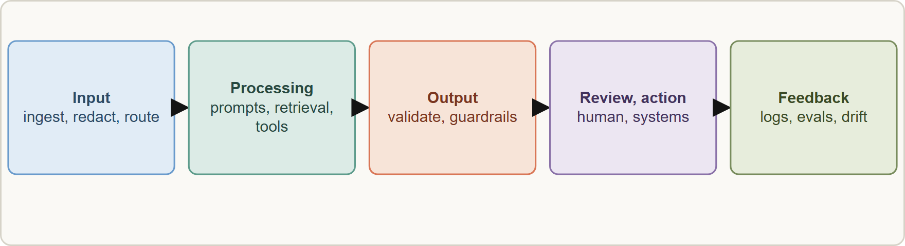
An End-to-End Architecture
Module 2
An end-to-end architecture: input and ingestion, processing with Claude and tools, output validation, review and action, then feedback and monitoring that loops back
Claude Architect Professional Exam Prep | for the CCAR-P exam
Module 2: Architectures and Patterns
4 / 29
Notes:
An End-to-End Architecture.
The figure shows this: An end-to-end architecture: input and ingestion, processing with Claude and tools, output validation, review and action, then feedback and monitoring that loops back.

Slide 5
An End-to-End Architecture, continued
Module 2
Stage | Responsibilities | Claim-intake example
Input | Receive, authenticate, normalize, redact, route | Parse PDFs, mask personal identifiers, tag the claim type
Processing | Prompts, retrieval, tools, orchestration, model calls | Classify, extract, retrieve coverage rules, draft a note
Output | Validate shape and content, apply guardrails | Schema check, rule check, confidence flag
Action and review | Human approval, system updates, notifications | Nurse approves; claim system updated
Feedback | Logs, corrections, metrics, evals, drift alerts | Reviewer edits become eval cases; accuracy dashboard
Feedback loops are part of the design, not an afterthought: they feed evaluation sets, prompt changes and monitoring (Modules 11 and 12).
Claude Architect Professional Exam Prep | for the CCAR-P exam
Module 2: Architectures and Patterns
5 / 29
Notes:
An End-to-End Architecture, continued.
Input. Responsibilities: Receive, authenticate, normalize, redact, route. Claim-intake example: Parse P D F s, mask personal identifiers, tag the claim type.
Processing. Responsibilities: Prompts, retrieval, tools, orchestration, model calls. Claim-intake example: Classify, extract, retrieve coverage rules, draft a note.
Output. Responsibilities: Validate shape and content, apply guardrails. Claim-intake example: Schema check, rule check, confidence flag.
Action and review. Responsibilities: Human approval, system updates, notifications. Claim-intake example: Nurse approves; claim system updated.
Feedback. Responsibilities: Logs, corrections, metrics, evals, drift alerts. Claim-intake example: Reviewer edits become eval cases; accuracy dashboard.
Feedback loops are part of the design, not an afterthought: they feed evaluation sets, prompt changes and monitoring (Modules eleven and twelve).

Slide 6
An End-to-End Architecture, continued
Module 2
Design for failure paths: retries, fallbacks, escalation to a human, dead-letter queue for bad inputs.
Keep deterministic code for checks that must always hold (validation, authorization, totals); use the model for language and judgment.
Separate concerns: ingestion, orchestration, model access, tools, storage, observability. This supports testing and replacement.
EXAM TIP An architecture answer should include validation of model output and a feedback path, not only the model call.
Claude Architect Professional Exam Prep | for the CCAR-P exam
Module 2: Architectures and Patterns
6 / 29
Notes:
An End-to-End Architecture, continued.
Design for failure paths: retries, fallbacks, escalation to a human, dead-letter queue for bad inputs.
Keep deterministic code for checks that must always hold (validation, authorization, totals); use the model for language and judgment.
Separate concerns: ingestion, orchestration, model access, tools, storage, observability. This supports testing and replacement.
Exam tip: An architecture answer should include validation of model output and a feedback path, not only the model call.

Slide 7
The Augmented LLM
Module 2
The augmented LLM is the basic building block: a model enhanced with retrieval, tools and memory. It can generate its own search queries, choose tools and decide what to retain.
Claude Architect Professional Exam Prep | for the CCAR-P exam
Module 2: Architectures and Patterns
7 / 29
Notes:
The Augmented L L M.
The augmented L L M is the basic building block: a model enhanced with retrieval, tools and memory. It can generate its own search queries, choose tools and decide what to retain.

Slide 8
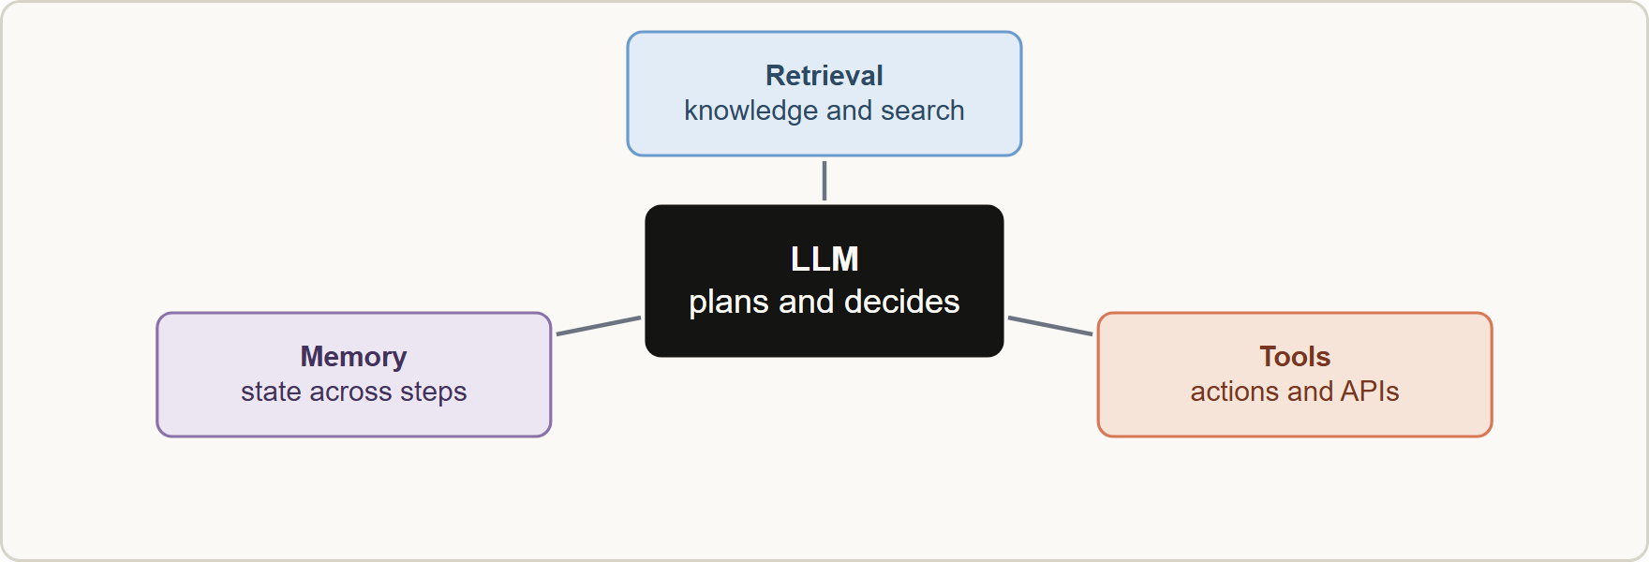
The Augmented LLM, continued
Module 2
Tailor the augmentations to the use case and give the model a well-documented interface (tool names, descriptions, schemas).
Most solutions are an augmented LLM inside a workflow: the code controls the path, the model does the language and judgment steps.
Tailor the augmentations to the use case and give the model a well-documented interface (tool names, descriptions, schemas).
Most solutions are an augmented LLM inside a workflow: the code controls the path, the model does the language and judgment steps.
Claude Architect Professional Exam Prep | for the CCAR-P exam
Module 2: Architectures and Patterns
8 / 29
Notes:
The Augmented L L M, continued.
The figure shows this: The augmented L L M: a model with retrieval for knowledge, tools for actions and memory for state.
Tailor the augmentations to the use case and give the model a well-documented interface (tool names, descriptions, schemas).
Most solutions are an augmented L L M inside a workflow: the code controls the path, the model does the language and judgment steps.

Slide 9
The Augmented LLM, continued
Module 2
Integration standards such as MCP connect tools and data in a reusable way (Module 8).
Claude Architect Professional Exam Prep | for the CCAR-P exam
Module 2: Architectures and Patterns
9 / 29
Notes:
The Augmented L L M, continued.
Integration standards such as M C P (Model Context Protocol) connect tools and data in a reusable way (Module eight).

Slide 10
Workflow Patterns
Module 2
A workflow orchestrates LLMs and tools through predefined code paths.
Claude Architect Professional Exam Prep | for the CCAR-P exam
Module 2: Architectures and Patterns
10 / 29
Notes:
Workflow Patterns.
A workflow orchestrates L L M s and tools through predefined code paths.

Slide 11
Workflow Patterns, continued
Module 2
Pattern | How it works | Use when | Trade-off
Prompt chaining | Sequential calls; each uses the previous output; optional gates | Task splits cleanly into fixed subtasks | More latency, higher accuracy
Routing | Classify the input, send to a specialized path or model | Distinct categories; accurate classification; easy vs hard queries | Misrouting risk; classifier needed
Parallelization: sectioning | Independent subtasks run at once | Speed; independent aspects | Merge logic
Parallelization: voting | Same task run several times | Higher confidence; guardrail checks | Cost multiplies
Orchestrator-workers | A central model splits work it cannot predict, delegates, synthesizes | Subtasks depend on the input (multi-file changes, research) | Cost, coordination
Claude Architect Professional Exam Prep | for the CCAR-P exam
Module 2: Architectures and Patterns
11 / 29
Notes:
Workflow Patterns, continued.
Prompt chaining. How it works: Sequential calls; each uses the previous output; optional gates. Use when: Task splits cleanly into fixed subtasks. Trade-off: More latency, higher accuracy.
Routing. How it works: Classify the input, send to a specialized path or model. Use when: Distinct categories; accurate classification; easy versus hard queries. Trade-off: Misrouting risk; classifier needed.
Parallelization: sectioning. How it works: Independent subtasks run at once. Use when: Speed; independent aspects. Trade-off: Merge logic.
Parallelization: voting. How it works: Same task run several times. Use when: Higher confidence; guardrail checks. Trade-off: Cost multiplies.
Orchestrator-workers. How it works: A central model splits work it cannot predict, delegates, synthesizes. Use when: Subtasks depend on the input (multi-file changes, research). Trade-off: Cost, coordination.

Slide 12
Workflow Patterns, continued
Module 2
Pattern | How it works | Use when | Trade-off
Evaluator-optimizer | One model generates, another critiques, loop | Clear criteria and measurable improvement from feedback | Extra calls; stop rule needed
Claude Architect Professional Exam Prep | for the CCAR-P exam
Module 2: Architectures and Patterns
12 / 29
Notes:
Workflow Patterns, continued.
Evaluator-optimizer. How it works: One model generates, another critiques, loop. Use when: Clear criteria and measurable improvement from feedback. Trade-off: Extra calls; stop rule needed.

Slide 13
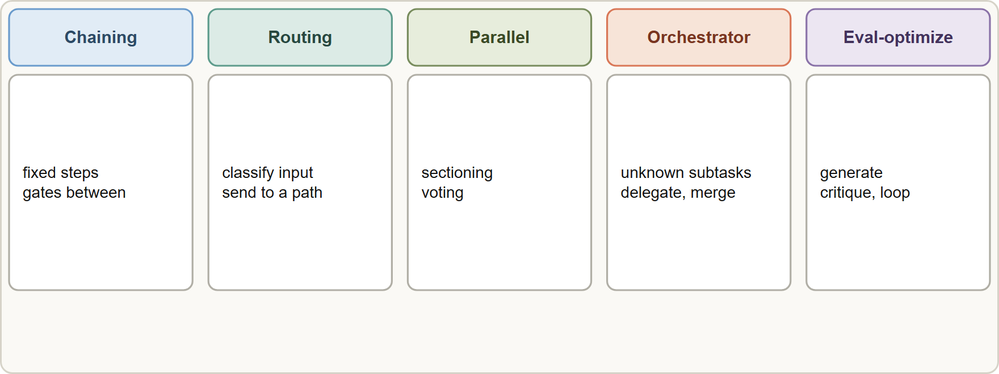
Workflow Patterns, continued
Module 2
Chaining trades latency for accuracy; routing can send easy queries to a smaller, cheaper model.
Sectioning and voting are the two forms of parallelization; voting gives diversity for confidence checks.
Use orchestrator-workers only when the subtasks cannot be listed in advance; otherwise plain parallelization is simpler.
Chaining trades latency for accuracy; routing can send easy queries to a smaller, cheaper model.
Sectioning and voting are the two forms of parallelization; voting gives diversity for confidence checks.
Use orchestrator-workers only when the subtasks cannot be listed in advance; otherwise plain parallelization is simpler.
Claude Architect Professional Exam Prep | for the CCAR-P exam
Module 2: Architectures and Patterns
13 / 29
Notes:
Workflow Patterns, continued.
The figure shows this: Five workflow patterns: prompt chaining, routing, parallelization, orchestrator-workers and evaluator-optimizer.
Chaining trades latency for accuracy; routing can send easy queries to a smaller, cheaper model.
Sectioning and voting are the two forms of parallelization; voting gives diversity for confidence checks.
Use orchestrator-workers only when the subtasks cannot be listed in advance; otherwise plain parallelization is simpler.

Slide 14
Workflow Patterns, continued
Module 2
Evaluator-optimizer needs clear criteria and a maximum number of rounds.
Claude Architect Professional Exam Prep | for the CCAR-P exam
Module 2: Architectures and Patterns
14 / 29
Notes:
Workflow Patterns, continued.
Evaluator-optimizer needs clear criteria and a maximum number of rounds.

Slide 15
Agents
Module 2
Use an agent when | Avoid an agent when
The path cannot be predicted or hardcoded | The steps are known
The task is open-ended (research, coding across files) | Latency and cost must be low and predictable
You can trust the model's decisions in a sandbox with guardrails | Errors would be costly and hard to undo without gates
An agent is an LLM that dynamically directs its own process and tool use, checks the environment at each step (ground truth) and decides when it is done.
Costs: higher token use and latency, and compounding errors across steps.
Claude Architect Professional Exam Prep | for the CCAR-P exam
Module 2: Architectures and Patterns
15 / 29
Notes:
Agents.
An agent is an L L M that dynamically directs its own process and tool use, checks the environment at each step (ground truth) and decides when it is done.
The path cannot be predicted or hardcoded. The steps are known.
The task is open-ended (research, coding across files). Latency and cost must be low and predictable.
You can trust the model's decisions in a sandbox with guardrails. Errors would be costly and hard to undo without gates.
Costs: higher token use and latency, and compounding errors across steps.

Slide 16
Agents, continued
Module 2
Controls: stopping conditions (maximum steps), human checkpoints, sandboxes, tool permissions, tracing.
Frameworks (the Claude Agent SDK and others) speed up work but add abstraction that hides prompts and complicates debugging. Start with direct API calls, understand the framework's code, and reduce abstraction for production.
Claude Architect Professional Exam Prep | for the CCAR-P exam
Module 2: Architectures and Patterns
16 / 29
Notes:
Agents, continued.
Controls: stopping conditions (maximum steps), human checkpoints, sandboxes, tool permissions, tracing.
Frameworks (the Claude Agent S D K (software development kit) and others) speed up work but add abstraction that hides prompts and complicates debugging. Start with direct A P I (application programming interface) calls, understand the framework's code, and reduce abstraction for production.

Slide 17
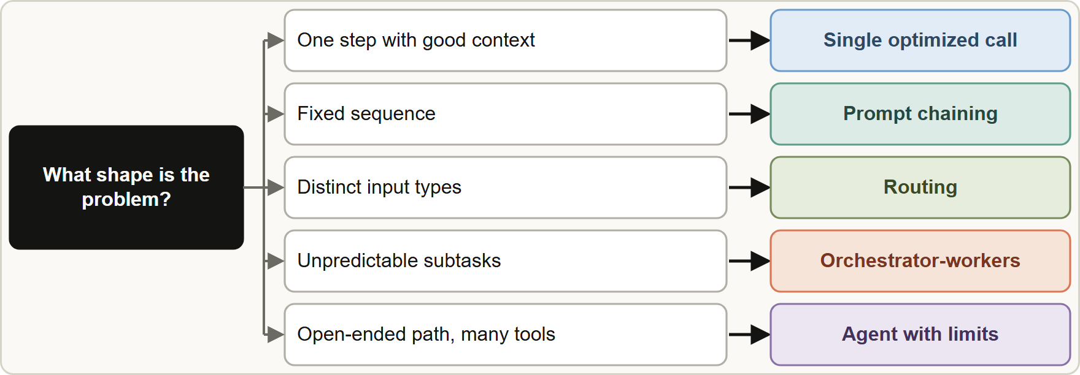
Selecting a Pattern
Module 2
Choosing a pattern from the shape of the problem: a single call, a workflow, orchestrator-workers or an agent
Claude Architect Professional Exam Prep | for the CCAR-P exam
Module 2: Architectures and Patterns
17 / 29
Notes:
Selecting a Pattern.
The figure shows this: Choosing a pattern from the shape of the problem: a single call, a workflow, orchestrator-workers or an agent.

Slide 18
Selecting a Pattern, continued
Module 2
Problem shape | Pattern
One step; good context and examples are enough | Single optimized call
Fixed sequence | Prompt chaining
Distinct input types | Routing
Independent parts; speed | Sectioning
Need confidence from diversity | Voting
Unpredictable subtasks | Orchestrator-workers
Quality improves with critique | Evaluator-optimizer
Open-ended path, many tools | Agent
EXAM TIP "Steps known in advance" means a workflow; "path depends on what is discovered" means an agent. When both could work, pick the simpler.
Claude Architect Professional Exam Prep | for the CCAR-P exam
Module 2: Architectures and Patterns
18 / 29
Notes:
Selecting a Pattern, continued.
One step; good context and examples are enough. Single optimized call.
Fixed sequence. Prompt chaining.
Distinct input types. Routing.
Independent parts; speed. Sectioning.
Need confidence from diversity. Voting.
Unpredictable subtasks. Orchestrator-workers.
Quality improves with critique. Evaluator-optimizer.
Open-ended path, many tools. Agent.
Exam tip: "Steps known in advance" means a workflow; "path depends on what is discovered" means an agent. When both could work, pick the simpler.
Exam tip: Validation and a feedback path are part of every end-to-end design; a bare model call is not an architecture.

Slide 19
Module Recap
Module 2
1
Stages
2
Augmented LLM
3
Workflows
Input · processing · output validation · review and action · feedback
Model plus retrieval, tools, memory
Chaining · routing · sectioning · voting · orchestrator-workers · evaluator-optimizer
4
Agent
5
Choose
6
Frameworks
Model directs its own path; costs and compounding errors; needs limits and gates
Known steps = workflow; unpredictable = orchestrator-workers or agent; simplest that works
Start with direct API calls; reduce abstraction for production
7
Keep in code
Validation, authorization, exact calculation
Claude Architect Professional Exam Prep | for the CCAR-P exam
Module 2: Architectures and Patterns
19 / 29
Notes:
Here is the recap.
Stages: Input, processing, output validation, review and action, feedback.
Augmented L L M: Model plus retrieval, tools, memory.
Workflows: Chaining, routing, sectioning, voting, orchestrator-workers, evaluator-optimizer.
Agent: Model directs its own path; costs and compounding errors; needs limits and gates.
Choose: Known steps equals workflow; unpredictable equals orchestrator-workers or agent; simplest that works.
Frameworks: Start with direct A P I calls; reduce abstraction for production.
Keep in code: Validation, authorization, exact calculation.

Slide 20
Practice Question 1
Module 2
Q1
A claims pipeline has five fixed steps, each of which can be validated. Which design is most appropriate?
A
A single autonomous agent that plans its own steps on each claim
B
A prompt-chaining workflow with validation gates between the steps
C
One large prompt that performs all five steps and returns a combined answer
D
A multi-agent system with one agent per step and a supervisor
Claude Architect Professional Exam Prep | for the CCAR-P exam
Module 2: Architectures and Patterns
20 / 29
Notes:
Question one.
A claims pipeline has five fixed steps, each of which can be validated. Which design is most appropriate?
The four options are on the screen.
[PAUSE 12]
The answer is B. Known, checkable steps suit a workflow; it is predictable and debuggable.

Slide 21
Practice Question 2
Module 2
Q2
A support system receives billing, technical and legal questions that need different prompts and tools. Which pattern fits best?
A
Routing: classify each request and send it to a specialized path
B
Orchestrator-workers: let a central model invent subtasks for each question
C
Evaluator-optimizer: generate an answer and critique it until it is perfect
D
Voting: send each request to several identical paths and take a majority
Claude Architect Professional Exam Prep | for the CCAR-P exam
Module 2: Architectures and Patterns
21 / 29
Notes:
Question two.
A support system receives billing, technical and legal questions that need different prompts and tools. Which pattern fits best?
The four options are on the screen.
[PAUSE 12]
The answer is A. Distinct categories with accurate classification are the routing use case.

Slide 22
Practice Question 3
Module 2
Q3
An architect wants higher confidence in a content-safety decision. Which approach does that most directly?
A
Prompt chaining: add a second paraphrasing step before the check, so that the content is rewritten twice
B
Sectioning: split the content into parts and check each part once, then publish the combined verdict
C
Voting: run the check several times or with several prompts and aggregate
D
Routing: send the content to a smaller model to save cost
Claude Architect Professional Exam Prep | for the CCAR-P exam
Module 2: Architectures and Patterns
22 / 29
Notes:
Question three.
An architect wants higher confidence in a content-safety decision. Which approach does that most directly?
The four options are on the screen.
[PAUSE 12]
The answer is C. Voting runs the check several times or with several prompts and aggregates the diverse outputs, which raises confidence in the decision.

Slide 23
Practice Question 4
Module 2
Q4
A coding task requires editing an unknown number of files depending on the request. Which pattern is most suitable?
A
A single call with all files pasted into the prompt
B
Routing to one of three predefined editing templates
C
Orchestrator-workers: a central model decides the subtasks and delegates them
D
Prompt chaining with a fixed list of file-editing steps defined by the architect in advance for every request
Claude Architect Professional Exam Prep | for the CCAR-P exam
Module 2: Architectures and Patterns
23 / 29
Notes:
Question four.
A coding task requires editing an unknown number of files depending on the request. Which pattern is most suitable?
The four options are on the screen.
[PAUSE 12]
The answer is C. Unpredictable subtasks that depend on the input are the orchestrator-workers case.

Slide 24
Practice Question 5
Module 2
Q5
What is the main risk of choosing an agent for a fixed, well-understood task?
A
Agents always produce lower quality than workflows
B
The agent cannot use tools that a workflow could call, because tools are limited to fixed pipelines
C
Higher cost, latency and compounding errors without a benefit over a workflow
D
Agents cannot be monitored with logs and traces
Claude Architect Professional Exam Prep | for the CCAR-P exam
Module 2: Architectures and Patterns
24 / 29
Notes:
Question five.
What is the main risk of choosing an agent for a fixed, well-understood task?
The four options are on the screen.
[PAUSE 12]
The answer is C. Agents add cost and risk; they pay off only when the path is genuinely unpredictable.

Slide 25
Practice Question 6
Module 2
Q6
Which TWO belong in every end-to-end Claude architecture? (Select TWO.)
A
Validation of model output before it triggers actions
B
A feedback path from corrections and metrics into evaluation and improvement
C
A single shared credential for all tools
D
Removal of all human review to reduce latency
E
A fully autonomous agent loop with no step limit
Claude Architect Professional Exam Prep | for the CCAR-P exam
Module 2: Architectures and Patterns
25 / 29
Notes:
Question six. Select two.
Which two belong in every end-to-end Claude architecture?
The five options are on the screen.
[PAUSE 15]
The answers are A and B. Validation and feedback are core; autonomy without limits and shared credentials are risks.

Slide 26
Practice Question 7
Module 2
Q7
A team adopts an agent framework and cannot understand why prompts behave strangely in production. What does this illustrate?
A
Frameworks are never suitable for production Claude systems
B
Prompts should be hidden from developers for security
C
The framework always overrides the model's instructions
D
Frameworks add abstraction that can hide prompts and responses, so understand the code and reduce abstraction for production
Claude Architect Professional Exam Prep | for the CCAR-P exam
Module 2: Architectures and Patterns
26 / 29
Notes:
Question seven.
A team adopts an agent framework and cannot understand why prompts behave strangely in production. What does this illustrate?
The four options are on the screen.
[PAUSE 12]
The answer is D. Start simple, understand what the framework does, and reduce abstraction when moving to production.

Slide 27
Practice Question 8
Module 2
Q8
In an evaluator-optimizer loop, which design element prevents endless refinement?
A
A larger context window for the generator
B
Running the generator and evaluator on the same prompt so that they always agree with each other
C
Clear evaluation criteria and a maximum number of rounds
D
Removing the evaluator after the first round
Claude Architect Professional Exam Prep | for the CCAR-P exam
Module 2: Architectures and Patterns
27 / 29
Notes:
Question eight.
In an evaluator-optimizer loop, which design element prevents endless refinement?
The four options are on the screen.
[PAUSE 12]
The answer is C. Criteria define "good enough" and a round limit bounds cost.

Slide 28
Practice Question 9
Module 2
Q9
A reviewer's corrections on drafted claim notes are not being captured. Which architectural gap is this?
A
Missing feedback loop from human review into evaluation data and prompt improvement
B
Missing routing layer in front of the model, so that every review comment is sent to a different model
C
Missing agent for the review step
D
Missing parallelization of the drafting step
Claude Architect Professional Exam Prep | for the CCAR-P exam
Module 2: Architectures and Patterns
28 / 29
Notes:
Question nine.
A reviewer's corrections on drafted claim notes are not being captured. Which architectural gap is this?
The four options are on the screen.
[PAUSE 12]
The answer is A. Feedback loops convert reviewer work into eval cases and improvements.

Slide 29
Answers at a Glance
Module 2
Question | Answer | Why
Q1 | B | Known, checkable steps suit a workflow
Q2 | A | Distinct categories with accurate classification are the routing use
Q3 | C | Voting runs the check several times or with several
Q4 | C | Unpredictable subtasks that depend on the input are the
Q5 | C | Agents add cost and risk
Q6 | A, B | Validation and feedback are core
Q7 | D | Start simple, understand what the framework does, and reduce
Q8 | C | Criteria define "good enough" and a round limit bounds
Q9 | A | Feedback loops convert reviewer work into eval cases and
Claude Architect Professional Exam Prep | for the CCAR-P exam
Module 2: Architectures and Patterns
29 / 29
Notes:
Here are all nine answers. Question one: B. Question two: A. Question three: C. Question four: C. Question five: C. Question six: A and B. Question seven: D. Question eight: C. Question nine: A.
In the next module, we continue the course.

