Slide 1
Module 3: Multi-Agent Orchestration and Decomposition
When a multi-agent design is worth its cost
Domain 1 · Solution Design & Architecture
Claude Architect Professional Exam Prep Masterclass
Module 3
Notes:
Welcome to Module three: Multi-Agent Orchestration and Decomposition. This module covers multi-agent orchestration and decomposition.
Each part of this module comes from the study notes of the same name, so you can read the notes after you watch.

Slide 2
What You Will Learn
Module 3
When a multi-agent design is worth its cost
The orchestrator-worker architecture and how to brief subagents
Decomposition techniques for complex problems
Production concerns: state, errors, tracing, deployment
Claude Architect Professional Exam Prep | for the CCAR-P exam
Module 3: Multi-Agent Orchestration and Decomposition
2 / 25
Notes:
By the end of this module you will be able to do four things.
When a multi-agent design is worth its cost.
The orchestrator-worker architecture and how to brief subagents.
Decomposition techniques for complex problems.
Production concerns: state, errors, tracing, deployment.

Slide 3
Case Check-In: Lumen Advisory and the Due-Diligence Research Tool
Module 3
CASE CHECK-IN · Lumen Advisory
A private-equity client wants market and regulatory research on 40 companies per week
One agent runs out of context and takes hours; parallel subagents can each cover a company and a lead agent merges the findings
Claude Architect Professional Exam Prep | for the CCAR-P exam
Module 3: Multi-Agent Orchestration and Decomposition
3 / 25
Notes:
Our running case is Lumen Advisory. Lumen Advisory and the Due-Diligence Research Tool.
A private-equity client wants market and regulatory research on forty companies per week.
One agent runs out of context and takes hours; parallel subagents can each cover a company and a lead agent merges the findings.

Slide 4
When Multi-Agent Pays Off
Module 3
Factor | Multi-agent fits | Single agent or workflow fits
Parallelism | Independent branches (companies, sources) | Strong dependencies between steps
Information size | More than one context window | Fits in one window
Value of result | High: justifies many tokens | Low or routine
Shared context | Little needed between branches | Heavy shared state (most coding)
Reported figures: agents use about 4x the tokens of chat and multi-agent systems about 15x; a lead-plus-subagents design beat a single agent by about 90 percent on a research eval, and parallelization cut research time by up to 90 percent. Token usage explained most performance variance.
Claude Architect Professional Exam Prep | for the CCAR-P exam
Module 3: Multi-Agent Orchestration and Decomposition
4 / 25
Notes:
When Multi-Agent Pays Off.
Parallelism. Multi-agent fits: Independent branches (companies, sources). Single agent or workflow fits: Strong dependencies between steps.
Information size. Multi-agent fits: More than one context window. Single agent or workflow fits: Fits in one window.
Value of result. Multi-agent fits: High: justifies many tokens. Single agent or workflow fits: Low or routine.
Shared context. Multi-agent fits: Little needed between branches. Single agent or workflow fits: Heavy shared state (most coding).
Reported figures: agents use about four times the tokens of chat and multi-agent systems about fifteen times; a lead-plus-subagents design beat a single agent by about ninety percent on a research eval, and parallelization cut research time by up to ninety percent. Token usage explained most performance variance.

Slide 5
When Multi-Agent Pays Off, continued
Module 3
Worth it only when value, parallelism and context size justify the cost; otherwise a workflow is cheaper and simpler.
EXAM TIP Multi-agent is justified by parallelizable, high-value work that exceeds one context window. Tasks with heavy shared context or many dependencies (for example most coding) are poor fits.
Claude Architect Professional Exam Prep | for the CCAR-P exam
Module 3: Multi-Agent Orchestration and Decomposition
5 / 25
Notes:
When Multi-Agent Pays Off, continued.
Worth it only when value, parallelism and context size justify the cost; otherwise a workflow is cheaper and simpler.
Exam tip: Multi-agent is justified by parallelizable, high-value work that exceeds one context window. Tasks with heavy shared context or many dependencies (for example most coding) are poor fits.

Slide 6
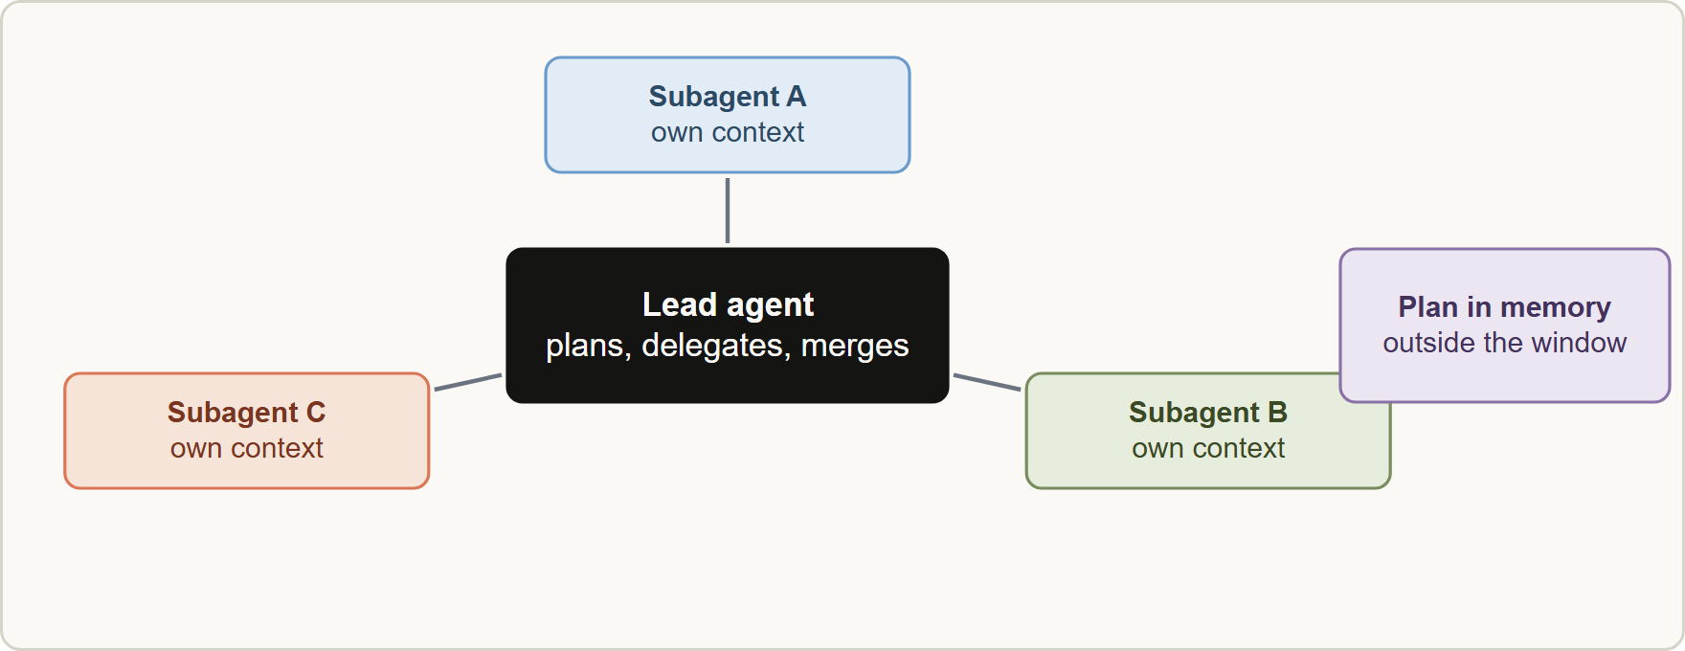
Orchestrator-Worker Design
Module 3
Orchestrator-worker architecture: a lead agent plans and delegates to parallel subagents with isolated contexts, results are verified and merged, and the plan is stored outside the context window
Claude Architect Professional Exam Prep | for the CCAR-P exam
Module 3: Multi-Agent Orchestration and Decomposition
6 / 25
Notes:
Orchestrator-Worker Design.
The figure shows this: Orchestrator-worker architecture: a lead agent plans and delegates to parallel subagents with isolated contexts, results are verified and merged, and the plan is stored outside the context window.

Slide 7
Orchestrator-Worker Design, continued
Module 3
Element | Practice
Lead agent | Plans, decomposes, delegates, synthesizes; saves the plan to external memory so it survives context limits
Subagents | Own isolated context; return summaries, not raw transcripts
Brief | Give each subagent a clear objective, output format, tool guidance and task boundaries to avoid duplicated work
Effort scaling | Put explicit rules in the prompt: simple lookup = one agent with a few tool calls; complex research = many subagents
Verification | A separate step checks claims and attaches sources
Tools | Distinct purposes with clear descriptions; poor descriptions send agents down wrong paths
Claude Architect Professional Exam Prep | for the CCAR-P exam
Module 3: Multi-Agent Orchestration and Decomposition
7 / 25
Notes:
Orchestrator-Worker Design, continued.
Lead agent. Plans, decomposes, delegates, synthesizes; saves the plan to external memory so it survives context limits.
Subagents. Own isolated context; return summaries, not raw transcripts.
Brief. Give each subagent a clear objective, output format, tool guidance and task boundaries to avoid duplicated work.
Effort scaling. Put explicit rules in the prompt: simple lookup equals one agent with a few tool calls; complex research equals many subagents.
Verification. A separate step checks claims and attaches sources.
Tools. Distinct purposes with clear descriptions; poor descriptions send agents down wrong paths.

Slide 8
Orchestrator-Worker Design, continued
Module 3
Context isolation keeps verbose exploration out of the lead's window (Module 6).
Parallel tool calls inside agents cut time further.
Start with broad queries and then narrow; use thinking as a planning scratchpad.
Claude Architect Professional Exam Prep | for the CCAR-P exam
Module 3: Multi-Agent Orchestration and Decomposition
8 / 25
Notes:
Orchestrator-Worker Design, continued.
Context isolation keeps verbose exploration out of the lead's window (Module six).
Parallel tool calls inside agents cut time further.
Start with broad queries and then narrow; use thinking as a planning scratchpad.

Slide 9
Decomposition
Module 3
Decomposition splits a complex problem into smaller solvable parts.
Claude Architect Professional Exam Prep | for the CCAR-P exam
Module 3: Multi-Agent Orchestration and Decomposition
9 / 25
Notes:
Decomposition.
Decomposition splits a complex problem into smaller solvable parts.

Slide 10
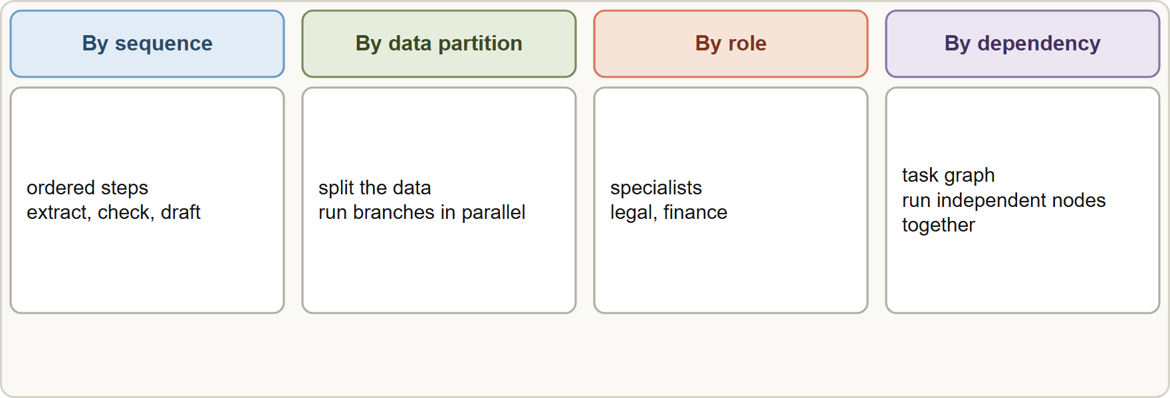
Decomposition, continued
Module 3
Four ways to decompose: by sequence of steps, by data partition, by role or skill, and by a dependency graph
Claude Architect Professional Exam Prep | for the CCAR-P exam
Module 3: Multi-Agent Orchestration and Decomposition
10 / 25
Notes:
Decomposition, continued.
The figure shows this: Four ways to decompose: by sequence of steps, by data partition, by role or skill, and by a dependency graph.

Slide 11
Decomposition, continued
Module 3
Style | How | Example
By sequence | Ordered steps | Extract, validate, enrich, draft
By data partition | Split the data and run branches in parallel | One subagent per company or document batch
By role | Specialists for skills | Legal-reading agent, financial-metrics agent
By dependency | Graph of tasks; run independent nodes in parallel | Build a plan, run in topological order
Hierarchical | Orchestrator decomposes at run time | Unknown number of files to edit
Decompose until each part has a clear input, output and check.
Minimize coupling between parts (little shared state).
Define the interface between parts (schema for hand-offs).
Keep human checkpoints at risky joins.
Claude Architect Professional Exam Prep | for the CCAR-P exam
Module 3: Multi-Agent Orchestration and Decomposition
11 / 25
Notes:
Decomposition, continued.
By sequence. How: Ordered steps. Example: Extract, validate, enrich, draft.
By data partition. How: Split the data and run branches in parallel. Example: One subagent per company or document batch.
By role. How: Specialists for skills. Example: Legal-reading agent, financial-metrics agent.
By dependency. How: Graph of tasks; run independent nodes in parallel. Example: Build a plan, run in topological order.
Hierarchical. How: Orchestrator decomposes at run time. Example: Unknown number of files to edit.
Decompose until each part has a clear input, output and check.
Minimize coupling between parts (little shared state).
Define the interface between parts (schema for hand-offs).
Keep human checkpoints at risky joins.

Slide 12
Production Concerns
Module 3
Concern | Practice
State and errors | Errors compound: checkpoint and resume instead of restarting; retries; let agents adapt when a tool fails
Debugging | Non-deterministic runs: trace every agent decision and tool call; monitor decision patterns
Deployment | Agents are mid-process during releases: use gradual (rainbow) deployments that shift traffic between versions
Latency | A lead that waits for each batch is a bottleneck; asynchronous designs add parallelism but also complexity
Cost control | Effort rules, step and token budgets, model tiering (cheaper subagents)
Evaluation | Start with about 20 queries; LLM judge with a rubric; judge outcomes, not fixed paths; add human testing
Claude Architect Professional Exam Prep | for the CCAR-P exam
Module 3: Multi-Agent Orchestration and Decomposition
12 / 25
Notes:
Production Concerns.
State and errors. Errors compound: checkpoint and resume instead of restarting; retries; let agents adapt when a tool fails.
Debugging. Non-deterministic runs: trace every agent decision and tool call; monitor decision patterns.
Deployment. Agents are mid-process during releases: use gradual (rainbow) deployments that shift traffic between versions.
Latency. A lead that waits for each batch is a bottleneck; asynchronous designs add parallelism but also complexity.
Cost control. Effort rules, step and token budgets, model tiering (cheaper subagents).
Evaluation. Start with about twenty queries; L L M (large language model) judge with a rubric; judge outcomes, not fixed paths; add human testing.

Slide 13
Production Concerns, continued
Module 3
Concern | Practice
Security | Per-agent least privilege; treat subagent output as untrusted data
EXAM TIP For long-running agent systems the architect's answer includes checkpointing, tracing, staged deployment and step or token budgets.
Claude Architect Professional Exam Prep | for the CCAR-P exam
Module 3: Multi-Agent Orchestration and Decomposition
13 / 25
Notes:
Production Concerns, continued.
Security. Per-agent least privilege; treat subagent output as untrusted data.
Exam tip: For long-running agent systems the architect's answer includes checkpointing, tracing, staged deployment and step or token budgets.
Exam tip: Multi-agent systems multiply tokens (about fifteen times chat): ask whether the value and parallelism justify the cost before choosing one.

Slide 14
Module Recap
Module 3
1
Cost
2
Worth it
3
Poor fit
Agents about 4x chat tokens; multi-agent about 15x
High value, parallelizable, beyond one context window
Heavy shared context, many dependencies (most coding)
4
Lead agent
5
Subagent brief
6
Isolation
Plan, delegate, synthesize; save plan externally
Objective, format, tool guidance, boundaries
Own context; return summaries
7
Decompose
8
Production
9
Evaluate
Sequence · data partition · role · dependency · hierarchical
Checkpoint, trace, rainbow deploy, budgets
About 20 queries, LLM judge rubric, human testing
Claude Architect Professional Exam Prep | for the CCAR-P exam
Module 3: Multi-Agent Orchestration and Decomposition
14 / 25
Notes:
Here is the recap.
Cost: Agents about four times chat tokens; multi-agent about fifteen times.
Worth it: High value, parallelizable, beyond one context window.
Poor fit: Heavy shared context, many dependencies (most coding).
Lead agent: Plan, delegate, synthesize; save plan externally.
Subagent brief: Objective, format, tool guidance, boundaries.
Isolation: Own context; return summaries.
Decompose: Sequence, data partition, role, dependency, hierarchical.
Production: Checkpoint, trace, rainbow deploy, budgets.
Evaluate: About twenty queries, L L M judge rubric, human testing.

Slide 15
Practice Question 1
Module 3
Q1
A research product must cover 40 independent companies per week, each needing many sources. Which design is most appropriate?
A
One agent that processes the 40 companies sequentially in a single conversation
B
A single prompt containing all 40 companies and all source documents
C
An orchestrator-worker design with parallel subagents, each with its own context, and a lead that merges results
D
A routing workflow that sends each company to a fixed three-step chain
Claude Architect Professional Exam Prep | for the CCAR-P exam
Module 3: Multi-Agent Orchestration and Decomposition
15 / 25
Notes:
Question one.
A research product must cover forty independent companies per week, each needing many sources. Which design is most appropriate?
The four options are on the screen.
[PAUSE 12]
The answer is C. Independent, high-value, context-heavy branches suit parallel subagents with isolated contexts and a lead that merges the findings.

Slide 16
Practice Question 2
Module 3
Q2
Which task is the poorest fit for a multi-agent design?
A
Editing tightly coupled code across files where every change depends on shared context
B
Researching a broad topic across separate branches before merging the findings into one report
C
Reviewing a large set of independent contracts in parallel
D
Gathering information from many independent sources for a market report
Claude Architect Professional Exam Prep | for the CCAR-P exam
Module 3: Multi-Agent Orchestration and Decomposition
16 / 25
Notes:
Question two.
Which task is the poorest fit for a multi-agent design?
The four options are on the screen.
[PAUSE 12]
The answer is A. Shared context and many dependencies make parallel agents inefficient.

Slide 17
Practice Question 3
Module 3
Q3
What should a lead agent do so that the plan survives when the context fills?
A
Increase the temperature so that the plan is regenerated each time
B
Repeat the plan in every subagent message to keep it visible
C
Ask the user to re-enter the plan whenever the context grows
D
Save the plan to external memory and reload it when needed
Claude Architect Professional Exam Prep | for the CCAR-P exam
Module 3: Multi-Agent Orchestration and Decomposition
17 / 25
Notes:
Question three.
What should a lead agent do so that the plan survives when the context fills?
The four options are on the screen.
[PAUSE 12]
The answer is D. External memory outside the window is the reliable store.

Slide 18
Practice Question 4
Module 3
Q4
Subagents are duplicating each other's searches. What is the most likely cause and fix?
A
Parallel tool calls are enabled; disable them everywhere
B
The briefs lack clear objectives and task boundaries; give each subagent a distinct objective and scope
C
The lead agent has too many tools; remove the lead's ability to plan
D
The model is too small, so every subagent should be replaced with the largest available model and the lead agent removed
Claude Architect Professional Exam Prep | for the CCAR-P exam
Module 3: Multi-Agent Orchestration and Decomposition
18 / 25
Notes:
Question four.
Subagents are duplicating each other's searches. What is the most likely cause and fix?
The four options are on the screen.
[PAUSE 12]
The answer is B. Duplicated work means the briefs lack distinct objectives and task boundaries, so each subagent needs a clear scope and output format.

Slide 19
Practice Question 5
Module 3
Q5
A multi-agent system fails midway through a long run. What design supports recovery?
A
Disabling retries to avoid repeating work that has already been done by earlier steps in the run
B
Restarting the whole run from the beginning each time a tool call fails or a subagent times out
C
Checkpointing state so the run resumes from the last good step
D
Increasing max_tokens on all agents
Claude Architect Professional Exam Prep | for the CCAR-P exam
Module 3: Multi-Agent Orchestration and Decomposition
19 / 25
Notes:
Question five.
A multi-agent system fails midway through a long run. What design supports recovery?
The four options are on the screen.
[PAUSE 12]
The answer is C. Checkpointing state lets a long run resume from the last good step instead of repeating expensive work after a failure.

Slide 20
Practice Question 6
Module 3
Q6
Which TWO are valid reasons to keep subagents' contexts isolated? (Select TWO.)
A
It allows subagents to share every credential
B
It guarantees that subagents never make errors
C
It removes the need for any briefing or objectives
D
It keeps verbose exploration out of the lead's context window
E
It lets subagents return short summaries instead of raw transcripts
Claude Architect Professional Exam Prep | for the CCAR-P exam
Module 3: Multi-Agent Orchestration and Decomposition
20 / 25
Notes:
Question six. Select two.
Which two are valid reasons to keep subagents' contexts isolated?
The five options are on the screen.
[PAUSE 15]
The answers are D and E. Isolation protects the lead's context and keeps hand-offs compact.

Slide 21
Practice Question 7
Module 3
Q7
How should a release of a long-running agent system be deployed?
A
Gradually shift traffic between versions so agents that are mid-process are not broken
B
Stop all running agents and discard their state
C
Replace all running instances at once during off-hours, so that no agent is ever mid-process during release
D
Deploy to every region simultaneously for consistency
Claude Architect Professional Exam Prep | for the CCAR-P exam
Module 3: Multi-Agent Orchestration and Decomposition
21 / 25
Notes:
Question seven.
How should a release of a long-running agent system be deployed?
The four options are on the screen.
[PAUSE 12]
The answer is A. Agents are mid-process, so gradual (rainbow) deployments avoid disruption.

Slide 22
Practice Question 8
Module 3
Q8
Which decomposition fits a task where the number of subtasks depends on the input?
A
A static routing table with one path per document type
B
A fixed sequence of five prompts defined at design time and executed identically for every input
C
Hierarchical decomposition by an orchestrator at run time
D
A single prompt with all instructions combined
Claude Architect Professional Exam Prep | for the CCAR-P exam
Module 3: Multi-Agent Orchestration and Decomposition
22 / 25
Notes:
Question eight.
Which decomposition fits a task where the number of subtasks depends on the input?
The four options are on the screen.
[PAUSE 12]
The answer is C. When the number of subtasks depends on the input, a run-time orchestrator must discover and assign them dynamically.

Slide 23
Practice Question 9
Module 3
Q9
An evaluation of a multi-agent system should begin with which approach?
A
Counting only the number of tool calls made
B
A small sample (about 20 queries) scored by an LLM judge with a rubric, plus human testing
C
A large benchmark run once at the end of development
D
Checking that every agent follows the same fixed sequence of steps as the reference implementation did
Claude Architect Professional Exam Prep | for the CCAR-P exam
Module 3: Multi-Agent Orchestration and Decomposition
23 / 25
Notes:
Question nine.
An evaluation of a multi-agent system should begin with which approach?
The four options are on the screen.
[PAUSE 12]
The answer is B. Start small, grade outcomes with a rubric, and add human testing.

Slide 24
Practice Question 10
Module 3
Q10
Token usage of a proposed multi-agent design is about 15 times that of a chat. Which question should the architect ask?
A
Can the agents be given larger context windows so that the multiple can be reduced to a small number?
B
Is the value of the result high enough, and parallel enough, to justify that cost?
C
Can the effort level be raised to make each agent more thorough?
D
Can the number of agents be doubled to cut wall-clock time further?
Claude Architect Professional Exam Prep | for the CCAR-P exam
Module 3: Multi-Agent Orchestration and Decomposition
24 / 25
Notes:
Question ten.
Token usage of a proposed multi-agent design is about fifteen times that of a chat. Which question should the architect ask?
The four options are on the screen.
[PAUSE 12]
The answer is B. The design pays off only when value and parallelism justify the token multiple.

Slide 25
Answers at a Glance
Module 3
Question | Answer | Why
Q1 | C | Independent, high-value, context-heavy branches suit parallel subagents with
Q2 | A | Shared context and many dependencies make parallel agents
Q3 | D | External memory outside the window is the reliable
Q4 | B | Duplicated work means the briefs lack distinct objectives
Q5 | C | Checkpointing state lets a long run resume from
Q6 | D, E | Isolation protects the lead's context and keeps hand-offs
Q7 | A | Agents are mid-process, so gradual (rainbow) deployments avoid
Q8 | C | When the number of subtasks depends on the
Q9 | B | Start small, grade outcomes with a rubric, and
Q10 | B | The design pays off only when value and
Claude Architect Professional Exam Prep | for the CCAR-P exam
Module 3: Multi-Agent Orchestration and Decomposition
25 / 25
Notes:
Here are all ten answers. Question one: C. Question two: A. Question three: D. Question four: B. Question five: C. Question six: D and E. Question seven: A. Question eight: C. Question nine: B. Question ten: B.
In the next module, we continue the course.

