Slide 1
Module 4: Selecting Claude Models
The Claude model tiers and what each is for
Domain 2 · Claude Models, Prompting & Context Engineering
Claude Architect Professional Exam Prep Masterclass
Module 4
Notes:
Welcome to Module four: Selecting Claude Models. This module covers selecting claude models.
Each part of this module comes from the study notes of the same name, so you can read the notes after you watch.

Slide 2
What You Will Learn
Module 4
The Claude model tiers and what each is for
The trade-offs: capability, latency, cost, context, availability
Effort, thinking and fast mode as tuning levers
Routing and cascades across tiers
How to justify a choice with evals and pin it for production
Claude Architect Professional Exam Prep | for the CCAR-P exam
Module 4: Selecting Claude Models
2 / 20
Notes:
By the end of this module you will be able to do five things.
The Claude model tiers and what each is for.
The trade-offs: capability, latency, cost, context, availability.
Effort, thinking and fast mode as tuning levers.
Routing and cascades across tiers.
How to justify a choice with evals and pin it for production.

Slide 3
Case Check-In: Lumen Advisory Picks Models for a Bank's Three Workloads
Module 4
CASE CHECK-IN · Lumen Advisory
Intent classification of 2 million messages a day, answers needed in under a second
Drafting replies from policy, moderate volume, quality matters
Quarterly regulatory analysis across hundreds of pages, run overnight, correctness-critical
Claude Architect Professional Exam Prep | for the CCAR-P exam
Module 4: Selecting Claude Models
3 / 20
Notes:
Our running case is Lumen Advisory. Lumen Advisory Picks Models for a Bank's Three Workloads.
Intent classification of two million messages a day, answers needed in under a second.
Drafting replies from policy, moderate volume, quality matters.
Quarterly regulatory analysis across hundreds of pages, run overnight, correctness-critical.

Slide 4
The Tiers and the Levers
DATES
Module 4
Tier (as of 8 Nov 2026) | Positioning | Latency | Price per MTok in / out | Default effort
Fable 5.1 | Demanding reasoning and long-horizon agentic work | Slower | $10 / $50 | high
Opus 5.5 | Long-running agentic coding and knowledge work; start here for most workloads | Moderate | $4 / $20 | medium
Sonnet 5.5 | Best combination of speed and intelligence | Fast | $2 / $10 | high
Haiku 5.5 | High-volume, latency-sensitive tasks: classification, extraction, routing | Fastest | from $0.10 / $0.50 | medium
Claude Architect Professional Exam Prep | for the CCAR-P exam
Module 4: Selecting Claude Models
4 / 20
Notes:
The Tiers and the Levers.
Fable five point one. Positioning: Demanding reasoning and long-horizon agentic work. Latency: Slower. Price per MTok in or out: ten dollars or fifty dollars. Default effort: high.
Opus five point five. Positioning: Long-running agentic coding and knowledge work; start here for most workloads. Latency: Moderate. Price per MTok in or out: four dollars or twenty dollars. Default effort: medium.
Sonnet five point five. Positioning: Best combination of speed and intelligence. Latency: Fast. Price per MTok in or out: two dollars or ten dollars. Default effort: high.
Haiku five point five. Positioning: High-volume, latency-sensitive tasks: classification, extraction, routing. Latency: Fastest. Price per MTok in or out: from zero dollars and ten cents or zero dollars and fifty cents. Default effort: medium.

Slide 5
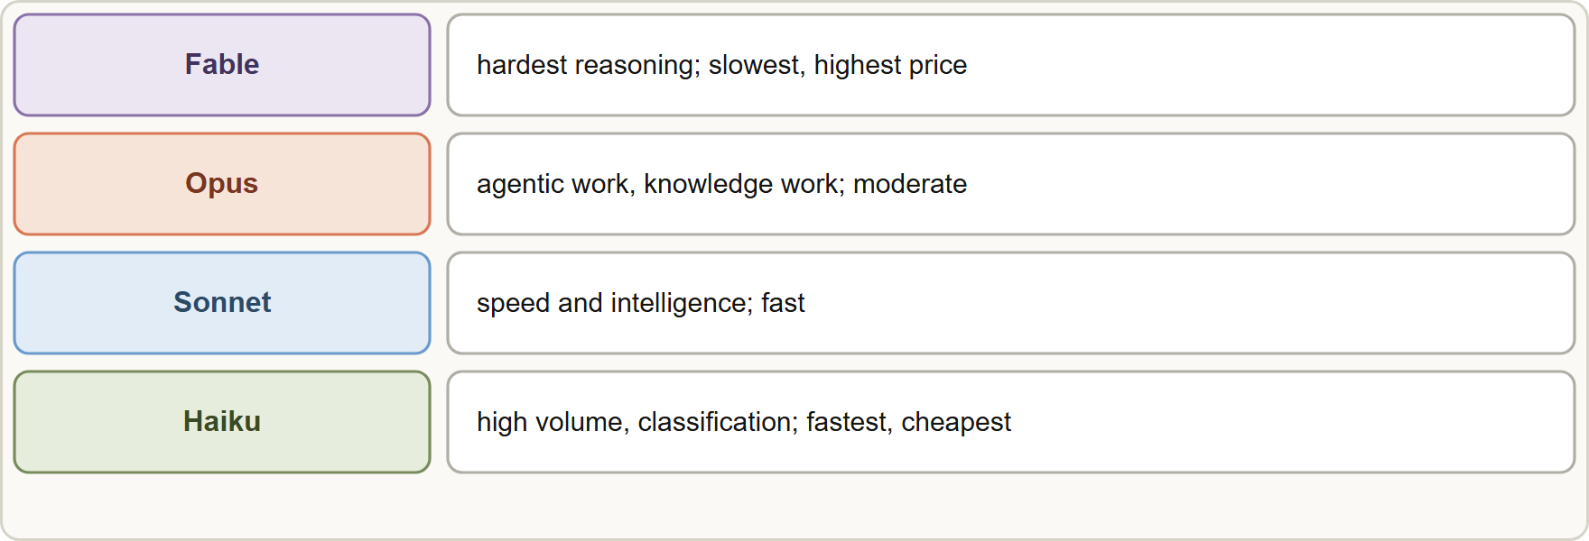
The Tiers and the Levers, continued
DATES
Module 4
All current models: 1M-token context window, text and image input, 128K max output (synchronous), reliable knowledge cutoff June 2026.
All current models: 1M-token context window, text and image input, 128K max output (synchronous), reliable knowledge cutoff June 2026.
Claude Architect Professional Exam Prep | for the CCAR-P exam
Module 4: Selecting Claude Models
5 / 20
Notes:
The Tiers and the Levers, continued.
The figure shows this: Model tiers trade speed and price for capability: Haiku is fastest and cheapest, Sonnet balances, Opus is stronger, Fable is the most capable and slowest.
All current models: one million token context window, text and image input, one hundred twenty-eight thousand max output (synchronous), reliable knowledge cutoff June two thousand twenty-six.

Slide 6
The Tiers and the Levers, continued
DATES
Module 4
Pricing levers: Batch API 50% off; cache reads cost 10% of base input (5% on Opus 5.5 and Sonnet 5.5, 2.5% on Fable 5.1); cache writes 1.25x (5-minute) or 2x (1-hour).
Effort (low to max) is a behavioral signal that trades thoroughness for tokens, latency and cost; adaptive thinking lets the model decide how much to think.
Fast mode buys higher output speed at premium pricing on supported models.
Model IDs are pinned snapshots: pin the full ID in production, test before moving, and plan for retirement dates (Anthropic-operated platforms: not sooner than 2027).
Claude Architect Professional Exam Prep | for the CCAR-P exam
Module 4: Selecting Claude Models
6 / 20
Notes:
The Tiers and the Levers, continued.
Pricing levers: Batch A P I (application programming interface) fifty percent off; cache reads cost ten percent of base input (five percent on Opus five point five and Sonnet five point five, two point five percent on Fable five point one); cache writes one point two five times (five-minute) or two times (one-hour).
Effort (low to max) is a behavioral signal that trades thoroughness for tokens, latency and cost; adaptive thinking lets the model decide how much to think.
Fast mode buys higher output speed at premium pricing on supported models.
Model I Ds are pinned snapshots: pin the full I D in production, test before moving, and plan for retirement dates (Anthropic-operated platforms: not sooner than two thousand twenty-seven).

Slide 7
The Tiers and the Levers, continued
Module 4
Platforms: Claude API, Amazon Bedrock, Google Cloud, Microsoft Foundry, Claude Platform on AWS. Availability, regional endpoints and compliance differ by platform (Module 14).
EXAM TIP Questions give a binding constraint (latency, cost, quality, compliance) and ask for the tier or lever. Name the tier by the role (classification = light, general = balanced, hard reasoning = strong).
Claude Architect Professional Exam Prep | for the CCAR-P exam
Module 4: Selecting Claude Models
7 / 20
Notes:
The Tiers and the Levers, continued.
Platforms: Claude A P I, Amazon Bedrock, Google Cloud, Microsoft Foundry, Claude Platform on A W S. Availability, regional endpoints and compliance differ by platform (Module fourteen).
Exam tip: Questions give a binding constraint (latency, cost, quality, compliance) and ask for the tier or lever. Name the tier by the role (classification equals light, general equals balanced, hard reasoning equals strong).

Slide 8
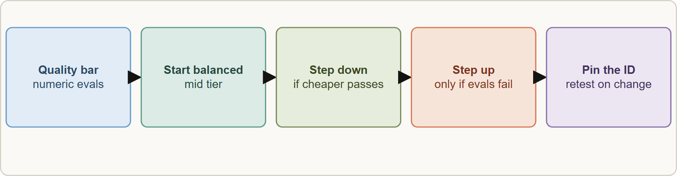
Making the Choice
Module 4
Model selection flow: define the quality bar with evals, start with a balanced tier, step down when a cheaper tier passes, step up only when evals fail, then pin the model ID
Claude Architect Professional Exam Prep | for the CCAR-P exam
Module 4: Selecting Claude Models
8 / 20
Notes:
Making the Choice.
The figure shows this: Model selection flow: define the quality bar with evals, start with a balanced tier, step down when a cheaper tier passes, step up only when evals fail, then pin the model I D.

Slide 9
Making the Choice, continued
Module 4
Workload | Likely choice | Why
High-volume classification, extraction, routing | Haiku (low effort) | Latency and cost dominate; the task is bounded
Customer-facing drafting, summarization | Sonnet | Quality and speed balanced
Complex analysis, agentic coding, long documents | Opus | Reasoning depth pays off
Hardest problems where evals on Opus at high effort still fail | Fable | Highest capability; accept latency and cost
Non-urgent bulk jobs | Any tier through Batch | 50% saving when latency does not matter
Evals decide. Choose the smallest model that passes your eval; "always the largest" and "always the smallest" are both wrong.
Claude Architect Professional Exam Prep | for the CCAR-P exam
Module 4: Selecting Claude Models
9 / 20
Notes:
Making the Choice, continued.
High-volume classification, extraction, routing. Likely choice: Haiku (low effort). Why: Latency and cost dominate; the task is bounded.
Customer-facing drafting, summarization. Likely choice: Sonnet. Why: Quality and speed balanced.
Complex analysis, agentic coding, long documents. Likely choice: Opus. Why: Reasoning depth pays off.
Hardest problems where evals on Opus at high effort still fail. Likely choice: Fable. Why: Highest capability; accept latency and cost.
Non-urgent bulk jobs. Likely choice: Any tier through Batch. Why: fifty percent saving when latency does not matter.
Evals decide. Choose the smallest model that passes your eval; "always the largest" and "always the smallest" are both wrong.

Slide 10
Making the Choice, continued
Module 4
Routing: a cheap classifier (or Haiku) sends easy requests to a small model and hard ones to a larger model.
Cascade: try the cheap model first and escalate on low confidence or failed validation.
Tune before upgrading: better prompt, retrieval or examples, then effort, then model tier.
Retest on every model change: behavior and prompts can shift; run regression evals.
Match context needs: a 1M window does not replace retrieval for very large corpora (Module 9).
Claude Architect Professional Exam Prep | for the CCAR-P exam
Module 4: Selecting Claude Models
10 / 20
Notes:
Making the Choice, continued.
Routing: a cheap classifier (or Haiku) sends easy requests to a small model and hard ones to a larger model.
Cascade: try the cheap model first and escalate on low confidence or failed validation.
Tune before upgrading: better prompt, retrieval or examples, then effort, then model tier.
Retest on every model change: behavior and prompts can shift; run regression evals.
Match context needs: a one million window does not replace retrieval for very large corpora (Module nine).

Slide 11
Trade-Off Table
Module 4
If you need... | Pull this lever | Cost of the lever
Lower latency | Smaller tier, lower effort, streaming, caching, shorter output | Possible quality loss
Lower cost | Smaller tier, caching, batch, shorter prompts, routing | Latency (batch) or quality
Higher quality | Stronger tier, higher effort, thinking, better retrieval | Cost and latency
Compliance | Platform and region choice, ZDR or BAA eligible features | Feature availability, setup
Stability | Pinned snapshot, regression evals | Delayed access to improvements
EXAM TIP The smallest model that passes the eval wins; "always the largest" and "always the smallest" are both distractors.
Claude Architect Professional Exam Prep | for the CCAR-P exam
Module 4: Selecting Claude Models
11 / 20
Notes:
Trade-Off Table.
Lower latency. Pull this lever: Smaller tier, lower effort, streaming, caching, shorter output. Cost of the lever: Possible quality loss.
Lower cost. Pull this lever: Smaller tier, caching, batch, shorter prompts, routing. Cost of the lever: Latency (batch) or quality.
Higher quality. Pull this lever: Stronger tier, higher effort, thinking, better retrieval. Cost of the lever: Cost and latency.
Compliance. Pull this lever: Platform and region choice, Z D R or B A A eligible features. Cost of the lever: Feature availability, setup.
Stability. Pull this lever: Pinned snapshot, regression evals. Cost of the lever: Delayed access to improvements.
Exam tip: The smallest model that passes the eval wins; "always the largest" and "always the smallest" are both distractors.
Exam tip: Tune in order: prompt and retrieval, then effort, then tier; pin the model I D and retest on every change.

Slide 12
Module Recap
DATES
Module 4
1
Tiers
2
Common
3
Savings
Haiku fastest/cheapest · Sonnet balanced · Opus strong, start here for most · Fable strongest, slowest
1M context; 128K output; cutoff June 2026
Batch 50% off; cache reads 10% (5% / 2.5% on some tiers)
4
Rule
5
Patterns
6
Tune order
Smallest model that passes the eval
Route by difficulty; cascade on low confidence
Prompt and retrieval, then effort, then tier
7
Pin
Full snapshot ID; regression evals on change
Claude Architect Professional Exam Prep | for the CCAR-P exam
Module 4: Selecting Claude Models
12 / 20
Notes:
Here is the recap.
Tiers: Haiku fastest or cheapest, Sonnet balanced, Opus strong, start here for most, Fable strongest, slowest.
Common: one million context; one hundred twenty-eight thousand output; cutoff June two thousand twenty-six.
Savings: Batch fifty percent off; cache reads ten percent (five percent or two point five percent on some tiers).
Rule: Smallest model that passes the eval.
Patterns: Route by difficulty; cascade on low confidence.
Tune order: Prompt and retrieval, then effort, then tier.
Pin: Full snapshot I D; regression evals on change.

Slide 13
Practice Question 1
Module 4
Q1
A bank classifies two million messages per day into 12 intents with a sub-second target. Which choice fits best?
A
The balanced tier with extended thinking enabled on every request
B
A multi-agent system with one agent per intent
C
The most capable tier at maximum effort for the best accuracy on every one of the two million messages
D
The fastest, lowest-cost tier at low effort, validated against an eval set
Claude Architect Professional Exam Prep | for the CCAR-P exam
Module 4: Selecting Claude Models
13 / 20
Notes:
Question one.
A bank classifies two million messages per day into twelve intents with a sub-second target. Which choice fits best?
The four options are on the screen.
[PAUSE 12]
The answer is D. Bounded, high-volume, latency-sensitive classification is the light tier's role.

Slide 14
Practice Question 2
Module 4
Q2
An overnight regulatory analysis is correctness-critical and latency does not matter. Which combination is best?
A
A synchronous multi-agent run during business hours so that analysts can watch it progress live
B
A strong tier at higher effort, run through the Batch API for the 50 percent saving
C
The fastest tier in streaming mode for a responsive experience
D
The smallest tier at low effort to minimize the bill
Claude Architect Professional Exam Prep | for the CCAR-P exam
Module 4: Selecting Claude Models
14 / 20
Notes:
Question two.
An overnight regulatory analysis is correctness-critical and latency does not matter. Which combination is best?
The four options are on the screen.
[PAUSE 12]
The answer is B. Quality-first model with batch discounts suits non-urgent, critical work.

Slide 15
Practice Question 3
Module 4
Q3
A team wants to save cost without hurting quality. What is the best method?
A
Run an eval, then move to the smallest tier that still passes the quality bar
B
Switch tiers weekly and keep whichever one feels better to the team during that particular week
C
Keep the largest tier and shorten the system prompt
D
Move all traffic to the smallest tier at once and monitor customer complaints to see if quality drops
Claude Architect Professional Exam Prep | for the CCAR-P exam
Module 4: Selecting Claude Models
15 / 20
Notes:
Question three.
A team wants to save cost without hurting quality. What is the best method?
The four options are on the screen.
[PAUSE 12]
The answer is A. Evals prove the cheaper tier is good enough.

Slide 16
Practice Question 4
Module 4
Q4
Why should a production system pin the full model ID?
A
Pinned IDs increase the context window
B
Pinned IDs are cheaper than aliases because Anthropic bills a lower rate for any pinned snapshot
C
Pinned IDs disable retirement of the model
D
Behavior is tied to a specific snapshot, so changes should be tested and rolled out deliberately
Claude Architect Professional Exam Prep | for the CCAR-P exam
Module 4: Selecting Claude Models
16 / 20
Notes:
Question four.
Why should a production system pin the full model I D?
The four options are on the screen.
[PAUSE 12]
The answer is D. Pinning gives stability; move only after regression evals.

Slide 17
Practice Question 5
Module 4
Q5
A router sends easy requests to a small model and hard ones to a large model. Which benefit does this give?
A
Automatic retirement of the large model
B
Elimination of the need for evals
C
Guaranteed identical answers from both models, so that results never differ between easy and hard cases
D
Lower average cost and latency while keeping quality where it is needed
Claude Architect Professional Exam Prep | for the CCAR-P exam
Module 4: Selecting Claude Models
17 / 20
Notes:
Question five.
A router sends easy requests to a small model and hard ones to a large model. Which benefit does this give?
The four options are on the screen.
[PAUSE 12]
The answer is D. Routing aligns capability and cost with task difficulty, so average cost and latency fall while hard cases still get the stronger model.

Slide 18
Practice Question 6
Module 4
Q6
Which TWO levers reduce latency for an interactive assistant? (Select TWO.)
A
Routing every request through the Batch API
B
Streaming the response so users see output early
C
Raising effort to maximum
D
Adding more few-shot examples to the prompt without limit
E
A smaller tier or lower effort for routine turns
Claude Architect Professional Exam Prep | for the CCAR-P exam
Module 4: Selecting Claude Models
18 / 20
Notes:
Question six. Select two.
Which two levers reduce latency for an interactive assistant?
The five options are on the screen.
[PAUSE 15]
The answers are B and E. Streaming improves perceived latency; smaller tier and lower effort cut generation time.

Slide 19
Practice Question 7
Module 4
Q7
Evals on the balanced tier fail on the hardest 10 percent of cases even after prompt and retrieval improvements. What is the next step?
A
Test a stronger tier or higher effort on those cases, perhaps via cascade or routing
B
Replace the model with a rules engine for all cases
C
Remove the hardest cases from the eval set so that the stronger tier is never needed for production
D
Lower the pass threshold to match current results
Claude Architect Professional Exam Prep | for the CCAR-P exam
Module 4: Selecting Claude Models
19 / 20
Notes:
Question seven.
Evals on the balanced tier fail on the hardest ten percent of cases even after prompt and retrieval improvements. What is the next step?
The four options are on the screen.
[PAUSE 12]
The answer is A. Step up only on evidence, ideally for just the hard slice.

Slide 20
Answers at a Glance
Module 4
Question | Answer | Why
Q1 | D | Bounded, high-volume, latency-sensitive classification is the light tier's role
Q2 | B | Quality-first model with batch discounts suits non-urgent, critical work
Q3 | A | Evals prove the cheaper tier is good enough
Q4 | D | Pinning gives stability; move only after regression evals
Q5 | D | Routing aligns capability and cost with task difficulty
Q6 | B, E | Streaming improves perceived latency
Q7 | A | Step up only on evidence, ideally for just the hard slice
Claude Architect Professional Exam Prep | for the CCAR-P exam
Module 4: Selecting Claude Models
20 / 20
Notes:
Here are all seven answers. Question one: D. Question two: B. Question three: A. Question four: D. Question five: D. Question six: B and E. Question seven: A.
In the next module, we continue the course.

