Slide 1
Module 5: System Prompts, Templates and Prompting Techniques
The anatomy of a system prompt and what belongs in it
Domain 2 · Claude Models, Prompting & Context Engineering
Claude Architect Professional Exam Prep Masterclass
Module 5
Notes:
Welcome to Module five: System Prompts, Templates and Prompting Techniques. This module covers system prompts, templates and prompting techniques.
Each part of this module comes from the study notes of the same name, so you can read the notes after you watch.

Slide 2
What You Will Learn
Module 5
The anatomy of a system prompt and what belongs in it
Templates: stable text plus variable slots
Zero-shot, few-shot and chain-of-thought and when each helps
Guardrail prompts and their limits
How to treat prompts as versioned, tested artifacts
Claude Architect Professional Exam Prep | for the CCAR-P exam
Module 5
2 / 21
Notes:
By the end of this module you will be able to do five things.
The anatomy of a system prompt and what belongs in it.
Templates: stable text plus variable slots.
Zero-shot, few-shot and chain-of-thought and when each helps.
Guardrail prompts and their limits.
How to treat prompts as versioned, tested artifacts.

Slide 3
Case Check-In: Lumen Advisory Writes the System Prompt for a Bank's Policy Assistant
Module 5
CASE CHECK-IN · Lumen Advisory
The assistant answers staff questions from a policy library
It must cite sources, say when policy is silent, refuse legal advice, and answer in a fixed JSON shape for the agent desktop
Claude Architect Professional Exam Prep | for the CCAR-P exam
Module 5
3 / 21
Notes:
Our running case is Lumen Advisory. Lumen Advisory Writes the System Prompt for a Bank's Policy Assistant.
The assistant answers staff questions from a policy library.
It must cite sources, say when policy is silent, refuse legal advice, and answer in a fixed Jason (Java Script Object Notation) shape for the agent desktop.

Slide 4
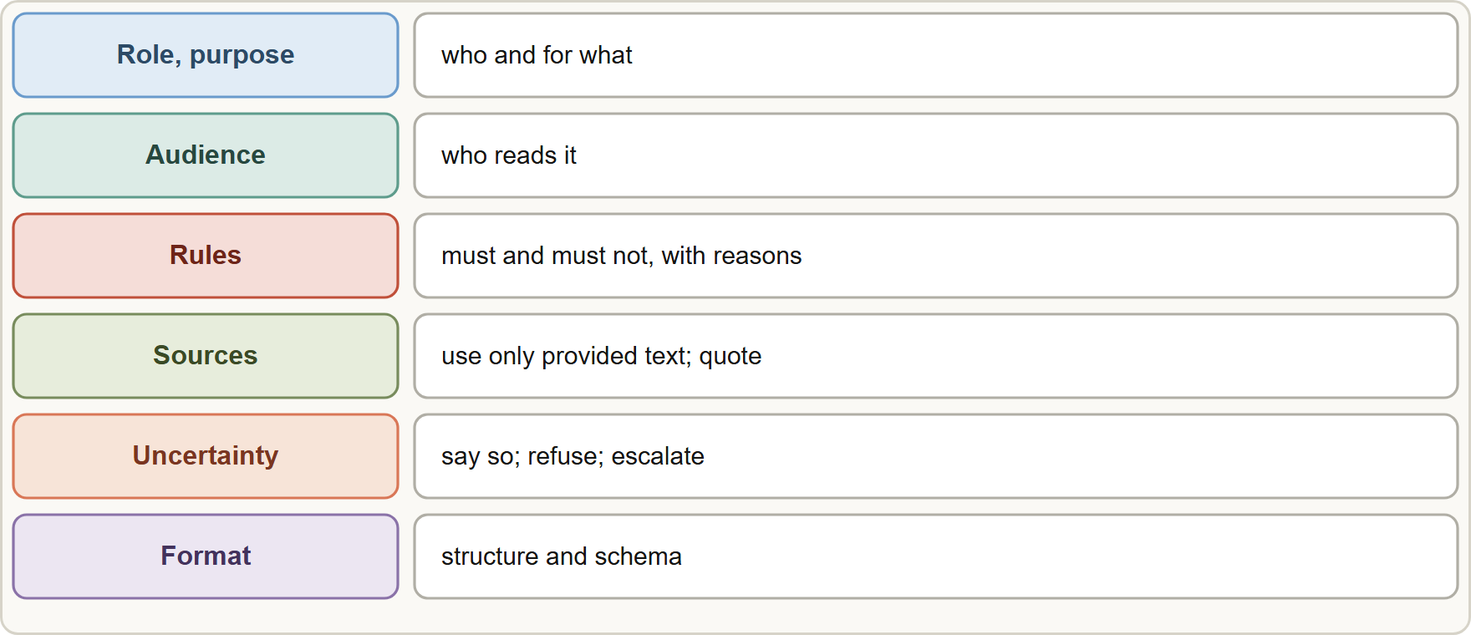
System Prompts
Module 5
Anatomy of a system prompt: role and purpose, audience, rules and boundaries, tone and format, how to use sources, uncertainty and refusal behavior, output schema
Claude Architect Professional Exam Prep | for the CCAR-P exam
Module 5
4 / 21
Notes:
System Prompts.
The figure shows this: Anatomy of a system prompt: role and purpose, audience, rules and boundaries, tone and format, how to use sources, uncertainty and refusal behavior, output schema.

Slide 5
System Prompts, continued
Module 5
Block | Write | Example
Role and purpose | Who the model is and the job | "You answer staff questions about retail-banking policy"
Audience | Who reads the output | "Contact-center agents, not customers"
Rules and boundaries | Must and must-not, with the reason | "Never give legal advice: staff cannot rely on it with customers"
Sources | How to use the context | "Use only the provided policy excerpts; quote the clause"
Uncertainty | What to do when unsure | "If the excerpts do not cover it, say so and suggest escalation"
Format | Structure, length, schema | "Return JSON with fields answer, citations, confidence"
Claude Architect Professional Exam Prep | for the CCAR-P exam
Module 5
5 / 21
Notes:
System Prompts, continued.
Role and purpose. Write: Who the model is and the job. Example: "You answer staff questions about retail-banking policy".
Audience. Write: Who reads the output. Example: "Contact-center agents, not customers".
Rules and boundaries. Write: Must and must-not, with the reason. Example: "Never give legal advice: staff cannot rely on it with customers".
Sources. Write: How to use the context. Example: "Use only the provided policy excerpts; quote the clause".
Uncertainty. Write: What to do when unsure. Example: "If the excerpts do not cover it, say so and suggest escalation".
Format. Write: Structure, length, schema. Example: "Return Jason with fields answer, citations, confidence".

Slide 6
System Prompts, continued
Module 5
Be clear and direct: Claude is a brilliant new employee with no context; state the task, the constraints and why.
Put long documents first and the question and instructions last; separate content with XML-style tags (<policy>, <question>).
A role sentence focuses tone and behavior.
Hard requirements belong in code (validation, permissions), with the prompt as the first layer, not the only one (Module 13).
Claude Architect Professional Exam Prep | for the CCAR-P exam
Module 5
6 / 21
Notes:
System Prompts, continued.
Be clear and direct: Claude is a brilliant new employee with no context; state the task, the constraints and why.
Put long documents first and the question and instructions last; separate content with X M L-style tags ( less than policy greater than, less than question greater than ).
A role sentence focuses tone and behavior.
Hard requirements belong in code (validation, permissions), with the prompt as the first layer, not the only one (Module thirteen).

Slide 7
Templates and Reuse
Module 5
A template holds stable instructions and named variable slots (user input, retrieved passages, customer tier).
Stable parts first, variable parts last: this keeps a cacheable prefix (Module 6).
Separate data from instructions with tags so injected text is treated as data.
Keep prompts in version control, with tests (evals) and a change log; roll back when quality drops.
Modular prompts: shared blocks (tone, safety rules) reused across assistants; per-use blocks (task, schema).
EXAM TIP Templates put the static content first and the dynamic content last. That ordering is also what makes prompt caching work.
Claude Architect Professional Exam Prep | for the CCAR-P exam
Module 5
7 / 21
Notes:
Templates and Reuse.
A template holds stable instructions and named variable slots (user input, retrieved passages, customer tier).
Stable parts first, variable parts last: this keeps a cacheable prefix (Module six).
Separate data from instructions with tags so injected text is treated as data.
Keep prompts in version control, with tests (evals) and a change log; roll back when quality drops.
Modular prompts: shared blocks (tone, safety rules) reused across assistants; per-use blocks (task, schema).
Exam tip: Templates put the static content first and the dynamic content last. That ordering is also what makes prompt caching work.

Slide 8
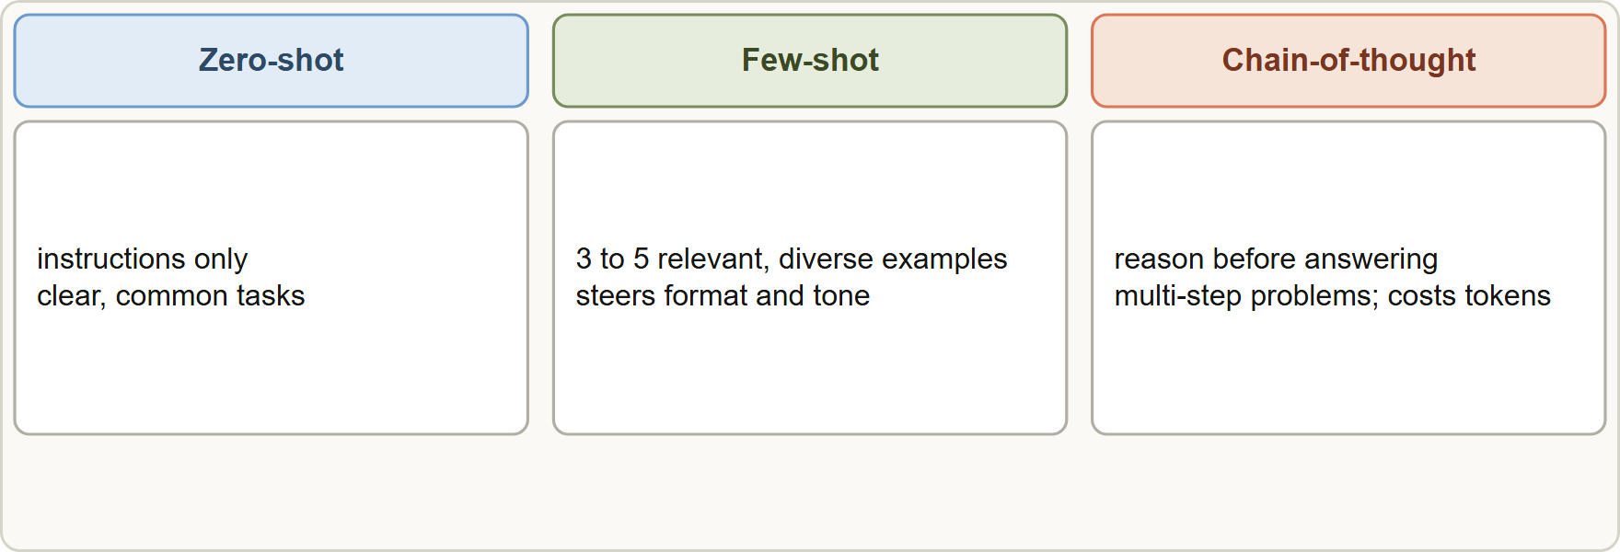
Prompting Techniques
Module 5
Three techniques: zero-shot with instructions only, few-shot with labeled examples, and chain-of-thought with reasoning before the answer
Claude Architect Professional Exam Prep | for the CCAR-P exam
Module 5
8 / 21
Notes:
Prompting Techniques.
The figure shows this: Three techniques: zero-shot with instructions only, few-shot with labeled examples, and chain-of-thought with reasoning before the answer.

Slide 9
Prompting Techniques, continued
Module 5
Technique | What it is | Use when | Watch for
Zero-shot | Instructions only, no examples | Clear, common tasks; strong models | Format drift on unusual outputs
Few-shot | 3 to 5 relevant, diverse examples in tags | Steering format, tone, edge cases; classification boundaries | Examples that are too similar bias the output; keep them in an examples block, not instructions
Chain-of-thought | Ask for step-by-step reasoning before the answer | Multi-step reasoning, math, analysis, checks | Extra tokens and latency; with thinking models prefer effort and adaptive thinking over manual step prompts
Claude Architect Professional Exam Prep | for the CCAR-P exam
Module 5
9 / 21
Notes:
Prompting Techniques, continued.
Zero-shot. What it is: Instructions only, no examples. Use when: Clear, common tasks; strong models. Watch for: Format drift on unusual outputs.
Few-shot. What it is: three to five relevant, diverse examples in tags. Use when: Steering format, tone, edge cases; classification boundaries. Watch for: Examples that are too similar bias the output; keep them in an examples block, not instructions.
Chain-of-thought. What it is: Ask for step-by-step reasoning before the answer. Use when: Multi-step reasoning, math, analysis, checks. Watch for: Extra tokens and latency; with thinking models prefer effort and adaptive thinking over manual step prompts.

Slide 10
Prompting Techniques, continued
Module 5
Technique | What it is | Use when | Watch for
Self-check / critique | Ask the model to review a draft against criteria | Quality pass before output | Not a replacement for external validation
Prompt chaining | Separate calls for stages | Complex tasks needing inspection | Latency
Examples are one of the most reliable ways to steer structure and tone; they must be relevant, diverse and clearly marked.
Structured outputs (schema-constrained decoding) enforce shape; they do not guarantee truth (validate values).
To reduce hallucination: allow "I don't know", ask for direct quotes before conclusions, require citations, and ground in provided sources.
Claude Architect Professional Exam Prep | for the CCAR-P exam
Module 5
10 / 21
Notes:
Prompting Techniques, continued.
Self-check or critique. What it is: Ask the model to review a draft against criteria. Use when: Quality pass before output. Watch for: Not a replacement for external validation.
Prompt chaining. What it is: Separate calls for stages. Use when: Complex tasks needing inspection. Watch for: Latency.
Examples are one of the most reliable ways to steer structure and tone; they must be relevant, diverse and clearly marked.
Structured outputs (schema-constrained decoding) enforce shape; they do not guarantee truth (validate values).
To reduce hallucination: allow "I don't know", ask for direct quotes before conclusions, require citations, and ground in provided sources.

Slide 11
Prompting Techniques, continued
Module 5
Test prompts on a dataset, not on a few hand-picked examples.
Claude Architect Professional Exam Prep | for the CCAR-P exam
Module 5
11 / 21
Notes:
Prompting Techniques, continued.
Test prompts on a dataset, not on a few hand-picked examples.

Slide 12
Guardrails in Prompts
Module 5
Guardrail | Purpose | Limits
Scope statement | Keep the assistant on topic | Users can still try to override
Refusal rules with reasons | Stop prohibited help | Not enforceable alone
Source-grounding rules | Reduce invention | Still needs verification
Untrusted-content notice | Treat tool and document text as data | Pair with isolation and least privilege
Output format and schema | Predictable downstream use | Shape only
Prompt guardrails are the first layer. Enforcement (hooks, validation, authorization, human approval) is in code (Module 13).
EXAM TIP Prompts are soft controls: they guide behavior but cannot enforce a hard rule, so pair them with code.
Claude Architect Professional Exam Prep | for the CCAR-P exam
Module 5
12 / 21
Notes:
Guardrails in Prompts.
Scope statement. Purpose: Keep the assistant on topic. Limits: Users can still try to override.
Refusal rules with reasons. Purpose: Stop prohibited help. Limits: Not enforceable alone.
Source-grounding rules. Purpose: Reduce invention. Limits: Still needs verification.
Untrusted-content notice. Purpose: Treat tool and document text as data. Limits: Pair with isolation and least privilege.
Output format and schema. Purpose: Predictable downstream use. Limits: Shape only.
Prompt guardrails are the first layer. Enforcement (hooks, validation, authorization, human approval) is in code (Module thirteen).
Exam tip: Prompts are soft controls: they guide behavior but cannot enforce a hard rule, so pair them with code.
Exam tip: Few-shot examples steer format and tone best; chain-of-thought helps multi-step reasoning at the price of tokens.

Slide 13
Module Recap
Module 5
1
System prompt
2
Order
3
Template
Role · audience · rules with reasons · sources · uncertainty · format
Long documents and stable text first; question and variables last
Stable text plus variable slots; tags separate data from instructions
4
Few-shot
5
CoT
6
Hallucination
3 to 5 relevant, diverse, tagged examples
For multi-step reasoning; costs tokens; use effort and thinking on thinking models
Allow abstaining, quote first, cite, ground
7
Schema
8
Prompts as code
Shape not truth: validate values
Version, test with evals, roll back
Claude Architect Professional Exam Prep | for the CCAR-P exam
Module 5
13 / 21
Notes:
Here is the recap.
System prompt: Role, audience, rules with reasons, sources, uncertainty, format.
Order: Long documents and stable text first; question and variables last.
Template: Stable text plus variable slots; tags separate data from instructions.
Few-shot: three to five relevant, diverse, tagged examples.
Co T: For multi-step reasoning; costs tokens; use effort and thinking on thinking models.
Hallucination: Allow abstaining, quote first, cite, ground.
Schema: Shape not truth: validate values.
Prompts as code: Version, test with evals, roll back.

Slide 14
Practice Question 1
Module 5
Q1
A prompt template places the user's question first, followed by a 6,000-token policy that is identical on every request. Latency and cost are both concerns. What change helps most?
A
Truncate the policy to its first few hundred tokens
B
Move the policy to the end of the prompt, after the user question
C
Put the static policy and instructions first, the user question last, and cache the stable prefix
D
Put the policy inside a few-shot example block so it is repeated for emphasis
Claude Architect Professional Exam Prep | for the CCAR-P exam
Module 5
14 / 21
Notes:
Question one.
A prompt template places the user's question first, followed by a six thousand-token policy that is identical on every request. Latency and cost are both concerns. What change helps most?
The four options are on the screen.
[PAUSE 12]
The answer is C. A stable prefix can be cached only if it comes first and does not change.

Slide 15
Practice Question 2
Module 5
Q2
An assistant must output labeled risk levels in a house style that is hard to describe. Which technique fits best?
A
Chain-of-thought with no examples
B
Zero-shot with a longer description of the style in prose only, repeated at the end of the prompt
C
Increasing temperature to vary the style
D
Few-shot prompting with a few relevant, diverse labeled examples
Claude Architect Professional Exam Prep | for the CCAR-P exam
Module 5
15 / 21
Notes:
Question two.
An assistant must output labeled risk levels in a house style that is hard to describe. Which technique fits best?
The four options are on the screen.
[PAUSE 12]
The answer is D. Examples are the most reliable way to convey format and tone.

Slide 16
Practice Question 3
Module 5
Q3
Why should instructions in a system prompt include the reason for a rule?
A
Reasons let users edit the rule
B
Reasons are required by the API schema
C
Reasons make the prompt longer, which improves caching because longer prompts are always cached longer
D
The model can apply the rule sensibly in situations the rule did not mention
Claude Architect Professional Exam Prep | for the CCAR-P exam
Module 5
16 / 21
Notes:
Question three.
Why should instructions in a system prompt include the reason for a rule?
The four options are on the screen.
[PAUSE 12]
The answer is D. Explaining the why lets Claude generalize the intent.

Slide 17
Practice Question 4
Module 5
Q4
A schema-constrained output returns well-formed JSON with a wrong account balance. What does this show?
A
The schema was too strict
B
The model must be retrained
C
Structured output guarantees shape, not truth, so values must be validated against the source
D
Few-shot examples were missing from the schema, so the model could not learn the correct balance values
Claude Architect Professional Exam Prep | for the CCAR-P exam
Module 5
17 / 21
Notes:
Question four.
A schema-constrained output returns well-formed Jason with a wrong account balance. What does this show?
The four options are on the screen.
[PAUSE 12]
The answer is C. A schema guarantees the shape of the output but not the truth of its values, so content must be validated against the source.

Slide 18
Practice Question 5
Module 5
Q5
Which TWO reduce hallucination in a document-grounded assistant? (Select TWO.)
A
Telling the model it must always provide an answer
B
Raising temperature so that answers are more creative
C
Removing the source documents to shorten the prompt
D
Allowing the model to answer "the documents do not say" and requiring citations
E
Asking for direct quotes before the conclusion
Claude Architect Professional Exam Prep | for the CCAR-P exam
Module 5
18 / 21
Notes:
Question five. Select two.
Which two reduce hallucination in a document-grounded assistant?
The five options are on the screen.
[PAUSE 15]
The answers are D and E. Permission to abstain and quote-first grounding make unsupported claims visible.

Slide 19
Practice Question 6
Module 5
Q6
When is chain-of-thought prompting most useful?
A
Simple extraction of one field from a short text where the answer is explicit in the first sentence
B
Latency-critical single-token classification where the answer must be returned within milliseconds
C
Prompts that must stay under a few tokens
D
Multi-step reasoning or analysis where intermediate steps improve the result
Claude Architect Professional Exam Prep | for the CCAR-P exam
Module 5
19 / 21
Notes:
Question six.
When is chain-of-thought prompting most useful?
The four options are on the screen.
[PAUSE 12]
The answer is D. Step-by-step reasoning helps complex tasks and costs extra tokens.

Slide 20
Practice Question 7
Module 5
Q7
Which statement about prompt guardrails is correct?
A
They replace the need for authorization checks
B
They are a first layer; hard requirements still need enforcement in code
C
They fully prevent prompt injection when worded strongly enough and placed at the top of the prompt
D
They are only useful for tone
Claude Architect Professional Exam Prep | for the CCAR-P exam
Module 5
20 / 21
Notes:
Question seven.
Which statement about prompt guardrails is correct?
The four options are on the screen.
[PAUSE 12]
The answer is B. Prompts can be overridden; enforce critical rules outside the model.

Slide 21
Answers at a Glance
Module 5
Question | Answer | Why
Q1 | C | A stable prefix can be cached only if it comes first and
Q2 | D | Examples are the most reliable way to convey format and tone
Q3 | D | Explaining the why lets Claude generalize the intent
Q4 | C | A schema guarantees the shape of the output but not the truth
Q5 | D, E | Permission to abstain and quote-first grounding make unsupported claims visible
Q6 | D | Step-by-step reasoning helps complex tasks and costs extra tokens
Q7 | B | Prompts can be overridden
Claude Architect Professional Exam Prep | for the CCAR-P exam
Module 5
21 / 21
Notes:
Here are all seven answers. Question one: C. Question two: D. Question three: D. Question four: C. Question five: D and E. Question six: D. Question seven: B.
In the next module, we continue the course.

