Slide 1
Module 6: Context, Tokens and Prompt Reuse
The context window as a budget and how to stay inside it
Domain 2 · Claude Models, Prompting & Context Engineering
Claude Architect Professional Exam Prep Masterclass
Module 6
Notes:
Welcome to Module six: Context, Tokens and Prompt Reuse. This module covers context, tokens and prompt reuse.
Each part of this module comes from the study notes of the same name, so you can read the notes after you watch.

Slide 2
What You Will Learn
Module 6
The context window as a budget and how to stay inside it
Context engineering techniques: pruning, compaction, isolation, external memory
Prompt caching: rules, ordering and savings
Modular prompts and Skills (progressive disclosure)
Token optimization levers and measurement
Claude Architect Professional Exam Prep | for the CCAR-P exam
Module 6: Context, Tokens and Prompt Reuse
2 / 22
Notes:
By the end of this module you will be able to do five things.
The context window as a budget and how to stay inside it.
Context engineering techniques: pruning, compaction, isolation, external memory.
Prompt caching: rules, ordering and savings.
Modular prompts and Skills (progressive disclosure).
Token optimization levers and measurement.

Slide 3
Case Check-In: Lumen Advisory and the Retail Client's Slow, Costly Assistant
Module 6
CASE CHECK-IN · Lumen Advisory
A retailer's assistant sends a 12,000-token policy and catalog extract on every request, plus the full chat history
By the afternoon, answers drift and the bill is three times the forecast
Claude Architect Professional Exam Prep | for the CCAR-P exam
Module 6: Context, Tokens and Prompt Reuse
3 / 22
Notes:
Our running case is Lumen Advisory. Lumen Advisory and the Retail Client's Slow, Costly Assistant.
A retailer's assistant sends a twelve thousand-token policy and catalog extract on every request, plus the full chat history.
By the afternoon, answers drift and the bill is three times the forecast.

Slide 4
The Context Is a Budget
Module 6
Everything in the window competes: system prompt, tools, history, documents, tool results. More is not better; relevant and well ordered is better.
The API is stateless: you resend what the model needs. Tokens are billed as input and output; thinking tokens bill as output.
Context drift and bloat raise cost and latency and lower quality.
Use token counting (an estimate endpoint) to plan prompts, route models and fit budgets.
Claude Architect Professional Exam Prep | for the CCAR-P exam
Module 6: Context, Tokens and Prompt Reuse
4 / 22
Notes:
The Context Is a Budget.
Everything in the window competes: system prompt, tools, history, documents, tool results. More is not better; relevant and well ordered is better.
The A P I (application programming interface) is stateless: you resend what the model needs. Tokens are billed as input and output; thinking tokens bill as output.
Context drift and bloat raise cost and latency and lower quality.
Use token counting (an estimate endpoint) to plan prompts, route models and fit budgets.

Slide 5
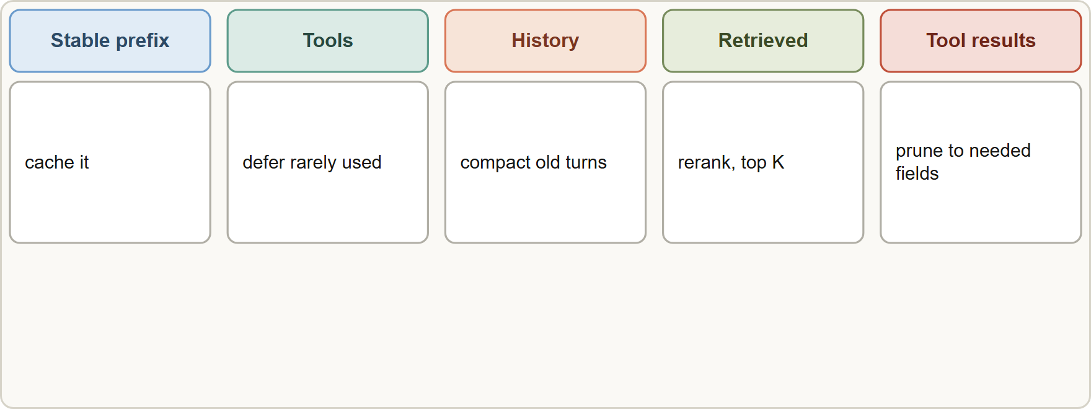
The Context Is a Budget, continued
Module 6
The context window is a budget: stable prefix, tools, history, retrieved passages and tool results compete; prune, compact, isolate and store outside to stay within it
Claude Architect Professional Exam Prep | for the CCAR-P exam
Module 6: Context, Tokens and Prompt Reuse
5 / 22
Notes:
The Context Is a Budget, continued.
The figure shows this: The context window is a budget: stable prefix, tools, history, retrieved passages and tool results compete; prune, compact, isolate and store outside to stay within it.

Slide 6
The Context Is a Budget, continued
Module 6
Technique | What it does | Use when
Prune tool output | Keep only fields the next step needs | Tools return verbose records
Compaction | Replace older turns with a summary (server-side or your own call) | Long conversations near the limit
Context editing | Clear old tool results automatically | Agent loops with big results
Isolation | Do verbose work in a subagent; return a summary | Exploration would flood the main window
External memory | Store facts in files or a store; load when relevant (memory tool) | Facts must outlive the window
Just-in-time retrieval | Fetch documents when needed | Large corpora (Module 9)
Claude Architect Professional Exam Prep | for the CCAR-P exam
Module 6: Context, Tokens and Prompt Reuse
6 / 22
Notes:
The Context Is a Budget, continued.
Prune tool output. What it does: Keep only fields the next step needs. Use when: Tools return verbose records.
Compaction. What it does: Replace older turns with a summary (server-side or your own call). Use when: Long conversations near the limit.
Context editing. What it does: Clear old tool results automatically. Use when: Agent loops with big results.
Isolation. What it does: Do verbose work in a subagent; return a summary. Use when: Exploration would flood the main window.
External memory. What it does: Store facts in files or a store; load when relevant (memory tool). Use when: Facts must outlive the window.
Just-in-time retrieval. What it does: Fetch documents when needed. Use when: Large corpora (Module nine).

Slide 7
The Context Is a Budget, continued
Module 6
Technique | What it does | Use when
Ordering | Long documents first; question and instructions last | Long-context prompts
Compaction can lose exact figures and commitments: keep them in a persistent block resent each turn.
A 1M-token window does not remove the need for retrieval on very large corpora, and long contexts cost more and can dilute attention.
Claude Architect Professional Exam Prep | for the CCAR-P exam
Module 6: Context, Tokens and Prompt Reuse
7 / 22
Notes:
The Context Is a Budget, continued.
Ordering. What it does: Long documents first; question and instructions last. Use when: Long-context prompts.
Compaction can lose exact figures and commitments: keep them in a persistent block resent each turn.
A one million token window does not remove the need for retrieval on very large corpora, and long contexts cost more and can dilute attention.

Slide 8
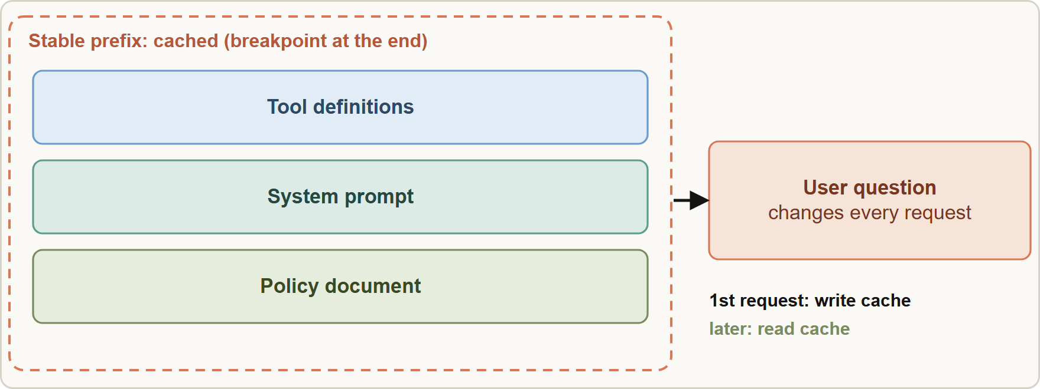
Prompt Caching
Module 6
Prompt caching: the stable prefix before the breakpoint is written once and read on later requests; only the changing suffix is processed fresh
Claude Architect Professional Exam Prep | for the CCAR-P exam
Module 6: Context, Tokens and Prompt Reuse
8 / 22
Notes:
Prompt Caching.
The figure shows this: Prompt caching: the stable prefix before the breakpoint is written once and read on later requests; only the changing suffix is processed fresh.

Slide 9
Prompt Caching, continued
Module 6
Rule | Detail
Prefix order | Tools, then system, then messages; the cache covers the exact prefix up to a breakpoint
Breakpoints | Automatic caching with one top-level cache_control, or explicit breakpoints (at most 4)
TTL | 5 minutes (default) or 1 hour; refreshed when the entry is read
Minimum | About 512 tokens on current tiers; shorter prompts run without caching and without an error
Price | Reads are a fraction of base input (10%; 5% or 2.5% on some tiers); writes 1.25x (5 min) or 2x (1 hour)
Claude Architect Professional Exam Prep | for the CCAR-P exam
Module 6: Context, Tokens and Prompt Reuse
9 / 22
Notes:
Prompt Caching, continued.
Prefix order. Tools, then system, then messages; the cache covers the exact prefix up to a breakpoint.
Breakpoints. Automatic caching with one top-level cache control, or explicit breakpoints (at most four).
T T L. five minutes (default) or one hour; refreshed when the entry is read.
Minimum. About five hundred twelve tokens on current tiers; shorter prompts run without caching and without an error.
Price. Reads are a fraction of base input (ten percent; five percent or two point five percent on some tiers); writes one point two five times (five min) or two times (one hour).

Slide 10
Prompt Caching, continued
Module 6
Rule | Detail
Invalidation | Any change in the prefix (a timestamp, a reordered tool, a different tool set) breaks the match
Check | usage fields cache_creation_input_tokens and cache_read_input_tokens
Stable content first, dynamic last. Never put timestamps, user names or random IDs before the cached text.
Keep tool definitions stable (deferred tool loading preserves the prefix; Module 7).
Caching reduces latency and cost together; it helps only when the same prefix repeats within the TTL.
It also makes contextual retrieval and large few-shot blocks cheap to reuse (Module 9).
EXAM TIP For a long, repeated static prompt with a short varying question, the best single optimization is caching the stable prefix (static first). Truncating needed context or shrinking the model blindly are the distractors.
Claude Architect Professional Exam Prep | for the CCAR-P exam
Module 6: Context, Tokens and Prompt Reuse
10 / 22
Notes:
Prompt Caching, continued.
Invalidation. Any change in the prefix (a timestamp, a reordered tool, a different tool set) breaks the match.
Check. usage fields cache creation input tokens and cache read input tokens.
Stable content first, dynamic last. Never put timestamps, user names or random I Ds before the cached text.
Keep tool definitions stable (deferred tool loading preserves the prefix; Module seven).
Caching reduces latency and cost together; it helps only when the same prefix repeats within the T T L.
It also makes contextual retrieval and large few-shot blocks cheap to reuse (Module nine).
Exam tip: For a long, repeated static prompt with a short varying question, the best single optimization is caching the stable prefix (static first). Truncating needed context or shrinking the model blindly are the distractors.

Slide 11
Modular Prompts and Skills
Module 6
Level | Loaded | Cost
Metadata (name, description) | Always, in the system prompt | Small
SKILL.md instructions | When the skill triggers | Moderate
Resources and scripts | As needed; scripts run without their code entering the context | Only when used
Modular prompts: compose a prompt from versioned blocks (safety, tone, task, schema, tool guidance). Shared blocks keep many assistants consistent.
Skills package procedures, scripts and reference files that Claude loads only when relevant.
Claude Architect Professional Exam Prep | for the CCAR-P exam
Module 6: Context, Tokens and Prompt Reuse
11 / 22
Notes:
Modular Prompts and Skills.
Modular prompts: compose a prompt from versioned blocks (safety, tone, task, schema, tool guidance). Shared blocks keep many assistants consistent.
Skills package procedures, scripts and reference files that Claude loads only when relevant.
Metadata (name, description). Loaded: Always, in the system prompt. Cost: Small.
Skill dot M D instructions. Loaded: When the skill triggers. Cost: Moderate.
Resources and scripts. Loaded: As needed; scripts run without their code entering the context. Cost: Only when used.

Slide 12
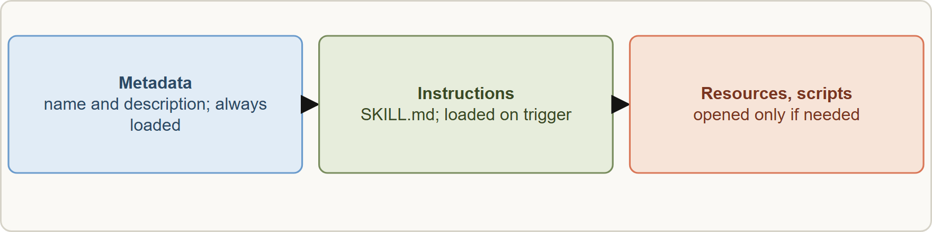
Modular Prompts and Skills, continued
Module 6
Use a Skill for a repeatable procedure (report format, review checklist); use a Project or knowledge store for background; use MCP for live data and actions.
Write precise descriptions (they decide when a skill triggers).
Use a Skill for a repeatable procedure (report format, review checklist); use a Project or knowledge store for background; use MCP for live data and actions.
Write precise descriptions (they decide when a skill triggers).
Claude Architect Professional Exam Prep | for the CCAR-P exam
Module 6: Context, Tokens and Prompt Reuse
12 / 22
Notes:
Modular Prompts and Skills, continued.
The figure shows this: Skills use progressive disclosure: metadata always, instructions when triggered, resources and scripts on demand.
Use a Skill for a repeatable procedure (report format, review checklist); use a Project or knowledge store for background; use M C P (Model Context Protocol) for live data and actions.
Write precise descriptions (they decide when a skill triggers).

Slide 13
Token Optimization Levers
Module 6
Lever | Effect
Cache the prefix | Cuts input cost and time-to-first-token on repeats
Shorter prompts and examples | Fewer input tokens
Ask for concise output; set max_tokens | Fewer output tokens (blunt cap cuts mid-sentence)
Structured output | Short, parseable answers
Route to smaller tiers | Lower price per token
Batch API | 50% off for non-urgent work
Prune, compact, isolate | Smaller context per turn
Lower effort | Fewer thinking tokens
Measure first (token counts, cache hit rate, cost per request) before optimizing (Module 12).
EXAM TIP Any change before the cache breakpoint (a timestamp, a reordered tool) breaks the cache; put variable text after the stable prefix.
Claude Architect Professional Exam Prep | for the CCAR-P exam
Module 6: Context, Tokens and Prompt Reuse
13 / 22
Notes:
Token Optimization Levers.
Cache the prefix. Cuts input cost and time-to-first-token on repeats.
Shorter prompts and examples. Fewer input tokens.
Ask for concise output; set max tokens. Fewer output tokens (blunt cap cuts mid-sentence).
Structured output. Short, parseable answers.
Route to smaller tiers. Lower price per token.
Batch A P I. fifty percent off for non-urgent work.
Prune, compact, isolate. Smaller context per turn.
Lower effort. Fewer thinking tokens.
Measure first (token counts, cache hit rate, cost per request) before optimizing (Module twelve).
Exam tip: Any change before the cache breakpoint (a timestamp, a reordered tool) breaks the cache; put variable text after the stable prefix.
Exam tip: Compaction can lose exact figures: keep numbers and commitments in a persistent block.

Slide 14
Module Recap
Module 6
1
Context
2
Techniques
3
Cache
A budget; stateless API; thinking bills as output
Prune · compact · edit · isolate · external memory · just-in-time retrieval
Static first; prefix exact; max 4 breakpoints; 5 min or 1 hour; about 512 minimum
4
Savings
5
Break
6
Skills
Reads 10% (5% / 2.5% some tiers); writes 1.25x / 2x
Any change in the prefix
Metadata always; instructions on trigger; resources on demand
7
Tokens
Cache, trim, concise output, route, batch, lower effort; measure first
Claude Architect Professional Exam Prep | for the CCAR-P exam
Module 6: Context, Tokens and Prompt Reuse
14 / 22
Notes:
Here is the recap.
Context: A budget; stateless A P I; thinking bills as output.
Techniques: Prune, compact, edit, isolate, external memory, just-in-time retrieval.
Cache: Static first; prefix exact; max four breakpoints; five min or one hour; about five hundred twelve minimum.
Savings: Reads ten percent (five percent or two point five percent some tiers); writes one point two five times or two times.
Break: Any change in the prefix.
Skills: Metadata always; instructions on trigger; resources on demand.
Tokens: Cache, trim, concise output, route, batch, lower effort; measure first.

Slide 15
Practice Question 1
Module 6
Q1
An assistant resends a 12,000-token catalog extract with every request, followed by a short user message. Which change cuts cost and latency most directly?
A
Move to the smallest tier regardless of quality
B
Place the catalog before the user message and enable prompt caching on that stable prefix
C
Reduce the catalog to its first section regardless of the question
D
Convert the catalog into few-shot examples placed after the user message so that it is repeated each time
Claude Architect Professional Exam Prep | for the CCAR-P exam
Module 6: Context, Tokens and Prompt Reuse
15 / 22
Notes:
Question one.
An assistant resends a twelve thousand-token catalog extract with every request, followed by a short user message. Which change cuts cost and latency most directly?
The four options are on the screen.
[PAUSE 12]
The answer is B. A repeated stable prefix is what caching reuses.

Slide 16
Practice Question 2
Module 6
Q2
Cache hits stopped after a developer added the current time to the start of the system prompt. Why?
A
The model now ignores cached content
B
The cache TTL was reduced by the change, so entries now expire before the next request arrives
C
Timestamps are not allowed in prompts
D
A changing value at the start of the prefix invalidates the exact-prefix match
Claude Architect Professional Exam Prep | for the CCAR-P exam
Module 6: Context, Tokens and Prompt Reuse
16 / 22
Notes:
Question two.
Cache hits stopped after a developer added the current time to the start of the system prompt. Why?
The four options are on the screen.
[PAUSE 12]
The answer is D. Any change in the prefix breaks the cache; put variable text after it.

Slide 17
Practice Question 3
Module 6
Q3
A conversation nears the context limit and must keep exact contract numbers. What is the best approach?
A
Summarize everything into one paragraph and discard the originals so that the context is as short as possible
B
Switch to the largest model so that nothing needs to be dropped, whatever the cost per request
C
Drop the oldest turns without replacement
D
Compact older turns, but keep the exact figures in a persistent block resent each turn
Claude Architect Professional Exam Prep | for the CCAR-P exam
Module 6: Context, Tokens and Prompt Reuse
17 / 22
Notes:
Question three.
A conversation nears the context limit and must keep exact contract numbers. What is the best approach?
The four options are on the screen.
[PAUSE 12]
The answer is D. Summaries can lose exact values; protect them separately.

Slide 18
Practice Question 4
Module 6
Q4
Which TWO describe how Skills reduce context cost? (Select TWO.)
A
Only metadata is always loaded; instructions load when the skill triggers
B
All skill files are loaded into every conversation up front
C
Skills replace the system prompt entirely
D
Skills remove the need for descriptions
E
Scripts can run without their source code entering the context
Claude Architect Professional Exam Prep | for the CCAR-P exam
Module 6: Context, Tokens and Prompt Reuse
18 / 22
Notes:
Question four. Select two.
Which two describe how Skills reduce context cost?
The five options are on the screen.
[PAUSE 15]
The answers are A and E. Progressive disclosure keeps most content out of the window until needed.

Slide 19
Practice Question 5
Module 6
Q5
A prompt of 300 tokens is sent with cache_control. No caching occurs and no error is returned. What is the likely reason?
A
The API silently disabled caching for the account because the prompt contained a cache_control field
B
Caching requires streaming to be enabled
C
Short prompts are cached only for one second
D
The prompt is below the minimum cacheable length, so it is processed without caching
Claude Architect Professional Exam Prep | for the CCAR-P exam
Module 6: Context, Tokens and Prompt Reuse
19 / 22
Notes:
Question five.
A prompt of three hundred tokens is sent with cache control. No caching occurs and no error is returned. What is the likely reason?
The four options are on the screen.
[PAUSE 12]
The answer is D. Prompts under the minimum run uncached without an error; check the usage fields.

Slide 20
Practice Question 6
Module 6
Q6
Which action is most likely to improve both latency and cost for repetitive long prompts?
A
Raising effort to maximum
B
Doubling the number of few-shot examples so that the model has more material to reuse each time
C
Caching a stable prefix and keeping dynamic text after it
D
Disabling streaming
Claude Architect Professional Exam Prep | for the CCAR-P exam
Module 6: Context, Tokens and Prompt Reuse
20 / 22
Notes:
Question six.
Which action is most likely to improve both latency and cost for repetitive long prompts?
The four options are on the screen.
[PAUSE 12]
The answer is C. Reuse of the static prefix reduces processing time and price.

Slide 21
Practice Question 7
Module 6
Q7
A subagent explores 200 files to answer a question. How should its results reach the lead agent?
A
By writing them into the system prompt of the lead so that the lead can reread them on every turn
B
As a concise summary, keeping the raw exploration in the subagent's own context
C
As the full transcript so that nothing is lost
D
As an unstructured paste of all file contents
Claude Architect Professional Exam Prep | for the CCAR-P exam
Module 6: Context, Tokens and Prompt Reuse
21 / 22
Notes:
Question seven.
A subagent explores two hundred files to answer a question. How should its results reach the lead agent?
The four options are on the screen.
[PAUSE 12]
The answer is B. Returning a concise summary keeps the subagent's raw exploration out of the lead's window and the lead's context small.

Slide 22
Answers at a Glance
Module 6
Question | Answer | Why
Q1 | B | A repeated stable prefix is what caching reuses
Q2 | D | Any change in the prefix breaks the cache
Q3 | D | Summaries can lose exact values
Q4 | A, E | Progressive disclosure keeps most content out of the window until needed
Q5 | D | Prompts under the minimum run uncached without an error
Q6 | C | Reuse of the static prefix reduces processing time and price
Q7 | B | Returning a concise summary keeps the subagent's raw exploration out of the
Claude Architect Professional Exam Prep | for the CCAR-P exam
Module 6: Context, Tokens and Prompt Reuse
22 / 22
Notes:
Here are all seven answers. Question one: B. Question two: D. Question three: D. Question four: A and E. Question five: D. Question six: C. Question seven: B.
In the next module, we continue the course.

