Slide 1
Module 7: Tools, Capability Bloat and Progressive Discovery
What capability bloat is and how it harms cost, accuracy and security
Domain 3 · Integration
Claude Architect Professional Exam Prep Masterclass
Module 7
Notes:
Welcome to Module seven: Tools, Capability Bloat and Progressive Discovery. This module covers tools, capability bloat and progressive discovery.
Each part of this module comes from the study notes of the same name, so you can read the notes after you watch.

Slide 2
What You Will Learn
Module 7
What capability bloat is and how it harms cost, accuracy and security
How to audit a tool and agent configuration
Progressive discovery: tool search, deferred loading, code execution with MCP
Monolithic context versus progressive discovery: when each wins
Tool design for the agent-computer interface
Claude Architect Professional Exam Prep | for the CCAR-P exam
Module 7
2 / 23
Notes:
By the end of this module you will be able to do five things.
What capability bloat is and how it harms cost, accuracy and security.
How to audit a tool and agent configuration.
Progressive discovery: tool search, deferred loading, code execution with M C P (Model Context Protocol).
Monolithic context versus progressive discovery: when each wins.
Tool design for the agent-computer interface.

Slide 3
Case Check-In: Lumen Advisory Audits a Support Agent With 140 Tools
Module 7
CASE CHECK-IN · Lumen Advisory
A client connected five MCP servers to one agent: ticketing, billing, CRM, wiki and monitoring
The agent now carries 140 tool definitions, picks the wrong tool, answers slowly and costs more
It can also change billing plans and close accounts, though support staff only read tickets and draft replies
Claude Architect Professional Exam Prep | for the CCAR-P exam
Module 7
3 / 23
Notes:
Our running case is Lumen Advisory. Lumen Advisory Audits a Support Agent With one hundred forty Tools.
A client connected five M C P servers to one agent: ticketing, billing, C R M, wiki and monitoring.
The agent now carries one hundred forty tool definitions, picks the wrong tool, answers slowly and costs more.
It can also change billing plans and close accounts, though support staff only read tickets and draft replies.

Slide 4
Capability Bloat
Module 7
Capability bloat = more tools, permissions and context than the role needs.
Claude Architect Professional Exam Prep | for the CCAR-P exam
Module 7
4 / 23
Notes:
Capability Bloat.
Capability bloat equals more tools, permissions and context than the role needs.

Slide 5
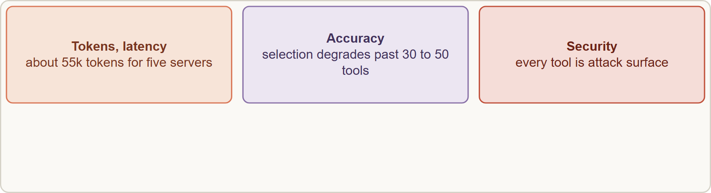
Capability Bloat, continued
Module 7
Capability bloat harms tokens and latency, accuracy through tool confusion, and security through excess privilege
Claude Architect Professional Exam Prep | for the CCAR-P exam
Module 7
5 / 23
Notes:
Capability Bloat, continued.
The figure shows this: Capability bloat harms tokens and latency, accuracy through tool confusion, and security through excess privilege.

Slide 6
Capability Bloat, continued
Module 7
Harm | Evidence
Tokens and latency | A multi-server setup (for example five common servers) can use about 55k tokens of definitions before any work
Accuracy | Tool selection degrades beyond about 30 to 50 tools
Security | Every tool is attack surface: a successful injection can use any tool the agent holds
Cost and caching | Larger prefixes cost more and can be disturbed by changes
Maintenance | More descriptions to keep consistent
Audit questions
Which tools does this role actually need? Remove the rest (least privilege).
Are descriptions distinct enough that two tools are not confused?
Claude Architect Professional Exam Prep | for the CCAR-P exam
Module 7
6 / 23
Notes:
Capability Bloat, continued.
Tokens and latency. A multi-server setup (for example five common servers) can use about fifty-five thousand tokens of definitions before any work.
Accuracy. Tool selection degrades beyond about thirty to fifty tools.
Security. Every tool is attack surface: a successful injection can use any tool the agent holds.
Cost and caching. Larger prefixes cost more and can be disturbed by changes.
Maintenance. More descriptions to keep consistent.
Audit questions.
Which tools does this role actually need? Remove the rest (least privilege).
Are descriptions distinct enough that two tools are not confused?

Slide 7
Capability Bloat, continued
Module 7
Can several fine-grained tools be merged into one well-designed tool?
Which tools are used rarely: candidates for deferred loading?
Does any tool allow destructive or irreversible actions without a gate?
EXAM TIP The first fix for excess capability is to remove tools the role does not need (least privilege). Logging or confirmation prompts are compensating controls, not removal of the privilege.
Claude Architect Professional Exam Prep | for the CCAR-P exam
Module 7
7 / 23
Notes:
Capability Bloat, continued.
Can several fine-grained tools be merged into one well-designed tool?
Which tools are used rarely: candidates for deferred loading?
Does any tool allow destructive or irreversible actions without a gate?
Exam tip: The first fix for excess capability is to remove tools the role does not need (least privilege). Logging or confirmation prompts are compensating controls, not removal of the privilege.

Slide 8
Progressive Discovery
Module 7
Instead of loading everything, expose capabilities on demand.
Claude Architect Professional Exam Prep | for the CCAR-P exam
Module 7
8 / 23
Notes:
Progressive Discovery.
Instead of loading everything, expose capabilities on demand.

Slide 9
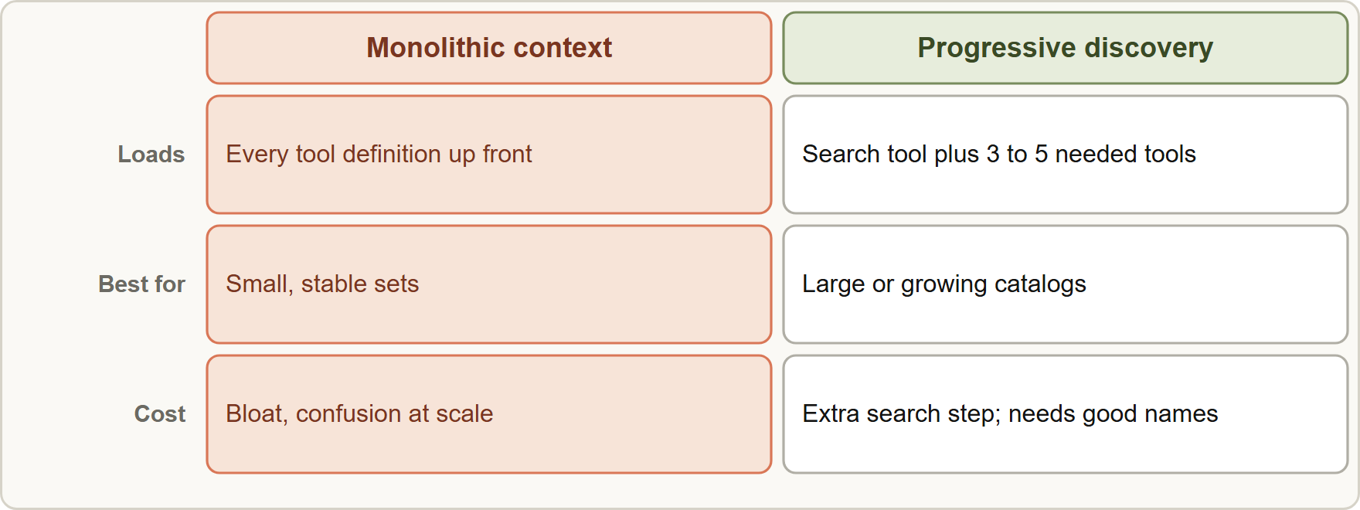
Progressive Discovery, continued
Module 7
Monolithic context loads every definition up front; progressive discovery lets the model search the catalog and load only the three to five tools it needs
Claude Architect Professional Exam Prep | for the CCAR-P exam
Module 7
9 / 23
Notes:
Progressive Discovery, continued.
The figure shows this: Monolithic context loads every definition up front; progressive discovery lets the model search the catalog and load only the three to five tools it needs.

Slide 10
Progressive Discovery, continued
Module 7
Mechanism | How it works | Notes
Tool search tool | Mark tools defer_loading: true; the model searches the catalog (regex or BM25 variant) and only matches load | All definitions are still sent in tools; at least one tool stays non-deferred; keep the 3 to 5 most used tools non-deferred; up to 10,000 tools; typically cuts definition tokens by over 85%
Custom search | Your own tool (embeddings) returns tool_reference blocks | For semantic matching
MCP toolsets | Set defer_loading in the mcp_toolset default or per tool | Aggregating many servers
Claude Architect Professional Exam Prep | for the CCAR-P exam
Module 7
10 / 23
Notes:
Progressive Discovery, continued.
Tool search tool. How it works: Mark tools defer loading: true; the model searches the catalog (regex or B M twenty-five variant) and only matches load. Notes: All definitions are still sent in tools; at least one tool stays non-deferred; keep the three to five most used tools non-deferred; up to ten thousand tools; typically cuts definition tokens by over eighty-five percent.
Custom search. How it works: Your own tool (embeddings) returns tool reference blocks. Notes: For semantic matching.
M C P toolsets. How it works: Set defer loading in the mcp toolset default or per tool. Notes: Aggregating many servers.

Slide 11
Progressive Discovery, continued
Module 7
Mechanism | How it works | Notes
Code execution with MCP | Present servers as a code API in a file tree; the agent lists and reads only needed files, and filters data in code | Example reduction from about 150,000 to 2,000 tokens; needs a secure sandbox
Skills | Metadata always, instructions on trigger | For procedures
Use tool search when you have 10 or more tools, definitions over 10k tokens, tool accuracy dropping, or many MCP servers (hundreds of tools). Standard calling is fine under about 10 tools or when every tool is used on every request.
Claude Architect Professional Exam Prep | for the CCAR-P exam
Module 7
11 / 23
Notes:
Progressive Discovery, continued.
Code execution with M C P. How it works: Present servers as a code A P I (application programming interface) in a file tree; the agent lists and reads only needed files, and filters data in code. Notes: Example reduction from about one hundred fifty thousand to two thousand tokens; needs a secure sandbox.
Skills. How it works: Metadata always, instructions on trigger. Notes: For procedures.
Use tool search when you have ten or more tools, definitions over ten thousand tokens, tool accuracy dropping, or many M C P servers (hundreds of tools). Standard calling is fine under about ten tools or when every tool is used on every request.

Slide 12
Progressive Discovery, continued
Module 7
Naming: use consistent prefixes (github_, slack_) and keywords in descriptions so one search finds a whole group; add a system-prompt line describing the categories.
Caching: a deferred tool cannot carry cache_control; deferred loading keeps the cached prefix stable.
Code execution keeps intermediate data out of the model (a 10,000-row sheet filtered to a few rows) and can tokenize sensitive values; its cost is the sandbox's operational and security overhead.
Claude Architect Professional Exam Prep | for the CCAR-P exam
Module 7
12 / 23
Notes:
Progressive Discovery, continued.
Naming: use consistent prefixes (github, slack ) and keywords in descriptions so one search finds a whole group; add a system-prompt line describing the categories.
Caching: a deferred tool cannot carry cache control; deferred loading keeps the cached prefix stable.
Code execution keeps intermediate data out of the model (a ten thousand-row sheet filtered to a few rows) and can tokenize sensitive values; its cost is the sandbox's operational and security overhead.

Slide 13
Monolithic versus progressive
Module 7
 | Monolithic context | Progressive discovery
Fits | Small, stable tool or knowledge sets; every item used each time | Large or growing catalogs; rare use
Pros | Simple; cache-friendly; no search step | Fewer tokens; better selection; scales
Cons | Bloat, confusion, cost at scale | Extra search step and latency; needs good names and descriptions
Claude Architect Professional Exam Prep | for the CCAR-P exam
Module 7
13 / 23
Notes:
Monolithic versus progressive.
Fits. Monolithic context: Small, stable tool or knowledge sets; every item used each time. Progressive discovery: Large or growing catalogs; rare use.
Pros. Monolithic context: Simple; cache-friendly; no search step. Progressive discovery: Fewer tokens; better selection; scales.
Cons. Monolithic context: Bloat, confusion, cost at scale. Progressive discovery: Extra search step and latency; needs good names and descriptions.

Slide 14
Tool Design for the Agent-Computer Interface
Module 7
Treat tool design like interface design: invest as much as in a human UI.
Write descriptions like a docstring for a junior developer: purpose, parameters, examples, edge cases, boundaries from similar tools.
Poka-yoke: make mistakes hard (for example, require absolute paths).
Choose formats the model writes easily; avoid overhead such as counting lines.
Return only what the next step needs; keep tool results compact and structured, with clear error messages.
Test with many inputs, observe mistakes, iterate; one team spent more time on tools than on the prompt.
EXAM TIP Deferred tools are still sent in tools; deferral only keeps them out of the context until found.
Claude Architect Professional Exam Prep | for the CCAR-P exam
Module 7
14 / 23
Notes:
Tool Design for the Agent-Computer Interface.
Treat tool design like interface design: invest as much as in a human U I.
Write descriptions like a docstring for a junior developer: purpose, parameters, examples, edge cases, boundaries from similar tools.
Poka-yoke: make mistakes hard (for example, require absolute paths).
Choose formats the model writes easily; avoid overhead such as counting lines.
Return only what the next step needs; keep tool results compact and structured, with clear error messages.
Test with many inputs, observe mistakes, iterate; one team spent more time on tools than on the prompt.
Exam tip: Deferred tools are still sent in tools; deferral only keeps them out of the context until found.
Exam tip: Use tool search from about ten tools or ten thousand tokens of definitions; under that, plain tool calling is simpler.

Slide 15
Module Recap
Module 7
1
Bloat
2
First fix
3
Tool search
About 55k tokens for five servers; accuracy falls beyond 30 to 50 tools; more attack surface
Remove tools the role does not need
Defer; regex or BM25; keep 3 to 5 loaded
4
Code execution with MCP
5
Monolithic
6
ACI
Simple, cache-friendly, small stable sets
Docstring-quality descriptions, examples, poka-yoke, compact results
Code API in a file tree; filter in sandbox
Claude Architect Professional Exam Prep | for the CCAR-P exam
Module 7
15 / 23
Notes:
Here is the recap.
Bloat: About fifty-five thousand tokens for five servers; accuracy falls beyond thirty to fifty tools; more attack surface.
First fix: Remove tools the role does not need.
Tool search: Defer; regex or B M twenty-five; keep three to five loaded.
Code execution with M C P: Code A P I in a file tree; filter in sandbox.
Monolithic: Simple, cache-friendly, small stable sets.
A C I: Docstring-quality descriptions, examples, poka-yoke, compact results.

Slide 16
Practice Question 1
Module 7
Q1
A procurement agent can read purchase orders, draft supplier emails, approve payments and cancel contracts, but buyers only need it to read orders and draft emails. Which change best reduces risk?
A
Swap in a larger model that follows the instruction "never pay without approval" more closely
B
Keep every tool and show a confirmation dialog before payments and cancellations
C
Remove the payment-approval and contract-cancellation tools from this agent's configuration
D
Keep every tool and write each approval and cancellation to an audit log for later review
Claude Architect Professional Exam Prep | for the CCAR-P exam
Module 7
16 / 23
Notes:
Question one.
A procurement agent can read purchase orders, draft supplier emails, approve payments and cancel contracts, but buyers only need it to read orders and draft emails. Which change best reduces risk?
The four options are on the screen.
[PAUSE 12]
The answer is C. Least privilege removes the unneeded capability; logs and dialogs only compensate for it.

Slide 17
Practice Question 2
Module 7
Q2
An agent connected to five MCP servers carries 140 tools and often calls the wrong one. What should the architect try?
A
Add a paragraph to the system prompt listing all 140 tools
B
Increase max_tokens so that the model can think longer about the choice among the hundred and forty tools
C
Defer most tools with the tool search tool, keeping a few frequently used tools loaded
D
Split the tool list in half and load a random half per request to reduce the overall token count
Claude Architect Professional Exam Prep | for the CCAR-P exam
Module 7
17 / 23
Notes:
Question two.
An agent connected to five M C P servers carries one hundred forty tools and often calls the wrong one. What should the architect try?
The four options are on the screen.
[PAUSE 12]
The answer is C. Deferred loading with search reduces definition tokens and selection confusion.

Slide 18
Practice Question 3
Module 7
Q3
For which situation is standard tool calling (without tool search) the better fit?
A
A library of several hundred tools that grows monthly as each team adds its own integrations
B
An aggregation of many MCP servers
C
Tool definitions that total more than 10k tokens
D
Six small tools that are all used on nearly every request
Claude Architect Professional Exam Prep | for the CCAR-P exam
Module 7
18 / 23
Notes:
Question three.
For which situation is standard tool calling (without tool search) the better fit?
The four options are on the screen.
[PAUSE 12]
The answer is D. Few, always-used, small tools do not need discovery.

Slide 19
Practice Question 4
Module 7
Q4
An agent processes a 10,000-row spreadsheet through tool calls and runs out of context. Which approach addresses the cause?
A
Let the agent filter the data in code inside a sandbox and return only the few relevant rows
B
Ask the model to remember all rows in its own words
C
Raise the effort level so that the model reads faster
D
Paste the full sheet into the system prompt to avoid tool calls, accepting the larger context cost
Claude Architect Professional Exam Prep | for the CCAR-P exam
Module 7
19 / 23
Notes:
Question four.
An agent processes a ten thousand-row spreadsheet through tool calls and runs out of context. Which approach addresses the cause?
The four options are on the screen.
[PAUSE 12]
The answer is A. Keeping intermediate results out of the model saves tokens and errors.

Slide 20
Practice Question 5
Module 7
Q5
Which TWO are valid statements about the tool search tool? (Select TWO.)
A
It can only be used with a single tool
B
All tool definitions are still sent in the request; deferred ones load into context only when found
C
Deferred tools can carry cache_control breakpoints
D
Deferring a tool also removes it from the request payload
E
At least one tool must remain non-deferred, and the search tool itself is never deferred
Claude Architect Professional Exam Prep | for the CCAR-P exam
Module 7
20 / 23
Notes:
Question five. Select two.
Which two are valid statements about the tool search tool?
The five options are on the screen.
[PAUSE 15]
The answers are B and E. Deferral controls what enters the context, not what is sent.

Slide 21
Practice Question 6
Module 7
Q6
What is the main trade-off of progressive discovery compared with a monolithic context?
A
No difference in latency or accuracy
B
Better caching but no ability to scale to many tools
C
Fewer tokens and better selection at scale, at the cost of an extra search step and the need for good descriptions
D
Higher token use but no need for descriptions
Claude Architect Professional Exam Prep | for the CCAR-P exam
Module 7
21 / 23
Notes:
Question six.
What is the main trade-off of progressive discovery compared with a monolithic context?
The four options are on the screen.
[PAUSE 12]
The answer is C. Discovery trades a search step for lean context.

Slide 22
Practice Question 7
Module 7
Q7
Which tool-design practice reduces misuse by the model?
A
Overlapping tools so the model can pick any of several
B
Short names and one-word descriptions to save tokens
C
Descriptions with examples, edge cases and clear boundaries from similar tools, plus arguments that are hard to misuse
D
Hiding error messages to avoid confusing the model
Claude Architect Professional Exam Prep | for the CCAR-P exam
Module 7
22 / 23
Notes:
Question seven.
Which tool-design practice reduces misuse by the model?
The four options are on the screen.
[PAUSE 12]
The answer is C. Clear interfaces and poka-yoke design lower error rates.

Slide 23
Answers at a Glance
Module 7
Question | Answer | Why
Q1 | C | Least privilege removes the unneeded capability
Q2 | C | Deferred loading with search reduces definition tokens and selection confusion
Q3 | D | Few, always-used, small tools do not need discovery
Q4 | A | Keeping intermediate results out of the model saves tokens and errors
Q5 | B, E | Deferral controls what enters the context, not what is sent
Q6 | C | Discovery trades a search step for lean context
Q7 | C | Clear interfaces and poka-yoke design lower error rates
Claude Architect Professional Exam Prep | for the CCAR-P exam
Module 7
23 / 23
Notes:
Here are all seven answers. Question one: C. Question two: C. Question three: D. Question four: A. Question five: B and E. Question six: C. Question seven: C.
In the next module, we continue the course.

