Slide 1
Module 8: Authentication, Authorization and Integration Protocols
Authentication versus authorization in a Claude system
Domain 3 · Integration
Claude Architect Professional Exam Prep Masterclass
Module 8
Notes:
Welcome to Module eight: Authentication, Authorization and Integration Protocols. This module covers authentication, authorization and integration protocols.
Each part of this module comes from the study notes of the same name, so you can read the notes after you watch.

Slide 2
What You Will Learn
Module 8
Authentication versus authorization in a Claude system
How to spot security gaps in an integration
OAuth 2.1 for MCP: roles, PKCE, audience, scopes
Choosing MCP, API/CLI or agent-to-agent
Claude Architect Professional Exam Prep | for the CCAR-P exam
Module 8
2 / 25
Notes:
By the end of this module you will be able to do four things.
Authentication versus authorization in a Claude system.
How to spot security gaps in an integration.
OAuth two point one for M C P (Model Context Protocol): roles, P K C E, audience, scopes.
Choosing M C P, A P I (application programming interface) or C L I (command-line interface) or agent-to-agent.

Slide 3
Case Check-In: Lumen Advisory Reviews a Healthcare Client's Records Assistant
Module 8
CASE CHECK-IN · Lumen Advisory
The assistant reads patient records through one shared service account with access to every record
A clinician asks about "my patients", yet the model could return any patient's chart
The API key sits in a mobile app
Claude Architect Professional Exam Prep | for the CCAR-P exam
Module 8
3 / 25
Notes:
Our running case is Lumen Advisory. Lumen Advisory Reviews a Healthcare Client's Records Assistant.
The assistant reads patient records through one shared service account with access to every record.
A clinician asks about "my patients", yet the model could return any patient's chart.
The A P I key sits in a mobile app.

Slide 4
Authentication and Authorization
Module 8
Authentication = who is calling. Authorization = what that identity may do. The model is never the access-control layer: it can be persuaded; code cannot.
Claude Architect Professional Exam Prep | for the CCAR-P exam
Module 8
4 / 25
Notes:
Authentication and Authorization.
Authentication equals who is calling. Authorization equals what that identity may do. The model is never the access-control layer: it can be persuaded; code cannot.

Slide 5
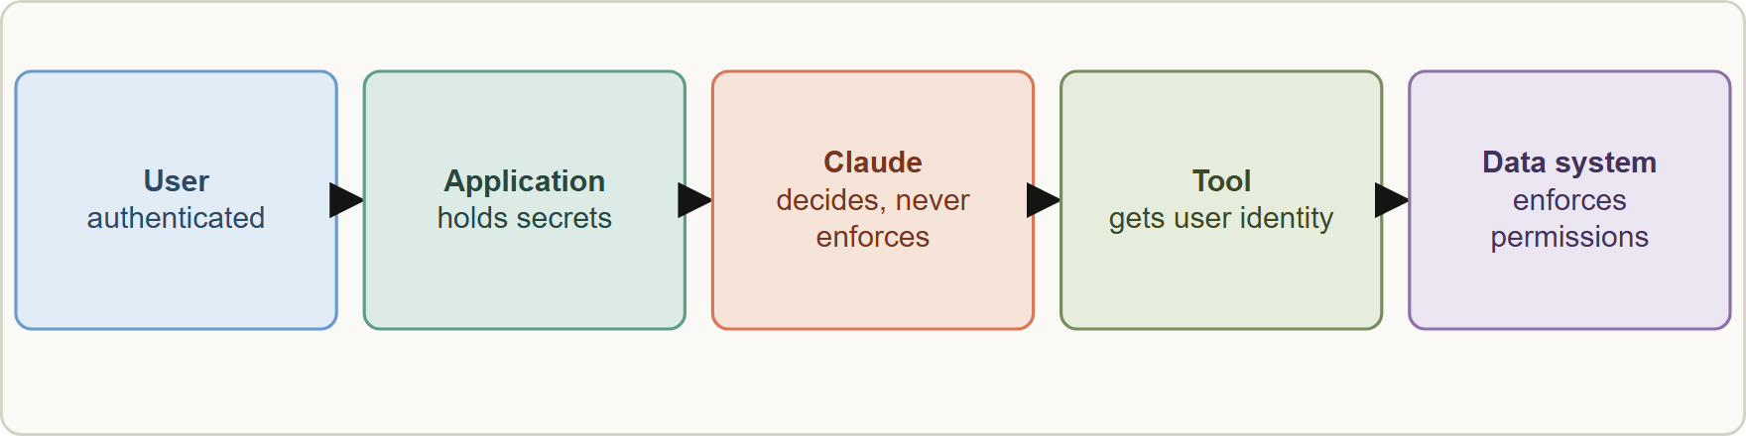
Authentication and Authorization, continued
Module 8
Identity must reach the tool and the data system: the application authenticates the user, passes their identity to the tool, and the data system enforces that user's permissions, not the model
Claude Architect Professional Exam Prep | for the CCAR-P exam
Module 8
5 / 25
Notes:
Authentication and Authorization, continued.
The figure shows this: Identity must reach the tool and the data system: the application authenticates the user, passes their identity to the tool, and the data system enforces that user's permissions, not the model.

Slide 6
Authentication and Authorization, continued
Module 8
Gap | Why it is a problem | Fix
Shared service credential for all users | Every user acts with the broadest access; no per-user audit | Propagate the end user's identity; use delegated tokens and the user's permissions
Authorization in the prompt ("only show the user's records") | Can be bypassed by injection or error | Enforce in the tool or data layer
Over-broad scopes or roles | Larger blast radius | Least-privilege scopes; split read and write
Long-lived tokens | Theft window | Short-lived tokens, refresh, rotation
Secrets in client code or prompts | Leak risk | Server-side secrets manager; environment variables; never in the browser or mobile app
Claude Architect Professional Exam Prep | for the CCAR-P exam
Module 8
6 / 25
Notes:
Authentication and Authorization, continued.
Shared service credential for all users. Why it is a problem: Every user acts with the broadest access; no per-user audit. Fix: Propagate the end user's identity; use delegated tokens and the user's permissions.
Authorization in the prompt ("only show the user's records"). Why it is a problem: Can be bypassed by injection or error. Fix: Enforce in the tool or data layer.
Over-broad scopes or roles. Why it is a problem: Larger blast radius. Fix: Least-privilege scopes; split read and write.
Long-lived tokens. Why it is a problem: Theft window. Fix: Short-lived tokens, refresh, rotation.
Secrets in client code or prompts. Why it is a problem: Leak risk. Fix: Server-side secrets manager; environment variables; never in the browser or mobile app.

Slide 7
Authentication and Authorization, continued
Module 8
Gap | Why it is a problem | Fix
No audit trail | Cannot investigate | Log identity, tool, arguments, result
Tools with destructive actions | Injection impact | Remove, or gate with human approval
Token passthrough | Confused-deputy risk | Server accepts only tokens issued for it
API keys: start with sk-ant-, are shown once, belong in a secrets manager, are read from an environment variable, should have expiry and be scoped to a workspace or service account; never ship them in browser or mobile code. Route calls through your back end.
Claude Architect Professional Exam Prep | for the CCAR-P exam
Module 8
7 / 25
Notes:
Authentication and Authorization, continued.
No audit trail. Why it is a problem: Cannot investigate. Fix: Log identity, tool, arguments, result.
Tools with destructive actions. Why it is a problem: Injection impact. Fix: Remove, or gate with human approval.
Token passthrough. Why it is a problem: Confused-deputy risk. Fix: Server accepts only tokens issued for it.
A P I keys: start with sk-ant-, are shown once, belong in a secrets manager, are read from an environment variable, should have expiry and be scoped to a workspace or service account; never ship them in browser or mobile code. Route calls through your back end.

Slide 8
Authentication and Authorization, continued
Module 8
Organizations on zero data retention cannot call the API from a browser at all (cross-origin calls are rejected).
EXAM TIP "Which control closes the gap?" Usually enforce the user's permissions in code at the tool or data layer with the real identity, not a stronger prompt and not a bigger model.
Claude Architect Professional Exam Prep | for the CCAR-P exam
Module 8
8 / 25
Notes:
Authentication and Authorization, continued.
Organizations on zero data retention cannot call the A P I from a browser at all (cross-origin calls are rejected).
Exam tip: "Which control closes the gap?" Usually enforce the user's permissions in code at the tool or data layer with the real identity, not a stronger prompt and not a bigger model.

Slide 9
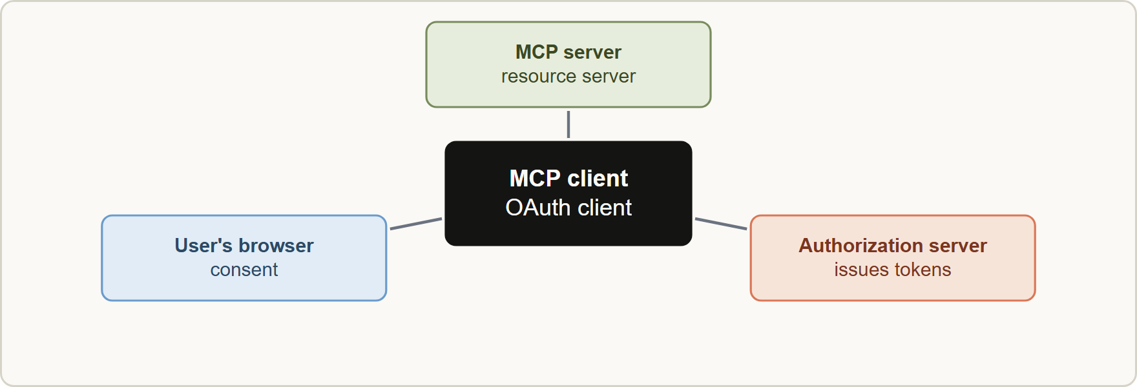
OAuth 2.1 and MCP
Module 8
MCP authorization roles: client, MCP server as resource server, authorization server, and the user's browser for consent
Claude Architect Professional Exam Prep | for the CCAR-P exam
Module 8
9 / 25
Notes:
OAuth two point one and M C P.
The figure shows this: M C P authorization roles: client, M C P server as resource server, authorization server, and the user's browser for consent.

Slide 10
OAuth 2.1 and MCP, continued
Module 8
Point | Detail
Scope | Authorization is optional in MCP; for HTTP transports follow the spec (OAuth 2.1); STDIO servers should not use it and read credentials from the environment
Roles | MCP server = resource server; MCP client = OAuth client; separate authorization server
Discovery | Servers publish protected resource metadata; clients discover the authorization server
PKCE | Clients protect the authorization-code flow with PKCE
Resource parameter | Client sends the server's canonical URI so the token is bound to it
Audience validation | The server must verify the token was issued for it
Claude Architect Professional Exam Prep | for the CCAR-P exam
Module 8
10 / 25
Notes:
OAuth two point one and M C P, continued.
Scope. Authorization is optional in M C P; for H T T P transports follow the spec (OAuth two point one); S T D I O servers should not use it and read credentials from the environment.
Roles. M C P server equals resource server; M C P client equals OAuth client; separate authorization server.
Discovery. Servers publish protected resource metadata; clients discover the authorization server.
P K C E. Clients protect the authorization-code flow with P K C E.
Resource parameter. Client sends the server's canonical U R I so the token is bound to it.
Audience validation. The server must verify the token was issued for it.

Slide 11
OAuth 2.1 and MCP, continued
Module 8
Point | Detail
No passthrough | Servers must not accept or forward tokens meant for other services; clients send only tokens from the server's own authorization server
Transport | Authorization: Bearer header on every request; never in the URL
Scopes | Request the minimum; the server's challenge names required scopes; 403 insufficient_scope triggers step-up with the union of scopes
Status codes | 401 missing or invalid token; 403 insufficient scope; 400 malformed request
Client registration | Client ID metadata documents preferred; pre-registration; dynamic registration is deprecated
Claude Architect Professional Exam Prep | for the CCAR-P exam
Module 8
11 / 25
Notes:
OAuth two point one and M C P, continued.
No passthrough. Servers must not accept or forward tokens meant for other services; clients send only tokens from the server's own authorization server.
Transport. Authorization: Bearer header on every request; never in the U R L (uniform resource locator).
Scopes. Request the minimum; the server's challenge names required scopes; four hundred three insufficient scope triggers step-up with the union of scopes.
Status codes. four hundred one missing or invalid token; four hundred three insufficient scope; four hundred malformed request.
Client registration. Client I D metadata documents preferred; pre-registration; dynamic registration is deprecated.

Slide 12
OAuth 2.1 and MCP, continued
Module 8
Confused deputy: a server that forwards the user's token to a downstream API (or accepts any token) can be tricked into acting with authority it should not hold.
Custom connectors reach servers over the public internet and the user must trust the server; only connect servers you trust.
Skills and hooks can add deterministic checks around tool calls (Module 13).
Claude Architect Professional Exam Prep | for the CCAR-P exam
Module 8
12 / 25
Notes:
OAuth two point one and M C P, continued.
Confused deputy: a server that forwards the user's token to a downstream A P I (or accepts any token) can be tricked into acting with authority it should not hold.
Custom connectors reach servers over the public internet and the user must trust the server; only connect servers you trust.
Skills and hooks can add deterministic checks around tool calls (Module thirteen).

Slide 13
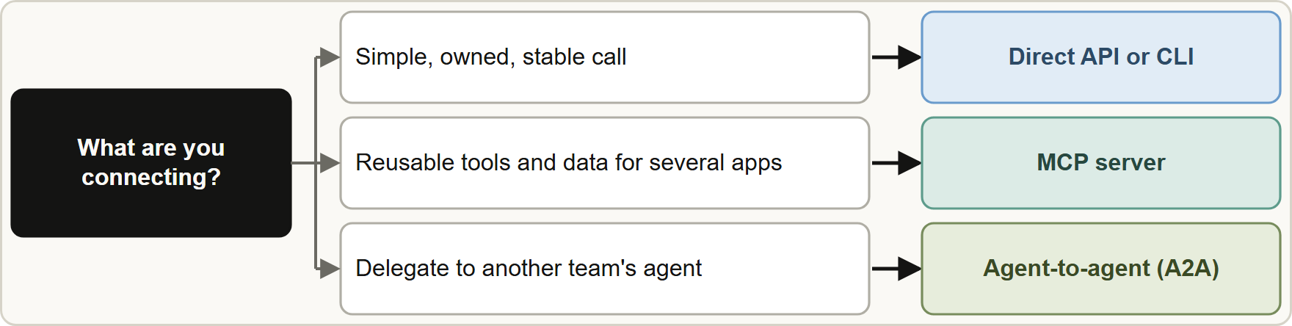
Choosing the Integration Mechanism
Module 8
Choosing an integration mechanism: direct API or CLI for simple owned integrations, MCP for reusable tool and data capabilities, agent-to-agent for delegating to separate agents
Claude Architect Professional Exam Prep | for the CCAR-P exam
Module 8
13 / 25
Notes:
Choosing the Integration Mechanism.
The figure shows this: Choosing an integration mechanism: direct A P I or C L I for simple owned integrations, M C P for reusable tool and data capabilities, agent-to-agent for delegating to separate agents.

Slide 14
Choosing the Integration Mechanism, continued
Module 8
Mechanism | What it is | Use when | Watch for
Direct API / CLI | Your code (or a shell tool) calls a service | Simple, one-off, fully owned, stable interface | Duplicated glue per app; each tool schema maintained separately
MCP | Open protocol connecting an agent to tools, data and prompts | A capability shared by several applications, maintained independently; a catalog of tools | Server trust, auth setup, tool bloat
Claude Architect Professional Exam Prep | for the CCAR-P exam
Module 8
14 / 25
Notes:
Choosing the Integration Mechanism, continued.
Direct A P I or C L I. What it is: Your code (or a shell tool) calls a service. Use when: Simple, one-off, fully owned, stable interface. Watch for: Duplicated glue per app; each tool schema maintained separately.
M C P. What it is: Open protocol connecting an agent to tools, data and prompts. Use when: A capability shared by several applications, maintained independently; a catalog of tools. Watch for: Server trust, auth setup, tool bloat.

Slide 15
Choosing the Integration Mechanism, continued
Module 8
Mechanism | What it is | Use when | Watch for
A2A (agent-to-agent) | Open protocol for agents to discover and delegate to other agents, across frameworks, staying opaque | A separate agent owned by another team or vendor must be called as a peer | Not a tool-call or SDK substitute; adds a network boundary
MCP and A2A are complementary: an agent uses MCP for its tools and A2A to collaborate with other agents.
CLI tools (for example git, kubectl) can be the simplest integration for coding agents, with permission rules around them.
Claude Architect Professional Exam Prep | for the CCAR-P exam
Module 8
15 / 25
Notes:
Choosing the Integration Mechanism, continued.
A to A (agent-to-agent). What it is: Open protocol for agents to discover and delegate to other agents, across frameworks, staying opaque. Use when: A separate agent owned by another team or vendor must be called as a peer. Watch for: Not a tool-call or S D K (software development kit) substitute; adds a network boundary.
M C P and A to A are complementary: an agent uses M C P for its tools and A to A to collaborate with other agents.
C L I tools (for example git, kubectl) can be the simplest integration for coding agents, with permission rules around them.

Slide 16
Choosing the Integration Mechanism, continued
Module 8
Prefer MCP when the same capability serves multiple agents or applications, or when an existing server already exists; prefer direct API when it is a single app and the interface is small.
EXAM TIP Authorization belongs in code with the real user identity; a shared service credential loses per-user permissions and audit.
Claude Architect Professional Exam Prep | for the CCAR-P exam
Module 8
16 / 25
Notes:
Choosing the Integration Mechanism, continued.
Prefer M C P when the same capability serves multiple agents or applications, or when an existing server already exists; prefer direct A P I when it is a single app and the interface is small.
Exam tip: Authorization belongs in code with the real user identity; a shared service credential loses per-user permissions and audit.
Exam tip: M C P servers must check the token audience and must never pass tokens through; tokens never go in the U R L.

Slide 17
Module Recap
Module 8
1
AuthN vs AuthZ
2
Gaps
3
API keys
Who versus what; enforce AuthZ in code, never in the model
Shared credentials · prompt-based authorization · broad scopes · long-lived tokens · secrets client-side · no audit · destructive tools
sk-ant-, shown once, secrets manager, server-side only, expiry
4
MCP auth
5
Codes
6
Choose
Optional; HTTP = OAuth 2.1; STDIO = environment; PKCE; resource parameter; audience check; no passthrough
401 token; 403 insufficient scope (step-up); 400 malformed
Direct API/CLI simple and owned; MCP reusable tools and data; A2A delegate to separate agents
Claude Architect Professional Exam Prep | for the CCAR-P exam
Module 8
17 / 25
Notes:
Here is the recap.
Auth N versus Auth Z: Who versus what; enforce Auth Z in code, never in the model.
Gaps: Shared credentials, prompt-based authorization, broad scopes, long-lived tokens, secrets client-side, no audit, destructive tools.
A P I keys: sk-ant-, shown once, secrets manager, server-side only, expiry.
M C P auth: Optional; H T T P equals OAuth two point one; S T D I O equals environment; P K C E; resource parameter; audience check; no passthrough.
Codes: four hundred one token; four hundred three insufficient scope (step-up); four hundred malformed.
Choose: Direct A P I or C L I simple and owned; M C P reusable tools and data; A to A delegate to separate agents.

Slide 18
Practice Question 1
Module 8
Q1
A records assistant uses one shared service account that can read every patient chart. Which change best fixes the gap?
A
Pass the end user's identity to the tool and enforce that user's permissions in the data layer
B
Add a system-prompt line telling the model to show only the current clinician's patients in every answer
C
Log every record access so that misuse can be found after the fact
D
Add a larger model that follows the instruction more reliably
Claude Architect Professional Exam Prep | for the CCAR-P exam
Module 8
18 / 25
Notes:
Question one.
A records assistant uses one shared service account that can read every patient chart. Which change best fixes the gap?
The four options are on the screen.
[PAUSE 12]
The answer is A. Authorization must be enforced in code with the real identity; prompts and logs do not prevent access.

Slide 19
Practice Question 2
Module 8
Q2
A mobile app calls the Claude API directly with a key embedded in the app. What is the right design?
A
Route calls through a back end that holds the key in a secrets manager and authenticates the user
B
Obfuscate the key inside the app binary so that it cannot be read by anyone who downloads the application
C
Restrict the key to one model
D
Rotate the embedded key every week
Claude Architect Professional Exam Prep | for the CCAR-P exam
Module 8
19 / 25
Notes:
Question two.
A mobile app calls the Claude A P I directly with a key embedded in the app. What is the right design?
The four options are on the screen.
[PAUSE 12]
The answer is A. A key shipped to clients is a leaked key; keep it server-side.

Slide 20
Practice Question 3
Module 8
Q3
An MCP server receives a token issued for a different service and passes it to a downstream API. Which principle is violated?
A
Token audience binding and the prohibition on token passthrough
B
Use of the Bearer header
C
Dynamic client registration of every new client against the authorization server at each request
D
PKCE for public clients
Claude Architect Professional Exam Prep | for the CCAR-P exam
Module 8
20 / 25
Notes:
Question three.
An M C P server receives a token issued for a different service and passes it to a downstream A P I. Which principle is violated?
The four options are on the screen.
[PAUSE 12]
The answer is A. Servers must accept only tokens issued for them and must not forward others (confused deputy).

Slide 21
Practice Question 4
Module 8
Q4
An MCP server returns 403 with error insufficient_scope and a scope for write access. What should a well-behaved client do?
A
Request every scope the server supports in advance
B
Retry the same request in a tight loop with the same token until the server grants the extra permission
C
Put the token in the URL query string to bypass the check
D
Run a step-up authorization with the union of previous and required scopes, with a retry limit
Claude Architect Professional Exam Prep | for the CCAR-P exam
Module 8
21 / 25
Notes:
Question four.
An M C P server returns four hundred three with error insufficient scope and a scope for write access. What should a well-behaved client do?
The four options are on the screen.
[PAUSE 12]
The answer is D. Step-up requests the needed scopes, preserving earlier ones, and limits retries.

Slide 22
Practice Question 5
Module 8
Q5
Which TWO are correct about MCP authorization? (Select TWO.)
A
Authorization is mandatory for every MCP implementation
B
Access tokens may be sent in the URL query string for convenience
C
HTTP transports follow OAuth 2.1, while STDIO servers should read credentials from the environment
D
Servers must validate that access tokens were issued for them as the audience
E
A client may reuse any token it holds across all servers
Claude Architect Professional Exam Prep | for the CCAR-P exam
Module 8
22 / 25
Notes:
Question five. Select two.
Which two are correct about M C P authorization?
The five options are on the screen.
[PAUSE 15]
The answers are C and D. Audience validation is required; transport determines the mechanism; tokens never go in U R L s.

Slide 23
Practice Question 6
Module 8
Q6
Three internal applications need the same CRM lookup and update capability, maintained by the CRM team. Which integration is most appropriate?
A
An agent-to-agent protocol connection between each pair of applications
B
An MCP server owned by the CRM team and reused by all three applications
C
A shared prompt that tells the model how to call the CRM's REST API in the same way for all three apps
D
Three separate direct API integrations written by each application team
Claude Architect Professional Exam Prep | for the CCAR-P exam
Module 8
23 / 25
Notes:
Question six.
Three internal applications need the same C R M lookup and update capability, maintained by the C R M team. Which integration is most appropriate?
The four options are on the screen.
[PAUSE 12]
The answer is B. A reusable, independently maintained capability is the M C P use case.

Slide 24
Practice Question 7
Module 8
Q7
A claims agent must hand a fraud-scoring task to an agent operated by a vendor using a different framework. Which mechanism fits best?
A
Agent-to-agent communication, since a separate agent is being delegated to as a peer
B
A direct SQL connection to the vendor's database
C
An MCP server that exposes the vendor's internal model weights so that the claims agent can call them
D
Copying the vendor's prompts into the claims agent so that it can imitate the vendor's fraud model
Claude Architect Professional Exam Prep | for the CCAR-P exam
Module 8
24 / 25
Notes:
Question seven.
A claims agent must hand a fraud-scoring task to an agent operated by a vendor using a different framework. Which mechanism fits best?
The four options are on the screen.
[PAUSE 12]
The answer is A. A to A is for agents collaborating across owners and frameworks.

Slide 25
Answers at a Glance
Module 8
Question | Answer | Why
Q1 | A | Authorization must be enforced in code with the real identity
Q2 | A | A key shipped to clients is a leaked key
Q3 | A | Servers must accept only tokens issued for them and must not forward
Q4 | D | Step-up requests the needed scopes, preserving earlier ones, and limits retries
Q5 | C, D | Audience validation is required
Q6 | B | A reusable, independently maintained capability is the MCP use case
Q7 | A | A2A is for agents collaborating across owners and frameworks
Claude Architect Professional Exam Prep | for the CCAR-P exam
Module 8
25 / 25
Notes:
Here are all seven answers. Question one: A. Question two: A. Question three: A. Question four: D. Question five: C and D. Question six: B. Question seven: A.
In the next module, we continue the course.

