Slide 1
Module 9: RAG Pipelines: Chunking and Indexing
The stages of a RAG pipeline and what can go wrong at each
Domain 3 · Integration
Claude Architect Professional Exam Prep Masterclass
Module 9
Notes:
Welcome to Module nine: R A G Pipelines: Chunking and Indexing. This module covers r a g pipelines: chunking and indexing.
Each part of this module comes from the study notes of the same name, so you can read the notes after you watch.

Slide 2
What You Will Learn
Module 9
The stages of a RAG pipeline and what can go wrong at each
Chunking strategies and sizes
Indexing: embeddings, keyword (BM25) and hybrid indexes, metadata
Contextual retrieval and freshness management
When not to use RAG
Claude Architect Professional Exam Prep | for the CCAR-P exam
Module 9: RAG Pipelines: Chunking and Indexing
2 / 25
Notes:
By the end of this module you will be able to do five things.
The stages of a R A G pipeline and what can go wrong at each.
Chunking strategies and sizes.
Indexing: embeddings, keyword (B M twenty-five) and hybrid indexes, metadata.
Contextual retrieval and freshness management.
When not to use R A G.

Slide 3
Case Check-In: Lumen Advisory Builds a Knowledge Assistant for a Law-Adjacent Compliance Team
Module 9
CASE CHECK-IN · Lumen Advisory
30,000 pages of regulations, internal policies and past rulings, updated weekly
Analysts need cited answers with exact clause numbers
After one weekly refresh the assistant starts giving confident wrong answers
Claude Architect Professional Exam Prep | for the CCAR-P exam
Module 9: RAG Pipelines: Chunking and Indexing
3 / 25
Notes:
Our running case is Lumen Advisory. Lumen Advisory Builds a Knowledge Assistant for a Law-Adjacent Compliance Team.
thirty thousand pages of regulations, internal policies and past rulings, updated weekly.
Analysts need cited answers with exact clause numbers.
After one weekly refresh the assistant starts giving confident wrong answers.

Slide 4
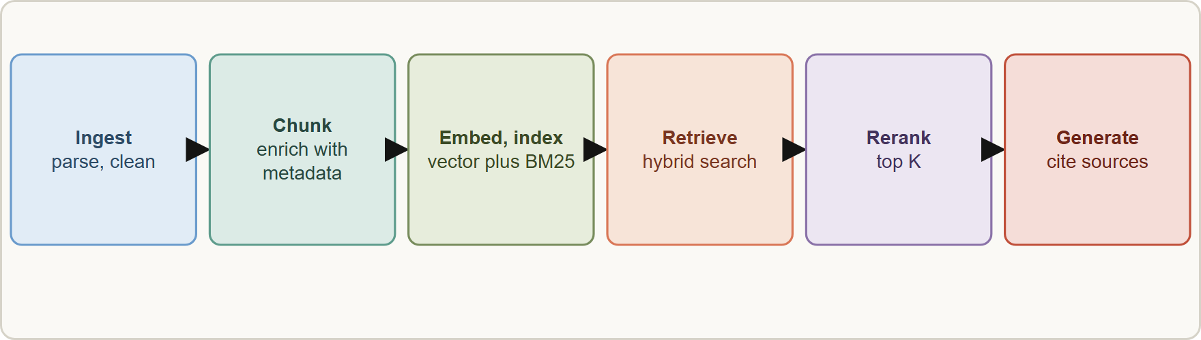
The Pipeline
Module 9
A RAG pipeline: ingest and parse, clean, chunk, enrich, embed and index, retrieve, rerank, generate with citations; an offline indexing half and an online query half
Claude Architect Professional Exam Prep | for the CCAR-P exam
Module 9: RAG Pipelines: Chunking and Indexing
4 / 25
Notes:
The Pipeline.
The figure shows this: A R A G pipeline: ingest and parse, clean, chunk, enrich, embed and index, retrieve, rerank, generate with citations; an offline indexing half and an online query half.

Slide 5
The Pipeline, continued
Module 9
Stage | Purpose | Typical failure
Ingest and parse | Read PDFs, HTML, tables | Lost tables, scanned pages, broken order
Clean | Remove boilerplate, deduplicate | Repeated headers dominate results
Chunk | Split into retrievable units | Chunks too big (diluted) or too small (no context)
Enrich | Add metadata and context | Missing source, date, section
Embed and index | Vectors plus keyword index | Mismatched embeddings; stale index
Retrieve | Find candidates | Misses exact identifiers; irrelevant hits
Rerank | Reorder by relevance | Skipped; latency added
Generate with citations | Answer from the chunks | Unsupported claims; wrong citations
Claude Architect Professional Exam Prep | for the CCAR-P exam
Module 9: RAG Pipelines: Chunking and Indexing
5 / 25
Notes:
The Pipeline, continued.
Ingest and parse. Purpose: Read P D F s, H T M L, tables. Typical failure: Lost tables, scanned pages, broken order.
Clean. Purpose: Remove boilerplate, deduplicate. Typical failure: Repeated headers dominate results.
Chunk. Purpose: Split into retrievable units. Typical failure: Chunks too big (diluted) or too small (no context).
Enrich. Purpose: Add metadata and context. Typical failure: Missing source, date, section.
Embed and index. Purpose: Vectors plus keyword index. Typical failure: Mismatched embeddings; stale index.
Retrieve. Purpose: Find candidates. Typical failure: Misses exact identifiers; irrelevant hits.
Rerank. Purpose: Reorder by relevance. Typical failure: Skipped; latency added.
Generate with citations. Purpose: Answer from the chunks. Typical failure: Unsupported claims; wrong citations.

Slide 6
The Pipeline, continued
Module 9
Offline half (ingest to index) and online half (retrieve to answer) fail differently; separate their monitoring.
Diagnose from the symptom: confident wrong answers after a document refresh, with model and latency unchanged, point first to retrieval or indexing (stale, missing or mismatched chunks), not to the model.
EXAM TIP When quality drops after a data refresh and the model is unchanged, investigate the retrieval and indexing step first.
Claude Architect Professional Exam Prep | for the CCAR-P exam
Module 9: RAG Pipelines: Chunking and Indexing
6 / 25
Notes:
The Pipeline, continued.
Offline half (ingest to index) and online half (retrieve to answer) fail differently; separate their monitoring.
Diagnose from the symptom: confident wrong answers after a document refresh, with model and latency unchanged, point first to retrieval or indexing (stale, missing or mismatched chunks), not to the model.
Exam tip: When quality drops after a data refresh and the model is unchanged, investigate the retrieval and indexing step first.

Slide 7
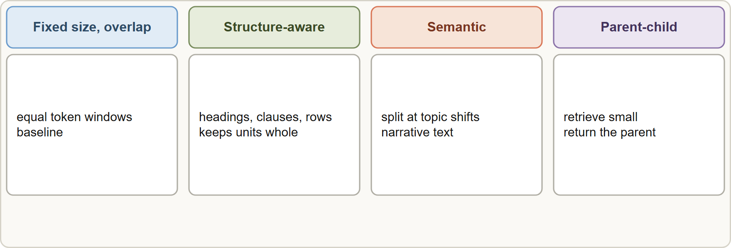
Chunking
Module 9
Chunking strategies: fixed size with overlap, structure-aware by headings, semantic by topic shift, and hierarchical parent and child chunks
Claude Architect Professional Exam Prep | for the CCAR-P exam
Module 9: RAG Pipelines: Chunking and Indexing
7 / 25
Notes:
Chunking.
The figure shows this: Chunking strategies: fixed size with overlap, structure-aware by headings, semantic by topic shift, and hierarchical parent and child chunks.

Slide 8
Chunking, continued
Module 9
Strategy | How | Best for | Risk
Fixed size with overlap | Equal token windows, small overlap | Uniform text; baseline | Cuts clauses and tables in half
Structure-aware | Split on headings, sections, clauses, rows | Regulations, manuals, code | Uneven sizes
Semantic | Split where topics change | Narrative text | Extra processing
Hierarchical (parent-child) | Retrieve small chunks, return the larger parent | Precision plus context | More storage and logic
Special handling | Tables, code, lists kept intact | Structured content | Parser effort
Chunks are usually no more than a few hundred tokens; size, boundaries and overlap all change retrieval quality. Test sizes on your data.
Claude Architect Professional Exam Prep | for the CCAR-P exam
Module 9: RAG Pipelines: Chunking and Indexing
8 / 25
Notes:
Chunking, continued.
Fixed size with overlap. How: Equal token windows, small overlap. Best for: Uniform text; baseline. Risk: Cuts clauses and tables in half.
Structure-aware. How: Split on headings, sections, clauses, rows. Best for: Regulations, manuals, code. Risk: Uneven sizes.
Semantic. How: Split where topics change. Best for: Narrative text. Risk: Extra processing.
Hierarchical (parent-child). How: Retrieve small chunks, return the larger parent. Best for: Precision plus context. Risk: More storage and logic.
Special handling. How: Tables, code, lists kept intact. Best for: Structured content. Risk: Parser effort.
Chunks are usually no more than a few hundred tokens; size, boundaries and overlap all change retrieval quality. Test sizes on your data.

Slide 9
Chunking, continued
Module 9
Too large: relevance is diluted and context is wasted. Too small: meaning is lost ("the fee is 2%" without whose fee).
Keep units whole: a clause, a table with its header, a function.
Store metadata: source, section path, date, version, access group, language. Metadata enables filtering and citations.
Claude Architect Professional Exam Prep | for the CCAR-P exam
Module 9: RAG Pipelines: Chunking and Indexing
9 / 25
Notes:
Chunking, continued.
Too large: relevance is diluted and context is wasted. Too small: meaning is lost ("the fee is two percent" without whose fee).
Keep units whole: a clause, a table with its header, a function.
Store metadata: source, section path, date, version, access group, language. Metadata enables filtering and citations.

Slide 10
Indexing
Module 9
Choice | Guidance
Embeddings | Anthropic offers no embedding model; use a provider such as Voyage AI (general, multilingual, code, finance, law, multimodal, contextualized chunk models) and evaluate vendors on your data
Query vs document | Embed with the right `input_type` (query or document) for retrieval
Similarity | Normalized vectors: cosine = dot product
Dimension and quantization | Smaller dimensions or int8/binary quantization cut storage (4x to 32x) with some accuracy cost
Vector index | Fast approximate nearest-neighbor search over embeddings
Keyword index (BM25) | Lexical ranking; strong for exact identifiers, codes, names
Hybrid | Combine vector and BM25 scores; best general default
Claude Architect Professional Exam Prep | for the CCAR-P exam
Module 9: RAG Pipelines: Chunking and Indexing
10 / 25
Notes:
Indexing.
Embeddings. Anthropic offers no embedding model; use a provider such as Voyage A I (general, multilingual, code, finance, law, multimodal, contextualized chunk models) and evaluate vendors on your data.
Query versus document. Embed with the right input type (query or document) for retrieval.
Similarity. Normalized vectors: cosine equals dot product.
Dimension and quantization. Smaller dimensions or int eight or binary quantization cut storage (four times to thirty-two times) with some accuracy cost.
Vector index. Fast approximate nearest-neighbor search over embeddings.
Keyword index (B M twenty-five). Lexical ranking; strong for exact identifiers, codes, names.
Hybrid. Combine vector and B M twenty-five scores; best general default.

Slide 11
Indexing, continued
Module 9
Choice | Guidance
Domain models | Legal, finance, code embeddings help specialized corpora
Claude Architect Professional Exam Prep | for the CCAR-P exam
Module 9: RAG Pipelines: Chunking and Indexing
11 / 25
Notes:
Indexing, continued.
Domain models. Legal, finance, code embeddings help specialized corpora.

Slide 12
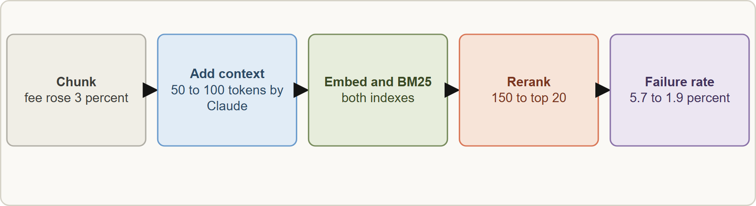
Contextual retrieval
Module 9
A chunk like "the fee rose 3%" loses meaning out of context. Contextual retrieval has Claude write 50 to 100 tokens of document-level context for each chunk and prepend it before embedding and before the BM25 index.
A chunk like "the fee rose 3%" loses meaning out of context. Contextual retrieval has Claude write 50 to 100 tokens of document-level context for each chunk and prepend it before embedding and before the BM25 index.
Claude Architect Professional Exam Prep | for the CCAR-P exam
Module 9: RAG Pipelines: Chunking and Indexing
12 / 25
Notes:
Contextual retrieval.
The figure shows this: Contextual retrieval: prepend fifty to one hundred tokens of chunk-specific context before embedding and B M twenty-five indexing; combine with reranking for the lowest failure rate.
A chunk like "the fee rose three percent" loses meaning out of context. Contextual retrieval has Claude write fifty to one hundred tokens of document-level context for each chunk and prepend it before embedding and before the B M twenty-five index.

Slide 13
Contextual retrieval, continued
Module 9
Reported results (failure rate = 1 minus recall@20, baseline 5.7%): contextual embeddings -35%; with contextual BM25 -49%; with reranking -67%.
Prompt caching makes this cheap: load the document once and reference it for every chunk.
Rerank: retrieve a larger candidate set (for example 150), rerank, pass the top K (for example 20) to the model; more chunks help up to a point, then distract. Reranking adds some latency.
Claude Architect Professional Exam Prep | for the CCAR-P exam
Module 9: RAG Pipelines: Chunking and Indexing
13 / 25
Notes:
Contextual retrieval, continued.
Reported results (failure rate equals one minus recall@twenty, baseline five point seven percent): contextual embeddings -thirty-five percent; with contextual B M twenty-five -forty-nine percent; with reranking -sixty-seven percent.
Prompt caching makes this cheap: load the document once and reference it for every chunk.
Rerank: retrieve a larger candidate set (for example one hundred fifty), rerank, pass the top K (for example twenty) to the model; more chunks help up to a point, then distract. Reranking adds some latency.

Slide 14
Freshness, Security and Evaluation
Module 9
Concern | Practice
Freshness | Incremental re-indexing; version documents; delete removed content; re-embed when the embedding model changes (never mix spaces); validate after each refresh
Access control | Store access metadata; filter retrieval by the user's permissions (Module 8)
Prompt injection | Retrieved text is untrusted data: tag it, state that, limit tool power
Citations | Return source and location; verify that quoted text exists
Evaluation | Measure retrieval (recall@k, precision) separately from generation (faithfulness, correctness)
Monitoring | Index age, empty-result rate, rerank scores, citation validity
Claude Architect Professional Exam Prep | for the CCAR-P exam
Module 9: RAG Pipelines: Chunking and Indexing
14 / 25
Notes:
Freshness, Security and Evaluation.
Freshness. Incremental re-indexing; version documents; delete removed content; re-embed when the embedding model changes (never mix spaces); validate after each refresh.
Access control. Store access metadata; filter retrieval by the user's permissions (Module eight).
Prompt injection. Retrieved text is untrusted data: tag it, state that, limit tool power.
Citations. Return source and location; verify that quoted text exists.
Evaluation. Measure retrieval (recall@k, precision) separately from generation (faithfulness, correctness).
Monitoring. Index age, empty-result rate, rerank scores, citation validity.

Slide 15
When not to use RAG
Module 9
If the knowledge base is under about 200,000 tokens (roughly 500 pages), consider putting it in the prompt with caching instead.
Use RAG when the corpus is larger, changes often, or needs per-user access filtering and citations to sources.
EXAM TIP Quality drops after a data or embedding change with the model unchanged: check retrieval and indexing first.
Claude Architect Professional Exam Prep | for the CCAR-P exam
Module 9: RAG Pipelines: Chunking and Indexing
15 / 25
Notes:
When not to use R A G.
If the knowledge base is under about two hundred thousand tokens (roughly five hundred pages), consider putting it in the prompt with caching instead.
Use R A G when the corpus is larger, changes often, or needs per-user access filtering and citations to sources.
Exam tip: Quality drops after a data or embedding change with the model unchanged: check retrieval and indexing first.
Exam tip: Under about two hundred thousand tokens, a cached prompt may beat building R A G.

Slide 16
Module Recap
Module 9
1
Pipeline
2
Diagnose
3
Chunks
Ingest · clean · chunk · enrich · embed and index · retrieve · rerank · generate with citations
Wrong answers after a refresh: check retrieval and index first
A few hundred tokens; keep units whole; metadata for filtering and citation
4
Strategies
5
Index
6
Contextual retrieval
Fixed with overlap · structure-aware · semantic · hierarchical
Vector plus BM25 (hybrid); embed with the right input_type; no Anthropic embedding model
50 to 100 tokens of context; failure -35%, -49%, -67% with BM25 and rerank
7
Rerank
8
No RAG
9
Freshness
Retrieve about 150, pass top 20
Under about 200,000 tokens: cached prompt
Incremental re-index; re-embed on model change; filter by access
Claude Architect Professional Exam Prep | for the CCAR-P exam
Module 9: RAG Pipelines: Chunking and Indexing
16 / 25
Notes:
Here is the recap.
Pipeline: Ingest, clean, chunk, enrich, embed and index, retrieve, rerank, generate with citations.
Diagnose: Wrong answers after a refresh: check retrieval and index first.
Chunks: A few hundred tokens; keep units whole; metadata for filtering and citation.
Strategies: Fixed with overlap, structure-aware, semantic, hierarchical.
Index: Vector plus B M twenty-five (hybrid); embed with the right input type; no Anthropic embedding model.
Contextual retrieval: fifty to one hundred tokens of context; failure -thirty-five percent, -forty-nine percent, -sixty-seven percent with B M twenty-five and rerank.
Rerank: Retrieve about one hundred fifty, pass top twenty.
No R A G: Under about two hundred thousand tokens: cached prompt.
Freshness: Incremental re-index; re-embed on model change; filter by access.

Slide 17
Practice Question 1
Module 9
Q1
After a team switches to a new embedding provider, a support assistant starts citing passages about the wrong products. Prompts, model and latency are unchanged, and the ingestion jobs report success. What should the architect check first?
A
Whether the stored document vectors were re-embedded with the new provider so queries and documents share one vector space
B
Whether the generation model has quietly been replaced by a weaker snapshot
C
Whether the context window of the model has been reduced
D
Whether the temperature value was changed during the migration
Claude Architect Professional Exam Prep | for the CCAR-P exam
Module 9: RAG Pipelines: Chunking and Indexing
17 / 25
Notes:
Question one.
After a team switches to a new embedding provider, a support assistant starts citing passages about the wrong products. Prompts, model and latency are unchanged, and the ingestion jobs report success. What should the architect check first?
The four options are on the screen.
[PAUSE 12]
The answer is A. Vectors from different embedding models are incompatible, so retrieval returns poor matches while everything else looks healthy.

Slide 18
Practice Question 2
Module 9
Q2
Exact statute numbers and clause identifiers are being missed by an embeddings-only retriever. What is the best improvement?
A
Increase the embedding dimension of the existing index so that exact identifiers become more distinctive
B
Switch to a larger generation model
C
Lower the chunk overlap to zero so that every chunk is shorter and identifiers appear only once
D
Add a BM25 keyword index and combine it with the vector index (hybrid search)
Claude Architect Professional Exam Prep | for the CCAR-P exam
Module 9: RAG Pipelines: Chunking and Indexing
18 / 25
Notes:
Question two.
Exact statute numbers and clause identifiers are being missed by an embeddings-only retriever. What is the best improvement?
The four options are on the screen.
[PAUSE 12]
The answer is D. Lexical search catches exact identifiers that embeddings can miss.

Slide 19
Practice Question 3
Module 9
Q3
Chunks such as "the fee increased by 3 percent" retrieve poorly because the surrounding context is lost. Which technique addresses this directly?
A
Remove metadata from the chunks
B
Truncate all chunks to one sentence
C
Contextual retrieval: prepend chunk-specific context before embedding and BM25 indexing
D
Increase top-K from 20 to 200 without reranking, so that the relevant chunk is certain to be included
Claude Architect Professional Exam Prep | for the CCAR-P exam
Module 9: RAG Pipelines: Chunking and Indexing
19 / 25
Notes:
Question three.
Chunks such as "the fee increased by three percent" retrieve poorly because the surrounding context is lost. Which technique addresses this directly?
The four options are on the screen.
[PAUSE 12]
The answer is C. A short, document-level context line prepended before embedding and keyword indexing restores the meaning that the chunk lost.

Slide 20
Practice Question 4
Module 9
Q4
A corpus of 60,000 tokens changes monthly and has no per-user access rules. What is a reasonable design?
A
Place it in the prompt as a cached prefix, without building a RAG pipeline
B
Build a full vector pipeline with reranking and a cluster, then re-index it every time a document changes
C
Fine-tune a model on it every month
D
Split it into 1,000 tiny chunks and retrieve randomly
Claude Architect Professional Exam Prep | for the CCAR-P exam
Module 9: RAG Pipelines: Chunking and Indexing
20 / 25
Notes:
Question four.
A corpus of sixty thousand tokens changes monthly and has no per-user access rules. What is a reasonable design?
The four options are on the screen.
[PAUSE 12]
The answer is A. Below about two hundred thousand tokens, a cached prompt can be simpler and faster.

Slide 21
Practice Question 5
Module 9
Q5
Which TWO are required when the embedding model is replaced? (Select TWO.)
A
Keep the old document vectors and embed only new queries with the new model
B
Re-embed the corpus with the new model so that queries and documents share one vector space
C
Re-evaluate retrieval quality on a test set before cutting over
D
Remove the keyword index
E
Mix old and new vectors in one index to save time
Claude Architect Professional Exam Prep | for the CCAR-P exam
Module 9: RAG Pipelines: Chunking and Indexing
21 / 25
Notes:
Question five. Select two.
Which two are required when the embedding model is replaced?
The five options are on the screen.
[PAUSE 15]
The answers are B and C. Vectors from different models are incompatible; validate before switching.

Slide 22
Practice Question 6
Module 9
Q6
A table in a PDF is split between two chunks and answers about it are wrong. What is the best fix?
A
Use structure-aware chunking that keeps the table with its header intact
B
Increase the overlap on all chunks
C
Convert the table to an image and skip chunking altogether, relying on the model to read the picture
D
Use a larger model to guess the missing rows
Claude Architect Professional Exam Prep | for the CCAR-P exam
Module 9: RAG Pipelines: Chunking and Indexing
22 / 25
Notes:
Question six.
A table in a P D F is split between two chunks and answers about it are wrong. What is the best fix?
The four options are on the screen.
[PAUSE 12]
The answer is A. Structure-aware chunking keeps a table together with its header, so retrieval returns the whole table instead of a fragment.

Slide 23
Practice Question 7
Module 9
Q7
Which design lets the system return precise passages while still giving the model enough context?
A
Using only very large chunks everywhere so that every answer can include a lot of surrounding text
B
Using only single-sentence chunks everywhere
C
Hierarchical chunking: retrieve small child chunks and return their larger parent
D
Returning random neighbors of the best chunk
Claude Architect Professional Exam Prep | for the CCAR-P exam
Module 9: RAG Pipelines: Chunking and Indexing
23 / 25
Notes:
Question seven.
Which design lets the system return precise passages while still giving the model enough context?
The four options are on the screen.
[PAUSE 12]
The answer is C. Retrieving small child chunks and returning their larger parent balances precision with the context the model needs.

Slide 24
Practice Question 8
Module 9
Q8
A user-specific restriction must hold in a RAG system. Where should it be enforced?
A
In retrieval, by filtering on access metadata for the authenticated user
B
In the system prompt, by asking the model to ignore restricted passages that it should not show anyone
C
In the response, by asking the model to redact restricted text
D
In the embedding model, by training it on allowed documents only
Claude Architect Professional Exam Prep | for the CCAR-P exam
Module 9: RAG Pipelines: Chunking and Indexing
24 / 25
Notes:
Question eight.
A user-specific restriction must hold in a R A G system. Where should it be enforced?
The four options are on the screen.
[PAUSE 12]
The answer is A. Enforce access in code before the model sees data.

Slide 25
Answers at a Glance
Module 9
Question | Answer | Why
Q1 | A | Vectors from different embedding models are incompatible
Q2 | D | Lexical search catches exact identifiers that embeddings can miss
Q3 | C | A short, document-level context line prepended before embedding and keyword indexing
Q4 | A | Below about 200,000 tokens
Q5 | B, C | Vectors from different models are incompatible
Q6 | A | Structure-aware chunking keeps a table together with its header
Q7 | C | Retrieving small child chunks and returning their larger parent balances precision
Q8 | A | Enforce access in code before the model sees data
Claude Architect Professional Exam Prep | for the CCAR-P exam
Module 9: RAG Pipelines: Chunking and Indexing
25 / 25
Notes:
Here are all eight answers. Question one: A. Question two: D. Question three: C. Question four: A. Question five: B and C. Question six: A. Question seven: C. Question eight: A.
In the next module, we continue the course.

