Slide 1
Module 10: Retrieval Strategies, Latency Trade-offs and Observability
How to match retrieval to the data shape and the query pattern
Domain 3 · Integration
Claude Architect Professional Exam Prep Masterclass
Module 10
Notes:
Welcome to Module ten: Retrieval Strategies, Latency Trade-offs and Observability. This module covers retrieval strategies, latency trade-offs and observability.
Each part of this module comes from the study notes of the same name, so you can read the notes after you watch.

Slide 2
What You Will Learn
Module 10
How to match retrieval to the data shape and the query pattern
The accuracy, latency and cost trade-off and how to justify a configuration
Observability at scale: what to log, trace and measure, and how to sample
Claude Architect Professional Exam Prep | for the CCAR-P exam
Module 10
2 / 26
Notes:
By the end of this module you will be able to do three things.
How to match retrieval to the data shape and the query pattern.
The accuracy, latency and cost trade-off and how to justify a configuration.
Observability at scale: what to log, trace and measure, and how to sample.

Slide 3
Case Check-In: Lumen Advisory Designs Search for a Retailer's Three Data Sets
Module 10
CASE CHECK-IN · Lumen Advisory
Product manuals (long prose), order records (tables), and a code repository for the support tooling team
Questions range from "how do I reset the ice maker?" to "total returns last quarter for store 12" to "where is the refund rule implemented?"
Claude Architect Professional Exam Prep | for the CCAR-P exam
Module 10
3 / 26
Notes:
Our running case is Lumen Advisory. Lumen Advisory Designs Search for a Retailer's Three Data Sets.
Product manuals (long prose), order records (tables), and a code repository for the support tooling team.
Questions range from "how do I reset the ice maker?" to "total returns last quarter for store twelve" to "where is the refund rule implemented?".

Slide 4
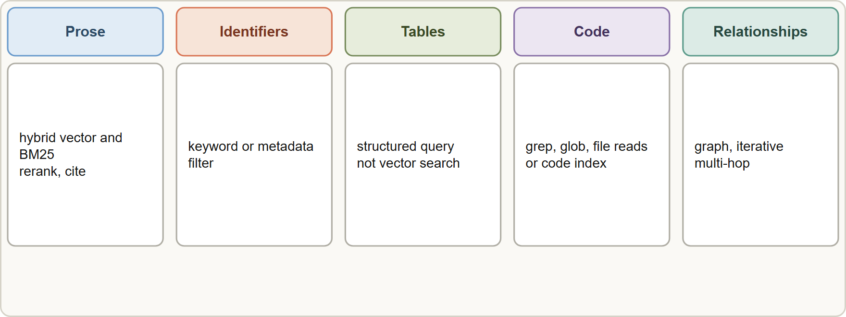
Retrieval Matched to Data and Query
Module 10
Retrieval by data shape: prose uses hybrid semantic and keyword search, tables use structured queries, code uses search tools and indexes, relationships use graph or multi-hop lookups
Claude Architect Professional Exam Prep | for the CCAR-P exam
Module 10
4 / 26
Notes:
Retrieval Matched to Data and Query.
The figure shows this: Retrieval by data shape: prose uses hybrid semantic and keyword search, tables use structured queries, code uses search tools and indexes, relationships use graph or multi-hop lookups.

Slide 5
Retrieval Matched to Data and Query, continued
Module 10
Data shape | Query pattern | Retrieval strategy
Long prose (manuals, policies) | Natural-language questions | Hybrid vector plus BM25, rerank, structure-aware chunks, citations
Identifiers and exact terms | Lookup by code, name, clause | Keyword/BM25 or metadata filter
Structured tables | Aggregation, filters, joins | Query the database (text-to-SQL or a parameterized tool), not vector search
Code | Find definitions and usages | Agentic search with grep/glob and file reads, or a code-embedding index
Relationships (org charts, dependencies) | Multi-hop | Graph queries or iterative retrieval across hops
Time-sensitive data | "Latest" | Metadata filters and recency weighting; freshness checks
Small fixed corpus | Any | Full context with caching
Claude Architect Professional Exam Prep | for the CCAR-P exam
Module 10
5 / 26
Notes:
Retrieval Matched to Data and Query, continued.
Long prose (manuals, policies). Query pattern: Natural-language questions. Retrieval strategy: Hybrid vector plus B M twenty-five, rerank, structure-aware chunks, citations.
Identifiers and exact terms. Query pattern: Lookup by code, name, clause. Retrieval strategy: Keyword or B M twenty-five or metadata filter.
Structured tables. Query pattern: Aggregation, filters, joins. Retrieval strategy: Query the database (text-to-S Q L (Structured Query Language) or a parameterized tool), not vector search.
Code. Query pattern: Find definitions and usages. Retrieval strategy: Agentic search with grep or glob and file reads, or a code-embedding index.
Relationships (org charts, dependencies). Query pattern: Multi-hop. Retrieval strategy: Graph queries or iterative retrieval across hops.
Time-sensitive data. Query pattern: "Latest". Retrieval strategy: Metadata filters and recency weighting; freshness checks.
Small fixed corpus. Query pattern: Any. Retrieval strategy: Full context with caching.

Slide 6
Retrieval Matched to Data and Query, continued
Module 10
Query pattern | Technique
Direct lookup | Keyword or metadata filter
Vague or short | Query rewriting or expansion by the model
Multi-part or multi-hop | Decompose, retrieve per part, then combine (agentic retrieval)
Needs breadth then precision | Retrieve wide, rerank, pass top K
Needs authoritative sourcing | Retrieve with metadata (source, date) and cite
Do not use vector search for aggregations. Sums, counts and joins belong in SQL or an analytics tool; let the model write a validated, parameterized query or call a safe tool.
Claude Architect Professional Exam Prep | for the CCAR-P exam
Module 10
6 / 26
Notes:
Retrieval Matched to Data and Query, continued.
Direct lookup. Keyword or metadata filter.
Vague or short. Query rewriting or expansion by the model.
Multi-part or multi-hop. Decompose, retrieve per part, then combine (agentic retrieval).
Needs breadth then precision. Retrieve wide, rerank, pass top K.
Needs authoritative sourcing. Retrieve with metadata (source, date) and cite.
Do not use vector search for aggregations. Sums, counts and joins belong in S Q L or an analytics tool; let the model write a validated, parameterized query or call a safe tool.

Slide 7
Retrieval Matched to Data and Query, continued
Module 10
Agentic retrieval (the model searches iteratively) improves recall for hard questions at the price of latency and tokens; reserve it for queries that need it, and route simple lookups to a single fast search.
Evaluate retrieval separately (recall@k, precision, empty-result rate) from answer quality.
EXAM TIP The answer follows the data shape: prose = hybrid semantic search; exact identifiers = keyword; tables = structured query; code = search tools. "Put everything in a vector store" is the distractor.
Claude Architect Professional Exam Prep | for the CCAR-P exam
Module 10
7 / 26
Notes:
Retrieval Matched to Data and Query, continued.
Agentic retrieval (the model searches iteratively) improves recall for hard questions at the price of latency and tokens; reserve it for queries that need it, and route simple lookups to a single fast search.
Evaluate retrieval separately (recall@k, precision, empty-result rate) from answer quality.
Exam tip: The answer follows the data shape: prose equals hybrid semantic search; exact identifiers equals keyword; tables equals structured query; code equals search tools. "Put everything in a vector store" is the distractor.

Slide 8
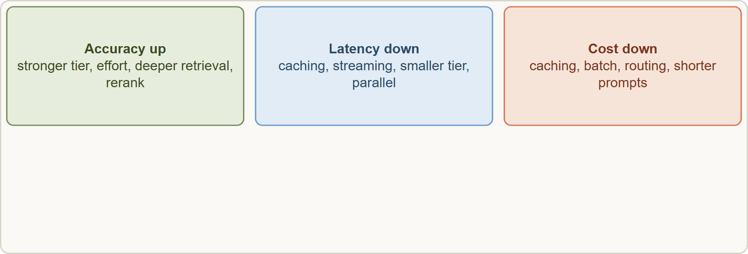
Accuracy-Latency-Cost Trade-offs
Module 10
The accuracy, latency and cost triangle with levers: model tier, effort, retrieval depth, reranking, caching, streaming and batch
Claude Architect Professional Exam Prep | for the CCAR-P exam
Module 10
8 / 26
Notes:
Accuracy-Latency-Cost Trade-offs.
The figure shows this: The accuracy, latency and cost triangle with levers: model tier, effort, retrieval depth, reranking, caching, streaming and batch.

Slide 9
Accuracy-Latency-Cost Trade-offs, continued
Module 10
Lever | Accuracy | Latency | Cost
Stronger tier | Up | Up | Up
Higher effort / thinking | Up | Up | Up
More retrieved chunks / rerank | Up (to a point) | Up | Up
Prompt caching | Same | Down | Down
Streaming | Same | Perceived latency down (time to first token) | Same
Smaller tier / lower effort | Down | Down | Down
Routing by difficulty | Held | Down on average | Down
Batch API | Same | Much higher (not interactive) | Down (50%)
Parallel calls | Same | Down (wall-clock) | Same or up
Shorter output / `max_tokens` | Risk if cut off | Down | Down
Claude Architect Professional Exam Prep | for the CCAR-P exam
Module 10
9 / 26
Notes:
Accuracy-Latency-Cost Trade-offs, continued.
Stronger tier. Accuracy: Up. Latency: Up. Cost: Up.
Higher effort or thinking. Accuracy: Up. Latency: Up. Cost: Up.
More retrieved chunks or rerank. Accuracy: Up (to a point). Latency: Up. Cost: Up.
Prompt caching. Accuracy: Same. Latency: Down. Cost: Down.
Streaming. Accuracy: Same. Latency: Perceived latency down (time to first token). Cost: Same.
Smaller tier or lower effort. Accuracy: Down. Latency: Down. Cost: Down.
Routing by difficulty. Accuracy: Held. Latency: Down on average. Cost: Down.
Batch A P I (application programming interface). Accuracy: Same. Latency: Much higher (not interactive). Cost: Down (fifty percent).
Parallel calls. Accuracy: Same. Latency: Down (wall-clock). Cost: Same or up.
Shorter output or max tokens. Accuracy: Risk if cut off. Latency: Down. Cost: Down.

Slide 10
Accuracy-Latency-Cost Trade-offs, continued
Module 10
Justify with data: measure p50 and p95 latency, time to first token, accuracy on a test set and cost per request for each configuration; choose by the client's priority (Module 1).
First get a prompt that works, then optimize latency; premature trimming hides what top quality looks like.
Use streaming for interactive UIs, batch for non-urgent bulk, caching nearly always when a prefix repeats.
Ask for sentence or paragraph limits rather than word counts when shortening output.
Claude Architect Professional Exam Prep | for the CCAR-P exam
Module 10
10 / 26
Notes:
Accuracy-Latency-Cost Trade-offs, continued.
Justify with data: measure p fifty and p ninety-five latency, time to first token, accuracy on a test set and cost per request for each configuration; choose by the client's priority (Module one).
First get a prompt that works, then optimize latency; premature trimming hides what top quality looks like.
Use streaming for interactive U I s, batch for non-urgent bulk, caching nearly always when a prefix repeats.
Ask for sentence or paragraph limits rather than word counts when shortening output.

Slide 11
Observability at Scale
Module 10
Observability lets you understand a running system from its outputs. For LLM systems add content quality to the usual latency, errors and cost.
Claude Architect Professional Exam Prep | for the CCAR-P exam
Module 10
11 / 26
Notes:
Observability at Scale.
Observability lets you understand a running system from its outputs. For L L M (large language model) systems add content quality to the usual latency, errors and cost.

Slide 12
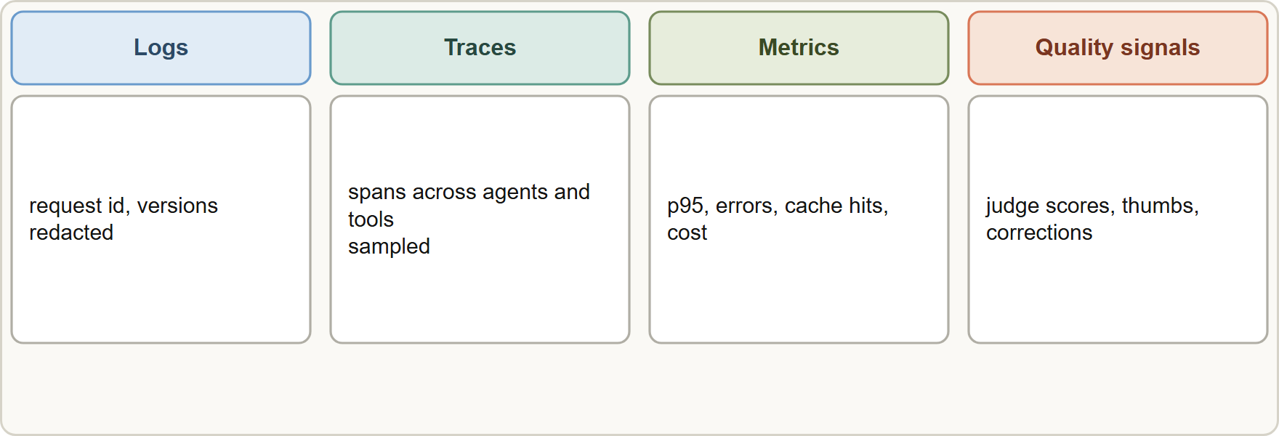
Observability at Scale, continued
Module 10
Observability pillars: logs, traces and metrics feed dashboards, alerts and evaluation datasets
Claude Architect Professional Exam Prep | for the CCAR-P exam
Module 10
12 / 26
Notes:
Observability at Scale, continued.
The figure shows this: Observability pillars: logs, traces and metrics feed dashboards, alerts and evaluation datasets.

Slide 13
Observability at Scale, continued
Module 10
Signal | What to capture | Why
Logs | Request id (the request-id header), model, prompt version, token counts, tool calls, errors, outcome | Reproduce and audit
Traces | Per-run spans across retrieval, model calls, tools and subagents | Debug non-deterministic multi-step runs
Metrics | p50/p95 latency, time to first token, error and retry rates, cache hit rate, cost per request, escalation rate | Trends and alerts
Quality signals | Sampled LLM-judge or human scores, thumbs, correction rates, citation validity | Detect drift
Cost attribution | Usage by workspace, API key, model, team | Chargeback and budgets
Challenges and answers
Claude Architect Professional Exam Prep | for the CCAR-P exam
Module 10
13 / 26
Notes:
Observability at Scale, continued.
Logs. What to capture: Request id (the request-id header), model, prompt version, token counts, tool calls, errors, outcome. Why: Reproduce and audit.
Traces. What to capture: Per-run spans across retrieval, model calls, tools and subagents. Why: Debug non-deterministic multi-step runs.
Metrics. What to capture: p fifty or p ninety-five latency, time to first token, error and retry rates, cache hit rate, cost per request, escalation rate. Why: Trends and alerts.
Quality signals. What to capture: Sampled L L M-judge or human scores, thumbs, correction rates, citation validity. Why: Detect drift.
Cost attribution. What to capture: Usage by workspace, A P I key, model, team. Why: Chargeback and budgets.
Challenges and answers.

Slide 14
Observability at Scale, continued
Module 10
Challenge | Practice
Volume | Sample detailed traces; aggregate metrics for everything
Privacy | Redact PII in logs; content logging off by default and enabled narrowly; access controls and retention limits
Non-determinism | Log prompt version, parameters and retrieved context so a run can be replayed
Multi-step runs | Correlate with a trace id across agents and tools
Cost surprises | Per-workspace keys, usage and cost APIs, budget alerts, cache-efficiency tracking
Metric cardinality | Limit labels; avoid unbounded values such as user ids in metric labels
Drift | Version prompts and models; compare against eval baselines after each change
Claude Architect Professional Exam Prep | for the CCAR-P exam
Module 10
14 / 26
Notes:
Observability at Scale, continued.
Volume. Sample detailed traces; aggregate metrics for everything.
Privacy. Redact P I I in logs; content logging off by default and enabled narrowly; access controls and retention limits.
Non-determinism. Log prompt version, parameters and retrieved context so a run can be replayed.
Multi-step runs. Correlate with a trace id across agents and tools.
Cost surprises. Per-workspace keys, usage and cost A P I s, budget alerts, cache-efficiency tracking.
Metric cardinality. Limit labels; avoid unbounded values such as user ids in metric labels.
Drift. Version prompts and models; compare against eval baselines after each change.

Slide 15
Observability at Scale, continued
Module 10
Anthropic usage and cost reporting (Admin API or analytics API) groups by model, workspace, API key, service tier, context window, data residency and speed; data appears within about 5 minutes; admin credentials are required.
Claude Code can export OpenTelemetry metrics and events (cost, tokens by type, sessions, tool decisions) to your backend; it is off until enabled, prompt text is not logged by default, and admins can set it through managed settings (Module 17).
Alert on leading indicators: rising retry or error rates, falling cache hit rate, growing latency tail, rising escalation or thumbs-down rates.
EXAM TIP At scale, the right monitoring answer combines aggregate metrics, sampled traces, redacted logs and quality sampling; logging everything with full content is both costly and a privacy risk.
Claude Architect Professional Exam Prep | for the CCAR-P exam
Module 10
15 / 26
Notes:
Observability at Scale, continued.
Anthropic usage and cost reporting (Admin A P I or analytics A P I) groups by model, workspace, A P I key, service tier, context window, data residency and speed; data appears within about five minutes; admin credentials are required.
Claude Code can export Open Telemetry metrics and events (cost, tokens by type, sessions, tool decisions) to your backend; it is off until enabled, prompt text is not logged by default, and admins can set it through managed settings (Module seventeen).
Alert on leading indicators: rising retry or error rates, falling cache hit rate, growing latency tail, rising escalation or thumbs-down rates.
Exam tip: At scale, the right monitoring answer combines aggregate metrics, sampled traces, redacted logs and quality sampling; logging everything with full content is both costly and a privacy risk.

Slide 16
Observability at Scale, continued
Module 10
EXAM TIP Choose the retrieval by data shape: prose hybrid, identifiers keyword, tables structured query, code search tools.
Claude Architect Professional Exam Prep | for the CCAR-P exam
Module 10
16 / 26
Notes:
Observability at Scale, continued.
Exam tip: Choose the retrieval by data shape: prose hybrid, identifiers keyword, tables structured query, code search tools.

Slide 17
Module Recap
Module 10
1
By shape
2
Never
3
Query rewriting
Prose: hybrid plus rerank · identifiers: keyword · tables: structured query · code: search tools · relationships: iterative or graph
Vector search for sums and joins
For vague or short queries
4
Trade-offs
5
Metrics
6
Observability
Tier, effort, retrieval depth, rerank up = accuracy, latency, cost up; caching down; batch cheap but slow
p50 and p95 latency, time to first token, cost per request, cache hit rate, errors
Logs (request id), traces, metrics, quality sampling, cost attribution
7
Scale
8
Reporting
Sample traces; redact PII; limit cardinality; alert on leading indicators
Usage and cost by model, workspace, key; about 5 minutes fresh
Claude Architect Professional Exam Prep | for the CCAR-P exam
Module 10
17 / 26
Notes:
Here is the recap.
By shape: Prose: hybrid plus rerank, identifiers: keyword, tables: structured query, code: search tools, relationships: iterative or graph.
Never: Vector search for sums and joins.
Query rewriting: For vague or short queries.
Trade-offs: Tier, effort, retrieval depth, rerank up equals accuracy, latency, cost up; caching down; batch cheap but slow.
Metrics: p fifty and p ninety-five latency, time to first token, cost per request, cache hit rate, errors.
Observability: Logs (request id), traces, metrics, quality sampling, cost attribution.
Scale: Sample traces; redact P I I; limit cardinality; alert on leading indicators.
Reporting: Usage and cost by model, workspace, key; about five minutes fresh.

Slide 18
Practice Question 1
Module 10
Q1
A retailer's users ask "total returns for store 12 last quarter" over a table of 40 million order rows. Which approach fits best?
A
Ask the model to guess the figure from similar past questions
B
Let the model call a validated, parameterized query tool and return the computed result
C
Paste a sample of rows into the prompt and ask the model to estimate the total for the whole quarter
D
Embed every order row and retrieve the nearest rows to the question
Claude Architect Professional Exam Prep | for the CCAR-P exam
Module 10
18 / 26
Notes:
Question one.
A retailer's users ask "total returns for store twelve last quarter" over a table of forty million order rows. Which approach fits best?
The four options are on the screen.
[PAUSE 12]
The answer is B. Aggregations over structured data belong in a database query, not vector search.

Slide 19
Practice Question 2
Module 10
Q2
A search for a specific clause number "14(b)(2)" keeps returning loosely related passages. What helps most?
A
Increasing the number of retrieved passages from 5 to 50
B
Removing the clause numbers from the index to reduce noise from the identifiers in the passages
C
A keyword (BM25) or metadata lookup combined with the semantic search
D
Using a larger generation model with the same retriever
Claude Architect Professional Exam Prep | for the CCAR-P exam
Module 10
19 / 26
Notes:
Question two.
A search for a specific clause number "fourteen(b)(two)" keeps returning loosely related passages. What helps most?
The four options are on the screen.
[PAUSE 12]
The answer is C. Exact identifiers such as clause numbers need lexical matching, which a keyword index adds to the semantic search.

Slide 20
Practice Question 3
Module 10
Q3
A hard multi-hop question needs facts from three documents that link to each other. Which retrieval approach suits it?
A
A single vector search with a larger top-K so that all three linked documents are surely included
B
Decompose the question and retrieve iteratively, with the model issuing follow-up searches
C
A single keyword search on the full question text
D
Skip retrieval and rely on the model's training data, which already covers the three linked documents
Claude Architect Professional Exam Prep | for the CCAR-P exam
Module 10
20 / 26
Notes:
Question three.
A hard multi-hop question needs facts from three documents that link to each other. Which retrieval approach suits it?
The four options are on the screen.
[PAUSE 12]
The answer is B. Iterative, agentic retrieval handles multi-hop questions, at a latency cost.

Slide 21
Practice Question 4
Module 10
Q4
An interactive assistant must feel responsive and cost less, and quality is acceptable. Which TWO levers fit? (Select TWO.)
A
Cache the stable prompt prefix
B
Raise effort to maximum for every turn
C
Route every request through the Batch API
D
Stream the response so users see the first tokens quickly
E
Retrieve 200 passages for every question
Claude Architect Professional Exam Prep | for the CCAR-P exam
Module 10
21 / 26
Notes:
Question four. Select two.
An interactive assistant must feel responsive and cost less, and quality is acceptable. Which two levers fit?
The five options are on the screen.
[PAUSE 15]
The answers are A and D. Streaming improves perceived latency; caching lowers time and cost.

Slide 22
Practice Question 5
Module 10
Q5
Latency p95 doubled after adding a reranking step, with quality up slightly. How should the architect decide?
A
Keep reranking because quality always outranks latency
B
Compare the gain against the latency budget and the client's priority, then tune candidate count or reranker size
C
Add a second reranker to restore latency
D
Remove reranking because latency always outranks quality
Claude Architect Professional Exam Prep | for the CCAR-P exam
Module 10
22 / 26
Notes:
Question five.
Latency p ninety-five doubled after adding a reranking step, with quality up slightly. How should the architect decide?
The four options are on the screen.
[PAUSE 12]
The answer is B. Compare the measured quality gain with the latency budget and the client's priority, then tune the candidate count or reranker size.

Slide 23
Practice Question 6
Module 10
Q6
A team logs the full prompt and response for every request in a regulated workflow. What is the better observability design?
A
Keep logging everything indefinitely in a shared bucket for convenience
B
Log only the final answer text with user names attached
C
Aggregate metrics for all traffic, sampled and redacted traces, and content logging only where needed and controlled
D
Disable all logging to protect privacy
Claude Architect Professional Exam Prep | for the CCAR-P exam
Module 10
23 / 26
Notes:
Question six.
A team logs the full prompt and response for every request in a regulated workflow. What is the better observability design?
The four options are on the screen.
[PAUSE 12]
The answer is C. Aggregate metrics for all traffic plus sampled, redacted traces balance debuggability against privacy, cost and retention duties.

Slide 24
Practice Question 7
Module 10
Q7
Spend for one product line is rising unexpectedly. Which setup makes the cause easiest to find?
A
Asking developers to estimate their own usage
B
One shared key for all applications and a monthly invoice review by the finance team after the bill arrives
C
Separate workspaces or keys per application and reports grouped by model and key, with budget alerts
D
Lowering max_tokens on every application
Claude Architect Professional Exam Prep | for the CCAR-P exam
Module 10
24 / 26
Notes:
Question seven.
Spend for one product line is rising unexpectedly. Which setup makes the cause easiest to find?
The four options are on the screen.
[PAUSE 12]
The answer is C. Attribution by workspace and key enables chargeback and investigation.

Slide 25
Practice Question 8
Module 10
Q8
Which metric is a leading indicator of a prompt-cache regression after a release?
A
A rising count of user logins
B
A rising number of documentation page views by developers
C
A falling number of deployments
D
A falling cache hit rate with rising input cost
Claude Architect Professional Exam Prep | for the CCAR-P exam
Module 10
25 / 26
Notes:
Question eight.
Which metric is a leading indicator of a prompt-cache regression after a release?
The four options are on the screen.
[PAUSE 12]
The answer is D. A changed prefix breaks caching; the hit rate drops first.

Slide 26
Answers at a Glance
Module 10
Question | Answer | Why
Q1 | B | Aggregations over structured data belong in a database query
Q2 | C | Exact identifiers such as clause numbers need lexical matching
Q3 | B | Iterative, agentic retrieval handles multi-hop questions, at a latency cost
Q4 | A, D | Streaming improves perceived latency
Q5 | B | Compare the measured quality gain with the latency budget and the
Q6 | C | Aggregate metrics for all traffic plus sampled
Q7 | C | Attribution by workspace and key enables chargeback and investigation
Q8 | D | A changed prefix breaks caching
Claude Architect Professional Exam Prep | for the CCAR-P exam
Module 10
26 / 26
Notes:
Here are all eight answers. Question one: B. Question two: C. Question three: B. Question four: A and D. Question five: B. Question six: C. Question seven: C. Question eight: D.
In the next module, we continue the course.

