Slide 1
Module 11: Evaluation Metrics, Datasets and Frameworks
How to turn requirements into measurable success criteria and metrics
Domain 4 · Evaluation, Testing & Optimization
Claude Architect Professional Exam Prep Masterclass
Module 11
Notes:
Welcome to Module eleven: Evaluation Metrics, Datasets and Frameworks. This module covers evaluation metrics, datasets and frameworks.
Each part of this module comes from the study notes of the same name, so you can read the notes after you watch.

Slide 2
What You Will Learn
Module 11
How to turn requirements into measurable success criteria and metrics
How to build evaluation datasets
Mixed methodologies: code-graded, LLM-graded, human-graded
An evaluation framework that runs on every change
Claude Architect Professional Exam Prep | for the CCAR-P exam
Module 11: Evaluation Metrics, Datasets and Frameworks
2 / 28
Notes:
By the end of this module you will be able to do four things.
How to turn requirements into measurable success criteria and metrics.
How to build evaluation datasets.
Mixed methodologies: code-graded, L L M (large language model)-graded, human-graded.
An evaluation framework that runs on every change.

Slide 3
Case Check-In: Lumen Advisory Defines "Good" for a Bank's Claims-Triage Assistant
Module 11
CASE CHECK-IN · Lumen Advisory
The bank says "it must be accurate, fast, cheap and safe"
Lumen turns each word into a number and a test
Claude Architect Professional Exam Prep | for the CCAR-P exam
Module 11: Evaluation Metrics, Datasets and Frameworks
3 / 28
Notes:
Our running case is Lumen Advisory. Lumen Advisory Defines "Good" for a Bank's Claims-Triage Assistant.
The bank says "it must be accurate, fast, cheap and safe".
Lumen turns each word into a number and a test.

Slide 4
Success Criteria and Metrics
Module 11
Good criteria are specific, measurable, achievable and relevant. Most systems need several dimensions at once.
Claude Architect Professional Exam Prep | for the CCAR-P exam
Module 11: Evaluation Metrics, Datasets and Frameworks
4 / 28
Notes:
Success Criteria and Metrics.
Good criteria are specific, measurable, achievable and relevant. Most systems need several dimensions at once.

Slide 5
Success Criteria and Metrics, continued
Module 11
Dimension | Example metric and target | How to measure
Accuracy / task fidelity | 95% correct triage category on a held-out set | Exact match against labels
Faithfulness (RAG) | 98% of claims supported by cited passages | LLM-judge or citation check
Retrieval quality | recall@20 at least 97% | Labeled relevant passages
Consistency | Same answer for paraphrases | Similarity across paraphrase sets
Latency | p95 under 3 seconds; time to first token under 1 second | Timing logs
Cost | Under $0.02 per case | Token and price accounting
Safety | Under 0.1% of outputs flagged harmful | Classifier or judge on samples
Claude Architect Professional Exam Prep | for the CCAR-P exam
Module 11: Evaluation Metrics, Datasets and Frameworks
5 / 28
Notes:
Success Criteria and Metrics, continued.
Accuracy or task fidelity. Example metric and target: ninety-five percent correct triage category on a held-out set. How to measure: Exact match against labels.
Faithfulness (R A G). Example metric and target: ninety-eight percent of claims supported by cited passages. How to measure: L L M-judge or citation check.
Retrieval quality. Example metric and target: recall@twenty at least ninety-seven percent. How to measure: Labeled relevant passages.
Consistency. Example metric and target: Same answer for paraphrases. How to measure: Similarity across paraphrase sets.
Latency. Example metric and target: p ninety-five under three seconds; time to first token under one second. How to measure: Timing logs.
Cost. Example metric and target: Under zero dollars and two cents per case. How to measure: Token and price accounting.
Safety. Example metric and target: Under zero point one percent of outputs flagged harmful. How to measure: Classifier or judge on samples.

Slide 6
Success Criteria and Metrics, continued
Module 11
Dimension | Example metric and target | How to measure
Security | 0 successful injection attacks in the red-team set | Adversarial tests
Reliability | Error and timeout rate below 0.5% | Production metrics
Claude Architect Professional Exam Prep | for the CCAR-P exam
Module 11: Evaluation Metrics, Datasets and Frameworks
6 / 28
Notes:
Success Criteria and Metrics, continued.
Security. Example metric and target: zero successful injection attacks in the red-team set. How to measure: Adversarial tests.
Reliability. Example metric and target: Error and timeout rate below zero point five percent. How to measure: Production metrics.

Slide 7
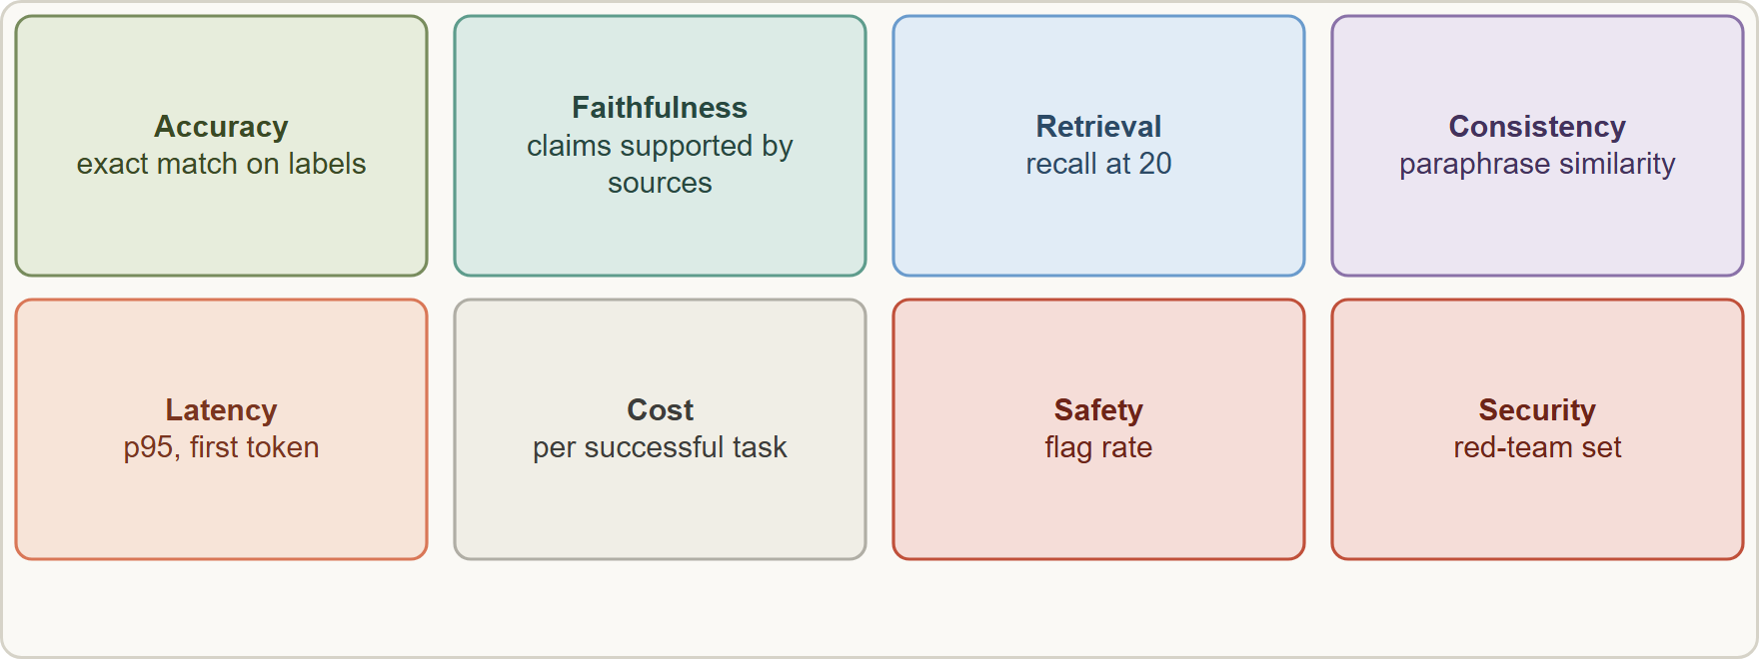
Success Criteria and Metrics, continued
Module 11
Metric families: task-specific (F1, BLEU, ROUGE), generic (accuracy, precision, recall), operational (latency, uptime), safety (flag rate), qualitative scales (Likert or rubric) alongside numbers.
Define the threshold before you test, and which metrics are gates (must pass) versus tracked.
Metric families: task-specific (F1, BLEU, ROUGE), generic (accuracy, precision, recall), operational (latency, uptime), safety (flag rate), qualitative scales (Likert or rubric) alongside numbers.
Define the threshold before you test, and which metrics are gates (must pass) versus tracked.
Claude Architect Professional Exam Prep | for the CCAR-P exam
Module 11: Evaluation Metrics, Datasets and Frameworks
7 / 28
Notes:
Success Criteria and Metrics, continued.
The figure shows this: Evaluation dimensions: accuracy, faithfulness, retrieval, consistency, latency, cost, safety and security, each with a metric and a grading method.
Metric families: task-specific (F one, B L E U, R O U G E), generic (accuracy, precision, recall), operational (latency, uptime), safety (flag rate), qualitative scales (Likert or rubric) alongside numbers.
Define the threshold before you test, and which metrics are gates (must pass) versus tracked.

Slide 8
Success Criteria and Metrics, continued
Module 11
Precision and recall trade off: choose by the cost of a miss versus a false alarm (for example fraud flags).
EXAM TIP "Accurate" is not a metric. The architect's answer states specific numeric criteria on a held-out dataset, across several dimensions.
Claude Architect Professional Exam Prep | for the CCAR-P exam
Module 11: Evaluation Metrics, Datasets and Frameworks
8 / 28
Notes:
Success Criteria and Metrics, continued.
Precision and recall trade off: choose by the cost of a miss versus a false alarm (for example fraud flags).
Exam tip: "Accurate" is not a metric. The architect's answer states specific numeric criteria on a held-out dataset, across several dimensions.

Slide 9
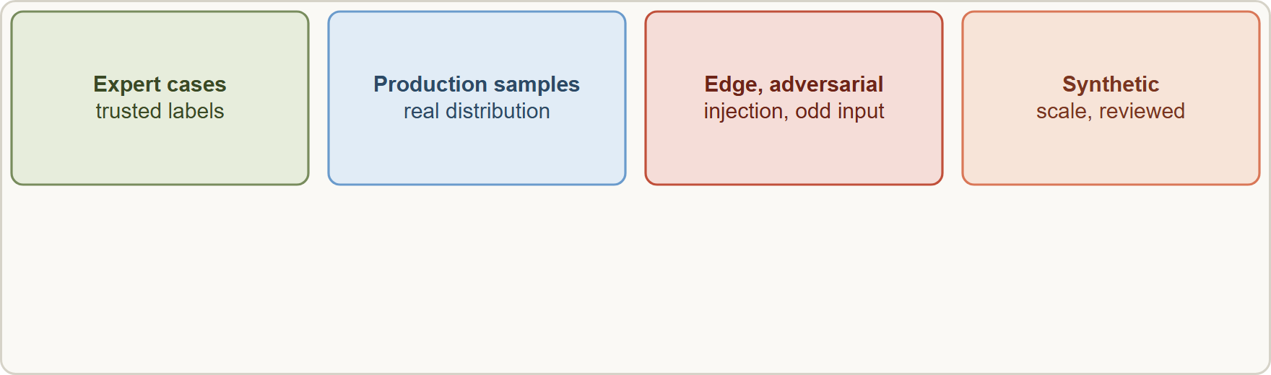
Evaluation Datasets
Module 11
An evaluation dataset combines expert-written cases, production samples, edge and adversarial cases and synthetic cases, split into development and held-out sets
Claude Architect Professional Exam Prep | for the CCAR-P exam
Module 11: Evaluation Metrics, Datasets and Frameworks
9 / 28
Notes:
Evaluation Datasets.
The figure shows this: An evaluation dataset combines expert-written cases, production samples, edge and adversarial cases and synthetic cases, split into development and held-out sets.

Slide 10
Evaluation Datasets, continued
Module 11
Source | Use
Expert-written golden cases | Core behavior with trusted labels
Production samples (consented, redacted) | Real distribution; update regularly
Edge cases | Empty, very long or irrelevant input, sarcasm, mixed signals, ambiguous items where humans disagree
Adversarial and red-team cases | Prompt injection, jailbreaks, data-exfiltration attempts
Synthetic cases | Scale and coverage; generated by a model and reviewed
Mirror the real task distribution and include edge cases.
Volume over polish: many automatically graded items beat a few hand-graded ones, but label quality matters; review disagreements.
Keep a held-out set untouched by prompt tuning to avoid overfitting to the dev set.
Claude Architect Professional Exam Prep | for the CCAR-P exam
Module 11: Evaluation Metrics, Datasets and Frameworks
10 / 28
Notes:
Evaluation Datasets, continued.
Expert-written golden cases. Core behavior with trusted labels.
Production samples (consented, redacted). Real distribution; update regularly.
Edge cases. Empty, very long or irrelevant input, sarcasm, mixed signals, ambiguous items where humans disagree.
Adversarial and red-team cases. Prompt injection, jailbreaks, data-exfiltration attempts.
Synthetic cases. Scale and coverage; generated by a model and reviewed.
Mirror the real task distribution and include edge cases.
Volume over polish: many automatically graded items beat a few hand-graded ones, but label quality matters; review disagreements.
Keep a held-out set untouched by prompt tuning to avoid overfitting to the dev set.

Slide 11
Evaluation Datasets, continued
Module 11
Version datasets; add every production failure as a new case (a regression set).
Avoid leakage: do not put eval answers in the prompt or few-shot examples.
Start small (about 20 representative cases) to find big problems fast, then grow.
Claude Architect Professional Exam Prep | for the CCAR-P exam
Module 11: Evaluation Metrics, Datasets and Frameworks
11 / 28
Notes:
Evaluation Datasets, continued.
Version datasets; add every production failure as a new case (a regression set).
Avoid leakage: do not put eval answers in the prompt or few-shot examples.
Start small (about twenty representative cases) to find big problems fast, then grow.

Slide 12
Mixed Methodologies
Module 11
Method | Strength | Weakness | Use for
Code-graded (exact match, regex, schema, unit checks) | Fast, cheap, reliable | Only for checkable answers | Classification, extraction, format, tool-call correctness
LLM-graded (rubric, Likert, binary) | Scales; handles nuance | Needs calibration; can be biased | Tone, faithfulness, completeness, helpfulness
Human-graded | Highest validity | Slow and costly | Calibration, high-stakes review, edge cases
Semantic similarity (embeddings, ROUGE) | Compares to a reference | Weak on correctness | Summaries, paraphrase consistency
Operational telemetry | Real behavior | Not about correctness | Latency, cost, errors
LLM-judge practice
Use a detailed rubric with clear criteria; ask for reasoning first, then a score or pass/fail.
Claude Architect Professional Exam Prep | for the CCAR-P exam
Module 11: Evaluation Metrics, Datasets and Frameworks
12 / 28
Notes:
Mixed Methodologies.
Code-graded (exact match, regex, schema, unit checks). Strength: Fast, cheap, reliable. Weakness: Only for checkable answers. Use for: Classification, extraction, format, tool-call correctness.
L L M-graded (rubric, Likert, binary). Strength: Scales; handles nuance. Weakness: Needs calibration; can be biased. Use for: Tone, faithfulness, completeness, helpfulness.
Human-graded. Strength: Highest validity. Weakness: Slow and costly. Use for: Calibration, high-stakes review, edge cases.
Semantic similarity (embeddings, R O U G E). Strength: Compares to a reference. Weakness: Weak on correctness. Use for: Summaries, paraphrase consistency.
Operational telemetry. Strength: Real behavior. Weakness: Not about correctness. Use for: Latency, cost, errors.
L L M-judge practice.
Use a detailed rubric with clear criteria; ask for reasoning first, then a score or pass or fail.

Slide 13
Mixed Methodologies, continued
Module 11
Prefer binary or small scales; use a different model from the generator as judge when possible.
Calibrate against a human-labeled sample and recheck periodically.
Judge outcomes, not one fixed path (agent paths vary).
Claude Architect Professional Exam Prep | for the CCAR-P exam
Module 11: Evaluation Metrics, Datasets and Frameworks
13 / 28
Notes:
Mixed Methodologies, continued.
Prefer binary or small scales; use a different model from the generator as judge when possible.
Calibrate against a human-labeled sample and recheck periodically.
Judge outcomes, not one fixed path (agent paths vary).

Slide 14
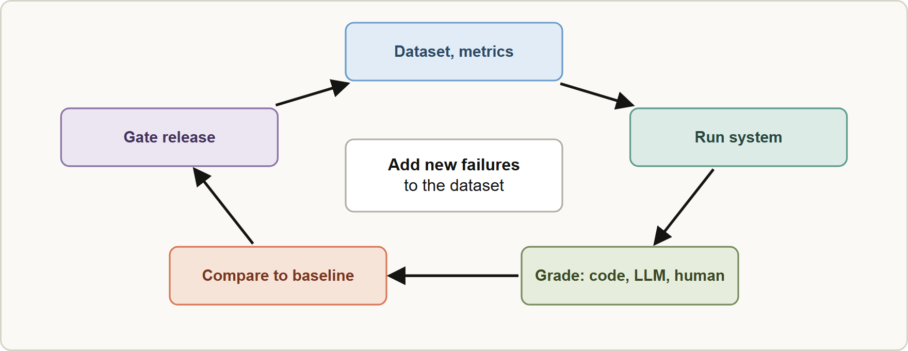
An Evaluation Framework
Module 11
Dataset and metrics with thresholds.
Harness that runs the system (prompt version, model, parameters, retrieval config) on every case and records outputs, latency and tokens.
Graders by method; store scores per case.
Compare to a baseline (current production) on the same cases.
Gate the release (CI): block if a gated metric regresses.
Dataset and metrics with thresholds.
Harness that runs the system (prompt version, model, parameters, retrieval config) on every case and records outputs, latency and tokens.
Graders by method; store scores per case.
Compare to a baseline (current production) on the same cases.
Gate the release (CI): block if a gated metric regresses.
Claude Architect Professional Exam Prep | for the CCAR-P exam
Module 11: Evaluation Metrics, Datasets and Frameworks
14 / 28
Notes:
An Evaluation Framework.
The figure shows this: An evaluation framework: dataset and metrics, run, grade with mixed methods, compare against the baseline, gate the release, and add new failures back.
Dataset and metrics with thresholds.
Harness that runs the system (prompt version, model, parameters, retrieval config) on every case and records outputs, latency and tokens.
Graders by method; store scores per case.
Compare to a baseline (current production) on the same cases.
Gate the release (C I): block if a gated metric regresses.

Slide 15
An Evaluation Framework, continued
Module 11
Online evals after release: sampled production scoring, thumbs, correction rates.
Feed back new failures into the dataset.
Evaluate components separately (retrieval, generation, tools) and end to end.
For agents, evaluate outcomes and also tool-use efficiency and safety; add human testing for what automation misses.
Security evals are part of the suite (injection, tool abuse); safety evals test refusals and harmful-output rates.
EXAM TIP "Accurate" is not a metric: state numeric targets on a held-out dataset across several dimensions.
Claude Architect Professional Exam Prep | for the CCAR-P exam
Module 11: Evaluation Metrics, Datasets and Frameworks
15 / 28
Notes:
An Evaluation Framework, continued.
Online evals after release: sampled production scoring, thumbs, correction rates.
Feed back new failures into the dataset.
Evaluate components separately (retrieval, generation, tools) and end to end.
For agents, evaluate outcomes and also tool-use efficiency and safety; add human testing for what automation misses.
Security evals are part of the suite (injection, tool abuse); safety evals test refusals and harmful-output rates.
Exam tip: "Accurate" is not a metric: state numeric targets on a held-out dataset across several dimensions.
Exam tip: Keep a held-out set untouched by tuning, and add every production failure to the regression set.

Slide 16
Module Recap
Module 11
1
Criteria
2
Dimensions
3
Dataset
Specific, measurable, achievable, relevant; multidimensional
Accuracy · faithfulness · retrieval · consistency · latency · cost · safety · security
Golden, production, edge, adversarial, synthetic; dev and held-out; versioned; regression set
4
Methods
5
Judge
6
Framework
Code (checkable) · LLM judge (nuance, calibrated) · human (calibration, high stakes)
Rubric, reasoning first, different model, calibrate
Dataset → run → grade → compare to baseline → gate → online → feed back
7
Start
About 20 cases, then grow
Claude Architect Professional Exam Prep | for the CCAR-P exam
Module 11: Evaluation Metrics, Datasets and Frameworks
16 / 28
Notes:
Here is the recap.
Criteria: Specific, measurable, achievable, relevant; multidimensional.
Dimensions: Accuracy, faithfulness, retrieval, consistency, latency, cost, safety, security.
Dataset: Golden, production, edge, adversarial, synthetic; dev and held-out; versioned; regression set.
Methods: Code (checkable), L L M judge (nuance, calibrated), human (calibration, high stakes).
Judge: Rubric, reasoning first, different model, calibrate.
Framework: Dataset to run to grade to compare to baseline to gate to online to feed back.
Start: About twenty cases, then grow.

Slide 17
Practice Question 1
Module 11
Q1
A client requires the assistant to be "accurate and fast." Which restatement is best?
A
"Accuracy will be reviewed by the team after launch"
B
"The assistant must beat all other assistants on the market"
C
"The assistant should feel accurate to the people who use it and respond reasonably quickly in most situations"
D
"At least 95 percent correct on a held-out set of 1,000 labeled cases and p95 latency under 3 seconds"
Claude Architect Professional Exam Prep | for the CCAR-P exam
Module 11: Evaluation Metrics, Datasets and Frameworks
17 / 28
Notes:
Question one.
A client requires the assistant to be "accurate and fast." Which restatement is best?
The four options are on the screen.
[PAUSE 12]
The answer is D. Specific, measurable criteria on a defined dataset are testable.

Slide 18
Practice Question 2
Module 11
Q2
Which grading method is most appropriate for checking that extracted invoice totals match labeled values?
A
Embedding similarity to a sample answer
B
An LLM judge with a Likert scale for tone and style
C
Human review of every single output
D
Code-based exact match against the labels
Claude Architect Professional Exam Prep | for the CCAR-P exam
Module 11: Evaluation Metrics, Datasets and Frameworks
18 / 28
Notes:
Question two.
Which grading method is most appropriate for checking that extracted invoice totals match labeled values?
The four options are on the screen.
[PAUSE 12]
The answer is D. Checkable answers should use fast, reliable code grading.

Slide 19
Practice Question 3
Module 11
Q3
An LLM judge is used to score the empathy of replies. What practice improves reliability?
A
Use the same model and prompt that generated the reply
B
Ask the judge for a long free-text opinion without a score
C
Use a one-line instruction and trust the first score
D
Use a detailed rubric, have it reason before scoring, use a different model from the generator, and calibrate against human labels
Claude Architect Professional Exam Prep | for the CCAR-P exam
Module 11: Evaluation Metrics, Datasets and Frameworks
19 / 28
Notes:
Question three.
An L L M judge is used to score the empathy of replies. What practice improves reliability?
The four options are on the screen.
[PAUSE 12]
The answer is D. Rubrics, reasoning, a separate judge and calibration make L L M grading dependable.

Slide 20
Practice Question 4
Module 11
Q4
Prompt changes keep improving the dev-set score but production quality does not improve. What is the likely cause?
A
The dev set is too small to compute averages, so the scores are dominated by random variation
B
The scoring method is too fast
C
The model has more parameters than needed, so it overfits to the dev set during every run
D
Overfitting to the dev set; a held-out set that is not used for tuning should be added
Claude Architect Professional Exam Prep | for the CCAR-P exam
Module 11: Evaluation Metrics, Datasets and Frameworks
20 / 28
Notes:
Question four.
Prompt changes keep improving the dev-set score but production quality does not improve. What is the likely cause?
The four options are on the screen.
[PAUSE 12]
The answer is D. Tuning against the same cases inflates scores; use a held-out set.

Slide 21
Practice Question 5
Module 11
Q5
Which TWO belong in an evaluation dataset? (Select TWO.)
A
The expected answers written into the system prompt
B
Production-like samples that reflect the real task distribution
C
Edge and adversarial cases such as very long input and injection attempts
D
Only cases that previously passed
E
Only easy examples so the pass rate looks high
Claude Architect Professional Exam Prep | for the CCAR-P exam
Module 11: Evaluation Metrics, Datasets and Frameworks
21 / 28
Notes:
Question five. Select two.
Which two belong in an evaluation dataset?
The five options are on the screen.
[PAUSE 15]
The answers are B and C. Realistic production-like cases and difficult edge or adversarial cases reveal the weaknesses that a clean sample would hide.

Slide 22
Practice Question 6
Module 11
Q6
A production failure is found. What should the team do with it?
A
Add it to the regression set so future changes are tested against it
B
Remove it from reports as an outlier
C
Keep it only in the incident log
D
Fix it in the prompt and forget the case, since it has been resolved and cannot recur
Claude Architect Professional Exam Prep | for the CCAR-P exam
Module 11: Evaluation Metrics, Datasets and Frameworks
22 / 28
Notes:
Question six.
A production failure is found. What should the team do with it?
The four options are on the screen.
[PAUSE 12]
The answer is A. Every production failure becomes a permanent regression case, so later changes are tested against it before release.

Slide 23
Practice Question 7
Module 11
Q7
A RAG assistant's answers sometimes include claims not in the retrieved passages. Which metric tracks this?
A
Latency at p50
B
Tokens per minute consumed by the retrieval service during the evaluation run
C
Faithfulness (the share of claims supported by cited passages)
D
Cache hit rate
Claude Architect Professional Exam Prep | for the CCAR-P exam
Module 11: Evaluation Metrics, Datasets and Frameworks
23 / 28
Notes:
Question seven.
A R A G assistant's answers sometimes include claims not in the retrieved passages. Which metric tracks this?
The four options are on the screen.
[PAUSE 12]
The answer is C. Faithfulness measures the share of claims supported by the retrieved passages, which is exactly the grounding problem described.

Slide 24
Practice Question 8
Module 11
Q8
How should fraud flags be tuned when missing fraud is far costlier than a false alarm?
A
Ignore both and maximize accuracy on balanced data
B
Favor precision, accepting lower recall, to keep the review queue short for the fraud analysts
C
Favor recall, accepting lower precision, and review the extra flags
D
Remove the threshold and flag nothing
Claude Architect Professional Exam Prep | for the CCAR-P exam
Module 11: Evaluation Metrics, Datasets and Frameworks
24 / 28
Notes:
Question eight.
How should fraud flags be tuned when missing fraud is far costlier than a false alarm?
The four options are on the screen.
[PAUSE 12]
The answer is C. Choose the metric trade-off by the cost of each error type.

Slide 25
Practice Question 9
Module 11
Q9
Which is the best first sample size for fast feedback on a new agent system?
A
No dataset until launch, then collect examples from the first week of production traffic
B
100,000 cases before any run
C
A single demo case
D
About 20 representative cases, then grow as patterns emerge
Claude Architect Professional Exam Prep | for the CCAR-P exam
Module 11: Evaluation Metrics, Datasets and Frameworks
25 / 28
Notes:
Question nine.
Which is the best first sample size for fast feedback on a new agent system?
The four options are on the screen.
[PAUSE 12]
The answer is D. A small first sample of about twenty cases reveals large effects early, and the set can grow as patterns emerge.

Slide 26
Practice Question 10
Module 11
Q10
Agent runs take different valid paths to the same result. How should they be graded?
A
By exact match of the sequence of tool calls against a reference run for every test case
B
By counting the number of tokens
C
By outcome and key constraints, rather than requiring one fixed sequence of steps
D
By the length of the final answer
Claude Architect Professional Exam Prep | for the CCAR-P exam
Module 11: Evaluation Metrics, Datasets and Frameworks
26 / 28
Notes:
Question ten.
Agent runs take different valid paths to the same result. How should they be graded?
The four options are on the screen.
[PAUSE 12]
The answer is C. Agents can take different valid paths, so grading should check the outcome and key constraints rather than one fixed sequence.

Slide 27
Practice Question 11
Module 11
Q11
A team wants an eval that catches regressions before every release. What is the right mechanism?
A
Wait for user complaints and then roll back
B
Run the dataset in CI against the candidate and gate the release on defined metrics versus the baseline
C
Run the dataset once per year
D
Ask reviewers to read a few outputs after each release and report anything that looks unusual to the team
Claude Architect Professional Exam Prep | for the CCAR-P exam
Module 11: Evaluation Metrics, Datasets and Frameworks
27 / 28
Notes:
Question eleven.
A team wants an eval that catches regressions before every release. What is the right mechanism?
The four options are on the screen.
[PAUSE 12]
The answer is B. Running the dataset in continuous integration and gating on metrics against the baseline protects every release from regressions.

Slide 28
Answers at a Glance
Module 11
Question | Answer | Why
Q1 | D | Specific, measurable criteria on a defined dataset are
Q2 | D | Checkable answers should use fast, reliable code grading
Q3 | D | Rubrics, reasoning, a separate judge and calibration make
Q4 | D | Tuning against the same cases inflates scores
Q5 | B, C | Realistic production-like cases and difficult edge or adversarial
Q6 | A | Every production failure becomes a permanent regression case
Q7 | C | Faithfulness measures the share of claims supported by
Q8 | C | Choose the metric trade-off by the cost of
Q9 | D | A small first sample of about twenty cases
Q10 | C | Agents can take different valid paths
Q11 | B | Running the dataset in continuous integration and gating
Claude Architect Professional Exam Prep | for the CCAR-P exam
Module 11: Evaluation Metrics, Datasets and Frameworks
28 / 28
Notes:
Here are all eleven answers. Question one: D. Question two: D. Question three: D. Question four: D. Question five: B and C. Question six: A. Question seven: C. Question eight: C. Question nine: D. Question ten: C. Question eleven: B.
In the next module, we continue the course.

