Slide 1
Module 14: Compliance and Ethical AI
How to map a regulation to architecture choices (GDPR, HIPAA, FedRAMP)
Domain 5 · Governance, Safety & Risk Management
Claude Architect Professional Exam Prep Masterclass
Module 14 · Part 1
Notes:
Welcome to Module fourteen: Compliance and Ethical A I. This module covers compliance and ethical a i.
Each part of this module comes from the study notes of the same name, so you can read the notes after you watch.

Slide 2
What You Will Learn
Part 1
How to map a regulation to architecture choices (GDPR, HIPAA, FedRAMP)
Anthropic's data handling arrangements: retention, ZDR, BAA, residency
Which platform routes meet which regime
Ethical AI: bias, fairness and transparency in design
Claude Architect Professional Exam Prep | for the CCAR-P exam
Module 14: Compliance and Ethical AI
2 / 26
Notes:
By the end of this module you will be able to do four things.
How to map a regulation to architecture choices (G D P R, H I P A A, Fed R A M P).
Anthropic's data handling arrangements: retention, Z D R, B A A, residency.
Which platform routes meet which regime.
Ethical A I: bias, fairness and transparency in design.

Slide 3
Case Check-In: Lumen Advisory Serves Three Regulated Clients
Part 1
CASE CHECK-IN · Lumen Advisory
A European retailer (GDPR), a US hospital group (HIPAA) and a federal agency (FedRAMP)
Each wants the same assistant; each needs a different platform, contract and data flow
Claude Architect Professional Exam Prep | for the CCAR-P exam
Module 14: Compliance and Ethical AI
3 / 26
Notes:
Our running case is Lumen Advisory. Lumen Advisory Serves Three Regulated Clients.
A European retailer (G D P R), a U S hospital group (H I P A A) and a federal agency (Fed R A M P).
Each wants the same assistant; each needs a different platform, contract and data flow.

Slide 4
Compliance Is an Architecture Decision
Part 1
Law is not a certification Claude "has": compliance depends on how and where you process data, the contracts in place and your controls. Always confirm current status with Anthropic and legal counsel.
Claude Architect Professional Exam Prep | for the CCAR-P exam
Module 14: Compliance and Ethical AI
4 / 26
Notes:
Compliance Is an Architecture Decision.
Law is not a certification Claude "has": compliance depends on how and where you process data, the contracts in place and your controls. Always confirm current status with Anthropic and legal counsel.

Slide 5
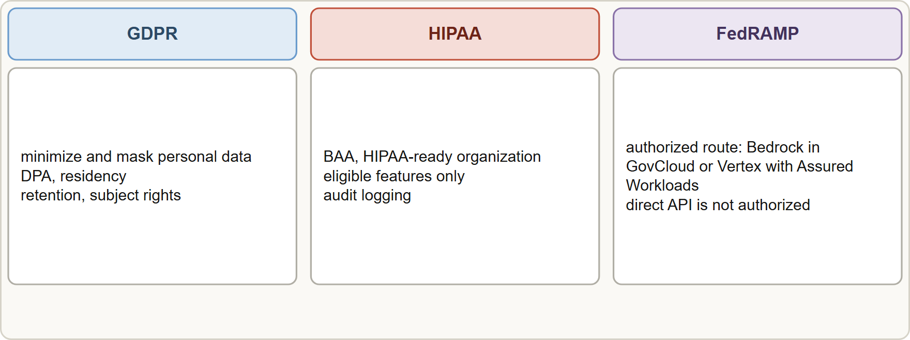
Compliance Is an Architecture Decision, continued
Part 1
Three regimes and their architecture responses: GDPR with a data processing addendum, residency and minimization; HIPAA with a BAA and eligible features; FedRAMP with an authorized platform route
Claude Architect Professional Exam Prep | for the CCAR-P exam
Module 14: Compliance and Ethical AI
5 / 26
Notes:
Compliance Is an Architecture Decision, continued.
The figure shows this: Three regimes and their architecture responses: G D P R with a data processing addendum, residency and minimization; H I P A A with a B A A and eligible features; Fed R A M P with an authorized platform route.

Slide 6
Compliance Is an Architecture Decision, continued
Part 1
Regime | Protects | Architecture responses
GDPR (EU personal data) | Personal data of people in the EU | Lawful basis, minimization, DPA with the processor, data residency or transfer mechanism, retention limits, data-subject rights (access, deletion), records of processing
HIPAA (US health data) | Protected health information (PHI) | BAA with the vendor, HIPAA-ready configuration and eligible features only, access controls and audit logging, minimum necessary data
Claude Architect Professional Exam Prep | for the CCAR-P exam
Module 14: Compliance and Ethical AI
6 / 26
Notes:
Compliance Is an Architecture Decision, continued.
G D P R (E U personal data). Protects: Personal data of people in the E U. Architecture responses: Lawful basis, minimization, D P A with the processor, data residency or transfer mechanism, retention limits, data-subject rights (access, deletion), records of processing.
H I P A A (U S health data). Protects: Protected health information (P H I). Architecture responses: B A A with the vendor, H I P A A-ready configuration and eligible features only, access controls and audit logging, minimum necessary data.

Slide 7
Compliance Is an Architecture Decision, continued
Part 1
Regime | Protects | Architecture responses
FedRAMP (US federal cloud) | Federal data in cloud services | Use a FedRAMP-authorized route, for example Claude through Amazon Bedrock in AWS GovCloud or Google Cloud Vertex AI with Assured Workloads; the direct Claude API is not FedRAMP authorized
Others (PCI DSS, SOC 2, sector rules) | Cards, controls, sector data | Tokenize or avoid card data; evidence from the vendor's attestations
Claude Architect Professional Exam Prep | for the CCAR-P exam
Module 14: Compliance and Ethical AI
7 / 26
Notes:
Compliance Is an Architecture Decision, continued.
Fed R A M P (U S federal cloud). Protects: Federal data in cloud services. Architecture responses: Use a Fed R A M P-authorized route, for example Claude through Amazon Bedrock in A W S Gov Cloud or Google Cloud Vertex A I with Assured Workloads; the direct Claude A P I (application programming interface) is not Fed R A M P authorized.
Others (P C I D S S, S O C two, sector rules). Protects: Cards, controls, sector data. Architecture responses: Tokenize or avoid card data; evidence from the vendor's attestations.

Slide 8
Anthropic Data Handling Arrangements
Part 1
Arrangement | What it means | Notes
Standard commercial terms | Customer content from the API is not used for training by default; retention is minimal and feature-specific | Retained data is never used for training without permission
Zero data retention (ZDR) | Anthropic does not store prompts or responses at rest after the response | Enabled per organization by the account team; individual features are eligible or not; ZDR organizations cannot call the API from a browser (use a back end)
Claude Architect Professional Exam Prep | for the CCAR-P exam
Module 14: Compliance and Ethical AI
8 / 26
Notes:
Anthropic Data Handling Arrangements.
Standard commercial terms. What it means: Customer content from the A P I is not used for training by default; retention is minimal and feature-specific. Notes: Retained data is never used for training without permission.
Zero data retention (Z D R). What it means: Anthropic does not store prompts or responses at rest after the response. Notes: Enabled per organization by the account team; individual features are eligible or not; Z D R organizations cannot call the A P I from a browser (use a back end).

Slide 9
Anthropic Data Handling Arrangements, continued
Part 1
Arrangement | What it means | Notes
HIPAA readiness | Signed BAA plus a HIPAA-enabled organization; encryption, access control and audit logging | Applies to eligible features only; not every feature qualifies (for example some server tools are not HIPAA eligible)
Covered Models | Designated models require 30-day retention | ZDR is not available for them unless Anthropic authorizes it
Data residency | Choose inference geography (inference_geo, for example global or US) | Track by usage reports
Cloud platforms | On Amazon Bedrock and Google Cloud (Google managed) the cloud provider is the data processor; their BAA, DPA, residency and certifications apply | Feature availability differs by platform
Claude Architect Professional Exam Prep | for the CCAR-P exam
Module 14: Compliance and Ethical AI
9 / 26
Notes:
Anthropic Data Handling Arrangements, continued.
H I P A A readiness. What it means: Signed B A A plus a H I P A A-enabled organization; encryption, access control and audit logging. Notes: Applies to eligible features only; not every feature qualifies (for example some server tools are not H I P A A eligible).
Covered Models. What it means: Designated models require thirty-day retention. Notes: Z D R is not available for them unless Anthropic authorizes it.
Data residency. What it means: Choose inference geography (inference geo, for example global or U S). Notes: Track by usage reports.
Cloud platforms. What it means: On Amazon Bedrock and Google Cloud (Google managed) the cloud provider is the data processor; their B A A, D P A, residency and certifications apply. Notes: Feature availability differs by platform.

Slide 10
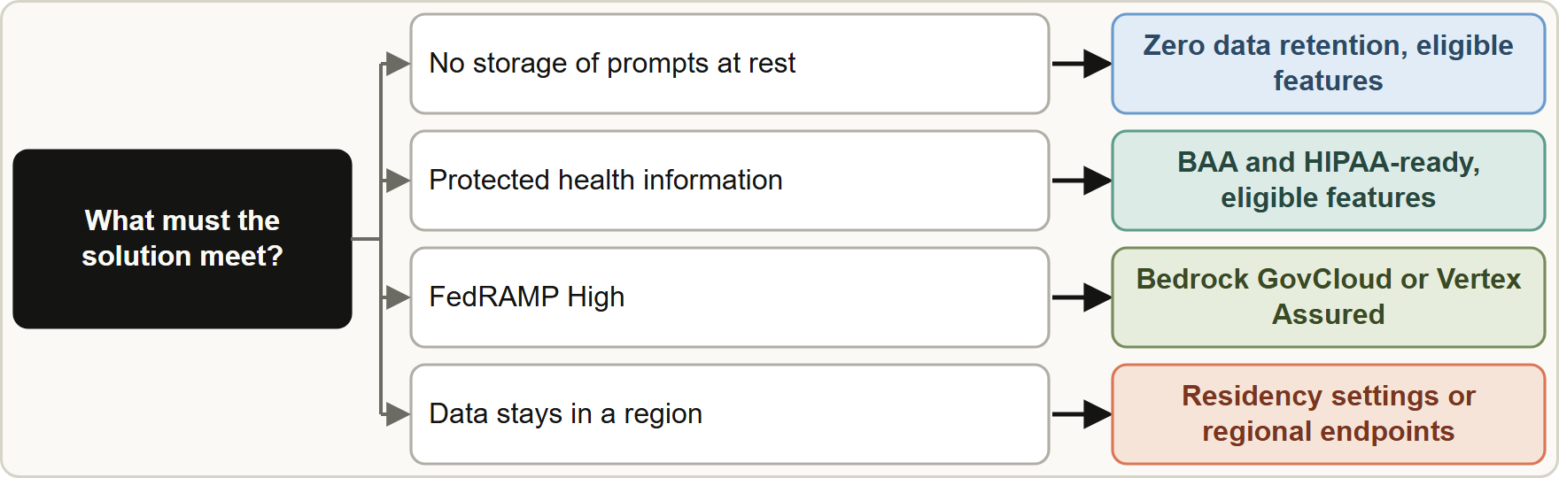
Anthropic Data Handling Arrangements, continued
Part 1
Design practices for any regime
Classify data; send the minimum to the model; mask or tokenize PII before the prompt and restore it after (also possible inside a sandbox).
Keep logs free of regulated content or protect and expire them.
Design practices for any regime
Classify data; send the minimum to the model; mask or tokenize PII before the prompt and restore it after (also possible inside a sandbox).
Keep logs free of regulated content or protect and expire them.
Claude Architect Professional Exam Prep | for the CCAR-P exam
Module 14: Compliance and Ethical AI
10 / 26
Notes:
Anthropic Data Handling Arrangements, continued.
The figure shows this: Mapping a requirement to a route: Z D R on eligible features, B A A with H I P A A readiness, Fed R A M P through Gov Cloud or Vertex with Assured Workloads, regional processing through residency settings.
Design practices for any regime.
Classify data; send the minimum to the model; mask or tokenize P I I before the prompt and restore it after (also possible inside a sandbox).
Keep logs free of regulated content or protect and expire them.

Slide 11
Anthropic Data Handling Arrangements, continued
Part 1
Enforce access control per user (Module 8); encrypt in transit and at rest.
Document data flows, subprocessors, retention and deletion paths.
Plan incident response and audit evidence.
Check feature eligibility (ZDR or HIPAA) before using a feature in a regulated workflow.
EXAM TIP Match the regime to the route and contract: HIPAA = BAA plus HIPAA-ready eligible features; FedRAMP = a FedRAMP-authorized cloud route, not the direct API; GDPR = DPA, minimization and residency. "Any API call is compliant" is the distractor.
Claude Architect Professional Exam Prep | for the CCAR-P exam
Module 14: Compliance and Ethical AI
11 / 26
Notes:
Anthropic Data Handling Arrangements, continued.
Enforce access control per user (Module eight); encrypt in transit and at rest.
Document data flows, subprocessors, retention and deletion paths.
Plan incident response and audit evidence.
Check feature eligibility (Z D R or H I P A A) before using a feature in a regulated workflow.
Exam tip: Match the regime to the route and contract: H I P A A equals B A A plus H I P A A-ready eligible features; Fed R A M P equals a Fed R A M P-authorized cloud route, not the direct A P I; G D P R equals D P A, minimization and residency. "Any A P I call is compliant" is the distractor.

Slide 12
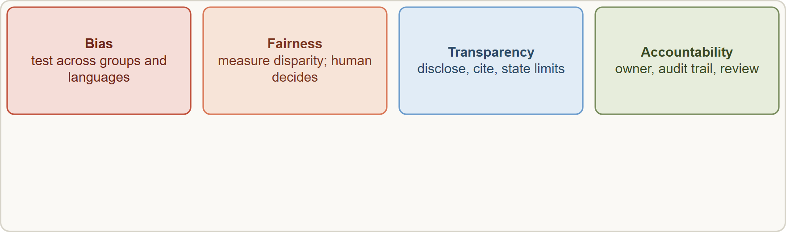
Ethical AI: Bias, Fairness and Transparency
Part 1
Ethical AI in design: bias testing, fairness across groups, transparency through disclosure and citations, and accountability through human oversight
Claude Architect Professional Exam Prep | for the CCAR-P exam
Module 14: Compliance and Ethical AI
12 / 26
Notes:
Ethical A I: Bias, Fairness and Transparency.
The figure shows this: Ethical A I in design: bias testing, fairness across groups, transparency through disclosure and citations, and accountability through human oversight.

Slide 13
Ethical AI: Bias, Fairness and Transparency, continued
Part 1
Principle | Design practice
Bias | Test outputs across demographic and language groups; include diverse cases in evals; review prompts and data for skew; measure disparity (error rate gaps)
Fairness | Define the fairness criterion with stakeholders (equal error rates, equal opportunity); keep humans decisive for consequential decisions; provide appeal paths
Transparency | Disclose AI involvement; show citations and sources; explain limits and confidence; document the system (what it does and does not do)
Accountability | Name an owner; keep audit trails; qualified human review for high-risk uses
Privacy | Minimization, consent, retention limits
Safety and non-harm | Guardrails, red-teaming, incident response
Claude Architect Professional Exam Prep | for the CCAR-P exam
Module 14: Compliance and Ethical AI
13 / 26
Notes:
Ethical A I: Bias, Fairness and Transparency, continued.
Bias. Test outputs across demographic and language groups; include diverse cases in evals; review prompts and data for skew; measure disparity (error rate gaps).
Fairness. Define the fairness criterion with stakeholders (equal error rates, equal opportunity); keep humans decisive for consequential decisions; provide appeal paths.
Transparency. Disclose A I involvement; show citations and sources; explain limits and confidence; document the system (what it does and does not do).
Accountability. Name an owner; keep audit trails; qualified human review for high-risk uses.
Privacy. Minimization, consent, retention limits.
Safety and non-harm. Guardrails, red-teaming, incident response.

Slide 14
Ethical AI: Bias, Fairness and Transparency, continued
Part 2
Principle | Design practice
Provenance | Claude outputs can carry watermarks and content credentials: a mark is a signal, not proof; absence proves nothing
Fairness is measured, not assumed: add subgroup metrics to the eval suite.
High-risk decisions about people need a qualified human who can change the result, and disclosure to the affected person.
Be honest about limitations to users and stakeholders (Module 15).
EXAM TIP Match the regime to the route and contract: BAA and eligible features, FedRAMP-authorized route, DPA with residency.
Claude Architect Professional Exam Prep | for the CCAR-P exam
Module 14: Compliance and Ethical AI
14 / 26
Notes:
Ethical A I: Bias, Fairness and Transparency, continued.
Provenance. Claude outputs can carry watermarks and content credentials: a mark is a signal, not proof; absence proves nothing.
Fairness is measured, not assumed: add subgroup metrics to the eval suite.
High-risk decisions about people need a qualified human who can change the result, and disclosure to the affected person.
Be honest about limitations to users and stakeholders (Module fifteen).
Exam tip: Match the regime to the route and contract: B A A and eligible features, Fed R A M P-authorized route, D P A with residency.
Exam tip: Fairness is measured: add subgroup metrics to the eval suite and keep a human decisive for consequential decisions.

Slide 15
Module Recap
Part 2
1
GDPR
2
HIPAA
3
FedRAMP
Lawful basis, minimization, DPA, residency, retention, rights
BAA, HIPAA-ready org, eligible features only, audit logging
Authorized route: Bedrock in GovCloud or Vertex with Assured Workloads; direct API not authorized
4
ZDR
5
Covered Models
6
Cloud platforms
No storage at rest; per org; feature eligibility; no browser calls
30-day retention; no ZDR
Provider is the processor; its contracts apply
7
Practice
8
Ethics
9
Marks
Classify, minimize, mask, access control, document, incident plan
Subgroup testing, human decisions, disclosure, citations, accountability
Signal not proof
Claude Architect Professional Exam Prep | for the CCAR-P exam
Module 14: Compliance and Ethical AI
15 / 26
Notes:
Here is the recap.
G D P R: Lawful basis, minimization, D P A, residency, retention, rights.
H I P A A: B A A, H I P A A-ready org, eligible features only, audit logging.
Fed R A M P: Authorized route: Bedrock in Gov Cloud or Vertex with Assured Workloads; direct A P I not authorized.
Z D R: No storage at rest; per org; feature eligibility; no browser calls.
Covered Models: thirty-day retention; no Z D R.
Cloud platforms: Provider is the processor; its contracts apply.
Practice: Classify, minimize, mask, access control, document, incident plan.
Ethics: Subgroup testing, human decisions, disclosure, citations, accountability.
Marks: Signal not proof.

Slide 16
Practice Question 1
Part 2
Q1
A US hospital group wants an assistant that processes patient notes through the Claude API. What is required?
A
A signed BAA with a HIPAA-enabled organization, and use of only HIPAA-eligible features
B
A browser-based call from the clinician's device to avoid server logs and keep patient data off the back end
C
Zero data retention alone, with no contract changes
D
Nothing beyond an API key, because the API is secure by default and health data is handled the same way
Claude Architect Professional Exam Prep | for the CCAR-P exam
Module 14: Compliance and Ethical AI
16 / 26
Notes:
Question one.
A U S hospital group wants an assistant that processes patient notes through the Claude A P I. What is required?
The four options are on the screen.
[PAUSE 12]
The answer is A. H I P A A needs a B A A and eligible features; other options do not satisfy it.

Slide 17
Practice Question 2
Part 2
Q2
A federal agency needs FedRAMP High for a Claude-based service. Which route fits?
A
A consumer chat account used by staff
B
A self-built wrapper around the public website
C
Claude through a FedRAMP-authorized cloud route such as Amazon Bedrock in AWS GovCloud or Vertex AI with Assured Workloads
D
The direct Claude API with an enterprise key
Claude Architect Professional Exam Prep | for the CCAR-P exam
Module 14: Compliance and Ethical AI
17 / 26
Notes:
Question two.
A federal agency needs Fed R A M P High for a Claude-based service. Which route fits?
The four options are on the screen.
[PAUSE 12]
The answer is C. The direct A P I is not Fed R A M P authorized; use an authorized cloud route.

Slide 18
Practice Question 3
Part 2
Q3
A European retailer must limit personal data in prompts and prove processing terms. Which TWO actions help? (Select TWO.)
A
Minimize and mask personal data before it reaches the model
B
Send full customer records to the model for convenience
C
Store prompts indefinitely so that deletion is unnecessary
D
Put a data processing addendum and residency settings in place
E
Disable all logging and documentation
Claude Architect Professional Exam Prep | for the CCAR-P exam
Module 14: Compliance and Ethical AI
18 / 26
Notes:
Question three. Select two.
A European retailer must limit personal data in prompts and prove processing terms. Which two actions help?
The five options are on the screen.
[PAUSE 15]
The answers are A and D. Minimization and a D P A with residency address G D P R obligations.

Slide 19
Practice Question 4
Part 2
Q4
A team enables a server tool in a HIPAA workflow without checking eligibility. What is the risk?
A
The model will refuse all medical text
B
The feature may not be HIPAA eligible, which could break the compliance arrangement
C
The feature will double the context window and therefore also double the cost of every HIPAA request
D
Nothing; all features are equal
Claude Architect Professional Exam Prep | for the CCAR-P exam
Module 14: Compliance and Ethical AI
19 / 26
Notes:
Question four.
A team enables a server tool in a H I P A A workflow without checking eligibility. What is the risk?
The four options are on the screen.
[PAUSE 12]
The answer is B. Check feature eligibility before using it in regulated flows.

Slide 20
Practice Question 5
Part 2
Q5
What does a zero data retention arrangement mean for browser-based calls?
A
Organizations with ZDR cannot call the API directly from a browser; use a back end
B
Browser calls become mandatory
C
Browser calls need no authentication
D
Browser calls are cached for thirty days so that repeated requests do not need to be sent again
Claude Architect Professional Exam Prep | for the CCAR-P exam
Module 14: Compliance and Ethical AI
20 / 26
Notes:
Question five.
What does a zero data retention arrangement mean for browser-based calls?
The four options are on the screen.
[PAUSE 12]
The answer is A. Cross-origin browser requests are rejected for Z D R organizations.

Slide 21
Practice Question 6
Part 2
Q6
A hiring-support assistant shows a higher error rate for resumes in one language. What should the architect do?
A
Ignore it, because overall accuracy is high and the subgroup differences are probably just random noise
B
Add subgroup evaluation, investigate causes, adjust data or prompts, and keep a human decision-maker
C
Tell users to avoid that language
D
Remove the language from the evaluation set so that the reported error rates look the same for all groups
Claude Architect Professional Exam Prep | for the CCAR-P exam
Module 14: Compliance and Ethical AI
21 / 26
Notes:
Question six.
A hiring-support assistant shows a higher error rate for resumes in one language. What should the architect do?
The four options are on the screen.
[PAUSE 12]
The answer is B. Fairness requires measuring disparities and acting on them.

Slide 22
Practice Question 7
Part 2
Q7
Which statement about AI-generated-content marks (watermarks, content credentials) is correct?
A
A mark proves the content is factually correct and checked, so it can be published without further review
B
Marks can never be removed or altered
C
A missing mark proves content is human-made
D
A detected mark is a signal, not proof, and a missing mark does not prove content is human-made
Claude Architect Professional Exam Prep | for the CCAR-P exam
Module 14: Compliance and Ethical AI
22 / 26
Notes:
Question seven.
Which statement about A I-generated-content marks (watermarks, content credentials) is correct?
The four options are on the screen.
[PAUSE 12]
The answer is D. A detected mark is a useful signal rather than proof, and a missing mark proves nothing about who wrote the content.

Slide 23
Practice Question 8
Part 2
Q8
Models designated as Covered Models require what retention?
A
Indefinite retention
B
No retention rules apply to these models, so each customer decides whether to store anything at all
C
30-day retention, so ZDR is not available for them unless authorized
D
Zero retention only
Claude Architect Professional Exam Prep | for the CCAR-P exam
Module 14: Compliance and Ethical AI
23 / 26
Notes:
Question eight.
Models designated as Covered Models require what retention?
The four options are on the screen.
[PAUSE 12]
The answer is C. Covered Models require thirty-day retention, so zero data retention is not available for them unless Anthropic authorizes it.

Slide 24
Practice Question 9
Part 2
Q9
A consultant says "Claude is HIPAA compliant" and proposes using any API feature. Which response is right?
A
Agree if the client signs an NDA
B
Agree, since Anthropic holds every possible attestation
C
Disagree, because Claude can never process health data
D
Compliance depends on the BAA, configuration, eligible features and your controls, not on a blanket claim
Claude Architect Professional Exam Prep | for the CCAR-P exam
Module 14: Compliance and Ethical AI
24 / 26
Notes:
Question nine.
A consultant says "Claude is H I P A A compliant" and proposes using any A P I feature. Which response is right?
The four options are on the screen.
[PAUSE 12]
The answer is D. Regimes are met by contract, configuration and controls.

Slide 25
Practice Question 10
Part 2
Q10
Which practice best supports transparency to end users?
A
Providing answers without sources to keep them short and avoid exposing the retrieval system to readers
B
Hiding that a model is used to avoid confusion
C
Describing the system as always correct
D
Disclosing AI involvement, showing citations and explaining limits
Claude Architect Professional Exam Prep | for the CCAR-P exam
Module 14: Compliance and Ethical AI
25 / 26
Notes:
Question ten.
Which practice best supports transparency to end users?
The four options are on the screen.
[PAUSE 12]
The answer is D. Transparency means disclosing A I involvement, showing citations and sources, and being honest about the system's limits.

Slide 26
Answers at a Glance
Part 2
Question | Answer | Why
Q1 | A | HIPAA needs a BAA and eligible features
Q2 | C | The direct API is not FedRAMP authorized
Q3 | A, D | Minimization and a DPA with residency address GDPR
Q4 | B | Check feature eligibility before using it in regulated
Q5 | A | Cross-origin browser requests are rejected for ZDR organizations
Q6 | B | Fairness requires measuring disparities and acting on them
Q7 | D | A detected mark is a useful signal rather
Q8 | C | Covered Models require 30-day retention
Q9 | D | Regimes are met by contract, configuration and controls
Q10 | D | Transparency means disclosing AI involvement
Claude Architect Professional Exam Prep | for the CCAR-P exam
Module 14: Compliance and Ethical AI
26 / 26
Notes:
Here are all ten answers. Question one: A. Question two: C. Question three: A and D. Question four: B. Question five: A. Question six: B. Question seven: D. Question eight: C. Question nine: D. Question ten: D.
In the next module, we continue the course.

