Slide 1
Module 15: Discovery, Communication and Expectations
Structured discovery: questions, stakeholders, requirements
Domain 6 · Stakeholder Communication & Lifecycle Management
Claude Architect Professional Exam Prep Masterclass
Module 15
Notes:
Welcome to Module fifteen: Discovery, Communication and Expectations. This module covers discovery, communication and expectations.
Each part of this module comes from the study notes of the same name, so you can read the notes after you watch.

Slide 2
What You Will Learn
Module 15
Structured discovery: questions, stakeholders, requirements
How to communicate architecture decisions and trade-offs to different audiences
Expectation management: honest limits, SLAs, SLOs
Feedback loops with stakeholders
Claude Architect Professional Exam Prep | for the CCAR-P exam
Module 15: Discovery, Communication and Expectations
2 / 26
Notes:
By the end of this module you will be able to do four things.
Structured discovery: questions, stakeholders, requirements.
How to communicate architecture decisions and trade-offs to different audiences.
Expectation management: honest limits, S L A s (service level agreement), S L O s.
Feedback loops with stakeholders.

Slide 3
Case Check-In: Lumen Advisory Runs Discovery for an Airline's Disruption Assistant
Module 15
CASE CHECK-IN · Lumen Advisory
The airline wants an assistant to rebook passengers during disruptions
Operations, legal, customer care, IT security and the CFO each want different things
Claude Architect Professional Exam Prep | for the CCAR-P exam
Module 15: Discovery, Communication and Expectations
3 / 26
Notes:
Our running case is Lumen Advisory. Lumen Advisory Runs Discovery for an Airline's Disruption Assistant.
The airline wants an assistant to rebook passengers during disruptions.
Operations, legal, customer care, I T security and the C F O each want different things.

Slide 4
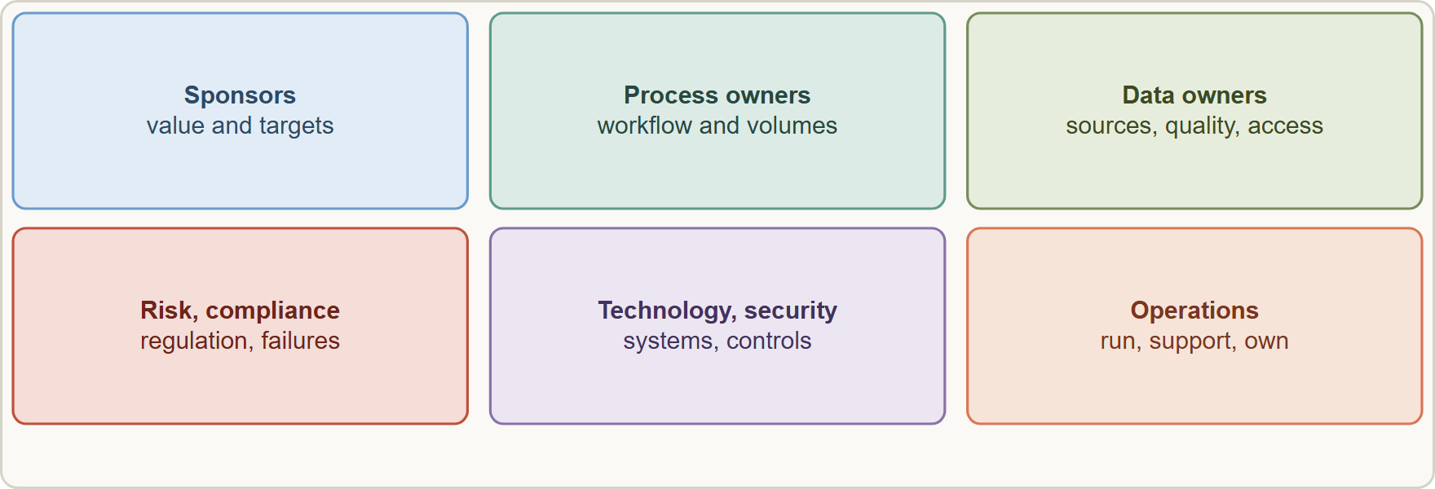
Structured Discovery
Module 15
A discovery map: business sponsors, process owners, data owners, risk and compliance, technology and security, and operations, each answering a different question
Claude Architect Professional Exam Prep | for the CCAR-P exam
Module 15: Discovery, Communication and Expectations
4 / 26
Notes:
Structured Discovery.
The figure shows this: A discovery map: business sponsors, process owners, data owners, risk and compliance, technology and security, and operations, each answering a different question.

Slide 5
Structured Discovery, continued
Module 15
Area | Questions | Output
Business value | What outcome, for whom, worth what? What happens if we do nothing? | Goals, pillars, targets (Module 1)
Process and users | How is the work done today? Who touches it? Where are the pain points and volumes? | Process map, personas, baselines
Data | What data exists, where, how clean, who owns it, how sensitive? | Data inventory, access rules
Systems | Which systems to integrate; APIs, auth, limits? | Integration list, constraints
Risk and compliance | Which regulations, policies, audit needs; what failures are unacceptable? | Risk register, regimes (Module 14)
Claude Architect Professional Exam Prep | for the CCAR-P exam
Module 15: Discovery, Communication and Expectations
5 / 26
Notes:
Structured Discovery, continued.
Business value. Questions: What outcome, for whom, worth what? What happens if we do nothing? Output: Goals, pillars, targets (Module one).
Process and users. Questions: How is the work done today? Who touches it? Where are the pain points and volumes? Output: Process map, personas, baselines.
Data. Questions: What data exists, where, how clean, who owns it, how sensitive? Output: Data inventory, access rules.
Systems. Questions: Which systems to integrate; A P I s (application programming interface), auth, limits? Output: Integration list, constraints.
Risk and compliance. Questions: Which regulations, policies, audit needs; what failures are unacceptable? Output: Risk register, regimes (Module fourteen).

Slide 6
Structured Discovery, continued
Module 15
Area | Questions | Output
Quality | How will we know it works? Examples of good and bad outputs? | Eval dataset seeds, acceptance criteria
Non-functional | Latency, availability, scale, cost ceiling | Target SLOs, budget
Operations | Who runs it, supports it, owns prompts and knowledge? | RACI, runbook outline
Practices
Interview every stakeholder group, not only the sponsor; ask for real examples (tickets, documents, edge cases).
Separate needs from solutions: "faster rebooking", not "an agent".
Prioritize requirements (must, should, could) and record assumptions and open questions with owners.
Run a thin prototype early to turn opinions into evidence.
Claude Architect Professional Exam Prep | for the CCAR-P exam
Module 15: Discovery, Communication and Expectations
6 / 26
Notes:
Structured Discovery, continued.
Quality. Questions: How will we know it works? Examples of good and bad outputs? Output: Eval dataset seeds, acceptance criteria.
Non-functional. Questions: Latency, availability, scale, cost ceiling. Output: Target S L O s, budget.
Operations. Questions: Who runs it, supports it, owns prompts and knowledge? Output: R A C I, runbook outline.
Practices.
Interview every stakeholder group, not only the sponsor; ask for real examples (tickets, documents, edge cases).
Separate needs from solutions: "faster rebooking", not "an agent".
Prioritize requirements (must, should, could) and record assumptions and open questions with owners.
Run a thin prototype early to turn opinions into evidence.

Slide 7
Structured Discovery, continued
Module 15
Capture constraints that shape the architecture: data residency, platform standards, skills, timelines.
EXAM TIP Good discovery gathers measurable outcomes, real examples, data and risk constraints from all stakeholder groups before any design commitment.
Claude Architect Professional Exam Prep | for the CCAR-P exam
Module 15: Discovery, Communication and Expectations
7 / 26
Notes:
Structured Discovery, continued.
Capture constraints that shape the architecture: data residency, platform standards, skills, timelines.
Exam tip: Good discovery gathers measurable outcomes, real examples, data and risk constraints from all stakeholder groups before any design commitment.

Slide 8
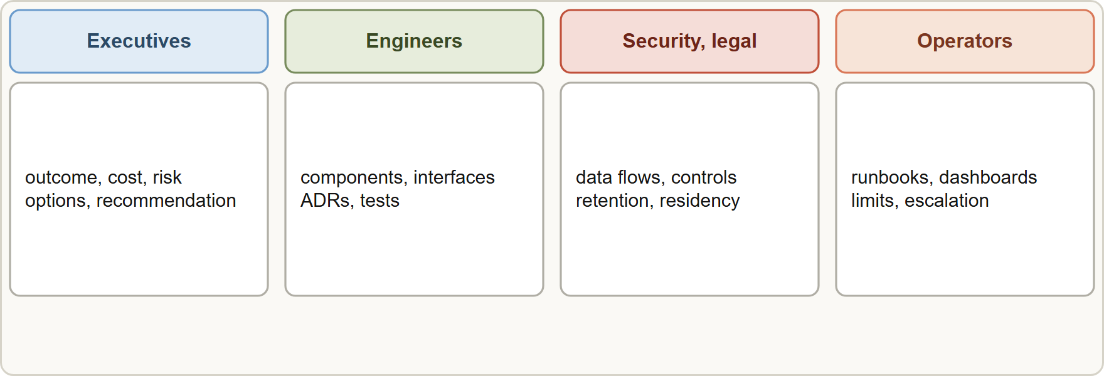
Communicating Decisions and Trade-offs
Module 15
Tailoring the message: executives want value, risk and cost; engineers want design and interfaces; security and legal want data flows and controls; operators want runbooks and limits
Claude Architect Professional Exam Prep | for the CCAR-P exam
Module 15: Discovery, Communication and Expectations
8 / 26
Notes:
Communicating Decisions and Trade-offs.
The figure shows this: Tailoring the message: executives want value, risk and cost; engineers want design and interfaces; security and legal want data flows and controls; operators want runbooks and limits.

Slide 9
Communicating Decisions and Trade-offs, continued
Module 15
Audience | Needs | Format
Executives | Outcome, cost, risk, timeline, decision needed | One-page summary, options with a recommendation
Engineers | Components, interfaces, patterns, test strategy | Architecture diagrams, ADRs, API specs
Security, legal, compliance | Data flows, controls, retention, residency | Data-flow diagram, control mapping, DPIA inputs
Operators and support | How to run, monitor, escalate | Runbooks, dashboards, limits
End users | What it does, what it does not, how to get help | Plain-language guidance, disclosure
Presenting a decision
State the decision and the problem it solves.
Show options (at least two or three) with criteria (cost, latency, accuracy, risk, effort).
Give a recommendation and the trade-offs accepted.
Claude Architect Professional Exam Prep | for the CCAR-P exam
Module 15: Discovery, Communication and Expectations
9 / 26
Notes:
Communicating Decisions and Trade-offs, continued.
Executives. Needs: Outcome, cost, risk, timeline, decision needed. Format: One-page summary, options with a recommendation.
Engineers. Needs: Components, interfaces, patterns, test strategy. Format: Architecture diagrams, A D R s, A P I specs.
Security, legal, compliance. Needs: Data flows, controls, retention, residency. Format: Data-flow diagram, control mapping, D P I A inputs.
Operators and support. Needs: How to run, monitor, escalate. Format: Runbooks, dashboards, limits.
End users. Needs: What it does, what it does not, how to get help. Format: Plain-language guidance, disclosure.
Presenting a decision.
State the decision and the problem it solves.
Show options (at least two or three) with criteria (cost, latency, accuracy, risk, effort).
Give a recommendation and the trade-offs accepted.

Slide 10
Communicating Decisions and Trade-offs, continued
Module 15
List assumptions, risks and mitigations, and what would change the decision.
Record it as an architecture decision record (ADR) [Beyond the guide].
Quantify trade-offs with evaluation results and measured cost and latency, not adjectives.
Be honest about limits: Claude can be wrong, outputs need validation, knowledge has a cutoff, quality is probabilistic, behavior can change with model versions.
Do not promise perfect accuracy, zero risk or fixed outcomes; give ranges and confidence.
Claude Architect Professional Exam Prep | for the CCAR-P exam
Module 15: Discovery, Communication and Expectations
10 / 26
Notes:
Communicating Decisions and Trade-offs, continued.
List assumptions, risks and mitigations, and what would change the decision.
Record it as an architecture decision record (A D R).
Quantify trade-offs with evaluation results and measured cost and latency, not adjectives.
Be honest about limits: Claude can be wrong, outputs need validation, knowledge has a cutoff, quality is probabilistic, behavior can change with model versions.
Do not promise perfect accuracy, zero risk or fixed outcomes; give ranges and confidence.

Slide 11
SLAs, SLOs and Expectation Alignment
Module 15
Term | Meaning | LLM-specific notes
SLA | Commitment to a customer, often contractual | Promise only what the system and dependencies can deliver
SLO | Internal target that supports the SLA | Set for latency (p95), availability, quality (eval score), cost
SLI | The measured indicator | Time to first token, error rate, faithfulness rate, escalation rate
Error budget | Allowed shortfall | Governs release pace
An SLA for an LLM system depends on platform availability, rate limits, capacity and model behavior; plan retries with backoff, fallbacks (another model or platform, cached answers, human handoff) and capacity (rate-limit tiers, batch for non-urgent work).
Claude Architect Professional Exam Prep | for the CCAR-P exam
Module 15: Discovery, Communication and Expectations
11 / 26
Notes:
S L A s, S L O s and Expectation Alignment.
S L A. Meaning: Commitment to a customer, often contractual. L L M (large language model)-specific notes: Promise only what the system and dependencies can deliver.
S L O. Meaning: Internal target that supports the S L A. L L M-specific notes: Set for latency (p ninety-five), availability, quality (eval score), cost.
S L I. Meaning: The measured indicator. L L M-specific notes: Time to first token, error rate, faithfulness rate, escalation rate.
Error budget. Meaning: Allowed shortfall. L L M-specific notes: Governs release pace.
An S L A for an L L M system depends on platform availability, rate limits, capacity and model behavior; plan retries with backoff, fallbacks (another model or platform, cached answers, human handoff) and capacity (rate-limit tiers, batch for non-urgent work).

Slide 12
SLAs, SLOs and Expectation Alignment, continued
Module 15
Separate performance SLAs (speed, uptime) from quality targets (accuracy), because quality is statistical: specify it as percent on a defined test set and sampled production, not "always correct".
Human review time counts toward end-to-end SLAs.
Align expectations early: demos use curated inputs; share the eval set and failure examples.
Claude Architect Professional Exam Prep | for the CCAR-P exam
Module 15: Discovery, Communication and Expectations
12 / 26
Notes:
S L A s, S L O s and Expectation Alignment, continued.
Separate performance S L A s (speed, uptime) from quality targets (accuracy), because quality is statistical: specify it as percent on a defined test set and sampled production, not "always correct".
Human review time counts toward end-to-end S L A s.
Align expectations early: demos use curated inputs; share the eval set and failure examples.

Slide 13
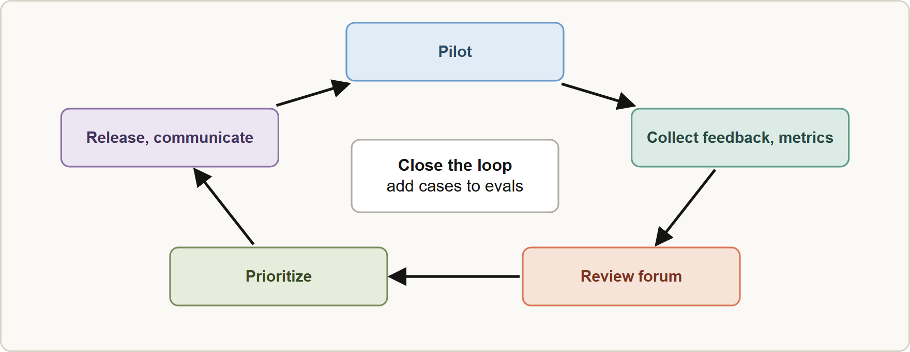
Feedback Loops
Module 15
Channels: in-product thumbs and comments, reviewer overrides, support tickets, steering reviews, metric dashboards.
Regular cadence: a review forum with sponsors, operators and risk.
Triage feedback into categories (prompt, retrieval, data, tool, UX, policy) and prioritize by impact.
Channels: in-product thumbs and comments, reviewer overrides, support tickets, steering reviews, metric dashboards.
Regular cadence: a review forum with sponsors, operators and risk.
Triage feedback into categories (prompt, retrieval, data, tool, UX, policy) and prioritize by impact.
Claude Architect Professional Exam Prep | for the CCAR-P exam
Module 15: Discovery, Communication and Expectations
13 / 26
Notes:
Feedback Loops.
The figure shows this: Stakeholder feedback loop: pilot, collect feedback and metrics, review in a regular forum, prioritize, release, communicate what changed.
Channels: in-product thumbs and comments, reviewer overrides, support tickets, steering reviews, metric dashboards.
Regular cadence: a review forum with sponsors, operators and risk.
Triage feedback into categories (prompt, retrieval, data, tool, U X, policy) and prioritize by impact.

Slide 14
Feedback Loops, continued
Module 15
Close the loop: tell stakeholders what changed and why; add feedback cases to the eval set.
Manage scope: new requests get impact analysis (cost, risk, latency) before acceptance.
EXAM TIP Run discovery with all stakeholder groups, ask for real examples, and separate needs from solutions.
Claude Architect Professional Exam Prep | for the CCAR-P exam
Module 15: Discovery, Communication and Expectations
14 / 26
Notes:
Feedback Loops, continued.
Close the loop: tell stakeholders what changed and why; add feedback cases to the eval set.
Manage scope: new requests get impact analysis (cost, risk, latency) before acceptance.
Exam tip: Run discovery with all stakeholder groups, ask for real examples, and separate needs from solutions.
Exam tip: Quality is statistical: write S L A s as measurable targets on a test set, never as "always correct".

Slide 15
Module Recap
Module 15
1
Discovery
2
Method
3
Message
Business value · process · data · systems · risk · quality · non-functional · operations
All stakeholder groups; real examples; needs not solutions; assumptions logged; thin prototype
Tailor to audience; options, recommendation, trade-offs, assumptions, ADR
4
Honesty
5
SLA / SLO / SLI
6
Resilience
Probabilistic quality; limits; no absolute promises
Commitment / target / measurement; p95 latency, availability, quality on test set
Backoff, fallbacks, capacity, human handoff
7
Feedback
Collect, triage, prioritize, release, communicate, add to evals
Claude Architect Professional Exam Prep | for the CCAR-P exam
Module 15: Discovery, Communication and Expectations
15 / 26
Notes:
Here is the recap.
Discovery: Business value, process, data, systems, risk, quality, non-functional, operations.
Method: All stakeholder groups; real examples; needs not solutions; assumptions logged; thin prototype.
Message: Tailor to audience; options, recommendation, trade-offs, assumptions, A D R.
Honesty: Probabilistic quality; limits; no absolute promises.
S L A or S L O or S L I: Commitment or target or measurement; p ninety-five latency, availability, quality on test set.
Resilience: Backoff, fallbacks, capacity, human handoff.
Feedback: Collect, triage, prioritize, release, communicate, add to evals.

Slide 16
Practice Question 1
Module 15
Q1
A sponsor says "just build an agent." What is the best discovery response?
A
Ask the sponsor to write the system prompt so that the requirements are captured in the sponsor's own words
B
Ask for outcomes, baselines, real examples, constraints and stakeholders before choosing a pattern
C
Start building an agent so that the sponsor sees visible progress and the team learns from the first demo
D
Choose the largest model and demonstrate
Claude Architect Professional Exam Prep | for the CCAR-P exam
Module 15: Discovery, Communication and Expectations
16 / 26
Notes:
Question one.
A sponsor says "just build an agent." What is the best discovery response?
The four options are on the screen.
[PAUSE 12]
The answer is B. Discovery separates needs from solutions and produces testable requirements.

Slide 17
Practice Question 2
Module 15
Q2
Which stakeholder group is most likely to be missed in early discovery and cause late surprises?
A
The marketing team
B
The team that will write the first demo
C
Risk, compliance and security owners
D
The people who will use the tool in their daily workflow only
Claude Architect Professional Exam Prep | for the CCAR-P exam
Module 15: Discovery, Communication and Expectations
17 / 26
Notes:
Question two.
Which stakeholder group is most likely to be missed in early discovery and cause late surprises?
The four options are on the screen.
[PAUSE 12]
The answer is C. Late discovery of regulatory or security constraints forces redesign.

Slide 18
Practice Question 3
Module 15
Q3
An executive asks for a recommendation among three architectures. How should the architect present it?
A
Ask the executive to choose without a recommendation
B
Present a deep technical comparison of embeddings and chunk sizes
C
Present only the preferred option with its advantages
D
State the options against agreed criteria, recommend one with accepted trade-offs, and list assumptions and risks
Claude Architect Professional Exam Prep | for the CCAR-P exam
Module 15: Discovery, Communication and Expectations
18 / 26
Notes:
Question three.
An executive asks for a recommendation among three architectures. How should the architect present it?
The four options are on the screen.
[PAUSE 12]
The answer is D. Executives need options, a recommendation, risks and a decision.

Slide 19
Practice Question 4
Module 15
Q4
A client demands "100 percent accuracy" in an SLA for an LLM assistant. What should the architect do?
A
Promise it only for the first month
B
Explain that quality is statistical, and agree measurable targets on a defined test set and sampled production, with human review for critical cases
C
Accept it to win the contract and rely on prompt improvements
D
Remove accuracy from the SLA entirely
Claude Architect Professional Exam Prep | for the CCAR-P exam
Module 15: Discovery, Communication and Expectations
19 / 26
Notes:
Question four.
A client demands "one hundred percent accuracy" in an S L A for an L L M assistant. What should the architect do?
The four options are on the screen.
[PAUSE 12]
The answer is B. Set honest, measurable quality targets rather than absolute promises.

Slide 20
Practice Question 5
Module 15
Q5
Which TWO are valid components of a performance SLO for an interactive assistant? (Select TWO.)
A
Availability or error rate within an agreed budget
B
The exact wording of every answer
C
p95 latency and time to first token under defined thresholds
D
A promise that the model never changes
E
Guaranteed zero hallucinations
Claude Architect Professional Exam Prep | for the CCAR-P exam
Module 15: Discovery, Communication and Expectations
20 / 26
Notes:
Question five. Select two.
Which two are valid components of a performance S L O for an interactive assistant?
The five options are on the screen.
[PAUSE 15]
The answers are A and C. Performance objectives are measurable operational indicators such as p ninety-five latency and error rate, not promises about every answer.

Slide 21
Practice Question 6
Module 15
Q6
What should be included when documenting a major design decision?
A
Only the final choice
B
A list of the people who disagreed with the decision and the objections that each of them raised
C
The vendor's marketing description
D
Context, options considered, the decision, trade-offs accepted and what would change it
Claude Architect Professional Exam Prep | for the CCAR-P exam
Module 15: Discovery, Communication and Expectations
21 / 26
Notes:
Question six.
What should be included when documenting a major design decision?
The four options are on the screen.
[PAUSE 12]
The answer is D. An architecture decision record captures the context, options, decision and trade-offs so future teams understand the reasoning.

Slide 22
Practice Question 7
Module 15
Q7
Which design supports an availability SLA when the model platform is occasionally rate-limited?
A
A single call with no retry
B
Retries with exponential backoff, capacity planning, and fallbacks such as another model, cached answers or human handoff
C
Disabling monitoring to reduce load
D
Raising max_tokens
Claude Architect Professional Exam Prep | for the CCAR-P exam
Module 15: Discovery, Communication and Expectations
22 / 26
Notes:
Question seven.
Which design supports an availability S L A when the model platform is occasionally rate-limited?
The four options are on the screen.
[PAUSE 12]
The answer is B. Resilience patterns protect the S L A against dependency limits.

Slide 23
Practice Question 8
Module 15
Q8
Stakeholder feedback arrives in tickets, comments and reviewer overrides. What should the team do with it?
A
Triage it by category and impact, add cases to the eval set, release changes and communicate them
B
Ignore feedback that cannot be reproduced, since it cannot be tested and is therefore not actionable for the engineering team
C
Use it only to rewrite the demo
D
Keep it in a spreadsheet until the quarterly review, then decide which items are worth discussing with sponsors
Claude Architect Professional Exam Prep | for the CCAR-P exam
Module 15: Discovery, Communication and Expectations
23 / 26
Notes:
Question eight.
Stakeholder feedback arrives in tickets, comments and reviewer overrides. What should the team do with it?
The four options are on the screen.
[PAUSE 12]
The answer is A. A closed loop turns feedback into improvements and trust.

Slide 24
Practice Question 9
Module 15
Q9
A demo with curated inputs impressed the sponsor, who now expects the same quality on all production traffic. What should the architect do?
A
Share the evaluation results and failure examples to reset expectations with evidence
B
Say nothing so that confidence stays high
C
Limit production traffic to curated inputs
D
Increase the model size without telling the sponsor, so that production quality moves closer to the demo
Claude Architect Professional Exam Prep | for the CCAR-P exam
Module 15: Discovery, Communication and Expectations
24 / 26
Notes:
Question nine.
A demo with curated inputs impressed the sponsor, who now expects the same quality on all production traffic. What should the architect do?
The four options are on the screen.
[PAUSE 12]
The answer is A. Sharing evaluation results and failure examples resets expectations with evidence about real performance instead of a curated demo.

Slide 25
Practice Question 10
Module 15
Q10
A new feature request arrives mid-project. What is the best response?
A
Reject all changes
B
Run an impact analysis on cost, risk, latency and schedule, then prioritize with stakeholders
C
Assign it to the least busy engineer without analysis, since small requests rarely affect the schedule
D
Accept it immediately
Claude Architect Professional Exam Prep | for the CCAR-P exam
Module 15: Discovery, Communication and Expectations
25 / 26
Notes:
Question ten.
A new feature request arrives mid-project. What is the best response?
The four options are on the screen.
[PAUSE 12]
The answer is B. An impact analysis on cost, risk, latency and schedule lets stakeholders prioritize the request without breaking commitments.

Slide 26
Answers at a Glance
Module 15
Question | Answer | Why
Q1 | B | Discovery separates needs from solutions and produces testable
Q2 | C | Late discovery of regulatory or security constraints forces
Q3 | D | Executives need options, a recommendation, risks and a
Q4 | B | Set honest, measurable quality targets rather than absolute
Q5 | A, C | Performance objectives are measurable operational indicators such as
Q6 | D | An architecture decision record captures the context
Q7 | B | Resilience patterns protect the SLA against dependency limits
Q8 | A | A closed loop turns feedback into improvements and
Q9 | A | Sharing evaluation results and failure examples resets expectations
Q10 | B | An impact analysis on cost
Claude Architect Professional Exam Prep | for the CCAR-P exam
Module 15: Discovery, Communication and Expectations
26 / 26
Notes:
Here are all ten answers. Question one: B. Question two: C. Question three: D. Question four: B. Question five: A and C. Question six: D. Question seven: B. Question eight: A. Question nine: A. Question ten: B.
In the next module, we continue the course.

