Slide 1
Module 16: Documentation and Lifecycle Management
What to document for a Claude solution
Domain 6 · Stakeholder Communication & Lifecycle Management
Claude Architect Professional Exam Prep Masterclass
Module 16
Notes:
Welcome to Module sixteen: Documentation and Lifecycle Management. This module covers documentation and lifecycle management.
Each part of this module comes from the study notes of the same name, so you can read the notes after you watch.

Slide 2
What You Will Learn
Module 16
What to document for a Claude solution
How to give implementation guidance to a delivery team
The lifecycle phases and the architect's role in each
Change management for models, prompts and data
Claude Architect Professional Exam Prep | for the CCAR-P exam
Module 16: Documentation and Lifecycle Management
2 / 23
Notes:
By the end of this module you will be able to do four things.
What to document for a Claude solution.
How to give implementation guidance to a delivery team.
The lifecycle phases and the architect's role in each.
Change management for models, prompts and data.

Slide 3
Case Check-In: Lumen Advisory Hands Over a Claims Assistant to the Insurer's Team
Module 16
CASE CHECK-IN · Lumen Advisory
Lumen's engagement ends in three months; the insurer's team must run, monitor and evolve the system
Two prior projects failed to survive hand-off because prompts lived in a developer's notebook
Claude Architect Professional Exam Prep | for the CCAR-P exam
Module 16: Documentation and Lifecycle Management
3 / 23
Notes:
Our running case is Lumen Advisory. Lumen Advisory Hands Over a Claims Assistant to the Insurer's Team.
Lumen's engagement ends in three months; the insurer's team must run, monitor and evolve the system.
Two prior projects failed to survive hand-off because prompts lived in a developer's notebook.

Slide 4
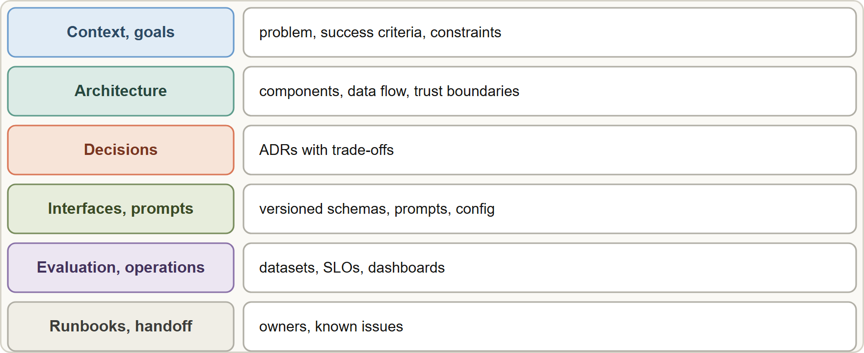
Documenting an Architecture
Module 16
A documentation set: context and goals, architecture and data flow, decision records, interfaces and prompts, evaluation and operations, runbooks and handoff
Claude Architect Professional Exam Prep | for the CCAR-P exam
Module 16: Documentation and Lifecycle Management
4 / 23
Notes:
Documenting an Architecture.
The figure shows this: A documentation set: context and goals, architecture and data flow, decision records, interfaces and prompts, evaluation and operations, runbooks and handoff.

Slide 5
Documenting an Architecture, continued
Module 16
Document | Contents
Context and goals | Problem, users, success criteria, constraints, non-goals
Architecture overview | Components, pattern, data flow, trust boundaries, platform and region
Decision records (ADRs) | Decision, options, trade-offs, date, owner, status
Interfaces | API and tool schemas, MCP servers, authentication, error handling
Prompts and configuration | Versioned system prompts, templates, model IDs and parameters, retrieval settings, Skills, CLAUDE.md
Data | Sources, ownership, chunking and index design, refresh schedule, retention, access rules
Evaluation | Datasets, metrics, thresholds, how to run the eval suite, results history
Security and compliance | Threat model, controls, regime mapping, DPAs and BAAs, audit evidence
Claude Architect Professional Exam Prep | for the CCAR-P exam
Module 16: Documentation and Lifecycle Management
5 / 23
Notes:
Documenting an Architecture, continued.
Context and goals. Problem, users, success criteria, constraints, non-goals.
Architecture overview. Components, pattern, data flow, trust boundaries, platform and region.
Decision records (A D R s). Decision, options, trade-offs, date, owner, status.
Interfaces. A P I (application programming interface) and tool schemas, M C P (Model Context Protocol) servers, authentication, error handling.
Prompts and configuration. Versioned system prompts, templates, model I Ds and parameters, retrieval settings, Skills, Claude dot M D.
Data. Sources, ownership, chunking and index design, refresh schedule, retention, access rules.
Evaluation. Datasets, metrics, thresholds, how to run the eval suite, results history.
Security and compliance. Threat model, controls, regime mapping, D P A s and B A A s, audit evidence.

Slide 6
Documenting an Architecture, continued
Module 16
Document | Contents
Operations | Dashboards, alerts, SLOs, runbooks, incident process, on-call, cost budgets
Handoff | Known issues, backlog, upgrade path, contacts
Docs live with the code: in the repository, reviewed with changes; keep prompts, schemas and evals in version control.
Use diagrams (context, components, sequence for key flows, data flow) and keep them current.
Write for the reader's task: onboarding, changing a prompt, responding to an alert.
Do not store secrets in docs; point to the secrets manager.
EXAM TIP A complete handoff includes versioned prompts and configuration, evals, runbooks and decision records, not only code and a diagram.
Claude Architect Professional Exam Prep | for the CCAR-P exam
Module 16: Documentation and Lifecycle Management
6 / 23
Notes:
Documenting an Architecture, continued.
Operations. Dashboards, alerts, S L O s, runbooks, incident process, on-call, cost budgets.
Handoff. Known issues, backlog, upgrade path, contacts.
Docs live with the code: in the repository, reviewed with changes; keep prompts, schemas and evals in version control.
Use diagrams (context, components, sequence for key flows, data flow) and keep them current.
Write for the reader's task: onboarding, changing a prompt, responding to an alert.
Do not store secrets in docs; point to the secrets manager.
Exam tip: A complete handoff includes versioned prompts and configuration, evals, runbooks and decision records, not only code and a diagram.

Slide 7
Implementation Guidance
Module 16
Give delivery teams clear guidelines: patterns to use and to avoid, prompt and tool conventions, error-handling and retry policy, logging standards, security rules, evaluation gates, naming and versioning.
Provide a reference implementation or template repository.
Define a definition of done: eval thresholds met, security review complete, runbook written, monitoring in place.
Set up reviews: architecture review for significant changes; prompt and eval review for behavior changes.
Start thin: a vertical slice (one workflow end to end with eval and monitoring) before widening.
Capture coding-assistant conventions for the team (CLAUDE.md, shared settings, Skills) so AI-assisted development follows standards (Module 17).
Claude Architect Professional Exam Prep | for the CCAR-P exam
Module 16: Documentation and Lifecycle Management
7 / 23
Notes:
Implementation Guidance.
Give delivery teams clear guidelines: patterns to use and to avoid, prompt and tool conventions, error-handling and retry policy, logging standards, security rules, evaluation gates, naming and versioning.
Provide a reference implementation or template repository.
Define a definition of done: eval thresholds met, security review complete, runbook written, monitoring in place.
Set up reviews: architecture review for significant changes; prompt and eval review for behavior changes.
Start thin: a vertical slice (one workflow end to end with eval and monitoring) before widening.
Capture coding-assistant conventions for the team (Claude dot M D, shared settings, Skills) so A I-assisted development follows standards (Module seventeen).

Slide 8
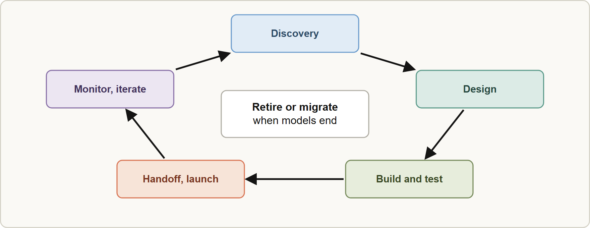
Lifecycle Phases
Module 16
The lifecycle: discovery, design, build and test, handoff and launch, then monitor and iterate in a loop
Claude Architect Professional Exam Prep | for the CCAR-P exam
Module 16: Documentation and Lifecycle Management
8 / 23
Notes:
Lifecycle Phases.
The figure shows this: The lifecycle: discovery, design, build and test, handoff and launch, then monitor and iterate in a loop.

Slide 9
Lifecycle Phases, continued
Module 16
Phase | Architect's focus | Outputs
Discovery | Requirements, constraints, data, risk, success criteria | Problem statement, risks, baselines (Modules 1 and 15)
Design | Pattern, model, retrieval, integration, security, compliance, evaluation plan | Architecture, ADRs, threat model
Build and test | Prototype, vertical slice, evals, security tests, load tests | Working system, eval results
Handoff and launch | Documentation, training, runbooks, staged rollout, SLAs | Handoff pack, canary plan
Monitor and iterate | Dashboards, quality sampling, feedback loop, cost control, change management | Improvement backlog, reports
Retire or migrate | Model and platform retirements, data deletion | Migration plan
Claude Architect Professional Exam Prep | for the CCAR-P exam
Module 16: Documentation and Lifecycle Management
9 / 23
Notes:
Lifecycle Phases, continued.
Discovery. Architect's focus: Requirements, constraints, data, risk, success criteria. Outputs: Problem statement, risks, baselines (Modules one and fifteen).
Design. Architect's focus: Pattern, model, retrieval, integration, security, compliance, evaluation plan. Outputs: Architecture, A D R s, threat model.
Build and test. Architect's focus: Prototype, vertical slice, evals, security tests, load tests. Outputs: Working system, eval results.
Handoff and launch. Architect's focus: Documentation, training, runbooks, staged rollout, S L A s (service level agreement). Outputs: Handoff pack, canary plan.
Monitor and iterate. Architect's focus: Dashboards, quality sampling, feedback loop, cost control, change management. Outputs: Improvement backlog, reports.
Retire or migrate. Architect's focus: Model and platform retirements, data deletion. Outputs: Migration plan.

Slide 10
Change Management for Models, Prompts and Data
Module 16
Change | Risk | Practice
Model version upgrade or retirement | Behavior and prompts shift; old models retire (Anthropic-operated platforms commit to dates; partner platforms set their own) | Pin IDs; track retirement dates; run regression evals on the new model; migrate by canary; update prompts per the model's guidance
Prompt changes | Silent quality shifts | Version, review, A/B test, roll back
Data and index refresh | Stale or broken retrieval | Validate after each refresh; monitor index age
Tool or API changes | Breaking schemas | Contract tests; versioned tools; deprecation notices
Regulatory change | New obligations | Compliance review calendar
Claude Architect Professional Exam Prep | for the CCAR-P exam
Module 16: Documentation and Lifecycle Management
10 / 23
Notes:
Change Management for Models, Prompts and Data.
Model version upgrade or retirement. Risk: Behavior and prompts shift; old models retire (Anthropic-operated platforms commit to dates; partner platforms set their own). Practice: Pin I Ds; track retirement dates; run regression evals on the new model; migrate by canary; update prompts per the model's guidance.
Prompt changes. Risk: Silent quality shifts. Practice: Version, review, A or B test, roll back.
Data and index refresh. Risk: Stale or broken retrieval. Practice: Validate after each refresh; monitor index age.
Tool or A P I changes. Risk: Breaking schemas. Practice: Contract tests; versioned tools; deprecation notices.
Regulatory change. Risk: New obligations. Practice: Compliance review calendar.

Slide 11
Change Management for Models, Prompts and Data, continued
Module 16
Change | Risk | Practice
Scale growth | Rate limits, cost | Capacity plan, tiers, batch, caching
Keep an upgrade playbook: evaluate, adjust, canary, monitor, retire the old path.
Own the backlog: tech debt in prompts, evals and docs is real debt.
Plan knowledge transfer: who owns prompts, knowledge bases, evals and on-call after the architect leaves.
EXAM TIP Prompts, schemas and evals are code: version them and review them with the change.
Claude Architect Professional Exam Prep | for the CCAR-P exam
Module 16: Documentation and Lifecycle Management
11 / 23
Notes:
Change Management for Models, Prompts and Data, continued.
Scale growth. Risk: Rate limits, cost. Practice: Capacity plan, tiers, batch, caching.
Keep an upgrade playbook: evaluate, adjust, canary, monitor, retire the old path.
Own the backlog: tech debt in prompts, evals and docs is real debt.
Plan knowledge transfer: who owns prompts, knowledge bases, evals and on-call after the architect leaves.
Exam tip: Prompts, schemas and evals are code: version them and review them with the change.
Exam tip: Plan model retirements early: pin, run regression evals, canary, then retire the old path.

Slide 12
Module Recap
Module 16
1
Docs
2
Store
3
Guidance
Context · architecture · ADRs · interfaces · prompts and config · data · evals · security · operations · handoff
With the code, versioned and reviewed; no secrets
Patterns, conventions, reference implementation, definition of done, reviews
4
Phases
5
Changes
6
Ownership
Discovery · design · build and test · handoff and launch · monitor and iterate · retire or migrate
Pin models; regression evals; canary; prompt versioning; data validation; contract tests
Named owners; knowledge transfer
Claude Architect Professional Exam Prep | for the CCAR-P exam
Module 16: Documentation and Lifecycle Management
12 / 23
Notes:
Here is the recap.
Docs: Context, architecture, A D R s, interfaces, prompts and config, data, evals, security, operations, handoff.
Store: With the code, versioned and reviewed; no secrets.
Guidance: Patterns, conventions, reference implementation, definition of done, reviews.
Phases: Discovery, design, build and test, handoff and launch, monitor and iterate, retire or migrate.
Changes: Pin models; regression evals; canary; prompt versioning; data validation; contract tests.
Ownership: Named owners; knowledge transfer.

Slide 13
Practice Question 1
Module 16
Q1
The architect's engagement ends soon. Which handoff package best lets the client's team operate the system?
A
A recorded demo of the system working
B
The architect's personal notes
C
Versioned prompts and configuration, the eval suite, runbooks, decision records and architecture and data-flow diagrams
D
The source code and a short slide deck
Claude Architect Professional Exam Prep | for the CCAR-P exam
Module 16: Documentation and Lifecycle Management
13 / 23
Notes:
Question one.
The architect's engagement ends soon. Which handoff package best lets the client's team operate the system?
The four options are on the screen.
[PAUSE 12]
The answer is C. Operations need prompts, evals, runbooks and reasoning, not just code.

Slide 14
Practice Question 2
Module 16
Q2
A prompt change shipped last month cannot be traced. What practice would have prevented this?
A
Letting each developer keep a local copy
B
Documenting prompts only in a presentation that is shared with the sponsor at the end of each project phase
C
Storing prompts in a shared chat thread
D
Keeping prompts, templates and parameters in version control with review, tests and release notes
Claude Architect Professional Exam Prep | for the CCAR-P exam
Module 16: Documentation and Lifecycle Management
14 / 23
Notes:
Question two.
A prompt change shipped last month cannot be traced. What practice would have prevented this?
The four options are on the screen.
[PAUSE 12]
The answer is D. Prompts are code, so keeping them in version control with review, tests and release notes makes every change traceable.

Slide 15
Practice Question 3
Module 16
Q3
A model used in production will be retired on a published date. What is the best approach?
A
Ignore the date because aliases update themselves
B
Switch all traffic immediately without testing
C
Track the date, run regression evals on a replacement, canary the migration and update prompts as needed
D
Wait until the model stops working and then switch
Claude Architect Professional Exam Prep | for the CCAR-P exam
Module 16: Documentation and Lifecycle Management
15 / 23
Notes:
Question three.
A model used in production will be retired on a published date. What is the best approach?
The four options are on the screen.
[PAUSE 12]
The answer is C. Plan migrations early with evals and a gradual rollout.

Slide 16
Practice Question 4
Module 16
Q4
Which TWO belong in a definition of done for a new Claude feature? (Select TWO.)
A
Eval thresholds met on the defined dataset
B
A runbook and monitoring in place
C
Zero open questions about the roadmap
D
A demo that worked once
E
The developer's confidence
Claude Architect Professional Exam Prep | for the CCAR-P exam
Module 16: Documentation and Lifecycle Management
16 / 23
Notes:
Question four. Select two.
Which two belong in a definition of done for a new Claude feature?
The five options are on the screen.
[PAUSE 15]
The answers are A and B. Quality gates and operational readiness make a feature done.

Slide 17
Practice Question 5
Module 16
Q5
What is the best way to begin building a large Claude solution?
A
Build only the user interface first
B
Build every component fully before testing any
C
A thin vertical slice with evaluation and monitoring end to end, then widen
D
Start with the most complex edge case and build the full architecture around that single scenario
Claude Architect Professional Exam Prep | for the CCAR-P exam
Module 16: Documentation and Lifecycle Management
17 / 23
Notes:
Question five.
What is the best way to begin building a large Claude solution?
The four options are on the screen.
[PAUSE 12]
The answer is C. A slice proves the architecture and exposes risk early.

Slide 18
Practice Question 6
Module 16
Q6
Where should architecture documents and prompts be stored?
A
In individual email attachments that each engineer keeps in their own mailbox between releases
B
In the production database
C
In a wiki that nobody updates
D
With the code in version control, reviewed alongside changes, with no secrets
Claude Architect Professional Exam Prep | for the CCAR-P exam
Module 16: Documentation and Lifecycle Management
18 / 23
Notes:
Question six.
Where should architecture documents and prompts be stored?
The four options are on the screen.
[PAUSE 12]
The answer is D. Docs and prompts evolve with the system and need review.

Slide 19
Practice Question 7
Module 16
Q7
Which lifecycle phase includes quality sampling, dashboards and the improvement backlog?
A
Design
B
Discovery
C
Retire
D
Monitor and iterate
Claude Architect Professional Exam Prep | for the CCAR-P exam
Module 16: Documentation and Lifecycle Management
19 / 23
Notes:
Question seven.
Which lifecycle phase includes quality sampling, dashboards and the improvement backlog?
The four options are on the screen.
[PAUSE 12]
The answer is D. Monitor and iterate is the ongoing operation phase, where quality sampling and dashboards feed the improvement backlog.

Slide 20
Practice Question 8
Module 16
Q8
A tool provider changes a response schema and the agent breaks. Which practice reduces such breakage?
A
Contract tests and versioned tool schemas with deprecation notices
B
Removing validation from the agent
C
Hard-coding the schema in the prompt only, so that the model adapts when the provider changes it
D
Avoiding all external tools
Claude Architect Professional Exam Prep | for the CCAR-P exam
Module 16: Documentation and Lifecycle Management
20 / 23
Notes:
Question eight.
A tool provider changes a response schema and the agent breaks. Which practice reduces such breakage?
The four options are on the screen.
[PAUSE 12]
The answer is A. Contract tests and versioned tool schemas with deprecation notices catch breaking changes before they reach production.

Slide 21
Practice Question 9
Module 16
Q9
Who should own prompts, knowledge bases and evals after the architect leaves?
A
Named owners in the client's team, with documented responsibilities and an on-call or support path
B
The model provider
C
Whoever notices a problem first
D
No one specifically; the system is automatic and the model provider will fix any problem that appears
Claude Architect Professional Exam Prep | for the CCAR-P exam
Module 16: Documentation and Lifecycle Management
21 / 23
Notes:
Question nine.
Who should own prompts, knowledge bases and evals after the architect leaves?
The four options are on the screen.
[PAUSE 12]
The answer is A. Ownership and knowledge transfer keep the system healthy.

Slide 22
Practice Question 10
Module 16
Q10
Which document records why a vector database was chosen over keyword search alone?
A
The deployment script
B
An architecture decision record with options, trade-offs and status
C
The marketing brief
D
The monitoring dashboard that shows which retrieval method was used for each request in production
Claude Architect Professional Exam Prep | for the CCAR-P exam
Module 16: Documentation and Lifecycle Management
22 / 23
Notes:
Question ten.
Which document records why a vector database was chosen over keyword search alone?
The four options are on the screen.
[PAUSE 12]
The answer is B. An architecture decision record documents the options considered and the trade-offs behind a choice such as a vector database.

Slide 23
Answers at a Glance
Module 16
Question | Answer | Why
Q1 | C | Operations need prompts, evals, runbooks and reasoning, not
Q2 | D | Prompts are code, so keeping them in version
Q3 | C | Plan migrations early with evals and a gradual
Q4 | A, B | Quality gates and operational readiness make a feature
Q5 | C | A slice proves the architecture and exposes risk
Q6 | D | Docs and prompts evolve with the system and
Q7 | D | Monitor and iterate is the ongoing operation phase
Q8 | A | Contract tests and versioned tool schemas with deprecation
Q9 | A | Ownership and knowledge transfer keep the system healthy
Q10 | B | An architecture decision record documents the options considered
Claude Architect Professional Exam Prep | for the CCAR-P exam
Module 16: Documentation and Lifecycle Management
23 / 23
Notes:
Here are all ten answers. Question one: C. Question two: D. Question three: C. Question four: A and B. Question five: C. Question six: D. Question seven: D. Question eight: A. Question nine: A. Question ten: B.
In the next module, we continue the course.

