Slide 1
Module 17: Developer Productivity and Operational Enablement
How to configure Claude Code for a team: scopes, shared settings, managed policy
Domain 7 · Developer Productivity & Operational Enablement
Claude Architect Professional Exam Prep Masterclass
Module 17
Notes:
Welcome to Module seventeen: Developer Productivity and Operational Enablement. This module covers developer productivity and operational enablement.
Each part of this module comes from the study notes of the same name, so you can read the notes after you watch.

Slide 2
What You Will Learn
Module 17
How to configure Claude Code for a team: scopes, shared settings, managed policy
Team standards: CLAUDE.md, permissions, hooks, Skills, plugins, MCP
AI-assisted workflows and their guardrails
Operational enablement: debugging, incidents, cost and usage visibility
Claude Architect Professional Exam Prep | for the CCAR-P exam
Module 17
2 / 25
Notes:
By the end of this module you will be able to do four things.
How to configure Claude Code for a team: scopes, shared settings, managed policy.
Team standards: Claude dot M D, permissions, hooks, Skills, plugins, M C P (Model Context Protocol).
A I-assisted workflows and their guardrails.
Operational enablement: debugging, incidents, cost and usage visibility.

Slide 3
Case Check-In: Lumen Advisory Rolls Out Claude Code to a Bank's 300 Engineers
Module 17
CASE CHECK-IN · Lumen Advisory
The bank's security team wants model and permission limits and no secrets exposure
Platform engineering wants shared standards and usage visibility by team
Developers want autonomy in their own folders
Claude Architect Professional Exam Prep | for the CCAR-P exam
Module 17
3 / 25
Notes:
Our running case is Lumen Advisory. Lumen Advisory Rolls Out Claude Code to a Bank's three hundred Engineers.
The bank's security team wants model and permission limits and no secrets exposure.
Platform engineering wants shared standards and usage visibility by team.
Developers want autonomy in their own folders.

Slide 4
Configuring Claude Code for Teams
Module 17
Scope | File | Applies to | Use for
User | ~/.claude/settings.json | One developer, all projects | Personal preferences
Shared project | .claude/settings.json (commit it) | Everyone in the repository | Team permissions, hooks, plugins, project environment variables
Project local | .claude/settings.local.json (kept out of git) | One developer, one project | Personal overrides
Managed | Deployed by the organization (managed-settings.json, MDM, or server-managed settings from the admin console) | Everyone it is deployed to | Security policy and compliance
Four settings scopes
Claude Architect Professional Exam Prep | for the CCAR-P exam
Module 17
4 / 25
Notes:
Configuring Claude Code for Teams.
Four settings scopes.
User. File: about or dot Claude settings.json. Applies to: One developer, all projects. Use for: Personal preferences.
Shared project. File: dot Claude settings.json (commit it). Applies to: Everyone in the repository. Use for: Team permissions, hooks, plugins, project environment variables.
Project local. File: dot Claude settings.local.json (kept out of git). Applies to: One developer, one project. Use for: Personal overrides.
Managed. File: Deployed by the organization (managed-settings.json, M D M, or server-managed settings from the admin console). Applies to: Everyone it is deployed to. Use for: Security policy and compliance.

Slide 5
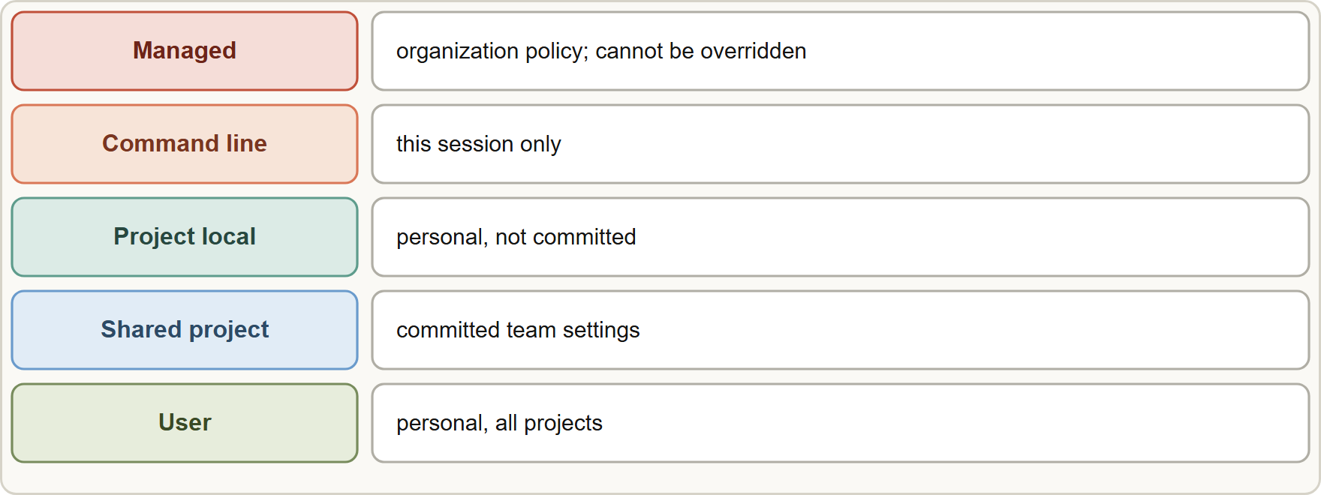
Configuring Claude Code for Teams, continued
Module 17
Precedence (highest first): managed, command line, project local, shared project, user. A key set higher overrides the same key below it; lists such as permission rules merge across scopes.
Precedence (highest first): managed, command line, project local, shared project, user. A key set higher overrides the same key below it; lists such as permission rules merge across scopes.
Claude Architect Professional Exam Prep | for the CCAR-P exam
Module 17
5 / 25
Notes:
Configuring Claude Code for Teams, continued.
The figure shows this: Settings precedence from highest to lowest: managed, command line, project local, shared project, user; list settings such as permission rules merge across scopes.
Precedence (highest first): managed, command line, project local, shared project, user. A key set higher overrides the same key below it; lists such as permission rules merge across scopes.

Slide 6
Configuring Claude Code for Teams, continued
Module 17
Managed settings lock what developers cannot change: allowed and denied models (availableModels, deniedModels), permission policy, telemetry destination, and more. A few restrictive keys are honored from any scope.
Repository files cannot grant everything: for example bypassPermissions and telemetry exporters do not take effect from project settings, and committed allow rules wait for the developer to trust the folder.
Verify with /status (which sources loaded) and claude doctor (rejected entries).
EXAM TIP To enforce a policy developers must not override, use managed settings. To share team conventions, commit .claude/settings.json and CLAUDE.md. Personal tweaks belong in user or local files.
Claude Architect Professional Exam Prep | for the CCAR-P exam
Module 17
6 / 25
Notes:
Configuring Claude Code for Teams, continued.
Managed settings lock what developers cannot change: allowed and denied models (available Models, denied Models), permission policy, telemetry destination, and more. A few restrictive keys are honored from any scope.
Repository files cannot grant everything: for example bypass Permissions and telemetry exporters do not take effect from project settings, and committed allow rules wait for the developer to trust the folder.
Verify with or status (which sources loaded) and claude doctor (rejected entries).
Exam tip: To enforce a policy developers must not override, use managed settings. To share team conventions, commit dot Claude settings.json and Claude dot M D. Personal tweaks belong in user or local files.

Slide 7
Team Standards and Extensions
Module 17
Mechanism | Purpose | Notes
CLAUDE.md (committed) | Persistent project instructions: conventions, commands, architecture notes | Keep concise; it loads into context
Permission rules (allow, ask, deny) | What Claude may run or read | Deny secrets files (for example .env) and dangerous commands
Hooks | Deterministic scripts at events (for example before a tool runs) | Enforce rules prompts cannot guarantee: block, format, log
Skills | Reusable procedures loaded on demand | Share review checklists, migration procedures
Plugins | Bundle skills, commands, hooks and MCP servers for distribution | Record sources and versions
MCP servers (shared config) | Connect issue trackers, docs, databases | Apply least privilege and OAuth (Module 8)
Claude Architect Professional Exam Prep | for the CCAR-P exam
Module 17
7 / 25
Notes:
Team Standards and Extensions.
Claude dot M D (committed). Purpose: Persistent project instructions: conventions, commands, architecture notes. Notes: Keep concise; it loads into context.
Permission rules (allow, ask, deny). Purpose: What Claude may run or read. Notes: Deny secrets files (for example.env) and dangerous commands.
Hooks. Purpose: Deterministic scripts at events (for example before a tool runs). Notes: Enforce rules prompts cannot guarantee: block, format, log.
Skills. Purpose: Reusable procedures loaded on demand. Notes: Share review checklists, migration procedures.
Plugins. Purpose: Bundle skills, commands, hooks and M C P servers for distribution. Notes: Record sources and versions.
M C P servers (shared config). Purpose: Connect issue trackers, docs, databases. Notes: Apply least privilege and OAuth (Module eight).

Slide 8
Team Standards and Extensions, continued
Module 17
Mechanism | Purpose | Notes
Sandboxing | Contain commands and file access | Reduce blast radius
Headless mode (claude -p) | Run in scripts and CI | Use scoped permissions; --bare skips auto-discovery for reproducible scripted runs
Secrets: never in CLAUDE.md or committed settings; deny reads of secret files; use environment variables and a secrets manager.
Model and cost control: restrict available models by policy; use OpenTelemetry to see cost and tokens by team.
Claude Architect Professional Exam Prep | for the CCAR-P exam
Module 17
8 / 25
Notes:
Team Standards and Extensions, continued.
Sandboxing. Purpose: Contain commands and file access. Notes: Reduce blast radius.
Headless mode (claude dash p). Purpose: Run in scripts and C I. Notes: Use scoped permissions; dash dash bare skips auto-discovery for reproducible scripted runs.
Secrets: never in Claude dot M D or committed settings; deny reads of secret files; use environment variables and a secrets manager.
Model and cost control: restrict available models by policy; use Open Telemetry to see cost and tokens by team.

Slide 9
Team Standards and Extensions, continued
Module 17
Telemetry is off until enabled; metrics include cost, token usage by type, sessions, commits, pull requests and tool decisions; prompt content is not logged by default; admins push settings through managed settings; add team and cost-center attributes with OTEL_RESOURCE_ATTRIBUTES (watch label cardinality).
EXAM TIP Managed settings enforce what developers must not override; committed CLAUDE.md and .claude/settings.json share conventions.
Claude Architect Professional Exam Prep | for the CCAR-P exam
Module 17
9 / 25
Notes:
Team Standards and Extensions, continued.
Telemetry is off until enabled; metrics include cost, token usage by type, sessions, commits, pull requests and tool decisions; prompt content is not logged by default; admins push settings through managed settings; add team and cost-center attributes with O T E L R E S O U R C E A T T R I B U T E S (watch label cardinality).
Exam tip: Managed settings enforce what developers must not override; committed Claude dot M D and dot Claude settings.json share conventions.
Exam tip: Hooks and permission rules enforce deterministically; a sentence in Claude dot M D is only guidance.

Slide 10
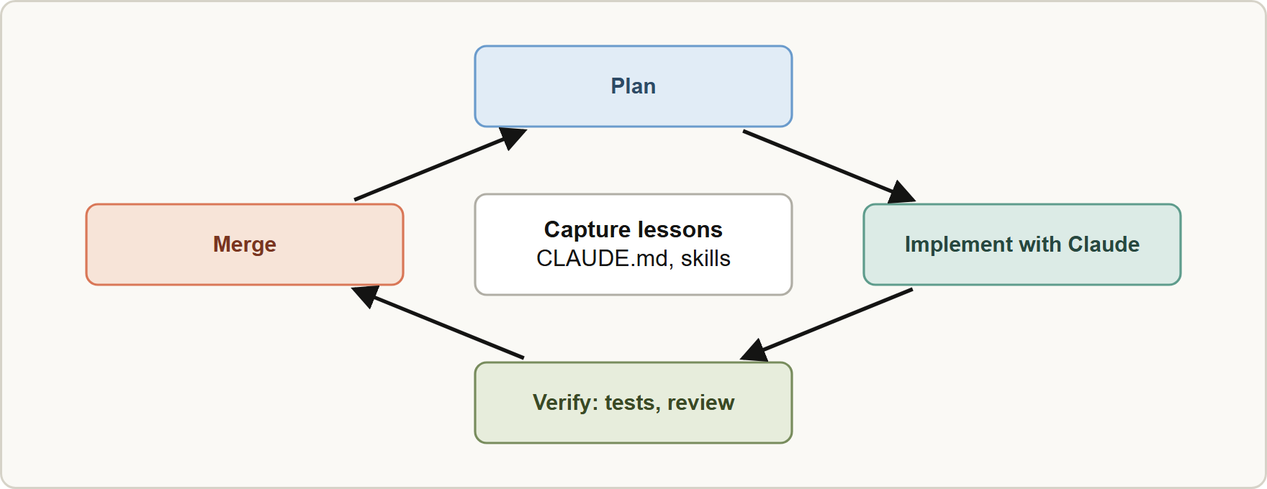
AI-Assisted Developer Workflows
Module 17
AI-assisted development loop: plan, implement with Claude, verify with tests and human review, merge, and capture lessons in CLAUDE.md and skills
Claude Architect Professional Exam Prep | for the CCAR-P exam
Module 17
10 / 25
Notes:
A I-Assisted Developer Workflows.
The figure shows this: A I-assisted development loop: plan, implement with Claude, verify with tests and human review, merge, and capture lessons in Claude dot M D and skills.

Slide 11
AI-Assisted Developer Workflows, continued
Module 17
Workflow | How Claude helps | Guardrail
Code understanding | Explore a large codebase, explain modules | Verify claims against the code
Implementation | Plan, then implement changes across files | Plan mode first; small reviewed diffs
Tests | Generate and extend tests; run them | Tests are the verification; review test quality
Code review | First-pass review in CI against team rules | Human reviewers remain accountable
Documentation | Draft and update docs | Review for accuracy
Migrations and refactors | Repetitive edits at scale | Scripted checks, staged rollout
Verification over trust: run tests, linters and type checks; require review; do not merge unreviewed AI changes.
Claude Architect Professional Exam Prep | for the CCAR-P exam
Module 17
11 / 25
Notes:
A I-Assisted Developer Workflows, continued.
Code understanding. How Claude helps: Explore a large codebase, explain modules. Guardrail: Verify claims against the code.
Implementation. How Claude helps: Plan, then implement changes across files. Guardrail: Plan mode first; small reviewed diffs.
Tests. How Claude helps: Generate and extend tests; run them. Guardrail: Tests are the verification; review test quality.
Code review. How Claude helps: First-pass review in C I against team rules. Guardrail: Human reviewers remain accountable.
Documentation. How Claude helps: Draft and update docs. Guardrail: Review for accuracy.
Migrations and refactors. How Claude helps: Repetitive edits at scale. Guardrail: Scripted checks, staged rollout.
Verification over trust: run tests, linters and type checks; require review; do not merge unreviewed A I changes.

Slide 12
AI-Assisted Developer Workflows, continued
Module 17
Plan first for non-trivial work; keep changes small.
Capture lessons in CLAUDE.md and Skills so the next session starts better.
Measure productivity honestly (cycle time, review time, defect rate), not only lines produced.
Protect IP and data: control what code and data may leave the environment; use managed policy and approved platforms.
Claude Architect Professional Exam Prep | for the CCAR-P exam
Module 17
12 / 25
Notes:
A I-Assisted Developer Workflows, continued.
Plan first for non-trivial work; keep changes small.
Capture lessons in Claude dot M D and Skills so the next session starts better.
Measure productivity honestly (cycle time, review time, defect rate), not only lines produced.
Protect I P and data: control what code and data may leave the environment; use managed policy and approved platforms.

Slide 13
Debugging and Operational Support
Module 17
Incident triage: Claude can read logs, traces and recent changes, form hypotheses and propose fixes; keep read-only access by default and approval for production changes.
Reproduce first: use request ids, trace ids, prompt and model versions to replay (Module 12).
Runbooks as Skills: encode diagnosis procedures so responders and Claude follow the same steps.
Observability access: connect monitoring and ticket systems through MCP with least privilege.
Post-incident: update runbooks, evals and CLAUDE.md with the lesson.
Usage visibility: dashboards of cost and tokens by team, budgets and alerts; Claude Code analytics and usage APIs report per-user estimates for governance.
Claude Architect Professional Exam Prep | for the CCAR-P exam
Module 17
13 / 25
Notes:
Debugging and Operational Support.
Incident triage: Claude can read logs, traces and recent changes, form hypotheses and propose fixes; keep read-only access by default and approval for production changes.
Reproduce first: use request ids, trace ids, prompt and model versions to replay (Module twelve).
Runbooks as Skills: encode diagnosis procedures so responders and Claude follow the same steps.
Observability access: connect monitoring and ticket systems through M C P with least privilege.
Post-incident: update runbooks, evals and Claude dot M D with the lesson.
Usage visibility: dashboards of cost and tokens by team, budgets and alerts; Claude Code analytics and usage A P I s (application programming interface) report per-user estimates for governance.

Slide 14
Module Recap
Module 17
1
Scopes
2
Precedence
3
Policy
User · shared project (commit) · project local (not committed) · managed (org)
Managed > command line > project local > shared project > user; lists merge
Managed settings (models, permissions, telemetry); /status, claude doctor
4
Standards
5
Deterministic
6
Telemetry
CLAUDE.md, permission rules, hooks, Skills, plugins, MCP, sandbox
Hooks and permission rules, not prose
Off until enabled; no prompt text by default; managed settings; team attributes
7
Workflows
8
Ops
Plan, small diffs, tests, review, capture lessons
Read-only by default; approval for prod changes; runbooks as Skills
Claude Architect Professional Exam Prep | for the CCAR-P exam
Module 17
14 / 25
Notes:
Here is the recap.
Scopes: User, shared project (commit), project local (not committed), managed (org).
Precedence: Managed greater than command line greater than project local greater than shared project greater than user; lists merge.
Policy: Managed settings (models, permissions, telemetry); or status, claude doctor.
Standards: Claude dot M D, permission rules, hooks, Skills, plugins, M C P, sandbox.
Deterministic: Hooks and permission rules, not prose.
Telemetry: Off until enabled; no prompt text by default; managed settings; team attributes.
Workflows: Plan, small diffs, tests, review, capture lessons.
Ops: Read-only by default; approval for prod changes; runbooks as Skills.

Slide 15
Practice Question 1
Module 17
Q1
A security team must ensure developers cannot use unapproved models or bypass permission policy. Which mechanism enforces this?
A
Managed settings deployed by the organization, such as allowed and denied models and permission policy
B
A shared project settings file that each developer can override locally for their own sessions at any time
C
A reminder in the onboarding document
D
A line in the committed CLAUDE.md asking developers to use only the approved models for all their work
Claude Architect Professional Exam Prep | for the CCAR-P exam
Module 17
15 / 25
Notes:
Question one.
A security team must ensure developers cannot use unapproved models or bypass permission policy. Which mechanism enforces this?
The four options are on the screen.
[PAUSE 12]
The answer is A. Managed settings sit at the top of precedence and cannot be overridden.

Slide 16
Practice Question 2
Module 17
Q2
Where should team conventions such as build commands and architecture notes be stored so every developer's sessions use them?
A
In the local settings file that is kept out of git and is private to each developer
B
In a committed CLAUDE.md and shared project settings
C
In individual chat histories
D
In each developer's user settings
Claude Architect Professional Exam Prep | for the CCAR-P exam
Module 17
16 / 25
Notes:
Question two.
Where should team conventions such as build commands and architecture notes be stored so every developer's sessions use them?
The four options are on the screen.
[PAUSE 12]
The answer is B. Committed, shared files give everyone the same standards.

Slide 17
Practice Question 3
Module 17
Q3
A developer sets model in project local settings; a managed setting restricts allowed models. What happens?
A
Claude Code stops running
B
The local setting wins because it is more specific than the organization's managed restriction
C
The managed restriction wins because managed settings have the highest precedence
D
Both are merged and the developer chooses
Claude Architect Professional Exam Prep | for the CCAR-P exam
Module 17
17 / 25
Notes:
Question three.
A developer sets model in project local settings; a managed setting restricts allowed models. What happens?
The four options are on the screen.
[PAUSE 12]
The answer is C. Managed policy has the highest precedence, so a project-local value cannot override an organization's model restriction.

Slide 18
Practice Question 4
Module 17
Q4
Which TWO enforce behavior deterministically rather than by instruction? (Select TWO.)
A
A deny permission rule for commands that delete data
B
A comment in the code
C
A hook that blocks reading secret files before a tool runs
D
A request in the pull request template
E
A sentence in CLAUDE.md asking Claude to avoid risky commands
Claude Architect Professional Exam Prep | for the CCAR-P exam
Module 17
18 / 25
Notes:
Question four. Select two.
Which two enforce behavior deterministically rather than by instruction?
The five options are on the screen.
[PAUSE 15]
The answers are A and C. Hooks and permission rules are enforced by the tool, not by the model's compliance.

Slide 19
Practice Question 5
Module 17
Q5
The platform team wants cost and token usage by team from Claude Code. What should they do?
A
Ask developers to email their usage figures to the platform team at the end of every single month
B
Enable OpenTelemetry through managed settings and add team and cost-center resource attributes
C
Disable telemetry to avoid privacy risk
D
Turn on logging of all prompt text for every developer so that usage can be attributed to teams and cost centers
Claude Architect Professional Exam Prep | for the CCAR-P exam
Module 17
19 / 25
Notes:
Question five.
The platform team wants cost and token usage by team from Claude Code. What should they do?
The four options are on the screen.
[PAUSE 12]
The answer is B. Telemetry through managed settings gives cost data; prompt content stays off by default.

Slide 20
Practice Question 6
Module 17
Q6
A repository's committed settings try to configure the telemetry exporter and bypassPermissions. What is the result?
A
They are merged with managed settings
B
Those keys do not take effect from repository files; policy should come from managed or user settings
C
They apply for everyone who clones the repository, as soon as each developer has trusted the project folder
D
They apply only on Mondays
Claude Architect Professional Exam Prep | for the CCAR-P exam
Module 17
20 / 25
Notes:
Question six.
A repository's committed settings try to configure the telemetry exporter and bypass Permissions. What is the result?
The four options are on the screen.
[PAUSE 12]
The answer is B. Security-sensitive keys such as bypass Permissions and telemetry exporters are ignored from repository files and need managed or user settings.

Slide 21
Practice Question 7
Module 17
Q7
An AI-generated change passes review quickly but later breaks production. Which workflow improvement is most relevant?
A
Remove human review to move faster
B
Plan first, keep diffs small, run tests and checks, and require meaningful human review
C
Merge automatically after the model says it is confident, because its review is faster than a human's
D
Ask Claude to review its own change only
Claude Architect Professional Exam Prep | for the CCAR-P exam
Module 17
21 / 25
Notes:
Question seven.
An A I-generated change passes review quickly but later breaks production. Which workflow improvement is most relevant?
The four options are on the screen.
[PAUSE 12]
The answer is B. Verification and accountable human review remain essential: plan first, keep diffs small, run tests and review meaningfully.

Slide 22
Practice Question 8
Module 17
Q8
During an incident, an assistant should help diagnose a production fault. What access design is appropriate?
A
Full production write access so that it can fix issues quickly without waiting for any approval
B
No access to any telemetry
C
Read-only access to logs and traces by default, with human approval for production changes
D
Shared administrator credentials
Claude Architect Professional Exam Prep | for the CCAR-P exam
Module 17
22 / 25
Notes:
Question eight.
During an incident, an assistant should help diagnose a production fault. What access design is appropriate?
The four options are on the screen.
[PAUSE 12]
The answer is C. Read-only access by default with approval for production changes follows least privilege during incident response.

Slide 23
Practice Question 9
Module 17
Q9
A team wants a reusable diagnosis procedure that both responders and Claude follow. What fits best?
A
An email thread
B
A larger model
C
A paragraph pasted into every chat by each responder at the start of every incident they handle
D
A shared Skill (runbook) loaded when the situation matches
Claude Architect Professional Exam Prep | for the CCAR-P exam
Module 17
23 / 25
Notes:
Question nine.
A team wants a reusable diagnosis procedure that both responders and Claude follow. What fits best?
The four options are on the screen.
[PAUSE 12]
The answer is D. A shared Skill packages the runbook as a procedure that loads when the situation matches, so responders and Claude follow the same steps.

Slide 24
Practice Question 10
Module 17
Q10
Why is Claude Code telemetry not logging prompt text by default?
A
Privacy by default: content logging is off unless explicitly enabled
B
Prompt text cannot be logged technically
C
Telemetry is not available in managed environments, where only the administrator can see usage
D
It would reduce the context window
Claude Architect Professional Exam Prep | for the CCAR-P exam
Module 17
24 / 25
Notes:
Question ten.
Why is Claude Code telemetry not logging prompt text by default?
The four options are on the screen.
[PAUSE 12]
The answer is A. Content gates are off by default and must be enabled deliberately.

Slide 25
Answers at a Glance
Module 17
Question | Answer | Why
Q1 | A | Managed settings sit at the top of precedence
Q2 | B | Committed, shared files give everyone the same standards
Q3 | C | Managed policy has the highest precedence
Q4 | A, C | Hooks and permission rules are enforced by the
Q5 | B | Telemetry through managed settings gives cost data
Q6 | B | Security-sensitive keys such as bypassPermissions and telemetry exporters
Q7 | B | Verification and accountable human review remain essential: plan
Q8 | C | Read-only access by default with approval for production
Q9 | D | A shared Skill packages the runbook as a
Q10 | A | Content gates are off by default and must
Claude Architect Professional Exam Prep | for the CCAR-P exam
Module 17
25 / 25
Notes:
Here are all ten answers. Question one: A. Question two: B. Question three: C. Question four: A and C. Question five: B. Question six: B. Question seven: B. Question eight: C. Question nine: D. Question ten: A.
In the next module, we continue the course.

